Slide 1
THE BOOK OF DANIEL
Dr. Andy Woods

Slide 2
Message
Times of the Gentiles are revealed prophetically (2, 7, 8-12) and ethically (1, 3-6)

Slide 3
Synthetic Outline
Historical (1-7):
Daniel interprets, 3rd person, gentile nations
Intro “Hebrew” (1)
Aramaic chiasm (2-7)

Slide 4
Synthetic Outline
Prophetic (8-12):
Angel interprets, 1st person, Jewish nation, Hebrew
Ram & Goat (8)
70 weeks (9)
Final vision (10-12)

Slide 5
Synthetic Outline
Historical (1-7):
Daniel interprets, 3rd person, gentile nations
Intro “Hebrew” (1)
Aramaic chiasm (2-7)

Slide 6
Synthetic Outline
Historical (1-7):
Daniel interprets, 3rd person, gentile nations
Intro “Hebrew” (1)
Aramaic chiasm (2-7)

Slide 7
Synthetic Outline
Chiasm “Aramaic” ( 2-7)
1. Gentile History (2)
2. Protection (3)
3. Revelation to a gentile king (4)
3. Revelation to a gentile king (5)
2. Protection (6)
1. Gentile history (7)

Slide 8
Synthetic Outline
Chiasm “Aramaic” ( 2-7)
1. Gentile History (2)
2. Protection (3)
3. Revelation to a gentile king (4)
3. Revelation to a gentile king (5)
2. Protection (6)
1. Gentile history (7)

Slide 9
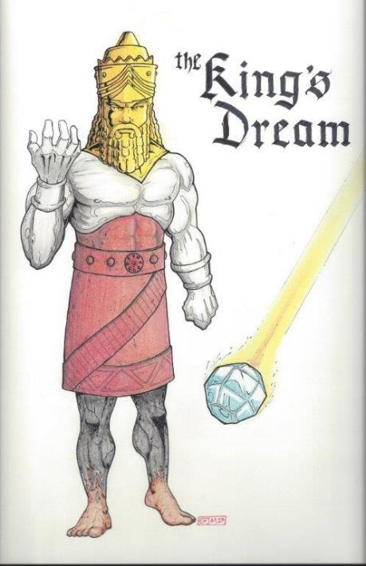
Statue
&
Stone

Slide 10
Synthetic Outline
Chiasm “Aramaic” ( 2-7)
1. Gentile History (2)
2. Protection (3)
3. Revelation to a gentile king (4)
3. Revelation to a gentile king (5)
2. Protection (6)
1. Gentile history (7)

Slide 11
Synthetic Outline
Chiasm “Aramaic” ( 2-7)
1. Gentile History (2)
2. Protection (3)
3. Revelation to a gentile king (4)
3. Revelation to a gentile king (5)
2. Protection (6)
1. Gentile history (7)

Slide 12
Succession of Gentile Rulers
1-4: Nebuchadnezzar of Babylon
5: Belshazzar of Babylon
6: Darius of Media – Persia
7-8: Belshazzar of Babylon
9: Darius of Media – Persia
10-12: Cyrus of Media – Persia

Slide 13
Succession of Gentile Rulers
1-4: Nebuchadnezzar of Babylon
5: Belshazzar of Babylon
6: Darius of Media – Persia
7-8: Belshazzar of Babylon
9: Darius of Media – Persia
10-12: Cyrus of Media – Persia

Slide 14
Daniel’s Age
CHAPTER | EVENTS | AGE
1 | Taken to Babylonian captivity | 15
2 | Interpreting Nebuchadnezzar’s 1st dream (huge image) | 17
3 | Daniel’s 3 friends cast into the fiery furnace | 19 or 20
4 | Interpreting Nebuchadnezzar’s 2nd dream (huge tree) | 45-50
5 | Interpreting handwriting of the wall at Belshazzar’s feast | Early 80’s
6 | Delivered from the den of lions | c.83
7-8 | Daniel’s visions and dreams | Mid-60’s
9 | Daniel’s seventy “sevens” prophecy | Early-80’s
10-12 | Final dreams and visions | Mid-80’s

Slide 15
Daniel’s Age
CHAPTER | EVENTS | AGE
1 | Taken to Babylonian captivity | 15
2 | Interpreting Nebuchadnezzar’s 1st dream (huge image) | 17
3 | Daniel’s 3 friends cast into the fiery furnace | 19 or 20
4 | Interpreting Nebuchadnezzar’s 2nd dream (huge tree) | 45-50
5 | Interpreting handwriting of the wall at Belshazzar’s feast | Early 80’s
6 | Delivered from the den of lions | c.83
7-8 | Daniel’s visions and dreams | Mid-60’s
9 | Daniel’s seventy “sevens” prophecy | Early-80’s
10-12 | Final dreams and visions | Mid-80’s

Slide 16
Chapter 4 Outline
Introduction (1-3)
Dream Described by Nebuchadnezzar (4-18)
Dream Interpreted by Daniel (19-27)
Dream Fulfilled by God (28-37)

Slide 17
Chapter 4 Outline
Introduction (1-3)
Dream Described by Nebuchadnezzar (4-18)
Dream Interpreted by Daniel (19-27)
Dream Fulfilled by God (28-37)

Slide 18
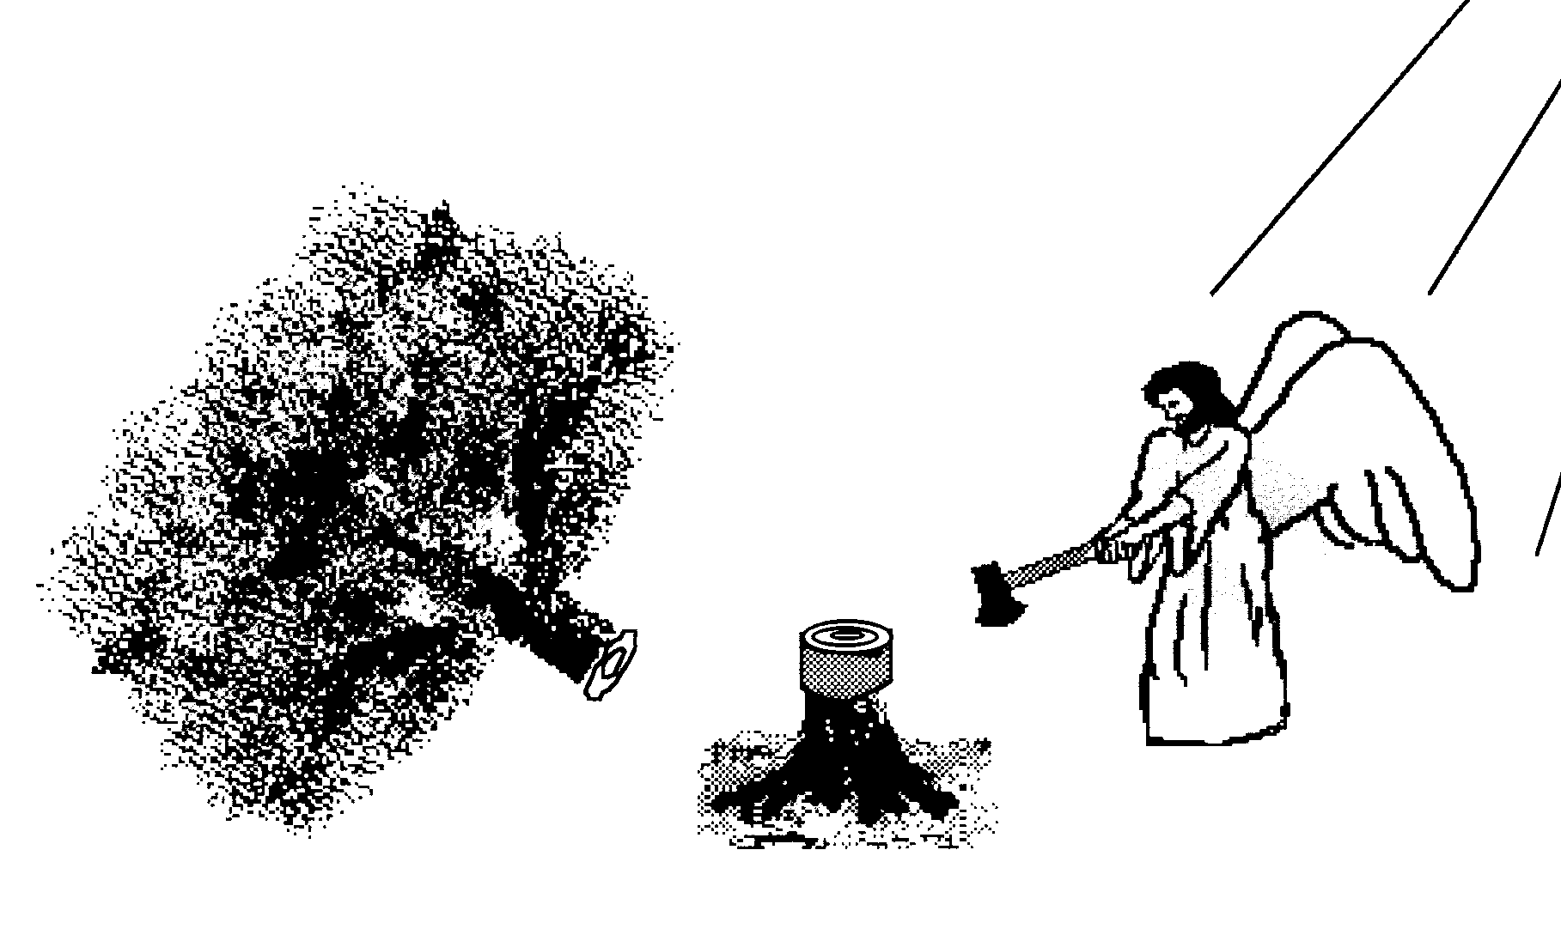
I. Introduction 4:1-3
Nebuchadnezzar’s public decree v. 1
Nebuchadnezzar’s personal testimony v. 2
Nebuchadnezzar’s change in attitude v. 3

Slide 19
I. Introduction 4:1-3
Nebuchadnezzar’s public decree v. 1
Nebuchadnezzar’s personal testimony v. 2
Nebuchadnezzar’s change in attitude v. 3

Slide 20
I. Introduction 4:1-3
Nebuchadnezzar’s public decree v. 1
Nebuchadnezzar’s personal testimony v. 2
Nebuchadnezzar’s change in attitude v. 3

Slide 21
I. Introduction 4:1-3
Nebuchadnezzar’s public decree v. 1
Nebuchadnezzar’s personal testimony v. 2
Nebuchadnezzar’s change in attitude v. 3

Slide 22
Daniel 4:30 (NASB)
“The king reflected and said, ‘Is this not Babylon the great, which I myself have built as a royal residence by the might of my power and for the glory of my majesty?’”

Slide 23
Daniel 2:37-38 (NASB)
You, O king, are the king of kings, to whom the God of heaven has given the kingdom, the power, the strength and the glory; ³⁸ and wherever the sons of men dwell, or the beasts of the field, or the birds of the sky, He has given them into your hand and has caused you to rule over them all. You are the head of gold.

Slide 24
Chapter 4 Outline
Introduction (1-3)
Dream Described by Nebuchadnezzar (4-18)
Dream Interpreted by Daniel (19-27)
Dream Fulfilled by God (28-37)

Slide 25
II. Dream Described By Nebuchadnezzar 4:4-18
To the wise men v. 4-7
To Daniel v. 8-18

Slide 26
II. Dream Described By Nebuchadnezzar 4:4-18
To the wise men v. 4-7
To Daniel v. 8-18

Slide 27
A. To the Wise Men (4-7)
Nebuchadnezzar’s fear v. 4-5
The wise men's failure v. 6-7

Slide 28
A. To the Wise Men (4-7)
Nebuchadnezzar’s fear v. 4-5
The wise men's failure v. 6-7

Slide 29
A. To the Wise Men (4-7)
Nebuchadnezzar’s fear v. 4-5
The wise men's failure v. 6-7

Slide 30
Nebuchadnezzar Demands the Revelation & Interpretation (2:2-13)
Nebuchadnezzar’s command (2:2-3)
Chaldean’s 1st response (2:4)
Nebuchadnezzar reaffirms his command (2:5-6)
Chaldean’s 2nd response (2:7)
Nebuchadnezzar reaffirms his command (2:8-9)
Chaldean’s 3rd response (2:10-11)
Nebuchadnezzar’s order for destruction (2:12-13)

Slide 31
II. Dream Described By Nebuchadnezzar 4:4-18
To the wise men v. 4-7
To Daniel v. 8-18

Slide 32
B. To Daniel (8-18)
Daniel’s entrance v. 8-9
The growing tree v. 10-12
The tree chopped down (13-14)
The stump remains (15a)
Animalistic behavior (15b-16)
Chapter lesson (17)
Nebuchadnezzar’s request (18)

Slide 33
B. To Daniel (8-18)
Daniel’s entrance v. 8-9
The growing tree v. 10-12
The tree chopped down (13-14)
The stump remains (15a)
Animalistic behavior (15b-16)
Chapter lesson (17)
Nebuchadnezzar’s request (18)

Slide 34
Changing of the Names (Dan. 1:6)
Jewish names (Deut. 6:6-7; Prov. 22:6)
Daniel – God is my judge
Hananiah – Yahweh is gracious
Mishael – Who is what God is?
Azariah – Yahweh has helped

Slide 35
Changing of the Names (Dan. 1:7)
Babylonian names (Gen 2:19)
Beltshazzar – Lady protect the king
Shadrach – I am fearful of God
Meshach – I am of little account
Abed-nego – Servant of Nebo

Slide 36
Synthetic Outline
Chiasm “Aramaic” ( 2-7)
1. Gentile History (2)
2. Protection (3)
3. Revelation to a gentile king (4)
3. Revelation to a gentile king (5)
2. Protection (6)
1. Gentile history (7)

Slide 37
Synthetic Outline
Chiasm “Aramaic” ( 2-7)
1. Gentile History (2)
2. Protection (3)
3. Revelation to a gentile king (4)
3. Revelation to a gentile king (5)
2. Protection (6)
1. Gentile history (7)

Slide 38
Statue
&
Stone

Slide 39
B. To Daniel (8-18)
Daniel’s entrance v. 8-9
The growing tree v. 10-12
The tree chopped down (13-14)
The stump remains (15a)
Animalistic behavior (15b-16)
Chapter lesson (17)
Nebuchadnezzar’s request (18)

Slide 40
B. To Daniel (8-18)
Daniel’s entrance v. 8-9
The growing tree v. 10-12
The tree chopped down (13-14)
The stump remains (15a)
Animalistic behavior (15b-16)
Chapter lesson (17)
Nebuchadnezzar’s request (18)

Slide 41
Angelology
Dr. Andy Woods

Slide 42
Activities of the Angels
Past
Witnessed creation (Job 38:7)
Brought judgment (Gen 19:22; Acts 12:22-23)
Accompanied the Law (Gal 3:19)
Announced births of John and Christ (Luke 1:11-13, 26-27)
Strengthened Christ (Matt 4:11)
Announced resurrection (Matt 28:1-7)
Observed Ascension (Acts 1:11)
Brought messages (Luke 1:13)

Slide 43
Activities of the Angels (cont’d)
Present
Protect believers (Ps 34:7; 91:11-12)
Deliver God’s answers to prayer (Dan 9:23; 10:12)
Take souls to heaven (Luke 16:22)
Involvement in government (Dan 10:21; 11:1; 12:1)

Slide 44
Activities of the Angels (cont’d)
Future
Rapture (1 Thess 4:16)
Judged by humans (1 Cor 6:3)
Tribulation judgments (Rev 8:2; 16:1)
Return of Christ (Matt 24:31; 25:31)
Bind Satan (Rev 20:1-2)

Slide 45
B. To Daniel (8-18)
Daniel’s entrance v. 8-9
The growing tree v. 10-12
The tree chopped down (13-14)
The stump remains (15a)
Animalistic behavior (15b-16)
Chapter lesson (17)
Nebuchadnezzar’s request (18)

Slide 46
B. To Daniel (8-18)
Daniel’s entrance v. 8-9
The growing tree v. 10-12
The tree chopped down (13-14)
The stump remains (15a)
Animalistic behavior (15b-16)
Chapter lesson (17)
Nebuchadnezzar’s request (18)

Slide 47
B. To Daniel (8-18)
Daniel’s entrance v. 8-9
The growing tree v. 10-12
The tree chopped down (13-14)
The stump remains (15a)
Animalistic behavior (15b-16)
Chapter lesson (17)
Nebuchadnezzar’s request (18)

Slide 48
B. To Daniel (8-18)
Daniel’s entrance v. 8-9
The growing tree v. 10-12
The tree chopped down (13-14)
The stump remains (15a)
Animalistic behavior (15b-16)
Chapter lesson (17)
Nebuchadnezzar’s request (18)

Slide 49
Chapter 4 Outline
Introduction (1-3)
Dream Described by Nebuchadnezzar (4-18)
Dream Interpreted by Daniel (19-27)
Dream Fulfilled by God (28-37)

Slide 50
III. Dream Interpreted By Daniel 4:19-27
Daniel’s reluctance v. 19
Interpretation of the tree v. 20-22
Chopping down of the tree v. 23-25
Interpretation of the preserved stump v. 26
Daniel’s advice to Nebuchadnezzar v. 27

Slide 51
III. Dream Interpreted By Daniel 4:19-27
Daniel’s reluctance v. 19
Interpretation of the tree v. 20-22
Chopping down of the tree v. 23-25
Interpretation of the preserved stump v. 26
Daniel’s advice to Nebuchadnezzar v. 27

Slide 52
Daniel 2:36 (NASB)
This was the dream; now we will tell its interpretation before the king.

Slide 53
III. Dream Interpreted By Daniel 4:19-27
Daniel’s reluctance v. 19
Interpretation of the tree v. 20-22
Chopping down of the tree v. 23-25
Interpretation of the preserved stump v. 26
Daniel’s advice to Nebuchadnezzar v. 27

Slide 54
Daniel 2:37-38 (NASB)
You, O king, are the king of kings, to whom the God of heaven has given the kingdom, the power, the strength and the glory; ³⁸ and wherever the sons of men dwell, or the beasts of the field, or the birds of the sky, He has given them into your hand and has caused you to rule over them all. You are the head of gold.

Slide 55
III. Dream Interpreted By Daniel 4:19-27
Daniel’s reluctance v. 19
Interpretation of the tree v. 20-22
Chopping down of the tree v. 23-25
Interpretation of the preserved stump v. 26
Daniel’s advice to Nebuchadnezzar v. 27

Slide 56
Daniel 2:36 (NASB)
This was the dream; now we will tell its interpretation before the king.

Slide 57
Daniel 2:37-38 (NASB)
You, O king, are the king of kings, to whom the God of heaven has given the kingdom, the power, the strength and the glory; ³⁸ and wherever the sons of men dwell, or the beasts of the field, or the birds of the sky, He has given them into your hand and has caused you to rule over them all. You are the head of gold.

Slide 58
III. Dream Interpreted By Daniel 4:19-27
Daniel’s reluctance v. 19
Interpretation of the tree v. 20-22
Chopping down of the tree v. 23-25
Interpretation of the preserved stump v. 26
Daniel’s advice to Nebuchadnezzar v. 27

Slide 59
III. Dream Interpreted By Daniel 4:19-27
Daniel’s reluctance v. 19
Interpretation of the tree v. 20-22
Chopping down of the tree v. 23-25
Interpretation of the preserved stump v. 26
Daniel’s advice to Nebuchadnezzar v. 27

Slide 60
Grace Before Judgment
Gen 6:3
1 Cor 11:31
Rev 2:21
Parent analogy

Slide 61
Chapter 4 Outline
Introduction (1-3)
Dream Described by Nebuchadnezzar (4-18)
Dream Interpreted by Daniel (19-27)
Dream Fulfilled by God (28-37)

Slide 62
IV. Dream Fulfilled By God Daniel 4:28-37
Nebuchadnezzar’s insanity v. 28-33
Nebuchadnezzar’s humility v. 34-37

Slide 63
IV. Dream Fulfilled By God Daniel 4:28-37
Nebuchadnezzar’s insanity v. 28-33
Nebuchadnezzar’s humility v. 34-37

Slide 64
A. Nebuchadnezzar’s Insanity (28-33)
Daniel’s prophecy fulfilled v. 28-29
Nebuchadnezzar’s pride v. 30
Nebuchadnezzar’s pride v. 31-33

Slide 65
A. Nebuchadnezzar’s Insanity (28-33)
Daniel’s prophecy fulfilled v. 28-29
Nebuchadnezzar’s pride v. 30
Nebuchadnezzar’s pride v. 31-33

Slide 66
A. Nebuchadnezzar’s Insanity (28-33)
Daniel’s prophecy fulfilled v. 28-29
Nebuchadnezzar’s pride v. 30
Nebuchadnezzar’s pride v. 31-33

Slide 67
Daniel 4:30 (NASB)
“The king reflected and said, ‘Is this not Babylon the great, which I myself have built as a royal residence by the might of my power and for the glory of my majesty?’”

Slide 68
Daniel 2:37-38 (NASB)
You, O king, are the king of kings, to whom the God of heaven has given the kingdom, the power, the strength and the glory; ³⁸ and wherever the sons of men dwell, or the beasts of the field, or the birds of the sky, He has given them into your hand and has caused you to rule over them all. You are the head of gold.

Slide 69
A. Nebuchadnezzar’s Insanity (28-33)
Daniel’s prophecy fulfilled v. 28-29
Nebuchadnezzar’s pride v. 30
Nebuchadnezzar’s pride v. 31-33

Slide 70
Scripture and Pride
Prov 16:18
Isa 14:12-15; Ezek 28:12-17
1 Tim 3:6
Acts 12:20-23
2 Cor 12:7-10
1 Pet 5:5-6

Slide 71
Hall of the Humbled (Prov. 16:18; 1 Peter 5:5)
Satan (Isa. 14:12-15; Ezek. 28:12-17; 1 Tim. 3:6)
Uzziah (2 Chron 26:16)
Herod (Acts 12:20-23)
Paul (2 Cor 12:1-10)

Slide 72
IV. Dream Fulfilled By God Daniel 4:28-37
Nebuchadnezzar’s insanity v. 28-33
Nebuchadnezzar’s humility v. 34-37

Slide 73
B. Nebuchadnezzar’s Humility (34-37)
Nebuchadnezzar’s Humiliation v. 34-35
Nebuchadnezzar’s Restoration v. 36-37

Slide 74
B. Nebuchadnezzar’s Humility (34-37)
Nebuchadnezzar’s Humiliation v. 34-35
Nebuchadnezzar’s Restoration v. 36-37

Slide 75
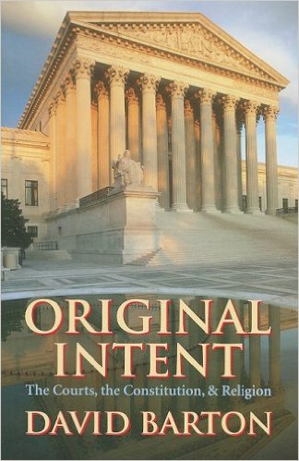
David Barton, Original Intent, p. 245

Slide 76
B. Nebuchadnezzar’s Humility (34-37)
Nebuchadnezzar’s Humiliation v. 34-35
Nebuchadnezzar’s Restoration v. 36-37

Slide 77
Conclusion

Slide 78
Chapter 4 Outline
Introduction (1-3)
Dream Described by Nebuchadnezzar (4-18)
Dream Interpreted by Daniel (19-27)
Dream Fulfilled by God (28-37)

