Slide 1
Soteriology Session 44
Dr. Andy Woods
Senior Pastor – Sugar Land Bible Church
Adjunct Professor of Bible & Theology – College of Biblical Studies

Slide 2
Occasion of Hebrews
A.D. 70
Acts 2:40
Heb. 3:1 (Christian confession)
Unbelieving Jews placing audience under duress to return to Judaism
Second generation (Heb. 2:3-4)
Audience being worn down
Temple still standing (Heb. 8:4, 13; 9:6; 10:1-2; 13:10)

Slide 3
Purpose of Hebrews
Encouragement / motivation to not lapse back into Judaism
What believers already have in Christ is superior to every vestige of Judaism (Angels, Moses, and the Aaronic priesthood)
Warnings

Slide 4
Message of Hebrews
The superiority of the full revelation of Christ in comparison to OT Judaism is shown through Christ’s superiority to every major vestige of Judaism

Slide 5
Outline of Hebrews
Doctrinal section (1:1–10:18)
Christ’s attributes (1:1-3)
Christ is superior to the angels (1:4–2:18)
Christ is superior to Moses (3:1–4:13)
Christ is superior to Aaron (4:14–10:18)
Practical section (10:19–13:25)
Exhortations and pastoral reminders (10, 12, 13)
Hall of faith (11)
Benediction (13:20-25)

Slide 6
Warnings Throughout Hebrews
2:1-4 – Warning against drifting
3:7-4:13 – Warning against disobedience
5:10-6:20 – Warning against immaturity
10:26-39 – Warning against despising the truth
12:25-29 – Warning against denying the truth

Slide 7
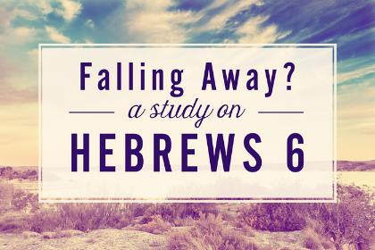
4 Views on Warning Passages
Calvinism/Reformed
Arminianism
Hypothetical
Loss of blessings

Slide 8
4 Views on Warning Passages
Calvinism/Reformed
Arminianism
Hypothetical
Loss of blessings

Slide 9
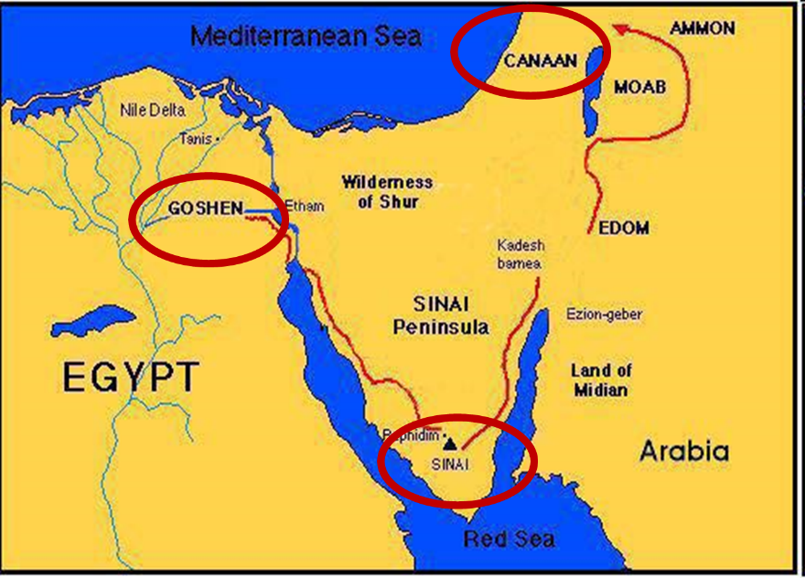

Slide 10
Kadesh Barnea Paradigm
 | Kadesh Barnea | Hebrews
Source of fear: | Giants | Unbelieving Jews
Disobedience: | Occupy Canaan | Do not lapse back into Judaism
Consequence: | Loss of Canaan | Loss of maturity; divine discipline

Slide 11
The Kadesh Barnea Paradigm as a Solution to the Problem of Hebrews 6:4-6
The Exodus Generation
Believing status
Loss of Canaan
The Hebrews
Believing status
Loss of blessings
Inadequate alternatives
Calvinism/Reformed
Arminianism
Hypothetical

Slide 12
Warnings Throughout Hebrews
2:1-4 – Warning against drifting
3:7-4:13 – Warning against disobedience
5:10-6:20 – Warning against immaturity
10:26-39 – Warning against despising the truth
12:25-29 – Warning against denying the truth

Slide 13
Warning Against Drifting (2:1-4)
Parenthesis in argument about angels (1:13; 2:5)
“We” (2:1, 3)
“Us” (2:3)
“Neglect” (2:3)
From the lesser to the greater (a fortiori)
Loss of blessing-fellowship, maturity, rewards, discipline (12:5-11)
Especially true since the message had been confirmed to the audience through apostolic signs and wonders (2:3-4)

Slide 14
Warnings Throughout Hebrews
2:1-4 – Warning against drifting
3:7-4:13 – Warning against disobedience
5:10-6:20 – Warning against immaturity
10:26-39 – Warning against despising the truth
12:25-29 – Warning against denying the truth

Slide 15
Warning Against Disobedience (3:7–4:13)
3:6 – “if” assumes possibility they would not
3:7-11 – Ps 95; Numbers 13‒14
3:12-19 – Forfeited blessings
4:1-13 – Rest available
Possibility of rest (4:1-2)
Pattern of rest (4:3-5)
Perpetuity of rest (4:6-10)
Exhortation to enter rest (4:11-13)

Slide 16
3 Reasons Why Christ is Superior to Aaron (4:14-16)
Heavenly position (4:14)
Tested in all ways (4:15)
Allows entrance into God’s throne room (4:16)

Slide 17
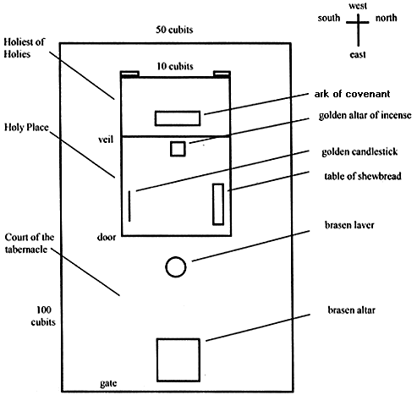
Tabernacle Diagram

Slide 18
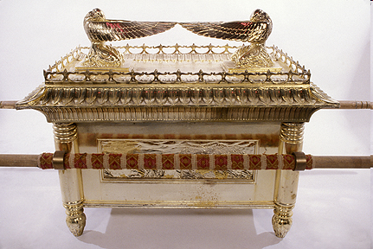
Ark of the Covenant

Slide 19
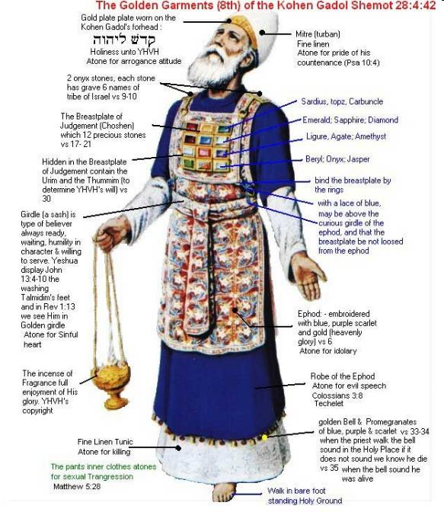

Slide 20
Why Understanding Melchizedek Requires Maturity (5:10)
Typology
Paucity of OT evidence (Gen 14:18-20; Ps 110:4)

Slide 21
Warnings Throughout Hebrews
2:1-4 – Warning against drifting
3:7-4:13 – Warning against disobedience
5:10-6:20 – Warning against immaturity
10:26-39 – Warning against despising the truth
12:25-29 – Warning against denying the truth

Slide 22
Warning Against Immaturity (5:11–6:20)
Fact of audience’s immaturity (5:11-14)
Items that must be left behind (6:1-3)
Warning (6:4-6)
Illustration (6:7-8)
Confidence (6:9-12)
Certainty of the promise (6:13-20)

Slide 23
Warnings Throughout Hebrews
2:1-4 – Warning against drifting
3:7-4:13 – Warning against disobedience
5:10-6:20 – Warning against immaturity
10:26-39 – Warning against despising the truth
12:25-29 – Warning against denying the truth

Slide 24
Warning Against Despising (10:26-39)
Believers (10:19, 19-25, 26, 29, 32, 34, 35)
Temptation to lapse back to escape persecution
26 – No power to forgive sins (Matt. 27:50-51; AD 70)
27, 30-31 – AD 70 (Luke 19:43-44)
28-29a – From the lesser to the greater (a fortiori)
29b – Three sins for publicly identifying with the nation that crucified Christ
32-36, 39 – Reminder of how their past faith has sustained them
37-38 – Follow the admonitions to the remnant in Habakkuk's day (Hab. 2:3)
–

Slide 25
Warning Against Despising (10:26-39)
Believers (10:19, 19-25, 26, 29, 32, 34, 35)
Temptation to lapse back to escape persecution
26 – No power to forgive sins (Matt. 27:50-51; AD 70)
27, 30-31 – AD 70 (Luke 19:43-44)
28-29a – From the lesser to the greater (a fortiori)
29b – Three sins for publicly identifying with the nation that crucified Christ
32-36, 39 – Reminder of how their past faith has sustained them
37-38 – Follow the admonitions to the remnant in Habakkuk's day (Hab. 2:3)
–

Slide 26
Eusebius (A.D. 260-340) Ecclesiastical History, 3.5.3
"But the people of the church in Jerusalem had been commanded by a revelation, vouchsafed to approved men there before the war, to leave the city and to dwell in a certain town of Perea called Pella. And when those that believed in Christ had come thither from Jerusalem, then, as if the royal city of the Jews and the whole land of Judea were entirely destitute of holy men, the judgment of God at length overtook those who had committed such outrages against Christ and his apostles, and totally destroyed that generation of impious men."
Epiphanius (De pond. et mens. 15) also records this flight of the Christians to Pella.)

Slide 27
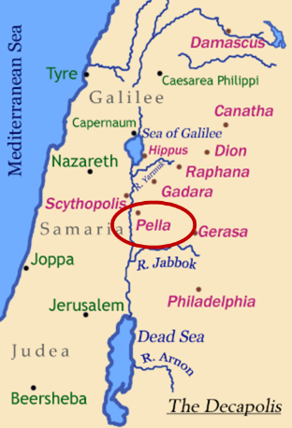
Pella
Pella was a town situated beyond the Jordan, in the north of Perea, within the dominions of Herod Agrippa II. The surrounding population was chiefly Gentile. See Pliny V. 18, and Josephus, B. J. III. 3. 3, and I. 4. 8.

Slide 28
Warning Against Despising (10:26-39)
Believers (10:19, 19-25, 26, 29, 32, 34, 35)
Temptation to lapse back to escape persecution
26 – No power to forgive sins (Matt. 27:50-51; AD 70)
27, 30-31 – AD 70 (Luke 19:43-44)
28-29a – From the lesser to the greater (a fortiori)
29b – Three sins for publicly identifying with the nation that crucified Christ
32-36, 39 – Reminder of how their past faith has sustained them
37-38 – Follow the admonitions to the remnant in Habakkuk's day (Hab. 2:3)
–

Slide 29
Arnold Fruchtenbaum Israelology, pg. 971-72
“The author moves towards giving his fourth warning and begins with a principle for those who reject the truth (10:26)...Now that they have received full knowledge of the truth, if they now willfully choose to apostasize from the faith and once and for all go back into Judaism, there remains no more sacrifice for their sin. The Messiah is the final sacrifice, and if He is rejected, there is no other sacrifice for sin available. Since for the believer all sin is dealt with for eternity, the question is: what is this sin that the cross of the Messiah does not cover in time? In this context, it is a voluntary sin which a believer wills to commit after he has been saved and has been warned of the consequences. It involves a repudiation of one’s previous confession of the Messiahship of Jesus.”

Slide 30
Arnold Fruchtenbaum Israelology, pg. 971-72
“…It involves a separation of the believer from other believers permanently and the return to Judaism, the Temple and all that it entails in order to escape persecution…The nature of the judgment is threefold: physical death (10:28–29); the A.D. 70 judgment being the time of death (10:25, 27); and the loss of rewards (10:35–36). The Old Testament teaches the fact of judgment (10:28). Under the Law of Moses, one was punished by physical death at the word of two or three witnesses. By the same token, physical death, not spiritual, will fall upon them as well, for punishment is greater under the Law of Christ than under the Law of Moses (10:25).”

Slide 31
Arnold Fruchtenbaum Israelology, pg. 971-72
“…It means treading underfoot the Son of God, and this is a rejection of God the Father who declared Him to be the Son of God. It means considering the blood of the covenant an unholy thing, and this is a rejection of God the Son whose blood it is, because it means to consider the blood of the Messiah no different than the blood of other men, common blood rather than better blood; and in this way implying that Jesus suffered justly for His own sins. It means doing despite unto the Spirit of grace, and this is a rejection of God the Holy Spirit…The reason judgment is necessary is because of the character of God (10:30–31). The author quotes from Deuteronomy 32:35–36 (10:30) to show that vengeance is the sole prerogative of God, and that God will judge His people. The author then draws his conclusion (10:31): it is a fearful thing to fall into the hands of the living God. For this reason, they must heed this fourth warning.”

Slide 32
Warnings Throughout Hebrews
2:1-4 – Warning against drifting
3:7-4:13 – Warning against disobedience
5:10-6:20 – Warning against immaturity
10:26-39 – Warning against despising the truth
12:25-29 – Warning against denying the truth

Slide 33
Warning Against Denying (12:25-29)
25 – From the lesser to the greater (a fortiori)
26-27, 29 – AD 70
28 – By contrast they are receiving an unshakeable kingdom
No loss of salvation

Slide 34
Conclusion

Slide 35
Warnings Throughout Hebrews
2:1-4 – Warning against drifting
3:7-4:13 – Warning against disobedience
5:10-6:20 – Warning against immaturity
10:26-39 – Warning against despising the truth
12:25-29 – Warning against denying the truth

