Slide 1
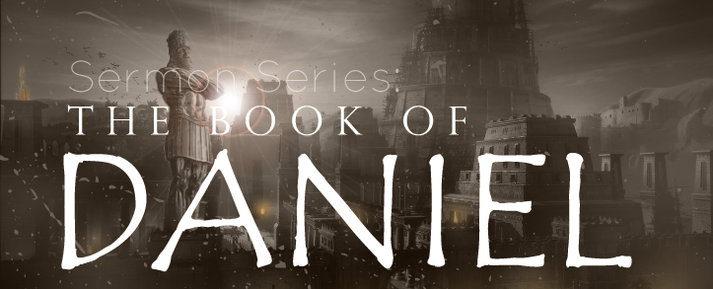
THE BOOK OF DANIEL
Dr. Andy Woods

Slide 2
Message
Times of the Gentiles are revealed prophetically (2, 7, 8-12) and ethically (1, 3-6)

Slide 3
Synthetic Outline
Historical (1-7):
Daniel interprets, 3rd person, gentile nations
Intro “Hebrew” (1)
Aramaic chiasm (2-7)

Slide 4
Synthetic Outline
Prophetic (8-12):
Angel interprets, 1st person, Jewish nation, Hebrew
Ram & Goat (8)
70 weeks (9)
Final vision (10-12)

Slide 5
Synthetic Outline
Historical (1-7):
Daniel interprets, 3rd person, gentile nations
Intro “Hebrew” (1)
Aramaic chiasm (2-7)

Slide 6
Synthetic Outline
Historical (1-7):
Daniel interprets, 3rd person, gentile nations
Intro “Hebrew” (1)
Aramaic chiasm (2-7)

Slide 7
Synthetic Outline
Chiasm “Aramaic” ( 2-7)
1. Gentile History (2)
2. Protection (3)
3. Revelation to a gentile king (4)
3. Revelation to a gentile king (5)
2. Protection (6)
1. Gentile history (7)

Slide 8
Synthetic Outline
Chiasm “Aramaic” ( 2-7)
1. Gentile History (2)
2. Protection (3)
3. Revelation to a gentile king (4)
3. Revelation to a gentile king (5)
2. Protection (6)
1. Gentile history (7)

Slide 9
Chapter 2 Outline
Nebuchadnezzar’s dream (2:1)
Nebuchadnezzar demands the revelation & interpretation (2:2-13)
Dream revealed to Daniel (2:14-23)
Daniel’s recitation & interpretation of the dream (2:24-30)
The dream’s contents & interpretation (2:31-45)
Daniel’s promotion (2:46-49)

Slide 10
Chapter 2 Outline
Nebuchadnezzar’s dream (2:1)
Nebuchadnezzar demands the revelation & interpretation (2:2-13)
Dream revealed to Daniel (2:14-23)
Daniel’s recitation & interpretation of the dream (2:24-30)
The dream’s contents & interpretation (2:31-45)
Daniel’s promotion (2:46-49)

Slide 11
CHAPTER AND VERSE IN DANIEL | CHRONOLOGICAL DATE | BIBLICAL DATE
1:1 | 605 | 3rd year of Jehoiakim
2:1 | 603 | 2nd year of Nebuchadnezzar
5 | Sat. night 10/12/539 (Hoehner)
7:1 | 553 | 1st year of Belshazzar
8:1 | 551 | 3rd year of Belshazzar
9:1 | 538 | 1st year of Darius
10:1 | 536 | 3rd year of Cyrus

Slide 12
Daniel’s Age
CHAPTER | EVENTS | AGE
1 | Taken into Babylonian Captivity | 15
2 | Interpreting Nebuchadnezzar’s 1st dream (huge image) | 17
3 | Daniel’s 3 friends cast into the fiery furnace | 19 or 20
4 | Interpreting Nebuchadnezzar’s 2nd dream (huge tree) | 45-50
5 | Interpreting handwriting of the wall at Belshazzar’s feast | Early 80’s
6 | Delivered from the den of lions | c.83
7-8 | Daniel’s visions and dreams | Mid-60’s
9 | Daniel’s seventy “sevens” prophecy | Early-80’s
10-12 | Final dreams and visions | Mid-80’s

Slide 13
Chapter 2 Outline
Nebuchadnezzar’s dream (2:1)
Nebuchadnezzar demands the revelation & interpretation (2:2-13)
Dream revealed to Daniel (2:14-23)
Daniel’s recitation & interpretation of the dream (2:24-30)
The dream’s contents & interpretation (2:31-45)
Daniel’s promotion (2:46-49)

Slide 14
Chapter 2 Outline
Nebuchadnezzar’s dream (2:1)
Nebuchadnezzar demands the revelation & interpretation (2:2-13)
Dream revealed to Daniel (2:14-23)
Daniel’s recitation & interpretation of the dream (2:24-30)
The dream’s contents & interpretation (2:31-45)
Daniel’s promotion (2:46-49)

Slide 15
Chapter 2 Outline
Nebuchadnezzar’s dream (2:1)
Nebuchadnezzar demands the revelation & interpretation (2:2-13)
Dream revealed to Daniel (2:14-23)
Daniel’s recitation & interpretation of the dream (2:24-30)
The dream’s contents & interpretation (2:31-45)
Daniel’s promotion (2:46-49)

Slide 16
Chapter 2 Outline
Nebuchadnezzar’s dream (2:1)
Nebuchadnezzar demands the revelation & interpretation (2:2-13)
Dream revealed to Daniel (2:14-23)
Daniel’s recitation & interpretation of the dream (2:24-30)
The dream’s contents & interpretation (2:31-45)
Daniel’s promotion (2:46-49)

Slide 17
Contents & Interpretation of the Dream (2:24-30)
Contents (2:31-35)
Interpretation (2:36-45)

Slide 18
Contents & Interpretation of the Dream (2:24-30)
Contents (2:31-35)
Interpretation (2:36-45)

Slide 19
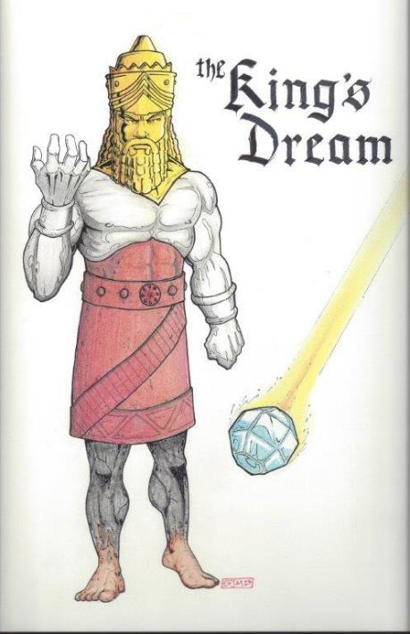
Statue
&
Stone

Slide 20
Contents & Interpretation of the Dream (2:24-30)
Contents (2:31-35)
Interpretation (2:36-45)

Slide 21
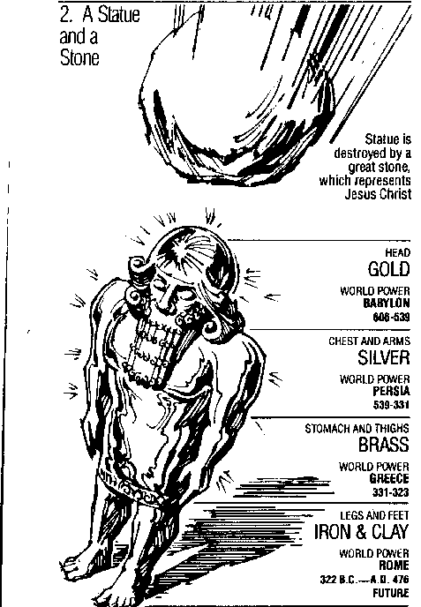
Statue & Stone

Slide 22
6 Empires
Babylon (2:36-38) 605-539 BC
Media-Persia (2:39a) 539-331 BC
Greece (2:39b) 331-63 BC
Rome I (2:40) 63 BC – 70 AD
Rome II (2:41-43) Tribulation
Kingdom (2:44-45) After 2nd Coming

Slide 23
Chapter 2 Outline
Nebuchadnezzar’s dream (2:1)
Nebuchadnezzar demands the revelation & interpretation (2:2-13)
Dream revealed to Daniel (2:14-23)
Daniel’s recitation & interpretation of the dream (2:24-30)
The dream’s contents & interpretation (2:31-45)
Daniel’s promotion (2:46-49)

Slide 24
The Promotion of Daniel (2:46-49)
Personal honor (2:46)
Praise to God (2:47)
Promotion of Daniel (2:48)
Promotion of Shadrach, Meshach, & Abed-nego (2:49)

Slide 25
The Promotion of Daniel (2:46-49)
Personal honor (2:46)
Praise to God (2:47)
Promotion of Daniel (2:48)
Promotion of Shadrach, Meshach, & Abed-nego (2:49)

Slide 26
The Promotion of Daniel (2:46-49)
Personal honor (2:46)
Praise to God (2:47)
Promotion of Daniel (2:48)
Promotion of Shadrach, Meshach, & Abed-nego (2:49)

Slide 27
The Promotion of Daniel (2:46-49)
Personal honor (2:46)
Praise to God (2:47)
Promotion of Daniel (2:48)
Promotion of Shadrach, Meshach, & Abed-nego (2:49)

Slide 28
1 Peter 5:6 (NASB)
“Therefore humble yourselves under the mighty hand of God, that He may exalt you at the proper time.”

Slide 30
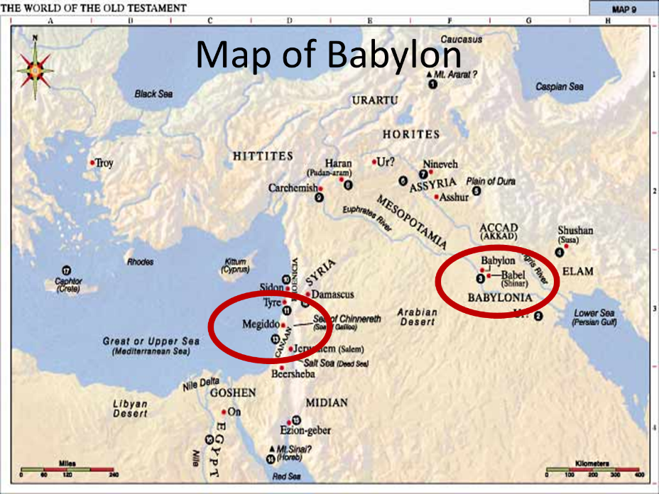

Slide 31
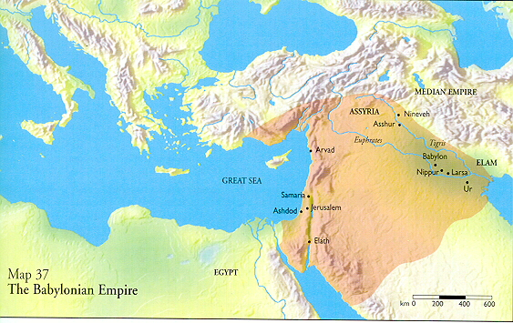

Slide 32
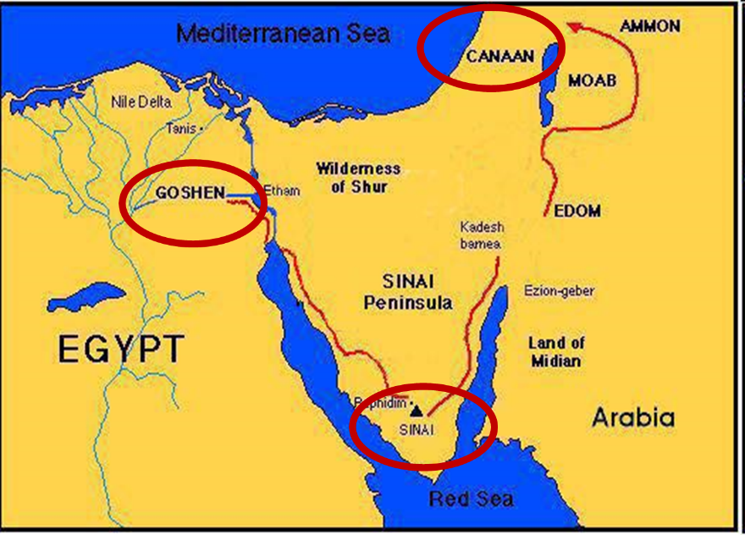

Slide 33
Balaam's 7 Oracles Blessing Israel (23-24)
First oracle (23:1-12), Balaam explained that God’s blessings upon Israel were irrevocable.
Second oracle (23:13-26), Balaam explained that the source of Israel’s blessing was her unique relationship to Yahweh
Third oracle (23:27–24:14), Balaam extolled Israel’s beauty.
Fourth oracle (24:15-19), Balaam explained that a future messianic deliverer (Gen 49:10) would spring forth and exercise dominion from Israel.

Slide 34
Balaam's 7 Oracles Blessing Israel (23-24)
Fifth oracle (Num 24:20) predicts Amalek’s destruction. Amalek was the first foe that Israel had to fight against after leaving Egypt (Exod 17).
Sixth oracle (24:21-22) predicts the destruction of the Midianite group known as the Kenites as well as Assyria.
The nations of the seventh oracle are difficult to identify (24:23-24).

Slide 35
Balaam's 7 Oracles Blessing Israel (23-24)
First oracle (23:1-12), Balaam explained that God’s blessings upon Israel were irrevocable.
Second oracle (23:13-26), Balaam explained that the source of Israel’s blessing was her unique relationship to Yahweh
Third oracle (23:27–24:14), Balaam extolled Israel’s beauty.
Fourth oracle (24:15-19), Balaam explained that a future messianic deliverer (Gen 49:10) would spring forth and exercise dominion from Israel.

Slide 36
Numbers 24:17 (NASB)
“I see him, but not now; I behold him, but not near; A star shall come forth from Jacob, A scepter shall rise from Israel, And shall crush through the forehead of Moab, And tear down all the sons of Sheth.”

Slide 37
Deuteronomy 23:4 (NASB)
“because they did not meet you with food and water on the way when you came out of Egypt, and because they hired against you Balaam the son of Beor from Pethor of Mesopotamia, to curse you.”

Slide 38
Messiah must present Himself to Israel on March 30, A.D. 33
Daniel 9:25

Slide 39
The Promotion of Daniel (2:46-49)
Personal honor (2:46)
Praise to God (2:47)
Promotion of Daniel (2:48)
Promotion of Shadrach, Meshach, & Abed-nego (2:49)

Slide 40
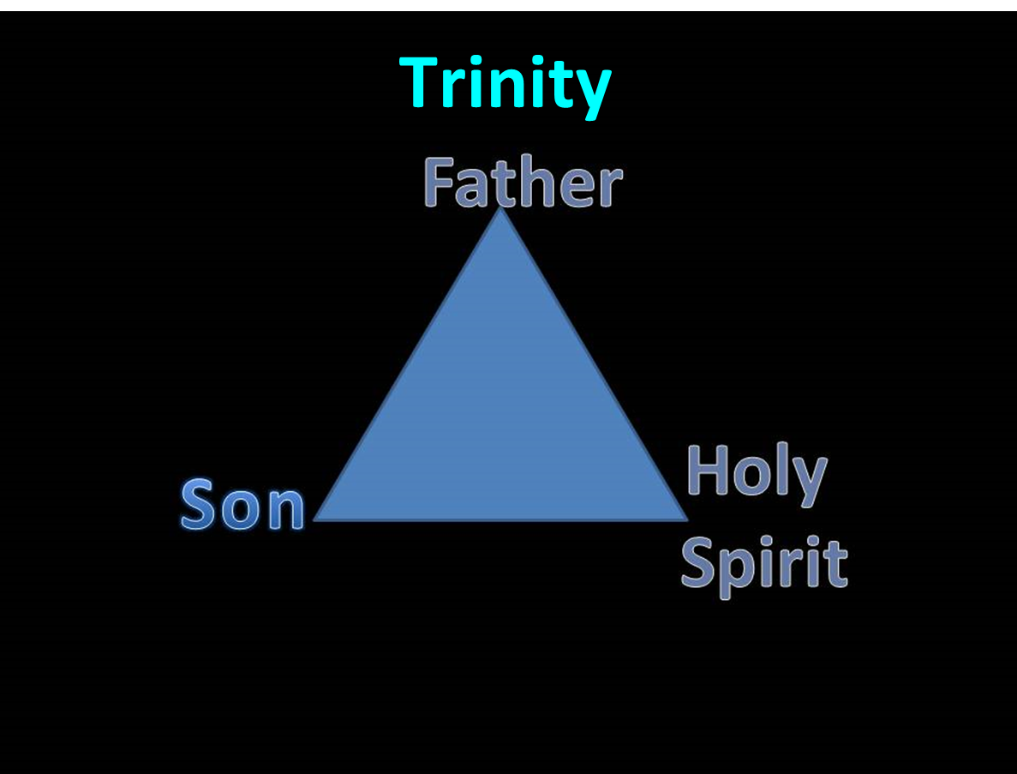

Slide 41
Takeaways from Daniel 2
Mosaic Law taught Israel how to live inside the land
The examples of the four Hebrew youths taught them how to live outside the land
Consecrate themselves to God
Live by faith from crisis to crisis entrusting the results to God
Allow God to promote us in His due time
Our cue as well

Slide 42
Conclusion

Slide 43
The Promotion of Daniel (2:46-49)
Personal honor (2:46)
Praise to God (2:47)
Promotion of Daniel (2:48)
Promotion of Shadrach, Meshach, & Abed-nego (2:49)

