Slide 1

Soteriology
Session 43
Dr. Andy Woods
Senior Pastor – Sugar Land Bible Church
Adjunct Professor of Bible & Theology – College of Biblical Studies

Slide 2
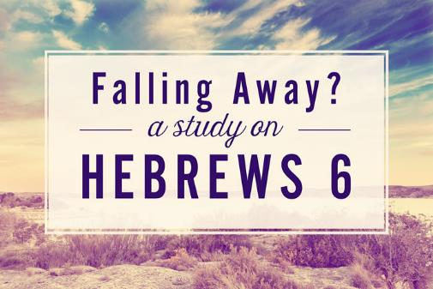
The Kadesh Barnea Paradigm as a Solution to the Problem of Hebrews 6:4-6
Dr. Andy Woods

Slide 3

Hebrews 6:4-6 (NASB)
⁴ For in the case of those who have once been enlightened and have tasted of the heavenly gift and have been made partakers of the Holy Spirit, ⁵ and have tasted the good word of God and the powers of the age to come, ⁶ and then have fallen away, it is impossible to renew them again to repentance, since they again crucify to themselves the Son of God and put Him to open shame.

Slide 4
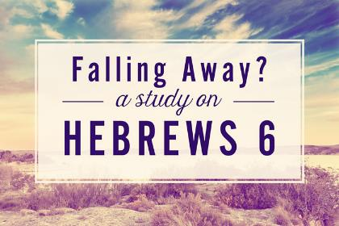
4 Views on Warning Passages
Calvinism/Reformed
Arminianism
Hypothetical
Loss of blessings

Slide 5
4 Views on Warning Passages
Calvinism/Reformed
Arminianism
Hypothetical
Loss of blessings

Slide 6
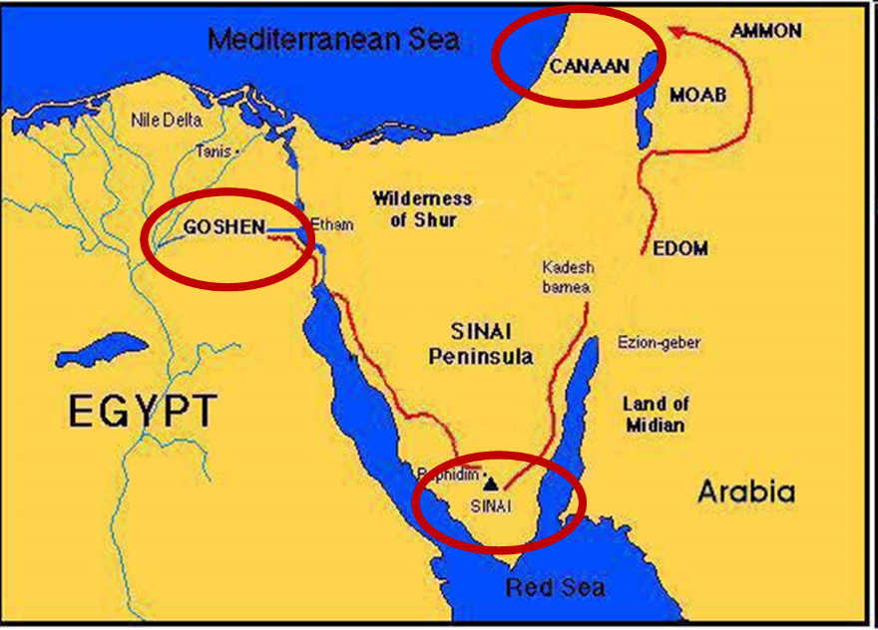

Slide 7
Kadesh Barnea Paradigm
 | Kadesh Barnea | Hebrews
Source of fear: | Giants | Unbelieving Jews
Disobedience: | Occupy Canaan | Do not lapse back into Judaism
Consequence: | Loss of Canaan | Loss of maturity; divine discipline

Slide 8
The Kadesh Barnea Paradigm as a Solution to the Problem of Hebrews 6:4-6
The Exodus Generation
  Believing status
  Loss of Canaan
The Hebrews
  Believing status
  Loss of blessings
Inadequate alternatives
  Calvinism/Reformed
  Arminianism
  Hypothetical

Slide 9
The Kadesh Barnea Paradigm as a Solution to the Problem of Hebrews 6:4-6
The Exodus Generation
  Believing status
  Loss of Canaan
The Hebrews
  Believing status
  Loss of blessings
Inadequate alternatives
  Calvinism/Reformed
  Arminianism
  Hypothetical

Slide 10
The Kadesh Barnea Paradigm as a Solution to the Problem of Hebrews 6:4-6
The Exodus Generation
  Believing status
  Loss of Canaan
The Hebrews
  Believing status
  Loss of blessings
Inadequate alternatives
  Calvinism/Reformed
  Arminianism
  Hypothetical

Slide 11
  A. Believing status
Old Testament
New Testament

Slide 12
  A. Believing status
Old Testament
New Testament

Slide 14
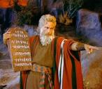
Exodus 14:30-31 (NASB)
³⁰ Thus the Lord saved Israel that day from the hand of the Egyptians, and Israel saw the Egyptians dead on the seashore. ³¹ When Israel saw the great power which the Lord had used against the Egyptians, the people feared the Lord, and they believed in the Lord and in His servant Moses.”

Slide 15
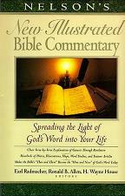
Exodus 14:31
“When we read so the people feared the Lord and the words that follow, we are meant to understand that the community had come to saving faith and so were a reborn people. They believed the Lord (the same wording used of Abraham’s saving faith in Gen. 15:6; read Paul’s comments in Rom. 4)…The people were transformed spiritually even as they were delivered physically.”
Nelson's New Illustrated Bible Commentary, 113.

Slide 16
  A. Believing status
Old Testament
New Testament

Slide 17
The Kadesh Barnea Paradigm as a Solution to the Problem of Hebrews 6:4-6
The Exodus Generation
  Believing status
  Loss of Canaan
The Hebrews
  Believing status
  Loss of blessings
Inadequate alternatives
  Calvinism/Reformed
  Arminianism
  Hypothetical

Slide 18
The Kadesh Barnea Paradigm as a Solution to the Problem of Hebrews 6:4-6
The Exodus Generation
  Believing status
  Loss of Canaan
The Hebrews
  Believing status
  Loss of blessings
Inadequate alternatives
  Calvinism/Reformed
  Arminianism
  Hypothetical

Slide 19
The Kadesh Barnea Paradigm as a Solution to the Problem of Hebrews 6:4-6
The Exodus Generation
  Believing status
  Loss of Canaan
The Hebrews
  Believing status
  Loss of blessings
Inadequate alternatives
  Calvinism/Reformed
  Arminianism
  Hypothetical

Slide 20
  A. Believing status
Extended context
Preceding context
Immediate context
Subsequent context

Slide 21
  A. Believing status
Extended context
Preceding context
Immediate context
Subsequent context

Slide 22

John 20:30-31 (NASB)
³⁰ “Therefore many other signs Jesus also performed in the presence of the disciples, which are not written in this book; ³¹ but these have been written so that you may believe that Jesus is the Christ, the Son of God; and that believing you may have life in His name.”

Slide 23
  A. Believing status
Extended context
Preceding context
Immediate context
Subsequent context

Slide 24
  2. Preceding Context
Hebrews 5:11-14
Hebrews 6:1-3

Slide 25
  2. Preceding Context
Hebrews 5:11-14
Hebrews 6:1-3

Slide 26

Heb. 5:11-14 (NASB)
¹¹ Concerning him we have much to say, and it is hard to explain, since you have become dull of hearing. ¹² For though by this time you ought to be teachers, you have need again for someone to teach you the elementary principles of the oracles of God, and you have come to need milk and not solid food. ¹³ For everyone who partakes only of milk is not accustomed to the word of righteousness, for he is an infant. ¹⁴ But solid food is for the mature, who because of practice have their senses trained to discern good and evil.

Slide 27
Heb. 5:11-14 (NASB)
¹¹ Concerning him we have much to say, and it is hard to explain, since you have become dull of hearing. ¹² For though by this time you ought to be teachers, you have need again for someone to teach you the elementary principles of the oracles of God, and you have come to need milk and not solid food. ¹³ For everyone who partakes only of milk is not accustomed to the word of righteousness, for he is an infant. ¹⁴ But solid food is for the mature, who because of practice have their senses trained to discern good and evil.

Slide 28
Heb. 5:11-14 (NASB)
¹¹ Concerning him we have much to say, and it is hard to explain, since you have become dull of hearing. ¹² For though by this time you ought to be teachers, you have need again for someone to teach you the elementary principles of the oracles of God, and you have come to need milk and not solid food. ¹³ For everyone who partakes only of milk is not accustomed to the word of righteousness, for he is an infant. ¹⁴ But solid food is for the mature, who because of practice have their senses trained to discern good and evil.

Slide 29
Heb. 5:11-14 (NASB)
¹¹ Concerning him we have much to say, and it is hard to explain, since you have become dull of hearing. ¹² For though by this time you ought to be teachers, you have need again for someone to teach you the elementary principles of the oracles of God, and you have come to need milk and not solid food. ¹³ For everyone who partakes only of milk is not accustomed to the word of righteousness, for he is an infant. ¹⁴ But solid food is for the mature, who because of practice have their senses trained to discern good and evil.

Slide 30
Heb. 5:11-14 (NASB)
¹¹ Concerning him we have much to say, and it is hard to explain, since you have become dull of hearing. ¹² For though by this time you ought to be teachers, you have need again for someone to teach you the elementary principles of the oracles of God, and you have come to need milk and not solid food. ¹³ For everyone who partakes only of milk is not accustomed to the word of righteousness, for he is an infant. ¹⁴ But solid food is for the mature, who because of practice have their senses trained to discern good and evil.

Slide 31
Heb. 5:11-14 (NASB)
¹¹ Concerning him we have much to say, and it is hard to explain, since you have become dull of hearing. ¹² For though by this time you ought to be teachers, you have need again for someone to teach you the elementary principles of the oracles of God, and you have come to need milk and not solid food. ¹³ For everyone who partakes only of milk is not accustomed to the word of righteousness, for he is an infant. ¹⁴ But solid food is for the mature, who because of practice have their senses trained to discern good and evil.

Slide 32
Heb. 5:11-14 (NASB)
¹¹ Concerning him we have much to say, and it is hard to explain, since you have become dull of hearing. ¹² For though by this time you ought to be teachers, you have need again for someone to teach you the elementary principles of the oracles of God, and you have come to need milk and not solid food. ¹³ For everyone who partakes only of milk is not accustomed to the word of righteousness, for he is an infant. ¹⁴ But solid food is for the mature, who because of practice have their senses trained to discern good and evil.

Slide 33
  2. Preceding Context
Hebrews 5:11-14
Hebrews 6:1-3

Slide 34
Heb. 6:1-3 (NASB)
¹ Therefore leaving the elementary teaching about the Christ, let us press on to maturity, not laying again a foundation of repentance from dead works and of faith toward God, ² of instruction about washings and laying on of hands, and the resurrection of the dead and eternal judgment. ³ And this we will do, if God permits.

Slide 35
Heb. 6:1-3 (NASB)
¹ Therefore leaving the elementary teaching about the Christ, let us press on to maturity, not laying again a foundation of repentance from dead works and of faith toward God, ² of instruction about washings and laying on of hands, and the resurrection of the dead and eternal judgment. ³ And this we will do, if God permits.

Slide 36
Heb. 6:1-3 (NASB)
¹ Therefore leaving the elementary teaching about the Christ, let us press on to maturity, not laying again a foundation of repentance from dead works and of faith toward God, ² of instruction about washings and laying on of hands, and the resurrection of the dead and eternal judgment. ³ And this we will do, if God permits.

Slide 37
Heb. 6:1-3 (NASB)
¹ Therefore leaving the elementary teaching about the Christ, let us press on to maturity, not laying again a foundation of repentance from dead works and of faith toward God, ² of instruction about washings and laying on of hands, and the resurrection of the dead and eternal judgment. ³ And this we will do, if God permits.

Slide 38
Heb. 6:1-3 (NASB)
¹ Therefore leaving the elementary teaching about the Christ, let us press on to maturity, not laying again a foundation of repentance from dead works and of faith toward God, ² of instruction about washings and laying on of hands, and the resurrection of the dead and eternal judgment. ³ And this we will do, if God permits.

Slide 39
Heb. 6:1-3 (NASB)
¹ Therefore leaving the elementary teaching about the Christ, let us press on to maturity, not laying again a foundation of repentance from dead works and of faith toward God, ² of instruction about washings and laying on of hands, and the resurrection of the dead and eternal judgment. ³ And this we will do, if God permits.

Slide 40
  A. Believing status
Extended context
Preceding context
Immediate context
Subsequent context

Slide 41
Heb. 6:4-6 (NASB)
⁴ For in the case of those who have once been enlightened and have tasted of the heavenly gift and have been made partakers of the Holy Spirit, ⁵ and have tasted the good word of God and the powers of the age to come, ⁶ and then have fallen away, it is impossible to renew them again to repentance, since they again crucify to themselves the Son of God and put Him to open shame.

Slide 42
Heb. 6:4-6 (NASB)
⁴ For in the case of those who have once been enlightened and have tasted of the heavenly gift and have been made partakers of the Holy Spirit, ⁵ and have tasted the good word of God and the powers of the age to come, ⁶ and then have fallen away, it is impossible to renew them again to repentance, since they again crucify to themselves the Son of God and put Him to open shame.

Slide 43
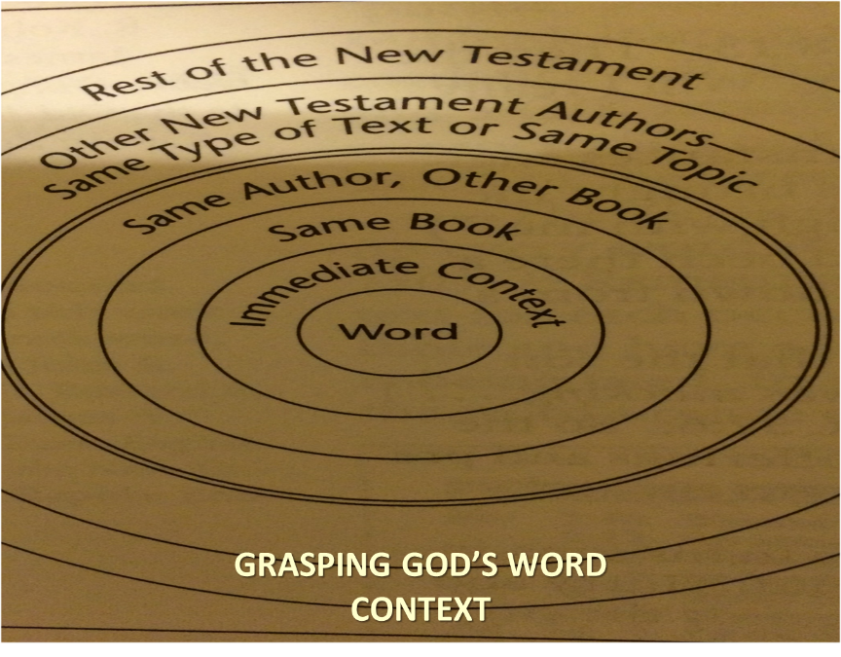

Slide 44
Heb. 6:4-6 (NASB)
⁴ For in the case of those who have once been enlightened and have tasted of the heavenly gift and have been made partakers of the Holy Spirit, ⁵ and have tasted the good word of God and the powers of the age to come, ⁶ and then have fallen away, it is impossible to renew them again to repentance, since they again crucify to themselves the Son of God and put Him to open shame.

Slide 45
Heb. 6:4-6 (NASB)
⁴ For in the case of those who have once been enlightened and have tasted of the heavenly gift and have been made partakers of the Holy Spirit, ⁵ and have tasted the good word of God and the powers of the age to come, ⁶ and then have fallen away, it is impossible to renew them again to repentance, since they again crucify to themselves the Son of God and put Him to open shame.

Slide 46
Heb. 6:4-6 (NASB)
⁴ For in the case of those who have once been enlightened and have tasted of the heavenly gift and have been made partakers of the Holy Spirit, ⁵ and have tasted the good word of God and the powers of the age to come, ⁶ and then have fallen away, it is impossible to renew them again to repentance, since they again crucify to themselves the Son of God and put Him to open shame.

Slide 47
Heb. 6:4-6 (NASB)
⁴ For in the case of those who have once been enlightened and have tasted of the heavenly gift and have been made partakers of the Holy Spirit, ⁵ and have tasted the good word of God and the powers of the age to come, ⁶ and then have fallen away, it is impossible to renew them again to repentance, since they again crucify to themselves the Son of God and put Him to open shame.

Slide 48
Heb. 6:4-6 (NASB)
⁴ For in the case of those who have once been enlightened and have tasted of the heavenly gift and have been made partakers of the Holy Spirit, ⁵ and have tasted the good word of God and the powers of the age to come, ⁶ and then have fallen away, it is impossible to renew them again to repentance, since they again crucify to themselves the Son of God and put Him to open shame.

Slide 49
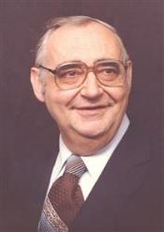
Dr. Roger R. Nicole
Professor Emeritus - Gordon-Conwell Theological Seminary
“The most immediate impulse would be to interpret this cluster of statements as describing regenerate persons."
R. Nicole, “Some Comments on Hebrews 6:4-6 and the Doctrine of the Perseverance of God with the Saints,” in Current Issues in Biblical and Patristic Interpretation, ed. G.G. Hawthorne (Grand Rapids: Eerdmans, 1975), 356.

Slide 50
Heb. 6:4-6 (NASB)
⁴ For in the case of those who have once been enlightened and have tasted of the heavenly gift and have been made partakers of the Holy Spirit, ⁵ and have tasted the good word of God and the powers of the age to come, ⁶ and then have fallen away, it is impossible to renew them again to repentance, since they again crucify to themselves the Son of God and put Him to open shame.

Slide 51
Heb. 6:4-6 (NASB)
⁴ For in the case of those who have once been enlightened and have tasted of the heavenly gift and have been made partakers of the Holy Spirit, ⁵ and have tasted the good word of God and the powers of the age to come, ⁶ and then have fallen away, it is impossible to renew them again to repentance, since they again crucify to themselves the Son of God and put Him to open shame.

Slide 52
Heb. 6:4-6 (NASB)
⁴ For in the case of those who have once been enlightened and have tasted of the heavenly gift and have been made partakers of the Holy Spirit, ⁵ and have tasted the good word of God and the powers of the age to come, ⁶ and then have fallen away, it is impossible to renew them again to repentance, since they again crucify to themselves the Son of God and put Him to open shame.

Slide 53
  A. Believing status
Extended context
Preceding context
Immediate context
Subsequent context

Slide 54

Hebrews 6:7–12 (NASB95)
⁷ For ground that drinks the rain which often falls on it and brings forth vegetation useful to those for whose sake it is also tilled, receives a blessing from God; ⁸ but if it yields thorns and thistles, it is worthless and close to being cursed, and it ends up being burned. ⁹ But, beloved, we are convinced of better things concerning you, and things that accompany salvation, though we are speaking in this way. ¹⁰ For God is not unjust so as to forget your work and the love which you have shown toward His name, in having ministered and in still ministering to the saints. ¹¹ And we desire that each one of you show the same diligence so as to realize the full assurance of hope until the end, ¹² so that you will not be sluggish, but imitators of those who through faith and patience inherit the promises.

Slide 55
Hebrews 6:7–12 (NASB95)
⁷ For ground that drinks the rain which often falls on it and brings forth vegetation useful to those for whose sake it is also tilled, receives a blessing from God; ⁸ but if it yields thorns and thistles, it is worthless and close to being cursed, and it ends up being burned. ⁹ But, beloved, we are convinced of better things concerning you, and things that accompany salvation, though we are speaking in this way. ¹⁰ For God is not unjust so as to forget your work and the love which you have shown toward His name, in having ministered and in still ministering to the saints. ¹¹ And we desire that each one of you show the same diligence so as to realize the full assurance of hope until the end, ¹² so that you will not be sluggish, but imitators of those who through faith and patience inherit the promises.

Slide 56
Hebrews 6:7–12 (NASB95)
⁷ For ground that drinks the rain which often falls on it and brings forth vegetation useful to those for whose sake it is also tilled, receives a blessing from God; ⁸ but if it yields thorns and thistles, it is worthless and close to being cursed, and it ends up being burned. ⁹ But, beloved, we are convinced of better things concerning you, and things that accompany salvation, though we are speaking in this way. ¹⁰ For God is not unjust so as to forget your work and the love which you have shown toward His name, in having ministered and in still ministering to the saints. ¹¹ And we desire that each one of you show the same diligence so as to realize the full assurance of hope until the end, ¹² so that you will not be sluggish, but imitators of those who through faith and patience inherit the promises.

Slide 57
Hebrews 6:7–12 (NASB95)
⁷ For ground that drinks the rain which often falls on it and brings forth vegetation useful to those for whose sake it is also tilled, receives a blessing from God; ⁸ but if it yields thorns and thistles, it is worthless and close to being cursed, and it ends up being burned. ⁹ But, beloved, we are convinced of better things concerning you, and things that accompany salvation, though we are speaking in this way. ¹⁰ For God is not unjust so as to forget your work and the love which you have shown toward His name, in having ministered and in still ministering to the saints. ¹¹ And we desire that each one of you show the same diligence so as to realize the full assurance of hope until the end, ¹² so that you will not be sluggish, but imitators of those who through faith and patience inherit the promises.

Slide 58
Exodus 14:30-31 (NASB)
³⁰ Thus the Lord saved Israel that day from the hand of the Egyptians, and Israel saw the Egyptians dead on the seashore. ³¹ When Israel saw the great power which the Lord had used against the Egyptians, the people feared the Lord, and they believed in the Lord and in His servant Moses.”

Slide 59
Exodus 14:31
“When we read so the people feared the Lord and the words that follow, we are meant to understand that the community had come to saving faith and so were a reborn people. They believed the Lord (the same wording used of Abraham’s saving faith in Gen. 15:6; read Paul’s comments in Rom. 4)…The people were transformed spiritually even as they were delivered physically.”
Nelson's New Illustrated Bible Commentary, 113.

Slide 61
Six Parts of a Suzerain-Vassal Treaty in Deuteronomy
Preamble (1:1-5)
Prologue (1:6–4:40)
Covenant obligations (5–26)
Storage and reading instructions (27:2-3; 31:9, 24, 26)
Witnesses (32:1)
Blessings and curses (28)

Slide 62
Hebrews 6:7–12 (NASB95)
⁷ For ground that drinks the rain which often falls on it and brings forth vegetation useful to those for whose sake it is also tilled, receives a blessing from God; ⁸ but if it yields thorns and thistles, it is worthless and close to being cursed, and it ends up being burned. ⁹ But, beloved, we are convinced of better things concerning you, and things that accompany salvation, though we are speaking in this way. ¹⁰ For God is not unjust so as to forget your work and the love which you have shown toward His name, in having ministered and in still ministering to the saints. ¹¹ And we desire that each one of you show the same diligence so as to realize the full assurance of hope until the end, ¹² so that you will not be sluggish, but imitators of those who through faith and patience inherit the promises.

Slide 63
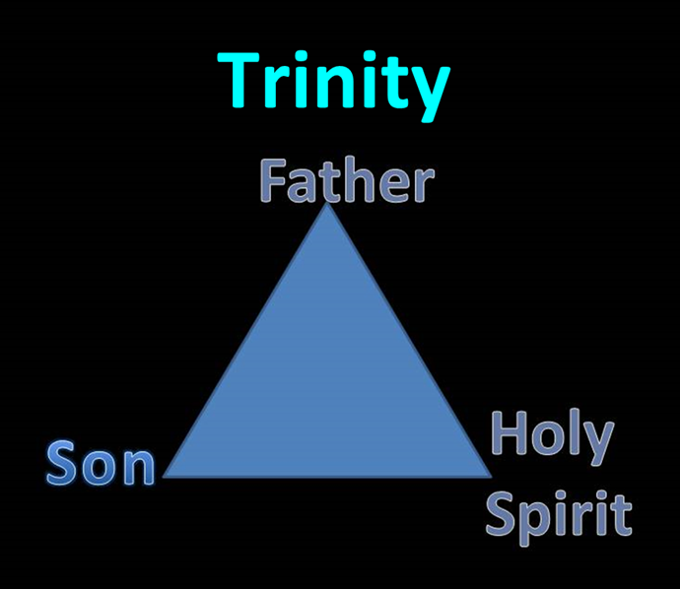

Slide 64
Hebrews 6:7–12 (NASB95)
⁷ For ground that drinks the rain which often falls on it and brings forth vegetation useful to those for whose sake it is also tilled, receives a blessing from God; ⁸ but if it yields thorns and thistles, it is worthless and close to being cursed, and it ends up being burned. ⁹ But, beloved, we are convinced of better things concerning you, and things that accompany salvation, though we are speaking in this way. ¹⁰ For God is not unjust so as to forget your work and the love which you have shown toward His name, in having ministered and in still ministering to the saints. ¹¹ And we desire that each one of you show the same diligence so as to realize the full assurance of hope until the end, ¹² so that you will not be sluggish, but imitators of those who through faith and patience inherit the promises.

Slide 65
Hebrews 6:7–12 (NASB95)
⁷ For ground that drinks the rain which often falls on it and brings forth vegetation useful to those for whose sake it is also tilled, receives a blessing from God; ⁸ but if it yields thorns and thistles, it is worthless and close to being cursed, and it ends up being burned. ⁹ But, beloved, we are convinced of better things concerning you, and things that accompany salvation, though we are speaking in this way. ¹⁰ For God is not unjust so as to forget your work and the love which you have shown toward His name, in having ministered and in still ministering to the saints. ¹¹ And we desire that each one of you show the same diligence so as to realize the full assurance of hope until the end, ¹² so that you will not be sluggish, but imitators of those who through faith and patience inherit the promises.

Slide 66
Hebrews 6:7–12 (NIV)
⁷ Land that drinks in the rain often falling on it and that produces a crop useful to those for whom it is farmed receives the blessing of God. ⁸ But land that produces thorns and thistles is worthless and is in danger of being cursed. In the end it will be burned.⁹ Even though we speak like this, dear friends, we are convinced of better things in your case—the things that have to do with salvation. ¹⁰ God is not unjust; he will not forget your work and the love you have shown him as you have helped his people and continue to help them. ¹¹ We want each of you to show this same diligence to the very end, so that what you hope for may be fully realized. ¹² We do not want you to become lazy, but to imitate those who through faith and patience inherit what has been promised.

Slide 67
Hebrews 6:7–12 (NASB95)
⁷ For ground that drinks the rain which often falls on it and brings forth vegetation useful to those for whose sake it is also tilled, receives a blessing from God; ⁸ but if it yields thorns and thistles, it is worthless and close to being cursed, and it ends up being burned. ⁹ But, beloved, we are convinced of better things concerning you, and things that accompany salvation, though we are speaking in this way. ¹⁰ For God is not unjust so as to forget your work and the love which you have shown toward His name, in having ministered and in still ministering to the saints. ¹¹ And we desire that each one of you show the same diligence so as to realize the full assurance of hope until the end, ¹² so that you will not be sluggish, but imitators of those who through faith and patience inherit the promises.

Slide 68
Hebrews 6:7–12 (NASB95)
⁷ For ground that drinks the rain which often falls on it and brings forth vegetation useful to those for whose sake it is also tilled, receives a blessing from God; ⁸ but if it yields thorns and thistles, it is worthless and close to being cursed, and it ends up being burned. ⁹ But, beloved, we are convinced of better things concerning you, and things that accompany salvation, though we are speaking in this way. ¹⁰ For God is not unjust so as to forget your work and the love which you have shown toward His name, in having ministered and in still ministering to the saints. ¹¹ And we desire that each one of you show the same diligence so as to realize the full assurance of hope until the end, ¹² so that you will not be sluggish, but imitators of those who through faith and patience inherit the promises.

Slide 69
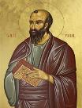
1 Corinthians 9:27
“but I discipline my body and make it my slave, so that, after I have preached to others, I myself will not be disqualified.”

Slide 70
Hebrews 6:7–12 (NASB95)
⁷ For ground that drinks the rain which often falls on it and brings forth vegetation useful to those for whose sake it is also tilled, receives a blessing from God; ⁸ but if it yields thorns and thistles, it is worthless and close to being cursed, and it ends up being burned. ⁹ But, beloved, we are convinced of better things concerning you, and things that accompany salvation, though we are speaking in this way. ¹⁰ For God is not unjust so as to forget your work and the love which you have shown toward His name, in having ministered and in still ministering to the saints. ¹¹ And we desire that each one of you show the same diligence so as to realize the full assurance of hope until the end, ¹² so that you will not be sluggish, but imitators of those who through faith and patience inherit the promises.

Slide 71
Exodus 14:30-31 (NASB)
³⁰ Thus the Lord saved Israel that day from the hand of the Egyptians, and Israel saw the Egyptians dead on the seashore. ³¹ When Israel saw the great power which the Lord had used against the Egyptians, the people feared the Lord, and they believed in the Lord and in His servant Moses.”

Slide 72
Exodus 14:31
“When we read so the people feared the Lord and the words that follow, we are meant to understand that the community had come to saving faith and so were a reborn people. They believed the Lord (the same wording used of Abraham’s saving faith in Gen. 15:6; read Paul’s comments in Rom. 4)…The people were transformed spiritually even as they were delivered physically.”
Nelson's New Illustrated Bible Commentary, 113.

Slide 74
Six Parts of a Suzerain-Vassal Treaty in Deuteronomy
Preamble (1:1-5)
Prologue (1:6–4:40)
Covenant obligations (5–26)
Storage and reading instructions (27:2-3; 31:9, 24, 26)
Witnesses (32:1)
Blessings and curses (28)

Slide 75
Hebrews 6:7–12 (NASB95)
⁷ For ground that drinks the rain which often falls on it and brings forth vegetation useful to those for whose sake it is also tilled, receives a blessing from God; ⁸ but if it yields thorns and thistles, it is worthless and close to being cursed, and it ends up being burned. ⁹ But, beloved, we are convinced of better things concerning you, and things that accompany salvation, though we are speaking in this way. ¹⁰ For God is not unjust so as to forget your work and the love which you have shown toward His name, in having ministered and in still ministering to the saints. ¹¹ And we desire that each one of you show the same diligence so as to realize the full assurance of hope until the end, ¹² so that you will not be sluggish, but imitators of those who through faith and patience inherit the promises.

Slide 76
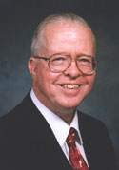
Zane Hodges
Professor NT Greek and Exegesis- Dallas Theological Seminary
“Naturally the reference to ‘burned’ has caused many to think of hell, but there is nothing in the text to suggest this…to think of hell here is to betray inattention to the imagery employed by the author. The burning of a field to destroy the rank growth it had produced was a practice known in ancient times. Its aim was not the destruction of the field itself (which, of course, the fire could not effect), but the destruction of the unwanted produce of the field. Thereafter the field might be serviceable for cultivation."
Zane Hodges, “Hebrews,” in The Bible Knowledge Commentary, ed. John F. Walvoord and Roy B. Zuck (Wheaton: Victor, 1983), 795-96.

Slide 77
Elder Pliny
Elder Pliny (AD 112) furnishes extra-biblical evidence of this practice when he says, “…some people also set fire to the stubble in the field…their chief reason, however, for this plan is to burn up the seed of weeds.”
Elder Pliny, Natural History, 18:72:300.

Slide 78
  A. Believing status
Extended context
Preceding context
Immediate context
Subsequent context

Slide 79
The Kadesh Barnea Paradigm as a Solution to the Problem of Hebrews 6:4-6
The Exodus Generation
  Believing status
  Loss of Canaan
The Hebrews
  Believing status
  Loss of blessings
Inadequate alternatives
  Calvinism/Reformed
  Arminianism
  Hypothetical

Slide 80
Heb. 6:4-6 (NASB)
⁴ For in the case of those who have once been enlightened and have tasted of the heavenly gift and have been made partakers of the Holy Spirit, ⁵ and have tasted the good word of God and the powers of the age to come, ⁶ and then have fallen away, it is impossible to renew them again to repentance, since they again crucify to themselves the Son of God and put Him to open shame.

Slide 81
Hebrews 6:7–12 (NASB95)
⁷ For ground that drinks the rain which often falls on it and brings forth vegetation useful to those for whose sake it is also tilled, receives a blessing from God; ⁸ but if it yields thorns and thistles, it is worthless and close to being cursed, and it ends up being burned. ⁹ But, beloved, we are convinced of better things concerning you, and things that accompany salvation, though we are speaking in this way. ¹⁰ For God is not unjust so as to forget your work and the love which you have shown toward His name, in having ministered and in still ministering to the saints. ¹¹ And we desire that each one of you show the same diligence so as to realize the full assurance of hope until the end, ¹² so that you will not be sluggish, but imitators of those who through faith and patience inherit the promises.

Slide 82
The Kadesh Barnea Paradigm as a Solution to the Problem of Hebrews 6:4-6
The Exodus Generation
  Believing status
  Loss of Canaan
The Hebrews
  Believing status
  Loss of blessings
Inadequate alternatives
  Calvinism/Reformed
  Arminianism
  Hypothetical

Slide 83
The Kadesh Barnea Paradigm as a Solution to the Problem of Hebrews 6:4-6
The Exodus Generation
  Believing status
  Loss of Canaan
The Hebrews
  Believing status
  Loss of blessings
Inadequate alternatives
  Calvinism/Reformed
  Arminianism
  Hypothetical

Slide 84
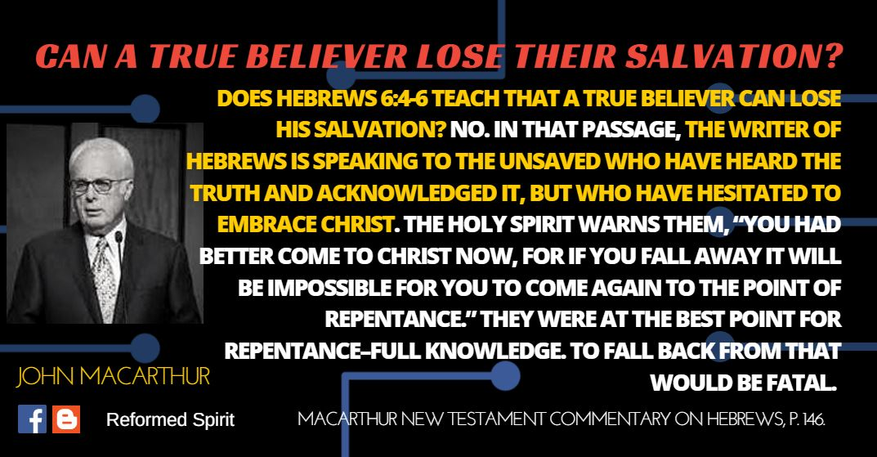

Slide 85
Heb. 6:4-6 (NASB)
⁴ For in the case of those who have once been enlightened and have tasted of the heavenly gift and have been made partakers of the Holy Spirit, ⁵ and have tasted the good word of God and the powers of the age to come, ⁶ and then have fallen away, it is impossible to renew them again to repentance, since they again crucify to themselves the Son of God and put Him to open shame.

Slide 86
Heb. 6:4-6 (NASB)
⁴ For in the case of those who have once been enlightened and have tasted of the heavenly gift and have been made partakers of the Holy Spirit, ⁵ and have tasted the good word of God and the powers of the age to come, ⁶ and then have fallen away, it is impossible to renew them again to repentance, since they again crucify to themselves the Son of God and put Him to open shame.

Slide 88
Heb. 6:4-6 (NASB)
⁴ For in the case of those who have once been enlightened and have tasted of the heavenly gift and have been made partakers of the Holy Spirit, ⁵ and have tasted the good word of God and the powers of the age to come, ⁶ and then have fallen away, it is impossible to renew them again to repentance, since they again crucify to themselves the Son of God and put Him to open shame.

Slide 89
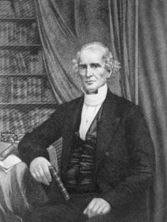
Albert Barnes
“…and it seems plain to me, that no other interpretation would ever have been thought of, if this view had not seemed to conflict with the doctrine of the ‘perseverance of the saints.’"
Albert Barnes, Notes, Explanatory and Practical, on the Epistle to the Hebrews (New York: Harper and Brothers Publishers, 1854), 134.

Slide 90
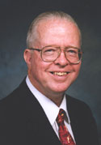
Zane Hodges
“The assertion that such a failure is not possible for a regenerate person is a theological proposition which is not supported by the New Testament...’"
Zane Hodges, “Hebrews,” in The Bible Knowledge Commentary, ed. John F. Walvoord and Roy B. Zuck (Wheaton: Victor, 1983), 795.

Slide 91
The Kadesh Barnea Paradigm as a Solution to the Problem of Hebrews 6:4-6
The Exodus Generation
  Believing status
  Loss of Canaan
The Hebrews
  Believing status
  Loss of blessings
Inadequate alternatives
  Calvinism/Reformed
  Arminianism
  Hypothetical

Slide 93
The Kadesh Barnea Paradigm as a Solution to the Problem of Hebrews 6:4-6
The Exodus Generation
  Believing status
  Loss of Canaan
The Hebrews
  Believing status
  Loss of blessings
Inadequate alternatives
  Calvinism/Reformed
  Arminianism
  Hypothetical

Slide 94
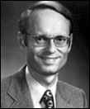
Charles Ryrie, Ryrie Study Bible,
Page 1521
“Others understand the passage to be a warning to genuine believers to urge them on in Christian growth and maturity. To ‘fall away’ is impossible (since, according to this view, true believers are eternally secure), but the phrase is placed in the sentence to strengthen the warning. It is similar to saying something like this to a class of students: ‘It is impossible for a student, once enrolled in this course, if he turns the clock back [which cannot be done], to start the course over. Therefore, let all students go on to deeper knowledge.’ In this view the phrases in verses 4-5 are understood to refer to the conversion experience.”

Slide 96
Conclusion

Slide 97
The Kadesh Barnea Paradigm as a Solution to the Problem of Hebrews 6:4-6
The Exodus Generation
  Believing status
  Loss of Canaan
The Hebrews
  Believing status
  Loss of blessings
Inadequate alternatives
  Calvinism/Reformed
  Arminianism
  Hypothetical

