Slide 1
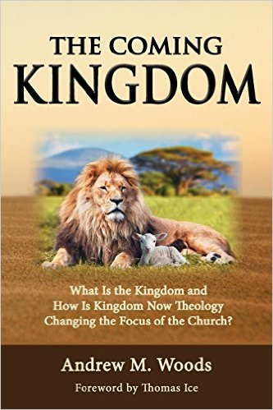

Slide 2

The Coming Kingdom
Chapter 1
Dr. Andy Woods
Senior Pastor – Sugar Land Bible Church
Adjunct Professor of Bible & Theology – College of Biblical Studies

Slide 3

Introductory Lesson
Kingdom confusion illustrations
Series outline
An important distinction

Slide 4
Introductory Lesson
Kingdom confusion illustrations
Series outline
An important distinction

Slide 5
Emergent: Kingdom
“The Kingdom of God is a central conversation in emerging communities… And let me tell you ‘Kingdom of God’ language is really big in the emerging church” (Italics added).
Doug Pagitt, cited in Oakland, Faith Undone, 163.

Slide 6
Emergent: Kingdom
“He selected 12 and trained them in a new way of life. He sent them to teach everyone this new way of life...Even if only a few would practice this new way, many would benefit. Oppressed people would be free. Poor people would be liberated from poverty. Minorities would be treated with respect. Sinners would be loved, not resented.”
Brian McLaren, A Generous Orthodoxy, 111.

Slide 7
Emergent: Kingdom
“Industrialists would realize that God cares for sparrows and wildflowers-so their industries should respect, not rape, the environment. The homeless would be invited in for a hot meal. The kingdom of God would come – not everywhere at once, not suddenly, but gradually like a seed growing in a field, like yeast spreading in a lump of bread dough, like light spreading across the sky at dawn.”
Brian McLaren, A Generous Orthodoxy, 111.

Slide 8
Emergent: Kingdom
“If Revelation were a blueprint of the distant future, it would have been unintelligible to its original readers…In light of this, Revelation becomes a powerful book about the kingdom of God here and now, available to all.”
Brian McLaren, cited in Oakland, Faith Undone, 158.

Slide 9
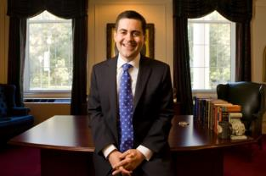
Russell Moore
President: Ethics and Religious Liberties Commission of the Southern Baptist Convention
“The locus of the kingdom of God in this age is within the church, where Jesus rules as king. As we live our lives together, we see the transforming power of the gospel and the in breaking of the future kingdom.”
Justin Taylor, “An Interview with Russell Moore,” www.thegospelcoalition.org.

Slide 10
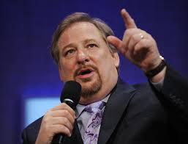
Kingdom
“I stand before you confidently right now and say to you that God is going to use you to change the world...I'm looking at a stadium full of people right now who are telling God they will do whatever it takes to establish God's Kingdom "on earth as it is in heaven." What will happen if the followers of Jesus say to Him, "We are yours?" What kind of spiritual awakening will occur?”
Rick Warren, cited in Oakland, Faith Undone, Kindle edition.

Slide 11
Kingdom
“If we are to be a part of this coming kingdom, God expects our lives – our churches and faith communities too – to be characterized by these authentic signs of our own transformation: compassion, mercy, justice, and love – demonstrated tangibly. Only then will our light break forth like the dawn, our healing quickly appear, and our cries for help be answered with a divine Here am I.”
Stearns, Hole in the Gospel, 57.

Slide 12
Kingdom
“The gospel that we have been given – the whole gospel – is God’s vision for a new way of living…Christ’s vision was of a redeemed world order populated by redeemed people – now. To accomplish this, we are to be salt and light in a dark and fallen world, the “yeast” that leavens the whole loaf of bread (the whole of society). We are the ones God has called to be His Church. It’s up to us. We are to be the change. But a changed world requires change agents, and change agents are people who have first been changed themselves.”
Stearns, Hole in the Gospel, 276, 243-44.

Slide 13
Introductory Lesson
Kingdom confusion illustrations
Series outline
An important distinction

Slide 14

Kingdom Study Outline
What does the Bible Says About the Kingdom?
The Main Problem with Kingdom Now NT interpretations
Why do some believe that we are in the kingdom now?
Why does it matter?

Slide 15
Introductory Lesson
Kingdom confusion illustrations
Series outline
An important distinction

Slide 16
Universal vs. Theocratic Kingdom
 | Universal Kingdom | Theocratic Kingdom
Time | Eternal (Ps 93:1-2) | Future (Dan 2:44)
Scope | Universal (Ps 103:19) | Earthly (Dan 2:35, 44-45)
Rule | God rules directly (Dan 4:17) | God rules indirectly through a human (Ps 2:6-9)
Existence | Always (Ps. 93:1-2) | Contingent upon a human response (Exod. 19:5-6; Matt. 3:2; 11:2-6, 14; 23:37-39)
Alva J. McClain, The Greatness of the Kingdom (Grand Rapids: Zondervan, 1959), 19-21

Slide 17

Exodus 19:5-6
“Now then, if you will indeed obey My voice and keep My covenant, then you shall be My own possession among all the peoples, for all the earth is Mine; and you shall be to Me a kingdom of priests and a holy nation.’ These are the words that you shall speak to the sons of Israel.”

Slide 18
Exodus 19:5-6
“Now then, if you will indeed obey My voice and keep My covenant, then you shall be My own possession among all the peoples, for all the earth is Mine; and you shall be to Me a kingdom of priests and a holy nation.’ These are the words that you shall speak to the sons of Israel.”

Slide 19
Universal vs. Theocratic Kingdom
 | Universal Kingdom | Theocratic Kingdom
Time | Eternal (Ps 93:1-2) | Future (Dan 2:44)
Scope | Universal (Ps 103:19) | Earthly (Dan 2:35, 44-45)
Rule | God rules directly (Dan 4:17) | God rules indirectly through a human (Ps 2:6-9)
Existence | Always (Ps. 93:1-2) | Contingent upon a human response (Exod. 19:5-6; Matt. 3:2; 11:2-6, 14; 23:37-39)
Alva J. McClain, The Greatness of the Kingdom (Grand Rapids: Zondervan, 1959), 19-21

Slide 20
Introductory Lesson
Kingdom confusion illustrations
Series outline
An important distinction

Slide 21
The Coming Kingdom
Chapter 2
Dr. Andy Woods
Senior Pastor – Sugar Land Bible Church
Adjunct Professor of Bible & Theology – College of Biblical Studies

Slide 22
Kingdom Study Outline
What does the Bible Says About the Kingdom?
The Main Problem with Kingdom Now NT interpretations
Why do some believe that we are in the kingdom now?
Why does it matter?

Slide 23
Kingdom Study Outline
What does the Bible Says About the Kingdom?
The Main Problem with Kingdom Now NT interpretations
Why do some believe that we are in the kingdom now?
Why does it matter?

Slide 24
1. Kingdom Throughout the Bible
Eden Abrahamic Covenant Mosaic Covenant Divided Kingdom Times of the Gentiles | Old Testament Prophets Post exile Offer of the King / Kingdom Rejection of the Offer Interim Age

Slide 25
1. Kingdom Throughout the Bible
Kingdom Mysteries Church Re-offer of the King/Kingdom Transfer of Kingdom Authority | Kingdom Establishment Eternal State Testimony of Early Church History

Slide 26
1. Kingdom Throughout the Bible
Eden Abrahamic Covenant Mosaic Covenant Divided Kingdom Times of the Gentiles | Old Testament Prophets Post exile Offer of the King / Kingdom Rejection of the Offer Interim Age

Slide 27

Genesis 1:26-28
²⁶ Then God said, “Let Us make man in Our image, according to Our likeness; and let them rule over the fish of the sea and over the birds of the sky and over the cattle and over all the earth, and over every creeping thing that creeps on the earth.” ²⁷ God created man in His own image, in the image of God He created him; male and female He created them. ²⁸ God blessed them; and God said to them, “Be fruitful and multiply, and fill the earth, and subdue it; and rule over the fish of the sea and over the birds of the sky and over every living thing that moves on the earth.”

Slide 28
Genesis 1:26-28
²⁶ Then God said, “Let Us make man in Our image, according to Our likeness; and let them rule over the fish of the sea and over the birds of the sky and over the cattle and over all the earth, and over every creeping thing that creeps on the earth.” ²⁷ God created man in His own image, in the image of God He created him; male and female He created them. ²⁸ God blessed them; and God said to them, “Be fruitful and multiply, and fill the earth, and subdue it; and rule over the fish of the sea and over the birds of the sky and over every living thing that moves on the earth.”

Slide 29
Genesis 2:19-20
¹⁹ Out of the ground the Lord God formed every beast of the field and every bird of the sky, and brought them to the man to see what he would call them; and whatever the man called a living creature, that was its name. ²⁰ The man gave names to all the cattle, and to the birds of the sky, and to every beast of the field, but for Adam there was not found a helper suitable for him.

Slide 30
Genesis 2:19-20
¹⁹ Out of the ground the Lord God formed every beast of the field and every bird of the sky, and brought them to the man to see what he would call them; and whatever the man called a living creature, that was its name. ²⁰ The man gave names to all the cattle, and to the birds of the sky, and to every beast of the field, but for Adam there was not found a helper suitable for him.

Slide 31
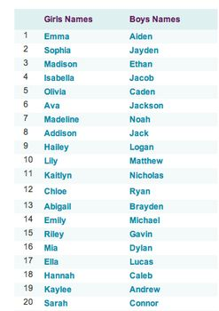
Biblical Significance of Naming
Genesis 1:8
Numbers 32:37-38
2 Kings 23:24
2 Kings 24:17
Daniel 1:6-7
Fruchtenbaum, Genesis, 84

Slide 32
Genesis 5:29 (NASB)
“Now he called his name Noah, saying, ‘This one will give us rest from our work and from the toil of our hands arising from the ground which the Lord has cursed.’”

Slide 33
Changing of the Names (Dan. 1:6)
Jewish names (Deut. 6:6-7; Prov. 22:6)
  Daniel-God is my judge
  Hananiah-Yahweh is gracious
  Mishael-Who is what God is?
  Azariah-Yahweh has helped

Slide 34
Changing of the Names (Dan. 1:7)
Babylonian names (Gen 2:19; Rom 12:2)
  Beltshazzar-Lady protect the king
  Shadrach-I am fearful of God
  Meshach-I am of little account
  Abed-nego-Servant of Nebo

Slide 35
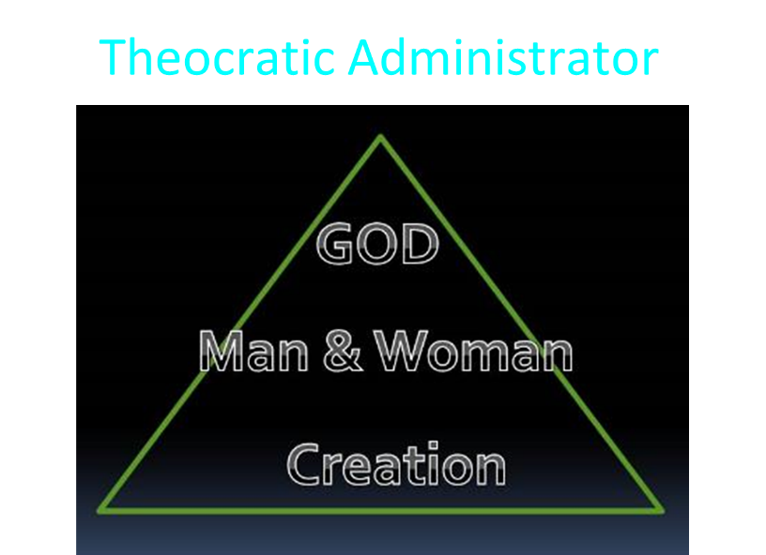

Slide 36
Results of Adam & Eve’s Sin
(Genesis 3:7-13)
Religion (3:7)
Broken fellowship (3:8-10)
“Buck passing” (3:11-13)
Reversal creation hierarchy (3:11-13)

Slide 37
Results of Adam & Eve’s Sin
(Genesis 3:7-13)
Religion (3:7)
Broken fellowship (3:8-10)
“Buck passing” (3:11-13)
Reversal creation hierarchy (3:11-13)

Slide 38

Names & Titles Demonstrating Satan’s Post-Fall, Earthly Authority
(Job 1:7; 2:2; Luke 4:5-8; Rom. 8:19-22)
Prince of this world (John 12:31; 14:30; 16:11)
God of this age (2 Cor. 4:4)
Prince and power of the air (Eph. 2:2)
Who the believer wrestles with (Eph. 6:12)
Roaring lion (1 Pet. 5:8)
Whole world lies in his power (1 John 5:19)

Slide 39

Charles Ryrie
Basic Theology, Page 511
“Why is an earthly kingdom necessary? Did He not receive His inheritance when He was raised and exalted in heaven? Is not His present rule His inheritance? Why does there need to be an earthly kingdom? Because He must be triumphant in the same arena where He was seemingly defeated. His rejection by the rulers of this world was on this earth (1 Cor. 2:8). His exaltation must also be on this earth. And so it shall be when He comes again to rule this world in righteousness. He has waited long for His inheritance; soon He shall receive it.”

Slide 40
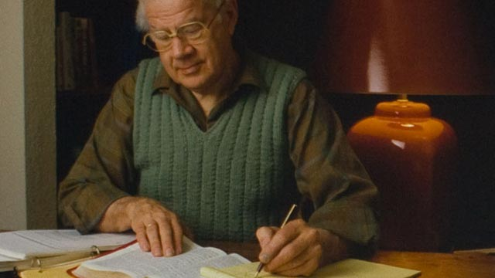
J. Dwight Pentecost
Thy kingdom Come, Page 316
“Apart from the reign of Christ…here on earth…And apart from this rule, God’s purpose for man would never be brought to conclusion. God’s purpose for the earth would be unrealized and the problem generated by Satan’s rebellion would never be resolved. Thus the physical, literal reign of Christ on the earth is a theological and biblical necessity—unless Satan is victorious over God.”

Slide 41
1. Kingdom Throughout the Bible
Eden Abrahamic Covenant Mosaic Covenant Divided Kingdom Times of the Gentiles | Old Testament Prophets Post exile Offer of the King / Kingdom Rejection of the Offer Interim Age

