Slide 3
2 Timothy Introduction
The Call to Christian Perseverance

Slide 4
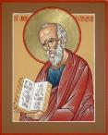
Answering Nine Questions
Who wrote it? – Paul
What do we know about the author? – An Apostle
To whom was it written? – Timothy
When was it written? - A.D. 67
Where was it written from? – Rome
Why was it written? – Timothy’s timidity
What is it about? – Perseverance
What is inside (outline)? – 4 part outline
What makes the book different? – Paul’s final word

Slide 5
Four Part Structure
General call to faithful endurance in the ministry (chapter 1)
Ten metaphors describing what faithful endurance looks like (chapter 2)
What to do in the midst of the coming apostasy (3:1–4:8)
How God met six needs in Paul’s life (4:9-22)

Slide 6
Four Part Structure
General call to faithful endurance in the ministry (chapter 1)
Ten metaphors describing what faithful endurance looks like (chapter 2)
What to do in the midst of the coming apostasy (3:1–4:8)
How God met six needs in Paul’s life (4:9-22)

Slide 7
Four Part Structure
General call to faithful endurance in the ministry (chapter 1)
Ten metaphors describing what faithful endurance looks like (chapter 2)
What to do in the midst of the coming apostasy (3:1–4:8)
How God met six needs in Paul’s life (4:9-22)

Slide 8
2 Timothy 2
Ten Metaphors Illustrating Endurance

Slide 9
Ten Metaphors
Teacher (2:2)
Soldier (2:3-4)
Athlete (2:5)
Farmer (2:6)
Christ (2:7-8)
Paul (2:9-10)
Trustworthy statement (2:11-13)
Workman (2:14-18)
Vessel (2:19-23)
Servant (2:24-26)

Slide 10
Four Part Structure
General call to faithful endurance in the ministry (chapter 1)
Ten metaphors describing what faithful endurance looks like (chapter 2)
What to do in the midst of the coming apostasy (3:1–4:8)
How God met six needs in Paul’s life (4:9-22)

Slide 11
THE LAST DAYS APOSTASY OF THE CHURCH
Dr. Andy Woods

Slide 12
Definition of Apostasy
apos = away from
histēmi = to stand
Apostasy = to stand away from
Apostasy = a departure from known (or previously embraced) truth

Slide 13
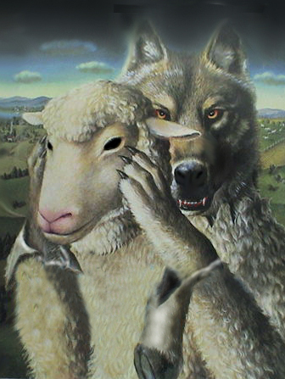
Ten Characteristics of Apostasy
Sign of the last days
A massive NT subject
Impacts every major doctrine
Primarily internal
Knows no limits

Slide 14
Ten Characteristics of Apostasy
Can happen quickly
Satanically energized
Destructive
Makes life difficult for the man of God
Impacts those who have not taken preventive measures

Slide 15
2 Timothy 3:1‒4:6
What to Do in the
Midst of the Apostasy

Slide 16
Apostasy (3:1‒4:8)
The Apostasy (3:1-9)
The evil (3:1-7)
The examples (3:8-9)
The Antidote (3:10‒4:8)
Paul’s example (3:10-13)
Preach the Word (3:14‒4:8)

Slide 17
Apostasy (3:1‒4:8)
The Apostasy (3:1-9)
The evil (3:1-7)
The examples (3:8-9)
The Antidote (3:10‒4:8)
Paul’s example (3:10-13)
Preach the Word (3:14‒4:8)

Slide 18
Apostasy (3:1‒4:8)
The Apostasy (3:1-9)
The evil (3:1-7)
The examples (3:8-9)
The Antidote (3:10‒4:8)
Paul’s example (3:10-13)
Preach the Word (3:14‒4:8)

Slide 19
A. The Evil (3:1-7)
Difficulty & danger (1)
Misplaced Love (2, 4)
Pride (2)
Alpha privitives (2-3)
Four concluding characteristics (5-7)

Slide 20
A. The Evil (3:1-7)
Difficulty & danger (1)
Misplaced Love (2, 4)
Pride (2)
Alpha privitives (2-3)
Four concluding characteristics (5-7)

Slide 21
A. The Evil (3:1-7)
Difficulty & danger (1)
Misplaced Love (2, 4)
Pride (2)
Alpha privitives (2-3)
Four concluding characteristics (5-7)

Slide 22
2. Misplaced love (2, 4)
Lovers of self (2)
Lovers of money (2)
Lovers of pleasure rather than lovers of God (4)

Slide 23
2. Misplaced love (2, 4)
Lovers of self (2)
Lovers of money (2)
Lovers of pleasure rather than lovers of God (4)

Slide 24
2. Misplaced love (2, 4)
Lovers of self (2)
Lovers of money (2)
Lovers of pleasure rather than lovers of God (4)

Slide 25
2. Misplaced love (2, 4)
Lovers of self (2)
Lovers of money (2)
Lovers of pleasure rather than lovers of God (4)

Slide 26
2 Tim 3:2-4
Lovers of self (vs. 2)
Lovers of $
Boastful
Arrogant
Blasphemers
Disobedient to parents
Unthankful
Unloving
Unholy
Unforgiving
Rather than lovers of God (vs. 4)
Slanderers
Without self-control
Brutal
Haters of good
Treacherous
Reckless
Conceited
Pleasure lovers

Slide 27
2. Misplaced love (2, 4)
Lovers of self (2)
Lovers of money (2)
Lovers of pleasure rather than lovers of God (4)

Slide 28
A. The Evil (3:1-7)
Difficulty & danger (1)
Misplaced Love (2, 4)
Pride (2)
Alpha privitives (2-3)
Four concluding characteristics (5-7)

Slide 29
3. Pride (2)
Boastful (2)
Arrogant (2)
Revilers (2)

Slide 30
3. Pride (2)
Boastful (2)
Arrogant (2)
Revilers (2)

Slide 31
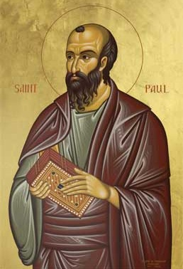
Ephesians 2:8-9
"For by grace you have been saved through faith; and that not of yourselves, it is the gift of God; not as a result of works, so that no one may boast."
Notes:
To what does “that” or “this” refer? Since it is a neuter pronoun it evidently does not refer to “grace” or “faith” both of which are feminine in gender in the Greek text. Probably it refers to the whole preceding clause that describes salvation (cf. 1:15; 3:1). Salvation is the gift of God. Constable, T. (2003). Tom Constable’s Expository Notes on the Bible (Eph 2:8). Galaxie Software.
More plausible is the…view, viz., that τοῦτο refers to the concept of a grace-by-faith salvation. As we have seen, τοῦτο regularly takes a conceptual antecedent. Whether faith is seen as a gift here or anywhere else in the NT is not addressed by this.⁵³
(⁵³ On an exegetical level, I am inclined to agree with Lincoln that “in Paul’s thinking faith can never be viewed as a meritorious work because in connection with justification he always contrasts faith with works of the law (cf. Gal 2:16; 3:2–5, 9, 10; Rom 3:27, 28)” (A. T. Lincoln, Ephesians [WBC] 111). If faith is not meritorious, but is instead the reception of the gift of salvation, then it is not a gift per se. Such a view does not preclude the notion that for faith to save, the Spirit of God must initiate the conversion process. Wallace, D. B. (1996). Greek Grammar beyond the Basics: An Exegetical Syntax of the New Testament (p. 335). Grand Rapids, MI: Zondervan.)

Slide 32
3. Pride (2)
Boastful (2)
Arrogant (2)
Revilers (2)

Slide 33
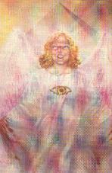
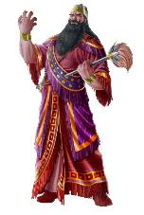
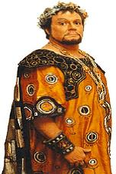
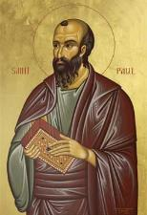
Hall of the Humbled (1 Peter 5:5)
Satan (Isa 14:12-15; Ezek 28:12-17; 1 Tim 3:6)
Nebuchadnezzar (Dan 4)
Herod (Acts 12:20-23)
Paul (2 Cor 12:1-10)

Slide 34
3. Pride (2)
Boastful (2)
Arrogant (2)
Revilers (2)

Slide 35
A. The Evil (3:1-7)
Difficulty & danger (1)
Misplaced Love (2, 4)
Pride (2)
Alpha privitives (2-3)
Four concluding characteristics (5-7)

Slide 36
4. Alpha Privitives (2-3)
Disobedient to parents (2)
Ungrateful (2)
Unholy (2)
Unloving (3)
Irreconcilable (3)
Break up-Malicious gossips (3)
Without self control (3)
Brutal (3)
Haters of good (3)

Slide 37
4. Alpha Privitives (2-3)
Disobedient to parents (2)
Ungrateful (2)
Unholy (2)
Unloving (3)
Irreconcilable (3)
Break up-Malicious gossips (3)
Without self control (3)
Brutal (3)
Haters of good (3)

Slide 38
4. Alpha Privitives (2-3)
Disobedient to parents (2)
Ungrateful (2)
Unholy (2)
Unloving (3)
Irreconcilable (3)
Break up-Malicious gossips (3)
Without self control (3)
Brutal (3)
Haters of good (3)

Slide 39
4. Alpha Privitives (2-3)
Disobedient to parents (2)
Ungrateful (2)
Unholy (2)
Unloving (3)
Irreconcilable (3)
Break up-Malicious gossips (3)
Without self control (3)
Brutal (3)
Haters of good (3)

Slide 40
4. Alpha Privitives (2-3)
Disobedient to parents (2)
Ungrateful (2)
Unholy (2)
Unloving (3)
Irreconcilable (3)
Break up-Malicious gossips (3)
Without self control (3)
Brutal (3)
Haters of good (3)

Slide 41
4. Alpha Privitives (2-3)
Disobedient to parents (2)
Ungrateful (2)
Unholy (2)
Unloving (3)
Irreconcilable (3)
Break up-Malicious gossips (3)
Without self control (3)
Brutal (3)
Haters of good (3)

Slide 42
4. Alpha Privitives (2-3)
Disobedient to parents (2)
Ungrateful (2)
Unholy (2)
Unloving (3)
Irreconcilable (3)
Break up-Malicious gossips (3)
Without self control (3)
Brutal (3)
Haters of good (3)

Slide 43
4. Alpha Privitives (2-3)
Disobedient to parents (2)
Ungrateful (2)
Unholy (2)
Unloving (3)
Irreconcilable (3)
Break up-Malicious gossips (3)
Without self control (3)
Brutal (3)
Haters of good (3)

Slide 44
4. Alpha Privitives (2-3)
Disobedient to parents (2)
Ungrateful (2)
Unholy (2)
Unloving (3)
Irreconcilable (3)
Break up-Malicious gossips (3)
Without self control (3)
Brutal (3)
Haters of good (3)

Slide 46
4. Alpha Privitives (2-3)
Disobedient to parents (2)
Ungrateful (2)
Unholy (2)
Unloving (3)
Irreconcilable (3)
Break up-Malicious gossips (3)
Without self control (3)
Brutal (3)
Haters of good (3)

Slide 47
A. The Evil (3:1-7)
Difficulty & danger (1)
Misplaced Love (2, 4)
Pride (2)
Alpha privitives (2-3)
Four concluding characteristics (5-7)

Slide 48
5. Four Concluding Characteristics (5-7)
Treacherous (4)
Reckless (4)
Conceited (4)
Holding to a form of godliness but denying its power (5-7)

Slide 49
5. Four Concluding Characteristics (5-7)
Treacherous (4)
Reckless (4)
Conceited (4)
Holding to a form of godliness but denying its power (5-7)

Slide 50
5. Four Concluding Characteristics (5-7)
Treacherous (4)
Reckless (4)
Conceited (4)
Holding to a form of godliness but denying its power (5-7)

Slide 51
5. Four Concluding Characteristics (5-7)
Treacherous (4)
Reckless (4)
Conceited (4)
Holding to a form of godliness but denying its power (5-7)

Slide 52
5. Four Concluding Characteristics (5-7)
Treacherous (4)
Reckless (4)
Conceited (4)
Holding to a form of godliness but denying its power (5-7)

Slide 53
Conclusion

Slide 54
A. The Evil (3:1-7)
Difficulty & danger (1)
Misplaced Love (2, 4)
Pride (2)
Alpha privitives (2-3)
Four concluding characteristics (5-7)

Slide 55
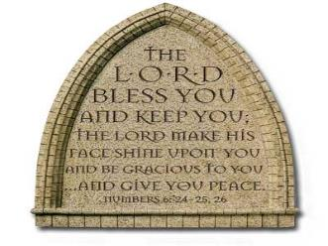
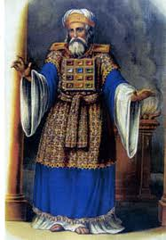
“The Lord bless you and keep you; the Lord make his face shine on you and be gracious to you; the Lord turn his face toward you and give you peace.” (NIV)

