Slide 1

Soteriology
Session 3
Dr. Andy Woods
Senior Pastor – Sugar Land Bible Church
Professor of Bible & Theology – College of Biblical Studies

Slide 2
Soteriology Overview
Definition
Election
Atonement
Salvation words
God’s one condition of salvation
Results of salvation
Eternal security
Faulty views of salvation

Slide 3
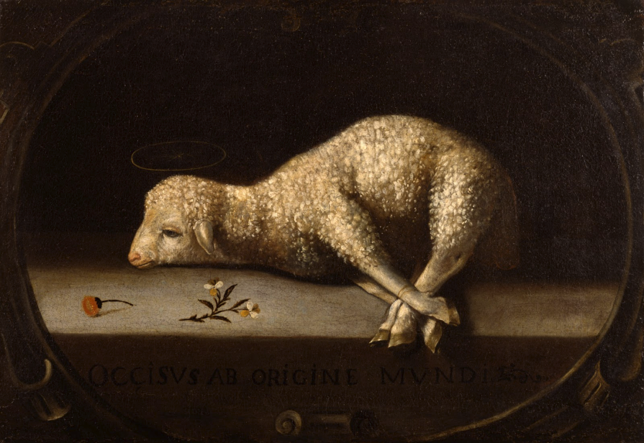
Soteriology Overview
This Session
Atonement

Slide 4
III. Atonement Preview
Definition
False views
Role of the blood
Extent
Finality
Old Testament illustrations

Slide 5
III. Atonement
Definition
False views
Role of the blood
Extent
Finality
Old Testament illustrations

Slide 6
Christ’s Atoning Death
Substitution-Isa 53:3-6
Illustrations
  Secret serviceman
  Bee sting

Slide 7
Christ’s Atoning Death
Substitution-Isa 53:3-6
Illustrations
  Secret serviceman
  Bee sting

Slide 8
Christ’s Atoning Death
Substitution-Isa 53:3-6
Illustrations
  Secret serviceman
  Bee sting

Slide 9
Christ’s Atoning Death
Substitution-Isa 53:3-6
Illustrations
  Secret serviceman
  Bee sting

Slide 10
Christ’s Atoning Death
Substitution-Isa 53:3-6
Illustrations
  Secret serviceman
  Bee sting

Slide 11
III. Atonement
Definition
False views
Role of the blood
Extent
Finality
Old Testament illustrations

Slide 12
Christ’s Atoning Death
False views of the atonement
  Ransom to Satan-Christ’s death is a ransom to Satan and not the Father (A.D. 185‒54)
  Moral influence-Christ’s death is an expression of God’s love (A.D. 1079‒1142)
  Moral example-Christ’s death inspires us to be sacrificial (A.D. 1539‒1604)
  Governmental-Christ’s death promotes respect for God’s Law (A.D. 1583‒1645)
  Accidental-Fate accidently ended Christ’s life

Slide 13
Christ’s Atoning Death
False views of the atonement
  Ransom to Satan-Christ’s death is a ransom to Satan and not the Father (A.D. 185‒54)
  Moral influence-Christ’s death is an expression of God’s love (A.D. 1079‒1142)
  Moral example-Christ’s death inspires us to be sacrificial (A.D. 1539‒1604)
  Governmental-Christ’s death promotes respect for God’s Law (A.D. 1583‒1645)
  Accidental-Fate accidently ended Christ’s life

Slide 14
Christ’s Atoning Death
False views of the atonement
  Ransom to Satan-Christ’s death is a ransom to Satan and not the Father (A.D. 185‒54)
  Moral influence-Christ’s death is an expression of God’s love (A.D. 1079‒1142)
  Moral example-Christ’s death inspires us to be sacrificial (A.D. 1539‒1604)
  Governmental-Christ’s death promotes respect for God’s Law (A.D. 1583‒1645)
  Accidental-Fate accidently ended Christ’s life

Slide 15
Christ’s Atoning Death
False views of the atonement
  Ransom to Satan-Christ’s death is a ransom to Satan and not the Father (A.D. 185‒54)
  Moral influence-Christ’s death is an expression of God’s love (A.D. 1079‒1142)
  Moral example-Christ’s death inspires us to be sacrificial (A.D. 1539‒1604)
  Governmental-Christ’s death promotes respect for God’s Law (A.D. 1583‒1645)
  Accidental-Fate accidently ended Christ’s life

Slide 16
Christ’s Atoning Death
False views of the atonement
  Ransom to Satan-Christ’s death is a ransom to Satan and not the Father (A.D. 185‒54)
  Moral influence-Christ’s death is an expression of God’s love (A.D. 1079‒1142)
  Moral example-Christ’s death inspires us to be sacrificial (A.D. 1539‒1604)
  Governmental-Christ’s death promotes respect for God’s Law (A.D. 1583‒1645)
  Accidental-Fate accidently ended Christ’s life

Slide 17
Christ’s Atoning Death
False views of the atonement
  Ransom to Satan-Christ’s death is a ransom to Satan and not the Father (A.D. 185‒54)
  Moral influence-Christ’s death is an expression of God’s love (A.D. 1079‒1142)
  Moral example-Christ’s death inspires us to be sacrificial (A.D. 1539‒1604)
  Governmental-Christ’s death promotes respect for God’s Law (A.D. 1583‒1645)
  Accidental-Fate accidently ended Christ’s life

Slide 18
III. Atonement
Definition
False views
Role of the blood
Extent
Finality
Old Testament illustrations

Slide 19
Christ’s Atoning Death
Role of Christ’s blood in the atonement-
  Acts 20:28
  Rom 5:9; Eph 1:7; 2:13; Col 1:20
  Heb 9:12, 22; 1 Pet 1:2; 1 John 1:7
  Rev 1:5; 5:9; 12:11
Free to us but expensive to Him
Significance of the Lord’s Table (1 Cor 11:23-26)

Slide 20
Christ’s Atoning Death
Role of Christ’s blood in the atonement-
  Acts 20:28
  Rom 5:9; Eph 1:7; 2:13; Col 1:20
  Heb 9:12, 22; 1 Pet 1:2; 1 John 1:7
  Rev 1:5; 5:9; 12:11
Free to us but expensive to Him
Significance of the Lord’s Table (1 Cor 11:23-26)

Slide 21
Christ’s Atoning Death
Role of Christ’s blood in the atonement-
  Acts 20:28
  Rom 5:9; Eph 1:7; 2:13; Col 1:20
  Heb 9:12, 22; 1 Pet 1:2; 1 John 1:7
  Rev 1:5; 5:9; 12:11
Free to us but expensive to Him
Significance of the Lord’s Table (1 Cor 11:23-26)

Slide 22
Christ’s Atoning Death
Role of Christ’s blood in the atonement-
  Acts 20:28
  Rom 5:9; Eph 1:7; 2:13; Col 1:20
  Heb 9:12, 22; 1 Pet 1:2; 1 John 1:7
  Rev 1:5; 5:9; 12:11
Free to us but expensive to Him
Significance of the Lord’s Table (1 Cor 11:23-26)

Slide 23
III. Atonement
Definition
False views
Role of the blood
Extent
Finality
Old Testament illustrations

Slide 24
Extent of the Atonement
Extent
  Limited
    Five point Calvinism-TULIP
    Biblical support
      Matt 20:28
      John 10:15
      Acts 20:28
      Eph 5:25

Slide 25
Extent of the Atonement
Extent
  Limited
    Five point Calvinism-TULIP
    Biblical support
      Matt 20:28
      John 10:15
      Acts 20:28
      Eph 5:25

Slide 26
Extent of the Atonement
Extent
  Limited
    Five point Calvinism-TULIP
    Biblical support
      Matt 20:28
      John 10:15
      Acts 20:28
      Eph 5:25

Slide 27
Extent of the Atonement
Extent
  Limited
    Five point Calvinism-TULIP
    Biblical support
      Matt 20:28
      John 10:15
      Acts 20:28
      Eph 5:25

Slide 28
Extent of the Atonement
Extent
  Unlimited-
    John 1:29; 3:16-17; 4:42; 6:51; 12:32, 47; Acts 17:30; 2 Cor 5:19; 1 Tim 2:4, 6; 4:10; Titus 2:11; Heb 2:9; 1 John 2:2; 2 Pet 2:1
    Contradiction?
      John 12:19
      Only?
      Non exclusive
    Savable vs. saved
    Christ died for you!

Slide 29
Extent of the Atonement
Extent
  Unlimited-
    John 1:29; 3:16-17; 4:42; 6:51; 12:32, 47; Acts 17:30; 2 Cor 5:19; 1 Tim 2:4, 6; 4:10; Titus 2:11; Heb 2:9; 1 John 2:2; 2 Pet 2:1
    Contradiction?
      John 12:19
      Only?
      Non exclusive
    Savable vs. saved
    Christ died for you!

Slide 30
Extent of the Atonement
Extent
  Unlimited-
    John 1:29; 3:16-17; 4:42; 6:51; 12:32, 47; Acts 17:30; 2 Cor 5:19; 1 Tim 2:4, 6; 4:10; Titus 2:11; Heb 2:9; 1 John 2:2; 2 Pet 2:1
    Contradiction?
      John 12:19
      Only?
      Non exclusive
    Savable vs. saved
    Christ died for you!

Slide 31
Extent of the Atonement
Extent
  Limited
    Five point Calvinism-TULIP
    Biblical support
      Matt 20:28
      John 10:15
      Acts 20:28
      Eph 5:25

Slide 32
Extent of the Atonement
Extent
  Unlimited-
    John 1:29; 3:16-17; 4:42; 6:51; 12:32, 47; Acts 17:30; 2 Cor 5:19; 1 Tim 2:4, 6; 4:10; Titus 2:11; Heb 2:9; 1 John 2:2; 2 Pet 2:1
    Contradiction?
      John 12:19
      Only?
      Non exclusive
    Savable vs. saved
    Christ died for you!

Slide 33
Extent of the Atonement
Extent
  Unlimited-
    John 1:29; 3:16-17; 4:42; 6:51; 12:32, 47; Acts 17:30; 2 Cor 5:19; 1 Tim 2:4, 6; 4:10; Titus 2:11; Heb 2:9; 1 John 2:2; 2 Pet 2:1
    Contradiction?
      John 12:19
      Only?
      Non exclusive
    Savable vs. saved
    Christ died for you!

Slide 34
Extent of the Atonement
Extent
  Unlimited-
    John 1:29; 3:16-17; 4:42; 6:51; 12:32, 47; Acts 17:30; 2 Cor 5:19; 1 Tim 2:4, 6; 4:10; Titus 2:11; Heb 2:9; 1 John 2:2; 2 Pet 2:1
    Contradiction?
      John 12:19
      Only?
      Non exclusive
    Savable vs. saved
    Christ died for you!

Slide 35
III. Atonement
Definition
False views
Role of the blood
Extent
Finality
Old Testament illustrations

Slide 36
Finality of the Atonement
Finality
  Sat down-
    Col 3:1
    Hebrews (Jewish readers) 1:3; 8:1; 10:12; 12:1-2
    Rev 3:21
  One time (hapax)-Heb 9:12, 26; 10:10, 12, 14
  Finished (teleō)-John 19:30

Slide 37
Finality of the Atonement
Finality
  Sat down-
    Col 3:1
    Hebrews (Jewish readers) 1:3; 8:1; 10:12; 12:1-2
    Rev 3:21
  One time (hapax)-Heb 9:12, 26; 10:10, 12, 14
  Finished (teleō)-John 19:30

Slide 38
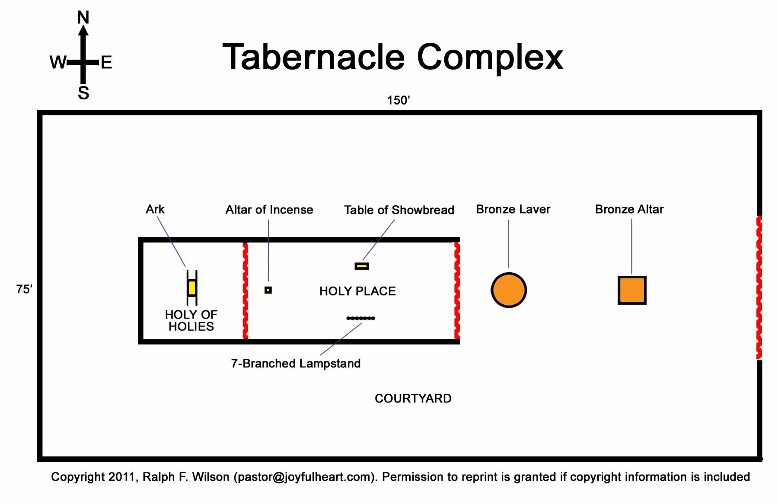
Tabernacle Diagram

Slide 39
Finality of the Atonement
Finality
  Sat down-
    Col 3:1
    Hebrews (Jewish readers) 1:3; 8:1; 10:12; 12:1-2
    Rev 3:21
  One time (hapax)-Heb 9:12, 26; 10:10, 12, 14
  Finished (teleō)-John 19:30

Slide 40
Finality of the Atonement
Finality
  Sat down-
    Col 3:1
    Hebrews (Jewish readers) 1:3; 8:1; 10:12; 12:1-2
    Rev 3:21
  One time (hapax)-Heb 9:12, 26; 10:10, 12, 14
  Finished (teleō)-John 19:30

Slide 41
Finality of the Atonement
Finality
  Sat down-
    Col 3:1
    Hebrews (Jewish readers) 1:3; 8:1; 10:12; 12:1-2
    Rev 3:21
  One time (hapax)-Heb 9:12, 26; 10:10, 12, 14
  Finished (teleō)-John 19:30

Slide 42
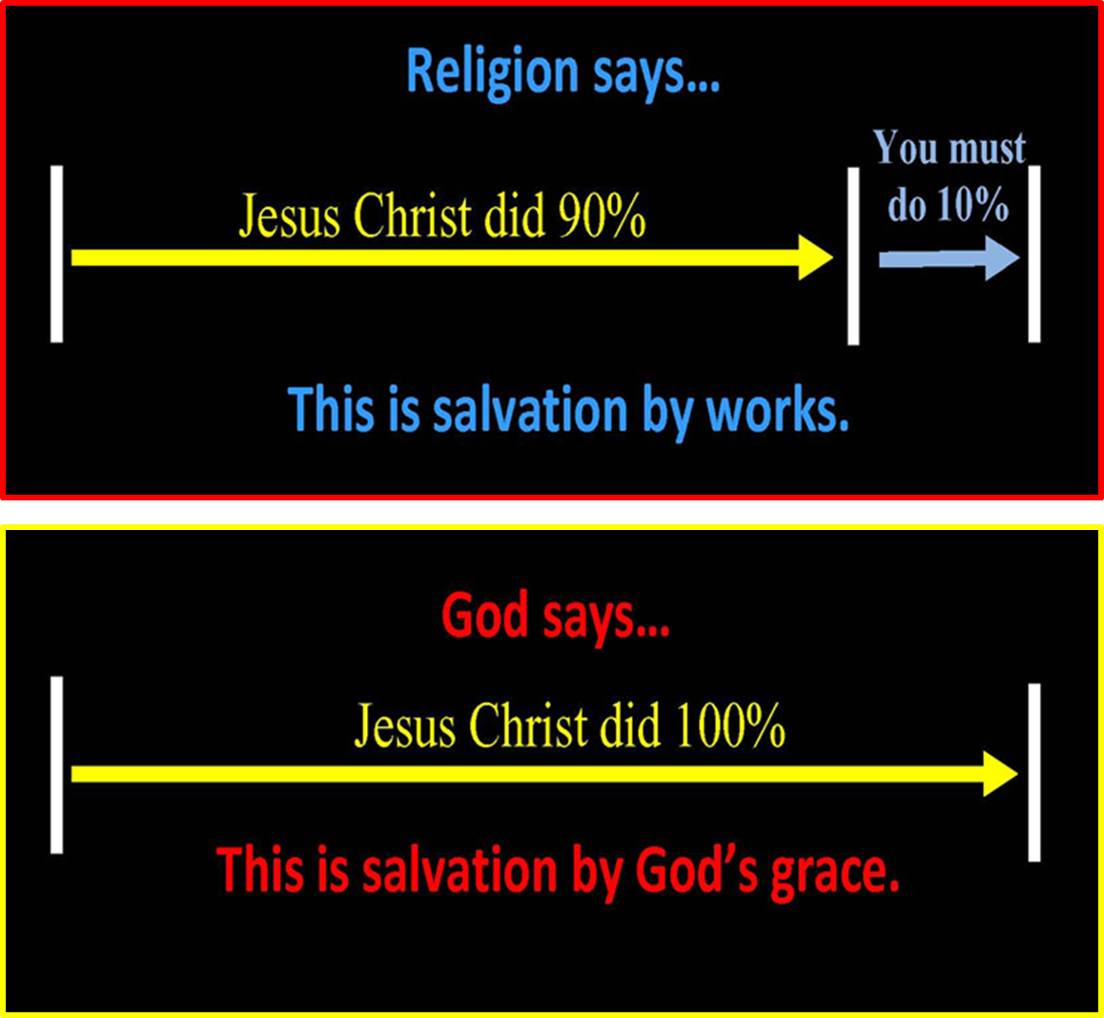

Slide 43
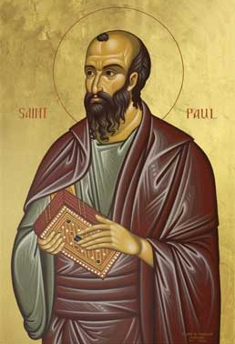
Romans 4:4-5
“ Now to the one who works, his wage is not credited as a favor, but as what is due. But to the one who does not work, but believes in Him who justifies the ungodly, his faith is credited as righteousness.”

Slide 44
III. Atonement
Definition
False views
Role of the blood
Extent
Finality
Old Testament illustrations

Slide 45
Illustrations of the Atonement
Animal skins-Gen 3:7, 21
Abraham offering Isaac-Gen 22
Passover Lamb-Exod 12
Levitical offerings-Lev 1-5
Day of Atonement-Lev 16
Red heifer-Num 19

Slide 46
Illustrations of the Atonement
Animal skins-Gen 3:7, 21
Abraham offering Isaac-Gen 22
Passover Lamb-Exod 12
Levitical offerings-Lev 1-5
Day of Atonement-Lev 16
Red heifer-Num 19

Slide 47
Illustrations of the Atonement
Animal skins-Gen 3:7, 21
Abraham offering Isaac-Gen 22
Passover Lamb-Exod 12
Levitical offerings-Lev 1-5
Day of Atonement-Lev 16
Red heifer-Num 19

Slide 48
Illustrations of the Atonement
Animal skins-Gen 3:7, 21
Abraham offering Isaac-Gen 22
Passover Lamb-Exod 12
Levitical offerings-Lev 1-5
Day of Atonement-Lev 16
Red heifer-Num 19

Slide 49
Illustrations of the Atonement
Animal skins-Gen 3:7, 21
Abraham offering Isaac-Gen 22
Passover Lamb-Exod 12
Levitical offerings-Lev 1-5
Day of Atonement-Lev 16
Red heifer-Num 19

Slide 50


Slide 51
Illustrations of the Atonement
Animal skins-Gen 3:7, 21
Abraham offering Isaac-Gen 22
Passover Lamb-Exod 12
Levitical offerings-Lev 1-5
Day of Atonement-Lev 16
Red heifer-Num 19

Slide 52
Tabernacle Diagram

Slide 53
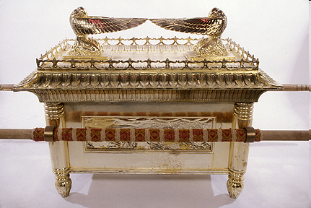
Ark of the Covenant

Slide 54
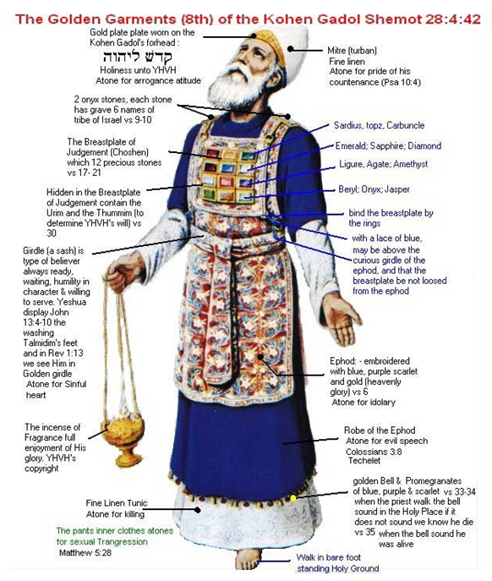

Slide 55
Illustrations of the Atonement
Animal skins-Gen 3:7, 21
Abraham offering Isaac-Gen 22
Passover Lamb-Exod 12
Levitical offerings-Lev 1-5
Day of Atonement-Lev 16
Red heifer-Num 19

Slide 56
III. Atonement Review
Definition
False views
Role of the blood
Extent
Finality
Old Testament illustrations

Slide 57
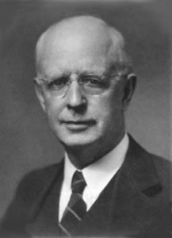
Soteriology Overview
Next Session
IV. Salvation Words

