Slide 1
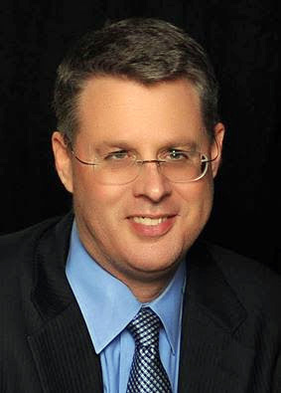
Soteriology Session 2
Dr. Andy Woods
Senior Pastor – Sugar Land Bible Church
Professor of Bible & Theology – College of Biblical Studies

Slide 2
Soteriology Overview
Definition
Election
Atonement
Salvation words
God’s one condition of salvation
Results of salvation
Eternal security
Faulty views of salvation

Slide 3
II. Election vs. Freewill
Definition and uses
Totality of God’s character
Divine sovereignty
Human responsibility
The Bible teaches both
Extremes to avoid

Slide 4
II. Election vs. Freewill
Definition and uses
Totality of God’s character
Divine sovereignty
Human responsibility
The Bible teaches both
Extremes to avoid

Slide 5
Definition & Uses
Definition – Action of God in choosing those who will be saved as members of the body of Christ
Many biblical uses
Israel – Deut 4:37; 7:7
Cyrus – Isa 45:1-4
Christ – Isa 42:1
Tribulation saints – Matt 24:22
Believers in Christ today – Col 3:12; Titus 1:1

Slide 6
Definition & Uses
Definition – Action of God in choosing those who will be saved as members of the body of Christ
Many biblical uses
Israel – Deut 4:37; 7:7
Cyrus – Isa 45:1-4
Christ – Isa 42:1
Tribulation saints – Matt 24:22
Believers in Christ today – Col 3:12; Titus 1:1

Slide 7
Definition & Uses
Definition – Action of God in choosing those who will be saved as members of the body of Christ
Many biblical uses
Israel – Deut 4:37; 7:7
Cyrus – Isa 45:1-4
Christ – Isa 42:1
Tribulation saints – Matt 24:22
Believers in Christ today – Col 3:12; Titus 1:1

Slide 8
II. Election vs. Freewill
Definition and uses
Totality of God’s character
Divine sovereignty
Human responsibility
The Bible teaches both
Extremes to avoid

Slide 9
Totality of God’s character
Harmony with God’s character
Love – John 3:16; Eph 1:4-5
Glory – Eph 1:4-6, 11; Jude 24-25
Eternal purpose – Eph 1:11
God’s desire for all to be saved – 1 Tim 2:4; 2 Pet 3:9
His ways our higher than our ways – Isa 55:8-9

Slide 10
II. Election vs. Freewill
Definition and uses
Totality of God’s character
Divine sovereignty
Human responsibility
The Bible teaches both
Extremes to avoid

Slide 11
Divine Sovereignty
Divine sovereignty
Pre-temporal choice
Unconditional
John 6:44, 65, 69-70; 15:16; Matt 16:15-17; Acts 13:48; 16:14; Rom 8:28-30; 9:6-24; Rev 13:8; 17:8
Those included
Individual – Jer 1:4-5; Gal 1:15-16; Rom 16:13; 2 John 1, 13
Group – 1 Pet 1:1-2
Those not included – John 13:18; Rom 9:22; 1 Pet 2:8
Product of election = good works – Jer. 1:4-5; Acts 9:15-16; Gal 1:15-16; Eph 2:10

Slide 12
Divine Sovereignty
Divine sovereignty
Pre-temporal choice
Unconditional
John 6:44, 65, 69-70; 15:16; Matt 16:15-17; Acts 13:48; 16:14; Rom 8:28-30; 9:6-24; Rev 13:8; 17:8
Those included
Individual – Jer 1:4-5; Gal 1:15-16; Rom 16:13; 2 John 1, 13
Group – 1 Pet 1:1-2
Those not included – John 13:18; Rom 9:22; 1 Pet 2:8
Product of election = good works – Jer. 1:4-5; Acts 9:15-16; Gal 1:15-16; Eph 2:10

Slide 13
Divine Sovereignty
Divine sovereignty
Pre-temporal choice
Unconditional
John 6:44, 65, 69-70; 15:16; Matt 16:15-17; Acts 13:48; 16:14; Rom 8:28-30; 9:6-24; Rev 13:8; 17:8
Those included
Individual – Jer 1:4-5; Gal 1:15-16; Rom 16:13; 2 John 1, 13
Group – 1 Pet 1:1-2
Those not included – John 13:18; Rom 9:22; 1 Pet 2:8
Product of election = good works – Jer. 1:4-5; Acts 9:15-16; Gal 1:15-16; Eph 2:10

Slide 14
Divine Sovereignty
Divine sovereignty
Pre-temporal choice
Unconditional
John 6:44, 65, 69-70; 15:16; Matt 16:15-17; Acts 13:48; 16:14; Rom 8:28-30; 9:6-24; Rev 13:8; 17:8
Those included
Individual – Jer 1:4-5; Gal 1:15-16; Rom 16:13; 2 John 1, 13
Group – 1 Pet 1:1-2
Those not included – John 13:18; Rom 9:22; 1 Pet 2:8
Product of election = good works – Jer. 1:4-5; Acts 9:15-16; Gal 1:15-16; Eph 2:10

Slide 16
Divine Sovereignty
Divine sovereignty
Pre-temporal choice
Unconditional
John 6:44, 65, 69-70; 15:16; Matt 16:15-17; Acts 13:48; 16:14; Rom 8:28-30; 9:6-24; Rev 13:8; 17:8
Those included
Individual – Jer 1:4-5; Gal 1:15-16; Rom 16:13; 2 John 1, 13
Group – 1 Pet 1:1-2
Those not included – John 13:18; Rom 9:22; 1 Pet 2:8
Product of election = good works – Jer. 1:4-5; Acts 9:15-16; Gal 1:15-16; Eph 2:10

Slide 17
Divine Sovereignty
Divine sovereignty
Pre-temporal choice
Unconditional
John 6:44, 65, 69-70; 15:16; Matt 16:15-17; Acts 13:48; 16:14; Rom 8:28-30; 9:6-24; Rev 13:8; 17:8
Those included
Individual – Jer 1:4-5; Gal 1:15-16; Rom 16:13; 2 John 1, 13
Group – 1 Pet 1:1-2
Those not included – John 13:18; Rom 9:22; 1 Pet 2:8
Product of election = good works – Jer. 1:4-5; Acts 9:15-16; Gal 1:15-16; Eph 2:10

Slide 18
Divine Sovereignty
Divine sovereignty
Pre-temporal choice
Unconditional
John 6:44, 65, 69-70; 15:16; Matt 16:15-17; Acts 13:48; 16:14; Rom 8:28-30; 9:6-24; Rev 13:8; 17:8
Those included
Individual – Jer 1:4-5; Gal 1:15-16; Rom 16:13; 2 John 1, 13
Group – 1 Pet 1:1-2
Those not included – John 13:18; Rom 9:22; 1 Pet 2:8
Product of election = good works – Jer. 1:4-5; Acts 9:15-16; Gal 1:15-16; Eph 2:10

Slide 19
Divine Sovereignty
Divine sovereignty
Pre-temporal choice
Unconditional
John 6:44, 65, 69-70; 15:16; Matt 16:15-17; Acts 13:48; 16:14; Rom 8:28-30; 9:6-24; Rev 13:8; 17:8
Those included
Individual – Jer 1:4-5; Gal 1:15-16; Rom 16:13; 2 John 1, 13
Group – 1 Pet 1:1-2
Those not included – John 13:18; Rom 9:22; 1 Pet 2:8
Product of election = good works – Jer. 1:4-5; Acts 9:15-16; Gal 1:15-16; Eph 2:10

Slide 20
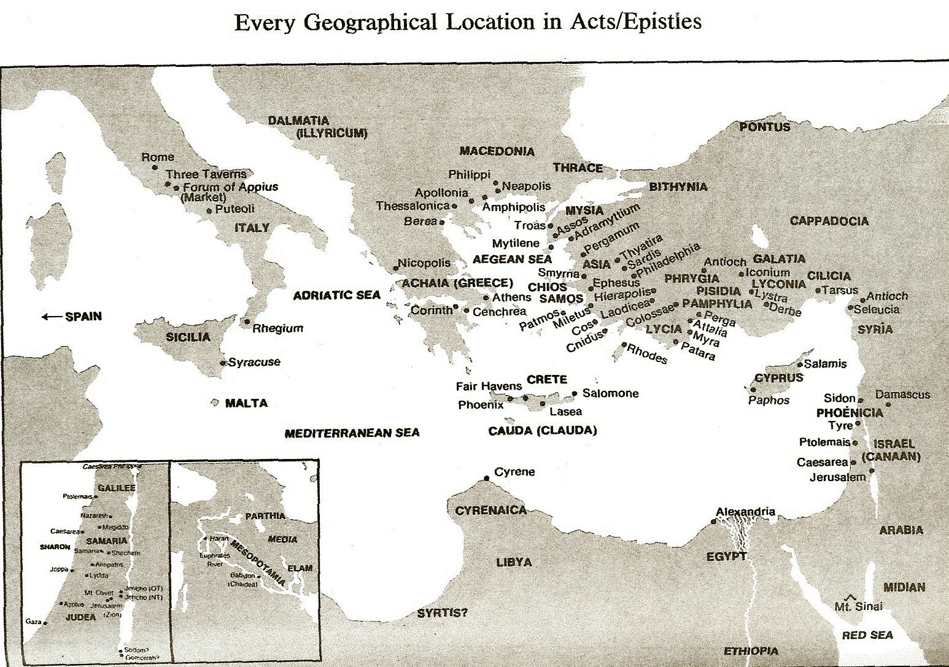

Slide 21
Divine Sovereignty
Divine sovereignty
Pre-temporal choice
Unconditional
John 6:44, 65, 69-70; 15:16; Matt 16:15-17; Acts 13:48; 16:14; Rom 8:28-30; 9:6-24; Rev 13:8; 17:8
Those included
Individual – Jer 1:4-5; Gal 1:15-16; Rom 16:13; 2 John 1, 13
Group – 1 Pet 1:1-2
Those not included – John 13:18; Rom 9:22; 1 Pet 2:8
Product of election = good works – Jer. 1:4-5; Acts 9:15-16; Gal 1:15-16; Eph 2:10

Slide 22
Divine Sovereignty
Divine sovereignty
Pre-temporal choice
Unconditional
John 6:44, 65, 69-70; 15:16; Matt 16:15-17; Acts 13:48; 16:14; Rom 8:28-30; 9:6-24; Rev 13:8; 17:8
Those included
Individual – Jer 1:4-5; Gal 1:15-16; Rom 16:13; 2 John 1, 13
Group – 1 Pet 1:1-2
Those not included – John 13:18; Rom 9:22; 1 Pet 2:8
Product of election = good works – Jer. 1:4-5; Acts 9:15-16; Gal 1:15-16; Eph 2:10

Slide 23
II. Election vs. Freewill
Definition and uses
Totality of God’s character
Divine sovereignty
Human responsibility
The Bible teaches both
Extremes to avoid

Slide 24
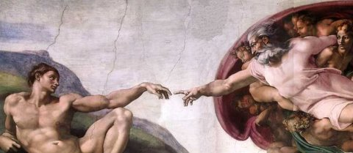
Human responsibility
Human responsibility
Gen 15:6; John 3:16; Acts 16:30-31; 17:30; Rev 22:17
Humanity as image bearers of God (Gen 1:26-27; 2:16-17; 9:6; Jas 3:9)

Slide 25
Human responsibility
Human responsibility
Gen 15:6; John 3:16; Acts 16:30-31; 17:30; Rev 22:17
Humanity as image bearers of God (Gen 1:26-27; 2:16-17; 9:6; Jas 3:9)

Slide 26
Human responsibility
Human responsibility
Gen 15:6; John 3:16; Acts 16:30-31; 17:30; Rev 22:17
Humanity as image bearers of God (Gen 1:26-27; 2:16-17; 9:6; Jas 3:9)

Slide 27
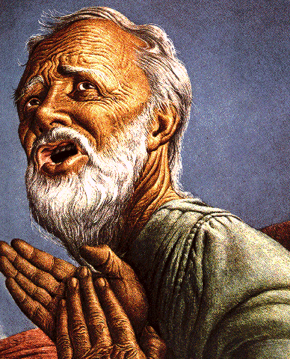
Human responsibility
BELIEF – GOD’S ONE CONDITION FOR JUSTIFICATION
Gen 15:6-Then he believed in the LORD; and He reckoned it to him as righteousness.
John 3:16-For God so loved the world, that He gave His only begotten Son, that whoever believes in Him shall not perish, but have eternal life.
Acts 16:30-31-"Sirs, what must I do to be saved?" They said, "Believe in the Lord Jesus, and you will be saved..."

Slide 28
Human responsibility
Human responsibility
Gen 15:6; John 3:16; Acts 16:30-31; 17:30; Rev 22:17
Humanity as image bearers of God (Gen 1:26-27; 2:16-17; 9:6; Jas 3:9)

Slide 29
Human responsibility
Human responsibility
Gen 15:6; John 3:16; Acts 16:30-31; 17:30; Rev 22:17
Humanity as image bearers of God (Gen 1:26-27; 2:16-17; 9:6; Jas 3:9)

Slide 30
II. Election vs. Freewill
Definition and uses
Totality of God’s character
Divine sovereignty
Human responsibility
The Bible teaches both
Extremes to avoid

Slide 31
The Bible teaches both
Both are biblically true
John 13:18; Acts 2:23
Ryrie A Survey of Bible Doctrine 118- “There are unsaved elect people alive today, though the elect are now lost and will not be saved until they believe.”
Giesler’s “Chosen But Free”
Ironside’s two signs
Husband and wife analogy (Eph. 5:22-33)
God can use the free moral choices of His creatures to accomplish His sovereign plan

Slide 32
The Bible teaches both
Both are biblically true
John 13:18; Acts 2:23
Ryrie A Survey of Bible Doctrine 118- “There are unsaved elect people alive today, though the elect are now lost and will not be saved until they believe.”
Giesler’s “Chosen But Free”
Ironside’s two signs
Husband and wife analogy (Eph. 5:22-33)
God can use the free moral choices of His creatures to accomplish His sovereign plan

Slide 33
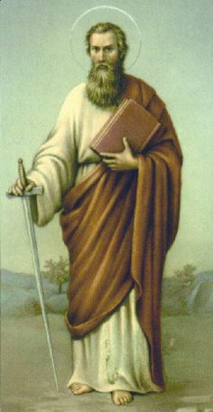
Acts 2:23
"this Man, delivered over by the predetermined plan and foreknowledge of God, you nailed to a cross by the hands of godless men and put Him to death"

Slide 34
The Bible teaches both
Both are biblically true
John 13:18; Acts 2:23
Ryrie A Survey of Bible Doctrine 118 – “There are unsaved elect people alive today, though the elect are now lost and will not be saved until they believe.”
Giesler’s “Chosen But Free”
Ironside’s two signs
Husband and wife analogy (Eph. 5:22-33)
God can use the free moral choices of His creatures to accomplish His sovereign plan

Slide 35
The Bible teaches both
Both are biblically true
John 13:18; Acts 2:23
Ryrie A Survey of Bible Doctrine 118 – “There are unsaved elect people alive today, though the elect are now lost and will not be saved until they believe.”
Giesler’s “Chosen But Free”
Ironside’s two signs
Husband and wife analogy (Eph. 5:22-33)
God can use the free moral choices of His creatures to accomplish His sovereign plan

Slide 36
The Bible teaches both
Both are biblically true
John 13:18; Acts 2:23
Ryrie A Survey of Bible Doctrine 118 – “There are unsaved elect people alive today, though the elect are now lost and will not be saved until they believe.”
Giesler’s “Chosen But Free”
H. A. Ironside’s two signs
Husband and wife analogy (Eph. 5:22-33)
God can use the free moral choices of His creatures to accomplish His sovereign plan

Slide 37
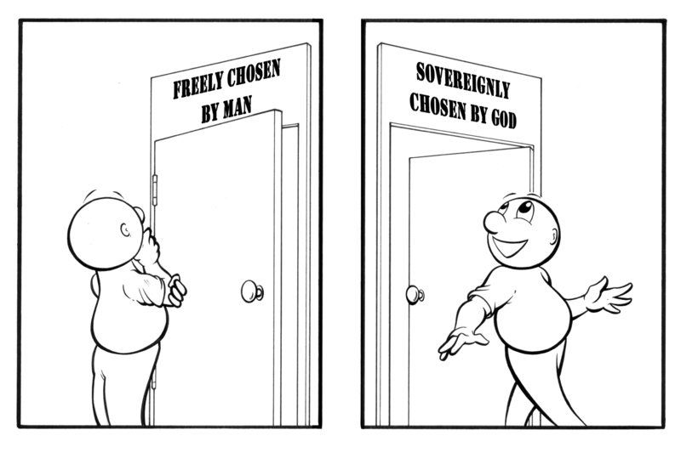
H. A. Ironside’s Two Signs

Slide 38
The Bible teaches both
Both are biblically true
John 13:18; Acts 2:23
Ryrie A Survey of Bible Doctrine 118 – “There are unsaved elect people alive today, though the elect are now lost and will not be saved until they believe.”
Giesler’s “Chosen But Free”
H. A. Ironside’s two signs
Husband and wife analogy (Eph. 5:22-33)
God can use the free moral choices of His creatures to accomplish His sovereign plan

Slide 39
Husband and Wife Analogy
Who chose Whom?
I chose her.
I chose him.
We chose each other.

Slide 40
The Bible teaches both
Both are biblically true
John 13:18; Acts 2:23
Ryrie A Survey of Bible Doctrine 118 – “There are unsaved elect people alive today, though the elect are now lost and will not be saved until they believe.”
Giesler’s “Chosen But Free”
H. A. Ironside’s two signs
Husband and wife analogy (Eph. 5:22-33)
God can use the free moral choices of His creatures to accomplish His sovereign plan

Slide 41
II. Election vs. Freewill
Definition and uses
Totality of God’s character
Divine sovereignty
Human responsibility
The Bible teaches both
Extremes to avoid

Slide 42
Extremes to avoid
Extremes to avoid
Using one set of texts to rewrite another set of texts
Regeneration precedes faith
Prescience (pre-sh(ē-)ən(t)s) View
Using election to remove human responsibility

Slide 43
Extremes to avoid
Extremes to avoid
Using one set of texts to rewrite another set of texts
Regeneration precedes faith
Prescience (pre-sh(ē-)ən(t)s) View
Using election to remove human responsibility

Slide 44
Extremes to avoid
Extremes to avoid
Using one set of texts to rewrite another set of texts
Regeneration precedes faith
Prescience (pre-sh(ē-)ən(t)s) View
Using election to remove human responsibility

Slide 45
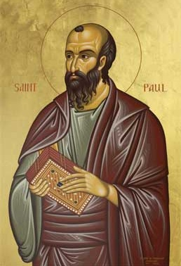
Ephesians 2:8-9
"For by grace you have been saved through faith; and that not of yourselves, it is the gift of God; not as a result of works, so that no one may boast."
Notes:
To what does “that” or “this” refer? Since it is a neuter pronoun it evidently does not refer to “grace” or “faith” both of which are feminine in gender in the Greek text. Probably it refers to the whole preceding clause that describes salvation (cf. 1:15; 3:1). Salvation is the gift of God. Constable, T. (2003). Tom Constable’s Expository Notes on the Bible (Eph 2:8). Galaxie Software.
More plausible is the…view, viz., that τοῦτο refers to the concept of a grace-by-faith salvation. As we have seen, τοῦτο regularly takes a conceptual antecedent. Whether faith is seen as a gift here or anywhere else in the NT is not addressed by this.⁵³
(⁵³ On an exegetical level, I am inclined to agree with Lincoln that “in Paul’s thinking faith can never be viewed as a meritorious work because in connection with justification he always contrasts faith with works of the law (cf. Gal 2:16; 3:2–5, 9, 10; Rom 3:27, 28)” (A. T. Lincoln, Ephesians [WBC] 111). If faith is not meritorious, but is instead the reception of the gift of salvation, then it is not a gift per se. Such a view does not preclude the notion that for faith to save, the Spirit of God must initiate the conversion process. Wallace, D. B. (1996). Greek Grammar beyond the Basics: An Exegetical Syntax of the New Testament (p. 335). Grand Rapids, MI: Zondervan.)

Slide 46
Extremes to avoid
Extremes to avoid
Using one set of texts to rewrite another set of texts
Regeneration precedes faith
Prescience (pre-sh(ē-)ən(t)s) View
Using election to remove human responsibility

Slide 47
Extremes to avoid
Extremes to avoid
Using one set of texts to rewrite another set of texts
Regeneration precedes faith
Prescience (pre-sh(ē-)ən(t)s) View
Using election to remove human responsibility

Slide 49
Extremes to avoid
Extremes to avoid
Using one set of texts to rewrite another set of texts
Regeneration precedes faith
Prescience (pre-sh(ē-)ən(t)s) View
Using election to remove human responsibility

Slide 50
CONCLUSION

Slide 51
II. Election vs. Freewill
Definition and uses
Totality of God’s character
Divine sovereignty
Human responsibility
The Bible teaches both
Extremes to avoid

Slide 52
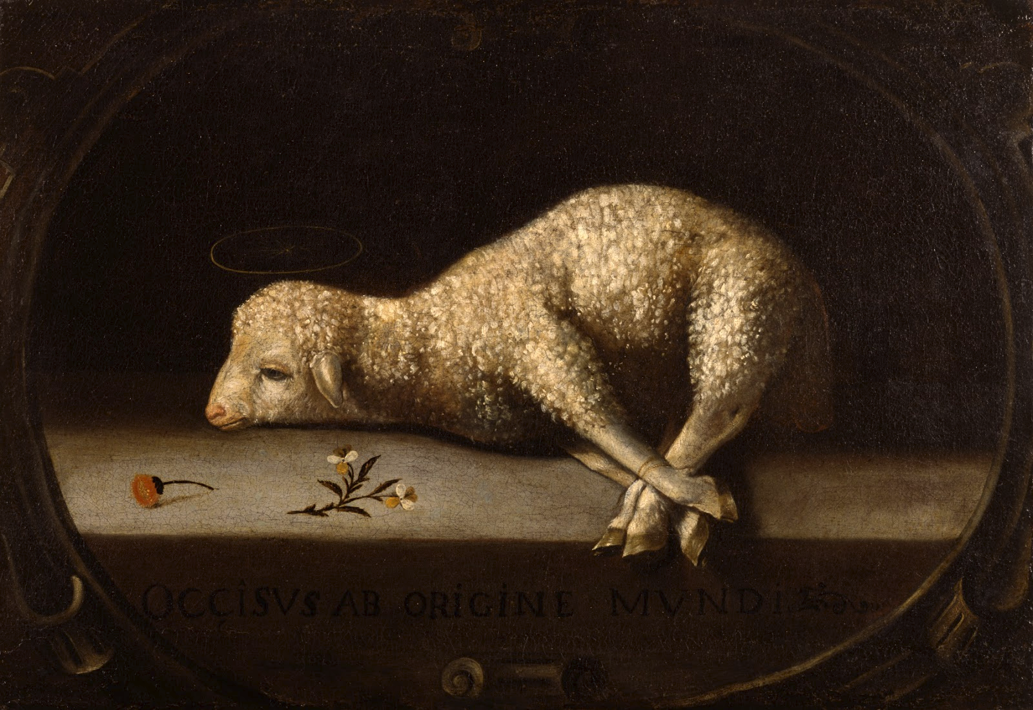
Soteriology Overview
Next Session
Atonement

Slide 53
Soteriology Overview
Definition
Election
Atonement
Salvation words
God’s one condition of salvation
Results of salvation
Eternal security
Faulty views of salvation

