Slide 1
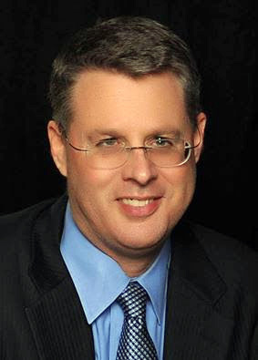
Soteriology Session 1
Dr. Andy Woods
Senior Pastor – Sugar Land Bible Church
Professor of Bible & Theology – College of Biblical Studies

Slide 2
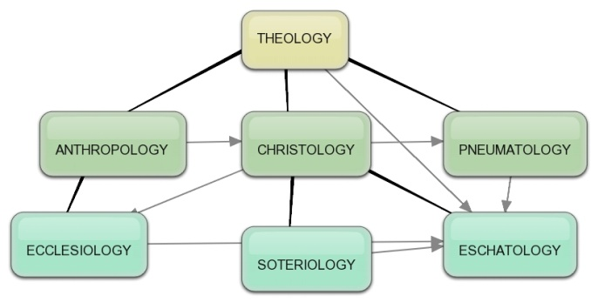
Areas of Systematic Theology
Prolegomena-Introduction
Theology-Study of God
Christology-Study of Christ
Pneumatology-Study of the Holy Spirit
Anthropology-Study of Man
Hamartiology-Study of sin
Soteriology-Study of salvation
Angelology-Study of angels
Ecclesiology-Study of the Church
Eschatology-Study of the end

Slide 3
Areas of Systematic Theology
Prolegomena-Introduction
Theology-Study of God
Christology-Study of Christ
Pneumatology-Study of the Holy Spirit
Anthropology-Study of Man
Hamartiology-Study of sin
Soteriology-Study of salvation
Angelology-Study of angels
Ecclesiology-Study of the Church
Eschatology-Study of the end

Slide 4
Areas of Systematic Theology
Prolegomena-Introduction
Theology-Study of God
Christology-Study of Christ
Pneumatology-Study of the Holy Spirit
Anthropology-Study of Man
Hamartiology-Study of sin
Soteriology-Study of salvation
Angelology-Study of angels
Ecclesiology-Study of the Church
Eschatology-Study of the end

Slide 5
Soteriology Overview
Definition & Introduction
Election
Atonement
Salvation words
God’s one condition of salvation
Results of salvation
Eternal security
Faulty views of salvation

Slide 6
Soteriology Overview
Definition & Introduction
Election
Atonement
Salvation words
God’s one condition of salvation
Results of salvation
Eternal security
Faulty views of salvation

Slide 7
Introduction
Importance – Gal 1:8-9
Meaning of “saved”
Salvation word group
Non-theological – Matt 9:21-22; Luke 8:36; Philip 1:19; John 12:27; Heb 11:7; Matt. 24:13
Theological – Matt 1:21; Luke 19:10; Rom 5:9; 2 Cor. 2:15
3 tenses of salvation

Slide 8
Introduction
Importance – Gal 1:8-9
Meaning of “saved”
Salvation word group
Non-theological – Matt 9:21-22; Luke 8:36; Philip 1:19; John 12:27; Heb 11:7; Matt. 24:13
Theological – Matt 1:21; Luke 19:10; Rom 5:9; 2 Cor. 2:15
3 tenses of salvation

Slide 9
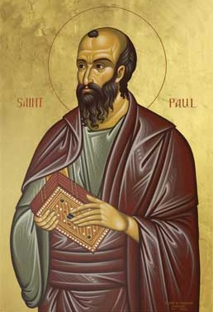
Galatians 1:8-9
“But even if we, or an angel from heaven, should preach to you a gospel contrary to what we have preached to you, he is to be accursed! As we have said before, so I say again now, if any man is preaching to you a gospel contrary to what you received, he is to be accursed!”

Slide 10
The Priceless Privilege (Chafer, Salvation, Page 118)
“The privilege of preaching the Gospel to one soul is priceless. So, in like manner, any blunder in its presentation may contribute to an eternal disaster and woe. Carelessness in preaching is criminal and ignorance is inexcusable. The Gospel is plain. Earnestness is important, but no amount of earnestness can be substituted for the exact statement of God's message to lost men.”

Slide 11
Introduction
Importance – Gal 1:8-9
Meaning of “saved”
Salvation word group
Non-theological – Matt 9:21-22; Luke 8:36; Philip 1:19; John 12:27; Heb 11:7; Matt. 24:13
Theological – Matt 1:21; Luke 19:10; Rom 5:9; 2 Cor. 2:15
3 tenses of salvation

Slide 12
Introduction
Importance – Gal 1:8-9
Meaning of “saved”
Salvation word group
Non-theological – Matt 9:21-22; Luke 8:36; Philip 1:19; John 12:27; Heb 11:7; Matt. 24:13
Theological – Matt 1:21; Luke 19:10; Rom 5:9; 2 Cor. 2:15
3 tenses of salvation

Slide 13
Salvation Word Group
Sōzō-Verb, To Save
Sōtēria-Noun, Salvation
Sōtērion-Noun, Salvation
Sōtēr-Noun, Savior

Slide 14
Introduction
Importance – Gal 1:8-9
Meaning of “saved”
Salvation word group
Non-theological – Matt 9:21-22; Luke 8:36; Philip 1:19; John 12:27; Heb 11:7; Matt. 24:13
Theological – Matt 1:21; Luke 19:10; Rom 5:9; 2 Cor. 2:15
3 tenses of salvation

Slide 15
Introduction
Importance – Gal 1:8-9
Meaning of “saved”
Salvation word group
Non-theological – Matt 9:21-22; Luke 8:36; Philip 1:19; John 12:27; Heb 11:7; Matt. 24:13
Theological – Matt 1:21; Luke 19:10; Rom 5:9; 2 Cor. 2:15
3 tenses of salvation

Slide 16
Introduction
Importance – Gal 1:8-9
Meaning of “saved”
Salvation word group
Non-theological – Matt 9:21-22; Luke 8:36; Philip 1:19; John 12:27; Heb 11:7; Matt. 24:13
Theological – Matt 1:21; Luke 19:10; Rom 5:9; 2 Cor. 2:15
3 tenses of salvation

Slide 17
Three Tenses of Salvation
Phase | Justification | Sanctification | Glorification
Tense | Past | Present | Future
Saved from sin’s: | Penalty | Power | Presence
Scripture | Eph 2:8-9; Titus 3:5 | Philip 2:12 | Rom 5:10

Slide 18
Notes:
Justification – Past – Trust in Christ Only! Automatic!
Glorification – Future – Die or Be Raptured Only! Automatic!
Sanctification – Present - Ongoing Process! Know God’s commands to Believers…and appropriate God’s Divine Resources moment by moment in order to grow. The Christian Life is Impossible to live in the power of the flesh.
Some Believers make great strides and some don’t.

Slide 19
Three Tenses of Salvation
Phase | Justification | Sanctification | Glorification
Tense | Past | Present | Future
Saved from sin’s: | Penalty | Power | Presence
Scripture | Eph 2:8-9; Titus 3:5 | Philip 2:12 | Rom 5:10

Slide 20
4 Kinds of People from 1 Corinthians 3:1-3
Spiritual Believers
Infant
Believers
Unbelievers
Carnal
Believers
Notes:
Ray Steadman – “1st Californians”
Unbelievers vs Categories of Believers
Unbelievers – ψυχικός psuchikós; Natural, pertaining to the natural as distinguished from the spiritual
Spiritual Believers – πνευματικός pneumatikós; of persons who are spiritual, enlightened by the Holy Spirit
Infant Believers – σάρκινος sárkinos; with propensities of the flesh unto sin; νήπιος nḗpios; an infant, child, baby without any definite limitation of age. (This relates to immaturity and lack of instruction)
Carnal Believers – σαρκικός sarkikós; tendency to satisfy the flesh, implying sinfulness, sinful propensity, carnal (This relates to disobedience and open rebellion)

Slide 21
4 Kinds of People from 1 Corinthians 3:1-3
¹ And I, brethren, could not speak to you as to spiritual people but as to carnal, as to babes in Christ. ² I fed you with milk and not with solid food; for until now you were not able to receive it, and even now you are still not able; ³ for you are still carnal. For where there are envy, strife, and divisions among you, are you not carnal and behaving like mere men? (NKJV)

Slide 22
Galatians 4:19
"My children, with whom I am again in labor until Christ is formed in you—"

Slide 23
College of Biblical Studies Doctrinal Statement
Every true believer is promised positional and ultimate sanctification with the possibility of progressive development in life spiritually, (progressive sanctification) (Heb. 10:10,14; Jn. 17:17; Eph. 5:26,27; 1 Thess. 4:3,4; 1 Jn. 3:2).

Slide 24
CONCLUSION

Slide 25
Soteriology Overview
Definition & Introduction
Election
Atonement
Salvation words
God’s one condition of salvation
Results of salvation
Eternal security
Faulty views of salvation

Slide 26
Soteriology Overview
Next Session
Election

