Slide 1
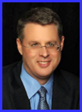
Dr. Andy Woods
Senior Pastor – Sugar Land Bible Church
President – Chafer Theological Seminary

Slide 2
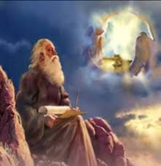
“After These Things” (Rev. 4‒22)
Before the Tribulation (4‒5)
During the Tribulation (6‒19)
After the Tribulation (20‒22)
Kingdom (20:1-10)
Great White Throne Judgment (20:11-15)
Destruction of the Earth (21:1)
New Heaven and New Earth (21‒22)

Slide 3
The Eternal State Revelation 21‒22
The New Heavens & Earth (21:1-8)
The New Jerusalem (21:9‒22:5)
Epilogue (22:6-21)

Slide 4
The Eternal State Revelation 21‒22
The New Heavens & Earth (21:1-8)
The New Jerusalem (21:9‒22:5)
Epilogue (22:6-21)

Slide 5
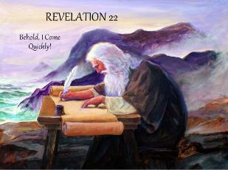
The Epilogue Revelation 22:6-21
Words of Comfort (22:6-17)
Words of Warning (22:18-19)
Words of Benediction (22:20-21)

Slide 6
The Epilogue Revelation 22:6-21
Words of Comfort (22:6-17)
Words of Warning (22:18-19)
Words of Benediction (22:20-21)

Slide 7
I. Words of Comfort Revelation 22:6-17
Faithful Words (6a)
Christ’s Soon Coming (6b-7a)
Blessing for Obedience (7b)
God Deserves Worship (8-9)
Prophecy Unsealed (10)
Destinies Fixed (11)
Rewards Given (12-13)
Redeemed Blessed (14-15)
God is Gracious (16-17)

Slide 8
The Epilogue Revelation 22:6-21
Words of Comfort (22:6-17)
Words of Warning (22:18-19)
Words of Benediction (22:20-21)

Slide 9
Revelation 22:18-19
“I testify to everyone who hears the words of the prophecy of this book: if anyone adds to them, God will add to him the plagues which are written in this book; ¹⁹ and if anyone takes away from the words of the book of this prophecy, God will take away his part from the tree of life and from the holy city, which are written in this book.”

Slide 10
Revelation 22:18-19
“I testify to everyone who hears the words of the prophecy of this book: if anyone adds to them, God will add to him the plagues which are written in this book; ¹⁹ and if anyone takes away from the words of the book of this prophecy, God will take away his part from the tree of life and from the holy city, which are written in this book.”

Slide 11
Genesis 2:16-17
“¹⁶ The Lord God commanded the man, saying, ‘From any tree of the garden you may eat freely; ¹⁷ but from the tree of the knowledge of good and evil you shall not eat, for in the day that you eat from it you will surely die.’”

Slide 12
Genesis 3:2-3
“² The woman said to the serpent, ‘From the fruit of the trees of the garden we may eat; ³ but from the fruit of the tree which is in the middle of the garden, God has said, ‘You shall not eat from it or touch it, or you will die.’”

Slide 13
Genesis 3:1, 4
“¹ Now the serpent was more crafty than any beast of the field which the Lord God had made. And he said to the woman, “Indeed, has God said, ‘You shall not eat from any tree of the garden’?” …⁴ The serpent said to the woman, ‘You surely will not die!’”

Slide 14
Revelation 22:17
“The Spirit and the bride say, ‘Come.’ And let the one who hears say, ‘Come.’ And let the one who is thirsty come; let the one who wishes take the water of life without cost.”

Slide 15
Revelation 22:18-19
“I testify to everyone who hears the words of the prophecy of this book: if anyone adds to them, God will add to him the plagues which are written in this book; ¹⁹ and if anyone takes away from the words of the book of this prophecy, God will take away his part from the tree of life and from the holy city, which are written in this book.”

Slide 17
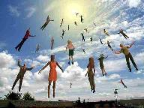
When Will the Rapture Take Place Relative to the Tribulation Period?
Pre-tribulation rapture theory
Mid-tribulation rapture theory
Post-tribulation rapture theory
Pre-wrath rapture theory
Partial rapture theory

Slide 19
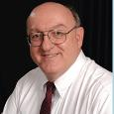
Dennis Rokser
“To unbelievers who would add to God’s Word in this fashion, the Lord promises to ‘add to him the plagues that are written in this book.’ The plagues spoken of in the book of Revelation occur during that future period of God’s judgment on the earth known as the Tribulation. If anyone reading Revelation accepts the invitation of verse 17 and becomes a believer in Christ prior to the Tribulation, that person will experience the pretribulational Rapture of the saints (1 Thess. 4:13-18) rather than the plagues of the Tribulation (1 Thess. 5:1-3). Therefore, the warning of Revelation 22:18 applies only to unbelievers. This is not a warning to believers to stay saved or to be rewarded for their perseverance.”
Dennis Rokser, Shall Never Perish Forever, p. 274

Slide 20
Dennis Rokser
“Verses 18-19 follow with a grave warning to unbelievers who would add to or subtract from the words of this book. Either adding to or taking away from the Word of God is characteristic of unbelievers who cannot simply accept by faith what God says in His Word. When God speaks, the response of the believing heart is simply ‘Amen.’ But the unbeliever does not accept what God says at face value, and so he must change the Word to suit himself.”
Dennis Rokser, Shall Never Perish Forever, p. 273.

Slide 21
2 Peter 3:16-17
“as also in all his letters, speaking in them of these things, in which are some things hard to understand, which the untaught and unstable distort, as they do also the rest of the Scriptures, to their own destruction. ¹⁷ You therefore, beloved, knowing this beforehand, be on your guard so that you are not carried away by the error of unprincipled men and fall from your own steadfastness.”

Slide 22
Revelation 22:18-19
“I testify to everyone who hears the words of the prophecy of this book: if anyone adds to them, God will add to him the plagues which are written in this book; ¹⁹ and if anyone takes away from the words of the book of this prophecy, God will take away his part [meros] from the tree of life and from the holy city, which are written in this book.”

Slide 23
Revelation 20:6
“Blessed and holy is the one who has a part [meros] in the first resurrection; over these the second death has no power, but they will be priests of God and of Christ and will reign with Him for a thousand years.”

Slide 24
Revelation 21:8
“But for the cowardly and ]unbelieving and abominable and murderers and immoral persons and sorcerers and idolaters and all liars, their part [meros] will be in the lake that burns with fire and brimstone, which is the second death.”

Slide 25
Revelation 22:18-19
“I testify to everyone who hears the words of the prophecy of this book: if anyone adds to them, God will add to him the plagues which are written in this book; ¹⁹ and if anyone takes away from the words of the book of this prophecy, God will take away his part [meros] from the tree of life and from the holy city, which are written in this book.”

Slide 26
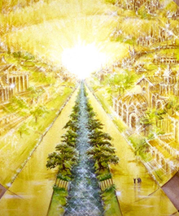

Slide 27
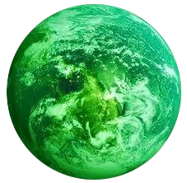
Jerusalem Descending
Notes:
The descending city is described as being like a stone called Jasper, only unlike the earthly stone, this one is clear as crystal. The ultimate state of heaven sounds more like a diamond, doesn’t it?

Slide 28
Dennis Rokser
“A common characteristic of cults and religions that profess to be ‘Christian’ is that they invariably add other books, creeds, council decisions, or ‘inspired’ writings of their founder or leaders to the Bible, and they put these on a par with God’s Word.”
Dennis Rokser, Shall Never Perish Forever, p. 274

Slide 29
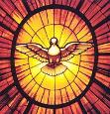
Test the Spirits
Deut. 13:1-5
Isa. 8:19-20
Acts 17:11
Gal. 1:8-9
1 Thess. 5:20-21
1 John 4:1
Rev. 2:2

Slide 30
Acts 17:11
“¹⁰ The brethren immediately sent Paul and Silas away by night to Berea, and when they arrived, they went into the synagogue of the Jews. ¹¹ Now these were more noble-minded than those in Thessalonica, for they received the word with great eagerness, examining the Scriptures daily to see whether these things were so.”

Slide 31
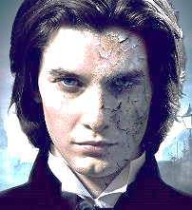
1 Thessalonians 5:21
“But examine everything carefully; hold fast to that which is good.”

Slide 32
1 John 4:1
“Beloved, do not believe every spirit, but test the spirits to see whether they are from God, because many false prophets have gone out into the world.”

Slide 33
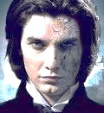
Revelation 2:2
“I know your deeds and your toil and perseverance, and that you cannot tolerate evil men, and you put to the test those who call themselves apostles, and they are not, and you found them to be false.”

Slide 34
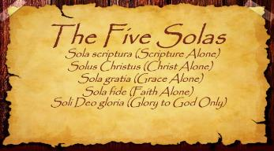
The Five Solas (Alone or By Itself)
Solus Christus – Christ alone
Sola Fide – faith alone
Sola Gratia – grace alone
Sola Scriptura – Scripture alone
Soli Deo Gloria – To the glory of God alone

Slide 35
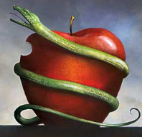
Complication of the Simple
2 Cor. 11:3
“But I fear, lest somehow, as the serpent deceived Eve by his craftiness, so your minds may be corrupted by from the simplicity that is in Christ.” (Italics mine)

Slide 36
Genesis 2:16-17
“¹⁶ The Lord God commanded the man, saying, ‘From any tree of the garden you may eat freely; ¹⁷ but from the tree of the knowledge of good and evil you shall not eat, for in the day that you eat from it you will surely die.’”

Slide 37
The Epilogue Revelation 22:6-21
Words of Comfort (22:6-17)
Words of Warning (22:18-19)
Words of Benediction (22:20-21)

Slide 38
Revelation 22:20-21
“He who testifies to these things says, ‘Yes, I am coming quickly.’ Amen. Come, Lord Jesus. The grace of the Lord Jesus be with all. Amen.”

Slide 39
Revelation 22:20-21
“He who testifies to these things says, ‘Yes, I am coming quickly.’ Amen. Come, Lord Jesus. The grace of the Lord Jesus be with all. Amen.”

Slide 40
“TIME-TEXTS” IN REVELATION R.C. Sproul, The Last Days According to Jesus, p.139
SHORTLY, QUICKLY “TACOS”
1:1 | …Things which must shortly take place
2:16 | Repent, or else I will come to you quickly.
3:11 | Behold, I come quickly!
22:6 | …Which must shortly take place.
22:7 | Behold, I come quickly!
22:12 | Behold, I am coming quickly!
22:20 | Surely, I am coming quickly!
NEAR, AT HAND “ENGYS”
1:3 | The time is near.
22:10 | The time is at hand.
ABOUT TO, ON THE POINT OF “MELLŌ”
1:19 | Write…the things that are about to take place.
3:10 | …the hour of trial…is about to come upon the whole world.

Slide 41
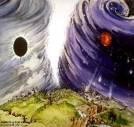
Chronological vs. Adverbial Use of Tacos
“I hope to come to you soon” (1 Tim 3:14) vs. “Leave Jerusalem quickly” (Acts 22:18)
LXX
Isaiah 13:22: “Her fateful time also will soon come”
Isaiah 51:5: “My righteous is near, My salvation has gone forth, And my arms will judge the peoples; The coastlands will wait upon me, And on My arms they will trust.”
Thomas Ice, End Times Controversy, pp.102-108

Slide 42
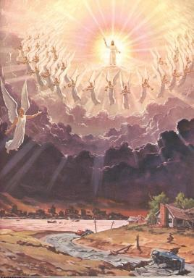
Imminency
Engys: “The Lord is near” (Phil 4:5)
Mellō: “and one who will share in the glory to be revealed” (1 Pet 5:1)

Slide 43
Revelation 22:20-21
“He who testifies to these things says, ‘Yes, I am coming quickly.’ Amen. Come, Lord Jesus. The grace of the Lord Jesus be with all. Amen.”

Slide 44
John 5:24
“Truly, truly [amēn, amēn], I say to you, he who hears My word, and believes Him who sent Me, has eternal life, and does not come into judgment, but has passed out of death into life.”

Slide 45
Revelation 22:20-21
“He who testifies to these things says, ‘Yes, I am coming quickly.’ Amen. Come, Lord Jesus. The grace of the Lord Jesus be with all. Amen.”

Slide 48
Scripture’s Five Crowns (Rev 4:10: 3:11; 2 John 8)
SCRIPTURE | CROWN | PURPOSE
1 Cor. 9:24-27 | Incorruptible | Gaining mastery over the flesh
1 Thess. 2:19-20 | Rejoicing | Soul winning
Jas. 1:12; Rev. 2:10 | Life | Enduring trials
1 Pet. 5:2-4 | Glory | Shepherding God’s people
2 Tim. 4:8 | Righteousness | Longing for His appearing

Slide 49
Revelation 22:20-21
“He who testifies to these things says, ‘Yes, I am coming quickly.’ Amen. Come, Lord Jesus. The grace of the Lord Jesus be with all. Amen.”

Slide 51
Revelation 22:20-21
“He who testifies to these things says, ‘Yes, I am coming quickly.’ Amen. Come, Lord Jesus. The grace of the Lord Jesus be with all. Amen.”

Slide 52
Revelation 22:20-21
“He who testifies to these things says, ‘Yes, I am coming quickly.’ Amen. Come, Lord Jesus. The grace of the Lord Jesus be with all. Amen.”

Slide 53
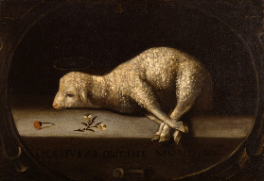
Extent of the Atonement
Unlimited
Biblical support
John 1:29; 3:16-17; 4:42; 6:51; 12:32, 47
Acts 17:30
2 Cor 5:19
1 Tim. 2:4, 6; 4:10
Titus 2:11
Heb. 2:9
2 Pet. 2:1
1 John 2:2; 4:14
Rev. 5:9

Slide 54
Conclusion

Slide 55
The Epilogue Revelation 22:6-21
Words of Comfort (22:6-17)
Words of Warning (22:18-19)
Words of Benediction (22:20-21)

Slide 56
“The Lord bless you and keep you; the Lord make his face shine on you and be gracious to you; the Lord turn his face toward you and give you peace.” (NIV)

