Slide 1
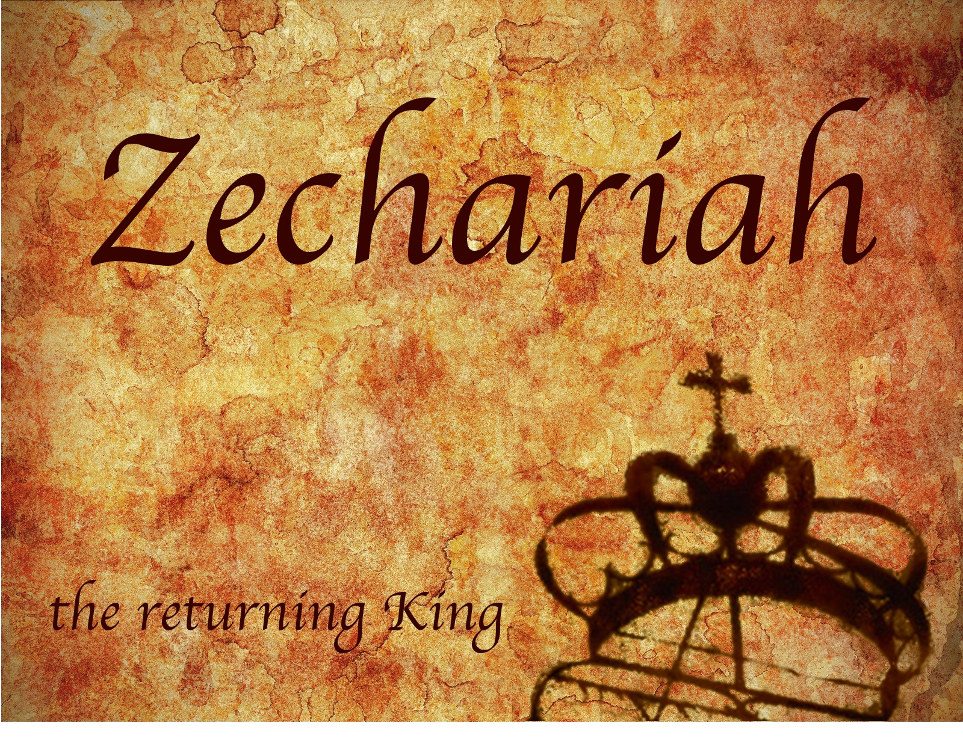
Zechariah
God Remembers!

Slide 2
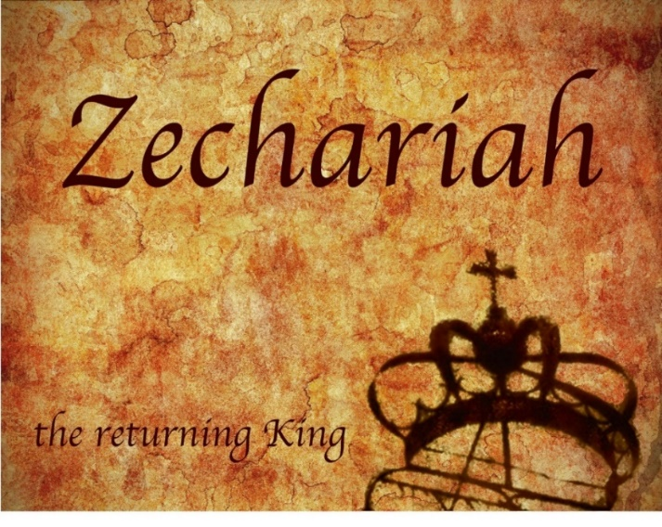
Structure
Introductory call to repentance (1:1-6)
Eight-night visions (1:7–6:15)
Question and answers about fasting (7–8)
Two burdens (9–14)

Slide 3
II. Eight Night Visions (1:7‒6:15)
Riders & horses among the myrtle trees (1:7-17)
Four horns & four craftsmen (1:18-21)
Man with the measuring line (2)
Cleansing of the High Priest Joshua (3)
Lampstand & olive tree (4)
Flying scroll (5:1-4)
Woman in the basket (5:5-11)
Four chariots (6:1-8)
Conclusion: crowning of Joshua (6:9-15)

Slide 4
ZECHARIAH’S EIGHT NIGHT VISIONS
Vision | Reference | Meaning
The Red-horse Rider among the Myrtles | 1:7-17 | God’s anger against the nations & blessing on restored Israel.
The Four Horns & the Four Craftsmen | 1:18-21 | God’s judgment on the nations that afflict Israel.
The Surveyor with a Measuring Line | Chapter 2 | God’s future blessing on restored Israel.
The Cleansing & Crowning of Joshua the Hight Priest. | Chapter 3 | Israel’s future cleansing from sin & reinstatement as a priestly nation.
The Golden Lampstand & the Two Olive Trees | Chapter 4 | Israel as the light to the nations under Messiah, the King-Priest.
The Flying Scroll | 5:1-4 | The severity & totality of divine judgment on individual Israelites.
The Woman in the Ephah | 5:5-11 | The removal of national Israel’s sin of rebellion against God.
The Four Chariots | 6:1-8 | Divine judgment on Gentile nations.

Slide 5
8. The Four Chariots (6:1-8)
The Vision (6:1-3)
The Interpretation (6:4-8)

Slide 6
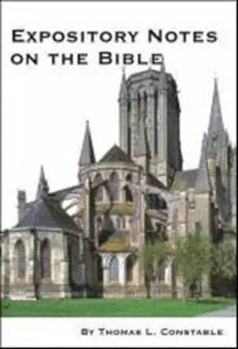
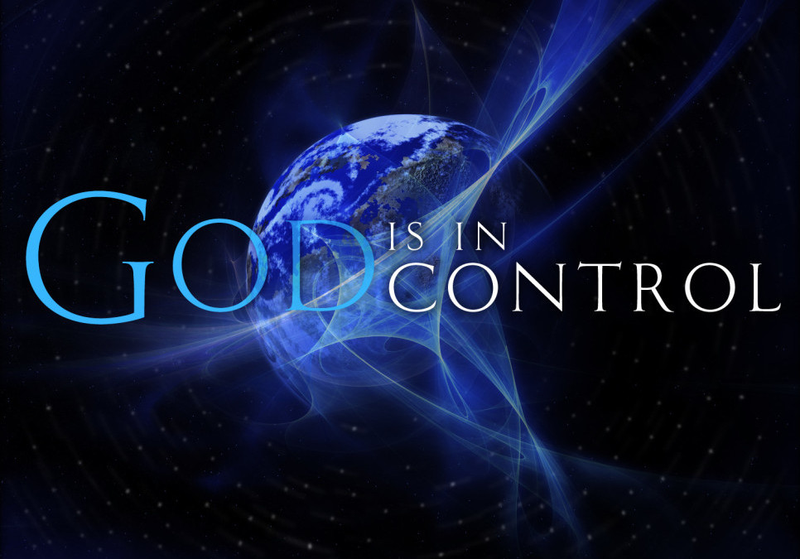
Thomas L. Constable
Constable’s online notes on Zechariah, p. 62.
“There is a similar emphasis on the fact that Yahweh controls history and subdues the nations that oppress Israel.”

Slide 7
8. The Four Chariots (6:1-8)
The Vision (6:1-3)
The Interpretation (6:4-8)

Slide 8
I. The Vision (6:1-3)
Four Chariots (1)
Four Horses (2-3)

Slide 9
I. The Vision (6:1-3)
Four Chariots (1)
Four Horses (2-3)

Slide 10
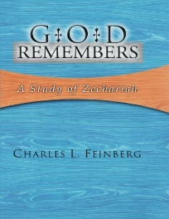
Charles L. Feinberg
God Remembers: A Study of Zechariah (Wheaton: Van Kampen, 1950, p. 76.
“Since the chariots go forth to actual geographical designations, as we shall see later, just so the mountains from whence they proceed are to be taken as representing a specific geographical locality. The mountains, in all probability, are Mount Zion and the Mount of Olives…Between these two mountains in Palestine [Israel] lies the Valley of Jehoshaphat, which is related in Scripture to the judgment of the nations.”

Slide 11
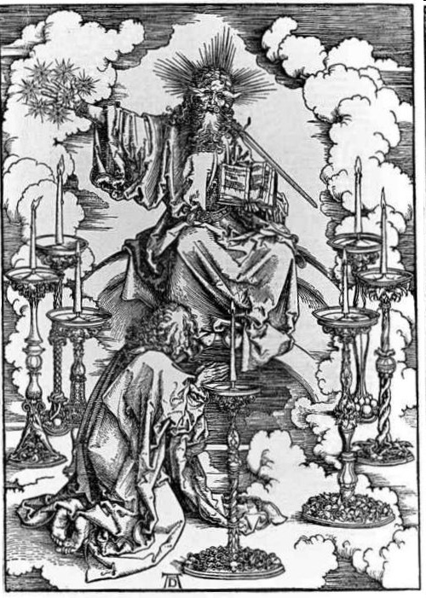
His Body (Rev. 1:14-16)
His hair (14a)
His eyes (14b)
His feet (15a)
His voice (15b)
His right hand (16a)
His mouth (16b)
His face (16c)

Slide 12
I. The Vision (6:1-3)
Four Chariots (1)
Four Horses (2-3)

Slide 13
8. The Four Chariots (6:1-8)
The Vision (6:1-3)
The Interpretation (6:4-8)

Slide 14
II. The Interpretation (6:4-8)
Zechariah’s Question (4)
Four Spirits Patrolling the Earth (5-7)
Destruction of the Land of the North (8)

Slide 15
II. The Interpretation (6:4-8)
Zechariah’s Question (4)
Four Spirits Patrolling the Earth (5-7)
Destruction of the Land of the North (8)

Slide 16
II. The Interpretation (6:4-8)
Zechariah’s Question (4)
Four Spirits Patrolling the Earth (5-7)
Destruction of the Land of the North (8)

Slide 17
Charles L. Feinberg
God Remembers: A Study of Zechariah (Wheaton: Van Kampen, 1950, p. 78.
“The four winds speak of divine judicial power exerted in judgment, carrying out the purposes of God. CF. Psalm 148:8; Jeremiah 49:36; Daniel 7:2; Revelation 7:1.”

Slide 18
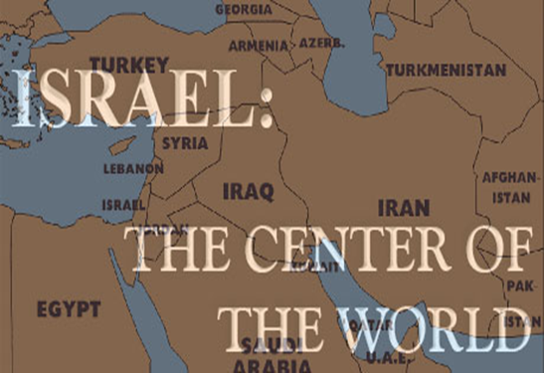
Ezekiel 38:12
“to capture spoil and to seize plunder, to turn your hand against the waste places which are now inhabited, and against the people who are gathered from the nations, who have acquired cattle and goods, who live at the center of the world.”

Slide 19
Ezekiel 5:5
“Thus says the Lord God, ‘This is Jerusalem; I have set her at the center of the nations, with lands around her.'”

Slide 20
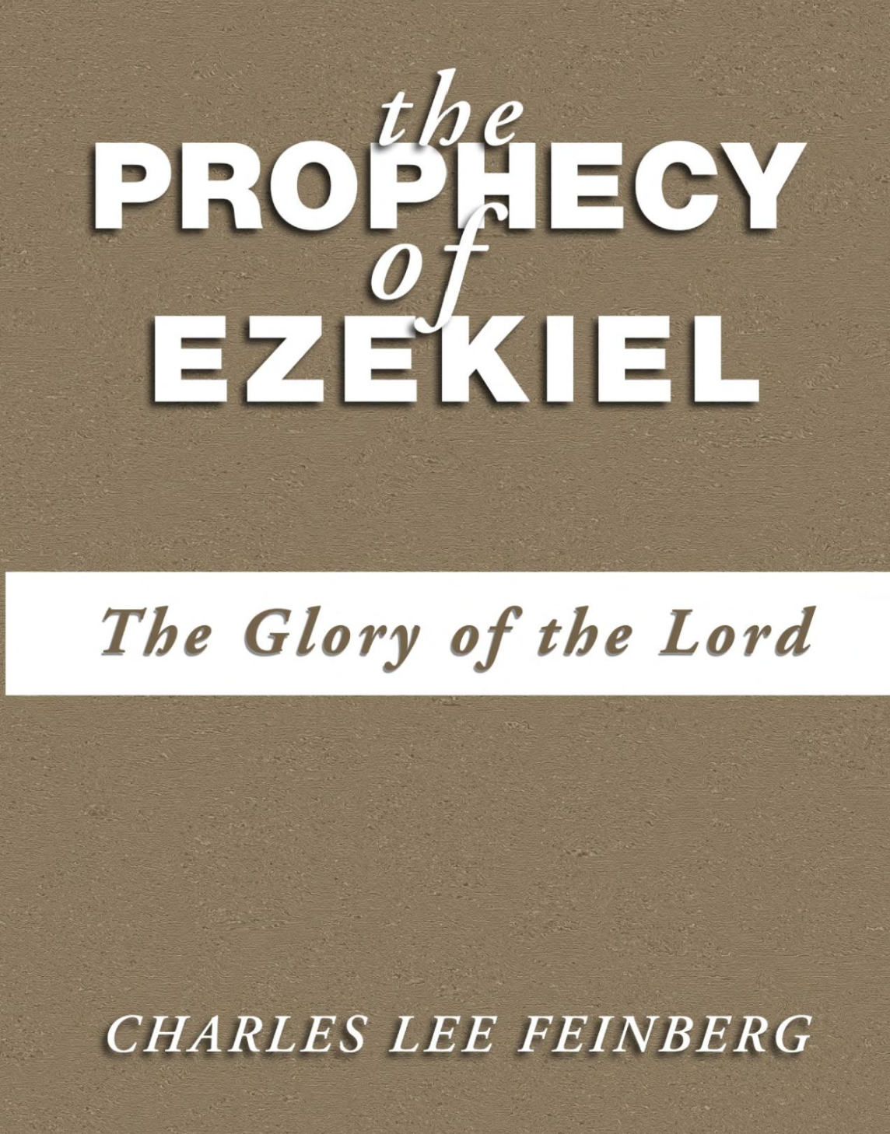
Charles L. Feinberg
The Prophecy of Ezekiel: The Glory of the Lord, Paperback ed. (Chicago: Moody, 1969; reprint, Chicago: Moody, 1984), 223.
“An interesting phrase is employed to define the place where God’s people will be dwelling. It is called the middle (literally, the navel) of the earth as explained in 5:5. The land of Israel is in the center of the earth as far as God’s purposes for the world are concerned (cf. Deut. 32:8). Rabbinic literature states: ‘As the navel is set in the center of the human body, so the land of Israel is the navel of the world…Situated in the center of the world, in Jerusalem in the center of the land of Israel, and the sanctuary in the center of Jerusalem, and the holy place in the center of the sanctuary, and the ark in the center of the holy place, and the foundation stone before the holy place, because from it the world was founded.’ Midrash, Tanachma, Qedoshim.”

Slide 21
Ezekiel 39:2, 4
“² and I will turn you around, drive you on, take you up from the remotest parts of the north and bring you against the mountains of Israel…⁴You will fall on the mountains of Israel, you and all your troops and the peoples who are with you; I will give you as food to every kind of predatory bird and beast of the field.”

Slide 23
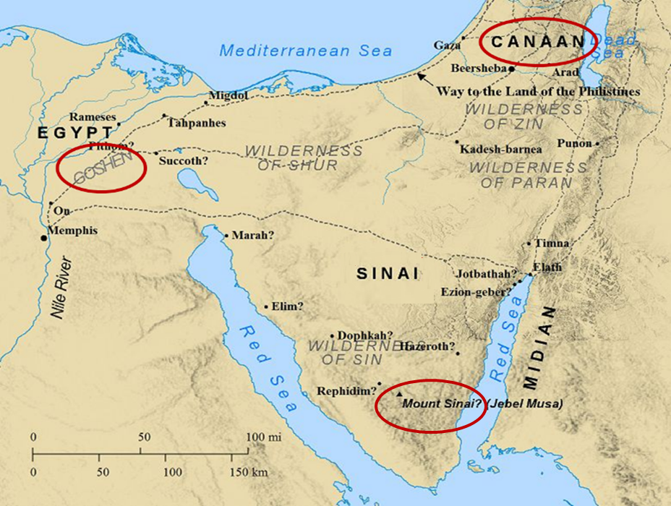

Slide 24
Charles L. Feinberg
God Remembers: A Study of Zechariah (Wheaton: Van Kampen, 1950, p. 79.
“The special prophetic application of what Zechariah had beheld was at that moment connected with the king of Babylon on the north [Jer. 1:14, 15; 25:9] and Egypt on the south. Between these two powers God would sustain His feeble flock, checkmating every effort to destroy them till Messiah should Himself appear.”

Slide 25
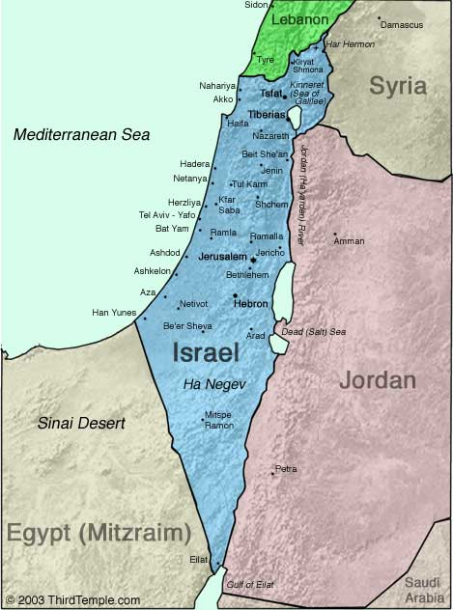

Slide 26
Thomas L. Constable
Constable’s online notes on Zechariah, p. 64-65.
“Because of the geography of Palestine [Israel], all of Israel's enemies came against her from the north or from the south; the Mediterranean Sea on the west, and the Arabian Desert on the east, prohibited major foreign invasions from those directions.”

Slide 27
Thomas L. Constable
Constable’s online notes on Zechariah, p. 65.
“Since the chariots went in compass directions, we should probably understand their judgment to be universal (cf. 2:6; Jer. 49:36; Ezek. 37:9; Rev. 7:1). They went north and south out of Palestine [Israel], but they executed judgment in every direction. The total picture is of God executing His judgments against all nations that oppose Israel.”

Slide 28
II. The Interpretation (6:4-8)
Zechariah’s Question (4)
Four Spirits Patrolling the Earth (5-7)
Destruction of the Land of the North (8)

Slide 29
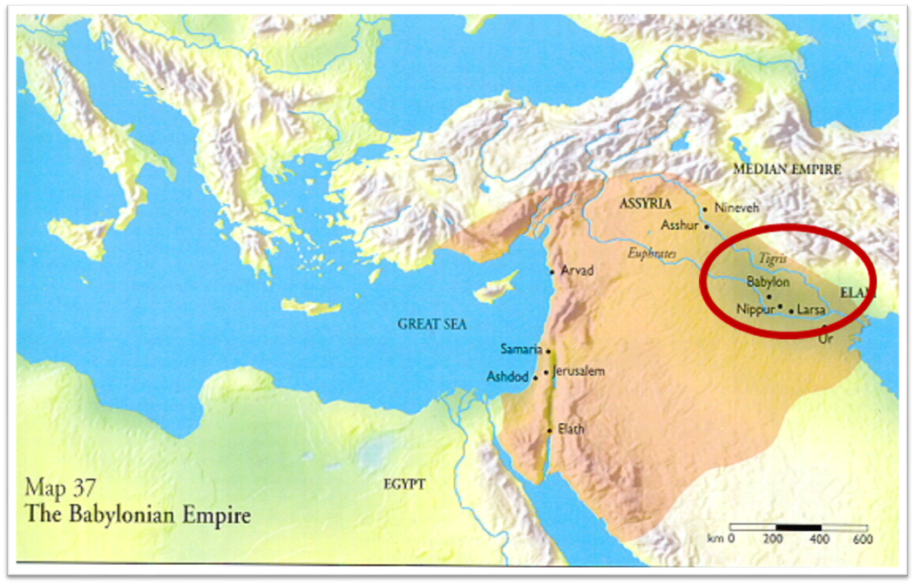

Slide 30
Isaiah’s Oracles Against the Nations (Isa 13–23)
Babylon (13:1-14:23) Assyria (14:24-27) Philistia (14:28-32) Moab (15-16) Damascus and Samaria (17) Ethiopia (18) | Egypt (19-20) Babylon (21:1-10) Edom (21:11-12) Arabia (21:13-17) Jerusalem (22) Tyre (23)

Slide 31
Charles L. Feinberg
God Remembers: A Study of Zechariah (Wheaton: Van Kampen, 1950, p. 79.
“Why, then, is Babylon again before us in verse 8? First, it would serve to comfort and encourage the returned remnant of Israel that had come from Babylon. Second, the Babylonian world-empire, as a matter of history, had already experienced the judgment of God in her overthrow and downfall. Third, it is where that wickedness will again be established and finally extirpated. Cf. 5:11. In the end time, the coming of Christ again in the establishment of His kingdom in righteousness will be preceded by final judgment on wicked Babylon.”

Slide 32
Zechariah 5:5-11
⁹ Then I lifted up my eyes and looked, and there two women were coming out with the wind in their wings; and they had wings like the wings of a stork, and they lifted up the ephah between the earth and the heavens. ¹⁰ I said to the angel who was speaking with me, “Where are they taking the ephah?” ¹¹ Then he said to me, “To build a temple for her in the land of Shinar; and when it is prepared, she will be set there on her own pedestal.”

Slide 33
Charles L. Feinberg
God Remembers: A Study of Zechariah (Wheaton: Van Kampen, 1950, p. 91.
“The first mention of Shinar in the Bible is in Genesis 10:10. (It is found in all, six other times: Gen. 11:2; 14:1, 9; Isa. 11:11; Dan. 1:2; and here). In all instances where it occurs it is used as a definite geographical designation. Strictly speaking it covers more than Babylon but is it is employed to denote this land.”

Slide 34
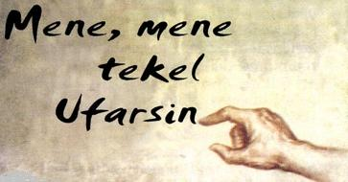
Daniel Interprets the Writing (5:24-28)

Slide 35
Herodotus, Histories, 1:191 (450 B.C.)
“…he (Cyrus) conducted the river by a channel into the lake…and so he made the former course of the river passable by the sinking of the stream. When this had been done, the Persians who had been posted for this very purpose entered by the bed of the river Euphrates into Babylon, the stream having sunk so far that it reached about to the middle of a man’s thigh…those Babylonians who dwelt in the middle did not know that they had been captured…”

Slide 36
James Pritchard
The Ancient Near East Texts Relating to the Old Testament, 315-16.
Without any battle... sparing Babylon... any calamity....I am Cyrus...king of Babylon....When I entered Babylon...under jubilation and rejoicing...troops walked around Babylon...in peace, I did not allow anybody to terrorize (any place) of the [country of Sumer] and Akkad. I strove for peace in Babylon...and in all his (other) sacred cities....I returned to (these) sacred cities on the other side of the Tigris, the sanctuaries of which have been in ruins for a long time, the images which (used) to live therein and established for them permanent sanctuaries.

Slide 37
James Pritchard
The Ancient Near East Texts Relating to the Old Testament, 315-16.
I (also) gathered all their (former) inhabitants and returned (to them) their habitations. Furthermore, I resettled... unharmed, in their (former) chapels, the places which make them happy. May all the gods whom I have resettled in their sacred cities ask daily Bel and Nebo for a long life for me...all of them I resettled in a peaceful place... ducks and doves,...I endeavoured to fortify/repair their dwelling places . . .

Slide 38
VI. 8 New Promises Genesis 12:1-3
Land (Gen. 12:1b)
Great nation (Gen. 12:2a)
Personal blessing (Gen. 12:2b)
Great name (Gen. 12:2c)
Blessing to others (Gen. 12:2d)
Blessing to blessers (Gen. 12:3a)
Cursing to cursers (Gen. 12:3b)
Blessing to the world (Gen. 12:3c)

Slide 39
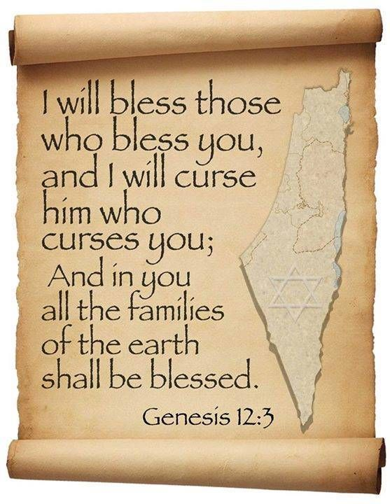
Genesis 12:3
“And I will bless those who bless you, And the one who curses you I will curse. And in you all the families of the earth will be blessed.”

Slide 40
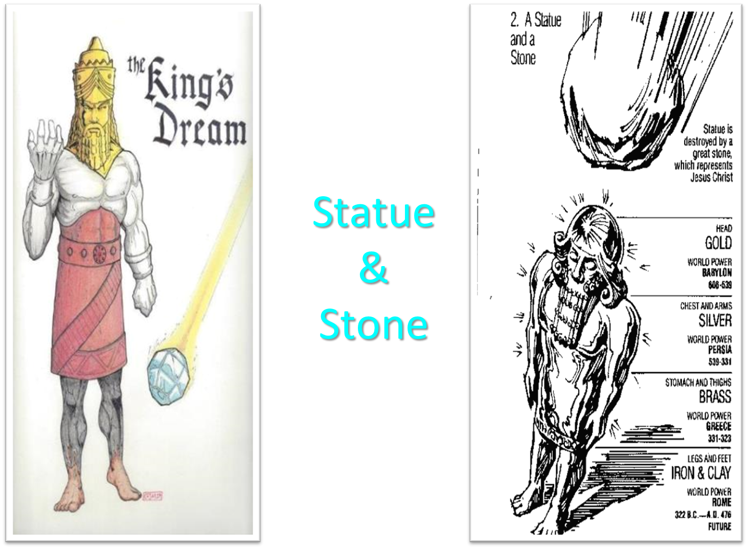

Slide 41
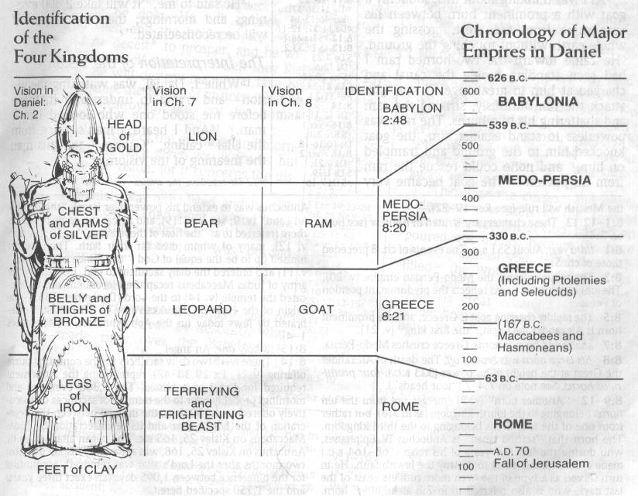

Slide 42
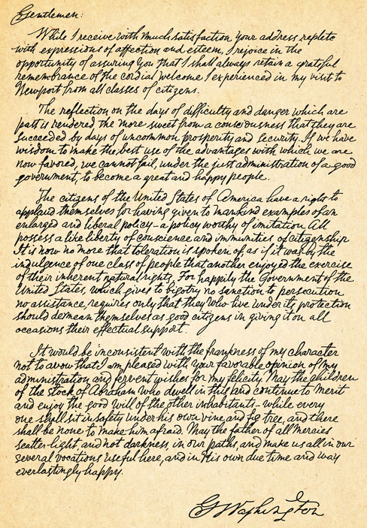
George Washington’s Letter to the Hebrew Congregation of Newport, Rhode Island, August 18, 1790
"I rejoice in the opportunity of assuring you, that I shall always retain a grateful remembrance of the cordial welcome I experienced in my visit to Newport... the Government of the United States, which gives to bigotry no sanction, to persecution no assistance... May the Children of the Stock of Abraham, who dwell in this land, continue to merit and enjoy the good will of the other Inhabitants; while every one shall sit in safety under his own vine and fig tree, and there shall be none to make him afraid."

Slide 43
Conclusion

Slide 44
8. The Four Chariots (6:1-8)
The Vision (6:1-3)
The Interpretation (6:4-8)

Slide 45
ZECHARIAH’S EIGHT NIGHT VISIONS
Vision | Reference | Meaning
The Red-horse Rider among the Myrtles | 1:7-17 | God’s anger against the nations & blessing on restored Israel.
The Four Horns & the Four Craftsmen | 1:18-21 | God’s judgment on the nations that afflict Israel.
The Surveyor with a Measuring Line | Chapter 2 | God’s future blessing on restored Israel.
The Cleansing & Crowning of Joshua the Hight Priest. | Chapter 3 | Israel’s future cleansing from sin & reinstatement as a priestly nation.
The Golden Lampstand & the Two Olive Trees | Chapter 4 | Israel as the light to the nations under Messiah, the King-Priest.
The Flying Scroll | 5:1-4 | The severity & totality of divine judgment on individual Israelites.
The Woman in the Ephah | 5:5-11 | The removal of national Israel’s sin of rebellion against God.
The Four Chariots | 6:1-8 | Divine judgment on Gentile nations.

Slide 46
II. Eight Night Visions (1:7‒6:15)
Riders & horses among the myrtle trees (1:7-17)
Four horns & four craftsmen (1:18-21)
Man with the measuring line (2)
Cleansing of the High Priest Joshua (3)
Lampstand & olive tree (4)
Flying scroll (5:1-4)
Woman in the basket (5:5-11)
Four chariots (6:1-8)
Conclusion: crowning of Joshua (6:9-15)

