Slide 1
Eternal Life and Abundant Spiritual Life: Yours for the Taking
2012 Sugarland Annual Ladies Luncheon
Sarah Witzig

Slide 2
Introduction
A. The meaning of “abundant”
1. Abundant means more than necessary, over and above

Slide 3
Introduction
A. The meaning of “abundant”
1. “Abundant” means more than necessary, over and above
2. “Abundant” is used to describe God

Slide 4
Numbers 14:18
‘The Lord is longsuffering and abundant in mercy, forgiving iniquity and transgression; but He by no means clears the guilty, visiting the iniquity of the fathers on the children to the third and fourth generation.’

Slide 5
Psalm 36:5–11
Your mercy, O Lord, is in the heavens; Your faithfulness reaches to the clouds.
Your righteousness is like the great mountains; Your judgments are a great deep; O Lord, You preserve man and beast.
How precious is Your lovingkindness, O God! Therefore the children of men put their trust under the shadow of Your wings.
They are abundantly satisfied with the fullness of Your house, And You give them drink from the river of Your pleasures.
For with You is the fountain of life; In Your light we see light.

Slide 6
Introduction
A. The meaning of “abundant”
1. “Abundant” means more than necessary, over and above
2. “Abundant” is used to describe God
B. The Context: The Healing of the Blind Man (John 9)

Slide 7
John 9:35–41
Jesus heard that they had cast him out; and when He had found him, He said to him, “Do you believe in the Son of God?”
He answered and said, “Who is He, Lord, that I may believe in Him?”
And Jesus said to him, “You have both seen Him and it is He who is talking with you.”
Then he said, “Lord, I believe!” And he worshiped Him.
And Jesus said, “For judgment I have come into this world, that those who do not see may see, and that those who see may be made blind.”
Then some of the Pharisees who were with Him heard these words, and said to Him, “Are we blind also?”
Jesus said to them, “If you were blind, you would have no sin; but now you say, ‘We see.’ Therefore your sin remains.

Slide 8
Principle:
Pride causes spiritual blindness. Humility aids in spiritual sight.
This is true for unbelievers to get saved, and for believers to live the Christian Life.

Slide 9
Principle:
Grace is the key to eternal life and abundant life

Slide 10
John 10:1–6
“Most assuredly, I say to you, he who does not enter the sheepfold by the door, but climbs up some other way, the same is a thief and a robber.
But he who enters by the door is the shepherd of the sheep.
To him the doorkeeper opens, and the sheep hear his voice; and he calls his own sheep by name and leads them out.
And when he brings out his own sheep, he goes before them; and the sheep follow him, for they know his voice.
Yet they will by no means follow a stranger, but will flee from him, for they do not know the voice of strangers.”
Jesus used this illustration, but they did not understand the things which He spoke to them.

Slide 11
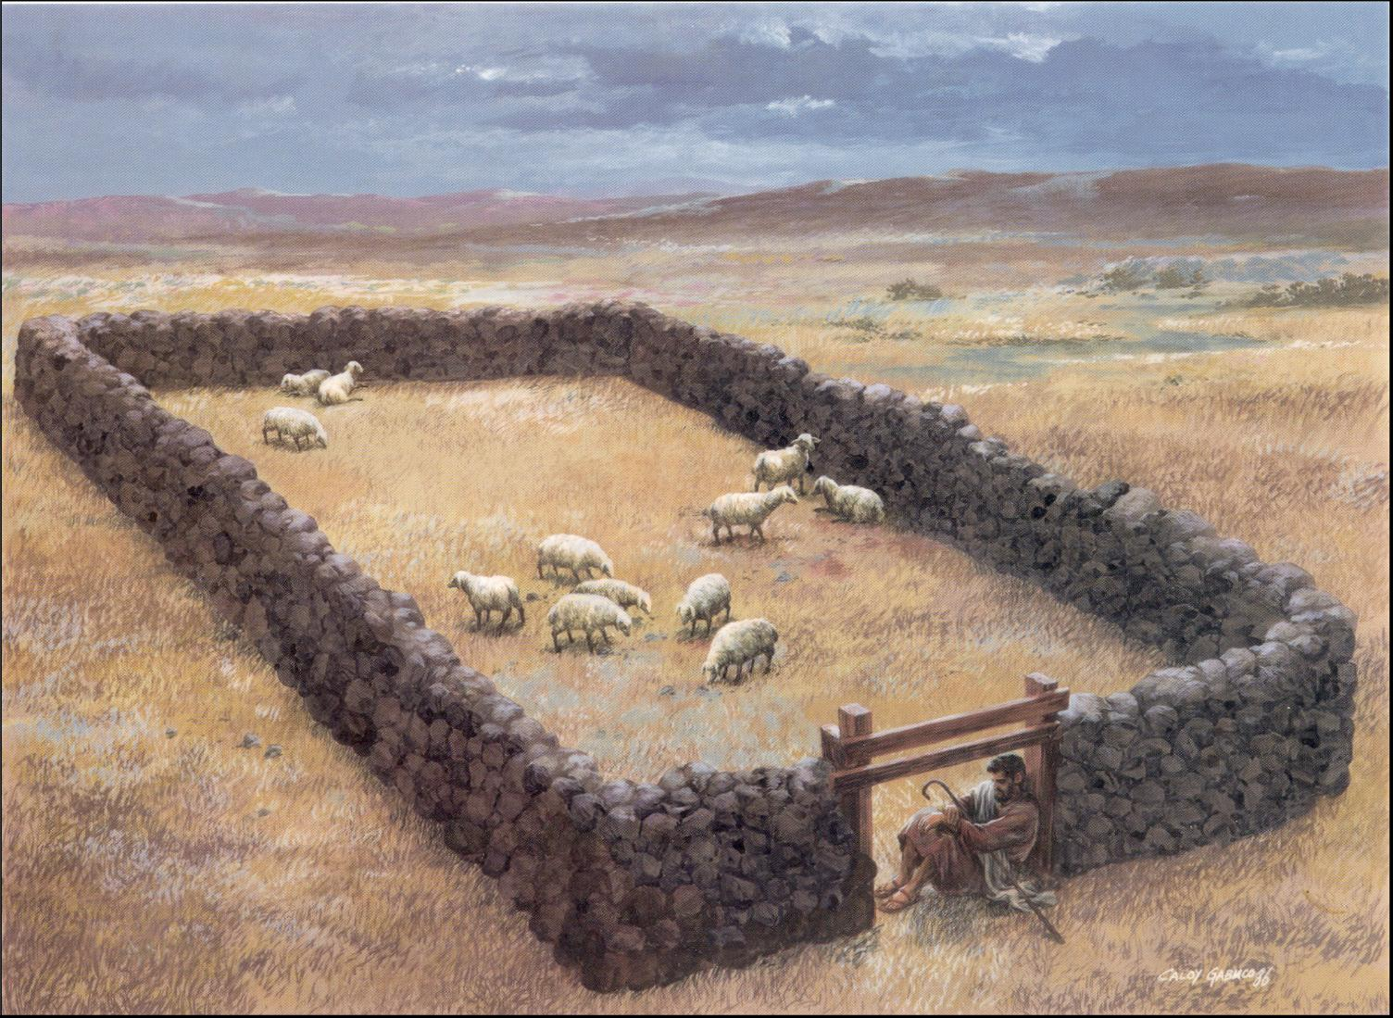
An Illustration to Teach the Pharisees
The Illustration is About Sheep and Shepherds

Slide 12
An Illustration to Teach the Pharisees
The Illustration is About Sheep and Shepherds
The Illustration Focuses on Knowing Jesus and Following Him

Slide 13
Jesus Extends the Illustration to Teach Everyone About Eternal Life and then the Abundant Life
John 10:7–10
Then Jesus said to them again, “Most assuredly, I say to you, I am the door of the sheep.
All who ever came before Me are thieves and robbers, but the sheep did not hear them.
I am the door. If anyone enters by Me, he will be saved, and will go in and out and find pasture.
The thief does not come except to steal, and to kill, and to destroy. I have come that they may have life, and that they may have it more abundantly.

Slide 14
Jesus Extends the Illustration to Teach Everyone About Eternal Life and then the Abundant Life
Jesus is the Door to Eternal Life

Slide 15
Jesus Extends the Illustration to Teach Everyone About Eternal Life and then the Abundant Life
Jesus is the Door to Eternal Life
There is only one door

Slide 16
John 14:6
Jesus said to him, “I am the way, the truth, and the life. No one comes to the Father except through Me.

Slide 17
Jesus Extends the Illustration to Teach Everyone About Eternal Life and then the Abundant Life
Jesus is the Door to Eternal Life
There is only one door
Jesus is standing before you offering eternal life

Slide 18
Jesus Extends the Illustration to Teach Everyone About Eternal Life and then the Abundant Life
Jesus is the Door to Eternal Life
There is only one door
Jesus is standing before you offering eternal life
* How can the death of Christ mean life for us?
Examining your heart condition

Slide 19
Jeremiah 17:9
“The heart is deceitful above all things, And desperately wicked; Who can know it?

Slide 20
Mark 7:21–22
For from within, out of the heart of men, proceed evil thoughts, adulteries, fornications, murders,
thefts, covetousness, wickedness, deceit, lewdness, an evil eye, blasphemy, pride, foolishness.

Slide 21
Romans 3:10-11
As it is written: "There is none righteous, no, not one; There is none who understands; There is none who seeks after God.”

Slide 22
Jesus Extends the Illustration to Teach Everyone About Eternal Life and then the Abundant Life
Jesus is the Door
There is only one door
Jesus is standing before you offering eternal life
* How can the death of Christ mean life for us?
Examining your heart condition
Humanity has a universal heart problem: SIN
You have a personal heart problem: YOUR SIN

Slide 23
You must not steal
You must not lie
You must not murder (strong anger)
You must not covet

Slide 24
Jesus Extends the Illustration to Teach Everyone About Eternal Life and then the Abundant Life
Jesus is the Door to Eternal Life
There is only one door
Jesus is standing before you offering eternal life
* How can the death of Christ mean life for us?
Examining your heart condition
Humanity has a universal heart problem: SIN
You have a personal heart problem: YOUR SIN
Contrast your heart with Christ’s
He has the only sinless heart in all of history
He is Holy which means pure and perfect

Slide 25
Romans 6:23
“For the wages of sin is death.”
Ephesians 2:1
“And you He made alive who were
dead in trespasses and sins.”

Slide 26
Jesus Extends the Illustration to Teach Everyone About Eternal Life and then the Abundant Life
Jesus is the Door to Eternal Life
There is only one door
Jesus is standing before you offering eternal life
* How can the death of Christ mean life for us?
Examining your heart condition
Contrast your heart with Christ’s
Christ is willing to exchange His heart with yours

Slide 27
Romans 5:8
But God demonstrates His own love toward us, in that while we were still sinners, Christ died for us.

Slide 28
1 Corinthians 15:3
. . . Christ died for our sins
Galatians 2:20
. . .the Son of God, who loved
me and gave Himself for me.

Slide 29
John 10:11
The Good Shepherd gives His life for the sheep.

Slide 30
2 Corinthians 5:21
For He made Him who knew no sin to be sin for us, that we might become the righteousness of God in Him.

Slide 31
Jesus Extends the Illustration to Teach Everyone About Eternal Life and then the Abundant Life
Jesus is the Door to Eternal Life
There is only one door
Jesus is standing before you offering eternal life
* How can the death of Christ mean life for us?
Examining your heart condition
Contrast your heart with Christ’s
Christ is willing to exchange His heart with yours
You receive Christ’s offer and enter His sheepfold by faith alone

Slide 32
John 3:16
For God so loved the world that He gave His only begotten Son, that whoever believes in Him should not perish but have everlasting life.

Slide 33
Romans 4:16
Therefore it is of faith that it might be according to grace . . .

Slide 34
Ephesians 2:8–9
For by grace you have been saved through faith, and that not of yourselves; it is the gift of God,
not of works, lest anyone should boast.

Slide 35
Romans 8:38–39
For I am persuaded that neither death nor life, nor angels nor principalities nor powers, nor things present nor things to come,
nor height nor depth, nor any other created thing, shall be able to separate us from the love of God which is in Christ Jesus our Lord.

Slide 36
Jesus Extends the Illustration to Teach Everyone About Eternal Life and then the Abundant Life
Jesus is the Door to Eternal Life
Jesus is the Door to Abundant Life
You receive the abundant life the same way you receive eternal life
You receive the abundant life by grace through faith

Slide 37
Colossians 2:6–7
As you therefore have received Christ Jesus the Lord, so walk in Him,
rooted and built up in Him and established in the faith, as you have been taught, abounding in it with thanksgiving.

Slide 38
Jesus Extends the Illustration to Teach Everyone About Eternal Life and then the Abundant Life
Jesus is the Door to Eternal Life
Jesus is the Door to Abundant Life
You receive the abundant life the same way you receive eternal life
You receive the abundant life by grace through faith
You enjoy the abundant life by faith in the Word of God
Being filled with the Spirit, abiding by faith, having fellowship with the Lord, walking by faith, depending on God, and yielding to the Lord are all terms referring to the “how” of the abundant life.

Slide 39
Jesus Extends the Illustration to Teach Everyone About Eternal Life and then the Abundant Life
Jesus is the Door to Eternal Life
Jesus is the Door to Abundant Life
You receive the abundant life the same way you receive eternal life
The abundant life stems from the relationship we have with the Lord Jesus Christ

Slide 40
Jesus Extends the Illustration to Teach Everyone About Eternal Life and then the Abundant Life
The abundant life stems from the relationship you have with the Lord Jesus Christ
The abundant life has nothing to do with physical blessings as some mistake it to be
The abundant life is about enjoying your spiritual life in Christ

Slide 41
John 15:4-5
“Abide in Me, and I in you. As the branch cannot bear fruit of itself, unless it abides in the vine, neither can you, unless you abide in Me. I am the vine, you are the branches. He who abides in Me, and I in him, bears much fruit; for without Me you can do nothing.”
John 15:11
These things I have spoken to you, that my joy may remain in you, and that your joy may be full.

Slide 42
Jesus Extends the Illustration to Teach Everyone About Eternal Life and then the Abundant Life
The abundant life stems from the relationship you have with the Lord Jesus Christ
The abundant life has nothing to do with physical blessings as some mistake it to be
The abundant life is about enjoying your spiritual life in Christ
The abundant life is not a performance but a relationship with Jesus Christ

Slide 43
Jesus Extends the Illustration to Teach Everyone About Eternal Life and then the Abundant Life
Jesus is the Door to Eternal Life
Jesus is the Door to Abundant Life
You receive the abundant life the same way you receive eternal life
The abundant life stems from the relationship you have with the Lord Jesus Christ
What keeps you from enjoying the abundant life?

Slide 44
Things That Will Keep You From Enjoying God’s Abundant Life
Lacking assurance about your eternal life
1 John 5:13
These things I have written to you who believe in the name of the Son of God, that you may know that you have eternal life.

Slide 45
Things That Will Keep You From Enjoying God’s Abundant Life
Lacking assurance about your eternal life
Pride
Self-effort
Legalism
Unbelief
Fear
A lack of self-honesty or self-evaluation

Slide 46
Things That Will Keep You From Enjoying God’s Abundant Life
Lacking assurance about your eternal life
Pride
Self-effort
Legalism
Unbelief
Fear
A lack of self-honesty or self-evaluation
Bitterness or an unwillingness to forgive someone
Idolatry
Unbiblical philosophies
Being Martha-like

Slide 47
Eternal Life and Abundant Spiritual Life: Yours for the Taking
2012 Sugarland Annual Ladies Luncheon
Sarah Witzig

