Slide 1

Ezekiel 36‒39
The Middle East Meltdown 2022
Dr. Andy Woods
Senior Pastor – Sugar Land Bible Church
President – Chafer Theological Seminary

Slide 2
Ezekiel 33‒48
Ezekiel recommissioned (33)
False shepherds removed (34)
Edom destroyed (35)
Israel’s restoration: physical & spiritual (36)
Israel’s restoration illustrated (37)
Means of restoration: Northern invasion (38)
Results of the Northern invasion: conversion (39)
Millennial Temple (40‒46)
Tribal land allotment (47‒48)

Slide 3
Ezekiel 36
Israel to prosper again (1-15)
Israel’s sins inhibiting prosperity (16-21)
Israel to be restored: physically & spiritually (22-38)

Slide 4
Ezekiel 36
Israel to prosper again (1-15)
Israel’s sins inhibiting prosperity (16-21)
Israel to be restored: physically & spiritually (22-38)

Slide 5

Ezekiel 39:2, 4
“² and I will turn you around, drive you on, take you up from the remotest parts of the north and bring you against the mountains of Israel…⁴You will fall on the mountains of Israel, you and all your troops and the peoples who are with you; I will give you as food to every kind of predatory bird and beast of the field.”

Slide 6
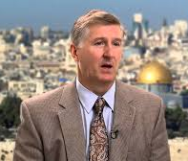
Mountains of Israel?
Mark Hitchcock, The Amazing Claims of Bible Prophecy: What You Need to Know in These Uncertain Times (Harvest House: Eugene, OR, 2010), 211.
“According to Ezekiel 39:2, 4, Israel must possess the ‘mountains of Israel’ when this invasion occurs...The famous Six Day war in Israel in 1967 helped set the stage for this to be fulfilled. Before the Six Day War, all the mountains of Israel, with the exception of a small strip of west Jerusalem, were in the hands of the Jordanian Arabs. Only since 1967 have the mountains of Israel been in Israel, thus setting the stage for the fulfillment of this prophecy.”

Slide 7


Dr. Arnold G. Fruchtenbaum
THE MODERN STATE OF ISRAEL IN BIBLE PROPHECY
Paper presented to the PTSG on 12-7-21, pps. 18-19
“But where in the Land of Israel will the invading armies be destroyed? The exact location is revealed in Ezekiel 39:2 and 4a: ‘and I will turn you about, and will lead you on, and will cause you to come up from the uttermost parts of the north; and I will bring you upon the mountains of Israel…you shall fall upon the mountains of Israel.’ The phrase ‘the mountains of Israel’ refers to the central mountain range that makes up the backbone of the country. In the Hebrew Scriptures, these mountains were known as the Hill Country of Ephraim and the Hill Country of Judah. Some of the famous biblical cities that lie within these mountains include Dothan, Shechem, Samaria, Shiloh, Bethel, Ai, Ramah, Bethlehem, Hebron, Debir, and most importantly, Jerusalem, which seems to be the target of the invading army. However, from 1948 until the Six-Day War in 1967, these mountains were not in Israel, but in Jordan.”

Slide 8
Dr. Arnold G. Fruchtenbaum
THE MODERN STATE OF ISRAEL IN BIBLE PROPHECY
Paper presented to the PTSG on 12-7-21, pps. 18-19
“They are now referred to politically as the West Bank. In 1948, Jordanian forces took over these mountains and annexed them as part of Jordan. All Israel had was a small corridor leading west to Jerusalem. The border between Israel and Jordan ran down the foot of these mountains, then cut into the mountains, dividing Jerusalem in two, and then went out again and continued along the foot of these mountains. Israel had maybe five percent or less of the mountains, while the rest belonged to Jordan. Only since 1967 have the mountains of Israel been in Israel. Besides the Temple compound falling into Jewish hands, another by-product of the Six-Day War was that these mountains also fell under Israeli sovereignty. Therefore, not only could this prophecy not have been fulfilled before 1948, but it could also not have been fulfilled before 1967.”

Slide 9
Dr. Arnold G. Fruchtenbaum
THE MODERN STATE OF ISRAEL IN BIBLE PROPHECY
Paper presented to the PTSG on 12-7-21, pps. 18-19
“The mountains of Israel (the West Bank) are yet to have a very important and relevant role in Bible prophecy. As for the present State of Israel, they became part of Israel in 1967. This is yet another way the modern Jewish State fits within Bible prophecy.”

Slide 10
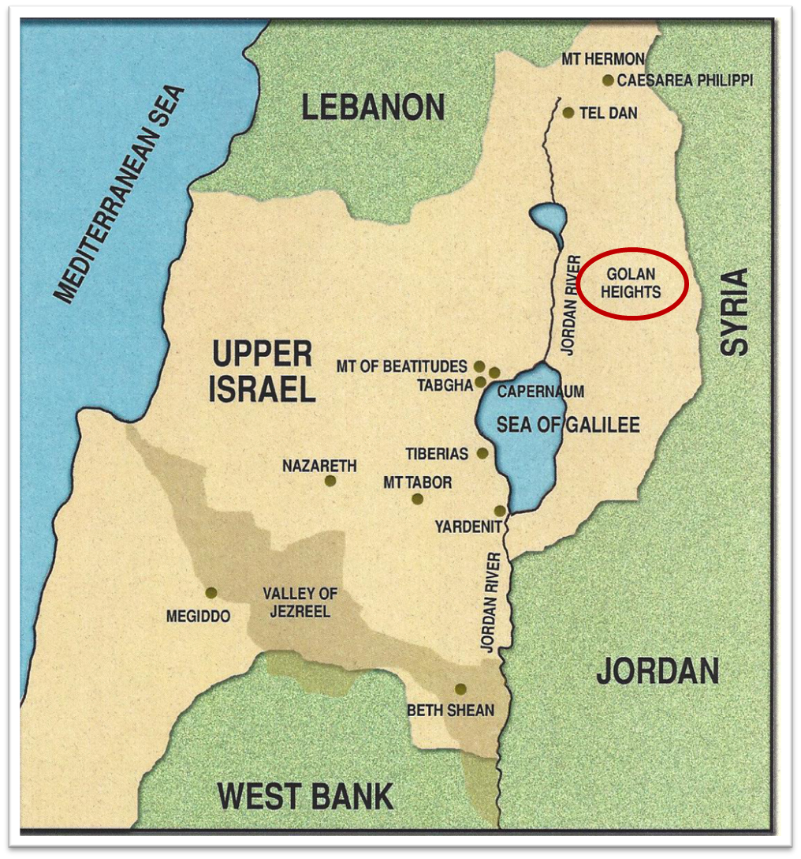

Slide 11
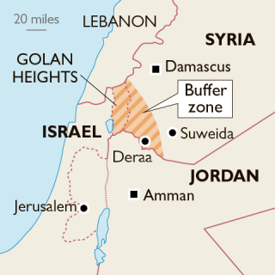

Slide 12

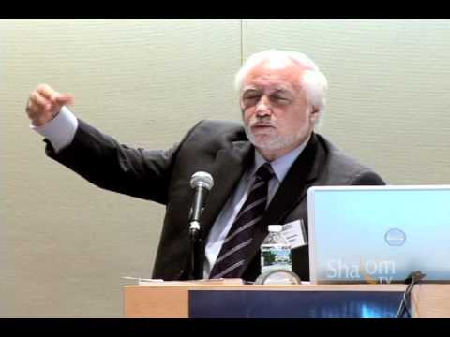

Slide 13
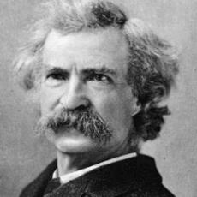
Mark Twain
The Innocents Abroad, Complete, 1st ed. (A Public Domain Book, 1869), 267, 285, 302. These quotes can be found in chapters 47, 49, 52.
“... A desolate country whose soil is rich enough, but is given over wholly to weeds… a silent mournful expanse…. a desolation is here that not even imagination can grace with the pomp of life and action…. we never saw a human being on the whole route…. there was hardly a tree or shrub anywhere. Even the olive tree and the cactus, those fast friends of a worthless soil, had almost deserted the country.”

Slide 14

Leviticus 26:43
“For the land will be abandoned by them, and will make up for its sabbaths while it is made desolate without them. They, meanwhile, will be making amends for their iniquity, because they rejected My ordinances and their soul abhorred My statutes.”

Slide 15
Ezekiel 38:8
“After many days you will be summoned; in the latter years you will come into the land that is restored from the sword, whose inhabitants have been gathered from many nations to the mountains of Israel which had been a continual waste; but its people were brought out from the nations, and they are living securely, all of them.”

Slide 16
Ezekiel 33‒48
Ezekiel recommissioned (33)
False shepherds removed (34)
Edom destroyed (35)
Israel’s restoration: physical & spiritual (36)
Israel’s restoration illustrated (37)
Means of restoration: Northern invasion (38)
Results of the Northern invasion: conversion (39)
Millennial Temple (40‒46)
Tribal land allotment (47‒48)

Slide 17
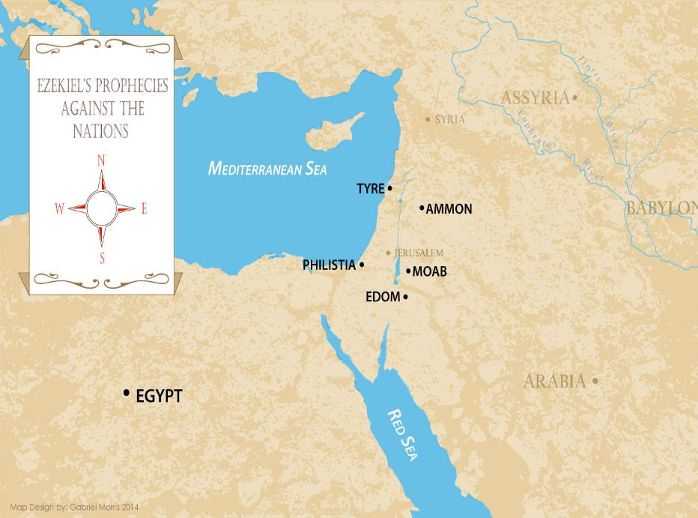

Slide 18
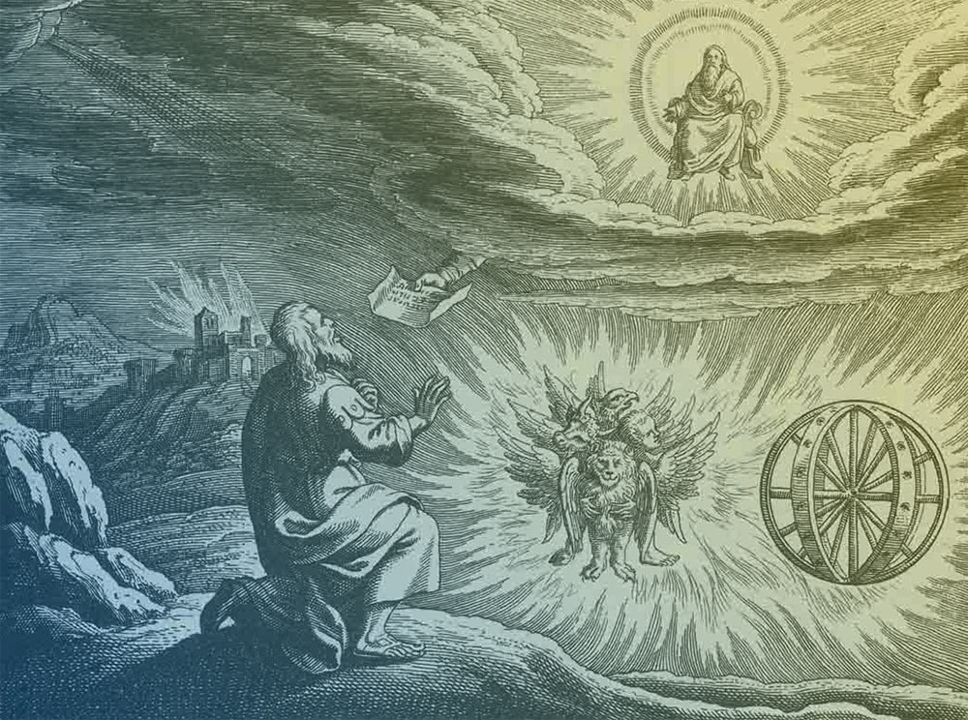
Source: Charles Dyer, Notes on Ezekiel
Judgment upon Judah (1-24)
Judgment upon the nations (25-32)
Israel’s future restoration (33-48)

Slide 19
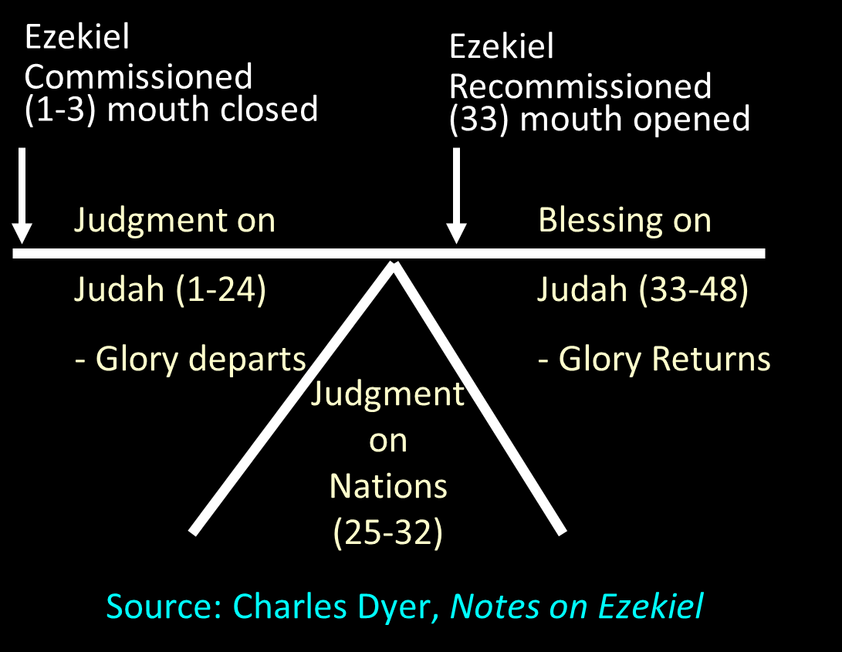

Slide 20


Slide 21


Slide 22
Ezekiel 36
Israel to prosper again (1-15)
Israel’s sins inhibiting prosperity (16-21)
Israel to be restored: physically & spiritually (22-38)

Slide 23
Six Parts of a Suzerain-Vassal Treaty in Deuteronomy
Preamble (1:1-5)
Prologue (1:6–4:40)
Covenant obligations (5–26)
Storage and reading instructions (27:2-3; 31:9, 24, 26)
Witnesses (32:1)
Blessings and curses (28)

Slide 24
Six Parts of a Suzerain-Vassal Treaty in Deuteronomy
Preamble (1:1-5)
Prologue (1:6–4:40)
Covenant obligations (5–26)
Storage and reading instructions (27:2-3; 31:9, 24, 26)
Witnesses (32:1)
Blessings and curses (28)

Slide 25
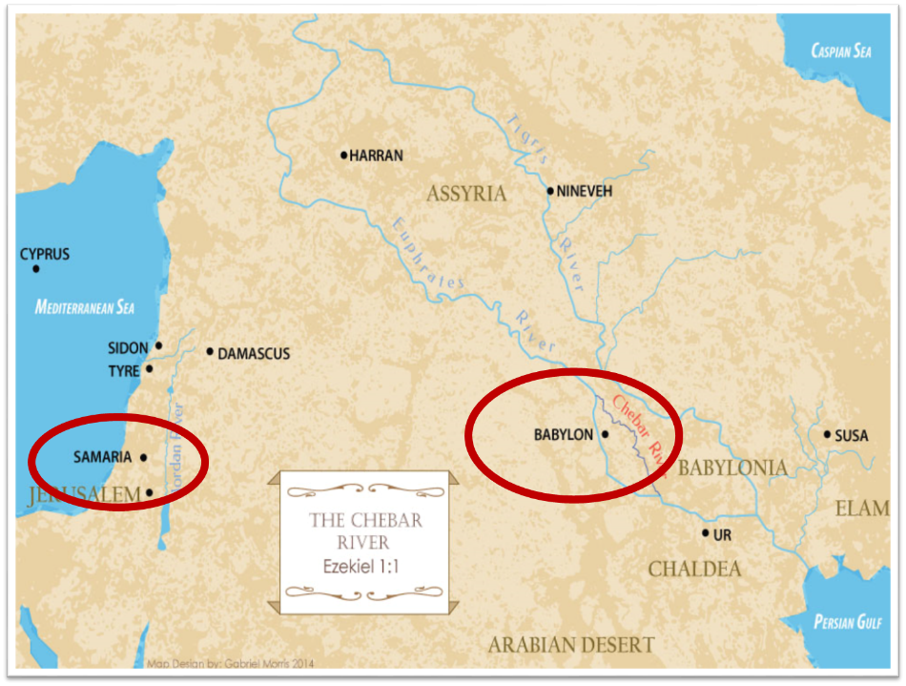

Slide 26
Israel's Judgments
Division of the kingdom in 931 B.C. (1 Kgs. 12)
Assyrian judgment in 722 B.C. (2 Kgs. 17)
Babylonian captivity in 586 B.C. (2 Kgs. 25)
Rome Diaspora in A.D. 70 (Luke 19:41-44)

Slide 27
Israel's Judgments
Division of the kingdom in 931 B.C. (1 Kgs. 12)
Assyrian judgment in 722 B.C. (2 Kgs. 17)
Babylonian captivity in 586 B.C. (2 Kgs. 25)
Rome Diaspora in A.D. 70 (Luke 19:41-44)

Slide 29

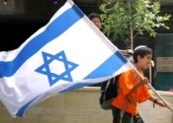
Charles L. Feinberg
The Prophecy of Ezekiel: The Glory of the Lord, Paperback ed. (Chicago: Moody, 1969; reprint, Chicago: Moody, 1984), 207.
“These prophecies, especially those in verses 12-15, could not have been fulfilled in the return from Babylon…Thus many take the primary reference to the return from Babylon. But the predictions will not be completely fulfilled until the future restoration, of which the return from Babylon was a foreshadowing.”

Slide 30
Ezekiel 36
Israel to prosper again (1-15)
Israel’s sins inhibiting prosperity (16-21)
Israel to be restored: physically & spiritually (22-38)

Slide 31

Ezekiel 36:22
“Therefore, say to the house of Israel, ‘This is what the Lord God says: “It is not for your sake, house of Israel, that I am about to act, but for My holy name, which you have profaned among the nations where you went.”

Slide 32
Ezekiel 36:22
“Therefore, say to the house of Israel, ‘This is what the Lord God says: “It is not for your sake, house of Israel, that I am about to act, but for My holy name, which you have profaned among the nations where you went.”

Slide 33


Slide 34
Exodus 2:24
“So God heard their groaning; and God remembered His covenant with Abraham, Isaac, and Jacob.”

Slide 35
Charles L. Feinberg
The Prophecy of Ezekiel: The Glory of the Lord, Paperback ed. (Chicago: Moody, 1969; reprint, Chicago: Moody, 1984), 206.
“It is vital to remember that’s such action on God’s part does not reveal in any sense a partiality toward Israel. It is rather a vindication of God‘s glory and will, for He has condescended to link his purposes on earth with the people of Israel.”

Slide 36
Dispensational Theology is a System of Theology
Traditional-normative dispensational theology is a system that embodies three essential, fundamental concepts called the sine qua non (lit. “without which is not”):
The consistent use of a plain, normal, literal, grammatical-historical method of interpretation;
Which reveals that the Church is distinct from Israel;
God’s overall purpose is to bring glory to Himself (Eph. 1:6, 12, 14).
Dr. Charles Ryrie, Dispensationalism, pp. 38-41

Slide 37
Doxological Purpose
God’s ultimate purpose for the ages is to glorify Himself. Scripture is not human-centered, as though salvation were the principle point, but God-centered, because His glory is at the center.
The glory of God is the primary principle that unifies all dispensations, the program of salvation being just one of the means by which God glorifies Himself. Each successive revelation of God’s plan for the ages, as well as His dealing with the elect, non-elect, angels, and nations all manifest His glory.
Dictionary of Premillennial Theology, Charles Ryrie, p. 94

Slide 38
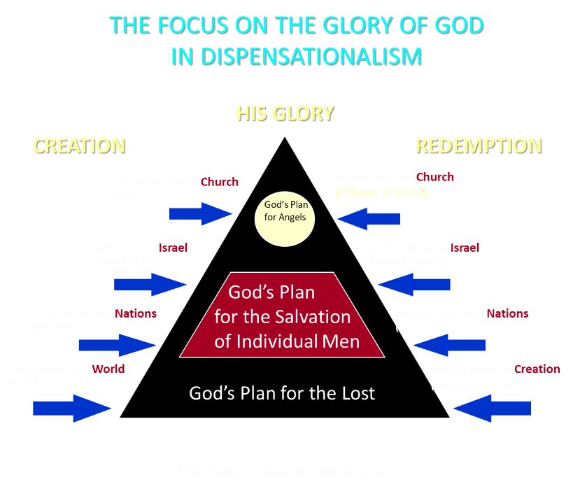

Slide 39

Ezekiel 36:24-28
²⁴ “For I will take you from the nations, gather you from all the lands and bring you into your own land. ²⁵ Then I will sprinkle clean water on you, and you will be clean; I will cleanse you from all your filthiness and from all your idols. ²⁶ Moreover, I will give you a new heart and put a new spirit within you; and I will remove the heart of stone from your flesh and give you a heart of flesh. ²⁷ I will put My Spirit within you and cause you to walk in My statutes, and you will be careful to observe My ordinances. ²⁸ You will live in the land that I gave to your forefathers; so you will be My people, and I will be your God.”

Slide 40
ISRAEL’S TWO REGATHERINGS
THE PRESENT (FIRST) REGATHERING | THE PERMANENT (SECOND) REGATHERING
Return to part of the land | Return to all the land
Return in unbelief | Return in faith
Restored to the land only | Restored to the land and the Lord
Sets the stage for Tribulation (discipline) | Sets the stage for Millennium (blessing)
Adapted from: Price, Jerusalem In Prophecy, 219

Slide 41


Slide 42

Jeremiah 31:31-34
“Behold, days are coming,” declares the Lord, “when I will make a new covenant with the house of Israel and with the house of Judah, ³² not like the covenant which I made with their fathers in the day I took them by the hand to bring them out of the land of Egypt, My covenant which they broke, although I was a husband to them,” declares the Lord. ³³ “But this is the covenant which I will make with the house of Israel after those days,” declares the Lord, . . .

Slide 43
Jeremiah 31:31-34
...“I will put My law within them and on their heart I will write it; and I will be their God, and they shall be My people. ³⁴ They will not teach again, each man his neighbor and each man his brother, saying, ‘Know the Lord,’ for they will all know Me, from the least of them to the greatest of them,” declares the Lord, “for I will forgive their iniquity, and their sin I will remember no more.”

Slide 44
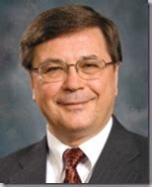
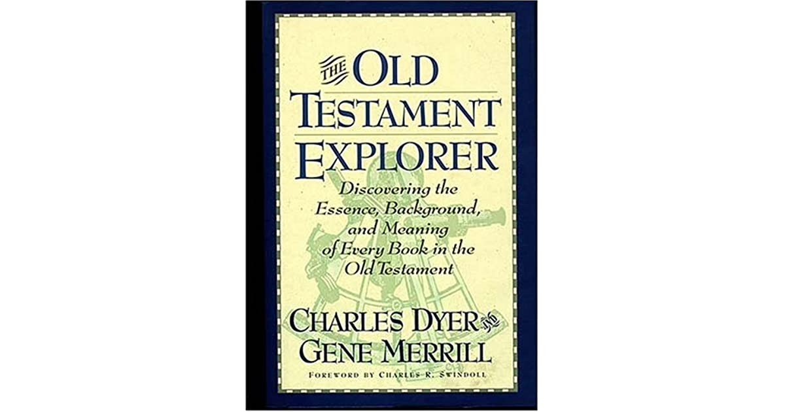
Charles H. Dyer
Old Testament Explorer, p. 690.
“Ezekiel 36 parallels the New Covenant God promised to Israel and Judah in Jeremiah 31. This covenant includes at least three specific elements: (a) restoration to the land (Ezek. 36:24; Jer. 31:27–29), (b) forgiveness of sin (Ezek. 36:25; Jer. 31:34), and (c) the indwelling presence of God’s Holy Spirit (Ezek. 36:26–27; Jer. 31:33).”

Slide 45
Six Parts of a Suzerain-Vassal Treaty in Deuteronomy
Preamble (1:1-5)
Prologue (1:6–4:40)
Covenant obligations (5–26)
Storage and reading instructions (27:2-3; 31:9, 24, 26)
Witnesses (32:1)
Blessings and curses (28)

Slide 46
Ezekiel 36:22
“Therefore, say to the house of Israel, ‘This is what the Lord God says: “It is not for your sake, house of Israel, that I am about to act, but for My holy name, which you have profaned among the nations where you went.”

Slide 47
Exodus 2:24
“So God heard their groaning; and God remembered His covenant with Abraham, Isaac, and Jacob.”

Slide 48
Mark Twain
The Innocents Abroad, Complete, 1st ed. (A Public Domain Book, 1869), 267, 285, 302. These quotes can be found in chapters 47, 49, 52.
“... A desolate country whose soil is rich enough, but is given over wholly to weeds… a silent mournful expanse…. a desolation is here that not even imagination can grace with the pomp of life and action…. we never saw a human being on the whole route…. there was hardly a tree or shrub anywhere. Even the olive tree and the cactus, those fast friends of a worthless soil, had almost deserted the country.”

Slide 49
Leviticus 26:43
“For the land will be abandoned by them, and will make up for its sabbaths while it is made desolate without them. They, meanwhile, will be making amends for their iniquity, because they rejected My ordinances and their soul abhorred My statutes.”

Slide 50
Ezekiel 38:8
“After many days you will be summoned; in the latter years you will come into the land that is restored from the sword, whose inhabitants have been gathered from many nations to the mountains of Israel which had been a continual waste; but its people were brought out from the nations, and they are living securely, all of them.”

Slide 51
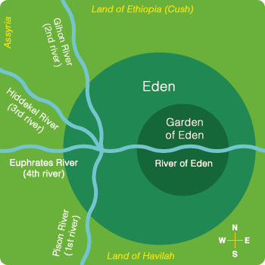

Slide 52

Divine Judgments
(3:14-19)
  Serpent (3:14-15)
  Woman (3:16)
  Man (3:17-19)

Slide 53
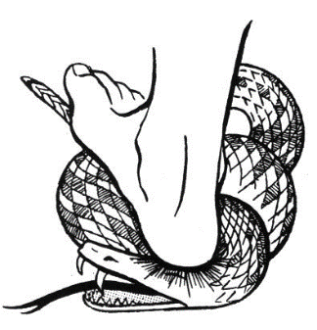
Serpent
(3:14-15)
  Serpent’s body (3:14)
  Protoevangelium (3:15)

Slide 54
Woman
(3:16)
  Painful child birth (3:16a)
  Relational conflict (3:16b)

Slide 55
Man
(3:17-19)
  Painful labor (3:17-19a)
  Death (3:19b)

Slide 56
Why?
COUNTRY | GROSS DOMESTIC PRODUCT
ISRAEL | $123 BILLION
Egypt | $81 billion
Syria | $26 billion
Lebanon | $21 billion
Jordan | $12 billion
Source: CIA World Fact Book, 2005

Slide 57


Slide 58
Levitical Feasts (23)
Feast | Season | Purpose | Type
Passover | Spring | Redemption | 1 Cor 5:7
Unleavened Bread | Spring | Separation | John 6:35
1st fruits | Spring | Praise | 1 Cor 15:20
Pentecost | Spring | Praise | Acts 2:1-4
Trumpets | Fall | New Year | Matt 24:31
Atonement | Fall | Lev 16 | Zech 12:10
Booths | Fall | Wilderness provision | Zech 14:16-18

Slide 59


Slide 60
CONCLUSION

Slide 61
Ezekiel 36
Israel to prosper again (1-15)
Israel’s sins inhibiting prosperity (16-21)
Israel to be restored: physically & spiritually (22-38)

Slide 62
Ezekiel 33‒48
Ezekiel recommissioned (33)
False shepherds removed (34)
Edom destroyed (35)
Israel’s restoration: physical & spiritual (36)
Israel’s restoration illustrated (37)
Means of restoration: Northern invasion (38)
Results of the Northern invasion: conversion (39)
Millennial Temple (40‒46)
Tribal land allotment (47‒48)

