Slide 1
Genesis 12‒50
Israel’s Birth & Preservation

Slide 2
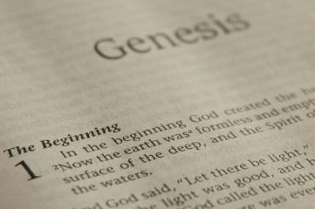
GENESIS STRUCTURE
Beginning of the Human race (Gen. 1‒11)
Beginning of the Hebrew race (Gen. 12‒50)

Slide 3
GENESIS STRUCTURE
Genesis 1-11 (four events)
Creation (1-2)
Fall (3-5)
Flood (6-9)
National dispersion (10-11)

Slide 4
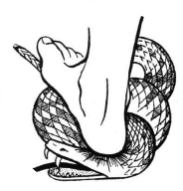
Genesis 3:15
“And I will put enmity Between you and the woman, And between your seed and her seed; He shall bruise you on the head, And you shall bruise him on the heel.”

Slide 5
GENESIS STRUCTURE
Beginning of the Human race (Gen. 1‒11)
Beginning of the Hebrew race (Gen. 12‒50)

Slide 6
GENESIS STRUCTURE
Genesis 12-50 (four people)
Abraham (12:1–25:11)
Isaac (25:12–26:35)
Jacob (27–36)
Joseph (37–50)

Slide 7
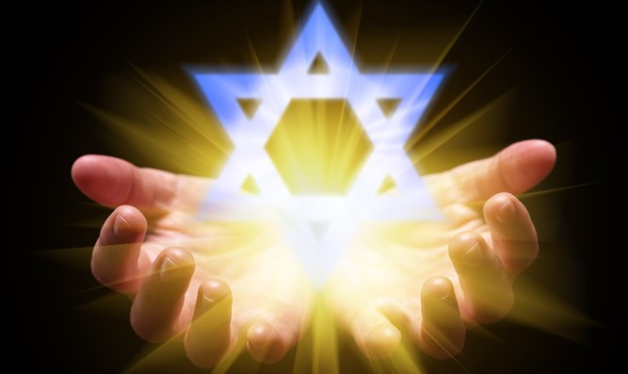
Isaiah 43:1
“But now, thus says the Lord, your Creator, O Jacob, And He who formed you, O Israel, 'Do not fear, for I have redeemed you; I have called you by name; you are Mine!'”

Slide 8
GENESIS STRUCTURE
Genesis 12-50 (four people)
Abraham (12:1–25:11)
Isaac (25:12–26:35)
Jacob (27–36)
Joseph (37–50)

Slide 9
Genesis 12‒15 Abram’s Early Journeys
Unconditional promises (Gen. 12:1-3)
From Haran to Canaan (Gen. 12:4-5)
In Canaan (Gen. 12:6-9)
In Egypt (Gen. 12:10-20)
Abram and Lot Separate (Gen. 13:1-13)
Reaffirmation of Abram’s promises (Gen. 13:14-18)
Abram Rescues Lot (14:1-24)
Abrahamic Covenant (15:1-21)

Slide 10
Genesis 15:1‒21 Abrahamic Covenant
Seed Promise Clarified (15:1-6)
Land Promise Ratified (15:7-21)

Slide 11
Genesis 15:1‒21 Abrahamic Covenant
Seed Promise Clarified (15:1-6)
Land Promise Ratified (15:7-21)

Slide 12
Seed Promise Clarified Genesis 15:1-6
God’s Promise (1)
Abram’s misunderstanding (2-3)
God’s clarification (4-5)
Abram’s response (6)

Slide 13
Genesis 15:1‒21 Abrahamic Covenant
Seed Promise Clarified (15:1-6)
Land Promise Ratified (15:7-21)

Slide 14
Land Promise Ratified Genesis 15:7-21
God’s Promise (7)
Abram’s Question (8)
Preparation of the Animal pieces (9-11)
Prophecy of redemption from Egyptian bondage (12-16)
Covenant ratification ritual (17-21)

Slide 15
Covenant Ratification Ritual Genesis 15:17-21
The ceremony (17)
The covenant (18a)
The land (18b-21)

Slide 16
Covenant Ratification Ritual Genesis 15:17-21
The ceremony (17)
The covenant (18a)
The land (18b-21)

Slide 17
Evidence of Abrahamic Covenant’s Unconditional Nature
ANE covenant ratification ceremony (Gen 15)
Lack of stated conditions for Israel’s obedience (Gen 15)
Covenant's eternality (Gen 17:7, 13, 19; Ps. 90:2)
Covenant's immutability (Heb 6:13-18; Mal. 3:6)
Trans-generational reaffirmation despite perpetual national disobedience (Jer 31:35-37)
Walvoord, The Millennial Kingdom, 149-52

Slide 18
Covenant Ratification Ritual Genesis 15:17-21
The ceremony (17)
The covenant (18a)
The land (18b-21)

Slide 19
Genesis 15:18-21
¹⁸ On that day the Lord made a covenant with Abram, saying, “To your descendants I have given this land, From the river of Egypt as far as the great river, the river Euphrates: ¹⁹ the Kenite and the Kenizzite and the Kadmonite ²⁰ and the Hittite and the Perizzite and the Rephaim ²¹ and the Amorite and the Canaanite and the Girgashite and the Jebusite.”

Slide 20
Covenant Ratification Ritual Genesis 15:17-21
The ceremony (17)
The covenant (18a)
The land (18b-21)

Slide 21
Genesis 15:18-21
¹⁸ On that day the Lord made a covenant with Abram, saying, “To your descendants I have given this land, From the river of Egypt as far as the great river, the river Euphrates: ¹⁹ the Kenite and the Kenizzite and the Kadmonite ²⁰ and the Hittite and the Perizzite and the Rephaim ²¹ and the Amorite and the Canaanite and the Girgashite and the Jebusite.”

Slide 22
Genesis 15:18-21
¹⁸ On that day the Lord made a covenant with Abram, saying, “To your descendants I have given this land, From the river of Egypt as far as the great river, the river Euphrates: ¹⁹ the Kenite and the Kenizzite and the Kadmonite ²⁰ and the Hittite and the Perizzite and the Rephaim ²¹ and the Amorite and the Canaanite and the Girgashite and the Jebusite.”

Slide 23
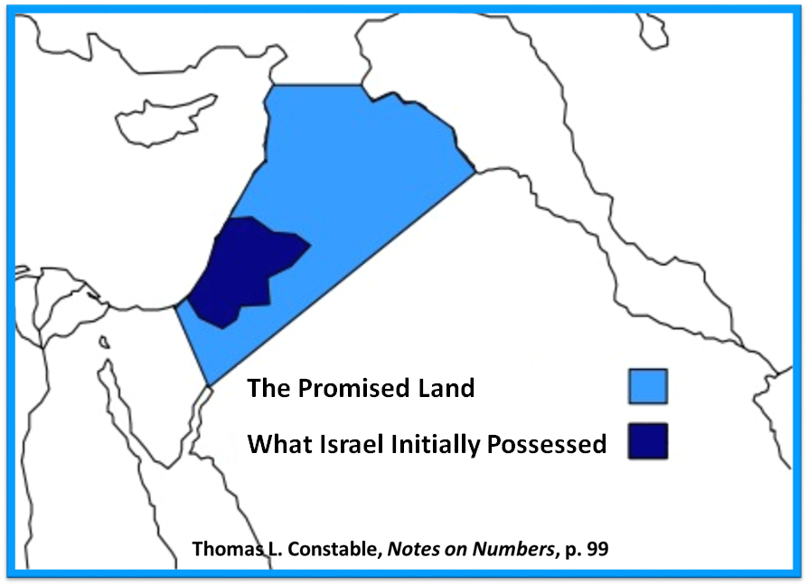

Slide 24
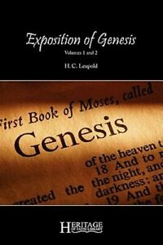
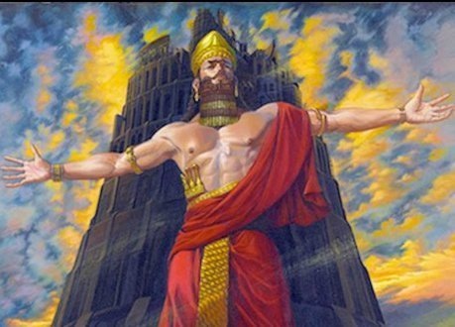
H. C. Leupold
H.C. Leupold, Exposition of Genesis, 490.
“‘The River of Egypt’ could hardly be the Wady el ‘Arish (Rhinocolura), for that insignificant winter torrent could hardly be set in contrast to the ‘Great River, the River Euphrates.’ Consequently, ‘the River of Egypt’ is the Nile.”

Slide 27
Dr. Arnold G. Fruchtenbaum
The Book of Genesis, 284
“The southern border of the Land is from the river of Egypt. The river of Egypt is not the Nile, as has often been misinterpreted; for if it was the Nile, the Jews were already in the Promised Land before they ever left Egypt. Nor is the River of Egypt the Wadi el-Arish, the wadi that runs through the center of the Sinai Peninsula, because that was referred to in the Bible as the Brook (nachal) of Egypt, not the River (nahar) of Egypt. The river of Egypt refers to the most eastern branch of the Nile Delta. As the Nile River flows from south to north before emptying into the Mediterranean Sea, it breaks up into various branches . . .

Slide 28
Dr. Arnold G. Fruchtenbaum
The Book of Genesis, 284
. . . flowing through the Nile Delta, and the most eastern branch was known as the River of Egypt. This is known today as the Pelogiac branch of the Nile Delta, which flows into Lake Sironbis. It is also known as the River Shihor, the fourteenth nome of Egypt.”

Slide 29
Evidence of Abrahamic Covenant’s Unconditional Nature
ANE covenant ratification ceremony (Gen 15)
Lack of stated conditions for Israel’s obedience (Gen 15)
Covenant's eternality (Gen 17:7, 13, 19; Ps. 90:2)
Covenant's immutability (Heb 6:13-18; Mal. 3:6)
Trans-generational reaffirmation despite perpetual national disobedience (Jer 31:35-37)
Walvoord, The Millennial Kingdom, 149-52

Slide 30
Land Promises Fulfilled in the Time of Joshua (Josh. 11:23; 21:43-45) or Solomon (1 Kgs. 4:21)?
Extended context (Josh 13:1-7; Judges 1:19, 21, 27, 29, 30-36)
Land gained in conquest was only a fraction of what was promised (1 Kgs. 4:25)
Jerusalem not conquered in Joshua’s day (Josh 15:63; 2 Sam 5)
Solomon’s reign extended to the border of Egypt (1 Kgs. 4:21) and not the River of Egypt (Gen. 15:18)
Solomon’s reign was tributary only (1 Kgs. 4:21)
Forever? (Gen 17:7-8, 13, 19)
Reaffirmation of land promises long after Joshua and Solomon’s time (Amos 9:11-15)
Fruchtenbaum, Israelology, 521-22, 631-32

Slide 31
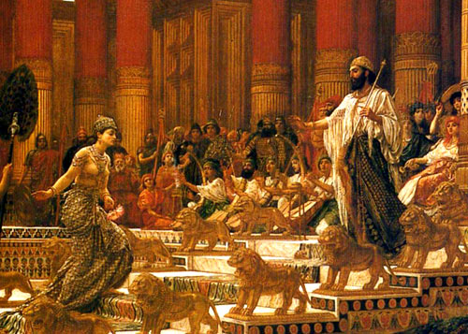
1 Kings 4:25
“So Judah and Israel lived securely, everyone under his vine and his fig tree, from Dan even to Beersheba, all the days of Solomon.”

Slide 32
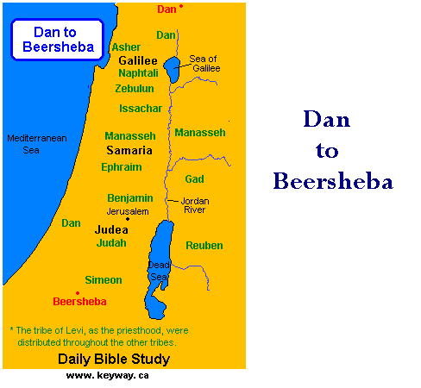

Slide 33
1 Kings 4:21
“Now Solomon ruled over all the kingdoms from the River to the land of the Philistines and to the border of Egypt; they brought tribute and served Solomon all the days of his life.”

Slide 34
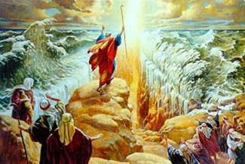
IMPORTANCE
God’s promises and covenant to Israel remain literal, reliable, unconditional, and unfulfilled (Gen. 23)
Basis of God’s intervention in history (Gen. 15:14-16; Exod. 2:24)
God must once again move His hand in history to fulfill His Word (Ezek. 36:22)
Forms the expectation of a future earthly kingdom

Slide 37
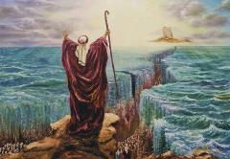
Deuteronomy 29:1
“These are the words of the covenant which the Lord commanded Moses to make with the sons of Israel in the land of Moab, besides the covenant which He had made with them at Horeb.”

Slide 38
Deuteronomy 30:3
“Then the Lord your God will restore you from captivity, and have compassion on you, and will gather you again from all the peoples where the Lord your God has scattered you.”

Slide 39
2 Samuel 7:12-16
“¹²When your days are complete and you lie down with your fathers, I will raise up your descendant after you, who will come forth from you, and I will establish his kingdom. ¹³ He shall build a house for My name, and I will establish the throne of his kingdom forever. ¹⁴ I will be a father to him and he will be a son to Me; when he commits iniquity, I will correct him with the rod of men. . .

Slide 40
2 Samuel 7:12-16
. . . and the strokes of the sons of men, 15 but My lovingkindness shall not depart from him, as I took it away from Saul, whom I removed from before you. ¹⁶ Your house and your kingdom shall endure before Me forever; your throne shall be established forever.” ¹⁷ In accordance with all these words and all this vision, so Nathan spoke to David.”

Slide 41
Jeremiah 31:31-34
“Behold, days are coming,” declares the Lord, “when I will make a new covenant with the house of Israel and with the house of Judah, ³² not like the covenant which I made with their fathers in the day I took them by the hand to bring them out of the land of Egypt, My covenant which they broke, although I was a husband to them,” declares the Lord. ³³ “But this is the covenant which I will make with the house of Israel after those days,” declares the Lord, . . .

Slide 42
Jeremiah 31:31-34
...“I will put My law within them and on their heart I will write it; and I will be their God, and they shall be My people. ³⁴ They will not teach again, each man his neighbor and each man his brother, saying, ‘Know the Lord,’ for they will all know Me, from the least of them to the greatest of them,” declares the Lord, “for I will forgive their iniquity, and their sin I will remember no more.”

Slide 43
Genesis 15:18-21
¹⁸ On that day the Lord made a covenant with Abram, saying, “To your descendants I have given this land, From the river of Egypt as far as the great river, the river Euphrates: ¹⁹ the Kenite and the Kenizzite and the Kadmonite ²⁰ and the Hittite and the Perizzite and the Rephaim ²¹ and the Amorite and the Canaanite and the Girgashite and the Jebusite.”

Slide 44
Ham’s Sons (vs. 6)
Cush
Mizraim
Put
Canaan

Slide 45
Canaan’s Sons (vs. 15-18)
Sidon
Heth
Jebusite
Amorite
Girgashite
Hivite
Arkite
Sinite
Arvadite
Zemarite
Hamathite
Perrizite

Slide 46
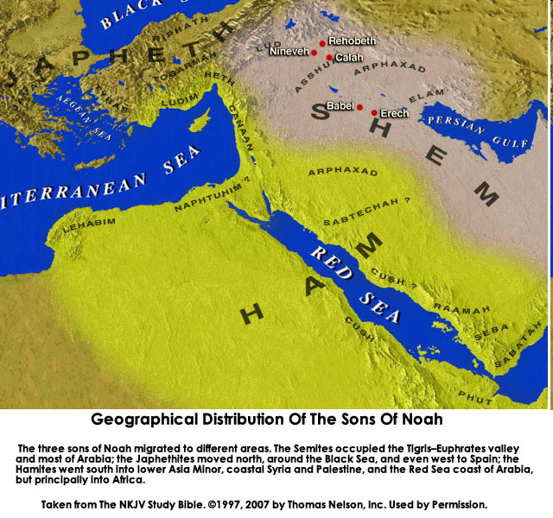
CANNAN

Slide 47
Genesis 15:16
“Then in the fourth generation they will return here, for the wrongdoing of the Amorite is not yet complete.”

Slide 49
Genesis 15:1‒21 Abrahamic Covenant
Seed Promise Clarified (15:1-6)
Land Promise Ratified (15:7-21)

Slide 50
Land Promise Ratified Genesis 15:7-21
God’s Promise (7)
Abram’s Question (8)
Preparation of the Animal pieces (9-11)
Prophecy of redemption from Egyptian bondage (12-16)
Covenant ratification ritual (17-21)

Slide 51
Covenant Ratification Ritual Genesis 15:17-21
The ceremony (17)
The covenant (18a)
The land (18b-21)

Slide 52
Genesis 12‒16 Abram’s Early Journeys
Unconditional promises (Gen. 12:1-3)
From Haran to Canaan (Gen. 12:4-5)
In Canaan (Gen. 12:6-9)
In Egypt (Gen. 12:10-20)
Abram and Lot Separate (Gen. 13:1-13)
Reaffirmation of Abram’s promises (Gen. 13:14-18)
Abram Rescues Lot (14:1-24)
Abrahamic Covenant (15:1-21)
Hagar & Ishmael (16:1-16)

Slide 53
Genesis 16:1‒16 Sarai and Hagar
Sarai & Hagar (16:1-6)
Angel of the Lord & Hagar (16:7-14)
Ishmael’s Birth (16:15-16)

Slide 54
Genesis 16:1‒16 Sarai and Hagar
Sarai & Hagar (16:1-6)
Angel of the Lord & Hagar (16:7-14)
Ishmael’s Birth (16:15-16)

Slide 55
Sarah & Hagar Genesis 16:1-6
Circumstances (1) Proposal (2a) Acceptance (2b) Consummation (3) Conception (4a) | Change of attitude (4b) Conflict & complaint (5) Response (6a) Harsh treatment (6b) Flight (6c)

Slide 56
Sarah & Hagar Genesis 16:1-6
Circumstances (1) Proposal (2a) Acceptance (2b) Consummation (3) Conception (4a) | Change of attitude (4b) Conflict & complaint (5) Response (6a) Harsh treatment (6b) Flight (6c)

Slide 57
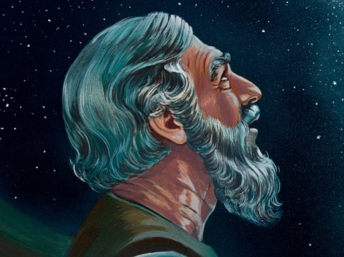
Genesis 15:4-5
Then behold, the word of the Lord came to him, saying, “This man will not be your heir; but one who will come forth from your own body, he shall be your heir.” ⁵ And He took him outside and said, “Now look toward the heavens, and count the stars, if you are able to count them.” And He said to him, “So shall your descendants be.”

Slide 59
Sarah & Hagar Genesis 16:1-6
Circumstances (1) Proposal (2a) Acceptance (2b) Consummation (3) Conception (4a) | Change of attitude (4b) Conflict & complaint (5) Response (6a) Harsh treatment (6b) Flight (6c)

Slide 60
Dr. Arnold G. Fruchtenbaum
The Book of Genesis, 286-88
“This offer was in keeping with the Nuzi Tablets and with the Code of Hammurabi in that if a wife proved to be barren, she was obligated to provide to her husband a handmaid through whom he could have children so that his seed does not die out. Therefore, what Sarai proposed was in keeping with the laws of that day…Hagar was being used to produce children because of the legal wife’s inability to do so. Again, this was quite in keeping with the laws of that day.”

Slide 61
Dr. Arnold G. Fruchtenbaum
The Book of Genesis, 286-88
“The Code of Hammurabi, which dates from the second millennium b.c., not that distant from Abraham’s own time, states: ‘When the freemen marries a priestess and she gave a female slave to her husband and she has then born children, if later that female slave has claimed equality with her mistress because she bore children, her mistress may not sell her; she may mark her with the slave mark and count her among the slaves.’ A second example is the Nuzi Tablets, also from the second millennium b.c.: ‘If Gilimninu, [the bride] will not bear children, Gilimninu shall take a woman of Lullo land as a wife for Shennima [the groom].’…Therefore, what Sarai was doing was in keeping with the laws of that day.”

Slide 62
Galatians 3:3
“Are you so foolish? Having begun by the Spirit, are you now being perfected by the flesh?”

Slide 63
Sarah & Hagar Genesis 16:1-6
Circumstances (1) Proposal (2a) Acceptance (2b) Consummation (3) Conception (4a) | Change of attitude (4b) Conflict & complaint (5) Response (6a) Harsh treatment (6b) Flight (6c)

Slide 64
Dr. Arnold G. Fruchtenbaum
The Book of Genesis, 287
“The same wording was used in Genesis 3:17, when Adam ‘obeyed’ his wife, and both of these ended up with negative consequences.”

Slide 65
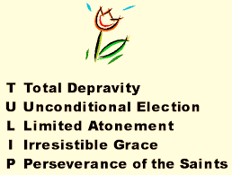
Running TULIP Through the Grid of Scripture
Total Depravity
Unconditional Election
Limited Atonement
Irresistible Grace
Perseverance of the Saints

Slide 66
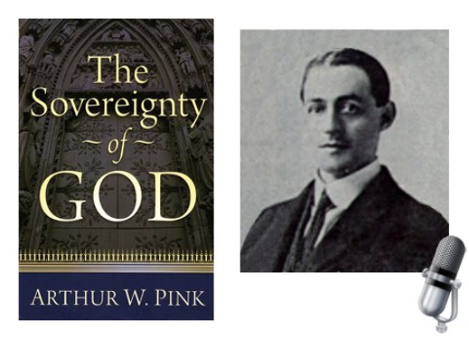
A. W. Pink
Practical Christianity, p. 16.
“Readers, if there is a reserve in your obedience, you are on your way to hell.”

Slide 67
Sarah & Hagar Genesis 16:1-6
Circumstances (1) Proposal (2a) Acceptance (2b) Consummation (3) Conception (4a) | Change of attitude (4b) Conflict & complaint (5) Response (6a) Harsh treatment (6b) Flight (6c)

Slide 68
Sarah & Hagar Genesis 16:1-6
Circumstances (1) Proposal (2a) Acceptance (2b) Consummation (3) Conception (4a) | Change of attitude (4b) Conflict & complaint (5) Response (6a) Harsh treatment (6b) Flight (6c)

Slide 69
Sarah & Hagar Genesis 16:1-6
Circumstances (1) Proposal (2a) Acceptance (2b) Consummation (3) Conception (4a) | Change of attitude (4b) Conflict & complaint (5) Response (6a) Harsh treatment (6b) Flight (6c)

Slide 70
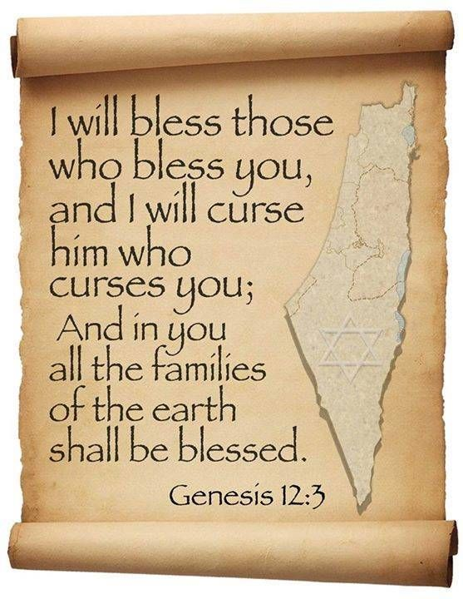
Genesis 12:3
“And I will bless those who bless you, And the one who curses [kalal] you I will curse [aor]. And in you all the families of the earth will be blessed.”

Slide 71
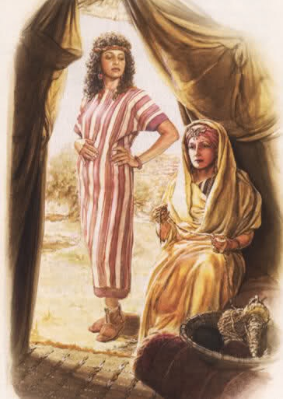
Dr. Arnold G. Fruchtenbaum
The Book of Genesis, 289
“This led to Hagar’s new attitude: When she saw that she had conceived, her mistress was despised in her eyes. In biblical days, few women were more despised than barren women were. Therefore, when Hagar conceived, she began to display this negative attitude toward barren women.”

Slide 72
Sarah & Hagar Genesis 16:1-6
Circumstances (1) Proposal (2a) Acceptance (2b) Consummation (3) Conception (4a) | Change of attitude (4b) Conflict & complaint (5) Response (6a) Harsh treatment (6b) Flight (6c)

Slide 73
Sarah & Hagar Genesis 16:1-6
Circumstances (1) Proposal (2a) Acceptance (2b) Consummation (3) Conception (4a) | Change of attitude (4b) Conflict & complaint (5) Response (6a) Harsh treatment (6b) Flight (6c)

Slide 74
Dr. Arnold G. Fruchtenbaum
The Book of Genesis, 289-90
“Hagar is still officially, legally, and technically Sarai’s possession. Returning Hagar to slave status was in keeping with the laws of that day. The Code of Hammurabi reads: ‘If she gave a female slave to her husband, and she has then born [sic] children; if that female slave has claimed equality with her mistress because she had born [sic] children, her mistress may not sell her, she may put her among the slaves.’ While Hagar could not be sold to someone else now that she has conceived, she could be returned to slave status, and that is essentially what happened.”

Slide 75
Sarah & Hagar Genesis 16:1-6
Circumstances (1) Proposal (2a) Acceptance (2b) Consummation (3) Conception (4a) | Change of attitude (4b) Conflict & complaint (5) Response (6a) Harsh treatment (6b) Flight (6c)

Slide 76
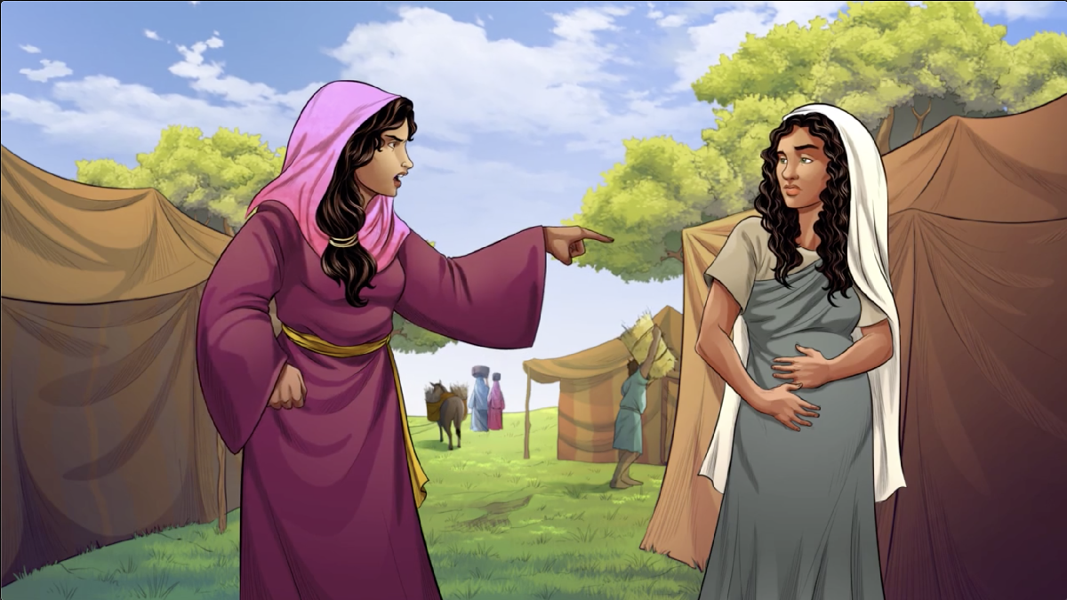
Dr. Arnold G. Fruchtenbaum
The Book of Genesis, 290
“Genesis 16:6b records Hagar’s flight. The cause was: Sarai dealt harshly with her. This is the same word that is used of the Egyptian affliction of Israel in Exodus 1:11–12. The irony here is that the Jewish woman is afflicting the Egyptian. The result was: She [Hagar] fled from her face.”

Slide 77
Sarah & Hagar Genesis 16:1-6
Circumstances (1) Proposal (2a) Acceptance (2b) Consummation (3) Conception (4a) | Change of attitude (4b) Conflict & complaint (5) Response (6a) Harsh treatment (6b) Flight (6c)

Slide 78
Genesis 16:1‒16 Sarai and Hagar
Sarai & Hagar (16:1-6)
Angel of the Lord & Hagar (16:7-14)
Ishmael’s Birth (16:15-16)

Slide 79
Angel of the Lord & Hagar Genesis 16:7-14
Angel of the Lord (7a) Location (7b) Questions (8a) Answer (8b) | Command (9) Prophecies (10-12) Response (13) Location (14)

Slide 80
Angel of the Lord & Hagar Genesis 16:7-14
Angel of the Lord (7a) Location (7b) Questions (8a) Answer (8b) | Command (9) Prophecies (10-12) Response (13) Location (14)

Slide 81
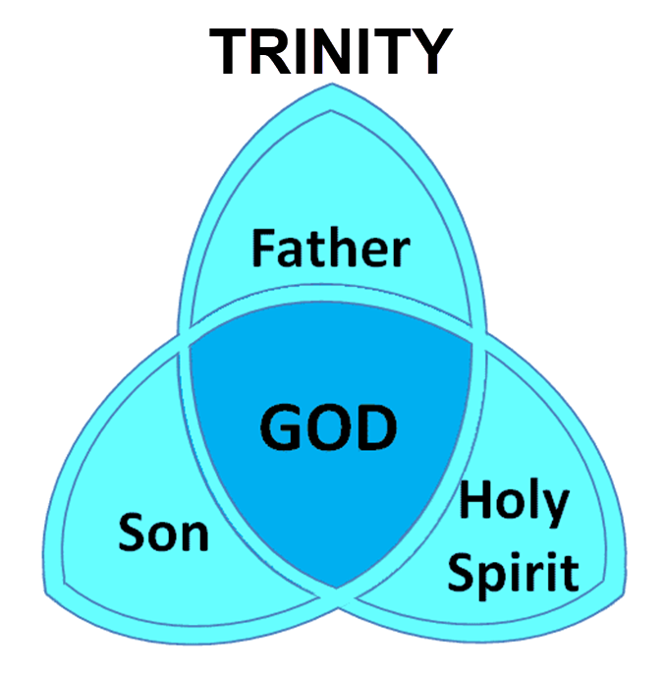

Slide 82
Angel of the Lord & Hagar Genesis 16:7-14
Angel of the Lord (7a) Location (7b) Questions (8a) Answer (8b) | Command (9) Prophecies (10-12) Response (13) Location (14)

Slide 83
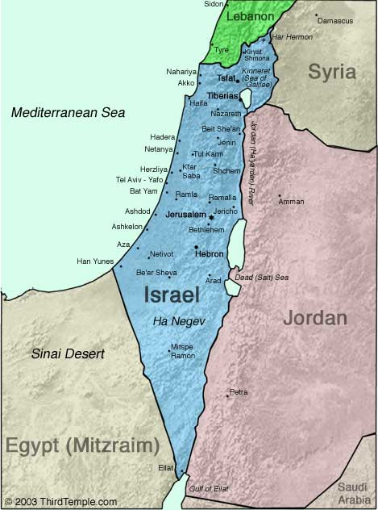
Negev

Slide 85
Angel of the Lord & Hagar Genesis 16:7-14
Angel of the Lord (7a) Location (7b) Questions (8a) Answer (8b) | Command (9) Prophecies (10-12) Response (13) Location (14)

Slide 86
Angel of the Lord & Hagar Genesis 16:7-14
Angel of the Lord (7a) Location (7b) Questions (8a) Answer (8b) | Command (9) Prophecies (10-12) Response (13) Location (14)

Slide 87
Angel of the Lord & Hagar Genesis 16:7-14
Angel of the Lord (7a) Location (7b) Questions (8a) Answer (8b) | Command (9) Prophecies (10-12) Response (13) Location (14)

Slide 88
Angel of the Lord & Hagar Genesis 16:7-14
Angel of the Lord (7a) Location (7b) Questions (8a) Answer (8b) | Command (9) Prophecies (10-12) Response (13) Location (14)

Slide 89
Prophecies Genesis 16:10-12
Seed (10)
Name (11)
Nature (12)
Roamer (12a)
Aggressor (12b)
Retaliated against (12c)
Against his brother [Israel] (12d)

Slide 90
Prophecies Genesis 16:10-12
Seed (10)
Name (11)
Nature (12)
Roamer (12a)
Aggressor (12b)
Retaliated against (12c)
Against his brother [Israel] (12d)

Slide 91
Prophecies Genesis 16:10-12
Seed (10)
Name (11)
Nature (12)
Roamer (12a)
Aggressor (12b)
Retaliated against (12c)
Against his brother [Israel] (12d)

Slide 92
Prophecies Genesis 16:10-12
Seed (10)
Name (11)
Nature (12)
Roamer (12a)
Aggressor (12b)
Retaliated against (12c)
Against his brother [Israel] (12d)

Slide 93
Prophecies Genesis 16:10-12
Seed (10)
Name (11)
Nature (12)
Roamer (12a)
Aggressor (12b)
Retaliated against (12c)
Against his brother [Israel] (12d)

Slide 94
Prophecies Genesis 16:10-12
Seed (10)
Name (11)
Nature (12)
Roamer (12a)
Aggressor (12b)
Retaliated against (12c)
Against his brother [Israel] (12d)

Slide 95
Prophecies Genesis 16:10-12
Seed (10)
Name (11)
Nature (12)
Roamer (12a)
Aggressor (12b)
Retaliated against (12c)
Against his brother [Israel] (12d)

Slide 96
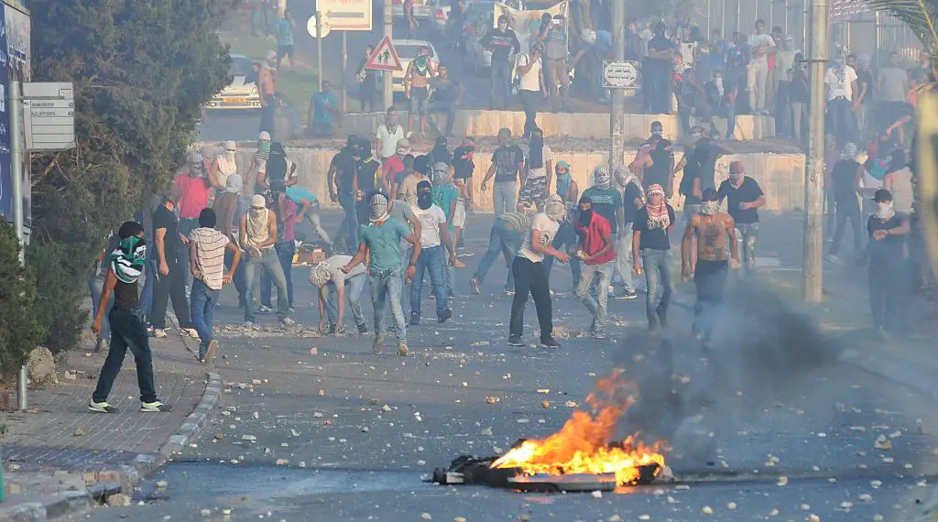
Dr. Arnold G. Fruchtenbaum
The Book of Genesis, 292
“This principle has been frequently repeated in the years of Israel’s history since 1948. Arab aggression by means of war and terrorist attacks have led to heavy Israeli retaliation.”

Slide 97
Prophecies Genesis 16:10-12
Seed (10)
Name (11)
Nature (12)
Roamer (12a)
Aggressor (12b)
Retaliated against (12c)
Against his brother [Israel] (12d)

Slide 98
B. Angel of the Lord & Hagar Genesis 16:7-14
Angel of the Lord (7a) Location (7b) Questions (8a) Answer (8b) | Command (9) Prophecies (10-12) Response (13) Location (14)

Slide 99
B. Angel of the Lord & Hagar Genesis 16:7-14
Angel of the Lord (7a) Location (7b) Questions (8a) Answer (8b) | Command (9) Prophecies (10-12) Response (13) Location (14)

Slide 101
Negev

Slide 102
Genesis 16:1‒16 Sarai and Hagar
Sarai & Hagar (16:1-6)
Angel of the Lord & Hagar (16:7-14)
Ishmael’s Birth (16:15-16)

Slide 103
Ishmael’s Birth Genesis 16:15-16
Birth of a son (15a)
Name: Ishmael (15b)
Abram’s age (16)

Slide 104
Ishmael’s Birth Genesis 16:15-16
Birth of a son (15a)
Name: Ishmael (15b)
Abram’s age (16)

Slide 105
Ishmael’s Birth Genesis 16:15-16
Birth of a son (15a)
Name: Ishmael (15b)
Abram’s age (16)

Slide 106
Ishmael’s Birth Genesis 16:15-16
Birth of a son (15a)
Name: Ishmael (15b)
Abram’s age (16)

Slide 107
Conclusion

Slide 108
Genesis 16:1‒16 Sarai and Hagar
Sarai & Hagar (16:1-6)
Angel of the Lord & Hagar (16:7-14)
Ishmael’s Birth (16:15-16)

Slide 109
“The Lord bless you and keep you; the Lord make his face shine on you and be gracious to you; the Lord turn his face toward you and give you peace.” (NIV)

