Slide 1


Genesis 6‒9
The Flood and Continuation of the Messianic Promise

Slide 2


GENESIS STRUCTURE
  Beginning of the Human race (Gen. 1‒11)
  Beginning of the Hebrew race (Gen. 12‒50)

Slide 3

GENESIS STRUCTURE
  Genesis 1-11 (four events)
    Creation (1-2)
    Fall (3-5)
    Flood (6-9)
    National dispersion (10-11)

Slide 4
GENESIS STRUCTURE
  Genesis 1-11 (four events)
    Creation (1-2)
    Fall (3-5)
    Flood (6-9)
    National dispersion (10-11)

Slide 5


Genesis 3:15
“And I will put enmity Between you and the woman, And between your seed and her seed; He shall bruise you on the head, And you shall bruise him on the heel.”

Slide 6
GENESIS STRUCTURE
  Genesis 1-11 (four events)
    Creation (1-2)
    Fall (3-5)
    Flood (6-9)
    National dispersion (10-11)

Slide 7
The Flood
(Gen 6–9)
  Events before the flood (Gen 6)
  The flood (Gen 7)
  The abating of the waters (Gen 8)
  Events following the flood (Gen 9)

Slide 8

Genesis 8:20–9:29
Post Flood events

Slide 9
Outline
  Noahic Covenant (Gen 8:20–9:17)
  Promise (Gen 8:20-22)
  Provision (Gen 9:1-7)
  Covenant and sign (Gen 9:8-17)
  Post Flood Sin (Gen 9:18-29)

Slide 10
Outline
  Noahic Covenant (Gen 8:20–9:17)
  Promise (Gen 8:20-22)
  Provision (Gen 9:1-7)
  Covenant and sign (Gen 9:8-17)
  Post Flood Sin (Gen 9:18-29)

Slide 11
Outline
  Noahic Covenant (Gen 8:20–9:17)
  Promise (Gen 8:20-22)
  Provision (Gen 9:1-7)
  Covenant and sign (Gen 9:8-17)
  Post Flood Sin (Gen 9:18-29)

Slide 12
Noahic Covenant: Promise
(Gen 8:20-22)
  Noah’s initial sacrifice (8:20)
  Divine promise not to flood the earth again (Gen 8:21a)
  Ongoing depravity thus necessitating the work of a future Messiah (Gen 8:21b)
  Uninterrupted season or cycles (Gen 8:22) – global warming?

Slide 13
Outline
  Noahic Covenant (Gen 8:20–9:17)
  Promise (Gen 8:20-22)
  Provision (Gen 9:1-7)
  Covenant and sign (Gen 9:8-17)
  Post Flood Sin (Gen 9:18-29)

Slide 14
Noahic Covenant: Provision
(Gen 9:1-7)
  Re-creation theme (Gen 9:1, 2, 7)
  Man becomes carnivorous (Gen. 1:29-30; 2:17; 9:3)
  Cultural precedent for the Mosaic Law (Gen 9:4; Lev 17:11)

Slide 15
Noahic Covenant: Provision
(Gen 9:1-7)
  Re-creation theme (Gen 9:1, 2, 7)
  Man becomes carnivorous (Gen. 1:29-30; 2:17; 9:3)
  Cultural precedent for the Mosaic Law (Gen 9:4; Lev 17:11)

Slide 16

Genesis 1:26-28
²⁶ Then God said, “Let Us make man in Our image, according to Our likeness; and let them rule over the fish of the sea and over the birds of the sky and over the cattle and over all the earth, and over every creeping thing that creeps on the earth.” ²⁷ God created man in His own image, in the image of God He created him; male and female He created them. ²⁸ God blessed them; and God said to them, “Be fruitful and multiply, and fill the earth, and subdue it; and rule over the fish of the sea and over the birds of the sky and over every living thing that moves on the earth.”

Slide 17
Genesis 5:1-2
“¹ This is the book of the generations of Adam. In the day when God created man, He made him in the likeness of God. ² He created them male and female, and He blessed them and named them Man in the day when they were created.”

Slide 18
Genesis 1:26-28
²⁶ Then God said, “Let Us make man in Our image, according to Our likeness; and let them rule over the fish of the sea and over the birds of the sky and over the cattle and over all the earth, and over every creeping thing that creeps on the earth.” ²⁷ God created man in His own image, in the image of God He created him; male and female He created them. ²⁸ God blessed them; and God said to them, “Be fruitful and multiply, and fill the earth, and subdue it; and rule over the fish of the sea and over the birds of the sky and over every living thing that moves on the earth.”

Slide 19
Genesis 1:26-28
²⁶ Then God said, “Let Us make man in Our image, according to Our likeness; and let them rule over the fish of the sea and over the birds of the sky and over the cattle and over all the earth, and over every creeping thing that creeps on the earth.” ²⁷ God created man in His own image, in the image of God He created him; male and female He created them. ²⁸ God blessed them; and God said to them, “Be fruitful and multiply, and fill the earth, and subdue it; and rule over the fish of the sea and over the birds of the sky and over every living thing that moves on the earth.”

Slide 20
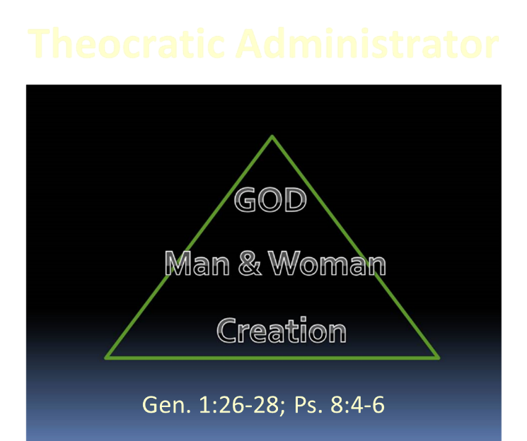

Slide 21
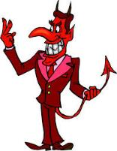
Names & Titles Demonstrating Satan’s Post-Fall, Earthly Authority
(Job 1:7; 2:2; Luke 4:5-8; Rom. 8:19-22)
Prince of this world (John 12:31; 14:30; 16:11)
God of this age (2 Cor. 4:4)
Prince and power of the air (Eph. 2:2)
Who the believer wrestles with (Eph. 6:12)
Roaring lion (1 Pet. 5:8)
Whole world lies in his power (1 John 5:19)

Slide 22


Dr. Arnold G. Fruchtenbaum
The Book of Genesis, 185, 187
“Nevertheless, the command to subdue the earth is not repeated, since this authority now belongs to Satan, who usurped the authority from man when man fell... The command to multiply is repeated again, but the command to subdue the earth is not repeated. So man retains the authority over the animal kingdom and the vegetable kingdom; but he does not have the authority over the earth. That authority has been given to Satan, who usurped the authority from man. John 12:31 states that Satan is the prince of this world; II Corinthians 4:4 states he is the god of this age; and Luke 4:6 states that Satan has the authority over the kingdoms of this world.”

Slide 23
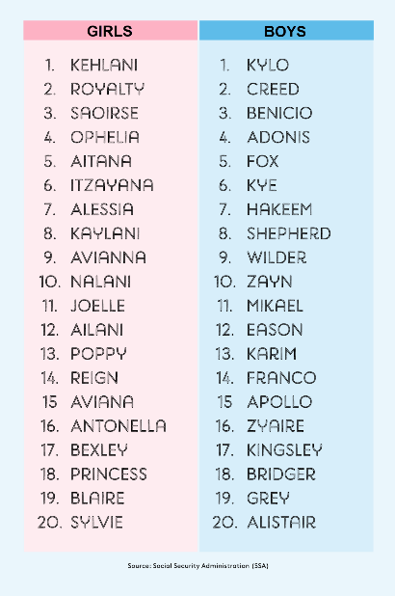
Biblical Significance of Naming
Genesis 1:8
Numbers 32:37-38
2 Kings 23:24
2 Kings 24:17
Daniel 1:6-7
Fruchtenbaum, The Book of Genesis, 84

Slide 24
Noahic Covenant: Provision
(Gen 9:1-7)
  Re-creation theme (Gen 9:1, 2, 7)
  Man becomes carnivorous (Gen. 1:29-30; 2:17; 9:3)
  Cultural precedent for the Mosaic Law (Gen 9:4; Lev 17:11)

Slide 25

Genesis 9:3
“Every moving thing that is alive shall be food for you; I give all to you, as I gave the green plant.”

Slide 26

Genesis 1:29-30
“²⁹ Then God said, ‘Behold, I have given you every plant yielding seed that is on the surface of all the earth, and every tree which has fruit yielding seed; it shall be food for you; ³⁰ and to every beast of the earth and to every bird of the sky and to every thing that moves on the earth which has life, I have given every green plant for food’; and it was so.”

Slide 27
Genesis 2:16-17
“¹⁶ The Lord God commanded the man, saying, ‘From any tree of the garden you may eat freely; ¹⁷ but from the tree of the knowledge of good and evil you shall not eat, for in the day that you eat from it you will surely die (muwth).’”

Slide 28
Genesis 3:19
“By the sweat of your face You will eat bread, Till you return to the ground, Because from it you were taken; For you are dust, And to dust you shall return.”

Slide 29
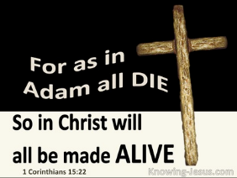
1 Corinthians 15:21-22
“²¹ For since by a man came death, by a man also came the resurrection of the dead. ²² For as in Adam all die, so also in Christ all will be made alive.”

Slide 30

Romans 5:12
“Therefore, just as through one man sin entered into the world, and death through sin, and so death spread to all men, because all sinned—.”

Slide 31


Slide 32

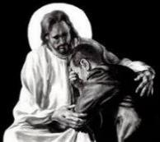
Revelation 21:4
“and He will wipe away every tear from their eyes; and there will no longer be any death; there will no longer be any mourning, or crying, or pain; the first things have passed away.”

Slide 33
Noahic Covenant: Provision
(Gen 9:1-7)
  Re-creation theme (Gen 9:1, 2, 7)
  Man becomes carnivorous (Gen. 1:29-30; 2:17; 9:3)
  Cultural precedent for the Mosaic Law (Gen 9:4; Lev 17:11)

Slide 34


Slide 35
Dr. Arnold G. Fruchtenbaum
The Book of Genesis, 186
“This principle that the life of the flesh is in the blood is the same prohibition later incorporated into the Mosaic Law (Lev. 3:17, 17:10–14, 7:26–27; Deut. 12:15–16, 12:20–24). This prohibition will play a later role in the advice given to Gentile believers in Acts 15:29. Furthermore, drinking blood is often connected with demonism; thus this prohibition might be, to some degree, a response to the events of Genesis 6:1–4 when intermarriage between humans and fallen angels took place.”

Slide 36
Noahic Covenant: Provision
(Gen 9:1-7)
  Origin of human government (Rom 13:1-7; 1 Pet 2:13-14; Titus 3:1; 1 Tim 2:1-4)
  Capital punishment (Gen 9:5-6)
  Rationale (8:21; 6:11; 9:6b)
  Scriptural support (Rom 13:4; Matt 26:52)

Slide 37
Noahic Covenant: Provision
(Gen 9:1-7)
  Origin of human government (Rom 13:1-7; 1 Pet 2:13-14; Titus 3:1; 1 Tim 2:1-4)
  Capital punishment (Gen 9:5-6)
  Rationale (8:21; 6:11; 9:6b)
  Scriptural support (Rom 13:4; Matt 26:52)

Slide 38

Romans 13:3-5
“For rulers are not a cause of fear for good behavior, but for evil. Do you want to have no fear of authority? Do what is good and you will have praise from the same; for it is a minister of God to you for good. But if you do what is evil, be afraid; for it does not bear the sword for nothing; for it is a minister of God, an avenger who brings wrath on the one who practices evil.”

Slide 39

1 Peter 2:13-14
“Submit yourselves for the Lord’s sake to every human institution, whether to a king as the one in authority, or to governors as sent by him for the punishment of evildoers and the praise of those who do right.”

Slide 40
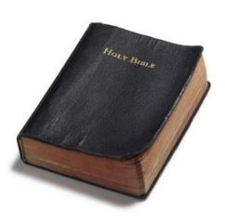
Founders’ Sources
34% Bible
8.3% Baron Montesquieu
7.9% William Blackstone
2.9% John Locke
Donald S. Lutz, The Origins of American Constitutionalism (Baton Rouge, LA: Louisiana State University Press, 1988), 141.

Slide 41
Founders’ Sources
34% Bible
8.3% Baron Montesquieu
7.9% William Blackstone
2.9% John Locke
Donald S. Lutz, The Origins of American Constitutionalism (Baton Rouge, LA: Louisiana State University Press, 1988), 141.

Slide 42
Founders’ Sources
34% Bible
8.3% Baron Montesquieu
7.9% William Blackstone
2.9% John Locke
Donald S. Lutz, The Origins of American Constitutionalism (Baton Rouge, LA: Louisiana State University Press, 1988), 141.

Slide 43

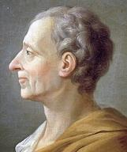
Baron Montesquieu
“The Christian religion…is a stranger to mere despotic power. The mildness so frequently recommended in the Gospel, is incompatible with the despotic rage with which a prince punishes his subjects, and exercises himself in cruelty…[W]e shall see, that we owe to Christianity, in government, a certain political law; and in war, a certain law of nations; benefits which nature can sufficiently acknowledge.”
Alvin J. Schmidt, Under the Influence: How Christianity Transformed Civilization (Grand Rapids: Zondervan, 2001), 257-58.

Slide 44
Founders’ Sources
34% Bible
8.3% Baron Montesquieu
7.9% William Blackstone
2.9% John Locke
Donald S. Lutz, The Origins of American Constitutionalism (Baton Rouge, LA: Louisiana State University Press, 1988), 141.

Slide 45

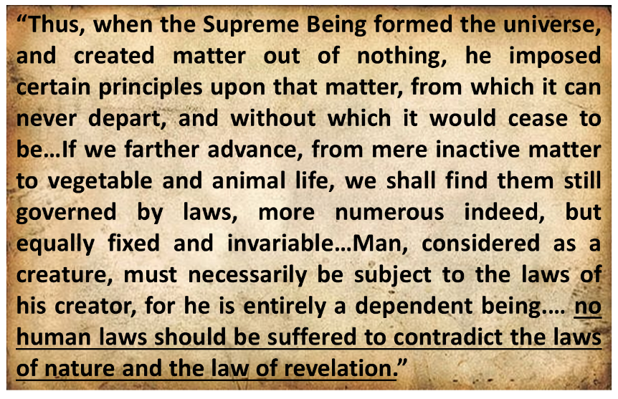
Sir William Blackstone
Sir Commentaries on the Laws of New England, 5 vols. (Philadelphia: Robert Bell Union Library, 1771; reprint, NY: Layston, 1967), 1:38-39, 42.

Slide 46
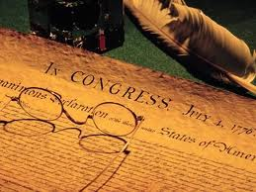
Declaration of Independence
“the Laws of Nature and of Nature’s God,”
“we hold these truths to be self evident, that all men are created equal,”
“they are endowed by their Creator with certain unalienable Rights,”
“appealing to the Supreme Judge of the world for the rectitude of our intentions,”
“with firm reliance on the protection of Divine Providence.”
Church of the Holy Trinity v. U.S., 143 U.S. 457, 467-68 (1892)

Slide 47
Founders’ Sources
34% Bible
8.3% Baron Montesquieu
7.9% William Blackstone
2.9% John Locke
Donald S. Lutz, The Origins of American Constitutionalism (Baton Rouge, LA: Louisiana State University Press, 1988), 141.

Slide 48
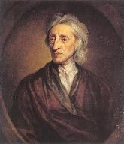
John Locke
“Locke’s theory reflects St. Paul’s Christian understanding of the natural law. Although he has often been referred to as a deist, it is clear from his writings that he considered himself a Christian. In his monograph The Reasonableness of Christianity (1695), he talks about sinners being ‘restored by Christ at the resurrection.’ Frequently, he also cites Scripture references in support of his arguments.”
Alvin J. Schmidt, Under the Influence: How Christianity Transformed Civilization (Grand Rapids: Zondervan, 2001), 253-54.

Slide 49
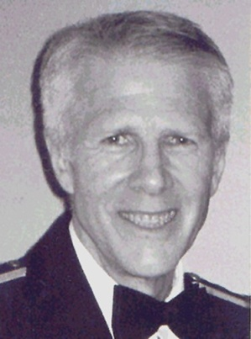
John Locke
“...Locke contributed the theory of social compact: the idea that men in a state of nature realize their rights are insecure, and compact together to establish a government and cede to that government certain power so that government may use that power to secure the rest of their rights...The social compact theory, like the covenant, allows the government only the power God and/or people delegate. This is the cornerstone of limited government. It finds expression in the Tenth Amendment to the Constitution and in the Declaration of Independence which states that governments exist to secure human rights and ‘derive their just powers from the consent of the governed.’"
John Eidsmoe, Christianity and the Constitution: The Faith of Our Founding Fathers (Grand Rapids, MI: Baker, 1987), 62.

Slide 50
John Locke
“Locke frequently cited the Bible in his political writings. In his first treatise on government he cited the Bible eighty times. Forty-two of these citations are from Genesis, mostly chapters 1 and 3. Twenty-two biblical citations appear in his second treatise in which he argued that parents have authority over their children based upon the creation of Adam and Eve and their offspring. He also argued that man has the right to possess property since God gave the earth to Adam and later to Noah. He based the social compact which government is established upon ‘that Paction which God made with Noah after the Deluge.’ His basic doctrines of parental authority, private property, and social compact were based on the historical existence of Adam and Noah."
John Eidsmoe, Christianity and the Constitution: The Faith of Our Founding Fathers (Grand Rapids, MI: Baker, 1987), 61.

Slide 51

Synthetic Outline
  Chiasm in “Aramaic” ( Dan. 2-7)
1. Gentile History (2)
  2. Protection (3)
    3. Revelation to a gentile king (4)
    3'. Revelation to a gentile king (5)
  2. Protection (6)
1. Gentile history (7)

Slide 52
Synthetic Outline
  Chiasm in “Aramaic” ( Dan. 2-7)
1. Gentile History (2)
  2. Protection (3)
    3. Revelation to a gentile king (4)
    3'. Revelation to a gentile king (5)
  2. Protection (6)
1. Gentile history (7)

Slide 53
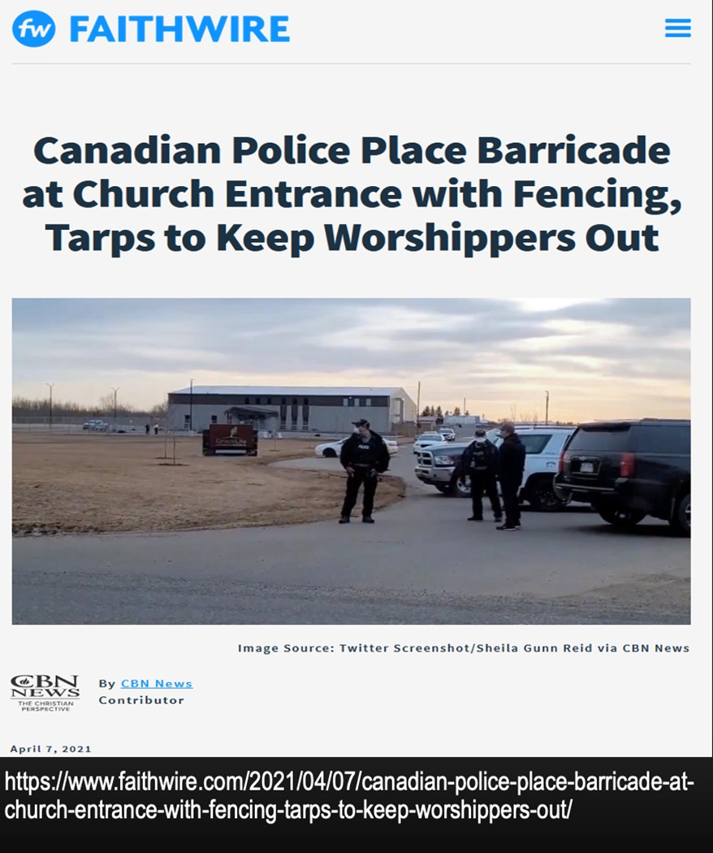

Slide 54
Noahic Covenant: Provision
(Gen 9:1-7)
  Origin of human government (Rom 13:1-7; 1 Pet 2:13-14; Titus 3:1; 1 Tim 2:1-4)
  Capital punishment (Gen 9:5-6)
  Rationale (6:11; 8:21; 9:6b)
  Scriptural support (Rom 13:4; Matt 26:52)

Slide 55
Noahic Covenant: Provision
(Gen 9:1-7)
  Origin of human government (Rom 13:1-7; 1 Pet 2:13-14; Titus 3:1; 1 Tim 2:1-4)
  Capital punishment (Gen 9:5-6)
  Rationale (6:11; 8:21; 9:6b)
  Scriptural support (Rom 13:4; Matt 26:52)

Slide 56

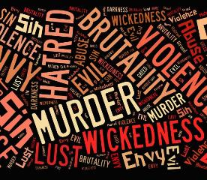
Genesis 6:11
“Now the earth was corrupt in the sight of God, and the earth was filled with violence [חָמָס; chamas].”

Slide 57
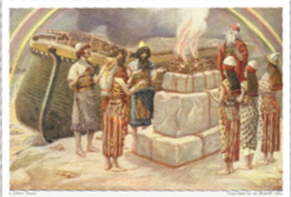
Genesis 8:21
The Lord smelled the soothing aroma; and the Lord said to Himself, “I will never again curse the ground on account of man, for the intent of man’s heart is evil from his youth; and I will never again destroy every living thing, as I have done.[emphasis mine].

Slide 58


Genesis 9:6
“Whoever sheds man’s blood, By man his blood shall be shed, For in the image of God He made man.”

Slide 59
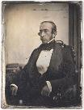
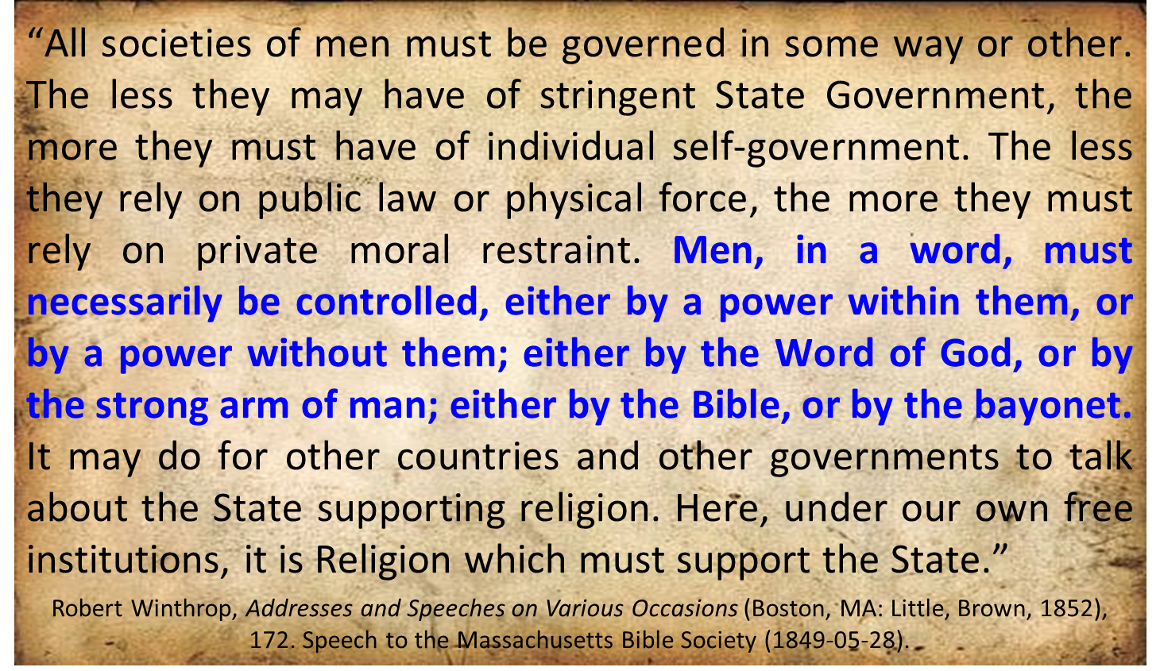
Robert Charles Winthrop

Slide 60
Noahic Covenant: Provision
(Gen 9:1-7)
  Origin of human government (Rom 13:1-7; 1 Pet 2:13-14; Titus 3:1; 1 Tim 2:1-4)
  Capital punishment (Gen 9:5-6)
  Rationale (6:11; 8:21; 9:6b)
  Scriptural support (Rom 13:4; Matt 26:52)

Slide 61
Romans 13:3-5
“For rulers are not a cause of fear for good behavior, but for evil. Do you want to have no fear of authority? Do what is good and you will have praise from the same; for it is a minister of God to you for good. But if you do what is evil, be afraid; for it does not bear the sword for nothing; for it is a minister of God, an avenger who brings wrath on the one who practices evil.”

Slide 62
1 Peter 2:13-14
“Submit yourselves for the Lord’s sake to every human institution, whether to a king as the one in authority, or to governors as sent by him for the punishment of evildoers and the praise of those who do right.”

Slide 63

Genesis 1:27
God created man in His own image, in the image of God He created him; male and female He created them.

Slide 64
Genesis 6:11
“Now the earth was corrupt in the sight of God, and the earth was filled with violence [חָמָס; chamas].”

Slide 65
Genesis 9:6
“Whoever sheds man’s blood, By man his blood shall be shed, For in the image of God He made man.”

Slide 66
Genesis 5:1-2
“¹ This is the book of the generations of Adam. In the day when God created man, He made him in the likeness of God. ² He created them male and female, and He blessed them and named them Man in the day when they were created.”

Slide 67
Declaration of Independence
“the Laws of Nature and of Nature’s God,”
“we hold these truths to be self evident, that all men are created equal,”
“they are endowed by their Creator with certain unalienable Rights,”
“appealing to the Supreme Judge of the world for the rectitude of our intentions,”
“with firm reliance on the protection of Divine Providence.”
Church of the Holy Trinity v. U.S., 143 U.S. 457, 467-68 (1892)

Slide 68
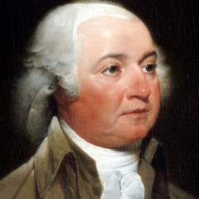
John Adams
John Adams - America's second President "Rights [are] antecedent to all earthly government; Rights... cannot be repealed or restrained by human laws; Rights [are] derived from the great Legislature of the universe."
John Adams, The Works of John Adams, Second President of the United States, ed. Charles Francis Adams, 10 vols. (Boston: Little, Brown, 1856), 3:449.

Slide 69
Declaration of Independence
“We hold these truths to be self-evident, that all men are created equal, that they are endowed by their Creator with certain unalienable Rights, that among these are Life, Liberty and the pursuit of Happiness.”
“That TO SECURE THESE RIGHTS, Governments are instituted among Men, deriving their just powers from the consent of the governed,”
“That whenever any Form of Government becomes destructive of these ends, it is the Right of the People to alter or to abolish it, and to institute new Government…”
Declaration of Independence, In Congress, July 4, 1776, The unanimous Declaration of the thirteen united States of America

Slide 70
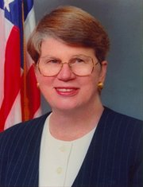
Speech by Attorney General Janet Reno, Newark, New Jersey, May 5, 1995. Quoted in James Bovard, “Waco Must Get a Hearing,” Wall Street Journal, May 15, 1995.
Former Attorney General Janet Reno
“You are part of a government that has given its people more freedom…than any other government in the history of the world.”

Slide 71
Objections to Capital Punishment
  Sixth commandment?
  Sermon on the Mount?
  We are no longer under the Mosaic Law?
  Deterrence? (Deut 13:10-11; 19:20; Eccl 8:11)
  Executed innocent?
  Racist?
  8th Amendment?
  Pro-life?

Slide 72
Objections to Capital Punishment
  Sixth commandment?
  Sermon on the Mount?
  We are no longer under the Mosaic Law?
  Deterrence? (Deut 13:10-11; 19:20; Eccl 8:11)
  Executed innocent?
  Racist?
  8th Amendment?
  Pro-life?

Slide 73

Exodus 20:13
“You shall not murder [רָצַח; ratsach].”

Slide 74
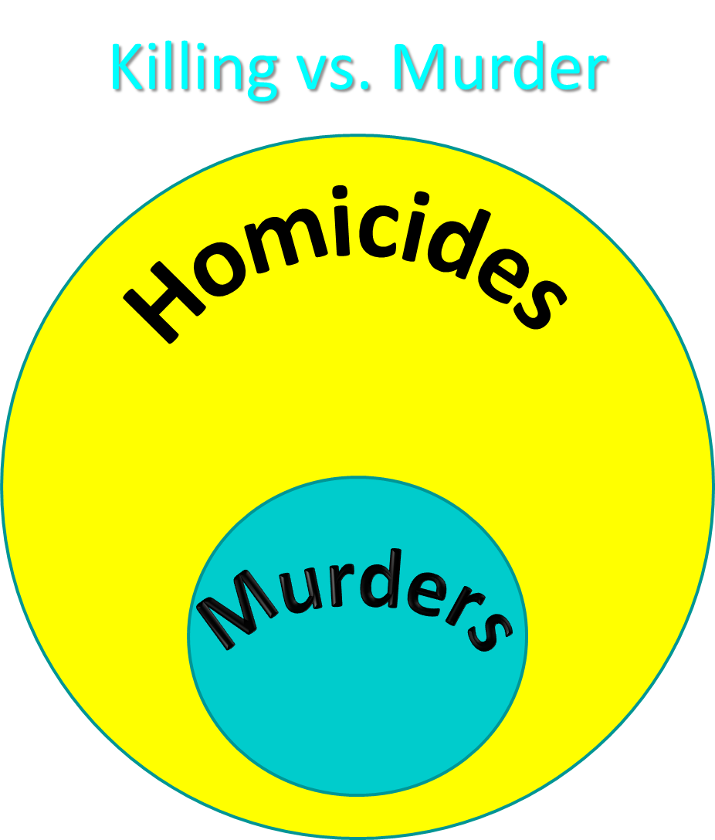

Slide 75
Objections to Capital Punishment
  Sixth commandment?
  Sermon on the Mount?
  We are no longer under the Mosaic Law?
  Deterrence? (Deut 13:10-11; 19:20; Eccl 8:11)
  Executed innocent?
  Racist?
  8th Amendment?
  Pro-life?

Slide 76
Objections to Capital Punishment
  Sixth commandment?
  Sermon on the Mount?
  We are no longer under the Mosaic Law?
  Deterrence? (Deut 13:10-11; 19:20; Eccl 8:11)
  Executed innocent?
  Racist?
  8th Amendment?
  Pro-life?

Slide 77
Noahic vs. Abrahamic & Mosaic Covenants
Name | NOAHIC | ABRAHAMIC | MOSAIC
Human agent | Noah | Abraham | Moses
Scripture | Gen. 8‒9 | Gen. 12‒17 | Exod. 19‒40
Covenant (Berith) | Gen. 9:9 | Gen. 15:18 | Exod. 19:5
Party | World, humanity | Israel, Hebrews | Israel, Hebrews
Israel | Pre-Israel | Post-Israel | Post-Israel

Slide 78
Noahic vs. Abrahamic & Mosaic Covenants
Covenant | NOAHIC | ABRAHAMIC | MOSAIC
Conditional or unconditional | Unconditional | Unconditional | Conditional
Promises | No more flood judgment, enduring earth, capital punishment | Ownership of land, seed, and blessing | Enjoyment or possession of land, seed, and blessing
Sign | Rainbow | Circumcision | Sabbath
Purpose | Restrain & preserve | Redemptive | Redemptive
Directly binding today? | Yes | No | No

Slide 79
Objections to Capital Punishment
  Sixth commandment?
  Sermon on the Mount?
  We are no longer under the Mosaic Law?
  Deterrence? (Deut 13:10-11; 19:20; Eccl 8:11)
  Executed innocent?
  Racist?
  8th Amendment?
  Pro-life?

Slide 80
Dr. Arnold G. Fruchtenbaum
The Book of Genesis, 186
“It is God Who mandates capital punishment...God has already exercised this prerogative of divine retribution with the Flood. However, there is also now to be human retribution, in 9:6: Whoso sheds man’s blood, by man shall his blood be shed. Man now has the authority to put another man to death. Capital punishment requires legal execution, and this enactment sets the stage for human government. Under the Noahic Covenant, the mandatory death penalty was only for the crime of premeditated murder. Later, the Mosaic Covenant will add other crimes requiring the death penalty, but as far as the Noahic Covenant goes, it is mandatory only for premeditated murder. The purpose is …

Slide 81
Dr. Arnold G. Fruchtenbaum
The Book of Genesis, 186
…not to deter crime, but to punish the evildoer. Much of the argument today about the use of capital punishment concerns whether it does or does not deter crime. Biblically speaking, that is irrelevant and not the issue. The issue for the Bible is punishing the evildoer, not reforming him or her. Genesis 9:6 concludes by giving the reason why there will be both divine and human retribution for the shedding of human blood: For in the image of God made he man. Therefore, although after the Fall it is a marred image, the image of God is still there.”

Slide 82

Deuteronomy 13:10-11
“So you shall stone him to death because he has sought to seduce you from the Lord your God who brought you out from the land of Egypt, out of the house of slavery. Then all Israel will hear and be afraid, and will never again do such a wicked thing among you.”

Slide 83
Ecclesiastes 8:11
“Because the sentence against an evil deed is not executed quickly, therefore the hearts of the sons of men among them are given fully to do evil.”

Slide 84
Objections to Capital Punishment
  Sixth commandment?
  Sermon on the Mount?
  We are no longer under the Mosaic Law?
  Deterrence? (Deut 13:10-11; 19:20; Eccl 8:11)
  Executed innocent?
  Racist?
  8th Amendment?
  Pro-life?

Slide 85
Objections to Capital Punishment
  Sixth commandment?
  Sermon on the Mount?
  We are no longer under the Mosaic Law?
  Deterrence? (Deut 13:10-11; 19:20; Eccl 8:11)
  Executed innocent?
  Racist?
  8th Amendment?
  Pro-life?

Slide 86
Objections to Capital Punishment
  Sixth commandment?
  Sermon on the Mount?
  We are no longer under the Mosaic Law?
  Deterrence? (Deut 13:10-11; 19:20; Eccl 8:11)
  Executed innocent?
  Racist?
  8th Amendment?
  Pro-life?

Slide 87
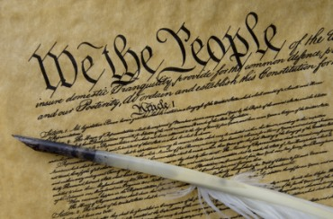
Eighth Amendment
“Excessive bail shall not be required, nor excessive fines imposed, nor cruel and unusual punishments inflicted.”

Slide 88
Fifth Amendment
“No person shall be held to answer for a capital, or otherwise infamous crime, unless on a presentment or indictment of a grand jury, except in cases arising in the land or naval forces, or in the militia, when in actual service in time of war or public danger; nor shall any person be subject for the same offense to be twice put in jeopardy of life or limb; nor shall be compelled in any criminal case to be a witness against himself, nor be deprived of life, liberty, or property, without due process of law; nor shall private property be taken for public use, without just compensation.”

Slide 89
Objections to Capital Punishment
  Sixth commandment?
  Sermon on the Mount?
  We are no longer under the Mosaic Law?
  Deterrence? (Deut 13:10-11; 19:20; Eccl 8:11)
  Executed innocent?
  Racist?
  8th Amendment?
  Pro-life?

Slide 90
ABORTION OR CAPITAL PUNISHMENT?
 | ABORTION | CAPITAL PUNISHMENT
Birth? | Unborn | Born
Crime? | No crime | Committed a crime
Trial? | Not tried by a jury of peers | Tried by a jury of peers
Guilt? | Innocent | Guilty

Slide 91
Noahic Covenant: Provision
(Gen 9:1-7)
  Re-creation theme (Gen 9:1, 2, 7)
  Man becomes carnivorous (Gen. 1:29-30; 2:17; 9:3)
  Cultural precedent for the Mosaic Law (Gen 9:4; Lev 17:11)

Slide 92
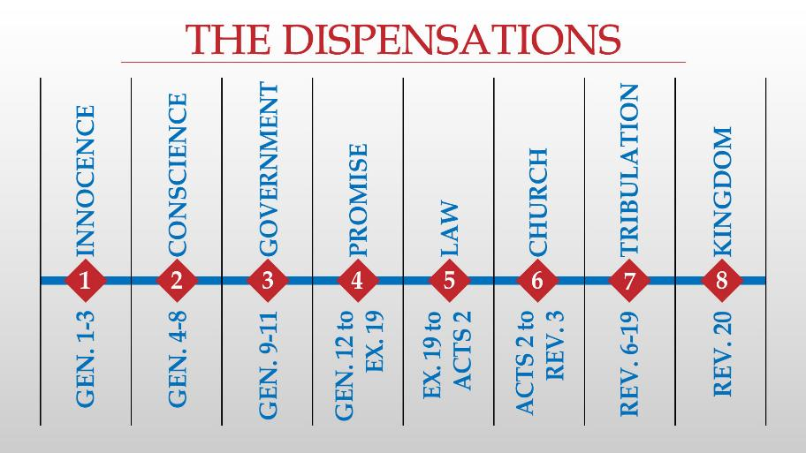

Slide 93
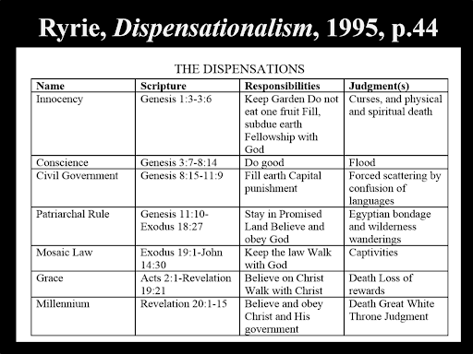

Slide 94
Conclusion

Slide 95
Genesis 8‒9 Outline
  Abating of the waters (8:1-5)
  Tests for dry land (8:6-14)
  Exit from the ark (8:15-19)
  Post-flood events (8:20‒9:29)

Slide 96
Outline
  Noahic Covenant (Gen 8:20–9:17)
  Promise (Gen 8:20-22)
  Provision (Gen 9:1-7)
  Covenant and sign (Gen 9:8-17)
  Post Flood Sin (Gen 9:18-29)

Slide 97
Noahic Covenant: Provision
(Gen 9:1-7)
  Re-creation theme (Gen 9:1, 2, 7)
  Man becomes carnivorous (Gen. 1:29-30; 2:17; 9:3)
  Cultural precedent for the Mosaic Law (Gen 9:4; Lev 17:11)

Slide 98

“The Lord bless you and keep you; the Lord make his face shine on you and be gracious to you; the Lord turn his face toward you and give you peace.” (NIV)

