Slide 1
THE RAPTURE
What and When? – Part 47
Andrew Marshall Woods, Th.M., JD., PhD.
Sr. Pastor, Sugar Land Bible Church

Slide 2
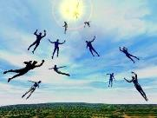
The Rapture Course Overview
What is the Rapture?
When is the Rapture?
Strengthening the Pre-Tribulational case
The opposing views
One second after the Rapture

Slide 3
The Rapture Course Overview
What is the Rapture?
When is the Rapture?
Strengthening the Pre-Tribulational case
The opposing views
One second after the Rapture

Slide 4
What is the Rapture?
An important doctrine
Distinct from the Second Advent
Catching away of all living believers (1 Thess 4:17)
Reunion (1 Thess 4:14-16)
Resurrection (1 Cor 15:50-54)
Exemption from death (1 Cor 15:51, 54-56)
Instantaneous (1 Cor 15:52)
Mystery (1 Cor 15:51)
Imminent (1 Cor 15:51; 1 Thess 4:15)
Traditional doctrine now being recovered

Slide 5
The Rapture Course Overview
What is the Rapture?
When is the Rapture?
Strengthening the Pre-Tribulational case
The opposing views
One second after the Rapture

Slide 6
When is the Rapture?
7 Arguments Favoring the Pre-Tribulation View
Tribulation's purpose concerns Israel (Jer 30:7; Dan 9:24)
No biblical reference to the church on earth during the Tribulation period (Rev 4-22)
Church is promised an exemption from divine wrath (1 Thess 1:10; 5:9; Rom 5:9; Rev 3:10; 6:17)
Rapture is imminent (1 Cor 15:51; 1 Thess 4:15)
Rapture is a comfort (1 Thess 4:18)
Antichrist cannot come to power until the restrainer is removed (2 Thess 2:6-7)
Symbolic parallels (2 Peter 2:5-9)

Slide 7
The Rapture Course Overview
What is the Rapture?
When is the Rapture?
Strengthening the Pre-Tribulational case
The opposing views
One second after the Rapture

Slide 8
Strengthening the Pre-Tribulation Case
John 14:1-4
Revelation 3:10
First Thessalonians 4‒5
Second Thessalonians 2:3a
Matthew 24‒25

Slide 9
The Rapture Course Overview
What is the Rapture?
When is the Rapture?
Strengthening the Pre-Tribulational case
The opposing views
One second after the Rapture

Slide 10
When Will the Rapture Take Place Relative to the Tribulation Period?
Pre-tribulation rapture theory
Mid-tribulation rapture theory
Post-tribulation rapture theory
Pre-wrath rapture theory
Partial rapture theory

Slide 12
Pre-Wrath Rapturism
Description of the view
Six problems with the view considering prior Pre-Tribulational Arguments
Four additional problems with the view

Slide 13
Pre-Wrath Rapturism
Description of the view
Six problems with the view considering prior Pre-Tribulational Arguments
Four additional problems with the view

Slide 14
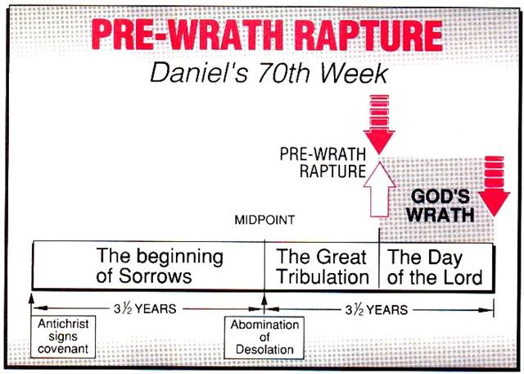
Marvin J. Rosenthal, The Pre-Wrath Rapture of the Church: A New Understanding of the Tribulation, and the Second Coming (Nashville, TN: Thomas Nelson, 1990), 112.

Slide 15
Pre-Wrath Rapturism
Description of the view
Six problems with the view considering prior Pre-Tribulational Arguments
Four additional problems with the view

Slide 16
II. Pre-Wrath Rapture Theory Problems
Places the Church in Daniel’s 70th Week
Fails to acknowledge the missing Church (Rev. 4‒22)
Confines God’s wrath to only a portion of the Tribulation's second half
Denies the Rapture’s imminency
Fails to consistently explain how the rapture is a comfort to the believer (John 14:1; 1 Thess. 4:18; Titus 2:13)
Misinterprets the restrainer (2 Thess. 2:6-7) as Michael the Archangel rather than the Holy Spirit

Slide 17
Pre-Wrath Rapturism
Description of the view
Six problems with the view considering prior Pre-Tribulational Arguments
Four additional problems with the view

Slide 18
III. Additional Problems with Pre-Wrath Rapturism
It imposes an artificial construct on Daniel’s 70th Week
Great Tribulation (unequaled distress) before God’s wrath?
It places the Rapture in Revelation 7:9-17
It places the Rapture in Matthew 24:31, 40-41

Slide 19
III. Additional Problems with Pre-Wrath Rapturism
It imposes an artificial construct on Daniel’s 70th Week
Great Tribulation (unequaled distress) before God’s wrath?
It places the Rapture in Revelation 7:9-17
It places the Rapture in Matthew 24:31, 40-41

Slide 20
Daniel 9:27
“And he will make a firm covenant with the many for one week, but in the middle of the week he will put a stop to sacrifice and grain offering; and on the wing of abominations will come one who makes desolate, even until a complete destruction, one that is decreed, is poured out on the one who makes desolate.”

Slide 22
PROPHETIC SYNONYMNS
Division of the Tribulation into two 3½ year periods
42 months - Rev. 11:2; 13:5
1260 days – Rev. 11:3; 12:6
Time, times, and a half a time – Dan. 7:25; 12:7; 12:14

Slide 23
Matthew 24:15-16, 20
“¹⁵ Therefore when you see the abomination of desolation which was spoken of through Daniel the prophet, standing in the holy place (let the reader understand) ¹⁶ then those who are in Judea must flee to the mountains…²⁰ But pray that your flight will not be in the winter, or on a Sabbath.”

Slide 24
Marvin J. Rosenthal, The Pre-Wrath Rapture of the Church: A New Understanding of the Tribulation, and the Second Coming (Nashville, TN: Thomas Nelson, 1990), 112.

Slide 25
Three Parts?
“…the Scriptures never divide the Tribulation period into thirds. Daniel’s prophecy divides the seventieth week in two (Dan 9:27); half of the Tribulation is described as numbering 1260 days (Rev 11:3; 12:6). In fact, since Revelation 12:14 explains that God will protect fleeing Jews for ‘a time, and times, and half a time’ (1260 days); and since the beginning of this period is the beginning of the last three and one-half years, the Great Tribulation (Matt 24:15-22) must last for 1260 days. The Bible never divides the 1260 days into two 630 days.”
Larry D. Pettegrew, "The Messiah's Lecture on the Future of Israel," in Forsaking Israel: How It Happened and Why It Matters, ed. Larry D. Petegrew (The Woodlands, TX: Kress Biblical Resources, 2020), 340..

Slide 26
Colossians 2:8
“See to it that there is no one who takes you captive through philosophy and empty deception in accordance with human tradition, in accordance with the elementary principles of the world, rather than in accordance with Christ.”

Slide 27
III. Additional Problems with Pre-Wrath Rapturism
It imposes an artificial construct on Daniel’s 70th Week
Great Tribulation (unequaled distress) before God’s wrath?
It places the Rapture in Revelation 7:9-17
It places the Rapture in Matthew 24:31, 40-41

Slide 28
Marvin J. Rosenthal, The Pre-Wrath Rapture of the Church: A New Understanding of the Tribulation, and the Second Coming (Nashville, TN: Thomas Nelson, 1990), 112.

Slide 29
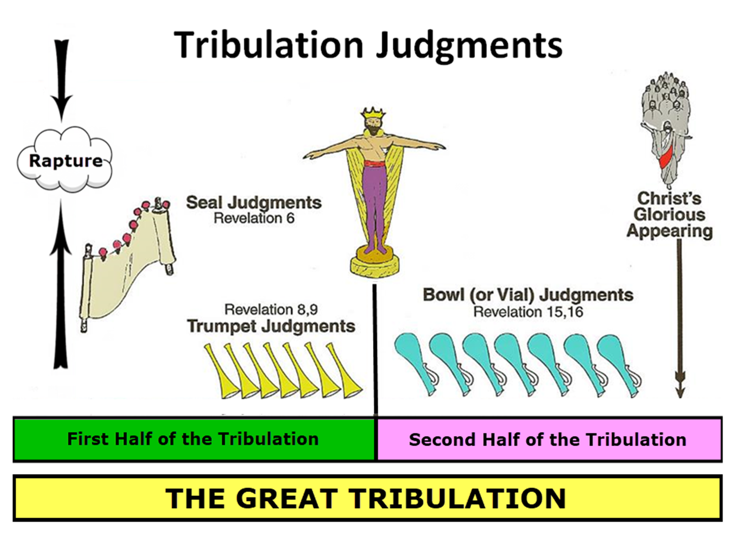
Matthew 24:21
“For then there will be a great tribulation, such as has not occurred since the beginning of the world until now, nor ever will.”

Slide 30
Marvin J. Rosenthal, The Pre-Wrath Rapture of the Church: A New Understanding of the Tribulation, and the Second Coming (Nashville, TN: Thomas Nelson, 1990), 112.

Slide 31
George Zeller "Pre-Wrath Confusion," online: http://www.middletownbiblechurch.org/proph/prewrath.htm, accessed 01 September 2015.
“The PRE-WRATH view teaches that the Day of the Lord begins after the Great Tribulation and that the Day of the Lord is the time of God's wrath. Matthew 24:21, Daniel 12:1 and Jeremiah 30:7 all teach that the Great Tribulation is the greatest time of trouble that the world has ever known. Therefore, if the Day of the Lord is distinct from the Great Tribulation, then the Day of the Lord must be LESS SEVERE than the Great Tribulation. But how can the great day of God's wrath be less severe and less troublesome than the Great Tribulation?”

Slide 32
George Zeller "Pre-Wrath Confusion," online: http://www.middletownbiblechurch.org/proph/prewrath.htm, accessed 01 September 2015.
“How can God's wrath be less severe than man's wrath? How can the trumpets and bowls be less severe than the fifth seal? How can God's wrath be less severe than Satan's wrath? How can unregenerate men and Satan cause more trouble for this world than the wrathful JUDGE Himself? The PRE-WRATH view, when compared with Matthew 24:21 and these other verses, makes the Day of the Lord an ANTICLIMAX!”

Slide 33
Unequaled Distress?
“A…flaw in the prewrath interpretation of Matthew 24:22 is its logical failure. The reason that the Great Tribulation is shortened, according to this verse, is that if it were not, no flesh would be saved. The point of the Scripture is that when the Great Tribulation is over, something better comes on the scene. In the prewrath scheme, however, something more horrible occurs after the Great Tribulation—the Day of the Lord.”
Larry D. Pettegrew, "The Messiah's Lecture on the Future of Israel," in Forsaking Israel: How It Happened and Why It Matters, ed. Larry D. Petegrew (The Woodlands, TX: Kress Biblical Resources, 2020), 341.

Slide 34
Unequaled Distress?
“If no flesh would have survived if the Great Tribulation were allowed to continue on twenty-one months, surely no flesh would survive if the Great Tribulation were to be cut short and followed by twenty-one months of a more horrible Day of the Lord. Moreover, Matthew 24:21 says that the Great Tribulation will be the worst time ever. So, how can it be replaced by the Day of the Lord which is more horrible? Wouldn’t that be the worst time ever? In fact, the Great Tribulation (Matt 24:21) and the Day of the Lord (Dan 12:1; Jer 30:7) are both said to be the worst time ever, so they must be the same time period or at least overlap.”
Larry D. Pettegrew, "The Messiah's Lecture on the Future of Israel," in Forsaking Israel: How It Happened and Why It Matters, ed. Larry D. Petegrew (The Woodlands, TX: Kress Biblical Resources, 2020), 341.

Slide 35
III. Additional Problems with Pre-Wrath Rapturism
It imposes an artificial construct on Daniel’s 70th Week
Great Tribulation (unequaled distress) before God’s wrath?
It places the Rapture in Revelation 7:9-17
It places the Rapture in Matthew 24:31, 40-41

Slide 37
Revelation 7:9, 13-14
“⁹ After these things I looked, and behold, a great multitude which no one could count, from every nation and all the tribes, peoples, and languages, standing before the throne and before the Lamb, clothed in white robes, and palm branches were in their hands…¹³ Then one of the elders responded, saying to me, . . .

Slide 38
Revelation 7:9, 13-14
. . ‘These who are clothed in the white robes, who are they, and where have they come from?’ ¹⁴ I said to him, ‘My lord, you know.’ And he said to me, ‘These are the ones who come out of the great tribulation [thlípsis], and they have washed their robes and made them white in the blood of the Lamb.’”

Slide 39
Marvin Rosenthal
“That great multitude represents the true Church which goes into the Seventieth Week of Daniel. They are raptured and at the end of the Great Tribulation but before the Day of the Lord begins. They are raptured before God’s wrath is poured out but are not exempt from the ultimate rebellion of unregenerate men...Therefore, in chapter 7 the Church is raptured. But immediately prior to the rapture of the Church the 144,000 Jews are sealed...The 144,000 must be sealed for protection to go through the Day of the Lord before the Church can be caught up to the throne in heaven.”
Marvin J. Rosenthal, The Pre-Wrath Rapture of the Church: A New Understanding of the Tribulation, and the Second Coming (Nashville, TN: Thomas Nelson, 1990), 185.

Slide 40
PRE-WRATH RAPTURIST – ALAN KURSCHNER
MATTHEW 24 | PARALLELS | REVELATION 6-7
4-5 | The Antichrist / False Christs | 1st Seal (6:1-2)
6-7 | Wars | 2nd Seal (6:3-4)
7 | Famine | 3rd Seal (6:5-6)
9, 21-22 | Martyrdom / (Great Tribulation) | 4th Seal (6:7-8)
9, 21-22 | Result of Martyrdom / (Great Tribulation) | 5th Seal (6:9-11)
29 | Celestial Disturbances | 6th Seal (6:12-17)
30-31 | Raptured Saints | Interlude (7:9-17))
14, 30, 37-40 | Day of the Lord’s Wrath | 7th Seal (Trumpet, Bowls)
Alan Kurschner, The Antichrist Before the Day of the Lord: What Every Christian Needs to Know About the Return of Christ (Pompton Lakes, NI: Eschatos, 2013, 99.

Slide 41
Revelation 7:9, 13-14
¹³ . . .‘These who are clothed in the white robes, who are they, and where have they come from?’ ¹⁴ I said to him, ‘My lord, you know.’ And he said to me, ‘These are the ones who come out of the great tribulation [thlípsis], and they have washed their robes and made them white in the blood of the Lamb.’”

Slide 42
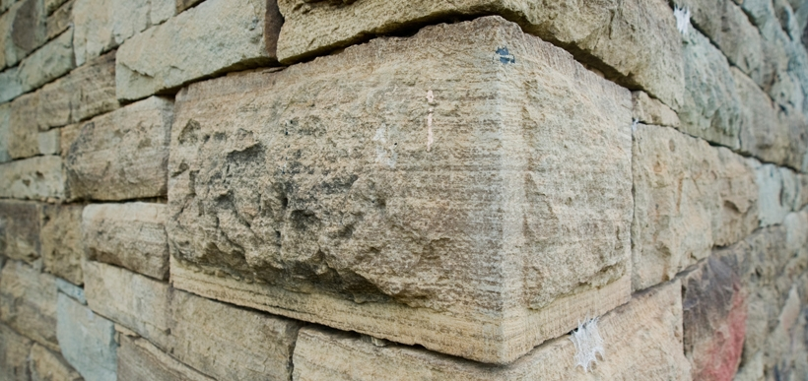
Ephesians 2:20
“having been built on the foundation of the apostles and prophets, Christ Jesus Himself being the corner stone.”

Slide 43
Revelation 7:9, 13-14
¹³ . . .‘These who are clothed in the white robes, who are they, and where have they come (erchomai) from?’ ¹⁴ I said to him, ‘My lord, you know.’ And he said to me, ‘These are the ones who come (erchomai) out of the great tribulation [thlípsis], and they have washed their robes and made them white in the blood of the Lamb.’”

Slide 44
1 Corinthians 15:52
“in a moment [atomos], in the twinkling of an eye, at the last trumpet; for the trumpet will sound, and the dead will be raised imperishable, and we will be changed.”

Slide 45
Rev. 7:14 Robert L. Thomas, Revelation 1–7: An Exegetical Commentary, ed. Kenneth Barker (Chicago: Moody, 1992), 497, n. 119.
"A…possible understanding that it is a departure after the Great Tribulation is completed (Marvin Rosenthal, The Pre-Wrath Rapture of the Church [Nashville: Thomas Nelson, 1990], p. 185) can be dismissed because it neglects the ongoing nature of the departure indicated by the present participle ἐρχόμενοι and rests on an unwarranted distinction between the Great Tribulation and the day of the God’s wrath."

Slide 46
Gerald B. Stanton
Kept from the Hour: Biblical Evidence for the Pretribulational Return of Christ (Grand Rapids: Zondervan, 1956; reprint, Miami Springs, FL: Schoettle, 1991), 390.
“However, the innumerable multitude is not like the Church, which goes to heaven as a group at the rapture. Rather, they are martyrs who one at a time lay down their lives throughout the seven-year period. The Greek present tense in Revelation 7:14 stresses that they ‘continually come’ out of great Tribulation, and obviously do not go to heaven as a single group. It is likewise strange, if they do represent the Church, that John could not recognize them, for John was an apostle of Christ, a member of the early Church, and part of its essential foundation. Also, the Church is composed of all believers since Pentecost, and cannot be limited solely to Tribulation martyrs.”

Slide 47
Distinctions Between 144,000 & Multitude
144,000 | MULTITUDE
Revelation 7:1-8 | Revelation 7:9-17
Numbered | Innumerable
Jews | All nations
Sealed | Slain
Sealed before the Tribulation | Converted out of the Tribulation
Hitchcock and Ice, The Truth Behind Left Behind, 77

Slide 48
III. Additional Problems with Pre-Wrath Rapturism
It imposes an artificial construct on Daniel’s 70th Week
Great Tribulation (unequaled distress) before God’s wrath?
It places the Rapture in Revelation 7:9-17
It places the Rapture in Matthew 24:31, 40-41

Slide 49
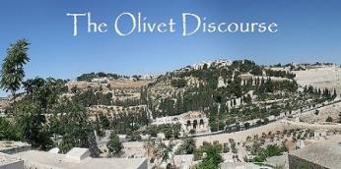
Matthew 24:31
“And He will send forth His angels with a great trumpet and they will gather together [episynagō] His elect from the four winds, from one end of the sky to the other.”

Slide 50
PRE-WRATH RAPTURIST – ALAN KURSCHNER
MATTHEW 24 | PARALLELS | REVELATION 6-7
4-5 | The Antichrist / False Christs | 1st Seal (6:1-2)
6-7 | Wars | 2nd Seal (6:3-4)
7 | Famine | 3rd Seal (6:5-6)
9, 21-22 | Martyrdom / (Great Tribulation) | 4th Seal (6:7-8)
9, 21-22 | Result of Martyrdom / (Great Tribulation) | 5th Seal (6:9-11)
29 | Celestial Disturbances | 6th Seal (6:12-17)
30-31 | Raptured Saints | Interlude (7:9-17))
14, 30, 37-40 | Day of the Lord’s Wrath | 7th Seal (Trumpet, Bowls)
Alan Kurschner, The Antichrist Before the Day of the Lord: What Every Christian Needs to Know About the Return of Christ (Pompton Lakes, NI: Eschatos, 2013, 99.

Slide 51
1 Thessalonians 4:16-18
¹⁶ For the Lord Himself will descend from heaven with a shout, with the voice of the archangel and with the trumpet of God, and the dead in Christ will rise first. ¹⁷ Then we who are alive and remain will be caught up together with them in the clouds to meet the Lord in the air, and so we shall always be with the Lord. ¹⁸ Therefore comfort one another with these words."

Slide 52
1 Corinthians 15:50-51
“⁵⁰ Now I say this, brethren, that flesh and blood cannot inherit the kingdom of God; nor does the perishable inherit the imperishable. ⁵¹ Behold, I tell you a mystery; we will not all sleep, but we will all be changed.”

Slide 53
Matthew 24:31
“And He will send forth His angels with a great trumpet and they will gather together [episynagō] His elect from the four winds, from one end of the sky to the other.”

Slide 54
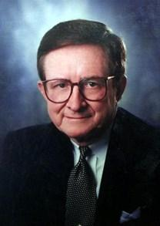
John A. Sproule
"An Exegetical Defense of Pretribulationalism" (Th.D. diss., Grace Theological Seminary, 1981), 53.
“Where does Paul mention the darkening of the sun (Matt. 24:29), the moon not giving its light (Matt. 24:29), the stars falling from the sky (Matt. 24:29), the powers of the heavens being shaken (Matt. 24:29), all the tribes of the earth mourning (Matt. 24:30), all the world seeing the coming of the Son of Man (Matt. 24:30), or God sending forth angels (Matt.24:31)?”

Slide 55
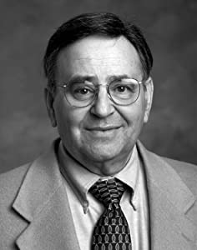
Paul D. Feinberg
"Response: Paul D. Feinberg," in The Rapture: Pre-, Mid-, or Posttribulational, ed. Richard R. Reiter (Grand Rapids: Zondervan, 1984), 225.
“Notice what happens when you examine both passages carefully. In Matthew the Son of Man comes on the clouds, while in 1 Thessalonians 4 the ascending believers are in them. In Matthew the angels gather the elect; in 1 Thessalonians the Lord Himself (note the emphasis) gathers the believers. Thessalonians only speaks of the voice of the archangel. In the Olivet Discourse nothing is said about a resurrection, while in the latter text it is the central point. In the two passages the differences in what will take place prior to the appearance of Christ is striking. Moreover, the order of ascent is absent from Matthew in spite of the fact that it is the central part of the epistle.”

Slide 56
2 Thessalonians 2:1
“Now we request you, brethren, with regard to the coming of our Lord Jesus Christ and our gathering (episynagōgē) together to Him.”

Slide 57
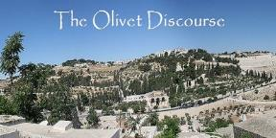
Preview of Matthew 24–25
The problem
The larger context
The immediate context (23:37-39)
The Disciples’ questions (24:1-3)
The Tribulation’s first half (24:4-14)
The Tribulation’s mid-point (24:15-20)
The Tribulation’s second half (24:21-22)
The Second Advent (24:23-31)
Eight parabolic exhortations (24:32‒25:46)

Slide 58
Matthew 23:37-39
³⁷ “Jerusalem, Jerusalem, who kills the prophets and stones those who are sent to her! How often I wanted to gather [episynagō] your children together, the way a hen gathers [episynagō] her chicks under her wings, and you were unwilling. ³⁸ Behold, your house is being left to you desolate! ³⁹ For I say to you, from now on you will not see Me until you say, ‘Blessed is He who comes in the name of the Lord!’”

Slide 59
Matthew 24:31
“And He will send forth His angels with a great trumpet and they will gather together [episynagō] His elect from the four winds, from one end of the sky to the other.”

Slide 60
Isaiah 27:13
“It will come about also in that day that a great trumpet will be blown, and those who were perishing in the land of Assyria and who were scattered in the land of Egypt will come and worship the Lord in the holy mountain at Jerusalem.”

Slide 61
Isaiah 11:11-12
^{“11} Then it will happen on that day that the Lord Will again recover the second time with His hand The remnant of His people, who will remain, From Assyria, Egypt, Pathros, Cush, Elam, Shinar, Hamath, And from the islands of the sea.¹² And He will lift up a standard for the nations And assemble the banished ones of Israel, And will gather the dispersed of Judah From the four corners of the earth.”

Slide 62
Matthew 24:36-41
³⁶ “But of that day and hour no one knows, not even the angels of heaven, nor the Son, but the Father alone. ³⁷ For the coming of the Son of Man will be just like the days of Noah. ³⁸ For as in those days before the flood they were eating and drinking, marrying and giving in marriage, until the day that Noah entered the ark, ³⁹ and they did not understand until the flood came and took (airō) them all away; so will the coming of the Son of Man be. ⁴⁰ Then there will be two men in the field; one will be taken (paralambanō) and one will be left. ⁴¹ “Two women will be grinding at the mill; one will be taken (paralambanō) and one will be left.”

Slide 63
John 14:1–4
¹ “Do not let your heart be troubled; believe in God, believe also in Me. ² “In My Father’s house are many dwelling places; if it were not so, I would have told you; for I go to prepare a place for you. ³ “If I go and prepare a place for you, I will come again and receive you (paralambanō) to Myself, that where I am, there you may be also. ⁴ “And you know the way where I am going.”

Slide 64
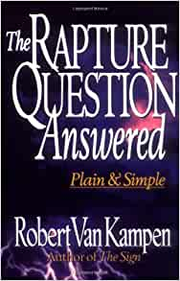
Robert Van Kampen
The Rapture Questioned Answered: Plain and Simple (Grand Rapids: Fleming Revell, 1997), 181-82.
“But is that what the text really teaches? The Greek answers, ‘No!’ The Greek word behind took that is used in connection with Noah—’the flood came and took them all away’—is from the Greek word aírō. But when Christ describes how it will be at ‘the coming of the Son of Man,’ when ‘one will be taken and one will be left,’ the Greek word for taken is entirely different. Here the Greek verb is paralambánō. That difference is both important and exciting! Paralambánō does not mean ‘to be taken away,’ as does the Greek verb aírō; it means ‘to embrace or to receive intimately, to or for oneself.’... Christ uses this word…in John 14:3…the most…

Slide 65
Robert Van Kampen
The Rapture Questioned Answered: Plain and Simple (Grand Rapids: Fleming Revell, 1997), 181-82.
“…quoted of all Rapture passages in the New Testament…’ Receive’ translates paralambánō. Rather than picturing someone who is being taken away to judgment, this Greek verb conveys quite the opposite. Paralambánō means to intimately receive someone to oneself, as in the passage above. It would be more than a little confusing, then, if Christ used the word paralambánō five times to refer to the wicked being taken away to judgment—which is absolutely contrary to the real intent of the Greek verb—and then the last time used it to refer to the righteous being received in an intimate manner by Himself at the rapture of His saints!”

Slide 66
John 19:15-16
“¹⁵ So they cried out, “Away with Him [airō], away with Him, crucify Him!” Pilate said to them, “Shall I crucify your King?” The chief priests answered, “We have no king but Caesar.” ¹⁶ So he then handed Him over [paralambanō] to them to be crucified.

Slide 67
John 19:15-16
“¹⁵ So they cried out, “Away with Him [airō], away with Him, crucify Him!” Pilate said to them, “Shall I crucify your King?” The chief priests answered, “We have no king but Caesar.” ¹⁶ So he then handed Him over [paralambanō] to them to be crucified.

Slide 68
Conclusion

Slide 69
Pre-Wrath Rapturism
Description of the view
Six problems with the view considering prior Pre-Tribulational Arguments
Four additional problems with the view

