Slide 1


PRACTICAL RIGHTEOUSNESS
Dr. Andy Woods
Senior Pastor – Sugar Land Bible Church
President – Chafer Theological Seminary

Slide 2
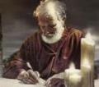
Answering Eleven Questions
Who wrote it? – James
What do we know about the author? – Christ’s ½ Brother
Who was the audience? – Believing Jews in the Diaspora
Where was if written from? – Jerusalem
When was the book written? – A.D. 44‒47
What was the book’s occasion? – Practical righteousness
What is the book’s purpose? – Achieving practical righteousness
What is the book about? – Practical righteousness
What is the book’s theme? – Daily living
What makes the book different? – Practicality
How is the book organized? – Faith and Wisdom

Slide 3

JAMES STRUCTURE
  Faith (James 1:1‒3:12)
  Wisdom (James 3:13‒5:20)

Slide 4
JAMES STRUCTURE
  Faith (James 1:1‒3:12)
  Wisdom (James 3:13‒5:20)

Slide 5

JAMES STRUCTURE
Faith (1:1–3:12)
  Trials (1:2-18)
  Obedience to the Word (1:19-27)
  Favoritism (2:1-13)
  Faith manifesting works (2:14-26)
  Tongue (3:1-12)

Slide 6
JAMES STRUCTURE
  Faith (James 1:1‒3:12)
  Wisdom (James 3:13‒5:20)

Slide 7

Structure
Wisdom (3:13–5:20)
  Wisdom defined (3:13-18)
  Spirituality (4:1-12)
  Commerce (4:13-17)
  Use of wealth (5:1-6)
  Waiting for the Lord’s return (5:7-12)
  Prayer (5:13-18)
  Restoration of the erring brother (5:19-20)

Slide 8
Structure
Wisdom (3:13–5:20)
  Wisdom defined (3:13-18)
  Spirituality (4:1-12)
  Commerce (4:13-17)
  Use of wealth (5:1-6)
  Waiting for the Lord’s return (5:7-12)
  Prayer (5:13-18)
  Restoration of the erring brother (5:19-20)

Slide 9
Wisdom
(3:13-18)
Wisdom is demonstrated by her actions (3:13)
Human or earthly wisdom (3:14-16)
Heavenly wisdom (3:17-18)

Slide 10
Structure
Wisdom (3:13–5:20)
  Wisdom defined (3:13-18)
  Spirituality (4:1-12)
  Commerce (4:13-17)
  Use of wealth (5:1-6)
  Waiting for the Lord’s return (5:7-12)
  Prayer (5:13-18)
  Restoration of the erring brother (5:19-20)

Slide 11

Spiritual Life
(4:1-12)
Avoid wrangling (4:1-3)
Avoid worldliness (4:4-6)
Essence of spiritual wisdom (4:7-12)

Slide 12
Spiritual Life
(4:1-12)
Avoid wrangling (4:1-3)
Avoid worldliness (4:4-6)
Essence of spiritual wisdom (4:7-12)

Slide 13
III. Essence of Spiritual Wisdom
(4:7-12)
  Submission to God (4:7a)
  Resist Satan (4:7b)
  Draw near to God (4:8a)
  Repent (4:8b-9)
  Humility (4:10)
  Forego judgment (11-12)

Slide 14

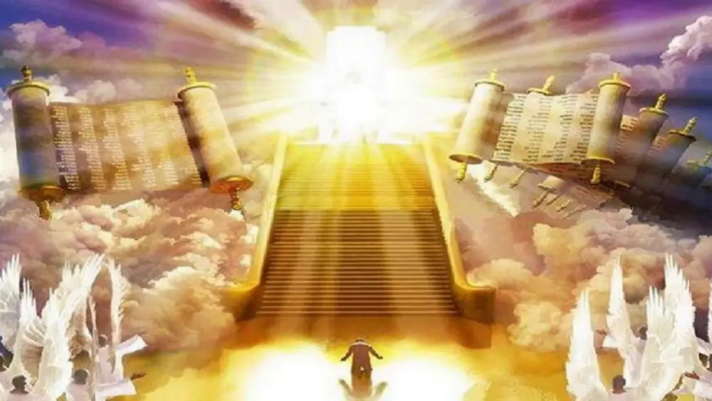
1 Corinthians 4:5
“Therefore do not go on passing judgment before the time, but wait until the Lord comes who will both bring to light the things hidden in the darkness and disclose the motives of men’s hearts; and then each man’s praise will come to him from God.”
Notes:
Rapture and Bema

Slide 15
Spiritual Life
(4:1-12)
Avoid wrangling (4:1-3)
Avoid worldliness (4:4-6)
Essence of spiritual wisdom (4:7-12)

Slide 16
III. Essence of Spiritual Wisdom
(4:7-12)
  Submission to God (4:7a)
  Resist Satan (4:7b)
  Draw near to God (4:8a)
  Repent (4:8b-9)
  Humility (4:10)
  Forego judgment (11-12)

Slide 17
Structure
Wisdom (3:13–5:20)
  Wisdom defined (3:13-18)
  Spirituality (4:1-12)
  Commerce (4:13-17)
  Use of wealth (5:1-6)
  Waiting for the Lord’s return (5:7-12)
  Prayer (5:13-18)
  Restoration of the erring brother (5:19-20)

Slide 18
Commercial Life
(4:13-17)
The Need to Plan while Depending Upon God (4:13-15)
The Problem of Planning without Depending Upon God (4:16-17)

Slide 19
Commercial Life
(4:13-17)
The Need to Plan while Depending Upon God (4:13-15)
The Problem of Planning without Depending Upon God (4:16-17)

Slide 20
I. The Need to Plan While Depending
(4:13-15)
  The Problem Exposed (4:13)
  The Reason for the Problem (4:14)
  The Preferred Mindset (4:15)

Slide 21
I. The Need to Plan While Depending
(4:13-15)
  The Problem Exposed (4:13)
  The Reason for the Problem (4:14)
  The Preferred Mindset (4:15)

Slide 22
I. The Need to Plan While Depending
(4:13-15)
  The Problem Exposed (4:13)
  The Reason for the Problem (4:14)
  The Preferred Mindset (4:15)

Slide 23

Date
(AD 44-47)
AD 70
AD 62-63
AD 49
AD 48-49
Sermon on the Mt
Primitive congregational worship (Jas 2:2; 3:1; 5:14)
Jas 1:1 = Acts 8:1-4; 11:19

Slide 24
Order of Paul’s Letters
Galatians (A.D. 49)
1‒2 Thessalonians (A.D. 51)
1‒2 Corinthians (A.D. 56)
Romans (A.D. 57)
Ephesians, Colossians, Philemon, Philippians (A.D. 60‒62)
1 Timothy, Titus (A.D. 62‒66)
2 Timothy (A.D. 67)

Slide 25
I. The Need to Plan While Depending
(4:13-15)
  The Problem Exposed (4:13)
  The Reason for the Problem (4:14)
  The Preferred Mindset (4:15)

Slide 26
Commercial Life
(4:13-17)
The Need to Plan while Depending Upon God (4:13-15)
The Problem of Planning without Depending Upon God (4:16-17)

Slide 27
II. The Problem of Planning Without Depending
(4:16-17)
  Boasting (4:16a)
  Arrogance (4:16b)
  Evil (4:16c)
  Sin (17)

Slide 28
II. The Problem of Planning Without Depending
(4:16-17)
  Boasting (4:16a)
  Arrogance (4:16b)
  Evil (4:16c)
  Sin (17)

Slide 29
II. The Problem of Planning Without Depending
(4:16-17)
  Boasting (4:16a)
  Arrogance (4:16b)
  Evil (4:16c)
  Sin (17)

Slide 30
II. The Problem of Planning Without Depending
(4:16-17)
  Boasting (4:16a)
  Arrogance (4:16b)
  Evil (4:16c)
  Sin (17)

Slide 31
II. The Problem of Planning Without Depending
(4:16-17)
  Boasting (4:16a)
  Arrogance (4:16b)
  Evil (4:16c)
  Sin (17)

Slide 32
CONCLUSION

Slide 33
Commercial Life
(4:13-17)
The Need to Plan while Depending Upon God (4:13-15)
The Problem of Planning without Depending Upon God (4:16-17)

Slide 34
Structure
Wisdom (3:13–5:20)
  Wisdom defined (3:13-18)
  Spirituality (4:1-12)
  Commerce (4:13-17)
  Use of wealth (5:1-6)
  Waiting for the Lord’s return (5:7-12)
  Prayer (5:13-18)
  Restoration of the erring brother (5:19-20)

