Slide 1


Genesis 6‒9
The Flood and Continuation of the Messianic Promise

Slide 2

GENESIS STRUCTURE
  Beginning of the Human race (Gen. 1‒11)
  Beginning of the Hebrew race (Gen. 12‒50)

Slide 3

GENESIS STRUCTURE
  Genesis 1-11 (four events)
    Creation (1-2)
    Fall (3-5)
    Flood (6-9)
    National dispersion (10-11)

Slide 4
GENESIS STRUCTURE
  Genesis 1-11 (four events)
    Creation (1-2)
    Fall (3-5)
    Flood (6-9)
    National dispersion (10-11)

Slide 5


Genesis 3:15
“And I will put enmity Between you and the woman, And between your seed and her seed; He shall bruise you on the head, And you shall bruise him on the heel.”

Slide 6
GENESIS STRUCTURE
  Genesis 1-11 (four events)
    Creation (1-2)
    Fall (3-5)
    Flood (6-9)
    National dispersion (10-11)

Slide 7

The Flood
(Gen 6–9)
  Events before the flood (Gen 6)
  The flood (Gen 7)
  The abating of the waters (Gen 8)
  Events following the flood (Gen 9)

Slide 8

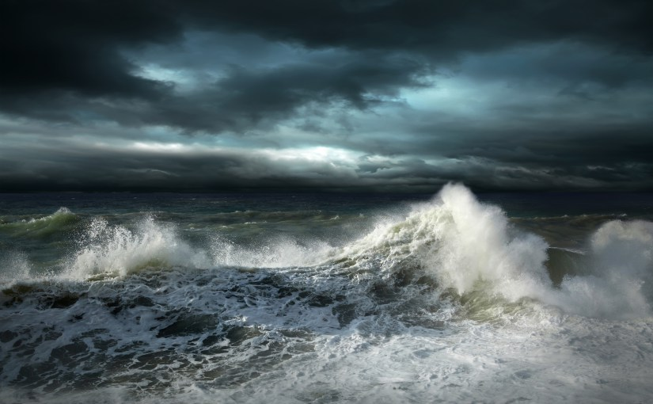
Genesis 7
The Flood

Slide 9
The Flood
(Gen 6–9)
  Events before the flood (Gen 6)
  The flood (Gen 7)
  The abating of the waters (Gen 8)
  Events following the flood (Gen 9)

Slide 10
Genesis 8‒9 Outline
  Abating of the waters (8:1-5)
  Tests for dry land (8:6-14)
  Exit from the ark (8:15-19)
  Post-flood events (8:20‒9:29)

Slide 11
Genesis 8‒9 Outline
  Abating of the waters (8:1-5)
  Tests for dry land (8:6-14)
  Exit from the ark (8:15-19)
  Post-flood events (8:20‒9:29)

Slide 12
Genesis 8‒9 Outline
  Abating of the waters (8:1-5)
  Tests for dry land (8:6-14)
  Exit from the ark (8:15-19)
  Post-flood events (8:20‒9:29)

Slide 13

Tests for Dry Land: Four Stages
(Gen 8:7-12)
  Raven – no return (8:7)
  First dove - returns (8:8-9)
  Second dove – returns with Olive leaf (8:10-11)
  Third dove – no return (8:12)

Slide 14
Genesis 8‒9 Outline
  Abating of the waters (8:1-5)
  Tests for dry land (8:6-14)
  Exit from the ark (8:15-19)
  Post-flood events (8:20‒9:29)

Slide 15
Tests for Dry Land: Four Stages
(Gen 8:7-12)
  Raven – no return (8:7)
  First dove - returns (8:8-9)
  Second dove – returns with Olive leaf (8:10-11)
  Third dove – no return (8:12)

Slide 16


Dr. Arnold G. Fruchtenbaum
The Book of Genesis, 177-78
“Until now, Noah received direct revelation from God, but now he must use natural means to find out the condition of the earth, since God is not speaking to him at this moment. This shows the balance between learning things by divine revelation and learning things by natural means. Both are seen as being valid options everywhere in the Scriptures. Therefore, he first used the raven, and now he uses the dove to find out the actual conditions on the earth.”

Slide 17

Genesis 6:1-4
“¹ Now it came about, when men began to multiply on the face of the land, and daughters were born to them, ² that the sons of God saw that the daughters of men were beautiful; and they took wives for themselves, whomever they chose. ³ Then the Lord said, ‘My Spirit shall not strive with man forever, because he also is flesh; nevertheless his days shall be one hundred and twenty years.’ ⁴ The Nephilim were on the earth in those days, and also afterward, when the sons of God came in to the daughters of men, and they bore children to them. Those were the mighty men who were of old, men of renown.”

Slide 18
Chronology of the Flood
Event | scripture | Calendar | Total days
Water receded | 8:12 | 12th month 17th day | 321 days
Noah removes the covering | 8:13 | 1st month 1st day | 378 days
Noah opens the ark door and disembarks | 8:14 | 2nd month 27th day | 378 days
Arnold Fruchtenbaum, The Book of Genesis, 179

Slide 19

1 Cor. 6:9-11
⁹ “Or do you not know that the unrighteous will not inherit the kingdom of God? Do not be deceived; neither fornicators, nor idolaters, nor adulterers, nor effeminate, nor homosexuals [arsenokoitēs], ¹⁰ nor thieves, nor the covetous, nor drunkards, nor revilers, nor swindlers, will inherit the kingdom of God. ¹¹ Such were some of you; but you were washed, but you were sanctified, but you were justified in the name of the Lord Jesus Christ and in the Spirit of our God.”

Slide 20
1 Cor. 6:9-11
⁹ “Or do you not know that the unrighteous will not inherit the kingdom of God? Do not be deceived; neither fornicators, nor idolaters, nor adulterers, nor effeminate, nor homosexuals, ¹⁰ nor thieves, nor the covetous, nor drunkards, nor revilers, nor swindlers, will inherit the kingdom of God. ¹¹ Such were some of you; but you were washed, but you were sanctified, but you were justified in the name of the Lord Jesus Christ and in the Spirit of our God.”

Slide 21
1 Cor. 6:9-11
⁹ “Or do you not know that the unrighteous will not inherit the kingdom of God? Do not be deceived; neither fornicators, nor idolaters, nor adulterers, nor effeminate, nor homosexuals, ¹⁰ nor thieves, nor the covetous, nor drunkards, nor revilers, nor swindlers, will inherit the kingdom of God. ¹¹ Such were some of you; but you were washed, but you were sanctified, but you were justified in the name of the Lord Jesus Christ and in the Spirit of our God.”

Slide 22
Genesis 1:26-28
²⁶ Then God said, “Let Us make man in Our image, according to Our likeness; and let them rule over the fish of the sea and over the birds of the sky and over the cattle and over all the earth, and over every creeping thing that creeps on the earth.” ²⁷ God created man in His own image, in the image of God He created him; male and female He created them. ²⁸ God blessed them; and God said to them, “Be fruitful and multiply, and fill the earth, and subdue it; and rule over the fish of the sea and over the birds of the sky and over every living thing that moves on the earth.”

Slide 23
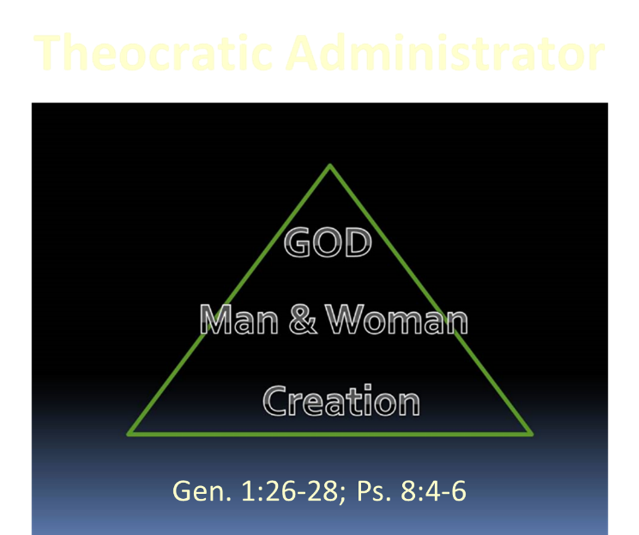

Slide 24
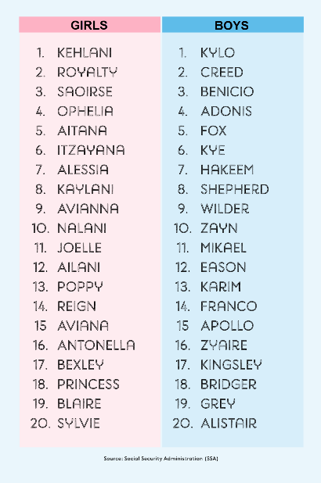
Biblical Significance of Naming
Genesis 1:8
Numbers 32:37-38
2 Kings 23:24
2 Kings 24:17
Daniel 1:6-7
Fruchtenbaum, The Book of Genesis, 84

Slide 25
Reasons Against a Local Flood
  Size of the ark (450 ft. long, 75 ft. wide, 45 ft. deep)?
  Analogy to global Second Advent (Matt 24:37-39; Rev 1:7; 2 Pet 3:5-7)
  Animals and birds on the ark?
  Church history

Slide 26
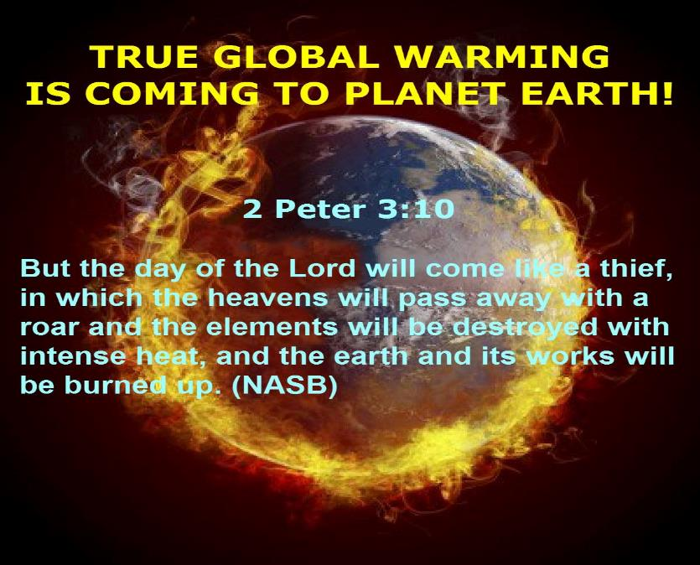

Slide 27
Reasons Against a Local Flood
  Size of the ark (450 ft. long, 75 ft. wide, 45 ft. deep)?
  Analogy to global Second Advent (Matt 24:37-39; Rev 1:7; 2 Pet 3:5-7)
  Animals and birds on the ark?
  Church history

Slide 28
BELIEVER OR UNBELIEVER?
Writer | Local Flood | Global Flood
Philo | X | ✓
Josephus | X | ✓
Justin Martyr | X | ✓
Theophilus of Antioch | X | ✓
Tertullian | X | ✓
Gregory of Nazianus | X | ✓
John Chrysostom | X | ✓
Augustine of Hippo | X | ✓
Jonathan Sarfati, Refuting Compromise (Green Forest, AR: Master Books), 244.

Slide 29
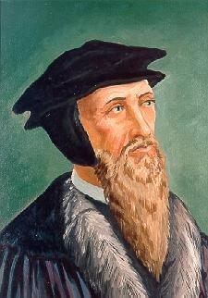
John Calvin
Genesis, 1554 (Edinburgh, UK: Banner of Truth, 1984), p. 272, emphasis mine.
“And the flood was forty days, etc. Moses conspicuously insists on this fact, in order to show that the whole world was immersed in the waters.”

Slide 30
UNIFORMITARIANISM IS NOT BIBLICISM
 | ERA | SCRIPTURE | DISTINCTIVES
1. | CREATION | Genesis 1-2 | No death
2. | FALL | Genesis 3-6 | Death, painful pregnancy & toil, long life spans, no human government
3. | FLOOD | Genesis 7-10 | Shorter life spans, human government, one language, no nations
4. | BABEL | Genesis 11-present | No global government, multiple languages, nations, ethnicities
5. | ANTICHRIST | Rapture to 2nd Advent | Global government, restrainer removed
6. | KINGDOM | Rev. 20:1-10 | Long life spans, kingdom conditions, reality of death, renovated earth
7. | ETERNAL STATE | Rev. 21-22 | No death, new earth

Slide 31
UNIFORMITARIANISM IS NOT BIBLICISM
 | ERA | SCRIPTURE | DISTINCTIVES
1. | CREATION | Genesis 1-2 | No death
2. | FALL | Genesis 3-6 | Death, painful pregnancy & toil, long life spans, no human government
3. | FLOOD | Genesis 7-10 | Shorter life spans, human government, one language, no nations
4. | BABEL | Genesis 11-present | No global government, multiple languages, nations, ethnicities
5. | ANTICHRIST | Rapture to 2nd Advent | Global government, restrainer removed
6. | KINGDOM | Rev. 20:1-10 | Long life spans, kingdom conditions, reality of death, renovated earth
7. | ETERNAL STATE | Rev. 21-22 | No death, new earth

Slide 32
UNIFORMITARIANISM IS NOT BIBLICISM
 | ERA | SCRIPTURE | DISTINCTIVES
1. | CREATION | Genesis 1-2 | No death
2. | FALL | Genesis 3-6 | Death, painful pregnancy & toil, long life spans, no human government
3. | FLOOD | Genesis 7-10 | Shorter life spans, human government, one language, no nations
4. | BABEL | Genesis 11-present | No global government, multiple languages, nations, ethnicities
5. | ANTICHRIST | Rapture to 2nd Advent | Global government, restrainer removed
6. | KINGDOM | Rev. 20:1-10 | Long life spans, kingdom conditions, reality of death, renovated earth
7. | ETERNAL STATE | Rev. 21-22 | No death, new earth

Slide 33
Genesis 8‒9 Outline
  Abating of the waters (8:1-5)
  Tests for dry land (8:6-14)
  Exit from the ark (8:15-19)
  Post-flood events (8:20‒9:29)

Slide 34

Genesis 8:20–9:29
Post Flood events

Slide 35
The Flood
(Gen 6–9)
  Events before the flood (Gen 6)
  The flood (Gen 7)
  The abating of the waters (Gen 8)
  Events following the flood (Gen 9)

Slide 36
Outline
  Noahic Covenant (Gen 8:20–9:17)
  Promise (Gen 8:20-22)
  Provision (Gen 9:1-7)
  Covenant and sign (Gen 9:8-17)
  Post Flood Sin (Gen 9:18-29)

Slide 37
Outline
  Noahic Covenant (Gen 8:20–9:17)
  Promise (Gen 8:20-22)
  Provision (Gen 9:1-7)
  Covenant and sign (Gen 9:8-17)
  Post Flood Sin (Gen 9:18-29)

Slide 38
Outline
  Noahic Covenant (Gen 8:20–9:17)
  Promise (Gen 8:20-22)
  Provision (Gen 9:1-7)
  Covenant and sign (Gen 9:8-17)
  Post Flood Sin (Gen 9:18-29)

Slide 39
Noahic Covenant: Promise
(Gen 8:20-22)
  Noah’s initial sacrifice (8:20)
  Divine promise not to flood the earth again (Gen 8:21a)
  Ongoing depravity thus necessitating the work of a future Messiah (Gen 8:21b)
  Uninterrupted season or cycles (Gen 8:22) – global warming?

Slide 40
Noahic Covenant: Promise
(Gen 8:20-22)
  Noah’s initial sacrifice (8:20)
  Divine promise not to flood the earth again (Gen 8:21a)
  Ongoing depravity thus necessitating the work of a future Messiah (Gen 8:21b)
  Uninterrupted season or cycles (Gen 8:22) – global warming?

Slide 41
Results of the Sin
(3:7-13)
  Religion (3:7)
  Broken fellowship (3:8-10)
  “Buck passing” (3:11-13)
  Reversal creation hierarchy (3:11-13)

Slide 42
God’s Provision
(3:20-24)
  Continuation of the race (3:20)
  Forgiveness (3:21, 7)
  Expulsion of Adam and Eve from Eden (3:22-24)

Slide 43
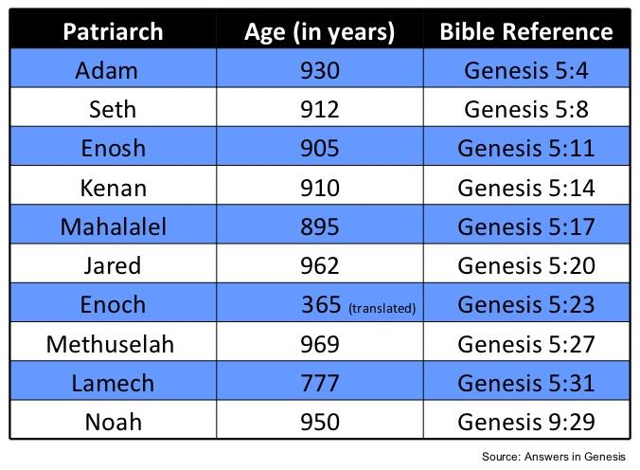

Slide 44
God’s Provision
(3:20-24)
  Continuation of the race (3:20)
  Forgiveness (3:21, 7)
  Expulsion of Adam and Eve from Eden (3:22-24)

Slide 45

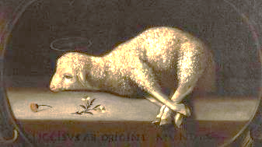
Exodus 12:5
“Your lamb shall be an unblemished male a year old; you may take it from the sheep or from the goats.”

Slide 46
John 1:29
“ The next day he saw Jesus coming to him, and said, ‘Behold, the Lamb of God who takes away the sin of the world.’”

Slide 47
Noahic Covenant: Promise
(Gen 8:20-22)
  Noah’s initial sacrifice (8:20)
  Divine promise not to flood the earth again (Gen 8:21a)
  Ongoing depravity thus necessitating the work of a future Messiah (Gen 8:21b)
  Uninterrupted season or cycles (Gen 8:22) – global warming?

Slide 48

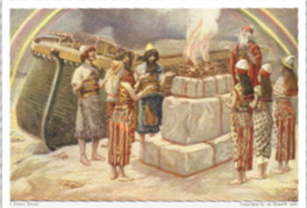
Genesis 8:21
The Lord smelled the soothing aroma; and the Lord said to Himself, “I will never again curse the ground on account of man, for the intent of man’s heart is evil from his youth; and I will never again destroy every living thing, as I have done.[emphasis mine].

Slide 49
Noahic Covenant: Promise
(Gen 8:20-22)
  Noah’s initial sacrifice (8:20)
  Divine promise not to flood the earth again (Gen 8:21a)
  Ongoing depravity thus necessitating the work of a future Messiah (Gen 8:21b)
  Uninterrupted season or cycles (Gen 8:22) – global warming?

Slide 50
Genesis 8:21
The Lord smelled the soothing aroma; and the Lord said to Himself, “I will never again curse the ground on account of man, for the intent of man’s heart is evil from his youth; and I will never again destroy every living thing, as I have done.[emphasis mine].

Slide 51


Psalm 51:5
“Behold, I was brought forth in guilt,
And in sin my mother conceived me.”

Slide 52
Jeremiah 17:9
“The heart is more deceitful than all else And is desperately sick; Who can understand it?.”

Slide 53
Mark 7:20-23
“²⁰ And He was saying, ‘That which proceeds out of the man, that is what defiles the man. ²¹ For from within, out of the heart of men, proceed the evil thoughts, fornications, thefts, murders, adulteries, ²² deeds of coveting and wickedness, as well as deceit, sensuality, envy, slander, pride and foolishness. ²³ All these evil things proceed from within and defile the man.’”

Slide 54

Romans 5:12
“Therefore, just as through one man sin entered into the world, and death through sin, and so death spread to all men, because all sinned—.”

Slide 55
Genesis 3:15
“And I will put enmity Between you and the woman, And between your seed and her seed; He shall bruise you on the head, And you shall bruise him on the heel.”

Slide 56
Noahic Covenant: Promise
(Gen 8:20-22)
  Noah’s initial sacrifice (8:20)
  Divine promise not to flood the earth again (Gen 8:21a)
  Ongoing depravity thus necessitating the work of a future Messiah (Gen 8:21b)
  Uninterrupted season or cycles (Gen 8:22) – global warming?

Slide 57


Genesis 8:22
While the earth remains, Seedtime and harvest, And cold and heat, And summer and winter, And day and night Shall not cease.

Slide 58
Genesis 8:22
While the earth remains, Seedtime and harvest, And cold and heat, And summer and winter, And day and night Shall not cease.

Slide 59
Genesis 8:22
While the earth remains, Seedtime and harvest, And cold and heat, And summer and winter, And day and night Shall not cease.

Slide 60

Genesis 1:14
Then God said, “Let there be lights in the expanse of the heavens to separate the day from the night, and let them be for signs and for seasons and for days and years.”

Slide 61
Genesis 8:22
While the earth remains, Seedtime and harvest, And cold and heat, And summer and winter, And day and night Shall not cease.

Slide 62

Genesis 8:22
While the earth remains, Seedtime and harvest, And cold and heat, And summer and winter, And day and night Shall not cease.

Slide 63
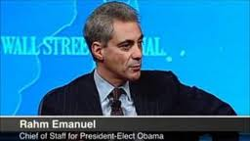
Management by Crisis
“You never let a serious crisis go to waste. And what I mean by that it’s an opportunity to do things you think you could not do before.” Rahm Emanuel
www.youtube.com/watch?v=Pb-YuhFWCr4

Slide 64
UN Globalism Conferences
UN CONFERENCE | STATED GOAL
Earth summit, Río de Janeiro, 1992 | Protect the environment
Human rights conference, Vienna, 1993 | Protect human rights
Population Conference, Cairo, 1994 | Prevent starvation and poverty
Women’s conference, Beijing, 1995 | Protect women’s rights
Habitat conference, Istanbul, 1996 | Provide global housing for all
Climate change conference, Copenhagen, 2009 | Implement climate change policy
Christopher Corbett, "The U.S. And Other U.N. Serfdoms," in Foreshocks of the Antichrist, ed. William T. James(Eugene, OR: Harvest House, 1997), 210-19.

Slide 65

The Ultimate Crisis
“In searching for a new enemy to unite us, we came up with the idea that pollution, the threat of global warming, water shortages, famine and the like would fit the bill...”
Alexander King and Betrand Schneider, The First Global Revolution (New York: Pantheon, 1991), 115.

Slide 66
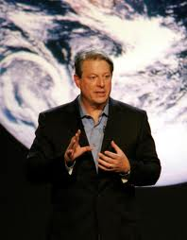
Gaia Hypothesis
According to Al Gore, “we must make the rescue of the environment the central organizing principle for civilization.”
Al Gore, Earth in the Balance (New York: Houghton Mifflin, 1992), 269.

Slide 67

Remarks on Climate Change
“When I think about the array of…global threats –… terrorism, epidemics, poverty, the proliferation of weapons of mass destruction – all challenges that know no borders – the reality is that climate change ranks right up there with every single one of them...Or think about the proliferation of weapons of mass destruction. It doesn’t keep us safe if the United States secures its nuclear arsenal, while other countries fail to prevent theirs from falling into the hands of terrorists…”
http://www.state.gov/secretary/remarks/2014/02/221704.htm

Slide 68
Genesis 1:26-28
²⁶ Then God said, “Let Us make man in Our image, according to Our likeness; and let them rule over the fish of the sea and over the birds of the sky and over the cattle and over all the earth, and over every creeping thing that creeps on the earth.” ²⁷ God created man in His own image, in the image of God He created him; male and female He created them. ²⁸ God blessed them; and God said to them, “Be fruitful and multiply, and fill the earth, and subdue it; and rule over the fish of the sea and over the birds of the sky and over every living thing that moves on the earth.”

Slide 70
Conclusion

Slide 71
Genesis 8‒9 Outline
  Abating of the waters (8:1-5)
  Tests for dry land (8:6-14)
  Exit from the ark (8:15-19)
  Post-flood events (8:20‒9:29)

Slide 72
Outline
  Noahic Covenant (Gen 8:20–9:17)
  Promise (Gen 8:20-22)
  Provision (Gen 9:1-7)
  Covenant and sign (Gen 9:8-17)
  Post Flood Sin (Gen 9:18-29)

Slide 73
Outline
  Noahic Covenant (Gen 8:20–9:17)
  Promise (Gen 8:20-22)
  Provision (Gen 9:1-7)
  Covenant and sign (Gen 9:8-17)
  Post Flood Sin (Gen 9:18-29)

Slide 74

“The Lord bless you and keep you; the Lord make his face shine on you and be gracious to you; the Lord turn his face toward you and give you peace.” (NIV)

