Slide 1
PRACTICAL RIGHTEOUSNESS
Dr. Andy Woods
Senior Pastor – Sugar Land Bible Church
President – Chafer Theological Seminary

Slide 2
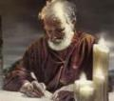
Answering Eleven Questions
Who wrote it? – James
What do we know about the author? – Christ’s ½ Brother
Who was the audience? – Believing Jews in the Diaspora
Where was if written from? – Jerusalem
When was the book written? – A.D. 44‒47
What was the book’s occasion? – Practical righteousness
What is the book’s purpose? – Achieving practical righteousness
What is the book about? – Practical righteousness
What is the book’s theme? – Daily living
What makes the book different? – Practicality
How is the book organized? – Faith and Wisdom

Slide 3
JAMES STRUCTURE
Faith (James 1:1‒3:12)
Wisdom (James 3:13‒5:20)

Slide 4
JAMES STRUCTURE
Faith (James 1:1‒3:12)
Wisdom (James 3:13‒5:20)

Slide 5
JAMES STRUCTURE
Faith (1:1–3:12)
Trials (1:2-18)
Obedience to the Word (1:19-27)
Favoritism (2:1-13)
Faith manifesting works (2:14-26)
Tongue (3:1-12)

Slide 6
JAMES STRUCTURE
Faith (James 1:1‒3:12)
Wisdom (James 3:13‒5:20)

Slide 7
Structure
Wisdom (3:13–5:20)
Wisdom defined (3:13-18)
Spirituality (4:1-12)
Commerce (4:13-17)
Use of wealth (5:1-6)
Waiting for the Lord’s return (5:7-12)
Prayer (5:13-18)
Restoration of the erring brother (5:19-20)

Slide 8
Structure
Wisdom (3:13–5:20)
Wisdom defined (3:13-18)
Spirituality (4:1-12)
Commerce (4:13-17)
Use of wealth (5:1-6)
Waiting for the Lord’s return (5:7-12)
Prayer (5:13-18)
Restoration of the erring brother (5:19-20)

Slide 9
Wisdom (3:13-18)
Wisdom is demonstrated by her actions (3:13)
Human or earthly wisdom (3:14-16)
Heavenly wisdom (3:17-18)

Slide 10
Structure
Wisdom (3:13–5:20)
Wisdom defined (3:13-18)
Spirituality (4:1-12)
Commerce (4:13-17)
Use of wealth (5:1-6)
Waiting for the Lord’s return (5:7-12)
Prayer (5:13-18)
Restoration of the erring brother (5:19-20)

Slide 11
Spiritual Life (4:1-12)
Avoid wrangling (4:1-3)
Avoid worldliness (4:4-6)
Essence of spiritual wisdom (4:7-12)

Slide 12
Spiritual Life (4:1-12)
Avoid wrangling (4:1-3)
Avoid worldliness (4:4-6)
Essence of spiritual wisdom (4:7-12)

Slide 13
III. Essence of Spiritual Wisdom (4:7-12)
Submission to God (4:7a)
Resist Satan (4:7b)
Draw near to God (4:8a)
Repent (4:8b-9)
Humility (4:10)
Forego judgment (11-12)

Slide 14
III. Essence of Spiritual Wisdom (4:7-12)
Submission to God (4:7a)
Resist Satan (4:7b)
Draw near to God (4:8a)
Repent (4:8b-9)
Humility (4:10)
Forego judgment (11-12)

Slide 15
Three Tenses of Salvation
Phase | Justification | Sanctification | Glorification
Tense | Past | Present | Future
Saved from sin’s: | Penalty | Power | Presence
Scripture | Eph 2:8-9; Titus 3:5 | Philip 2:12 | Rom 5:10
Nature | Single | Dual | Single

Slide 16
III. Essence of Spiritual Wisdom (4:7-12)
Submission to God (4:7a)
Resist Satan (4:7b)
Draw near to God (4:8a)
Repent (4:8b-9)
Humility (4:10)
Forego judgment (11-12)

Slide 17
Binding and Loosing
Matthew 16:18-19 “¹⁸ And I also say to you that you are Peter, and upon this rock I will build My church; and the gates of Hades will not overpower it. ¹⁹ I will give you the keys of the kingdom of heaven; and whatever you bind on earth shall have been bound in heaven, and whatever you loose on earth shall have been loosed in heaven.” | Matthew 18:18-20 “¹⁸ Truly I say to you, whatever you bind on earth shall have been bound in heaven; and whatever you loose on earth shall have been loosed in heaven. ¹⁹ Again I say to you, that if two of you agree on earth about anything that they may ask, it shall be done for them by My Father who is in heaven. ²⁰ For where two or three have gathered together in My name, I am there in their midst.”

Slide 18
Binding and Loosing Takeaways
Matt. 16:19 involves Peter’s future kingdom role.
Those on earth are to follow what heaven has already determined (and not vice versa).
Spiritual warfare is not in the context.
The authority to bind and to loose was only given to the apostles.
The Church has a more limited degree of authority to bind and to loose.

Slide 19
III. Essence of Spiritual Wisdom (4:7-12)
Submission to God (4:7a)
Resist Satan (4:7b)
Draw near to God (4:8a)
Repent (4:8b-9)
Humility (4:10)
Forego judgment (11-12)

Slide 20
Audience
Jewish (1:1)
Persecution (Acts 8:1-4; 11:19)
In Babylon-Mesopotamia or North-Central Turkey?
Believers (Jas 1:2-4)

Slide 21
III. Essence of Spiritual Wisdom (4:7-12)
Submission to God (4:7a)
Resist Satan (4:7b)
Draw near to God (4:8a)
Repent (4:8b-9)
Humility (4:10)
Forego judgment (11-12)

Slide 22
Three Tenses of Salvation
Phase | Justification | Sanctification | Glorification
Tense | Past | Present | Future
Saved from sin’s: | Penalty | Power | Presence
Scripture | Eph 2:8-9; Titus 3:5 | Philip 2:12 | Rom 5:10
Nature | Single | Dual | Single

Slide 23
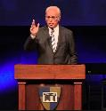
John F. MacArthur
The Gospel According to Jesus: What Does Jesus Mean When He Says, "Follow Me"? (Grand Rapids: Zondervan, 1988), 218-19.
“One of the most comprehensive invitations to salvation in all the Epistles comes in James 4:7 – 10. While James directs most of his epistle to genuine believers, it is also evident that he is concerned about those who are not genuine. He wants no one to be deceived regarding true salvation, so he calls for a real, living, saving faith that is distinct from the dead faith of chapter 2. He states his objective in 5:20. It is to see ‘the sinner converted from the error of his way and his soul saved from death.’ The invitation in 4:7 – 10 is directed at those who are not saved — guilty, wicked hearers of the Word who are not…

Slide 24
John F. MacArthur
The Gospel According to Jesus: What Does Jesus Mean When He Says, "Follow Me"? (Grand Rapids: Zondervan, 1988), 218-19.
…doers (cf. 1:21 – 22); who are still captive to dead faith (cf. 2:14 – 20); who are bitter, selfish, arrogant liars whose ‘wisdom is not what comes from above but is earthy, natural, demonic” (3:15); who are loving the world and thus are the enemies of God (4:4); whose inner spirit is still dominated by lusts (cf. 4:5); and who are proud and self-sufficient (cf. 4:6). They are in desperate need of God’s grace. But since God only ‘gives grace to the humble’ (v. 6), James calls these ‘sinners’ (a term used in Scripture only of the unregenerate) to turn from their pride and humble themselves. Ten imperatives . . .

Slide 25
John F. MacArthur
The Gospel According to Jesus: What Does Jesus Mean When He Says, "Follow Me"? (Grand Rapids: Zondervan, 1988), 218-19.
. . .delineate the commands in James’s call to sinners: submit yourself to God (salvation); resist the devil (transferring allegiance); draw near to God (intimacy of relationship); cleanse your hands (repentance); purify your hearts (confession); be miserable, mourn, weep, and let your laughter and joy be turned to gloom (sorrow). The final imperative summarizes the mentality of those who are converted: ‘Humble yourselves in the presence of the Lord.’ All this is a work of God, who gives His more abundant grace (4:6).”

Slide 26
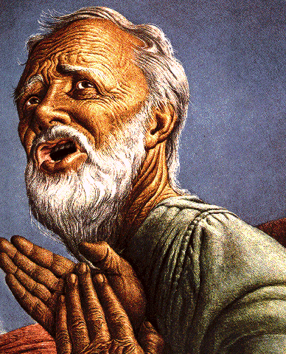
Belief – God’s One Condition for Justification
Gen 15:6
Then he believed in the LORD; and He reckoned it to him as righteousness.
John 3:16
For God so loved the world, that He gave His only begotten Son, that whoever believes in Him shall not perish, but have eternal life.
Acts 16:30-31
"Sirs, what must I do to be saved?" They said, "Believe in the Lord Jesus, and you will be saved..."

Slide 27
III. Essence of Spiritual Wisdom (4:7-12)
Submission to God (4:7a)
Resist Satan (4:7b)
Draw near to God (4:8a)
Repent (4:8b-9)
Humility (4:10)
Forego judgment (11-12)

Slide 28
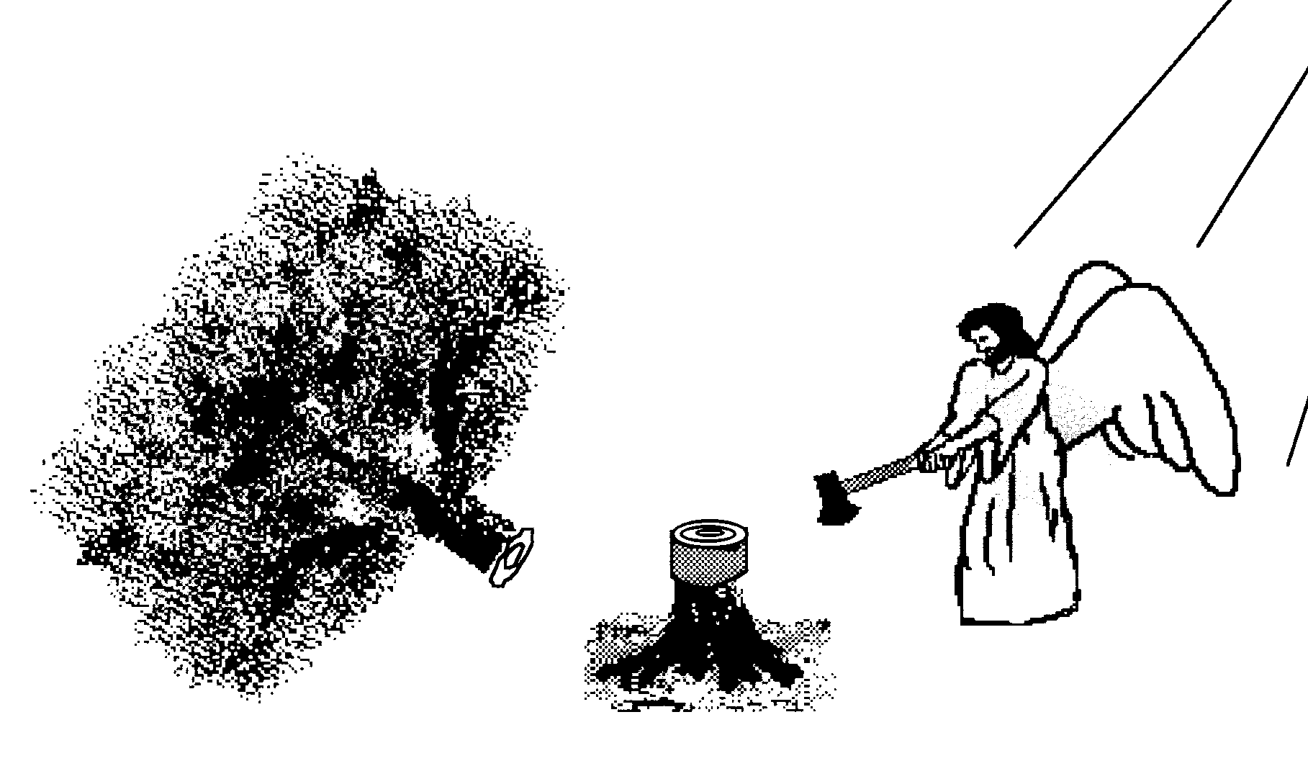
Hall of the Humbled (Prov. 16:18; 1 Peter 5:5)
Satan (Isa. 14:12-15; Ezek. 28:12-17; 1 Tim. 3:6)
Uzziah (2 Chron 26:16)
Herod (Acts 12:20-23)
Paul (2 Cor 12:1-10)

Slide 29
III. Essence of Spiritual Wisdom (4:7-12)
Submission to God (4:7a)
Resist Satan (4:7b)
Draw near to God (4:8a)
Repent (4:8b-9)
Humility (4:10)
Forego judgment (11-12)

Slide 30
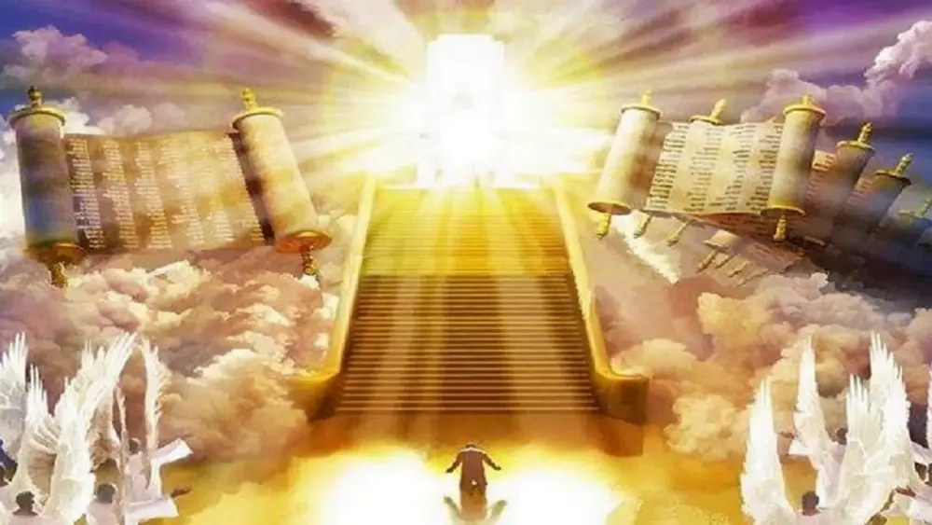
1 Corinthians 4:5
“Therefore do not go on passing judgment before the time, but wait until the Lord comes who will both bring to light the things hidden in the darkness and disclose the motives of men’s hearts; and then each man’s praise will come to him from God.”
Notes:
Rapture and Bema

Slide 31
CONCLUSION

Slide 32
Spiritual Life (4:1-12)
Avoid wrangling (4:1-3)
Avoid worldliness (4:4-6)
Essence of spiritual wisdom (4:7-12)

Slide 33
III. Essence of Spiritual Wisdom (4:7-12)
Submission to God (4:7a)
Resist Satan (4:7b)
Draw near to God (4:8a)
Repent (4:8b-9)
Humility (4:10)
Forego judgment (11-12)

Slide 34
Structure
Wisdom (3:13–5:20)
Wisdom defined (3:13-18)
Spirituality (4:1-12)
Commerce (4:13-17)
Use of wealth (5:1-6)
Waiting for the Lord’s return (5:7-12)
Prayer (5:13-18)
Restoration of the erring brother (5:19-20)

