Slide 1


Genesis 6‒9
The Flood and Continuation of the Messianic Promise

Slide 2

GENESIS STRUCTURE
  Beginning of the Human race (Gen. 1‒11)
  Beginning of the Hebrew race (Gen. 12‒50)

Slide 3

GENESIS STRUCTURE
  Genesis 1-11 (four events)
    Creation (1-2)
    Fall (3-5)
    Flood (6-9)
    National dispersion (10-11)

Slide 4
GENESIS STRUCTURE
  Genesis 1-11 (four events)
    Creation (1-2)
    Fall (3-5)
    Flood (6-9)
    National dispersion (10-11)

Slide 5


Genesis 3:15
“And I will put enmity Between you and the woman, And between your seed and her seed; He shall bruise you on the head, And you shall bruise him on the heel.”

Slide 6
GENESIS STRUCTURE
  Genesis 1-11 (four events)
    Creation (1-2)
    Fall (3-5)
    Flood (6-9)
    National dispersion (10-11)

Slide 7

The Flood
(Gen 6–9)
  Events before the flood (Gen 6)
  The flood (Gen 7)
  The abating of the waters (Gen 8)
  Events following the flood (Gen 9)

Slide 8

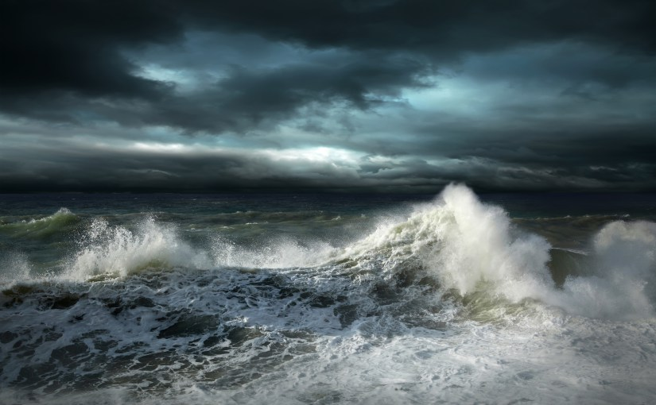
Genesis 7
The Flood

Slide 9
Genesis 7 Outline
  God’s instructions to enter the ark (7:1-4)
  Entrance into the ark (7:5-12)
  God seals the ark (7:13-16)
  Flood described (7:17-24)

Slide 10
The Flood
(Gen 6–9)
  Events before the flood (Gen 6)
  The flood (Gen 7)
  The abating of the waters (Gen 8)
  Events following the flood (Gen 9)

Slide 11
Genesis 8‒9 Outline
  Abating of the waters (8:1-5)
  Tests for dry land (8:6-14)
  Exit from the ark (8:15-19)
  Post-flood events (8:20‒9:29)

Slide 12
Genesis 8‒9 Outline
  Abating of the waters (8:1-5)
  Tests for dry land (8:6-14)
  Exit from the ark (8:15-19)
  Post-flood events (8:20‒9:29)

Slide 13


Dr. Arnold G. Fruchtenbaum
The Book of Genesis, 175
“The turning point begins with the remembrance of God in verse 1a: And God remembered Noah, and all the beasts, and all the cattle that were with him in the ark. The word remember does not mean remember in the sense that God temporarily forgot about the ark and its inhabitants; rather it means remembering in the sense of movement toward the object. For example, in Genesis 19:29, God remembered Abraham with a view to saving Lot; in Exodus 2:24, God remembered his covenant with the Patriarchs with a view to rescuing Israel; in Jeremiah 2:2, God remembered Israel with a view toward her restoration; in Jeremiah 31:20,….”

Slide 14
Dr. Arnold G. Fruchtenbaum
The Book of Genesis, 175
“…God remembered Ephraim with a view toward extending mercy to him; and in Luke 1:54–55, God remembered Israel with a view toward sending the Messiah to Israel. Furthermore, the sense was that of God remembering a covenant; although in this case the covenant itself had not yet been made. He said earlier in chapter 6, that He would establish His covenant with Noah. Furthermore, in 7:4 God remembered that the rain would only last forty days. All these usages fit into the word ‘remember.’”

Slide 15


Slide 16

John 10:27-29
“My sheep hear My voice, and I know them, and they follow Me; ²⁸ and I give eternal life to them, and they will never perish [ou mē; aiōnia]; and no one will snatch them out of My hand. ²⁹ My Father, who has given them to Me, is greater than all; and no one is able to snatch them out of the Father’s hand.”

Slide 17

Double Negation?
“This is the strongest way to negate something in Greek...οὐ μή rules out even the idea as being a possibility: ‘ου μή is the most decisive way of negativing someth. in the future.’”
Daniel B. Wallace, Greek Grammar Beyond the Basics: An Exegetical Syntax of the New Testament with Scripture, Subject, and Greek Word Indexes (Grand Rapids: Zondervan, 1996), 468.

Slide 18

God Remembered Noah
(Gen 8:1b-2)
  God used the wind to subside the flood water (Gen 8:1b)
  God closed the fountains of the deep (8:2a)
  God closed the fountains of the sky (8:2b)

Slide 19
God Remembered Noah
(Gen 8:1b-2)
  God used the wind to subside the flood water (Gen 8:1b)
  God closed the fountains of the deep (8:2a)
  God closed the fountains of the sky (8:2b)

Slide 20

Genesis 1:1-3
“¹ In the beginning God created the heavens and the earth. ² The earth was formless and void, and darkness was over the surface of the deep, and the Spirit of God was moving over the surface of the waters. ³ Then God said, ‘Let there be light’; and there was light.”

Slide 21

Ezekiel 37:7-11
So I prophesied as I was commanded; and as I prophesied, there was a noise, and behold, a rattling; and the bones came together, bone to its bone. ⁸ And I looked, and behold, sinews were on them, and flesh grew and skin covered them; but there was no breath in them. ⁹ Then He said to me, “Prophesy to the breath, prophesy, son of man, and say to the breath, ‘Thus says the Lord God, “Come from the four winds, O breath, and breathe on these slain, that they come to life.”’” ¹⁰ So I prophesied as He commanded me, and the breath came into them, and they came to life and stood on their feet, an exceedingly great army. ¹¹ Then He said to me, “Son of man, these bones are the whole house of Israel; behold, they say, ‘Our bones are dried up and our hope has perished. We are completely cut off’.”

Slide 22
God Remembered Noah
(Gen 8:1b-2)
  God used the wind to subside the flood water (Gen 8:1b)
  God closed the fountains of the deep (8:2a)
  God closed the fountains of the sky (8:2b)

Slide 23
God Remembered Noah
(Gen 8:1b-2)
  God used the wind to subside the flood water (Gen 8:1b)
  God closed the fountains of the deep (8:2a)
  God closed the fountains of the sky (8:2b)

Slide 24
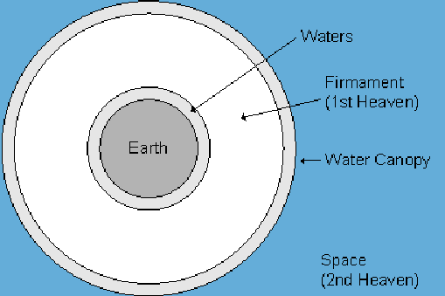

Slide 25
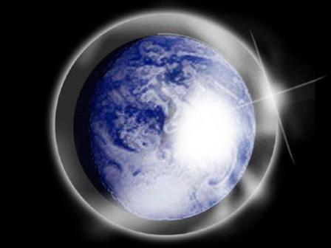

Slide 26
Day 2 Canopy Theory
(Gen 1:6-8)
Implied – Gen. 1:6-7; Ps. 148:4
Explains
  Long life spans of early man – Gen. 5:5, 27
  Strange beasts – (Gen. 1:24-25; Job 40‒41)
  Where the flood waters came from – (Gen. 2:5-6)
  Why man’s post-flood life span cut short – (Gen. 11:24-25)

Slide 27
Chronology of the Flood
Event | scripture | Calendar | Total days
Family enters ark | 7:7-9 | 2nd month 10th day | 0 days
Rain begins | 7:11 | 2nd month 17th day | 7 days
Rain stops | 7:12 | 3rd month 27th day | 47 days
Ark settles on Arat | 7:24 | 7th month 17th day | 157 days
Water begins to settle | 8:4 | 8th month 27th day | 197 days

Slide 28
Chronology of the Flood
Event | scripture | Calendar | Total days
Mountain tops exposed | 8:5 | 10th month 1st day | 231 days
Raven-no return | 8:6-7 | 11th month 11th day | 271 days
1st dove-returns | 8:8-9 | 11th month 18th day | 278 days
2nd dove-returns with Olive leaf | 8:10 | 11th month 25th day | 285 days
3rd dove-no return | 8:12 | 12th month 2nd day | 292 days

Slide 29
Chronology of the Flood
Event | scripture | Calendar | Total days
Water receded | 8:12 | 12th month 17th day | 321 days
Noah removes the covering | 8:13 | 1st month 1st day | 378 days
Noah opens the ark door and disembarks | 8:14 | 2nd month 27th day | 378 days
Arnold Fruchtenbaum, The Book of Genesis, 179

Slide 30
Chronology of the Flood
Event | scripture | Calendar | Total days
Family enters ark | 7:7-9 | 2nd month 10th day | 0 days
Rain begins | 7:11 | 2nd month 17th day | 7 days
Rain stops | 7:12 | 3rd month 27th day | 47 days
Ark settles on Arat | 7:24 | 7th month 17th day | 157 days
Water begins to settle | 8:4 | 8th month 27th day | 197 days

Slide 31
Dr. Arnold G. Fruchtenbaum
The Book of Genesis, 176
“In Genesis 8:4, the ark came to a stop: And the ark rested. This is the second time ‘rest’ is mentioned after Genesis 2:2–3.”

Slide 32
Chart courtesy of Thomas Stegall

Slide 33
Dr. Arnold G. Fruchtenbaum
The Book of Genesis, 176
“The date was: in the seventh month, on the seventeenth day of the month, and the place was: upon the mountains of Ararat. The ark rested on an unspecified mountain in the mountain range of Ararat, where the highest peak is 17,000 feet high; but there is no need to assume that it rested on the highest peak. The mountain range stretches between Southern Russia, Turkey, and Armenia, and it is not possible to know exactly from the text here where in the mountain range of Ararat the ark actually rested.”

Slide 34
Chronology of the Flood
Event | scripture | Calendar | Total days
Mountain tops exposed | 8:5 | 10th month 1st day | 231 days
Raven-no return | 8:6-7 | 11th month 11th day | 271 days
1st dove-returns | 8:8-9 | 11th month 18th day | 278 days
2nd dove-returns with Olive leaf | 8:10 | 11th month 25th day | 285 days
3rd dove-no return | 8:12 | 12th month 2nd day | 292 days

Slide 35
Genesis 8‒9 Outline
  Abating of the waters (8:1-5)
  Tests for dry land (8:6-14)
  Exit from the ark (8:15-19)
  Post-flood events (8:20‒9:29)

Slide 36
Tests for Dry Land: Four Stages
(Gen 8:7-12)
  Raven – no return (8:7)
  First dove - returns (8:8-9)
  Second dove – returns with Olive leaf (8:10-11)
  Third dove – no return (8:12)

Slide 37
Tests for Dry Land: Four Stages
(Gen 8:7-12)
  Raven – no return (8:7)
  First dove - returns (8:8-9)
  Second dove – returns with Olive leaf (8:10-11)
  Third dove – no return (8:12)

Slide 38
Tests for Dry Land: Four Stages
(Gen 8:7-12)
  Raven – no return (8:7)
  First dove - returns (8:8-9)
  Second dove – returns with Olive leaf (8:10-11)
  Third dove – no return (8:12)

Slide 39
Dr. Arnold G. Fruchtenbaum
The Book of Genesis, 177-78
“Until now, Noah received direct revelation from God, but now he must use natural means to find out the condition of the earth, since God is not speaking to him at this moment. This shows the balance between learning things by divine revelation and learning things by natural means. Both are seen as being valid options everywhere in the Scriptures. Therefore, he first used the raven, and now he uses the dove to find out the actual conditions on the earth.”

Slide 40
Tests for Dry Land: Four Stages
(Gen 8:7-12)
  Raven – no return (8:7)
  First dove - returns (8:8-9)
  Second dove – returns with Olive leaf (8:10-11)
  Third dove – no return (8:12)

Slide 41
Chronology of the Flood
Event | scripture | Calendar | Total days
Mountain tops exposed | 8:5 | 10th month 1st day | 231 days
Raven-no return | 8:6-7 | 11th month 11th day | 271 days
1st dove-returns | 8:8-9 | 11th month 18th day | 278 days
2nd dove-returns with Olive leaf | 8:10 | 11th month 25th day | 285 days
3rd dove-no return | 8:12 | 12th month 2nd day | 292 days

Slide 42
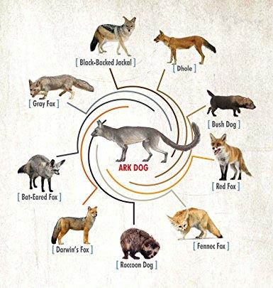

Slide 43
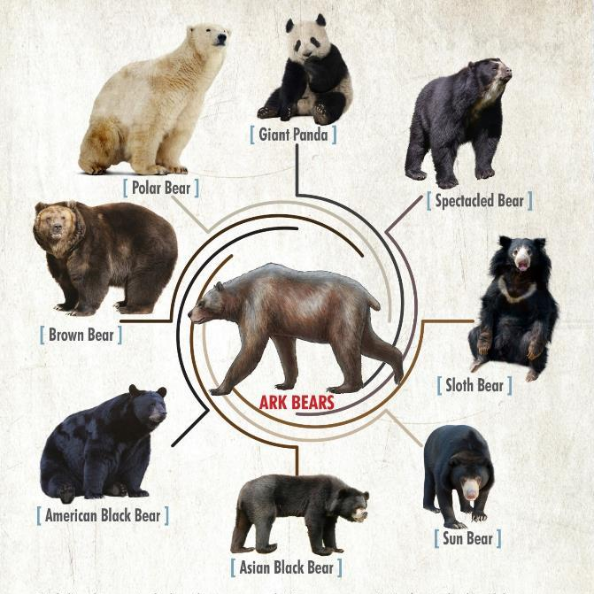

Slide 44
Tests for Dry Land: Four Stages
(Gen 8:7-12)
  Raven – no return (8:7)
  First dove - returns (8:8-9)
  Second dove – returns with Olive leaf (8:10-11)
  Third dove – no return (8:12)

Slide 45
Chronology of the Flood
Event | scripture | Calendar | Total days
Mountain tops exposed | 8:5 | 10th month 1st day | 231 days
Raven-no return | 8:6-7 | 11th month 11th day | 271 days
1st dove-returns | 8:8-9 | 11th month 18th day | 278 days
2nd dove-returns with Olive leaf | 8:10 | 11th month 25th day | 285 days
3rd dove-no return | 8:12 | 12th month 2nd day | 292 days

Slide 46
Chronology of the Flood
Event | scripture | Calendar | Total days
Water receded | 8:12 | 12th month 17th day | 321 days
Noah removes the covering | 8:13 | 1st month 1st day | 378 days
Noah opens the ark door and disembarks | 8:14 | 2nd month 27th day | 378 days
Arnold Fruchtenbaum, The Book of Genesis, 179

Slide 47
Genesis 8‒9 Outline
  Abating of the waters (8:1-5)
  Tests for dry land (8:6-14)
  Exit from the ark (8:15-19)
  Post-flood events (8:20‒9:29)

Slide 48
Genesis 6:1-4
“¹ Now it came about, when men began to multiply on the face of the land, and daughters were born to them, ² that the sons of God saw that the daughters of men were beautiful; and they took wives for themselves, whomever they chose. ³ Then the Lord said, ‘My Spirit shall not strive with man forever, because he also is flesh; nevertheless his days shall be one hundred and twenty years.’ ⁴ The Nephilim were on the earth in those days, and also afterward, when the sons of God came in to the daughters of men, and they bore children to them. Those were the mighty men who were of old, men of renown.”

Slide 49
1 Cor. 6:9-11
⁹ “Or do you not know that the unrighteous will not inherit the kingdom of God? Do not be deceived; neither fornicators, nor idolaters, nor adulterers, nor effeminate, nor homosexuals, ¹⁰ nor thieves, nor the covetous, nor drunkards, nor revilers, nor swindlers, will inherit the kingdom of God. ¹¹ Such were some of you; but you were washed, but you were sanctified, but you were justified in the name of the Lord Jesus Christ and in the Spirit of our God.”

Slide 50
1 Cor. 6:9-11
⁹ “Or do you not know that the unrighteous will not inherit the kingdom of God? Do not be deceived; neither fornicators, nor idolaters, nor adulterers, nor effeminate, nor homosexuals, ¹⁰ nor thieves, nor the covetous, nor drunkards, nor revilers, nor swindlers, will inherit the kingdom of God. ¹¹ Such were some of you; but you were washed, but you were sanctified, but you were justified in the name of the Lord Jesus Christ and in the Spirit of our God.”

Slide 51
1 Cor. 6:9-11
⁹ “Or do you not know that the unrighteous will not inherit the kingdom of God? Do not be deceived; neither fornicators, nor idolaters, nor adulterers, nor effeminate, nor homosexuals, ¹⁰ nor thieves, nor the covetous, nor drunkards, nor revilers, nor swindlers, will inherit the kingdom of God. ¹¹ Such were some of you; but you were washed, but you were sanctified, but you were justified in the name of the Lord Jesus Christ and in the Spirit of our God.”

Slide 52
Genesis 1:26-28
²⁶ Then God said, “Let Us make man in Our image, according to Our likeness; and let them rule over the fish of the sea and over the birds of the sky and over the cattle and over all the earth, and over every creeping thing that creeps on the earth.” ²⁷ God created man in His own image, in the image of God He created him; male and female He created them. ²⁸ God blessed them; and God said to them, “Be fruitful and multiply, and fill the earth, and subdue it; and rule over the fish of the sea and over the birds of the sky and over every living thing that moves on the earth.”

Slide 53
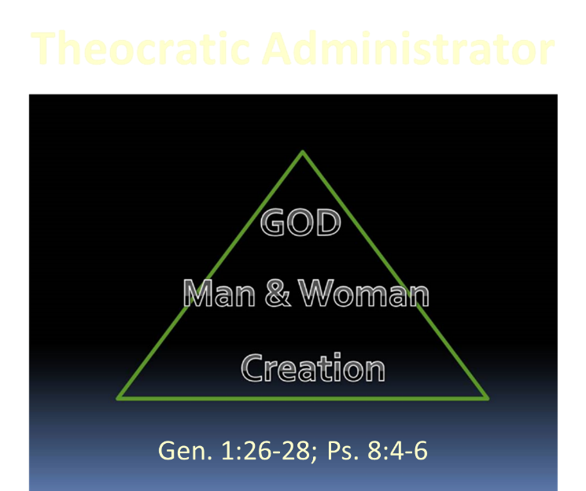

Slide 54
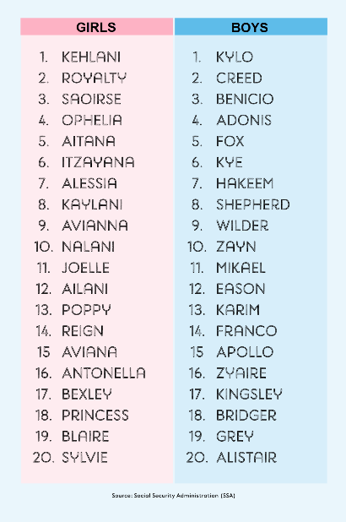
Biblical Significance of Naming
Genesis 1:8
Numbers 32:37-38
2 Kings 23:24
2 Kings 24:17
Daniel 1:6-7
Fruchtenbaum, The Book of Genesis, 84

Slide 55
Conclusion

Slide 56
Genesis 8‒9 Outline
  Abating of the waters (8:1-5)
  Tests for dry land (8:6-14)
  Exit from the ark (8:15-19)
  Post-flood events (8:20‒9:29)

Slide 57
Genesis 8‒9 Outline
  Abating of the waters (8:1-5)
  Tests for dry land (8:6-14)
  Exit from the ark (8:15-19)
  Post-flood events (8:20‒9:29)

Slide 58

“The Lord bless you and keep you; the Lord make his face shine on you and be gracious to you; the Lord turn his face toward you and give you peace.” (NIV)

