Slide 1
PRACTICAL RIGHTEOUSNESS
Dr. Andy Woods
Senior Pastor – Sugar Land Bible Church
President – Chafer Theological Seminary

Slide 2
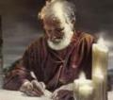
Answering Eleven Questions
Who wrote it? – James
What do we know about the author? – Christ’s ½ Brother
Who was the audience? – Believing Jews in the Diaspora
Where was if written from? – Jerusalem
When was the book written? – A.D. 44‒47
What was the book’s occasion? – Practical righteousness
What is the book’s purpose? – Achieving practical righteousness
What is the book about? – Practical righteousness
What is the book’s theme? – Daily living
What makes the book different? – Practicality
How is the book organized? – Faith and Wisdom

Slide 3
JAMES STRUCTURE
Faith (James 1:1‒3:12)
Wisdom (James 3:13‒5:20)

Slide 4
JAMES STRUCTURE
Faith (James 1:1‒3:12)
Wisdom (James 3:13‒5:20)

Slide 5
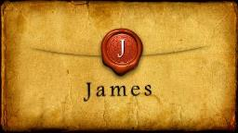
JAMES STRUCTURE
Faith (1:1–3:12)
Trials (1:2-18)
Obedience to the Word (1:19-27)
Favoritism (2:1-13)
Faith manifesting works (2:14-26)
Tongue (3:1-12)

Slide 6
JAMES STRUCTURE
Faith (James 1:1‒3:12)
Wisdom (James 3:13‒5:20)

Slide 7
Structure
Wisdom (3:13–5:20)
Wisdom defined (3:13-18)
Spirituality (4:1-12)
Commerce (4:13-17)
Use of wealth (5:1-6)
Waiting for the Lord’s return (5:7-12)
Prayer (5:13-18)
Restoration of the erring brother (5:19-20)

Slide 8
Structure
Wisdom (3:13–5:20)
Wisdom defined (3:13-18)
Spirituality (4:1-12)
Commerce (4:13-17)
Use of wealth (5:1-6)
Waiting for the Lord’s return (5:7-12)
Prayer (5:13-18)
Restoration of the erring brother (5:19-20)

Slide 9
Wisdom (3:13-18)
Wisdom is demonstrated by her actions (3:13)
Human or earthly wisdom (3:14-16)
Heavenly wisdom (3:17-18)

Slide 10
Structure
Wisdom (3:13–5:20)
Wisdom defined (3:13-18)
Spirituality (4:1-12)
Commerce (4:13-17)
Use of wealth (5:1-6)
Waiting for the Lord’s return (5:7-12)
Prayer (5:13-18)
Restoration of the erring brother (5:19-20)

Slide 11
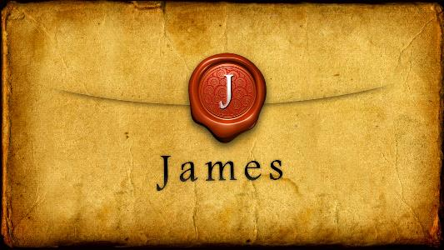
Spiritual Life (4:1-12)
Avoid wrangling (4:1-3)
Avoid worldliness (4:4-6)
Essence of spiritual wisdom (4:7-12)

Slide 12
Spiritual Life (4:1-12)
Avoid wrangling (4:1-3)
Avoid worldliness (4:4-6)
Essence of spiritual wisdom (4:7-12)

Slide 13
III. Essence of Spiritual Wisdom (4:7-12)
Submission to God (4:7a)
Resist Satan (4:7b)
Draw near to God (4:8a)
Repent (4:8b-9)
Humility (4:10)
Forego judgment (11-12)

Slide 14
III. Essence of Spiritual Wisdom (4:7-12)
Submission to God (4:7a)
Resist Satan (4:7b)
Draw near to God (4:8a)
Repent (4:8b-9)
Humility (4:10)
Forego judgment (11-12)

Slide 15
Three Tenses of Salvation
Phase | Justification | Sanctification | Glorification
Tense | Past | Present | Future
Saved from sin’s: | Penalty | Power | Presence
Scripture | Eph 2:8-9; Titus 3:5 | Philip 2:12 | Rom 5:10
Nature | Single | Dual | Single

Slide 16
III. Essence of Spiritual Wisdom (4:7-12)
Submission to God (4:7a)
Resist Satan (4:7b)
Draw near to God (4:8a)
Repent (4:8b-9)
Humility (4:10)
Forego judgment (11-12)

Slide 17
Revelation 20:1-3
“¹ Then I saw an angel coming down from heaven, holding the key of the abyss and a great chain in his hand. ² And he laid hold of the dragon, the serpent of old, who is the devil and Satan, and bound him for a thousand years; ³ and he threw him into the abyss, and shut it and sealed it over him, so that he would not deceive the nations any longer, until the thousand years were completed; after these things he must be released for a short time.”

Slide 18
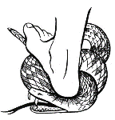
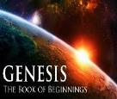
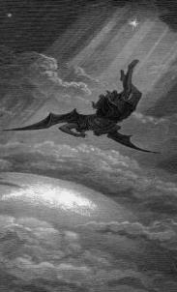
Satan’s Progressive Defeat
Initial eviction from heaven (Isa 14:12-15; Ezek 28:12-17)
Eden (Gen 3:15)
Pre-diluvian world (1 Pet 3:19-20)
Cross (John 12:31; 16:11; Col 2:15; Heb 2:14; 1 John 3:8)
Mid point of the Tribulation (Rev 12:9)
Beginning of millennium (Rev 20:2-3)
End of millennium (Rev 20:10)

Slide 20
Matthew 16:18-19
“¹⁸ And I also say to you that you are Peter, and upon this rock I will build My church; and the gates of Hades will not overpower it. ¹⁹ I will give you the keys of the kingdom of heaven; and whatever you bind on earth shall have been bound in heaven, and whatever you loose on earth shall have been loosed in heaven.”

Slide 21
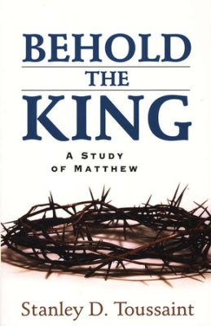
Stanley D. Toussaint Behold the King: A Study of Matthew (Grand Rapids, Kregel, 2005), 205-07.
“The Lord is promising to Peter an exalted position of great authority in the coming earthly kingdom…In other words, ‘to bind’ (deō) and ‘to loose” (luō) are references to the execution of Peter’s authority. The authority will be manifested in the coming earthly kingdom according to Christ’s promise. A problem exists as to the meaning of the future periphrastics in Matthew 16:19 (‘shall have been bound’ and ‘shall have been loose’). The Roman catholic church bases its sarcedotal authority on this verse, together with Matthew 18:18 and John 20:23.”

Slide 22
Stanley D. Toussaint Behold the King: A Study of Matthew (Grand Rapids, Kregel, 2005), 205-07.
“However, this false doctrine is largely the result of an improper translation. Because Jerome’s Latin Vulgate version, which was made around 400 A.D., many of the translators since then have translated the verbs in Matthew 16:19 as simple futures. Needless to say, the future periphrastics have been ignored in these translations. It is the unanimous testimony of Greek grammarians that the perfect tense denotes a past action, the results of which endure to the present. The periphrastic form of the perfect usually emphasizes the existing state. This changes the complexion of Matthew 16:19 completely.”

Slide 23
Stanley D. Toussaint Behold the King: A Study of Matthew (Grand Rapids, Kregel, 2005), 205-07.
“‘This is wrongly translated “shall be bound” and “shall be loosed,” seemingly to make Jesus teach that the apostles’ acts will determine the policies of heaven. They should be translated “shall have been bound” and “shall have been loose.” This makes the apostles’ acts a matter of inspiration or heavenly guidance.’ A good translation is given by Williams, who exercises great care in the translation of the Greek tenses, ‘and whatever you forbid on earth must be what is already forbidden in heaven, and whatever you permit on earth must be what is already permitted in heaven.’”

Slide 24
Stanley D. Toussaint Behold the King: A Study of Matthew (Grand Rapids, Kregel, 2005), 205-07.
“…Therefore, the verse is a promise to Peter of a place of authority in the future earthly kingdom. With this promise the Lord gives Peter the basis of the decisions which he shall make. Peter is to discern what is the mind of God and then judge accordingly.”

Slide 25
Matthew 18:18-20
“¹⁸ Truly I say to you, whatever you bind on earth shall have been bound in heaven; and whatever you loose on earth shall have been loosed in heaven. ¹⁹ Again I say to you, that if two of you agree on earth about anything that they may ask, it shall be done for them by My Father who is in heaven. ²⁰ For where two or three have gathered together in My name, I am there in their midst.”

Slide 26
Stanley D. Toussaint Behold the King: A Study of Matthew (Grand Rapids, Kregel, 2005), 218.
“Verses 18 to 20 speak of the principle which is to be followed in the [church] discipline. The injunction of verse 18 concerns the same principle as that of Matthew 16:19 except it is here addressed to all of the disciples. In Matthew 16:19 it was spoken only to Peter. The Lord is indicating to His disciples that, in the church, divine guidance is to be the rule to follow. To Peter the King promised authority in the kingdom, assuring him of guidance in the use of that authority. Now the Lord instructs His disciples concerning the subject of discipline in the church and also promises divine direction in their decisions.”

Slide 27
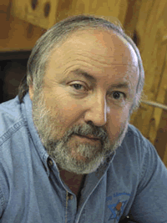
Arnold G. Fruchtenbaum
Yeshua: The Life of Messiah from a Messianic Jewish Perspective, 4 vols., vol. 3 (San Antonio, TX: Ariel Ministries, 2017), 2:590-93.
“Yeshua gave this special authority only to Peter at this time. After the resurrection, He extended and limited this authority to the other apostles exclusively. In modern days, this verse has been pulled out of context to signify something other than what is meant in the Jewish frame of reference. It has often been applied to spiritual warfare and demonology and loosing of Satan and his demons. However, neither Satan nor demons are found in this context. Rather, the context is the establishment of the church, and the issue at hand is apostolic authority.”

Slide 28
Arnold G. Fruchtenbaum
Yeshua: The Life of Messiah from a Messianic Jewish Perspective, 4 vols., vol. 3 (San Antonio, TX: Ariel Ministries, 2017), 2:590-93.
“The terms ‘binding’ and ‘loosing’ were commonly used in rabbinic writings. In fact, binding and loosing was authority the Pharisees claimed for themselves, but which God never gave them. He did however give it to the apostles. There were two basic concepts of binding and loosing in rabbinic thinking...Legislatively, to bind meant ‘to forbid,’ and to loose meant ‘to permit.’ Judicially, to bind meant ‘to punish,’ and to loose meant ‘not to punish,’ or ‘to set free from punishment.’...in rabbinic Judaism the expressions related ‘to humanly administered discipline in leadership rather than ultimate spiritual or moral authority.’”

Slide 29
Arnold G. Fruchtenbaum
Yeshua: The Life of Messiah from a Messianic Jewish Perspective, 4 vols., vol. 3 (San Antonio, TX: Ariel Ministries, 2017), 2:590-93.
“…Such typical statements found in rabbinic literature concern matters of permitting, forbidding, punishing, and not punishing certain actions. That was how the rabbis used ‘binding’ and ‘loosing’ in the context of the Second Temple period, and the usage of these terms in the Gospels must be interpreted in light of first-century Israel. Thus, the Messiah gave to Peter, and later to all the apostles, the authority to bind and loose both legislatively and judicially. Since there is no such thing as apostolic succession, the authority was not passed on beyond the apostles.”

Slide 30
Arnold G. Fruchtenbaum
Yeshua: The Life of Messiah from a Messianic Jewish Perspective, 4 vols., vol. 3 (San Antonio, TX: Ariel Ministries, 2017), 2:590-93.
“Later, in the Epistles, the apostles exercise binding and loosing, meaning they permitted things that were formally forbidden, and they forbade things that were formally permitted. Legislatively this authority was limited to the apostles only. The church has no authority to bind and loose legislatively. It has no authority to bind, meaning to issue further rules and regulations for believers to follow. Likewise, it has no authority to loose, meaning to release believers from the rules of Scripture.”

Slide 31
Arnold G. Fruchtenbaum
Yeshua: The Life of Messiah from a Messianic Jewish Perspective, 4 vols., vol. 3 (San Antonio, TX: Ariel Ministries, 2017), 2:590-93.
“One example of how the apostles practiced their authority in the judicial sense is found in Acts 5, when Peter passed the death sentence upon Ananias and Sapphira. Because they had lied to the Holy Spirit, he bound them for punishment, and they each dropped dead at his feet. The church has a limited authority to bind and loose in a judicial sense, but not to the same degree as the apostles. The apostles could impose a death sentence, while the church can only excommunicate the sinner, a point made later, in Matthew 18.”

Slide 32
Arnold G. Fruchtenbaum
Yeshua: The Life of Messiah from a Messianic Jewish Perspective, 4 vols., vol. 3 (San Antonio, TX: Ariel Ministries, 2017), 2:590-93.
“This authority was given to the apostles alone, and they kept it until the end of their lives. The church also has the authority to bind and to loose in a judicial sense, but not to the same degree as the apostles, who could issue a death sentence. The church can bind and loose to the point of breaking or not breaking fellowship with a sinning believer. It can excommunicate or not excommunicate. Notice, therefore, that this does not refer to binding Satan or his demons, so the context is not spiritual warfare, but Church discipline.”

Slide 33
Binding and Loosing Takeaways
Matt. 16:19 involves Peter’s future kingdom role.
Those on earth are to follow what heaven has already determined (and not vice versa).
Spiritual warfare is not in the context.
The authority to bind and to loose was only given to the apostles.
The Church has a more limited degree of authority to bind and to loose.

Slide 34
III. Essence of Spiritual Wisdom (4:7-12)
Submission to God (4:7a)
Resist Satan (4:7b)
Draw near to God (4:8a)
Repent (4:8b-9)
Humility (4:10)
Forego judgment (11-12)

Slide 35
Audience
Jewish (1:1)
Persecution (Acts 8:1-4; 11:19)
In Babylon-Mesopotamia or North-Central Turkey?
Believers (Jas 1:2-4)

Slide 36
III. Essence of Spiritual Wisdom (4:7-12)
Submission to God (4:7a)
Resist Satan (4:7b)
Draw near to God (4:8a)
Repent (4:8b-9)
Humility (4:10)
Forego judgment (11-12)

Slide 37
Three Tenses of Salvation
Phase | Justification | Sanctification | Glorification
Tense | Past | Present | Future
Saved from sin’s: | Penalty | Power | Presence
Scripture | Eph 2:8-9; Titus 3:5 | Philip 2:12 | Rom 5:10
Nature | Single | Dual | Single

Slide 38
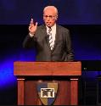
John F. MacArthur
The Gospel According to Jesus: What Does Jesus Mean When He Says, "Follow Me"? (Grand Rapids: Zondervan, 1988), 218-19.
“One of the most comprehensive invitations to salvation in all the Epistles comes in James 4:7 – 10. While James directs most of his epistle to genuine believers, it is also evident that he is concerned about those who are not genuine. He wants no one to be deceived regarding true salvation, so he calls for a real, living, saving faith that is distinct from the dead faith of chapter 2. He states his objective in 5:20. It is to see ‘the sinner converted from the error of his way and his soul saved from death.’”

Slide 39
John F. MacArthur
The Gospel According to Jesus: What Does Jesus Mean When He Says, "Follow Me"? (Grand Rapids: Zondervan, 1988), 218-19.
“The invitation in 4:7 – 10 is directed at those who are not saved — guilty, wicked hearers of the Word who are not doers (cf. 1:21 – 22); who are still captive to dead faith (cf. 2:14 – 20); who are bitter, selfish, arrogant liars whose ‘wisdom is not what comes from above but is earthy, natural, demonic” (3:15); who are loving the world and thus are the enemies of God (4:4); whose inner spirit is still dominated by lusts (cf. 4:5); and who are proud and self-sufficient (cf. 4:6). They are in desperate need of God’s grace.”

Slide 40
John F. MacArthur
The Gospel According to Jesus: What Does Jesus Mean When He Says, "Follow Me"? (Grand Rapids: Zondervan, 1988), 218-19.
“But since God only ‘gives grace to the humble’ (v. 6), James calls these ‘sinners’ (a term used in Scripture only of the unregenerate) to turn from their pride and humble themselves. Ten imperatives delineate the commands in James’s call to sinners: submit yourself to God (salvation); resist the devil (transferring allegiance); draw near to God (intimacy of relationship); cleanse your hands (repentance); purify your hearts (confession); be miserable, mourn, weep, and let your laughter and joy be turned to gloom (sorrow).”

Slide 41
John F. MacArthur
The Gospel According to Jesus: What Does Jesus Mean When He Says, "Follow Me"? (Grand Rapids: Zondervan, 1988), 218-19.
“The final imperative summarizes the mentality of those who are converted: ‘Humble yourselves in the presence of the Lord.’ All this is a work of God, who gives His more abundant grace (4:6).”

Slide 42
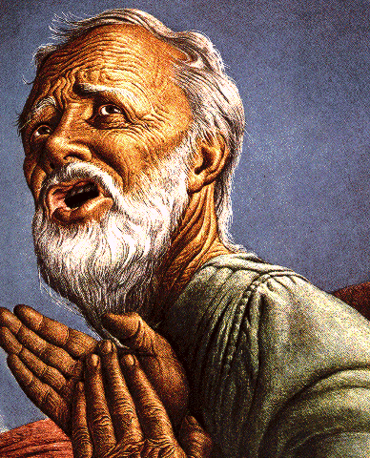
Belief – God’s One Condition for Justification
Gen 15:6
Then he believed in the LORD; and He reckoned it to him as righteousness.
John 3:16
For God so loved the world, that He gave His only begotten Son, that whoever believes in Him shall not perish, but have eternal life.
Acts 16:30-31
"Sirs, what must I do to be saved?" They said, "Believe in the Lord Jesus, and you will be saved..."

Slide 43
III. Essence of Spiritual Wisdom (4:7-12)
Submission to God (4:7a)
Resist Satan (4:7b)
Draw near to God (4:8a)
Repent (4:8b-9)
Humility (4:10)
Forego judgment (11-12)

Slide 44
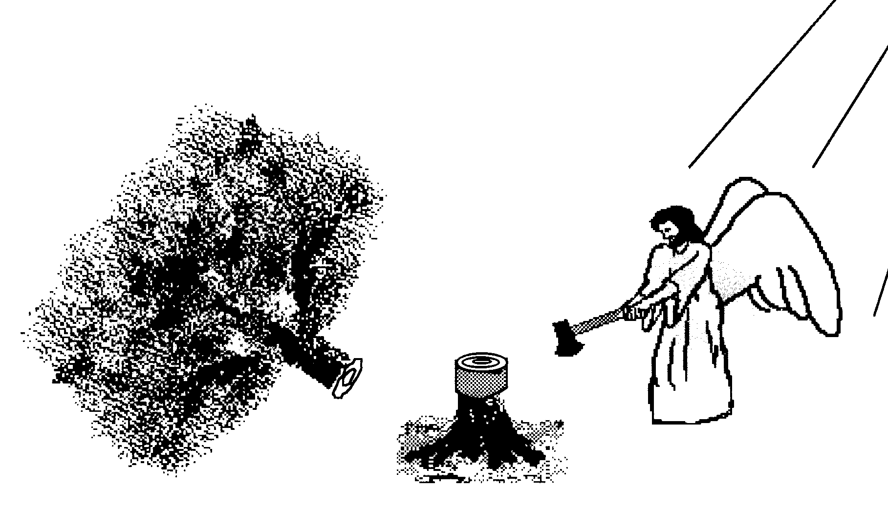
Hall of the Humbled (Prov. 16:18; 1 Peter 5:5)
Satan (Isa. 14:12-15; Ezek. 28:12-17; 1 Tim. 3:6)
Uzziah (2 Chron 26:16)
Herod (Acts 12:20-23)
Paul (2 Cor 12:1-10)

Slide 45
III. Essence of Spiritual Wisdom (4:7-12)
Submission to God (4:7a)
Resist Satan (4:7b)
Draw near to God (4:8a)
Repent (4:8b-9)
Humility (4:10)
Forego judgment (11-12)

Slide 46
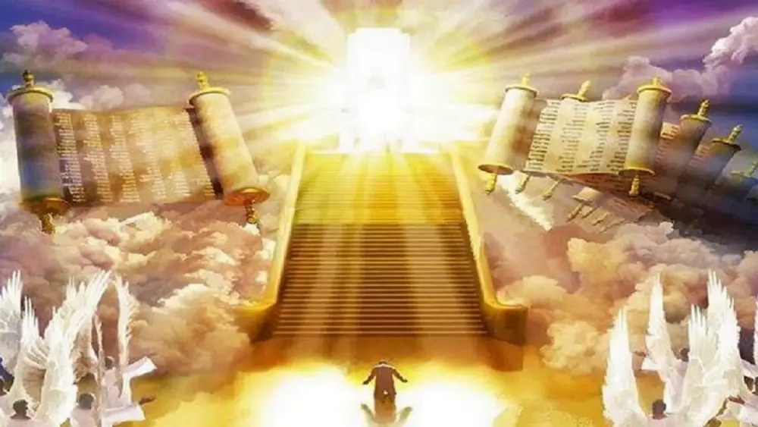
1 Corinthians 4:5
“Therefore do not go on passing judgment before the time, but wait until the Lord comes who will both bring to light the things hidden in the darkness and disclose the motives of men’s hearts; and then each man’s praise will come to him from God.”
Notes:
Rapture and Bema

Slide 47
CONCLUSION

Slide 48
Spiritual Life (4:1-12)
Avoid wrangling (4:1-3)
Avoid worldliness (4:4-6)
Essence of spiritual wisdom (4:7-12)

Slide 49
Structure
Wisdom (3:13–5:20)
Wisdom defined (3:13-18)
Spirituality (4:1-12)
Commerce (4:13-17)
Use of wealth (5:1-6)
Waiting for the Lord’s return (5:7-12)
Prayer (5:13-18)
Restoration of the erring brother (5:19-20)

