Slide 1
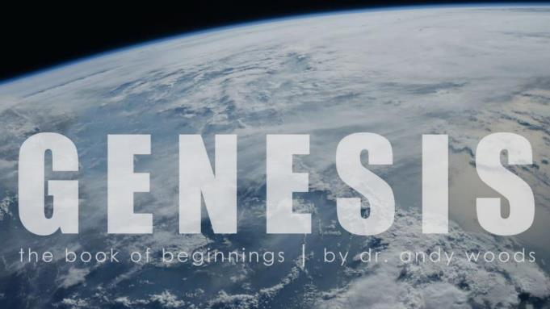
Genesis 6‒9
The Flood and Continuation of the Messianic Promise

Slide 2
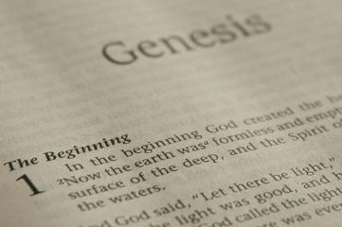
GENESIS STRUCTURE
Beginning of the Human race (Gen. 1‒11)
Beginning of the Hebrew race (Gen. 12‒50)

Slide 3
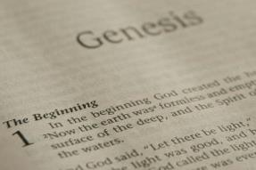
GENESIS STRUCTURE
Genesis 1-11 (four events)
Creation (1-2)
Fall (3-5)
Flood (6-9)
National dispersion (10-11)

Slide 4
GENESIS STRUCTURE
Genesis 1-11 (four events)
Creation (1-2)
Fall (3-5)
Flood (6-9)
National dispersion (10-11)

Slide 5
Genesis 3:15
“And I will put enmity Between you and the woman, And between your seed and her seed; He shall bruise you on the head, And you shall bruise him on the heel.”

Slide 6
GENESIS STRUCTURE
Genesis 1-11 (four events)
Creation (1-2)
Fall (3-5)
Flood (6-9)
National dispersion (10-11)

Slide 7
The Flood (Gen 6–9)
Events before the flood (Gen 6)
The flood (Gen 7)
The abating of the waters (Gen 8)
Events following the flood (Gen 9)

Slide 8
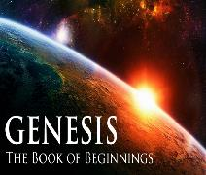
Genesis 7 The Flood

Slide 9
Genesis 7 Outline
God’s instructions to enter the ark (7:1-4)
Entrance into the ark (7:5-12)
God seals the ark (7:13-16)
Flood described (7:17-24)

Slide 10
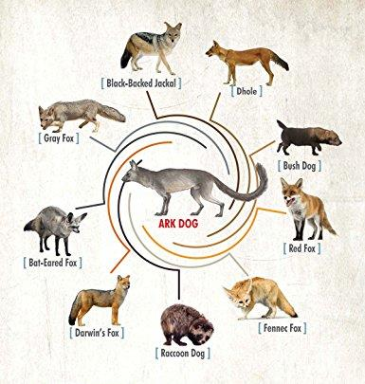

Slide 11
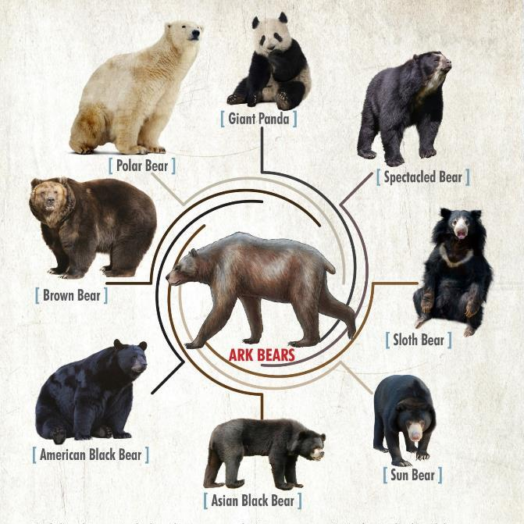

Slide 12
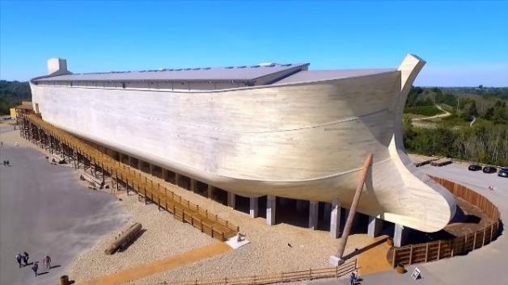
Dimensions of the Ark? (Genesis 6:15)
Ark = 450ft long, 75ft wide, 45 feet high
Ark capable of holding 125,000 animals

Slide 13
Genesis 6:1-4
“¹ Now it came about, when men began to multiply on the face of the land, and daughters were born to them, ² that the sons of God saw that the daughters of men were beautiful; and they took wives for themselves, whomever they chose. ³ Then the Lord said, ‘My Spirit shall not strive with man forever, because he also is flesh; nevertheless his days shall be one hundred and twenty years.’ ⁴ The Nephilim were on the earth in those days, and also afterward, when the sons of God came in to the daughters of men, and they bore children to them. Those were the mighty men who were of old, men of renown.”

Slide 14
Luke 16:24-26
“²⁴ And he cried out and said, ‘Father Abraham, have mercy on me, and send Lazarus so that he may dip the tip of his finger in water and cool off my tongue, for I am in agony in this flame.’ ²⁵ But Abraham said, ‘Child, remember that during your life you received your good things, and likewise Lazarus bad things; but now he is being comforted here, and you are in agony. ²⁶ And besides all this, between us and you there is a great chasm fixed, so that those who wish to come over from here to you will not be able, and that none may cross over from there to us.’”

Slide 15
Hebrews 9:27
And inasmuch as it is appointed for men to die once and after this comes judgment.

Slide 16
John 10:27-29
“My sheep hear My voice, and I know them, and they follow Me; ²⁸ and I give eternal life to them, and they will never perish [ou mē; aiōnia]; and no one will snatch them out of My hand. ²⁹ My Father, who has given them to Me, is greater than all; and no one is able to snatch them out of the Father’s hand.”

Slide 17
2 Timothy 2:11-13
“It is a trustworthy statement: For if we died with Him, we will also live with Him; ¹² If we endure, we will also reign with Him; If we deny Him, He also will deny us; ¹³ If we are faithless, He remains faithful, for He cannot deny Himself.”

Slide 18
Genesis 7 Outline
God’s instructions to enter the ark (7:1-4)
Entrance into the ark (7:5-12)
God seals the ark (7:13-16)
Flood described (7:17-24)

Slide 19
Dimensions of the Ark? (Genesis 6:15)
Ark = 450ft long, 75ft wide, 45 feet high
Ark capable of holding 125,000 animals

Slide 20
Dr. Arnold G. Fruchtenbaum
The Book of Genesis Record, 172
“Not only was the ark lifted up off the ground, it also floated on the face of the waters. It sailed only in the sense that it was driven by whatever wind there was; so it began to float on the face of the waters away from its original position. In fact, it began in the area of Mesopotamia [Iraq] and floated all the way to the area of Mount Ararat, which could be anywhere in the current countries of Southern Russia, Turkey, or Armenia.”

Slide 21
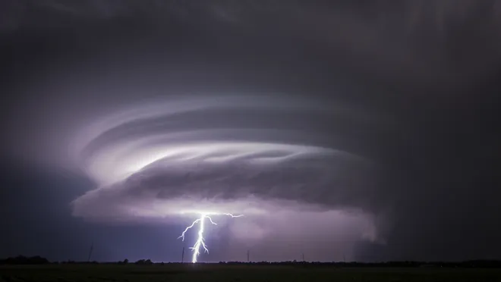
Exodus 9:24 (NIV)
“…It was the worst storm in all the land of Egypt since it had become a nation.”

Slide 22
H.C. Leupold Exposition of Genesis (Grand Rapids: Baker, 1942), vol. 1, p. 301-302.
“… ‘all the high mountains under all the heavens.’ One of these expressions alone would almost necessitate the impression that the author intends to convey the idea of the absolute universality of the Flood…Yet since ‘all’ is known to be used in a relative sense, the writer removes all ambiguity by adding the phrase ‘under all the heavens.’ A double ‘all’ (kol) cannot allow for so relative a sense. It almost constitutes a Hebrew superlative. So we believe that the text disposes of the question of the universality of the flood. By way of objection to this interpretation, those who believe in a limited flood…urge the fact that kol is used in a relative sense, as is clearly the case in passages such as Genesis 41:57; Exodus 9:25, 10:15; Deuteronomy 2:25; and 1 Kings 10:24. However, we still insist that this fact could overthrow a single kol, never a double kol, as our verse has it.”

Slide 23
Dr. Henry M. Morris
The Genesis Record, 200
“The water rise was quickly sufficient to ‘bear up the ark,’ indicating a depth of at least twenty feet in the earliest stages of the Flood, since the Ark was at least forty-four feet high and heavily loaded.”

Slide 24
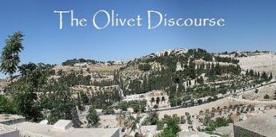
Matthew 24:21-22
“²¹ For then there will be a great tribulation, such as has not occurred since the beginning of the world until now, nor ever will. ²² Unless those days had been cut short, no life would have been saved; but for the sake of the elect those days will be cut short.”

Slide 25
Dr. Arnold G. Fruchtenbaum
The Book of Genesis Record, 172
“Genesis 7:21–23a describes the universality of the destruction…The emphasis is clearly on the destruction of all living things on dry land with the breath of life, again, excluding all fish life…The Hebrew word means ‘erased.’ They were blotted out.”

Slide 26
Acts 17:26
“and He made from one man every nation of mankind to live on all the face of the earth, having determined their appointed times and the boundaries of their habitation.”

Slide 27
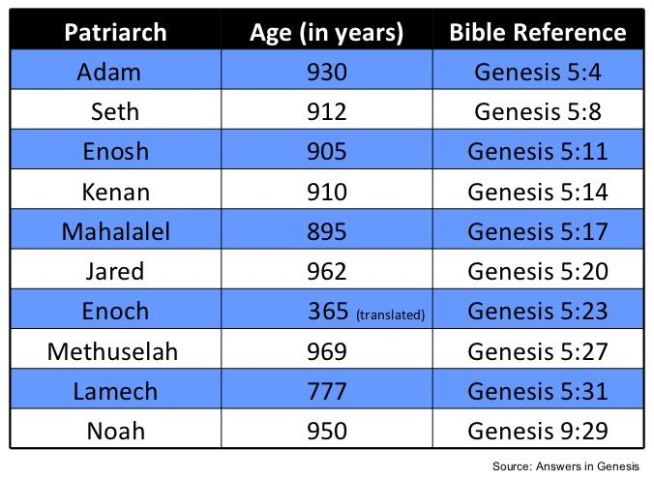

Slide 28
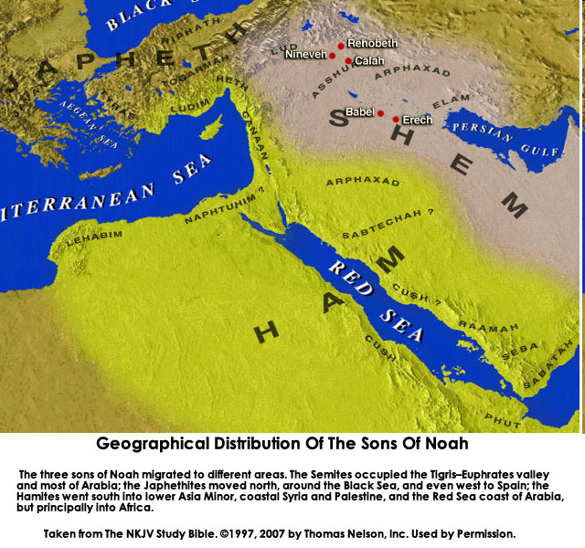

Slide 29
Genesis 7:19-23 (NIV)
¹⁹ “They rose greatly on the earth, and all the high mountains under the entire heaven were covered…²¹ Every living thing that moved on the earth perished—birds, livestock, wild animals, all the creatures that swarm over the earth, and all mankind. ²² Everything on dry land that had the breath of life in its nostrils died. ²³ Every living thing on the face of the earth was wiped out; men and animals and the creatures that move along the ground and the birds of the air were wiped from the earth. Only Noah was left, and those with him in the ark.”

Slide 30
Local Flood?
Definition
Motive - syncreticism of the Bible with and old earth protology
Biblical arguments
use of “all” in a relative sense (Genesis 41:57; Exodus 9:25, 10:15; Deuteronomy 2:25; and 1 Kings 10:24)
“Earth” = local land (Zech. 12:12; Matt. 2:6)
Phenomenological language (Josh. 10:12-13)

Slide 31
Local Flood?
Definition
Motive - syncreticism of the Bible with and old earth protology
Biblical arguments
use of “all” in a relative sense (Genesis 41:57; Exodus 9:24, 10:15; Deuteronomy 2:25; and 1 Kings 10:24)
“Earth” = local land (Zech. 12:12; Matt. 2:6)
Phenomenological language (Josh. 10:12-13)

Slide 32
Local Flood?
Definition
Motive - syncreticism of the Bible with and old earth protology
Biblical arguments
use of “all” in a relative sense (Genesis 41:57; Exodus 9:24, 10:15; Deuteronomy 2:25; and 1 Kings 10:24)
“Earth” = local land (Zech. 12:12; Matt. 2:6)
Phenomenological language (Josh. 10:12-13)

Slide 33
Local Flood?
Definition
Motive - syncreticism of the Bible with and old earth protology
Biblical arguments
use of “all” in a relative sense (Genesis 41:57; Exodus 9:24, 10:15; Deuteronomy 2:25; and 1 Kings 10:24)
“Earth” = local land (Zech. 12:12; Matt. 2:6)
Phenomenological language (Josh. 10:12-13)

Slide 34
Local Flood?
Definition
Motive - syncreticism of the Bible with and old earth protology
Biblical arguments
use of “all” in a relative sense (Genesis 41:57; Exodus 9:24, 10:15; Deuteronomy 2:25; and 1 Kings 10:24)
“Earth” = local land (Zech. 12:12; Matt. 2:6)
Phenomenological language (Josh. 10:12-13)

Slide 35
Exodus 9:24 (NIV)
“…It was the worst storm in all the land of Egypt since it had become a nation.”

Slide 36
Local Flood?
Definition
Motive - syncreticism of the Bible with and old earth protology
Biblical arguments
use of “all” in a relative sense (Genesis 41:57; Exodus 9:24, 10:15; Deuteronomy 2:25; and 1 Kings 10:24)
“Earth” = local land (Zech. 12:12; Matt. 2:6)
Phenomenological language (Josh. 10:12-13)

Slide 37
Genesis 6:11-13
¹¹ Now the earth was corrupt in the sight of God, and the earth was filled with violence. ¹² God looked on the earth, and behold, it was corrupt; for all flesh had corrupted their way upon the earth. ¹³ Then God said to Noah, “The end of all flesh has come before Me; for the earth is filled with violence because of them; and behold, I am about to destroy them with the earth.

Slide 38
Local Flood?
Definition
Motive - syncreticism of the Bible with and old earth protology
Biblical arguments
use of “all” in a relative sense (Genesis 41:57; Exodus 9:24, 10:15; Deuteronomy 2:25; and 1 Kings 10:24)
“Earth” = local land (Zech. 12:12; Matt. 2:6)
Phenomenological language (Josh. 10:12-13)

Slide 39
Answering the Local Flood Biblical Arguments
Relative sense of “all”? – Gen. 7:19-23
“all” left undefined
Double “all”
Land means “earth” (Gen. 1:1)
Phenomenological language? – Gen. 7:11; 8:2

Slide 40
Answering the Local Flood Biblical Arguments
Relative sense of “all”? – Gen. 7:19-23
“all” left undefined
Double “all”
Land means “earth” (Gen. 1:1)
Phenomenological language? – Gen. 7:11; 8:2

Slide 41
Answering the Local Flood Biblical Arguments
Relative sense of “all”? – Gen. 7:19-23
“all” left undefined
Double “all”
Land means “earth” (Gen. 1:1)
Phenomenological language? – Gen. 7:11; 8:2

Slide 42
Genesis 7:19-23 (NIV)
¹⁹ “They rose greatly on the earth, and all the high mountains under the entire heaven were covered…²¹ Every living thing that moved on the earth perished—birds, livestock, wild animals, all the creatures that swarm over the earth, and all mankind. ²² Everything on dry land that had the breath of life in its nostrils died. ²³ Every living thing on the face of the earth was wiped out; men and animals and the creatures that move along the ground and the birds of the air were wiped from the earth. Only Noah was left, and those with him in the ark.”

Slide 43
Answering the Local Flood Biblical Arguments
Relative sense of “all”? – Gen. 7:19-23
“all” left undefined
Double “all”
Land means “earth” (Gen. 1:1)
Phenomenological language? – Gen. 7:11; 8:2

Slide 44
H.C. Leupold Exposition of Genesis (Grand Rapids: Baker, 1942), vol. 1, p. 301-302.
“… ‘all the high mountains under all the heavens.’ One of these expressions alone would almost necessitate the impression that the author intends to convey the idea of the absolute universality of the Flood…Yet since ‘all’ is known to be used in a relative sense, the writer removes all ambiguity by adding the phrase ‘under all the heavens.’ A double ‘all’ (kol) cannot allow for so relative a sense. It almost constitutes a Hebrew superlative. So we believe that the text disposes of the question of the universality of the flood. By way of objection to this interpretation, those who believe in a limited flood…urge the fact that kol is used in a relative sense, as is clearly the case in passages such as Genesis 41:57; Exodus 9:25, 10:15; Deuteronomy 2:25; and 1 Kings 10:24. However, we still insist that this fact could overthrow a single kol, never a double kol, as our verse has it.”

Slide 45
Answering the Local Flood Biblical Arguments
Relative sense of “all”? – Gen. 7:19-23
“all” left undefined
Double “all”
Land means “earth” (Gen. 1:1)
Phenomenological language? – Gen. 7:11; 8:2

Slide 46
Genesis 1:1-3
“¹ In the beginning God created the heavens and the earth. ² The earth was formless and void, and darkness was over the surface of the deep, and the Spirit of God was moving over the surface of the waters. ³ Then God said, ‘Let there be light’; and there was light.”

Slide 47
Answering the Local Flood Biblical Arguments
Relative sense of “all”? – Gen. 7:19-23
“all” left undefined
Double “all”
Land means “earth” (Gen. 1:1)
Phenomenological language? – Gen. 7:11; 8:2

Slide 48
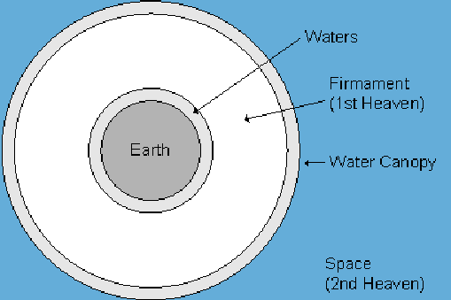

Slide 49
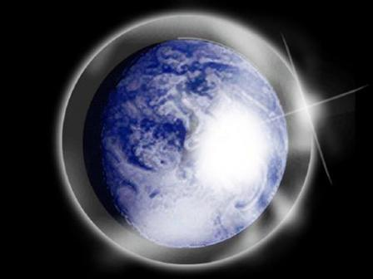

Slide 50
Reasons Against a Local Flood
Size of the ark (450 ft. long, 75 ft. wide, 45 ft. deep)?
Analogy to global Second Advent (Matt 24:37-39; Rev 1:7; 2 Pet 3:5-7)
Animals and birds on the ark?
Church history

Slide 51
Reasons Against a Local Flood
Size of the ark (450 ft. long, 75 ft. wide, 45 ft. deep)?
Analogy to global Second Advent (Matt 24:37-39; Rev 1:7; 2 Pet 3:5-7)
Animals and birds on the ark?
Church history

Slide 52
Dimensions of the Ark? (Genesis 6:15)
Ark = 450ft long, 75ft wide, 45 feet high
Ark capable of holding 125,000 animals

Slide 53
Hugh Ross
The Genesis Question (Navpress, Colorado Springs, CO 1998), 164-65.
“…when God pours out judgment, He gives ample warning ahead of time. He sends a spokesperson, a prophet, and gives that prophet a kind of platform from which to be heard. For the antediluvians, Noah was that prophet and the scaffolding around the ark was his platform.”

Slide 54
Reasons Against a Local Flood
Size of the ark (450 ft. long, 75 ft. wide, 45 ft. deep)?
Analogy to global Second Advent (Matt 24:37-39; Rev 1:7; 2 Pet 3:5-7)
Animals and birds on the ark?
Church history

Slide 55
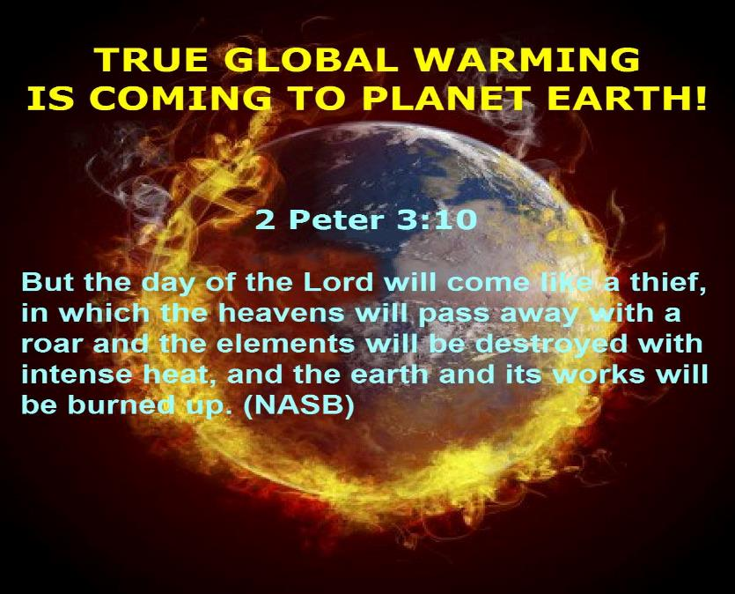

Slide 56
Reasons Against a Local Flood
Size of the ark (450 ft. long, 75 ft. wide, 45 ft. deep)?
Analogy to global Second Advent (Matt 24:37-39; Rev 1:7; 2 Pet 3:5-7)
Animals and birds on the ark?
Church history

Slide 57
Reasons Against a Local Flood
Size of the ark (450 ft. long, 75 ft. wide, 45 ft. deep)?
Analogy to global Second Advent (Matt 24:37-39; Rev 1:7; 2 Pet 3:5-7)
Animals and birds on the ark?
Church history

Slide 58
BELIEVER OR UNBELIEVER?
Writer | Local Flood | Global Flood
Philo | X | ✓
Josephus | X | ✓
Justin Martyr | X | ✓
Theophilus of Antioch | X | ✓
Tertullian | X | ✓
Gregory of Nazianus | X | ✓
John Chrysostom | X | ✓
Augustine of Hippo | X | ✓
SOURCE: Jonathan Sarfati, Refuting Compromise (Green Forest, AR: Master Books), 244.

Slide 59
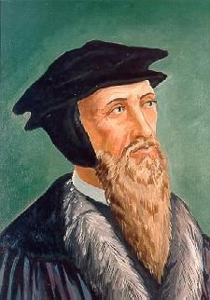
John Calvin
Genesis, 1554 (Edinburgh, UK: Banner of Truth, 1984), p. 272, emphasis mine.
“And the flood was forty days, etc. Moses conspicuously insists on this fact, in order to show that the whole world was immersed in the waters.”

Slide 60
UNIFORMITARIANISM IS NOT BIBLICISM
 | ERA | SCRIPTURE | DISTINCTIVES
1. | CREATION | Genesis 1-2 | No death
2. | FALL | Genesis 3-6 | Death, painful pregnancy & toil, long life spans, no human government
3. | FLOOD | Genesis 7-10 | Shorter life spans, human government, one language, no nations
4. | BABEL | Genesis 11-present | No global government, multiple languages, nations, ethnicities
5. | ANTICHRIST | Rapture to 2nd Advent | Global government, restrainer removed
6. | KINGDOM | Rev. 20:1-10 | Long life spans, kingdom conditions, reality of death, renovated earth
7. | ETERNAL STATE | Rev. 21-22 | No death, new earth

Slide 61
Conclusion

Slide 62
Genesis 7 Outline
God’s instructions to enter the ark (7:1-4)
Entrance into the ark (7:5-12)
God seals the ark (7:13-16)
Flood described (7:17-24)

Slide 63
“The Lord bless you and keep you; the Lord make his face shine on you and be gracious to you; the Lord turn his face toward you and give you peace.” (NIV)

