Slide 1
THE RAPTURE
What and When? – Part 44
Andrew Marshall Woods, Th.M., JD., PhD.
Sr. Pastor, Sugar Land Bible Church

Slide 2
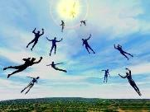
The Rapture Course Overview
What is the Rapture?
When is the Rapture?
Strengthening the Pre-Tribulational case
The opposing views
One second after the Rapture

Slide 3
The Rapture Course Overview
What is the Rapture?
When is the Rapture?
Strengthening the Pre-Tribulational case
The opposing views
One second after the Rapture

Slide 4
What is the Rapture?
An important doctrine
Distinct from the Second Advent
Catching away of all living believers (1 Thess 4:17)
Reunion (1 Thess 4:14-16)
Resurrection (1 Cor 15:50-54)
Exemption from death (1 Cor 15:51, 54-56)
Instantaneous (1 Cor 15:52)
Mystery (1 Cor 15:51)
Imminent (1 Cor 15:51; 1 Thess 4:15)
Traditional doctrine now being recovered

Slide 5
The Rapture Course Overview
What is the Rapture?
When is the Rapture?
Strengthening the Pre-Tribulational case
The opposing views
One second after the Rapture

Slide 6
When is the Rapture?
7 Arguments Favoring the Pre-Tribulation View
Tribulation's purpose concerns Israel (Jer 30:7; Dan 9:24)
No biblical reference to the church on earth during the Tribulation period (Rev 4-22)
Church is promised an exemption from divine wrath (1 Thess 1:10; 5:9; Rom 5:9; Rev 3:10; 6:17)
Rapture is imminent (1 Cor 15:51; 1 Thess 4:15)
Rapture is a comfort (1 Thess 4:18)
Antichrist cannot come to power until the restrainer is removed (2 Thess 2:6-7)
Symbolic parallels (2 Peter 2:5-9)

Slide 7
The Rapture Course Overview
What is the Rapture?
When is the Rapture?
Strengthening the Pre-Tribulational case
The opposing views
One second after the Rapture

Slide 8
Strengthening the Pre-Tribulation Case
John 14:1-4
Revelation 3:10
First Thessalonians 4‒5
Second Thessalonians 2:3a
Matthew 24‒25

Slide 9
The Rapture Course Overview
What is the Rapture?
When is the Rapture?
Strengthening the Pre-Tribulational case
The opposing views
One second after the Rapture

Slide 10
When Will the Rapture Take Place Relative to the Tribulation Period?
Pre-tribulation rapture theory
Mid-tribulation rapture theory
Post-tribulation rapture theory
Pre-wrath rapture theory
Partial rapture theory

Slide 12
Pre-Wrath Rapturism
Description of the view
Six problems with the view considering prior Pre-Tribulational Arguments
Four additional problems with the view

Slide 13
Pre-Wrath Rapturism
Description of the view
Six problems with the view considering prior Pre-Tribulational Arguments
Four additional problems with the view

Slide 14
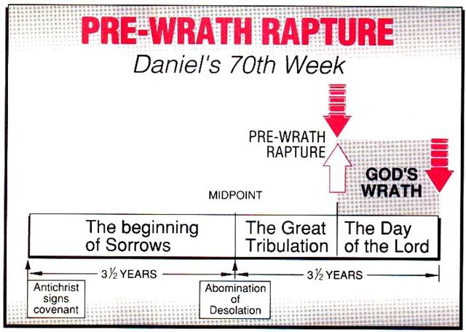
Marvin J. Rosenthal, The Pre-Wrath Rapture of the Church: A New Understanding of the Tribulation, and the Second Coming (Nashville, TN: Thomas Nelson, 1990), 112.

Slide 15
Pre-Wrath Rapturism
Description of the view
Six problems with the view considering prior Pre-Tribulational Arguments
Four additional problems with the view

Slide 16
II. Pre-Wrath Rapture Theory Problems
Places the Church in Daniel’s 70th Week
Fails to acknowledge the missing Church (Rev. 4‒22)
Confines God’s wrath to only a portion of the Tribulation's second half
Denies the Rapture’s imminency
Fails to consistently explain how the rapture is a comfort to the believer (John 14:1; 1 Thess. 4:18; Titus 2:13)
Misinterprets the restrainer (2 Thess. 2:6-7) as Michael the Archangel rather than the Holy Spirit

Slide 17
II. Pre-Wrath Rapture Theory Problems
Places the Church in Daniel’s 70th Week
Fails to acknowledge the missing Church (Rev. 4‒22)
Confines God’s wrath to only a portion of the Tribulation's second half
Denies the Rapture’s imminency
Fails to consistently explain how the rapture is a comfort to the believer (John 14:1; 1 Thess. 4:18; Titus 2:13)
Misinterprets the restrainer (2 Thess. 2:6-7) as Michael the Archangel rather than the Holy Spirit

Slide 18
Daniel 9:24
Seventy weeks have been decreed for your people and your holy city, to finish the transgression, to make an end of sin, to make atonement for iniquity, to bring in everlasting righteousness, to seal up vision and prophecy and to anoint the most holy place.

Slide 19
II. Pre-Wrath Rapture Theory Problems
Places the Church in Daniel’s 70th Week
Fails to acknowledge the missing Church (Rev. 4‒22)
Confines God’s wrath to only a portion of the Tribulation's second half
Denies the Rapture’s imminency
Fails to consistently explain how the rapture is a comfort to the believer (John 14:1; 1 Thess. 4:18; Titus 2:13)
Misinterprets the restrainer (2 Thess. 2:6-7) as Michael the Archangel rather than the Holy Spirit

Slide 20
II. Pre-Wrath Rapture Theory Problems
Places the Church in Daniel’s 70th Week
Fails to acknowledge the missing Church (Rev. 4‒22)
Confines God’s wrath to only a portion of the Tribulation's second half
Denies the Rapture’s imminency
Fails to consistently explain how the rapture is a comfort to the believer (John 14:1; 1 Thess. 4:18; Titus 2:13)
Misinterprets the restrainer (2 Thess. 2:6-7) as Michael the Archangel rather than the Holy Spirit

Slide 22
Marvin J. Rosenthal, The Pre-Wrath Rapture of the Church: A New Understanding of the Tribulation, and the Second Coming (Nashville, TN: Thomas Nelson, 1990), 112.

Slide 23
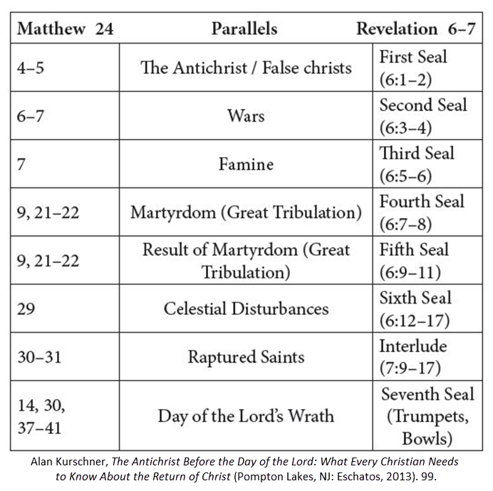

Slide 24
Matthew 24:7
“For nation will rise against nation, and kingdom against kingdom, and there will be famines and earthquakes in various places.”

Slide 25
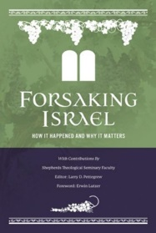
Earthquakes?
“This means that the earthquakes described in Matthew 24:7 (which Rosenthal thinks will occur in the first half of the seven-year era) are the result of the power of Satan or man. Toussaint observes, ‘Interestingly, Rosenthal never explains how the earthquakes in Matthew 24:7 are triggered by humans!’ (Toussaint, “Are the Church and the Rapture in Matthew 24?” The Return, Thomas Ice and Timothy J. Demy, eds. [Grand Rapids: Kregel, 1999], 133).’”
Larry D. Pettegrew, "The Messiah's Lecture on the Future of Israel," in Forsaking Israel: How It Happened and Why It Matters, ed. Larry D. Petegrew (The Woodlands, TX: Kress Biblical Resources, 2020), 364 n. 24.

Slide 26
Revelation 6:16-17
^{“16} and they said to the mountains and the rocks, ‘Fall on us and hide us from the sight of Him who sits on the throne, and from the wrath [orgḗ] of the Lamb; ¹⁷ for the great day of Their wrath [orgḗ] has come [ēlethen], and who is able to stand?’”

Slide 27
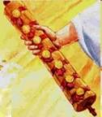
1st Six Seals (Revelation 6)
SEAL 1 – 6:1-2 – Advent of antichrist
SEAL 2 – 6:3-4 – War
SEAL 3 – 6:5-6 – Famine
SEAL 4 – 6:7-8 – Death
SEAL 5 – 6:9-11 – Martyrdoms
SEAL 6 – 6:12-17 – Cosmic disturbances

Slide 28
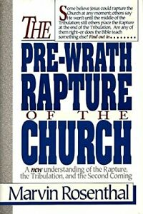
Marvin Rosenthal
“In Revelation 6:17 again the equivalent phrase ‘for the great day of his wrath is come [aorist]’ can be demonstrated to have but one meaning: God’s day of the Lord’s wrath is impending. It is about to happen; it has not yet occurred. There is no legitimate way that the phrase ‘the great day of his wrath is come’ in the context of Revelation 6:17 can be made retroactive to include the first six seals…Contextually, therefore, once again God‘s wrath cannot be understood to include the first six deals.”
Marvin J. Rosenthal, The Pre-Wrath Rapture of the Church: A New Understanding of the Tribulation, and the Second Coming (Nashville, TN: Thomas Nelson, 1990), 166, 71.

Slide 29
Rev. 6:16-17 Robert L. Thomas, Revelation 1–7: An Exegetical Commentary, ed. Kenneth Barker (Chicago: Moody, 1992), 457-58.
"Mankind in his rebellion correctly analyzes the cosmic and terrestrial disturbances as a part of the great end-time day of wrath from the one sitting on the throne and from the Lamb. The verb ēlethen (‘has come’) is aorist indicative, referring to a previous arrival of wrath, not something that is about to take place. Men see the arrival of this day at least as early as the cosmic upheavals that characterize the sixth seal (6:12-14), but upon reflection they probably recognize that it was already in effect with the death of one-fourth of the population (6:7-8), the worldwide famine (6:5-6), and the global warfare (6:3-4). The rapid sequence of all of these events could not escape notice, but the light of their true explanation does not dawn upon human consciousness until the severe phenomena of the sixth seal arrive."

Slide 30
Gerald B. Stanton
“...Rosenthal. For he constantly asserts that the outpoured wrath of God does not commence until Revelation 8:1, the seventh seal, which immediately introduces the unprecedented judgments of the seven trumpets…Even the most casual reading of Revelation 6:12-17 reveals that the cry of verses 6-17 is a scream of terror from the wicked, rebellious human leaders who have endured war and famine, death and destruction, a shattering earthquake, and a frightful disruption of heavenly bodies under the earlier judgments. Obviously, they are responding to past judgment and not judgments yet to come, for wicked men have no ability to speak a prophecy! It is true that the aorist tense normally has no time significance.”
Gerald B. Stanton, Kept from the Hour: Biblical Evidence for the Pretribulational Return of Christ (Grand Rapids: Zondervan, 1956; reprint, Miami Springs, FL: Schoettle, 1991), 387-88.

Slide 31
Gerald B. Stanton
“But the verb ēlethen is in the aorist tense and indicative mood, and when this occurs it refers to a past action and not to a future [H. E. Dana and Julius R. Mantey, A Manual Grammar of the Greek New Testament (New York: Macmillan, 1950), 178]. Hence, the proper translation is ‘the great day of his wrath is come,’ or as the vast majority of translators put it, the great day of his wrath has come.’ It is a major error to force the translation to declare, ‘the great day of his wrath will come.’ One can only conclude that this strong reference to the wrath of God is the direct response of the wicked to their shattering experience under the first six seals, and not a veiled prophecy of coming trumpet judgments.”
Gerald B. Stanton, Kept from the Hour: Biblical Evidence for the Pretribulational Return of Christ (Grand Rapids: Zondervan, 1956; reprint, Miami Springs, FL: Schoettle, 1991), 388.

Slide 32
1st Six Seals (Revelation 6)
SEAL 1 – 6:1-2 – Advent of antichrist
SEAL 2 – 6:3-4 – War
SEAL 3 – 6:5-6 – Famine
SEAL 4 – 6:7-8 – Death
SEAL 5 – 6:9-11 – Martyrdoms
SEAL 6 – 6:12-17 – Cosmic disturbances

Slide 33
Job 19:29
“Then be afraid of the sword for yourselves, For wrath brings the punishment of the sword, So that you may know there is judgment.”

Slide 34
2 Chronicles 36:16-17
^{“16} but they continually mocked the messengers of God, despised His words, and scoffed at His prophets, until the wrath of the Lord rose against His people, until there was no remedy. ¹⁷ So He brought up against them the king of the Chaldeans, who killed their young men with the sword in the house of their sanctuary, and had no compassion on young man or virgin, old man or frail; He handed them all over to him.”

Slide 35
Isaiah 51:19-20
^{“19} These two things have happened to you; Who will mourn for you? The devastation and destruction, famine and sword; How shall I comfort you? ²⁰ Your sons have fainted, They lie helpless at the head of every street, Like an antelope in a net, Full of the wrath of the Lord, The rebuke of your God.”

Slide 36
Jeremiah 21:5-7, 9
^{“5} And I Myself will make war against you with an outstretched hand and a mighty arm, and in anger, wrath, and great indignation. ⁶ I will also strike the inhabitants of this city, both the people and the animals; they will die of a great plague. ⁷ Then afterward,” declares the Lord, “I will hand Zedekiah king of Judah, his servants, and the people, that is, those who survive in this city from the plague, the . . .

Slide 37
Jeremiah 21:5-7, 9
…sword, and the famine, over to Nebuchadnezzar king of Babylon, to their enemies, and to those who seek their lives; and he will strike and kill them with the edge of the sword. He will not spare them nor have pity nor compassion.”’… ⁹ Anyone who stays in this city will die by the sword, by famine, or by plague; but anyone who leaves and goes over to the Chaldeans who are besieging you will live, and he will have his own life as plunder.”

Slide 38
Jeremiah 44:8, 11-12
^{“8} provoking Me to anger with the works of your hands, burning sacrifices to other gods in the land of Egypt where you are entering to reside, so that you may be eliminated and become a curse and a disgrace among all the nations of the earth?... ¹¹ “Therefore thus says the LORD of hosts, the God of Israel, ‘Behold, I am going to set My face against you for woe, even to cut off all Judah. ¹² And I will take . . .

Slide 39
Jeremiah 44:8, 11-12
...away the remnant of Judah who have set their minds on entering the land of Egypt to reside there, and they will all meet their end in the land of Egypt; they will fall by the sword or meet their end by famine. From the small to the great, they will die by the sword and famine; and they will become a curse, an object of horror, an imprecation, and a disgrace.”

Slide 40
Jeremiah 50:13, 25
^{“13} Because of the wrath of the Lord she will not be inhabited, But she will be completely desolate; Everyone who passes by Babylon will be horrified And will hiss because of all her wounds…²⁵ The Lord has opened His armory And has brought out the weapons of His indignation, For it is a work of the Lord God of armies In the land of the Chaldeans.”

Slide 41
Ezekiel 7:14-15
¹⁴‘They have blown the trumpet and made everything ready, but no one is going to the battle, for My wrath is against all their multitude. ¹⁵ The sword is outside the city and the plague and the famine are within. Anyone who is in the field will die by the sword, while famine and the plague will consume those in the city.

Slide 42
1st Six Seals (Revelation 6)
SEAL 1 – 6:1-2 – Advent of antichrist
SEAL 2 – 6:3-4 – War
SEAL 3 – 6:5-6 – Famine
SEAL 4 – 6:7-8 – Death
SEAL 5 – 6:9-11 – Martyrdoms
SEAL 6 – 6:12-17 – Cosmic disturbances

Slide 43
Revelation 6:8
^{“8} I looked, and behold, an ashen horse; and the one who sat on it had the name Death, and Hades was following with him. Authority was given to them over a fourth of the earth, to kill with sword, and famine, and plague, and by the wild animals of the earth.”

Slide 44
Ezekiel 5:15-17
“¹⁵ ‘So it shall be a reproach, a taunt, a lesson, and an astonishment to the nations that are all around you, when I execute judgments among you in anger and in fury and in furious rebukes. I, the Lord, have spoken. ¹⁶ When I send against them the terrible arrows of famine which shall be for destruction, which I will send to destroy you, I will increase the famine upon you and cut off your supply of bread. ¹⁷ So I will send against you famine and wild beasts, and they will bereave you. Pestilence and blood shall pass through you, and I will bring the sword against you. I, the Lord, have spoken.’ ”

Slide 45
Ezekiel 7:3, 8, 15
^{“3} Now upon you I will soon pour out My fury, And spend My anger upon you; I will judge you according to your ways, And I will repay you for all your abominations… ⁸ Now upon you I will soon pour out My fury, And spend My anger upon you; I will judge you according to your ways, And I will repay you for all your abominations. ¹⁵ The sword is outside the city and the plague and the famine are within. Anyone who is in the field will die by the sword, while famine and the plague will consume those in the city.”

Slide 46
Ezekiel 14:19, 21
^{“19} “Or if I send a pestilence into that land and pour out My fury on it in blood, and cut off from it man and beast.”…²¹ For thus says the Lord God: “How much more it shall be when I send My four severe judgments on Jerusalem—the sword and famine and wild beasts and pestilence—to cut off man and beast from it?”

Slide 47
Ezekiel 7:19
“‘They will throw their silver into the streets, And their gold will be like refuse; Their silver and their gold will not be able to deliver them In the day of the wrath of the Lord; They will not satisfy their souls, Nor fill their stomachs, Because it became their stumbling block of iniquity.”

Slide 48
Marvin J. Rosenthal, The Pre-Wrath Rapture of the Church: A New Understanding of the Tribulation, and the Second Coming (Nashville, TN: Thomas Nelson, 1990), 112.

Slide 49
Revelation 6:8
“I looked, and behold, an ashen horse; and the one who sat on it had the name Death, and Hades was following with him. Authority was given to them over a fourth of the earth, to kill with sword, and famine, and plague, and by the wild animals of the earth.”

Slide 50
1st Six Seals (Revelation 6)
SEAL 1 – 6:1-2 – Advent of antichrist
SEAL 2 – 6:3-4 – War
SEAL 3 – 6:5-6 – Famine
SEAL 4 – 6:7-8 – Death
SEAL 5 – 6:9-11 – Martyrdoms
SEAL 6 – 6:12-17 – Cosmic disturbances

Slide 51
Revelation 1:18
“I am He who lives, and was dead, and behold, I am alive forevermore. Amen. And I have the keys of Hades and of Death.”

Slide 52
Revelation 6:16-17
^{“16} and they said to the mountains and the rocks, ‘Fall on us and hide us from the sight of Him who sits on the throne, and from the wrath [orgḗ] of the Lamb; ¹⁷ for the great day of Their wrath [orgḗ] has come [erchomai], and who is able to stand?’”

Slide 53
1st Six Seals (Revelation 6)
SEAL 1 – 6:1-2 – Advent of antichrist
SEAL 2 – 6:3-4 – War
SEAL 3 – 6:5-6 – Famine
SEAL 4 – 6:7-8 – Death
SEAL 5 – 6:9-11 – Martyrdoms
SEAL 6 – 6:12-17 – Cosmic disturbances

Slide 55
II. Pre-Wrath Rapture Theory Problems
Places the Church in Daniel’s 70th Week
Fails to acknowledge the missing Church (Rev. 4‒22)
Confines God’s wrath to only a portion of the Tribulation's second half
Denies the Rapture’s imminency
Fails to consistently explain how the rapture is a comfort to the believer (John 14:1; 1 Thess. 4:18; Titus 2:13)
Misinterprets the restrainer (2 Thess. 2:6-7) as Michael the Archangel rather than the Holy Spirit

Slide 56
Imminent (1 Cor 15:51; 1 Thess 4:15)
Imminency definition
James 5:8; 1 Thess 1:10; 1 Cor 1:7; Philip 3:20
We are to be looking for Jesus Christ and not the Antichrist!
Motivator (Holiness, Evangelism)
Pre-wrath Rapturism denies imminency

Slide 57
Imminent (1 Cor 15:51; 1 Thess 4:15)
Imminency definition
James 5:8; 1 Thess 1:10; 1 Cor 1:7; Philip 3:20
We are to be looking for Jesus Christ and not the Antichrist!
Motivator (Holiness, Evangelism)
Pre-wrath Rapturism denies imminency

Slide 58
Wayne Brindle
"Biblical Evidence for the Imminence of the Rapture," Bibliotheca Sacra 158, no. 630 (April-June 2001): 138-51.
“Four criteria may be suggested, any one of which indicates imminence:
The passage speaks of Christ’s return as at any moment.
The passage speaks of Christ’s return as ‘near,’ without stating any signs that must precede His coming.
The passage speaks of Christ’s return as something that gives believers hope and encouragement, without indicating that these believers will suffer tribulation.
The passage speaks of Christ’s return as giving hope without relating it to God’s judgment of unbelievers.”

Slide 59
Imminent (1 Cor 15:51; 1 Thess 4:15)
Imminency definition
James 5:8; 1 Thess 1:10; 1 Cor 1:7; Philip 3:20
We are to be looking for Jesus Christ and not the Antichrist!
Motivator (Holiness, Evangelism)
Pre-wrath Rapturism denies imminency

Slide 60
John 14:1–4
¹ “Do not let your heart be troubled; believe in God, believe also in Me. ² “In My Father’s house are many dwelling places; if it were not so, I would have told you; for I go to prepare a place for you. ³ “If I go and prepare a place for you, I will come again and receive you to Myself, that where I am, there you may be also. ⁴ “And you know the way where I am going.”

Slide 61
1 Thessalonians 4:13-15
¹³ "But we do not want you to be uninformed, brethren, about those who are asleep, so that you will not grieve as do the rest who have no hope. ¹⁴ For if we believe that Jesus died and rose again, even so God will bring with Him those who have fallen asleep in Jesus. ¹⁵ For this we say to you by the word of the Lord, that we who are alive and remain until the coming of the Lord, will not precede those who have fallen asleep.

Slide 62
1 Corinthians 15:51
“Behold, I tell you a mystery; we will not all sleep, but we will all be changed.”

Slide 63
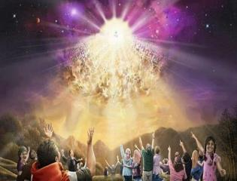
Titus 2:13
“Looking for the blessed hope and the appearing of the glory of our great God and Savior, Christ Jesus.”

Slide 64
Imminent (1 Cor 15:51; 1 Thess 4:15)
Imminency definition
James 5:8; 1 Thess 1:10; 1 Cor 1:7; Philip 3:20
We are to be looking for Jesus Christ and not the Antichrist!
Motivator (Holiness, Evangelism)
Pre-wrath Rapturism denies imminency

Slide 65
Robert H. Gundry, The Church and the Tribulation: Why Christ Won't Come Before the Antichrist Does (Grand Rapids: Zondervan, 1973).

Slide 66
Imminent (1 Cor 15:51; 1 Thess 4:15)
Imminency definition
James 5:8; 1 Thess 1:10; 1 Cor 1:7; Philip 3:20
We are to be looking for Jesus Christ and not the Antichrist!
Motivator (Holiness, Evangelism)
Pre-wrath Rapturism denies imminency

Slide 67
J. Dwight Pentecost
Prophecy For Today, Page 20
“A short time ago, I took occasion to go through the New Testament to mark each reference to the coming of the Lord Jesus Christ and to observe the use made of that teaching about His coming. I was struck a new with the fact that almost without exception, when the coming of Christ is mentioned in the New Testament, it is followed by an exhortation to godliness and holy living.”

Slide 68
1 John 3:2-3
^{“2} Beloved, now we are children of God, and it has not appeared as yet what we will be. We know that when He appears, we will be like Him, because we will see Him just as He is. ³ And everyone who has this hope set on Him purifies himself, just as He is pure.”

Slide 69
Matthew 24:46-50
^{“46} Blessed is that slave whom his master finds so doing when he comes. ⁴⁷ Truly I say to you that he will put him in charge of all his possessions. ⁴⁸ But if that evil slave says in his heart, ‘My master is not coming for a long time,’ ⁴⁹ and he begins to beat his fellow slaves, and he eats and drinks with those habitually drunk; ⁵⁰ then the master of that slave will come on a day that he does not expect, and at an hour that he does not know.”

Slide 70
Imminent (1 Cor 15:51; 1 Thess 4:15)
Imminency definition
James 5:8; 1 Thess 1:10; 1 Cor 1:7; Philip 3:20
We are to be looking for Jesus Christ and not the Antichrist!
Motivator (Holiness, Evangelism)
Pre-wrath Rapturism denies imminency

Slide 71
Marvin J. Rosenthal, The Pre-Wrath Rapture of the Church: A New Understanding of the Tribulation, and the Second Coming (Nashville, TN: Thomas Nelson, 1990), 112.

Slide 72
1st Six Seals (Revelation 6)
SEAL 1 – 6:1-2 – Advent of antichrist
SEAL 2 – 6:3-4 – War
SEAL 3 – 6:5-6 – Famine
SEAL 4 – 6:7-8 – Death
SEAL 5 – 6:9-11 – Martyrdoms
SEAL 6 – 6:12-17 – Cosmic disturbances

Slide 73
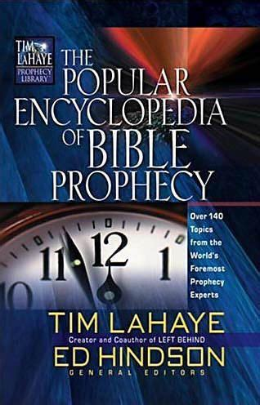
Tony Kessinger
“The doctrine of imminence holds that Christ can come to rapture His church at any moment. Believers in the early church, including the apostle Paul, believed that Christ could come in their lifetime (1 Thessalonians 1:10; 4:13-15; Titus 2:13). The church sees this doctrine as an incentive for ministry and godly living. Does this mean that Christ's return for His church will be at any moment, without any sign, and with no yet-to-be-fulfilled prophesied event to precede it?”
Tony Kessinger, "Pre-Wrath Rapture," in The Popular Encyclopedia of Bible Prophecy: Over 140 Topics from the World's Foremost Prophecy Experts, ed. Tim LaHaye and Ed Hindson (Eugene, OR: Harvest, 2004), 293.

Slide 74
Tony Kessinger
“Pre-wrath rapturists argue that Christ could come in any generation but that signs will herald the general time. Those signs include (1) the emergence of the antichrist, (2) wars and rumors of war, (3) famine, (4) pestilence, and (5) cosmic disturbance. Pre-wrath rapturists emphasize Christians' expectancy of Christ's return rather than its imminency. This expectancy of Christ's return is the catalyst for holy living.”
Tony Kessinger, "Pre-Wrath Rapture," in The Popular Encyclopedia of Bible Prophecy: Over 140 Topics from the World's Foremost Prophecy Experts, ed. Tim LaHaye and Ed Hindson (Eugene, OR: Harvest, 2004), 293.

Slide 75
Robert Lightner
“The prewrath Rapture view is different from the normal pretribulational view in that it does not consistently distinguish between God's program with Israel and His program with the church. The way it differs is that it has the church in Israel's seventieth week and does not hold to the doctrine of imminency”
Robert Lightner, Last Days Handbook: A Complete Guide to the End Times, Including the Meaning of the Year 2000 in Bible Prophecy, rev. ed. (Nashville: Thomas Nelson, 1997), 95.

Slide 76
Gerald B. Stanton
“Rosenthal‘s last chapter incorporates a final summary of his various positions, and also a final...attack against pre-tribulationalism and some of its leaders. The chapter sets forth the ‘pre-wrath rapture’ view as a ‘catalyst for holy living,’ without recognizing that much of that catalyst is lost if forty-two months of ‘sorrows’ and another twenty-one months of battle and martyrdom from the beast must come first.”
Gerald B. Stanton, Kept from the Hour: Biblical Evidence for the Pretribulational Return of Christ (Grand Rapids: Zondervan, 1956; reprint, Miami Springs, FL: Schoettle, 1991), 399.

Slide 78
II. Pre-Wrath Rapture Theory Problems
Places the Church in Daniel’s 70th Week
Fails to acknowledge the missing Church (Rev. 4‒22)
Confines God’s wrath to only a portion of the Tribulation's second half
Denies the Rapture’s imminency
Fails to consistently explain how the rapture is a comfort to the believer (John 14:1; 1 Thess. 4:18; Titus 2:13)
Misinterprets the restrainer (2 Thess. 2:6-7) as Michael the Archangel rather than the Holy Spirit

Slide 79
John 14:1–4
¹ “Do not let your heart be troubled; believe in God, believe also in Me. ² “In My Father’s house are many dwelling places; if it were not so, I would have told you; for I go to prepare a place for you. ³ “If I go and prepare a place for you, I will come again and receive you to Myself, that where I am, there you may be also. ⁴ “And you know the way where I am going.”

Slide 80
1 Thessalonians 4:16-18
¹⁶ For the Lord Himself will descend from heaven with a shout, with the voice of the archangel and with the trumpet of God, and the dead in Christ will rise first. ¹⁷ Then we who are alive and remain will be caught up [harpazō] together with them in the clouds to meet the Lord in the air, and so we shall always be with the Lord. ¹⁸ Therefore comfort one another with these words."

Slide 81
Titus 2:13
“Looking for the blessed hope and the appearing of the glory of our great God and Savior, Christ Jesus.”

Slide 83
Marvin J. Rosenthal, The Pre-Wrath Rapture of the Church: A New Understanding of the Tribulation, and the Second Coming (Nashville, TN: Thomas Nelson, 1990), 112.

Slide 84
1st Six Seals (Revelation 6)
SEAL 1 – 6:1-2 – Advent of antichrist
SEAL 2 – 6:3-4 – War
SEAL 3 – 6:5-6 – Famine
SEAL 4 – 6:7-8 – Death
SEAL 5 – 6:9-11 – Martyrdoms
SEAL 6 – 6:12-17 – Cosmic disturbances

Slide 85
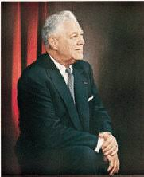
Donald Grey Barnhouse
Cited in Mark Hitchcock, “An Overview of Pretribulational arguments,” online: www.pre-trib.org, accessed 27 August 2013, 29-30.
“Jesus may come today, Glad day! Glad day!
And I would see my friend;
Dangers and troubles would end If Jesus should come today.
Glad day! Glad day! Is it the crowning day?
I’ll live for today, nor anxious be, Jesus, my Lord, I soon shall see;
Glad day! Glad day! Is it the crowning day?”

Slide 86
Donald Grey Barnhouse
Cited in Mark Hitchcock, “An Overview of Pretribulational arguments,” online: www.pre-trib.org, accessed 27 August 2013, 29-30.
By way of parody, Dr. Barnhouse also pointed out that if the midtrib or posttrib [or prewrath] advocates sang this song, it would instead have to say:
“Jesus can’t come today, Sad day! Sad day!
And I won't see my friend;
Dangers and troubles won’t end
Because Jesus can’t come today.
Sad day! Sad day! Today is not the crowning day?
I won’t live for today, and anxious I’ll be,
The Beast and the False Prophet I soon shall see,
Sad day! Sad day! Today is not the crowning day?”

Slide 87
II. Pre-Wrath Rapture Theory Problems
Places the Church in Daniel’s 70th Week
Fails to acknowledge the missing Church (Rev. 4‒22)
Confines God’s wrath to only a portion of the Tribulation's second half
Denies the Rapture’s imminency
Fails to consistently explain how the rapture is a comfort to the believer (John 14:1; 1 Thess. 4:18; Titus 2:13)
Misinterprets the restrainer (2 Thess. 2:6-7) as Michael the Archangel rather than the Holy Spirit

Slide 88
2 Thessalonians 2:6-7
⁶And you know what restrains [katechon; neuter] him now, so that in his time he will be revealed. ⁷For the mystery of lawlessness is already at work; only he who now restrains [katechōn; masculine] will do so until he is taken out of the way.

Slide 89
Marvin Rosenthal
“…of paramount importance is the identification of the one who restraints or hinders the Antichrist until ‘he [the restrainer] be taken out of the way.’ The restrainer is neither the Holy Spirit nor human government. Evidence is strained to support either of those contentions. There is, however, substantial evidence to identify the restrainer. He who restraints until ‘he be taken out of the way’ is the Archangel Michael.”
Marvin J. Rosenthal, The Pre-Wrath Rapture of the Church: A New Understanding of the Tribulation, and the Second Coming (Nashville, TN: Thomas Nelson, 1990), 112.

Slide 90
Marvin J. Rosenthal, The Pre-Wrath Rapture of the Church: A New Understanding of the Tribulation, and the Second Coming (Nashville, TN: Thomas Nelson, 1990), 112.

Slide 91
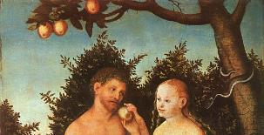
2 Thessalonians 2:9
“that is, the one whose coming is in accord with the activity of Satan, with all power and signs and false wonders.”

Slide 92
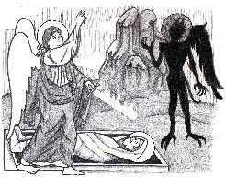
Jude 9
“But Michael the archangel, when he disputed with the devil and argued about the body of Moses, did not dare pronounce against him a railing judgment, but said, ‘The Lord rebuke you!’”

Slide 93
Daniel 12:1
“Now at that time Michael, the great prince who stands guard over the sons of your people [Israel], will arise. And there will be a time of distress such as never occurred since there was a nation until that time; and at that time your people, everyone who is found written in the book, will be rescued.”

Slide 94
2 Thessalonians 2:6-7
⁶And you know what restrains [katechon; neuter] him now, so that in his time he will be revealed. ⁷For the mystery of lawlessness is already at work; only he who now restrains [katechōn; masculine] will do so until he is taken out of the way.

Slide 95
Tony Kessinger
“The pre-wrath view holds to the rather inventive idea that Michael the archangel is the restrainer. This concept fails to take into consideration Michael's special protective ministry toward Israel.”
Tony Kessinger, "Pre-Wrath Rapture," in The Popular Encyclopedia of Bible Prophecy: Over 140 Topics from the World's Foremost Prophecy Experts, ed. Tim LaHaye and Ed Hindson (Eugene, OR: Harvest, 2004), 294.

Slide 96
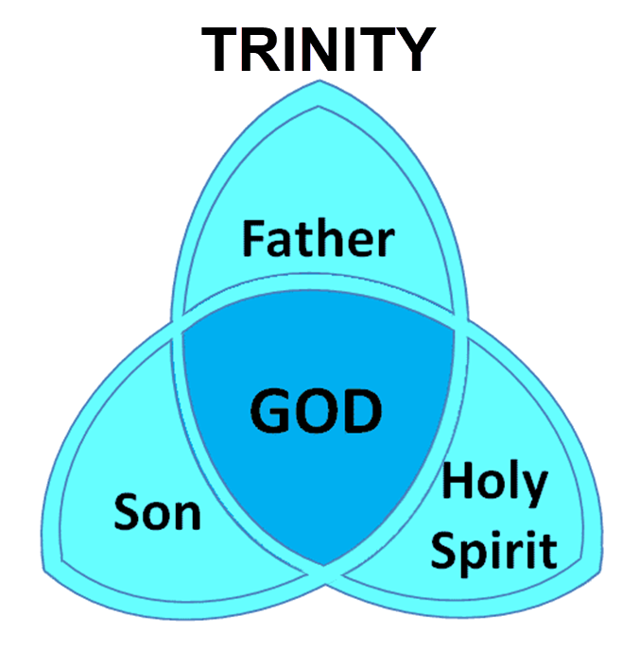

Slide 97
3 Reasons Why the Restrainer is the Holy Spirit (2 Thessalonians 2:6-7)
The Holy Spirit is omnipotent
The Holy Spirit view handles well the switch in gender from the neuter (vs. 6) to the masculine (vs. 7)
The Holy Spirit is active in the world (Gen. 6:3; John 16:7-11)

Slide 98
Restrainer Must First be Removed
Restrainer holds back the Antichrist (2 Thess 2:6-7)
Restrainer = the omnipotent Holy Spirit (2 Thess 2:9)
Holy Spirit permanently indwells all Christians (John 14:16; Rom 8:9)
Spirit indwelt Christians must first be removed prior to the Antichrist's advent

Slide 99
II. Pre-Wrath Rapture Theory Problems
Places the Church in Daniel’s 70th Week
Fails to acknowledge the missing Church (Rev. 4‒22)
Confines God’s wrath to only a portion of the Tribulation's second half
Denies the Rapture’s imminency
Fails to consistently explain how the rapture is a comfort to the believer (John 14:1; 1 Thess. 4:18; Titus 2:13)
Misinterprets the restrainer (2 Thess. 2:6-7) as Michael the Archangel rather than the Holy Spirit

Slide 100
Pre-Wrath Rapturism
Description of the view
Six problems with the view considering prior Pre-Tribulational Arguments
Four additional problems with the view

Slide 101
III. Additional Problems with Pre-Wrath Rapturism
It imposes an artificial construct on Daniel’s 70th Week
Great Tribulation (unequaled distress) before God’s wrath?
It places the Rapture in Revelation 7:9-17
It places the Rapture in Matthew 24:31

Slide 102
III. Additional Problems with Pre-Wrath Rapturism
It imposes an artificial construct on Daniel’s 70th Week
Great Tribulation (unequaled distress) before God’s wrath?
It places the Rapture in Revelation 7:9-17
It places the Rapture in Matthew 24:31

Slide 103
Daniel 9:27
And he will make a firm covenant with the many for one week, but in the middle of the week he will put a stop to sacrifice and grain offering; and on the wing of abominations will come one who makes desolate, even until a complete destruction, one that is decreed, is poured out on the one who makes desolate.

Slide 105
PROPHETIC SYNONYMNS
Division of the Tribulation into two 3½ year periods
42 months - Rev. 11:2; 13:5
1260 days – Rev. 11:3; 12:6
Time, times, and a half a time – Dan. 7:25; 12:7; 12:14

Slide 106
Matthew 24:15-16, 20
“¹⁵ Therefore when you see the abomination of desolation which was spoken of through Daniel the prophet, standing in the holy place (let the reader understand) ¹⁶ then those who are in Judea must flee to the mountains…²⁰ But pray that your flight will not be in the winter, or on a Sabbath.”

Slide 107
Marvin J. Rosenthal, The Pre-Wrath Rapture of the Church: A New Understanding of the Tribulation, and the Second Coming (Nashville, TN: Thomas Nelson, 1990), 112.

Slide 108
Three Parts?
“…the Scriptures never divide the Tribulation period into thirds. Daniel’s prophecy divides the seventieth week in two (Dan 9:27); half of the Tribulation is described as numbering 1260 days (Rev 11:3; 12:6). In fact, since Revelation 12:14 explains that God will protect fleeing Jews for ‘a time, and times, and half a time’ (1260 days); and since the beginning of this period is the beginning of the last three and one-half years, the Great Tribulation (Matt 24:15-22) must last for 1260 days. The Bible never divides the 1260 days into two 630 days.”
Larry D. Pettegrew, "The Messiah's Lecture on the Future of Israel," in Forsaking Israel: How It Happened and Why It Matters, ed. Larry D. Petegrew (The Woodlands, TX: Kress Biblical Resources, 2020), 340..

Slide 109
III. Additional Problems with Pre-Wrath Rapturism
It imposes an artificial construct on Daniel’s 70th Week
Great Tribulation (unequaled distress) before God’s wrath?
It places the Rapture in Revelation 7:9-17
It places the Rapture in Matthew 24:31

Slide 110
Marvin J. Rosenthal, The Pre-Wrath Rapture of the Church: A New Understanding of the Tribulation, and the Second Coming (Nashville, TN: Thomas Nelson, 1990), 112.

Slide 111
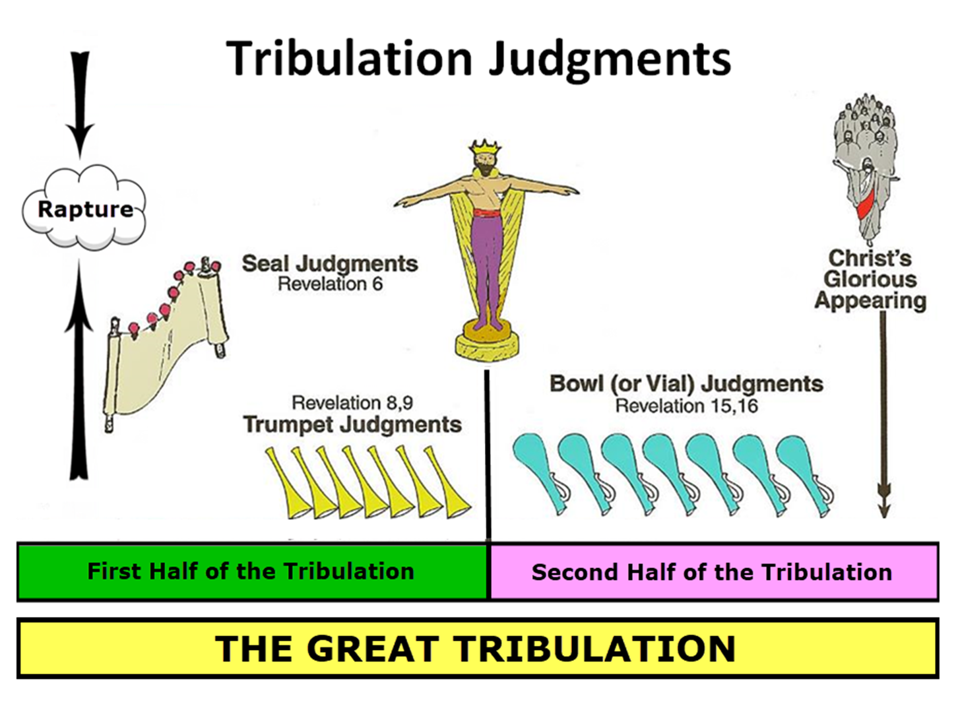
Matthew 24:21
“For then there will be a great tribulation, such as has not occurred since the beginning of the world until now, nor ever will.”

Slide 112
Marvin J. Rosenthal, The Pre-Wrath Rapture of the Church: A New Understanding of the Tribulation, and the Second Coming (Nashville, TN: Thomas Nelson, 1990), 112.

Slide 113
George Zeller "Pre-Wrath Confusion," online: http://www.middletownbiblechurch.org/proph/prewrath.htm, accessed 01 September 2015.
“The PRE-WRATH view teaches that the Day of the Lord begins after the Great Tribulation and that the Day of the Lord is the time of God's wrath. Matthew 24:21, Daniel 12:1 and Jeremiah 30:7 all teach that the Great Tribulation is the greatest time of trouble that the world has ever known. Therefore, if the Day of the Lord is distinct from the Great Tribulation, then the Day of the Lord must be LESS SEVERE than the Great Tribulation. But how can the great day of God's wrath be less severe and less troublesome than the Great Tribulation?”

Slide 114
George Zeller "Pre-Wrath Confusion," online: http://www.middletownbiblechurch.org/proph/prewrath.htm, accessed 01 September 2015.
“How can God's wrath be less severe than man's wrath? How can the trumpets and bowls be less severe than the fifth seal? How can God's wrath be less severe than Satan's wrath? How can unregenerate men and Satan cause more trouble for this world than the wrathful JUDGE Himself? The PRE-WRATH view, when compared with Matthew 24:21 and these other verses, makes the Day of the Lord an ANTICLIMAX!”

Slide 115
Unequaled Distress?
“A…flaw in the prewrath interpretation of Matthew 24:22 is its logical failure. The reason that the Great Tribulation is shortened, according to this verse, is that if it were not, no flesh would be saved. The point of the Scripture is that when the Great Tribulation is over, something better comes on the scene. In the prewrath scheme, however, something more horrible occurs after the Great Tribulation—the Day of the Lord.”
Larry D. Pettegrew, "The Messiah's Lecture on the Future of Israel," in Forsaking Israel: How It Happened and Why It Matters, ed. Larry D. Petegrew (The Woodlands, TX: Kress Biblical Resources, 2020), 341.

Slide 116
Unequaled Distress?
“If no flesh would have survived if the Great Tribulation were allowed to continue on twenty-one months, surely no flesh would survive if the Great Tribulation were to be cut short and followed by twenty-one months of a more horrible Day of the Lord. Moreover, Matthew 24:21 says that the Great Tribulation will be the worst time ever. So, how can it be replaced by the Day of the Lord which is more horrible? Wouldn’t that be the worst time ever? In fact, the Great Tribulation (Matt 24:21) and the Day of the Lord (Dan 12:1; Jer 30:7) are both said to be the worst time ever, so they must be the same time period or at least overlap.”
Larry D. Pettegrew, "The Messiah's Lecture on the Future of Israel," in Forsaking Israel: How It Happened and Why It Matters, ed. Larry D. Petegrew (The Woodlands, TX: Kress Biblical Resources, 2020), 341.

Slide 117
III. Additional Problems with Pre-Wrath Rapturism
It imposes an artificial construct on Daniel’s 70th Week
Great Tribulation (unequaled distress) before God’s wrath?
It places the Rapture in Revelation 7:9-17
It places the Rapture in Matthew 24:31

Slide 119
Revelation 7:9, 13-14
“⁹ After these things I looked, and behold, a great multitude which no one could count, from every nation and all the tribes, peoples, and languages, standing before the throne and before the Lamb, clothed in white robes, and palm branches were in their hands…¹³ Then one of the elders responded, saying to me, . . .

Slide 120
Revelation 7:9, 13-14
. . ‘These who are clothed in the white robes, who are they, and where have they come from?’ ¹⁴ I said to him, ‘My lord, you know.’ And he said to me, ‘These are the ones who come out of the great tribulation [thlípsis], and they have washed their robes and made them white in the blood of the Lamb.’”

Slide 121
Marvin Rosenthal
“That great multitude represents the true Church which goes into the Seventieth Week of Daniel. They are raptured and at the end of the Great Tribulation but before the Day of the Lord begins. They are raptured before God’s wrath is poured out but are not exempt from the ultimate rebellion of unregenerate men...Therefore, in chapter 7 the Church is raptured. But immediately prior to the rapture of the Church the 144,000 Jews are sealed...The 144,000 must be sealed for protection to go through the Day of the Lord before the Church can be caught up to the throne in heaven.”
Marvin J. Rosenthal, The Pre-Wrath Rapture of the Church: A New Understanding of the Tribulation, and the Second Coming (Nashville, TN: Thomas Nelson, 1990), 185.

Slide 122
Revelation 7:9, 13-14
¹³ . . .‘These who are clothed in the white robes, who are they, and where have they come from?’ ¹⁴ I said to him, ‘My lord, you know.’ And he said to me, ‘These are the ones who come out of the great tribulation [thlípsis], and they have washed their robes and made them white in the blood of the Lamb.’”

Slide 123
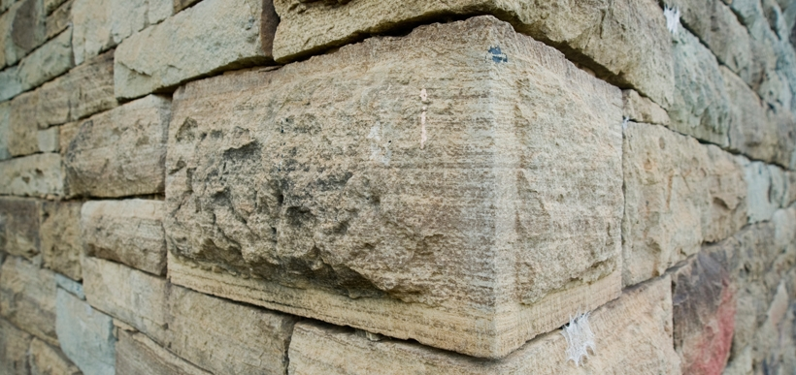
Ephesians 2:20
“having been built on the foundation of the apostles and prophets, Christ Jesus Himself being the corner stone.”

Slide 124
Revelation 7:9, 13-14
¹³ . . .‘These who are clothed in the white robes, who are they, and where have they come (erchomai) from?’ ¹⁴ I said to him, ‘My lord, you know.’ And he said to me, ‘These are the ones who come (erchomai) out of the great tribulation [thlípsis], and they have washed their robes and made them white in the blood of the Lamb.’”

Slide 125
1 Corinthians 15:52
“in a moment [atomos], in the twinkling of an eye, at the last trumpet; for the trumpet will sound, and the dead will be raised imperishable, and we will be changed.”

Slide 126
Rev. 7:14 Robert L. Thomas, Revelation 1–7: An Exegetical Commentary, ed. Kenneth Barker (Chicago: Moody, 1992), 497, n. 119.
"A…possible understanding that it is a departure after the Great Tribulation is completed (Marvin Rosenthal, The Pre-Wrath Rapture of the Church [Nashville: Thomas Nelson, 1990], p. 185) can be dismissed because it neglects the ongoing nature of the departure indicated by the present participle ἐρχόμενοι and rests on an unwarranted distinction between the Great Tribulation and the day of the God’s wrath."

Slide 127
Gerald B. Stanton
“However, the innumerable multitude is not like the Church, which goes to heaven as a group at the rapture. Rather, they are martyrs who one at a time lay down their lives throughout the seven-year period. The Greek present tense in Revelation 7:14 stresses that they ‘continually come’ out of great Tribulation, and obviously do not go to heaven as a single group. It is likewise strange, if they do represent the Church, that John could not recognize them, for John was an apostle of Christ, a member of the early Church, and part of its essential foundation. Also, the Church is composed of all believers since Pentecost, and cannot be limited solely to Tribulation martyrs.”
Gerald B. Stanton, Kept from the Hour: Biblical Evidence for the Pretribulational Return of Christ (Grand Rapids: Zondervan, 1956; reprint, Miami Springs, FL: Schoettle, 1991), 390.

Slide 128
Distinctions Between 144,000 & Multitude
144,000 | MULTITUDE
Revelation 7:1-8 | Revelation 7:9-17
Numbered | Innumerable
Jews | All nations
Sealed | Slain
Sealed before the Tribulation | Converted out of the Tribulation
Hitchcock and Ice, The Truth Behind Left Behind, 77

Slide 129
III. Additional Problems with Pre-Wrath Rapturism
It imposes an artificial construct on Daniel’s 70th Week
Great Tribulation (unequaled distress) before God’s wrath?
It places the Rapture in Revelation 7:9-17
It places the Rapture in Matthew 24:31

Slide 130
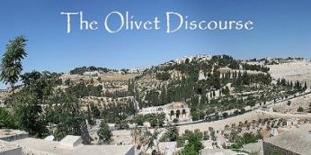
Matthew 24:31
“And He will send forth His angels with a great trumpet and they will gather together [episynagō] His elect from the four winds, from one end of the sky to the other.”

Slide 132
1 Thessalonians 4:16-18
¹⁶ For the Lord Himself will descend from heaven with a shout, with the voice of the archangel and with the trumpet of God, and the dead in Christ will rise first. ¹⁷ Then we who are alive and remain will be caught up together with them in the clouds to meet the Lord in the air, and so we shall always be with the Lord. ¹⁸ Therefore comfort one another with these words."

Slide 133
1 Corinthians 15:50-51
“⁵⁰ Now I say this, brethren, that flesh and blood cannot inherit the kingdom of God; nor does the perishable inherit the imperishable. ⁵¹ Behold, I tell you a mystery; we will not all sleep, but we will all be changed.”

Slide 134
Matthew 24:31
“And He will send forth His angels with a great trumpet and they will gather together [episynagō] His elect from the four winds, from one end of the sky to the other.”

Slide 135
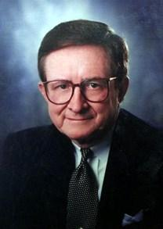
John A. Sproule
"An Exegetical Defense of Pretribulationalism" (Th.D. diss., Grace Theological Seminary, 1981), 53.
“Where does Paul mention the darkening of the sun (Matt. 24:29), the moon not giving its light (Matt. 24:29), the stars falling from the sky (Matt. 24:29), the powers of the heavens being shaken (Matt. 24:29), all the tribes of the earth mourning (Matt. 24:30), all the world seeing the coming of the Son of Man (Matt. 24:30), or God sending forth angels (Matt.24:31)?”

Slide 136
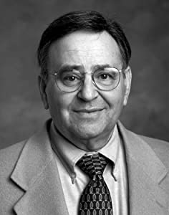
Paul D. Feinberg
"Response: Paul D. Feinberg," in The Rapture: Pre-, Mid-, or Posttribulational, ed. Richard R. Reiter (Grand Rapids: Zondervan, 1984), 225.
“Notice what happens when you examine both passages carefully. In Matthew the Son of Man comes on the clouds, while in 1 Thessalonians 4 the ascending believers are in them. In Matthew the angels gather the elect; in 1 Thessalonians the Lord Himself (note the emphasis) gathers the believers. Thessalonians only speaks of the voice of the archangel. In the Olivet Discourse nothing is said about a resurrection, while in the latter text it is the central point. In the two passages the differences in what will take place prior to the appearance of Christ is striking. Moreover, the order of ascent is absent from Matthew in spite of the fact that it is the central part of the epistle.”

Slide 137
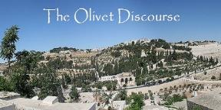
Preview of Matthew 24–25
The problem
The larger context
The immediate context (23:37-39)
The Disciples’ questions (24:1-3)
The Tribulation’s first half (24:4-14)
The Tribulation’s mid-point (24:15-20)
The Tribulation’s second half (24:21-22)
The Second Advent (24:23-31)
Eight parabolic exhortations (24:32‒25:46)

Slide 138
Matthew 23:37-39
³⁷ “Jerusalem, Jerusalem, who kills the prophets and stones those who are sent to her! How often I wanted to gather [episynagō] your children together, the way a hen gathers [episynagō] her chicks under her wings, and you were unwilling. ³⁸ Behold, your house is being left to you desolate! ³⁹ For I say to you, from now on you will not see Me until you say, ‘Blessed is He who comes in the name of the Lord!’”

Slide 139
Matthew 24:31
“And He will send forth His angels with a great trumpet and they will gather together [episynagō] His elect from the four winds, from one end of the sky to the other.”

Slide 140
Isaiah 27:13
“It will come about also in that day that a great trumpet will be blown, and those who were perishing in the land of Assyria and who were scattered in the land of Egypt will come and worship the Lord in the holy mountain at Jerusalem.”

Slide 141
Isaiah 11:11-12
^{“11} Then it will happen on that day that the Lord Will again recover the second time with His hand The remnant of His people, who will remain, From Assyria, Egypt, Pathros, Cush, Elam, Shinar, Hamath, And from the islands of the sea.¹² And He will lift up a standard for the nations And assemble the banished ones of Israel, And will gather the dispersed of Judah From the four corners of the earth.”

Slide 142
Conclusion

Slide 143
Pre-Wrath Rapturism
Description of the view
Six problems with the view considering prior Pre-Tribulational Arguments
Four additional problems with the view

