Slide 1
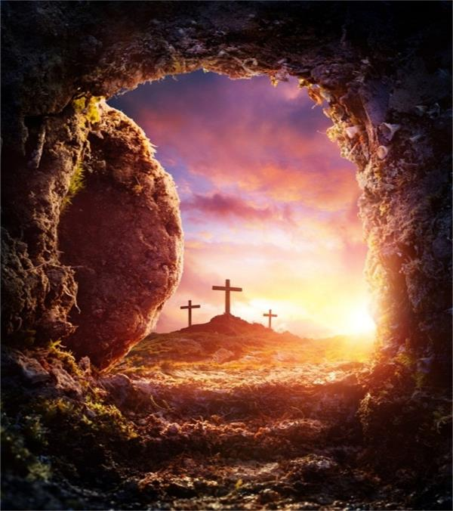
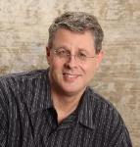
Holy Week in Advance
Dr. Andy Woods
Senior Pastor – Sugar Land Bible Church
President – Chafer Theological Seminary

Slide 2
Luke 24:27, 44
“²⁷ Then beginning with Moses and with all the prophets, He explained to them the things concerning Himself in all the Scriptures…⁴⁴ Now He said to them, ‘These are My words which I spoke to you while I was still with you, that all things which are written about Me in the Law of Moses and the Prophets and the Psalms must be fulfilled.’”

Slide 3
John 5:39, 46
“³⁹ You search the Scriptures because you think that in them you have eternal life; it is these that testify about Me . . . ⁴⁶ For if you believed Moses, you would believe Me, for he wrote about Me.”

Slide 4
Acts 17:1-3
“¹ Now when they had traveled through Amphipolis and Apollonia, they came to Thessalonica, where there was a synagogue of the Jews. ² And according to Paul’s custom, he visited them, and for three Sabbaths reasoned with them from the Scriptures, ³ explaining and giving evidence that the Christ had to suffer and rise from the dead, and saying, “‘This Jesus whom I am proclaiming to you is the Christ.’”

Slide 5
1 Corinthians 15:3-4
“³ For I handed down to you as of first importance what I also received, that Christ died for our sins according to the Scriptures, ⁴ and that He was buried, and that He was raised on the third day according to the Scriptures.”

Slide 6
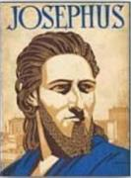
Josephus
Antiquities 18.3.3
“About this time there lived Jesus, a wise man, if indeed one ought to call him a man. For he was one who performed surprising deeds and was a teacher of such people as accept the truth gladly. He won over many Jews and many of the Greeks. He was the Christ. And when, upon the accusation of the principal men among us, Pilate had condemned him to a cross, those who had first come to love him did not cease. He appeared to them spending a third day restored to life, for the prophets of God had foretold these things and a thousand other marvels about him. And the tribe of the Christians, so called after him, has still to this day not disappeared.”

Slide 7
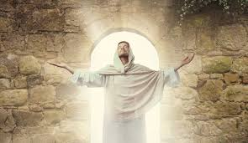
The Uniqueness of Jesus Christ
A man of verifiable history
A man of fulfilled prophecy
A man of predictive prophecy
A man of unimpeachable morality
A man of profound teaching
A man of authentic miracles
A man of bodily resurrection

Slide 8
The Uniqueness of Jesus Christ
A man of verifiable history
A man of fulfilled prophecy
A man of predictive prophecy
A man of unimpeachable morality
A man of profound teaching
A man of authentic miracles
A man of bodily resurrection

Slide 9
OT Prophecies About Holy Week
prophecy | scripture | fulfilled | years in advance
Day of Palm Sunday | Dan. 9:25 | Luke 19:42 | 600 years
Riding on a Donkey | Zech. 9:9 | Matt. 21:1-8 | 500 years
National Rejection | Dan. 9:26 | John 1:11 | 600 years
Innocent | Isa. 53:9 | 1 John 2:1 | 700 years
Silent Before Accusers | Isa. 53:7 | Mark 15:4-5 | 700 years

Slide 10
OT Prophecies About Christ
prophecy | scripture | fulfilled | years in advance
Gamble for His Clothing | Ps. 22:18 | Matt. 27:35-36 | 1000 years
Pierced | Isa. 53:5 | John 19:34 | 700 years
No Broken Bones | Ps. 22:17 | John 19:34-36 | 1000 years
Crucified Between Thieves | Isa. 53:12 | Matt. 27:38 | 700 years
Buried in Rich Man’s Tomb | Isa. 53:9 | John 19:38 | 700 years
Resurrect from the Dead | Ps. 16:10 | Acts 2:22-32 | 1000 years
Notes:
109 prophecies…
Peter Stoner – SCIENCE SPEAKS, An Evaluation of Certain Christian Evidences
To fulfill just 8 prophecies =1 X 10 to the twenty-eighth power!
Can we visualize this with an illustration? Suppose we took an atheistic professor, blindfolded him and covered the state of Texas two feet deep with silver dollars. Then we put a check on one of those silver dollars and mixed them up. The odds of one person fulfilling just these eight prophecies would be the same as this atheistic professor selecting the silver dollar upon which we have placed a check, in his first try.
https://www.bereanpublishers.com/the-odds-of-eight-messianic-prophecies-coming-true/

Slide 11
OT Prophecies About Holy Week
prophecy | scripture | fulfilled | years in advance
Day of Palm Sunday | Dan. 9:25 | Luke 19:42 | 600 years
Riding on a Donkey | Zech. 9:9 | Matt. 21:1-8 | 500 years
National Rejection | Dan. 9:26 | John 1:11 | 600 years
Innocent | Isa. 53:9 | 1 John 2:1 | 700 years
Silent Before Accusers | Isa. 53:7 | Mark 15:4-5 | 700 years

Slide 12
Daniel 9:25
“So you are to know and discern that from the issuing of a decree to restore and rebuild Jerusalem until Messiah the Prince there will be seven weeks and sixty-two weeks; it will be built again, with plaza and moat, even in times of distress.”

Slide 13
Messiah must present Himself to Israel on March 30, A.D. 33 Daniel 9:25

Slide 14
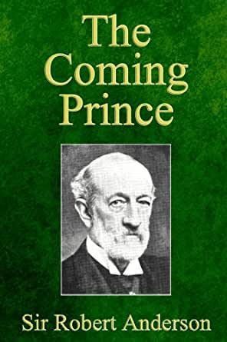

Slide 15
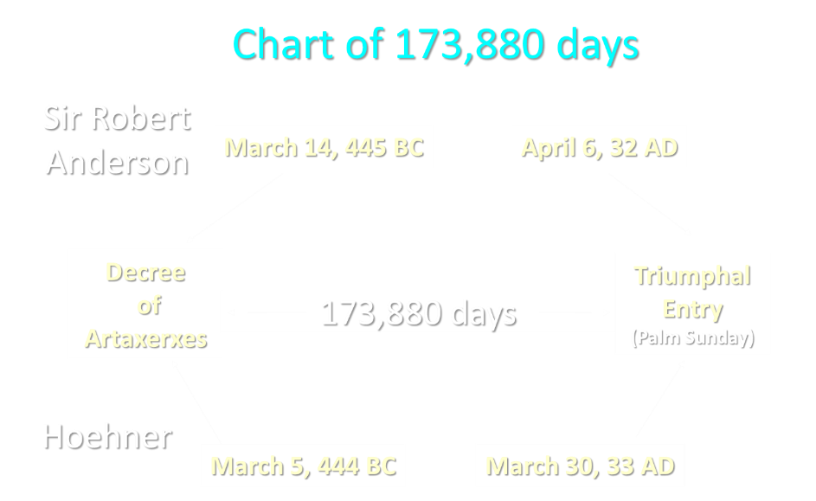

Slide 16
Luke 19:42-44
⁴² saying, “If you had known in this day, even you, the things which make for peace! But now they have been hidden from your eyes…⁴⁴ and they will level you to the ground and your children within you, and they will not leave in you one stone upon another, because you did not recognize the time of your visitation.”

Slide 17
OT Prophecies About Holy Week
prophecy | scripture | fulfilled | years in advance
Day of Palm Sunday | Dan. 9:25 | Luke 19:42 | 600 years
Riding on a Donkey | Zech. 9:9 | Matt. 21:1-8 | 500 years
National Rejection | Dan. 9:26 | John 1:11 | 600 years
Innocent | Isa. 53:9 | 1 John 2:1 | 700 years
Silent Before Accusers | Isa. 53:7 | Mark 15:4-5 | 700 years

Slide 18
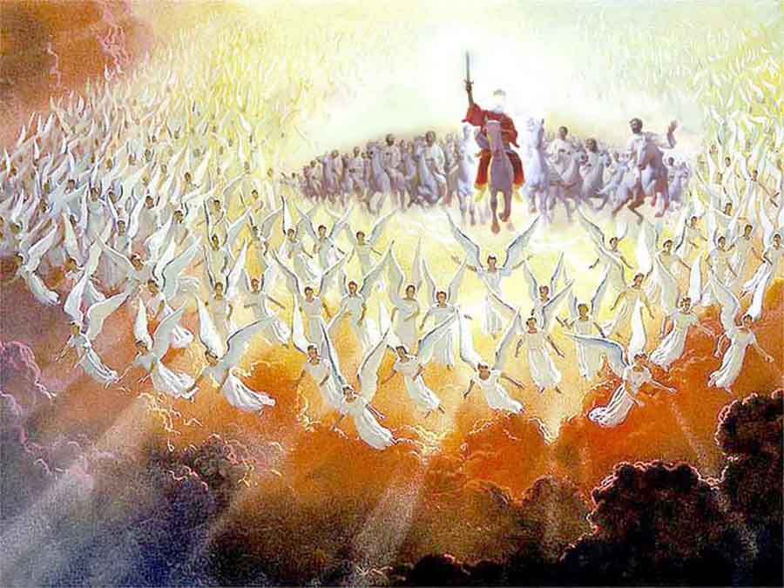

Slide 19
OT Prophecies About Holy Week
prophecy | scripture | fulfilled | years in advance
Day of Palm Sunday | Dan. 9:25 | Luke 19:42 | 600 years
Riding on a Donkey | Zech. 9:9 | Matt. 21:1-8 | 500 years
National Rejection | Dan. 9:26 | John 1:11 | 600 years
Innocent | Isa. 53:9 | 1 John 2:1 | 700 years
Silent Before Accusers | Isa. 53:7 | Mark 15:4-5 | 700 years

Slide 20
Daniel 9:26
“Then after the sixty-two weeks, the Messiah will be cut off and have nothing, and the people of the prince who is to come will destroy the city and the sanctuary. And its end will come with a flood; even to the end there will be war; desolations are determined.”

Slide 21
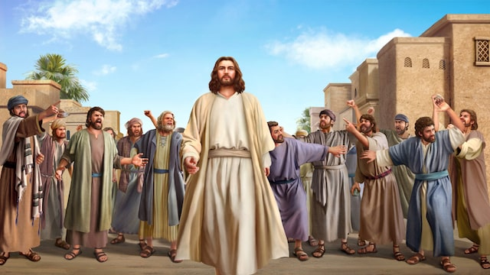
John 1:11
“He came to His own, and those who were His own did not receive Him.’”

Slide 22
OT Prophecies About Holy Week
prophecy | scripture | fulfilled | years in advance
Day of Palm Sunday | Dan. 9:25 | Luke 19:42 | 600 years
Riding on a Donkey | Zech. 9:9 | Matt. 21:1-8 | 500 years
National Rejection | Dan. 9:26 | John 1:11 | 600 years
Innocent | Isa. 53:9 | 1 John 2:1 | 700 years
Silent Before Accusers | Isa. 53:7 | Mark 15:4-5 | 700 years

Slide 23
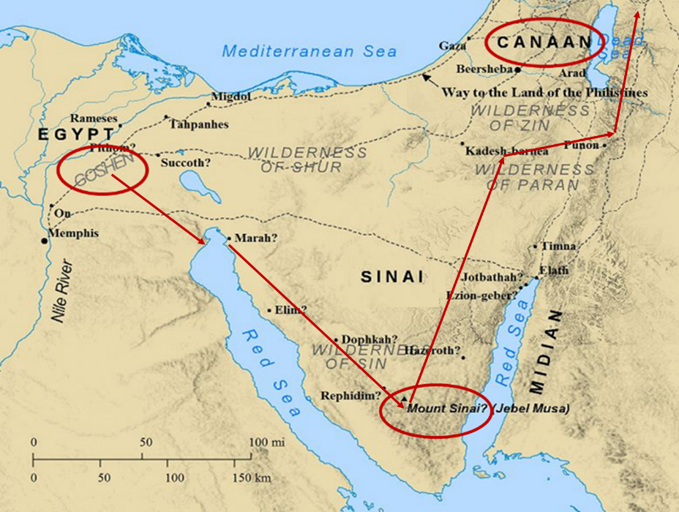

Slide 24
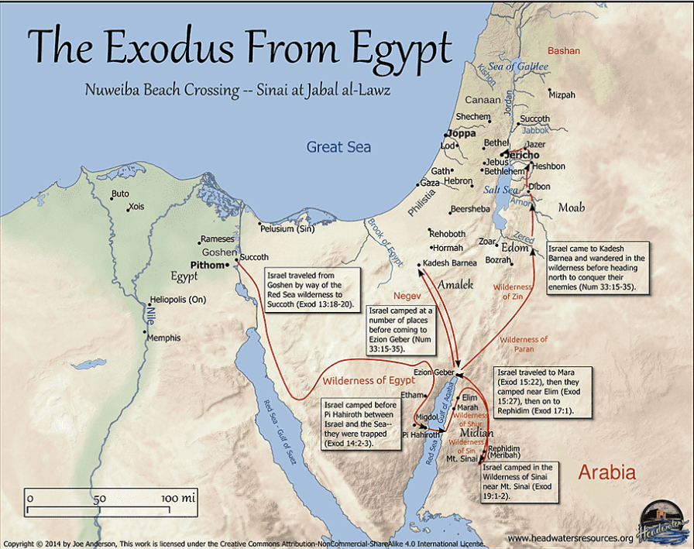

Slide 25
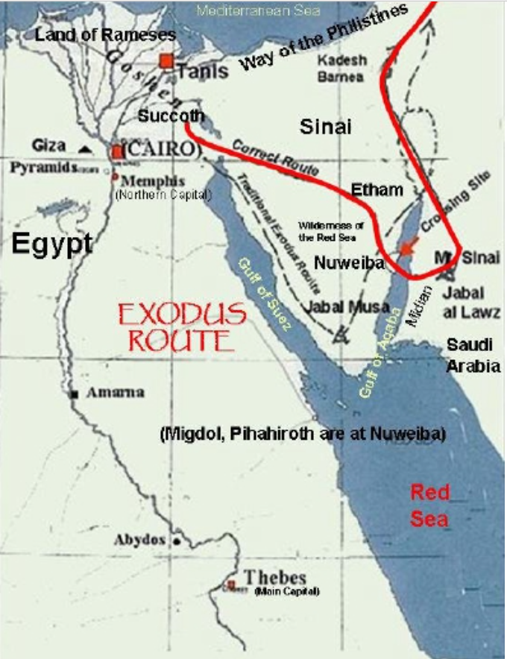

Slide 26
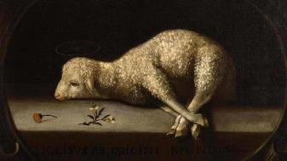
Exodus 12:5
“Your lamb shall be an unblemished male a year old; you may take it from the sheep or from the goats.”

Slide 27
CHRIST’S SIX TRIALS
religious or civil | order | scripture | judge | ruling
Religious – Jewish | 1 | John 18:12-14 | Annas | Ok given to kill Jesus
Religious – Jewish | 2 | Matt. 26:57-68 | Caiaphas | Blasphemy
Religious – Jewish | 3 | Matt. 27:1-2 | Sanhedrin | Death sentence
Civil – Roman | 4 | John 18:28-38a | Pilate | No guilty
Civil – Roman | 5 | Luke 23:6-12 | Herod | Not guilty
Civil – Roman | 6 | John 18:38b ‒19:16 | Pilate | Not guilty but Jesus turned over to Jews
Ryrie Study Bible, p. 1331.

Slide 28
OT Prophecies About Holy Week
prophecy | scripture | fulfilled | years in advance
Day of Palm Sunday | Dan. 9:25 | Luke 19:42 | 600 years
Riding on a Donkey | Zech. 9:9 | Matt. 21:1-8 | 500 years
National Rejection | Dan. 9:26 | John 1:11 | 600 years
Innocent | Isa. 53:9 | 1 John 2:1 | 700 years
Silent Before Accusers | Isa. 53:7 | Mark 15:4-5 | 700 years

Slide 29
OT Prophecies About Christ
prophecy | scripture | fulfilled | years in advance
Gamble for His Clothing | Ps. 22:18 | Matt. 27:35-36 | 1000 years
Pierced | Isa. 53:5 | John 19:34 | 700 years
No Broken Bones | Ps. 22:17 | John 19:34-36 | 1000 years
Crucified Between Thieves | Isa. 53:12 | Matt. 27:38 | 700 years
Buried in Rich Man’s Tomb | Isa. 53:9 | John 19:38 | 700 years
Resurrect from the Dead | Ps. 16:10 | Acts 2:22-32 | 1000 years
Notes:
109 prophecies…
Peter Stoner – SCIENCE SPEAKS, An Evaluation of Certain Christian Evidences
To fulfill just 8 prophecies =1 X 10 to the twenty-eighth power!
Can we visualize this with an illustration? Suppose we took an atheistic professor, blindfolded him and covered the state of Texas two feet deep with silver dollars. Then we put a check on one of those silver dollars and mixed them up. The odds of one person fulfilling just these eight prophecies would be the same as this atheistic professor selecting the silver dollar upon which we have placed a check, in his first try.
https://www.bereanpublishers.com/the-odds-of-eight-messianic-prophecies-coming-true/

Slide 30
OT Prophecies About Christ
prophecy | scripture | fulfilled | years in advance
Gamble for His Clothing | Ps. 22:18 | Matt. 27:35-36 | 1000 years
Pierced | Isa. 53:5 | John 19:34 | 700 years
No Broken Bones | Ps. 22:17 | John 19:34-36 | 1000 years
Crucified Between Thieves | Isa. 53:12 | Matt. 27:38 | 700 years
Buried in Rich Man’s Tomb | Isa. 53:9 | John 19:38 | 700 years
Resurrect from the Dead | Ps. 16:10 | Acts 2:22-32 | 1000 years
Notes:
109 prophecies…
Peter Stoner – SCIENCE SPEAKS, An Evaluation of Certain Christian Evidences
To fulfill just 8 prophecies =1 X 10 to the twenty-eighth power!
Can we visualize this with an illustration? Suppose we took an atheistic professor, blindfolded him and covered the state of Texas two feet deep with silver dollars. Then we put a check on one of those silver dollars and mixed them up. The odds of one person fulfilling just these eight prophecies would be the same as this atheistic professor selecting the silver dollar upon which we have placed a check, in his first try.
https://www.bereanpublishers.com/the-odds-of-eight-messianic-prophecies-coming-true/

Slide 31
OT Prophecies About Christ
prophecy | scripture | fulfilled | years in advance
Gamble for His Clothing | Ps. 22:18 | Matt. 27:35-36 | 1000 years
Pierced | Isa. 53:5 | John 19:34 | 700 years
No Broken Bones | Ps. 22:17 | John 19:34-36 | 1000 years
Crucified Between Thieves | Isa. 53:12 | Matt. 27:38 | 700 years
Buried in Rich Man’s Tomb | Isa. 53:9 | John 19:38 | 700 years
Resurrect from the Dead | Ps. 16:10 | Acts 2:22-32 | 1000 years
Notes:
109 prophecies…
Peter Stoner – SCIENCE SPEAKS, An Evaluation of Certain Christian Evidences
To fulfill just 8 prophecies =1 X 10 to the twenty-eighth power!
Can we visualize this with an illustration? Suppose we took an atheistic professor, blindfolded him and covered the state of Texas two feet deep with silver dollars. Then we put a check on one of those silver dollars and mixed them up. The odds of one person fulfilling just these eight prophecies would be the same as this atheistic professor selecting the silver dollar upon which we have placed a check, in his first try.
https://www.bereanpublishers.com/the-odds-of-eight-messianic-prophecies-coming-true/

Slide 32
Exodus 12:46
“It is to be eaten in a single house; you are not to bring any of the meat outside of the house, nor are you to break any bone of it.”

Slide 33
OT Prophecies About Christ
prophecy | scripture | fulfilled | years in advance
Gamble for His Clothing | Ps. 22:18 | Matt. 27:35-36 | 1000 years
Pierced | Isa. 53:5 | John 19:34 | 700 years
No Broken Bones | Ps. 22:17 | John 19:34-36 | 1000 years
Crucified Between Thieves | Isa. 53:12 | Matt. 27:38 | 700 years
Buried in Rich Man’s Tomb | Isa. 53:9 | John 19:38 | 700 years
Resurrect from the Dead | Ps. 16:10 | Acts 2:22-32 | 1000 years
Notes:
109 prophecies…
Peter Stoner – SCIENCE SPEAKS, An Evaluation of Certain Christian Evidences
To fulfill just 8 prophecies =1 X 10 to the twenty-eighth power!
Can we visualize this with an illustration? Suppose we took an atheistic professor, blindfolded him and covered the state of Texas two feet deep with silver dollars. Then we put a check on one of those silver dollars and mixed them up. The odds of one person fulfilling just these eight prophecies would be the same as this atheistic professor selecting the silver dollar upon which we have placed a check, in his first try.
https://www.bereanpublishers.com/the-odds-of-eight-messianic-prophecies-coming-true/

Slide 34
OT Prophecies About Christ
prophecy | scripture | fulfilled | years in advance
Gamble for His Clothing | Ps. 22:18 | Matt. 27:35-36 | 1000 years
Pierced | Isa. 53:5 | John 19:34 | 700 years
No Broken Bones | Ps. 22:17 | John 19:34-36 | 1000 years
Crucified Between Thieves | Isa. 53:12 | Matt. 27:38 | 700 years
Buried in Rich Man’s Tomb | Isa. 53:9 | John 19:38 | 700 years
Resurrect from the Dead | Ps. 16:10 | Acts 2:22-32 | 1000 years
Notes:
109 prophecies…
Peter Stoner – SCIENCE SPEAKS, An Evaluation of Certain Christian Evidences
To fulfill just 8 prophecies =1 X 10 to the twenty-eighth power!
Can we visualize this with an illustration? Suppose we took an atheistic professor, blindfolded him and covered the state of Texas two feet deep with silver dollars. Then we put a check on one of those silver dollars and mixed them up. The odds of one person fulfilling just these eight prophecies would be the same as this atheistic professor selecting the silver dollar upon which we have placed a check, in his first try.
https://www.bereanpublishers.com/the-odds-of-eight-messianic-prophecies-coming-true/

Slide 35
OT Prophecies About Christ
prophecy | scripture | fulfilled | years in advance
Gamble for His Clothing | Ps. 22:18 | Matt. 27:35-36 | 1000 years
Pierced | Isa. 53:5 | John 19:34 | 700 years
No Broken Bones | Ps. 22:17 | John 19:34-36 | 1000 years
Crucified Between Thieves | Isa. 53:12 | Matt. 27:38 | 700 years
Buried in Rich Man’s Tomb | Isa. 53:9 | John 19:38 | 700 years
Resurrect from the Dead | Ps. 16:10 | Acts 2:22-32 | 1000 years
Notes:
109 prophecies…
Peter Stoner – SCIENCE SPEAKS, An Evaluation of Certain Christian Evidences
To fulfill just 8 prophecies =1 X 10 to the twenty-eighth power!
Can we visualize this with an illustration? Suppose we took an atheistic professor, blindfolded him and covered the state of Texas two feet deep with silver dollars. Then we put a check on one of those silver dollars and mixed them up. The odds of one person fulfilling just these eight prophecies would be the same as this atheistic professor selecting the silver dollar upon which we have placed a check, in his first try.
https://www.bereanpublishers.com/the-odds-of-eight-messianic-prophecies-coming-true/

Slide 37
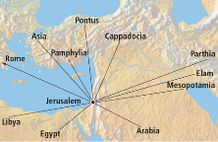
Acts 2 The Beginning of the Church Age
2:22-35 – Christ as the source of the manifestations
2:22 – Miracle worker
2:23 – Rejected by Israel
2:24-29 – Resurrected (Ps 16:8-11)
2:30-32 – Davidic descendant (Ps 132:11)
2:33-35 – At God’s right hand (Ps 110:1)

Slide 38
Josephus
Antiquities 18.3.3
“About this time there lived Jesus, a wise man, if indeed one ought to call him a man. For he was one who performed surprising deeds and was a teacher of such people as accept the truth gladly. He won over many Jews and many of the Greeks. He was the Christ. And when, upon the accusation of the principal men among us, Pilate had condemned him to a cross, those who had first come to love him did not cease. He appeared to them spending a third day restored to life, for the prophets of God had foretold these things and a thousand other marvels about him. And the tribe of the Christians, so called after him, has still to this day not disappeared.”

Slide 39
How Does Jesus Compare?
Deity | Tomb Status
Confucius | Occupied
Buddha | Occupied
Mohammed | Occupied
Jesus | ***EMPTY***
G.B. Hardy, Countdown

Slide 40
John 11:25-27
“²⁵ Jesus said to her, ‘I am the resurrection and the life; he who believes in Me will live even if he dies, ²⁶ and everyone who lives and believes in Me will never die. Do you believe this?’ ²⁷ She said to Him, ‘Yes, Lord; I have believed that You are the Christ, the Son of God, even He who comes into the world.’”

Slide 41
Conclusion

Slide 42
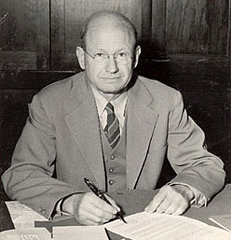
Dr. Peter Stoner
“Suppose that we take 10¹⁷ silver dollars and lay them on the face of Texas. They will cover all of the state two feet deep. Now mark one of these silver dollars and stir the whole mass thoroughly, all over the state. Blindfold a man and tell him that he can travel as far as he wishes, but he must pick up one silver dollar and say that this is the right one. What chance would he have of getting the right one? Just the same chance that the prophets would have had of writing these eight prophecies and having them all come true in any one man, from their day to the present time, providing they wrote using their own wisdom.”
Peter Stoner, Science Speaks: Scientific Proof of the Accuracy of Prophecy and the Bible (Chicago, Moody Press, 1969), 107. Online version at http://sciencespeaks.dstoner.net/

Slide 44
OT Prophecies About Holy Week
prophecy | scripture | fulfilled | years in advance
Day of Palm Sunday | Dan. 9:25 | Luke 19:42 | 600 years
Riding on a Donkey | Zech. 9:9 | Matt. 21:1-8 | 500 years
National Rejection | Dan. 9:26 | John 1:11 | 600 years
Innocent | Isa. 53:9 | 1 John 2:1 | 700 years
Silent Before Accusers | Isa. 53:7 | Mark 15:4-5 | 700 years

Slide 45
OT Prophecies About Christ
prophecy | scripture | fulfilled | years in advance
Gamble for His Clothing | Ps. 22:18 | Matt. 27:35-36 | 1000 years
Pierced | Isa. 53:5 | John 19:34 | 700 years
No Broken Bones | Ps. 22:17 | John 19:34-36 | 1000 years
Crucified Between Thieves | Isa. 53:12 | Matt. 27:38 | 700 years
Buried in Rich Man’s Tomb | Isa. 53:9 | John 19:38 | 700 years
Resurrect from the Dead | Ps. 16:10 | Acts 2:22-32 | 1000 years
Notes:
109 prophecies…
Peter Stoner – SCIENCE SPEAKS, An Evaluation of Certain Christian Evidences
To fulfill just 8 prophecies =1 X 10 to the twenty-eighth power!
Can we visualize this with an illustration? Suppose we took an atheistic professor, blindfolded him and covered the state of Texas two feet deep with silver dollars. Then we put a check on one of those silver dollars and mixed them up. The odds of one person fulfilling just these eight prophecies would be the same as this atheistic professor selecting the silver dollar upon which we have placed a check, in his first try.
https://www.bereanpublishers.com/the-odds-of-eight-messianic-prophecies-coming-true/

Slide 46
“The Lord bless you and keep you; the Lord make his face shine on you and be gracious to you; the Lord turn his face toward you and give you peace.” (NIV)

