Slide 1
PRACTICAL RIGHTEOUSNESS
Dr. Andy Woods
Senior Pastor – Sugar Land Bible Church
President – Chafer Theological Seminary

Slide 2
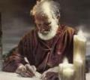
Answering Eleven Questions
Who wrote it? – James
What do we know about the author? – Christ’s ½ Brother
Who was the audience? – Believing Jews in the Diaspora
Where was if written from? – Jerusalem
When was the book written? – A.D. 44‒47
What was the book’s occasion? – Practical righteousness
What is the book’s purpose? – Achieving practical righteousness
What is the book about? – Practical righteousness
What is the book’s theme? – Daily living
What makes the book different? – Practicality
How is the book organized? – Faith and Wisdom

Slide 3
JAMES STRUCTURE
Faith (James 1:1‒3:12)
Wisdom (James 3:13‒5:20)

Slide 4
JAMES STRUCTURE
Faith (James 1:1‒3:12)
Wisdom (James 3:13‒5:20)

Slide 5
JAMES STRUCTURE
Faith (1:1–3:12)
Trials (1:2-18)
Obedience to the Word (1:19-27)
Favoritism (2:1-13)
Faith manifesting works (2:14-26)
Tongue (3:1-12)

Slide 6
JAMES STRUCTURE
Faith (James 1:1‒3:12)
Wisdom (James 3:13‒5:20)

Slide 7
Structure
Wisdom (3:13–5:20)
Wisdom defined (3:13-18)
Spirituality (4:1-12)
Commerce (4:13-17)
Use of wealth (5:1-6)
Waiting for the Lord’s return (5:7-12)
Prayer (5:13-18)
Restoration of the erring brother (5:19-20)

Slide 8
Structure
Wisdom (3:13–5:20)
Wisdom defined (3:13-18)
Spirituality (4:1-12)
Commerce (4:13-17)
Use of wealth (5:1-6)
Waiting for the Lord’s return (5:7-12)
Prayer (5:13-18)
Restoration of the erring brother (5:19-20)

Slide 9
Wisdom (3:13-18)
Wisdom is demonstrated by her actions (3:13)
Human or earthly wisdom (3:14-16)
Heavenly wisdom (3:17-18)

Slide 10
Structure
Wisdom (3:13–5:20)
Wisdom defined (3:13-18)
Spirituality (4:1-12)
Commerce (4:13-17)
Use of wealth (5:1-6)
Waiting for the Lord’s return (5:7-12)
Prayer (5:13-18)
Restoration of the erring brother (5:19-20)

Slide 11
Spiritual Life (4:1-12)
Avoid wrangling (4:1-3)
Avoid worldliness (4:4-6)
Essence of spiritual wisdom (4:7-12)

Slide 12
Spiritual Life (4:1-12)
Avoid wrangling (4:1-3)
Avoid worldliness (4:4-6)
Essence of spiritual wisdom (4:7-12)

Slide 13
I. Avoid Wrangling (4:1-3)
The problem (4:1a)
The source (4:1b-3)
Internal (4:1b-2a)
Prayerlessness (4:2b)
Misdirected prayer (4:3)

Slide 14
Spiritual Life (4:1-12)
Avoid wrangling (4:1-3)
Avoid worldliness (4:4-6)
Essence of spiritual wisdom (4:7-12)

Slide 15
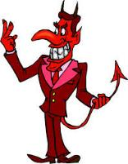
Names & Titles Demonstrating Satan’s Post-Fall, Earthly Authority (Job 1:7; 2:2; Luke 4:5-8; Rom. 8:19-22)
Prince of this world (John 12:31; 14:30; 16:11)
God of this age (2 Cor. 4:4)
Prince and power of the air (Eph. 2:2)
Who the believer wrestles with (Eph. 6:12)
Roaring lion (1 Pet. 5:8)
Whole world lies in his power (1 John 5:19)

Slide 16
II. Avoid Worldliness (4:4-6)
The Consequences (4:4-5)
Enmity against God (4:4)
Alienation of the Holy Spirit (4:5)
The Cause (4:6)

Slide 17
II. Avoid Worldliness (4:4-6)
The Consequences (4:4-5)
Enmity against God (4:4)
Alienation of the Holy Spirit (4:5)
The Cause (4:6)

Slide 18
II. Avoid Worldliness (4:4-6)
The Consequences (4:4-5)
Enmity against God (4:4)
Alienation of the Holy Spirit (4:5)
The Cause (4:6)

Slide 19
II. Avoid Worldliness (4:4-6)
The Consequences (4:4-5)
Enmity against God (4:4)
Alienation of the Holy Spirit (4:5)
The Cause (4:6)

Slide 20
1 Samuel 16:13-14
¹³ So Samuel took the horn of oil and anointed him in the midst of his brothers; and the Spirit of the Lord rushed upon David from that day forward. And Samuel set out and went to Ramah. ¹⁴ Now the Spirit of the Lord left Saul, and an evil spirit from the Lord terrified him.”

Slide 21
John 14:16-17
¹⁶ I will ask the Father, and He will give you another Helper, so that He may be with you forever; ¹⁷ the Helper is the Spirit of truth, whom the world cannot receive, because it does not see Him or know Him; but you know Him because He remains with you and will be in you.”

Slide 22
Work of the Spirit in the OT
 | OT/GOSPELS | TODAY
Reception of all of the Spirit at the moment of salvation? | Subsequent to salvation (Exod. 31:3) | At moment of salvation (Rom. 8:9)
How long is the indwelling? | Temporary indwelling (1 Sam. 16:14; Ps. 51:11) | Permanent indwelling (John 14:16)
Who is indwelt? | Selective indwelling (Joel 2:28) | Universal indwelling (1 Cor. 12:13)

Slide 23
Audience
Jewish (1:1)
Persecution (Acts 8:1-4; 11:19)
In Babylon-Mesopotamia or North-Central Turkey?
Believers (Jas 1:2-4)

Slide 24
II. Avoid Worldliness (4:4-6)
The Consequences (4:4-5)
Enmity against God (4:4)
Alienation of the Holy Spirit (4:5)
The Cause (4:6)

Slide 25
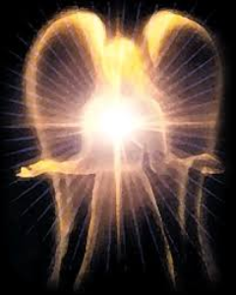
Original State and First Sin (cont’d)
Isaiah 14:12-15 – 5 “I will” statements:
I will…
Ascend to heaven (13)
Raise my throne above the stars of God (13)
Sit enthroned on the Mt. of the Assembly (13)
Ascend above the tops of the clouds (14)
Make myself like the Most High (14)

Slide 26
Original State and First Sin (cont’d)
Isaiah 14:12-15 – 5 “I will” statements:
I will…
Ascend to heaven (13)
Raise my throne above the stars of God (13)
Sit enthroned on the Mt. of the Assembly (13)
Ascend above the tops of the clouds (14)
Make myself like the Most High (14)

Slide 27
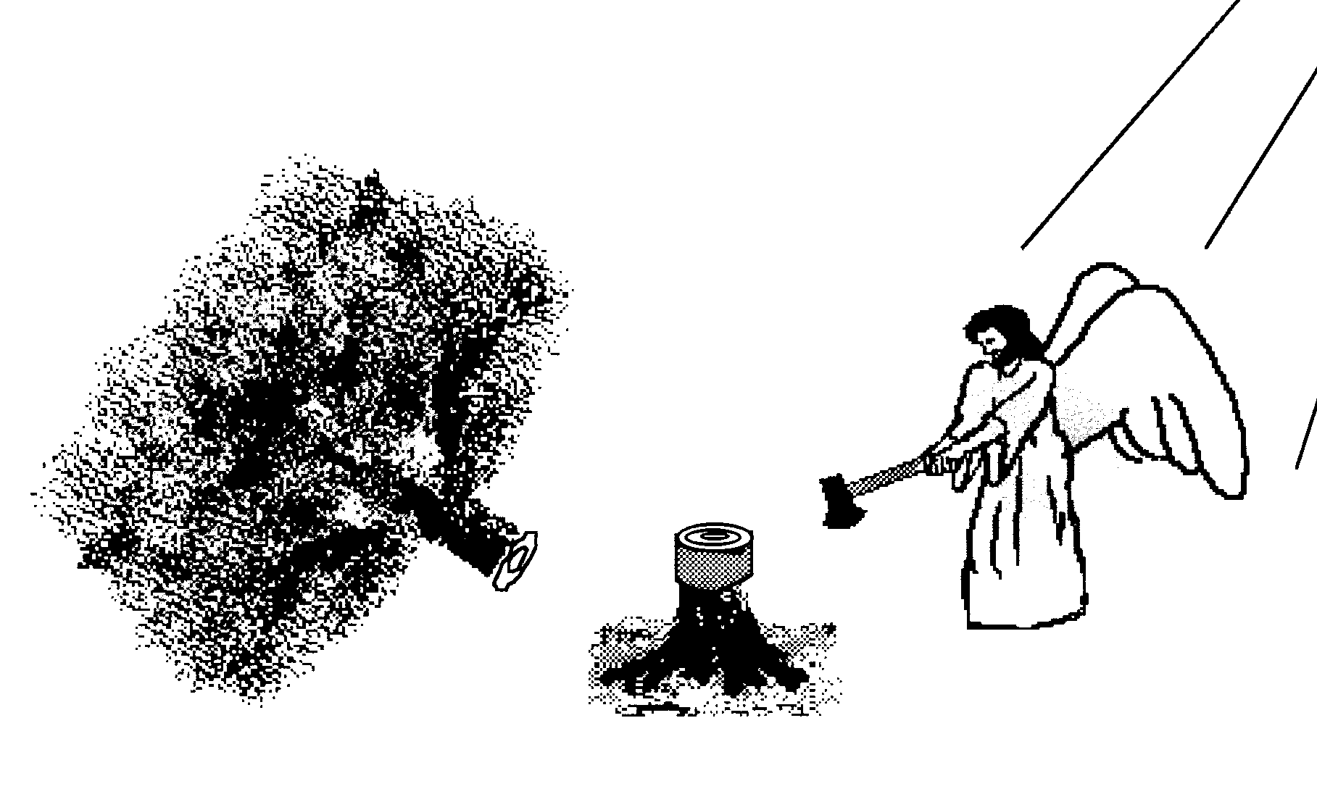
Hall of the Humbled (Prov. 16:18; 1 Peter 5:5)
Satan (Isa. 14:12-15; Ezek. 28:12-17; 1 Tim. 3:6)
Uzziah (2 Chron 26:16)
Herod (Acts 12:20-23)
Paul (2 Cor 12:1-10)

Slide 28
Scripture and Pride
Prov 16:18
Isa 14:12-15; Ezek 28:12-17
1 Tim 3:6
Acts 12:21-23
2 Cor 12:7
1 Pet 5:5

Slide 29
Spiritual Life (4:1-12)
Avoid wrangling (4:1-3)
Avoid worldliness (4:4-6)
Essence of spiritual wisdom (4:7-12)

Slide 30
III. Essence of Spiritual Wisdom (4:7-12)
Submission to God (4:7a)
Resist Satan (4:7b)
Draw near to God (4:8a)
Repent (4:8b-9)
Humility (4:10)
Forego judgment (11-12)

Slide 31
III. Essence of Spiritual Wisdom (4:7-12)
Submission to God (4:7a)
Resist Satan (4:7b)
Draw near to God (4:8a)
Repent (4:8b-9)
Humility (4:10)
Forego judgment (11-12)

Slide 32
Three Tenses of Salvation
Phase | Justification | Sanctification | Glorification
Tense | Past | Present | Future
Saved from sin’s: | Penalty | Power | Presence
Scripture | Eph 2:8-9; Titus 3:5 | Philip 2:12 | Rom 5:10
Nature | Single | Dual | Single

Slide 33
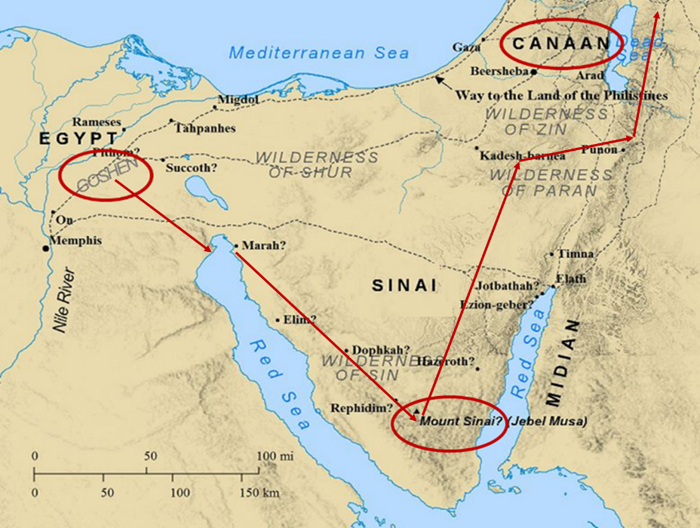

Slide 34
Notes:
See the Chronology of Christ's Life regarding Peter's conversion.

Slide 35
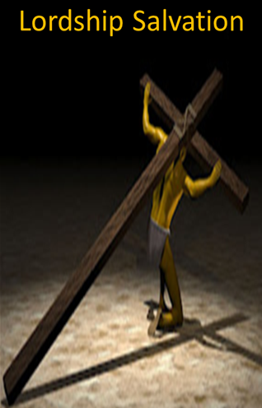
Lordship Sanctification
Rom. 6:12-13
Rom. 12:1-2
Eph. 6:10-20
1 Pet. 3:15

Slide 36
Lordship Sanctification

Slide 37
JUSTIFICATION – SALVATION | DISCIPLESHIP
FREE GIFT | COSTLY
RECEIVED THROUGH FAITH | ENTERED INTO THROUGH COMMITMENT AND OBEDIENCE THROUGH THE SPIRIT’S ENABLEMENT
NOT BY WORKS | INVOLVES OUR COOPERATION
INSTANT | LIFE-LONG PROCESS
JUSTIFICATION | SANCTIFICATION
JESUS PAID THE PRICE | BELIEVER PAYS THE PRICE
TRUSTING JESUS AS SAVIOR | FOLLOWING JESUS AS LORD
BELIEVE THE GOSPEL | OBEY THE COMMANDS
ONE CONDITION | MULTIPLE CONDITIONS
EXPERIENCED BY ALL CHRISTIANS | EXPERIENCED BY SOME CHRISTIANS
RESULTS IN ETERNAL LIFE | RESULTS IN REWARDS & AUTHORITY
Adapted from http://www.gracelife.org/resources/gracenotes.asp?id=23

Slide 38
III. Essence of Spiritual Wisdom (4:7-12)
Submission to God (4:7a)
Resist Satan (4:7b)
Draw near to God (4:8a)
Repent (4:8b-9)
Humility (4:10)
Forego judgment (11-12)

Slide 39
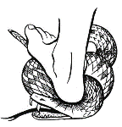
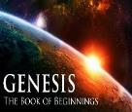
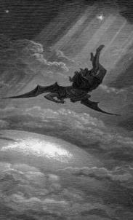
Satan’s Progressive Defeat
Initial eviction from heaven (Isa 14:12-15; Ezek 28:12-17)
Eden (Gen 3:15)
Pre-diluvian world (1 Pet 3:19-20)
Cross (John 12:31; 16:11; Col 2:15; Heb 2:14; 1 John 3:8)
Mid point of the Tribulation (Rev 12:9)
Beginning of millennium (Rev 20:2-3)
End of millennium (Rev 20:10)

Slide 41
Revelation 20:1-3
“¹ Then I saw an angel coming down from heaven, holding the key of the abyss and a great chain in his hand. ² And he laid hold of the dragon, the serpent of old, who is the devil and Satan, and bound him for a thousand years; ³ and he threw him into the abyss, and shut it and sealed it over him, so that he would not deceive the nations any longer, until the thousand years were completed; after these things he must be released for a short time.”

Slide 43
III. Essence of Spiritual Wisdom (4:7-12)
Submission to God (4:7a)
Resist Satan (4:7b)
Draw near to God (4:8a)
Repent (4:8b-9)
Humility (4:10)
Forego judgment (11-12)

Slide 44
Audience
Jewish (1:1)
Persecution (Acts 8:1-4; 11:19)
In Babylon-Mesopotamia or North-Central Turkey?
Believers (Jas 1:2-4)

Slide 45
III. Essence of Spiritual Wisdom (4:7-12)
Submission to God (4:7a)
Resist Satan (4:7b)
Draw near to God (4:8a)
Repent (4:8b-9)
Humility (4:10)
Forego judgment (11-12)

Slide 46
Three Tenses of Salvation
Phase | Justification | Sanctification | Glorification
Tense | Past | Present | Future
Saved from sin’s: | Penalty | Power | Presence
Scripture | Eph 2:8-9; Titus 3:5 | Philip 2:12 | Rom 5:10
Nature | Single | Dual | Single

Slide 47
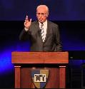
John F. MacArthur
“One of the most comprehensive invitations to salvation in all the Epistles comes in James 4:7 – 10. While James directs most of his epistle to genuine believers, it is also evident that he is concerned about those who are not genuine. He wants no one to be deceived regarding true salvation, so he calls for a real, living, saving faith that is distinct from the dead faith of chapter 2. He states his objective in 5:20. It is to see ‘the sinner converted from the error of his way and his soul saved from death.’”
John F. MacArthur, The Gospel According to Jesus: What Does Jesus Mean When He Says, "Follow Me"? (Grand Rapids: Zondervan, 1988), 218-19.

Slide 48
John F. MacArthur
“The invitation in 4:7 – 10 is directed at those who are not saved — guilty, wicked hearers of the Word who are not doers (cf. 1:21 – 22); who are still captive to dead faith (cf. 2:14 – 20); who are bitter, selfish, arrogant liars whose ‘wisdom is not what comes from above but is earthy, natural, demonic” (3:15); who are loving the world and thus are the enemies of God (4:4); whose inner spirit is still dominated by lusts (cf. 4:5); and who are proud and self-sufficient (cf. 4:6). They are in desperate need of God’s grace.”
John F. MacArthur, The Gospel According to Jesus: What Does Jesus Mean When He Says, "Follow Me"? (Grand Rapids: Zondervan, 1988), 218-19.

Slide 49
John F. MacArthur
“But since God only ‘gives grace to the humble’ (v. 6), James calls these ‘sinners’ (a term used in Scripture only of the unregenerate) to turn from their pride and humble themselves. Ten imperatives delineate the commands in James’s call to sinners: submit yourself to God (salvation); resist the devil (transferring allegiance); draw near to God (intimacy of relationship); cleanse your hands (repentance); purify your hearts (confession); be miserable, mourn, weep, and let your laughter and joy be turned to gloom (sorrow).”
John F. MacArthur, The Gospel According to Jesus: What Does Jesus Mean When He Says, "Follow Me"? (Grand Rapids: Zondervan, 1988), 218-19.

Slide 50
John F. MacArthur
“The final imperative summarizes the mentality of those who are converted: ‘Humble yourselves in the presence of the Lord.’ All this is a work of God, who gives His more abundant grace (4:6).”
John F. MacArthur, The Gospel According to Jesus: What Does Jesus Mean When He Says, "Follow Me"? (Grand Rapids: Zondervan, 1988), 218-19.

Slide 51
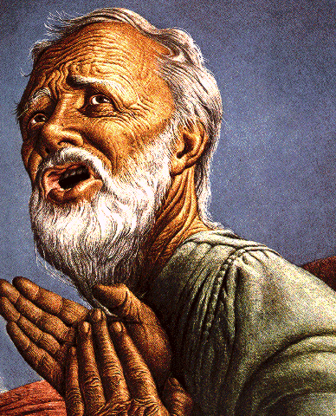
Belief – God’s One Condition for Justification
Gen 15:6
Then he believed in the LORD; and He reckoned it to him as righteousness.
John 3:16
For God so loved the world, that He gave His only begotten Son, that whoever believes in Him shall not perish, but have eternal life.
Acts 16:30-31
"Sirs, what must I do to be saved?" They said, "Believe in the Lord Jesus, and you will be saved..."

Slide 52
III. Essence of Spiritual Wisdom (4:7-12)
Submission to God (4:7a)
Resist Satan (4:7b)
Draw near to God (4:8a)
Repent (4:8b-9)
Humility (4:10)
Forego judgment (11-12)

Slide 53
Hall of the Humbled (Prov. 16:18; 1 Peter 5:5)
Satan (Isa. 14:12-15; Ezek. 28:12-17; 1 Tim. 3:6)
Uzziah (2 Chron 26:16)
Herod (Acts 12:20-23)
Paul (2 Cor 12:1-10)

Slide 54
III. Essence of Spiritual Wisdom (4:7-12)
Submission to God (4:7a)
Resist Satan (4:7b)
Draw near to God (4:8a)
Repent (4:8b-9)
Humility (4:10)
Forego judgment (11-12)

Slide 55
1 Corinthians 4:5
“Therefore do not go on passing judgment before the time, but wait until the Lord comes who will both bring to light the things hidden in the darkness and disclose the motives of men’s hearts; and then each man’s praise will come to him from God.”
Notes:
Rapture and Bema

Slide 56
CONCLUSION

Slide 57
Spiritual Life (4:1-12)
Avoid wrangling (4:1-3)
Avoid worldliness (4:4-6)
Essence of spiritual wisdom (4:7-12)

Slide 58
Structure
Wisdom (3:13–5:20)
Wisdom defined (3:13-18)
Spirituality (4:1-12)
Commerce (4:13-17)
Use of wealth (5:1-6)
Waiting for the Lord’s return (5:7-12)
Prayer (5:13-18)
Restoration of the erring brother (5:19-20)

