Slide 1
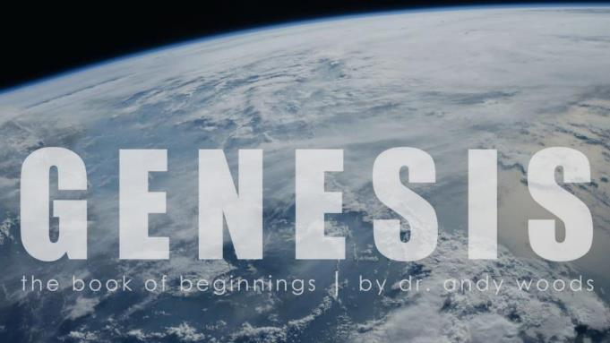
Genesis 6‒9
The Flood and Continuation of the Messianic Promise

Slide 2
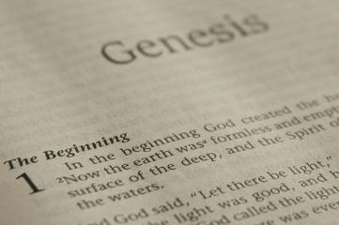
GENESIS STRUCTURE
Beginning of the Human race (Gen. 1‒11)
Beginning of the Hebrew race (Gen. 12‒50)

Slide 3
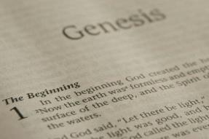
GENESIS STRUCTURE
Genesis 1-11 (four events)
Creation (1-2)
Fall (3-5)
Flood (6-9)
National dispersion (10-11)

Slide 4
GENESIS STRUCTURE
Genesis 1-11 (four events)
Creation (1-2)
Fall (3-5)
Flood (6-9)
National dispersion (10-11)

Slide 5
Genesis 3:15
“And I will put enmity Between you and the woman, And between your seed and her seed; He shall bruise you on the head, And you shall bruise him on the heel.”

Slide 6
GENESIS STRUCTURE
Genesis 1-11 (four events)
Creation (1-2)
Fall (3-5)
Flood (6-9)
National dispersion (10-11)

Slide 7
The Flood (Gen 6–9)
Events before the flood (Gen 6)
The flood (Gen 7)
The abating of the waters (Gen 8)
Events following the flood (Gen 9)

Slide 8
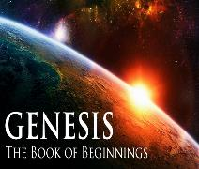
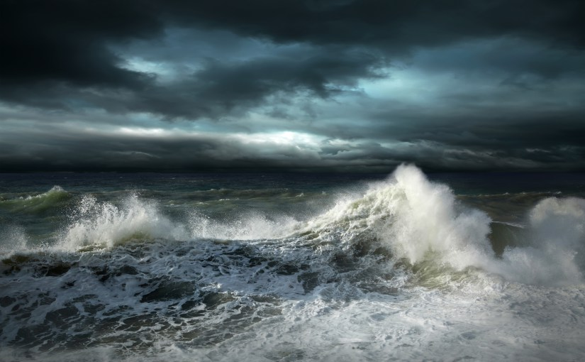
Genesis 7 The Flood

Slide 9
Genesis 7 Outline
God’s instructions to enter the ark (7:1-4)
Entrance into the ark (7:5-12)
God seals the ark (7:13-16)
Flood described (7:17-24)

Slide 10
Genesis 7 Outline
God’s instructions to enter the ark (7:1-4)
Entrance into the ark (7:5-12)
God seals the ark (7:13-16)
Flood described (7:17-24)

Slide 11
Genesis 6:1-4
“¹ Now it came about, when men began to multiply on the face of the land, and daughters were born to them, ² that the sons of God saw that the daughters of men were beautiful; and they took wives for themselves, whomever they chose. ³ Then the Lord said, ‘My Spirit shall not strive with man forever, because he also is flesh; nevertheless his days shall be one hundred and twenty years.’ ⁴ The Nephilim were on the earth in those days, and also afterward, when the sons of God came in to the daughters of men, and they bore children to them. Those were the mighty men who were of old, men of renown.”

Slide 12
Dr. Henry M. Morris
The Genesis Record, 144
“The ancient quibble about ‘Cain’s wife’ is thus seen to be quite trivial. Long before Cain died, there was a large population in the earth. By the time of the Deluge, 1,656 years after Creation by the Ussher chronology, even using the above conservative assumptions, the world population would have been at least seven billion people!”

Slide 13
How Did Noah Fit All of the Animals on to the Ark? (John 3:12)
No
Sea creatures (6:20)
Insects (7:22)
Plants (6:20)
John Woodmoorape, Noah’s Ark: A Feasibility Study

Slide 14
How Did Noah Fit All of the Animals on to the Ark? (John 3:12)
Limitations
Seven pairs or just sevens? (7:2)
Only clean animals (7:2; Lev 11; Deut 14)
Kind (6:20)
Extinct animals overstated
Not fully grown
Hibernation

Slide 15
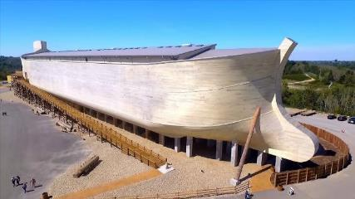
How Did Noah Fit All of the Animals on to the Ark? (John 3:12)
16,000 animals
Ark = 450ft long, 75ft wide, 45 feet high
Ark capable of holding 125,000 animals

Slide 16
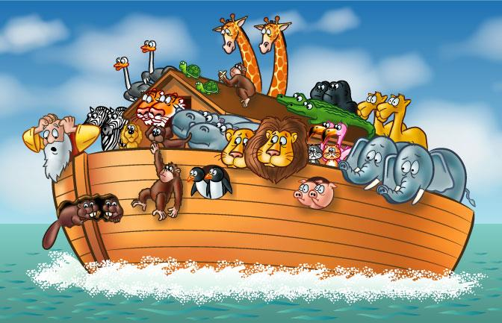

Slide 17
Dr. Arnold G. Fruchtenbaum
The Book of Genesis Record, 167
“According to rabbinic tradition, the reason for the seven-day delay was to allow for the seven days of mourning for Methuselah, who had just died. At any rate, the rain was to continue for forty days and forty nights once it began.”

Slide 18
Dr. Arnold G. Fruchtenbaum
The Book of Genesis Record, 137
“In Hebrew, Methuselah may mean ‘man of the spear, or more likely ‘when he dies, it shall be sent.’ If this is true, his name was given to him prophetically. ‘It shall be sent’ was a prophecy of the Flood, as Methuselah’s father, who was also functioning as a prophet according to Jude 14–15, gave him this name. Indeed, according to the chronology of Genesis, the very year Methuselah died was when the Flood came.”

Slide 19
Dr. Henry M. Morris
The Genesis Record, 192
“The words translated ‘every living substance’ are kol yeyum, and mean literally ‘all existence,’ or ‘all that grows up.’”

Slide 20
Genesis 7 Outline
God’s instructions to enter the ark (7:1-4)
Entrance into the ark (7:5-12)
God seals the ark (7:13-16)
Flood described (7:17-24)

Slide 21
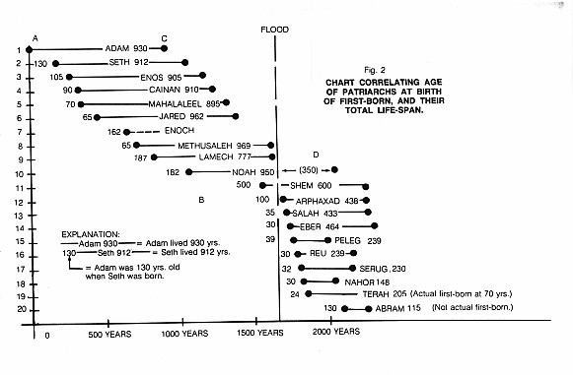

Slide 22
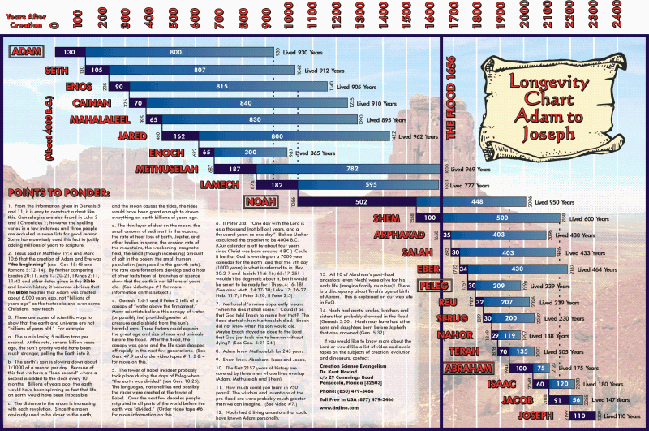

Slide 23
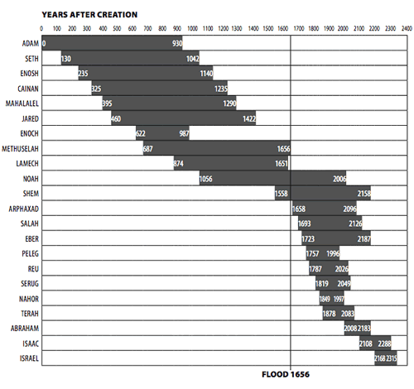

Slide 24
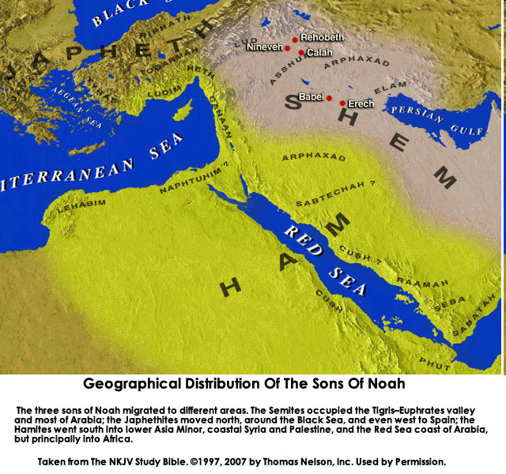

Slide 26
Dr. John Walvoord "An Interview: Dr. John Walvoord Looks at Dallas Seminary," Dallas Connection (Winter 1994, Vol. 1, No. 3), p. 4.
In 1994, "What do you predict will be the most significant theological issues over the next ten years?" He responded, "The hermeneutical problem of not interpreting the Bible literally, especially the prophetic areas. The church today is engulfed in the idea that one cannot interpret prophecy literally.”

Slide 27
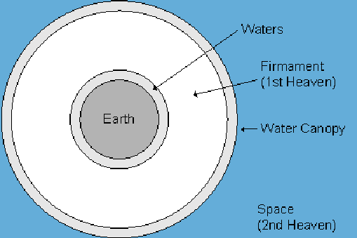

Slide 28
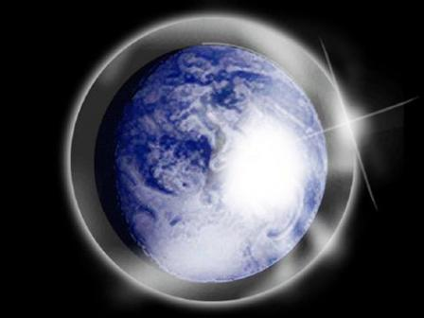

Slide 29
Day 2 Canopy Theory (Gen 1:6-8)
Implied – Gen. 1:6-7; Ps. 148:4
Explains
Long life spans of early man – Gen. 5:5, 27
Strange beasts – (Gen. 1:24-25; Job 40‒41)
Where the flood waters came from – (Gen. 2:5-6)
Why man’s post-flood life span cut short – (Gen. 11:24-25)

Slide 30
Dr. Henry M. Morris
The Genesis Record, 191
“A worldwide rain lasting forty days would be quite impossible under present atmospheric conditions; so this phenomenon required an utterly different source of atmospheric waters than now obtains. This we have already seen to be the ‘waters above the firmament,’ the vast thermal blanket of invisible water vapor that maintained the greenhouse effect in the antediluvian world. These waters somehow were to condense and fall on the earth.”

Slide 31
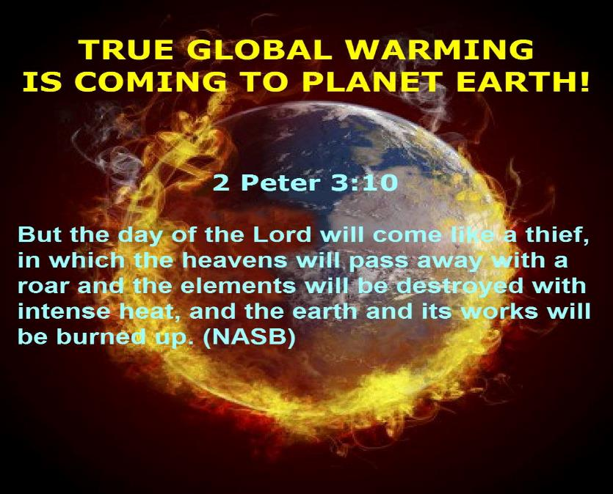

Slide 32
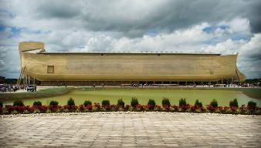
2 Peter 3:5 (KJV)
“For this they willingly are ignorant of [thelō], that by the word of God the heavens were of old, and the earth standing out of the water and in the water.”

Slide 33
Genesis 7 Outline
God’s instructions to enter the ark (7:1-4)
Entrance into the ark (7:5-12)
God seals the ark (7:13-16)
Flood described (7:17-24)

Slide 34
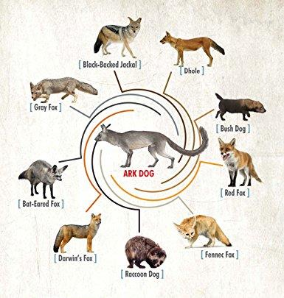

Slide 35
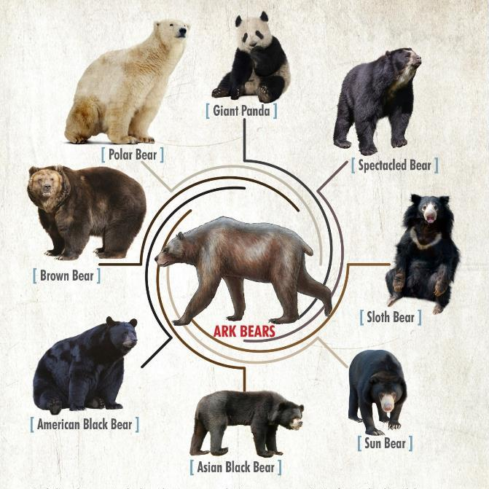

Slide 36
Genesis 6:1-4
“¹ Now it came about, when men began to multiply on the face of the land, and daughters were born to them, ² that the sons of God saw that the daughters of men were beautiful; and they took wives for themselves, whomever they chose. ³ Then the Lord said, ‘My Spirit shall not strive with man forever, because he also is flesh; nevertheless his days shall be one hundred and twenty years.’ ⁴ The Nephilim were on the earth in those days, and also afterward, when the sons of God came in to the daughters of men, and they bore children to them. Those were the mighty men who were of old, men of renown.”

Slide 37
John 10:27-29
“My sheep hear My voice, and I know them, and they follow Me; ²⁸ and I give eternal life to them, and they will never perish [ou mē; aiōnia]; and no one will snatch them out of My hand. ²⁹ My Father, who has given them to Me, is greater than all; and no one is able to snatch them out of the Father’s hand.”

Slide 38
2 Timothy 2:11-13
“It is a trustworthy statement: For if we died with Him, we will also live with Him; ¹² If we endure, we will also reign with Him; If we deny Him, He also will deny us; ¹³ If we are faithless, He remains faithful, for He cannot deny Himself.”

Slide 39
Genesis 7 Outline
God’s instructions to enter the ark (7:1-4)
Entrance into the ark (7:5-12)
God seals the ark (7:13-16)
Flood described (7:17-24)

Slide 40
Dimensions of the Ark? (Genesis 6:15)
Ark = 450ft long, 75ft wide, 45 feet high
Ark capable of holding 125,000 animals

Slide 41
Dr. Arnold G. Fruchtenbaum
The Book of Genesis Record, 172
“Not only was the ark lifted up off the ground, it also floated on the face of the waters. It sailed only in the sense that it was driven by whatever wind there was; so it began to float on the face of the waters away from its original position. In fact, it began in the area of Mesopotamia and floated all the way to the area of Mount Ararat, which could be anywhere in the current countries of Southern Russia, Turkey, or Armenia.”

Slide 42
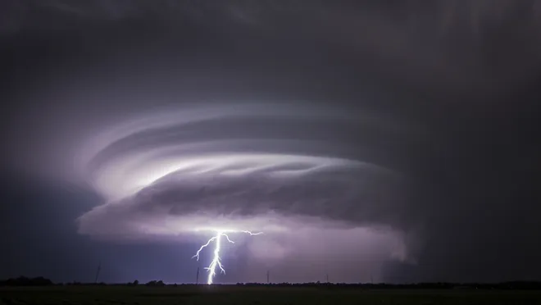
Exodus 9:24
“…It was the worst storm in all the land of Egypt since it had become a nation.” (NIV Emphasis mine)

Slide 43
H.C. Leupold Exposition of Genesis (Grand Rapids: Baker, 1942), vol. 1, p. 301-302.
“… ‘all the high mountains under all the heavens.’ One of these expressions alone would almost necessitate the impression that the author intends to convey the idea of the absolute universality of the Flood…Yet since ‘all’ is known to be used in a relative sense, the writer removes all ambiguity by adding the phrase ‘under all the heavens.’ A double ‘all’ (kol) cannot allow for so relative a sense. It almost constitutes a Hebrew superlative. So we believe that the text disposes of the question of the universality of the flood. By way of objection to this interpretation, those who believe in a limited flood…urge the fact that kol is used in a relative sense, as is clearly the case in passages such as Genesis 41:57; Exodus 9:25, 10:15; Deuteronomy 2:25; and 1 Kings 10:24. However, we still insist that this fact could overthrow a single kol, never a double kol, as our verse has it.”

Slide 44
Dr. Henry M. Morris
The Genesis Record, 200
“The water rise was quickly sufficient to ‘bear up the ark,’ indicating a depth of at least twenty feet in the earliest stages of the Flood, since the Ark was at least forty-four feet high and heavily loaded.”

Slide 45
Dr. Arnold G. Fruchtenbaum
The Book of Genesis Record, 172
“Genesis 7:21–23a describes the universality of the destruction…The emphasis is clearly on the destruction of all living things on dry land with the breath of life, again, excluding all fish life…The Hebrew word means ‘erased.’ They were blotted out.”

Slide 46
Acts 17:26
“and He made from one man every nation of mankind to live on all the face of the earth, having determined their appointed times and the boundaries of their habitation.” (Italics added)
46

Slide 47
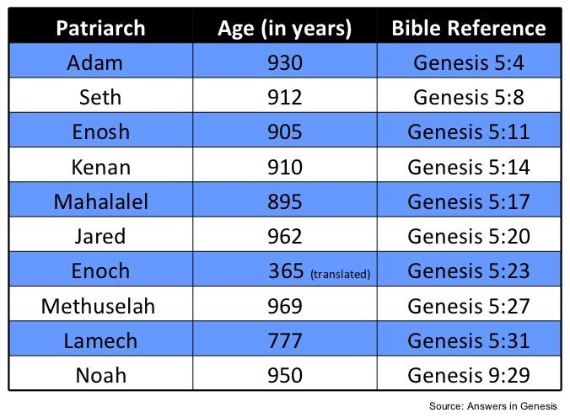

Slide 49
Genesis 7:19-23
“They rose greatly on the earth, and all the high mountains under the entire heaven were covered…Every living thing that moved on the earth perished—birds, livestock, wild animals, all the creatures that swarm over the earth, and all mankind. Everything on dry land that had the breath of life in its nostrils died. Every living thing on the face of the earth was wiped out; men and animals and the creatures that move along the ground and the birds of the air were wiped from the earth. Only Noah was left, and those with him in the ark.”

Slide 50
Local Flood?
Definition
Motive - syncreticism of the Bible with and old earth protology
Biblical arguments
use of “all” in a relative sense (Genesis 41:57; Exodus 9:25, 10:15; Deuteronomy 2:25; and 1 Kings 10:24)
“Earth” = local land (Zech. 12:12; Matt. 2:6)
Phenomenological language (Josh. 10:12-13)

Slide 51
Local Flood?
Definition
Motive - syncreticism of the Bible with and old earth protology
Biblical arguments
use of “all” in a relative sense (Genesis 41:57; Exodus 9:24, 10:15; Deuteronomy 2:25; and 1 Kings 10:24)
“Earth” = local land (Zech. 12:12; Matt. 2:6)
Phenomenological language (Josh. 10:12-13)

Slide 52
Local Flood?
Definition
Motive - syncreticism of the Bible with and old earth protology
Biblical arguments
use of “all” in a relative sense (Genesis 41:57; Exodus 9:24, 10:15; Deuteronomy 2:25; and 1 Kings 10:24)
“Earth” = local land (Zech. 12:12; Matt. 2:6)
Phenomenological language (Josh. 10:12-13)

Slide 53
Local Flood?
Definition
Motive - syncreticism of the Bible with and old earth protology
Biblical arguments
use of “all” in a relative sense (Genesis 41:57; Exodus 9:24, 10:15; Deuteronomy 2:25; and 1 Kings 10:24)
“Earth” = local land (Zech. 12:12; Matt. 2:6)
Phenomenological language (Josh. 10:12-13)

Slide 54
Local Flood?
Definition
Motive - syncreticism of the Bible with and old earth protology
Biblical arguments
use of “all” in a relative sense (Genesis 41:57; Exodus 9:24, 10:15; Deuteronomy 2:25; and 1 Kings 10:24)
“Earth” = local land (Zech. 12:12; Matt. 2:6)
Phenomenological language (Josh. 10:12-13)

Slide 55
Exodus 9:24
“…It was the worst storm in all the land of Egypt since it had become a nation.” (NIV Emphasis mine)

Slide 56
Local Flood?
Definition
Motive - syncreticism of the Bible with and old earth protology
Biblical arguments
use of “all” in a relative sense (Genesis 41:57; Exodus 9:24, 10:15; Deuteronomy 2:25; and 1 Kings 10:24)
“Earth” = local land (Zech. 12:12; Matt. 2:6)
Phenomenological language (Josh. 10:12-13)

Slide 57
Genesis 6:11-13
“¹¹ Now the earth was corrupt in the sight of God, and the earth was filled with violence. ¹² And God looked on the earth, and behold, it was corrupt; for humanity had corrupted its way upon the earth. ¹³ Then God said to Noah, ‘The end of humanity has come before Me; for the earth is filled with violence because of people; and behold, I am about to destroy them with the earth.’”

Slide 58
Local Flood?
Definition
Motive - syncreticism of the Bible with and old earth protology
Biblical arguments
use of “all” in a relative sense (Genesis 41:57; Exodus 9:24, 10:15; Deuteronomy 2:25; and 1 Kings 10:24)
“Earth” = local land (Zech. 12:12; Matt. 2:6)
Phenomenological language (Josh. 10:12-13)

Slide 59
Answering the Local Flood Biblical Arguments
Relative sense of “all”? – Gen. 7:19-23
“all” left undefined
Double “all”
Land means “earth” (Gen. 1:1)
Phenomenological language? – Gen. 7:11; 8:2

Slide 60
Answering the Local Flood Biblical Arguments
Relative sense of “all”? – Gen. 7:19-23
“all” left undefined
Double “all”
Land means “earth” (Gen. 1:1)
Phenomenological language? – Gen. 7:11; 8:2

Slide 61
Genesis 7:19-23
“They rose greatly on the earth, and all the high mountains under the entire heaven were covered…Every living thing that moved on the earth perished—birds, livestock, wild animals, all the creatures that swarm over the earth, and all mankind. Everything on dry land that had the breath of life in its nostrils died. Every living thing on the face of the earth was wiped out; men and animals and the creatures that move along the ground and the birds of the air were wiped from the earth. Only Noah was left, and those with him in the ark.”

Slide 62
H.C. Leupold Exposition of Genesis (Grand Rapids: Baker, 1942), vol. 1, p. 301-302.
“… ‘all the high mountains under all the heavens.’ One of these expressions alone would almost necessitate the impression that the author intends to convey the idea of the absolute universality of the Flood…Yet since ‘all’ is known to be used in a relative sense, the writer removes all ambiguity by adding the phrase ‘under all the heavens.’ A double ‘all’ (kol) cannot allow for so relative a sense. It almost constitutes a Hebrew superlative. So we believe that the text disposes of the question of the universality of the flood. By way of objection to this interpretation, those who believe in a limited flood…urge the fact that kol is used in a relative sense, as is clearly the case in passages such as Genesis 41:57; Exodus 9:25, 10:15; Deuteronomy 2:25; and 1 Kings 10:24. However, we still insist that this fact could overthrow a single kol, never a double kol, as our verse has it.”

Slide 63
Answering the Local Flood Biblical Arguments
Relative sense of “all”? – Gen. 7:19-23
“all” left undefined
Double “all”
Land means “earth” (Gen. 1:1)
Phenomenological language? – Gen. 7:11; 8:2

Slide 64
Genesis 1:1-3
“¹ In the beginning God created the heavens and the earth. ² The earth was formless and void, and darkness was over the surface of the deep, and the Spirit of God was moving over the surface of the waters. ³ Then God said, ‘Let there be light’; and there was light.”

Slide 65
Answering the Local Flood Biblical Arguments
Relative sense of “all”? – Gen. 7:19-23
“all” left undefined
Double “all”
Land means “earth” (Gen. 1:1)
Phenomenological language? – Gen. 7:11; 8:2

Slide 66
Reasons Against a Local Flood
Size of the ark (450 ft. long, 75 ft. wide, 45 ft. deep)?
Analogy to global Second Advent (Matt 24:37-39; Rev 1:7; 2 Pet 3:5-7)
Animals and birds on the ark?
Church history

Slide 67
Reasons Against a Local Flood
Size of the ark (450 ft. long, 75 ft. wide, 45 ft. deep)?
Analogy to global Second Advent (Matt 24:37-39; Rev 1:7; 2 Pet 3:5-7)
Animals and birds on the ark?
Church history

Slide 68
Dimensions of the Ark? (Genesis 6:15)
Ark = 450ft long, 75ft wide, 45 feet high
Ark capable of holding 125,000 animals

Slide 69
Hugh Ross
The Genesis Question (Navpress, Colorado Springs, CO 1998), 164-65.
“…when God pours out judgment, He gives ample warning ahead of time. He sends a spokesperson, a prophet, and gives that prophet a kind of platform from which to be heard. For the antediluvians, Noah was that prophet and the scaffolding around the ark was his platform.”

Slide 70
Reasons Against a Local Flood
Size of the ark (450 ft. long, 75 ft. wide, 45 ft. deep)?
Analogy to global Second Advent (Matt 24:37-39; Rev 1:7; 2 Pet 3:5-7)
Animals and birds on the ark?
Church history

Slide 71
Reasons Against a Local Flood
Size of the ark (450 ft. long, 75 ft. wide, 45 ft. deep)?
Analogy to global Second Advent (Matt 24:37-39; Rev 1:7; 2 Pet 3:5-7)
Animals and birds on the ark?
Church history

Slide 72
Reasons Against a Local Flood
Size of the ark (450 ft. long, 75 ft. wide, 45 ft. deep)?
Analogy to global Second Advent (Matt 24:37-39; Rev 1:7; 2 Pet 3:5-7)
Animals and birds on the ark?
Church history

Slide 73
BELIEVER OR UNBELIEVER?
Writer | Local Flood | Global Flood
Philo | X | ✓
Josephus | X | ✓
Justin Martyr | X | ✓
Theophilus of Antioch | X | ✓
Tertullian | X | ✓
Gregory of Nazianus | X | ✓
John Chrysostom | X | ✓
Augustine of Hippo | X | ✓
SOURCE: Jonathan Sarfati, Refuting Compromise (Green Forest, AR: Master Books), 244.

Slide 74
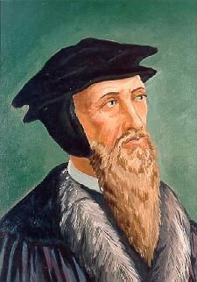
John Calvin
Genesis, 1554 (Edinburgh, UK: Banner of Truth, 1984), p. 272, emphasis mine.
“And the flood was forty days, etc. Moses conspicuously insists on this fact, in order to show that the whole world was immersed in the waters.”

Slide 75
UNIFORMITARIANISM IS NOT BIBLICISM
 | ERA | SCRIPTURE | DISTINCTIVES
1. | CREATION | Genesis 1-2 | No death
2. | FALL | Genesis 3-6 | Death, painful pregnancy & toil, long life spans, no human government
3. | FLOOD | Genesis 7-10 | Shorter life spans, human government, one language, no nations
4. | BABEL | Genesis 11-present | No global government, multiple languages, nations, ethnicities
5. | ANTICHRIST | Rapture to 2nd Advent | Global government, restrainer removed
6. | KINGDOM | Rev. 20:1-10 | Long life spans, kingdom conditions, reality of death, renovated earth
7. | ETERNAL STATE | Rev. 21-22 | No death, new earth

Slide 76
Conclusion

Slide 77
Genesis 7 Outline
God’s instructions to enter the ark (7:1-4)
Entrance into the ark (7:5-12)
God seals the ark (7:13-16)
Flood described (7:17-24)

Slide 78
“The Lord bless you and keep you; the Lord make his face shine on you and be gracious to you; the Lord turn his face toward you and give you peace.” (NIV)

