Slide 1
THE RAPTURE
What and When? – Part 42
Andrew Marshall Woods, Th.M., JD., PhD.
Sr. Pastor, Sugar Land Bible Church

Slide 2
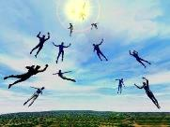
The Rapture Course Overview
What is the Rapture?
When is the Rapture?
Strengthening the Pre-Tribulational case
The opposing views
One second after the Rapture

Slide 3
The Rapture Course Overview
What is the Rapture?
When is the Rapture?
Strengthening the Pre-Tribulational case
The opposing views
One second after the Rapture

Slide 4
What is the Rapture?
An important doctrine
Distinct from the Second Advent
Catching away of all living believers (1 Thess 4:17)
Reunion (1 Thess 4:14-16)
Resurrection (1 Cor 15:50-54)
Exemption from death (1 Cor 15:51, 54-56)
Instantaneous (1 Cor 15:52)
Mystery (1 Cor 15:51)
Imminent (1 Cor 15:51; 1 Thess 4:15)
Traditional doctrine now being recovered

Slide 5
The Rapture Course Overview
What is the Rapture?
When is the Rapture?
Strengthening the Pre-Tribulational case
The opposing views
One second after the Rapture

Slide 6
When is the Rapture?
7 Arguments Favoring the Pre-Tribulation View
Tribulation's purpose concerns Israel (Jer 30:7; Dan 9:24)
No biblical reference to the church on earth during the Tribulation period (Rev 4-22)
Church is promised an exemption from divine wrath (1 Thess 1:10; 5:9; Rom 5:9; Rev 3:10; 6:17)
Rapture is imminent (1 Cor 15:51; 1 Thess 4:15)
Rapture is a comfort (1 Thess 4:18)
Antichrist cannot come to power until the restrainer is removed (2 Thess 2:6-7)
Symbolic parallels (2 Peter 2:5-9)

Slide 7
The Rapture Course Overview
What is the Rapture?
When is the Rapture?
Strengthening the Pre-Tribulational case
The opposing views
One second after the Rapture

Slide 8
Strengthening the Pre-Tribulation Case
John 14:1-4
Revelation 3:10
First Thessalonians 4‒5
Second Thessalonians 2:3a
Matthew 24‒25

Slide 9
The Rapture Course Overview
What is the Rapture?
When is the Rapture?
Strengthening the Pre-Tribulational case
The opposing views
One second after the Rapture

Slide 10
When Will the Rapture Take Place Relative to the Tribulation Period?
Pre-tribulation rapture theory
Mid-tribulation rapture theory
Post-tribulation rapture theory
Pre-wrath rapture theory
Partial rapture theory

Slide 12
Pre-Wrath Rapturism
Description of the view
Six problems with the view considering prior Pre-Tribulational Arguments
Three additional problems with the view

Slide 13
Pre-Wrath Rapturism
Description of the view
Six problems with the view considering prior Pre-Tribulational Arguments
Three additional problems with the view

Slide 14
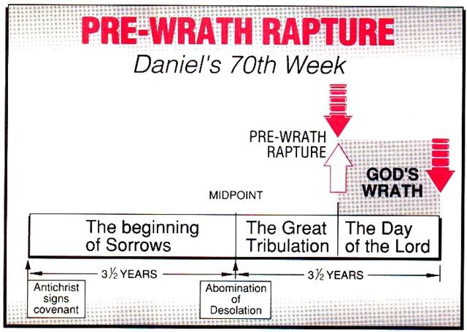
Marvin J. Rosenthal, The Pre-Wrath Rapture of the Church: A New Understanding of the Tribulation, and the Second Coming (Nashville, TN: Thomas Nelson, 1990), 112.

Slide 15
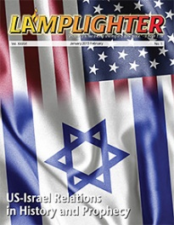
Dr. David Reagan
“I have a number of objections to this concept of the Rapture's timing. 1) The Name — I object to the name given the viewpoint by its proponents. The name is both confusing and vague. It is confusing because both the Pre-Trib and Mid-Trib views are ‘Pre- Wrath.’ The Pre-Trib view argues that the entire 7 years of the Tribulation (Daniel's 70th Week of Years) constitutes a pouring out of the wrath of God. The Mid-Trib view takes the position that only the second half of the Tribulation is the period of God's wrath. So, Rosenthal's name for his viewpoint does not distinguish it from the Pre-Trib and Mid-Trib views. All three are prewrath views.”
“The Pre-wrath Rapture,” online:
https://christinprophecy.org/articles/the-pre-wrath-rapture/, accessed March 20, 2020.

Slide 16
Dr. David Reagan
“The ‘Pre-Wrath’ name is also vague because it does not give a clue as to when the Rapture occurs in relation to the Tribulation. The name of the Pre-Trib view signifies a belief that the Rapture will occur before (pre) the Tribulation begins. The name of the Mid-Trib view clearly indicates a belief that the Rapture will occur in the middle of the Tribulation. The name of the Post-Trib view puts the Rapture after (post) the Tribulation. But the name, ‘Pre-Wrath’ gives no indication of when the Rapture will occur with relation to the Tribulation.”
“The Pre-wrath Rapture,” online:
https://christinprophecy.org/articles/the-pre-wrath-rapture/, accessed March 20, 2020.

Slide 17
Dr. David Reagan
“For that reason, I have decided to call the ‘Pre-Wrath’ view the Three-Quarters Tribulation Rapture viewpoint. And I will be abbreviating it throughout the rest of this article as the ‘3/4 Trib Rapture.’ I have given it that name because its proponents believe the Rapture will occur about three-quarters of the way through the Tribulation, or shortly thereafter.”
“The Pre-wrath Rapture,” online:
https://christinprophecy.org/articles/the-pre-wrath-rapture/, accessed March 20, 2020.

Slide 18
Dr. David Reagan
“In 1990 Marvin Rosenthal presented a fourth viewpoint in his book,The Pre-Wrath Rapture of the Church. Rosenthal was not the originator of this new viewpoint. Rather, he was the one who popularized it with his book. The person who conceived the "Pre-Wrath" view of the Rapture was a man named Robert Van Kampen (1938-1999). Van Kampen became one of America's richest men through his involvement in investment banking. During his lifetime he accumulated one of the largest private collections of rare and antique Bibles in North America. In the 1970's Van Kampen began developing the "Pre-Wrath" concept of the timing of the Rapture.”
“The Pre-wrath Rapture,” online:
https://christinprophecy.org/articles/the-pre-wrath-rapture/, accessed March 20, 2020.

Slide 19
Dr. David Reagan
“Once he had completed his work on the concept, he started trying to find a well known person in the field of Bible prophecy to endorse his new view. That person finally turned out to be Marvin Rosenthal, who at the time was serving as the director of a very influential ministry called Friends of Israel. Rosenthal tried to convince the board of the ministry to abandon its commitment to the Pre-Trib view and accept the new viewpoint. They refused, and Rosenthal was forced to depart. He went to Florida where he built the Holy Land Experience — a Christian theme park which has since been taken over by the Trinity Broadcasting Network.”
“The Pre-wrath Rapture,” online:
https://christinprophecy.org/articles/the-pre-wrath-rapture/, accessed March 20, 2020.

Slide 20
Dr. David Reagan
“Today, Rosenthal serves as the director of Zion's Hope, a ministry located in Winter Garden, Florida. Rosenthal's book was financed by Van Kampen's fortune, and he mailed out thousands of copies to pastors all over America. Later, Van Kampen wrote his own books about the ‘Pre-Wrath’ view, the most important being The Sign (1992).”
“The Pre-wrath Rapture,” online:
https://christinprophecy.org/articles/the-pre-wrath-rapture/, accessed March 20, 2020.

Slide 22
Marvin J. Rosenthal, The Pre-Wrath Rapture of the Church: A New Understanding of the Tribulation, and the Second Coming (Nashville, TN: Thomas Nelson, 1990), 112.

Slide 23
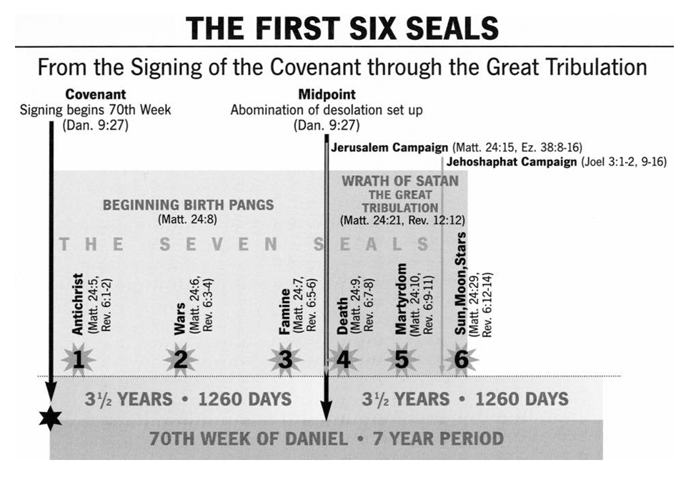

Slide 24
Marvin J. Rosenthal, The Pre-Wrath Rapture of the Church: A New Understanding of the Tribulation, and the Second Coming (Nashville, TN: Thomas Nelson, 1990), 112.

Slide 25
2 Thessalonians 2:6-7
⁶And you know what restrains [katechon; neuter] him now, so that in his time he will be revealed. ⁷For the mystery of lawlessness is already at work; only he who now restrains [katechōn; masculine] will do so until he is taken out of the way.

Slide 26
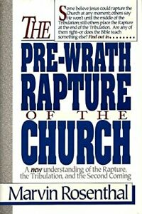
Marvin Rosenthal
“…of paramount importance is the identification of the one who restraints or hinders the Antichrist until ‘he [the restrainer] be taken out of the way.’ The restrainer is neither the Holy Spirit nor human government. Evidence is strained to support either of those contentions. There is, however, substantial evidence to identify the restrainer. He who restraints until ‘he be taken out of the way’ is the Archangel Michael.”
Marvin J. Rosenthal, The Pre-Wrath Rapture of the Church: A New Understanding of the Tribulation, and the Second Coming (Nashville, TN: Thomas Nelson, 1990), 112.

Slide 27
Marvin J. Rosenthal, The Pre-Wrath Rapture of the Church: A New Understanding of the Tribulation, and the Second Coming (Nashville, TN: Thomas Nelson, 1990), 112.

Slide 28
Revelation 6:16-17
^{“16} and they said to the mountains and the rocks, ‘Fall on us and hide us from the sight of Him who sits on the throne, and from the wrath [orgḗ] of the Lamb; ¹⁷ for the great day of Their wrath [orgḗ] has come, and who is able to stand?’”

Slide 29
Marvin J. Rosenthal, The Pre-Wrath Rapture of the Church: A New Understanding of the Tribulation, and the Second Coming (Nashville, TN: Thomas Nelson, 1990), 112.

Slide 30
Pre-Wrath Rapturism
Description of the view
Six problems with the view considering prior Pre-Tribulational Arguments
Three additional problems with the view

Slide 32
II. Pre-Wrath Rapture Theory Problems
Places the Church in Daniel’s 70th Week
Fails to acknowledge the missing Church (Rev. 4‒22)
Confines God’s wrath to only a portion of the Tribulation's second half
Denies the Rapture’s imminency
Fails to consistently explain how the rapture is a comfort to the believer (John 14:1; 1 Thess. 4:18; Titus 2:13)
Misinterprets the restrainer (2 Thess. 2:6-7) as Michael the Archangel rather than the Holy Spirit

Slide 33
II. Pre-Wrath Rapture Theory Problems
Places the Church in Daniel’s 70th Week
Fails to acknowledge the missing Church (Rev. 4‒22)
Confines God’s wrath to only a portion of the Tribulation's second half
Denies the Rapture’s imminency
Fails to consistently explain how the rapture is a comfort to the believer (John 14:1; 1 Thess. 4:18; Titus 2:13)
Misinterprets the restrainer (2 Thess. 2:6-7) as Michael the Archangel rather than the Holy Spirit

Slide 34
Daniel 9:24
Seventy weeks have been decreed for your people and your holy city, to finish the transgression, to make an end of sin, to make atonement for iniquity, to bring in everlasting righteousness, to seal up vision and prophecy and to anoint the most holy place.

Slide 35
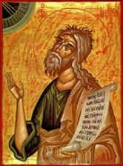
Jeremiah 30:7
“Alas! for that day is great, There is none like it; And it is the time of Jacob’s distress (Gen. 32:8; 35:10), But he will be saved from it.”

Slide 36
Robert Lightner
Robert Lightner, Last Days Handbook: A Complete Guide to the End Times, Including the Meaning of the Year 2000 in Bible Prophecy, rev. ed. (Nashville: Thomas Nelson, 1997), 95.
“The prewrath Rapture view is different from the normal pretribulational view in that it does not consistently distinguish between God's program with Israel and His program with the church. The way it differs is that it has the church in Israel's seventieth week...”

Slide 37
George Zeller "Pre-Wrath Confusion," online: http://www.middletownbiblechurch.org/proph/prewrath.htm, accessed 01 September 2015.
“The Pre-Wrath view CONFUSES the mysterious and parenthetical nature of the Church Age. It confuses CHURCH HISTORY with ISRAELITE HISTORY. God has a program for the Church and God has a distinct program for His people Israel. The two must not be confused. The clearest and most complete chronological prophecy that God has given to us is the 70-week prophecy in Daniel 9:24-27. These 70 weeks involve 490 years of Jewish history: "Seventy weeks are determined UPON THY PEOPLE AND UPON THY HOLY CITY." These 490 years pertain to the Jews and to Jerusalem, not to the Church.”

Slide 38
George Zeller "Pre-Wrath Confusion," online: http://www.middletownbiblechurch.org/proph/prewrath.htm, accessed 01 September 2015.
“Of the 490 years, the last seven years are yet unfulfilled. After the first 69 weeks the Messiah was cut off and we know that the Church Age began less than two months after the Messiah was cut off. Daniel's 70th week has remained unfulfilled for nearly 2000 years. The prophetic time clock has stopped ticking for all these years. The clock stopped ticking after the 69th week and has not yet resumed ticking. How can we explain this large 2000-year gap between the 69th week and the 70th week? The answer is revealed on the pages of the New Testament. DURING THIS 2000 YEAR GAP GOD IS INVOLVED IN THE FOLLOWING PROGRAM:”

Slide 39
George Zeller "Pre-Wrath Confusion," online: http://www.middletownbiblechurch.org/proph/prewrath.htm, accessed 01 September 2015.
“He is building His Church (Matt. 16:18; Acts 2:47).
He is taking out a people for His Name (Acts 15:14).
He is bringing in the fullness of the Gentiles (Rom. 11:25).
He is placing believers into a living organism (1 Cor. 12:13).
He is saving a "showcase" that will eternally display His matchless grace (Eph. 1:7).
He is manifesting Himself through His body which is upon the earth (1 Tim. 3:15-16).”

Slide 40
George Zeller "Pre-Wrath Confusion," online: http://www.middletownbiblechurch.org/proph/prewrath.htm, accessed 01 September 2015.
“Just as the Church had an abrupt beginning on the day of Pentecost shortly after the conclusion of the 69th week, so it should be expected that the Church will have an abrupt removal shortly before the beginning of the 70th week. The Pretribulational model harmonizes perfectly with Daniel's 70th week prophecy while at the same time recognizing the parenthetical and mysterious nature of the Church Age. It is "mysterious" in the sense that Church truth was unrevealed on the pages of the Old Testament and the Church Age was not foreseen by the prophets.”

Slide 41
George Zeller "Pre-Wrath Confusion," online: http://www.middletownbiblechurch.org/proph/prewrath.htm, accessed 01 September 2015.
“The Old Testament prophets did not tell us about the gap simply because they did not see the gap. It was unrevealed to them. They saw only the two mountain peaks which represent the first and second comings of Christ but they did not see the large valley in between. The Pre-Wrath view sees the Church as being on earth during a large part of Daniel's 70th week (the Church will be on earth, according to Rosenthal's charts, for approximately 3/4 of the last seven years, or approximately five years or more). ”

Slide 42
George Zeller "Pre-Wrath Confusion," online: http://www.middletownbiblechurch.org/proph/prewrath.htm, accessed 01 September 2015.
“This mixes up and confuses God's purpose for Israel and God's purpose for the Church. THE CHURCH HAS NEVER AND WILL NEVER BE PRESENT ON EARTH DURING ANY OF ISRAEL'S 70 WEEKS. The Church began after the 69th week ended and the Church will be raptured before the 70th week begins.... ”

Slide 43
Arnold G. Fruchtenbaum “Israel and the Church,” in Issues in Dispensationalism, ed. Wesley R. Willis and John R. Master (Chicago: Moody, 1994), 118.
“In the book of Acts, both Israel and the church exist simultaneously. The term Israel is used twenty times and ekklēsia (church) nineteen times, yet the two groups are always kept distinct.”
ISRAEL ≠ CHURCH

Slide 44
II. Pre-Wrath Rapture Theory Problems
Places the Church in Daniel’s 70th Week
Fails to acknowledge the missing Church (Rev. 4‒22)
Confines God’s wrath to only a portion of the Tribulation's second half
Denies the Rapture’s imminency
Fails to consistently explain how the rapture is a comfort to the believer (John 14:1; 1 Thess. 4:18; Titus 2:13)
Misinterprets the restrainer (2 Thess. 2:6-7) as Michael the Archangel rather than the Holy Spirit

Slide 45
Revelation 1:19
“Therefore write the things which you have seen, and the things which are, and the things which will take place after these things [meta tauta].”

Slide 46
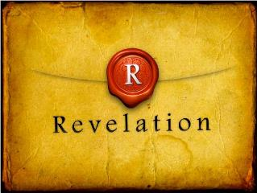
Revelation 1:19
Seen (1)
Are (2–3)
After these things (4–22)

Slide 47
Ephesians 2:14
For He Himself is our peace, who made both groups into one and broke down the barrier of the dividing wall.

Slide 48
Galatians 3:28
There is neither Jew nor Greek, there is neither slave nor free man, there is neither male nor female; for you are all one in Christ Jesus.

Slide 49
God’s Work Through Israel
Revelation 7 – 144,000 Jews
Revelation 11 – Two Jewish witnesses
Revelation 12 – Israel flees

Slide 50
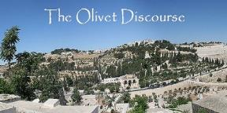
Preview of Matthew 24–25
The problem
The larger context
The immediate context (23:37-39)
The Disciples’ questions (24:1-3)
The Tribulation’s first half (24:4-14)
The Tribulation’s mid-point (24:15-20)
The Tribulation’s second half (24:21-22)
The Second Advent (24:23-31)
Eight parabolic exhortations (24:32‒25:46)

Slide 51
Psalm 50:5 (NKJV)
“Gather My saints together to Me, Those who have made a covenant with Me by sacrifice.”

Slide 52
Psalm 149:1 (NKJV)
“Praise the Lord! Sing to the Lord a new song, And His praise in the assembly of saints.”

Slide 53
Matthew 16:18
“I also say to you that you are Peter, and upon this rock I will build [oikodomeō] My church; and the gates of Hades WILL NOT overpower it.”

Slide 54
II. Pre-Wrath Rapture Theory Problems
Places the Church in Daniel’s 70th Week
Fails to acknowledge the missing Church (Rev. 4‒22)
Confines God’s wrath to only a portion of the Tribulation's second half
Denies the Rapture’s imminency
Fails to consistently explain how the rapture is a comfort to the believer (John 14:1; 1 Thess. 4:18; Titus 2:13)
Misinterprets the restrainer (2 Thess. 2:6-7) as Michael the Archangel rather than the Holy Spirit

Slide 56
Marvin J. Rosenthal, The Pre-Wrath Rapture of the Church: A New Understanding of the Tribulation, and the Second Coming (Nashville, TN: Thomas Nelson, 1990), 112.

Slide 57
Zephaniah 1:14-15
¹⁴ The great day of the Lord is near, Near and coming very quickly; Listen, the day of the Lord! In it the warrior cries out bitterly. ¹⁵ That day is a day of anger, A day of trouble and distress, A day of destruction and desolation, A day of darkness and gloom, A day of clouds and thick darkness.

Slide 58
Zephaniah 1:14-15
¹⁴ The great day of the Lord is near, Near and coming very quickly; Listen, the day of the Lord! In it the warrior cries out bitterly. ¹⁵ That day is a day of anger, A day of trouble and distress, A day of destruction and desolation, A day of darkness and gloom, A day of clouds and thick darkness.

Slide 59
Zephaniah 1:14-15
¹⁴ The great day of the Lord is near, Near and coming very quickly; Listen, the day of the Lord! In it the warrior cries out bitterly. ¹⁵ That day is a day of anger, A day of trouble and distress, A day of destruction and desolation, A day of darkness and gloom, A day of clouds and thick darkness.

Slide 60
Zephaniah 1:14-15
¹⁴ The great day of the Lord is near, Near and coming very quickly; Listen, the day of the Lord! In it the warrior cries out bitterly. ¹⁵ That day is a day of anger, A day of trouble and distress, A day of destruction and desolation, A day of darkness and gloom, A day of clouds and thick darkness.

Slide 61
Revelation 6:16-17
^{“16} and they said to the mountains and the rocks, ‘Fall on us and hide us from the sight of Him who sits on the throne, and from the wrath [orgḗ] of the Lamb; ¹⁷ for the great day of Their wrath [orgḗ] has come, and who is able to stand?’”

Slide 62
Rev. 6:16-17 Robert L. Thomas, Revelation 1–7: An Exegetical Commentary, ed. Kenneth Barker (Chicago: Moody, 1992), 457-58.
"Mankind in his rebellion correctly analyzes the cosmic and terrestrial disturbances as a part of the great end-time day of wrath from the one sitting on the throne and from the Lamb. The verb ēlethen ("has come") is aorist indicative, referring to a previous arrival of wrath, not something that is about to take place. Men see the arrival of this day at least as early as the cosmic upheavals that characterize the sixth seal (6:12-14), but upon reflection they probably recognize that it was already in effect with the death of one-fourth of the population (6:7-8), the worldwide famine (6:5-6), and the global warfare (6:3-4). The rapid sequence of all of these events could not escape notice, but the light of their true explanation does not dawn upon human consciousness until the severe phenomena of the sixth seal arrive."

Slide 63
Norman Geisler
Systematic Theology, vol. 4 (Minneapolis, MN: Bethany, 2004), 652.
“Absence of a word does not prove absence of the concept. For example, the word wrath does not appear in Genesis, yet God's wrath was poured out during the flood (6–8) and on Sodom and Gomorrah (19).”

Slide 64
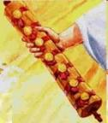
1st Six Seals (Revelation 6)
SEAL 1 – 6:1-2 – Advent of antichrist
SEAL 2 – 6:3-4 – War
SEAL 3 – 6:5-6 – Famine
SEAL 4 – 6:7-8 – Death
SEAL 5 – 6:9-11 – Martyrdoms
SEAL 6 – 6:12-17 – Cosmic disturbances

Slide 65
John 16:33
“These things I have spoken to you so that in Me you may have peace. In the world you have tribulation [thlípsis], but take courage; I have overcome the world.”

Slide 66
Revelation 7:14
“I said to him, “My lord, you know.” And he said to me, “These are the ones who come out of the great tribulation [thlípsis], and they have washed their robes and made them white in the blood of the Lamb.”

Slide 67
Romans 2:8-9
^{“8} but to those who are selfishly ambitious and do not obey the truth, but obey unrighteousness, wrath [orgḗ] and indignation [thumós]. ⁹ There will be tribulation [thlípsis] and distress for every soul of man who does evil, of the Jew first and also of the Greek.”

Slide 68
1st Six Seals (Revelation 6)
SEAL 1 – 6:1-2 – Advent of antichrist
SEAL 2 – 6:3-4 – War
SEAL 3 – 6:5-6 – Famine
SEAL 4 – 6:7-8 – Death
SEAL 5 – 6:9-11 – Martyrdoms
SEAL 6 – 6:12-17 – Cosmic disturbances

Slide 69
Isaiah 9:11-12
^{“11} Therefore the Lord raises superior adversaries against them from Rezin And provokes their enemies, ¹² The Arameans from the east and the Philistines from the west; And they devour Israel with gaping jaws. In spite of all this, His anger does not turn away, And His hand is still stretched out.”

Slide 70
Isaiah 10:5-6
^{“5} Woe to Assyria, the rod of My anger And the staff in whose hands is My indignation, ⁶ I send it against a godless nation And commission it against the people of My fury To capture spoils and to seize plunder, And to trample them down like mud in the streets.”

Slide 71
Isaiah 13:3, 17
^{“3} I have commanded My consecrated ones, I have also called for My warriors Who boast in My eminence, To execute My anger…¹⁷ Behold, I am going to stir up the Medes against them, Who will not value silver or take pleasure in gold.”

Slide 72
2 Samuel 24:1
“Now the anger of the Lord burned against Israel again, and He incited David against them to say, “Go, count Israel and Judah.”

Slide 73
1 Chronicles 21:1
“Then Satan stood up against Israel and incited David to count Israel.”

Slide 74
Romans 13:4
“for it is a servant of God to you for good. But if you do what is evil, be afraid; for it does not bear the sword for nothing; for it is a servant of God, an avenger who brings wrath [orgē] on the one who practices evil.”

Slide 75
2 Thessalonians 2:9-12
^{“9} that is, the one whose coming is in accord with the activity of Satan, with all power and false signs and wonders, ¹⁰ and with all the deception of wickedness for those who perish, because they did not accept the love of the truth so as to be saved. ¹¹ For this reason God will send upon them a deluding influence so that they will believe what is false, ¹² in order that they all may be judged who did not believe the truth, but took pleasure in wickedness.”

Slide 76
1st Six Seals (Revelation 6)
SEAL 1 – 6:1-2 – Advent of antichrist
SEAL 2 – 6:3-4 – War
SEAL 3 – 6:5-6 – Famine
SEAL 4 – 6:7-8 – Death
SEAL 5 – 6:9-11 – Martyrdoms
SEAL 6 – 6:12-17 – Cosmic disturbances

Slide 77
2 Chronicles 36:16-17
^{“16} but they continually mocked the messengers of God, despised His words, and scoffed at His prophets, until the wrath of the Lord rose against His people, until there was no remedy. ¹⁷ So He brought up against them the king of the Chaldeans, who killed their young men with the sword in the house of their sanctuary, and had no compassion on young man or virgin, old man or frail; He handed them all over to him.”

Slide 78
Isaiah 51:19-20
^{“19} These two things have happened to you; Who will mourn for you? The devastation and destruction, famine and sword; How shall I comfort you? ²⁰ Your sons have fainted, They lie helpless at the head of every street, Like an antelope in a net, Full of the wrath of the Lord, The rebuke of your God.”

Slide 79
Jeremiah 21:5-7, 9
^{“5} And I Myself will make war against you with an outstretched hand and a mighty arm, and in anger, wrath, and great indignation. ⁶ I will also strike the inhabitants of this city, both the people and the animals; they will die of a great plague. ⁷ Then afterward,” declares the Lord, “I will hand Zedekiah king of Judah, his servants, and the people, that is, those who survive in this city from the plague, the . . .

Slide 80
Jeremiah 21:5-7, 9
…sword, and the famine, over to Nebuchadnezzar king of Babylon, to their enemies, and to those who seek their lives; and he will strike and kill them with the edge of the sword. He will not spare them nor have pity nor compassion.”’… ⁹ Anyone who stays in this city will die by the sword, by famine, or by plague; but anyone who leaves and goes over to the Chaldeans who are besieging you will live, and he will have his own life as plunder.”

Slide 81
Jeremiah 44:8, 11-12
^{“8} provoking Me to anger with the works of your hands, burning sacrifices to other gods in the land of Egypt where you are entering to reside, so that you may be eliminated and become a curse and a disgrace among all the nations of the earth?... ¹² And I will take away the remnant of Judah who have set their minds on entering the land of Egypt to reside there, and they will all meet their end in the land of Egypt; . . .

Slide 82
Jeremiah 44:8, 11-12
. . . they will fall by the sword or meet their end by famine. From the small to the great, they will die by the sword and famine; and they will become a curse, an object of horror, an imprecation, and a disgrace.”

Slide 83
Jeremiah 50:13, 25
^{“13} Because of the wrath of the Lord she will not be inhabited, But she will be completely desolate; Everyone who passes by Babylon will be horrified And will hiss because of all her wounds…²⁵ The Lord has opened His armory And has brought out the weapons of His indignation, For it is a work of the Lord God of armies In the land of the Chaldeans.”

Slide 84
Ezekiel 7:14-15
^{“14} They have blown the trumpet and made everything ready, but no one is going to the battle, for My wrath is against all their multitude. ¹⁵ The sword is outside the city and the plague and the famine are within. Anyone who is in the field will die by the sword, while famine and the plague will consume those in the city.”

Slide 85
Revelation 6:8
^{“8} I looked, and behold, an ashen horse; and the one who sat on it had the name Death, and Hades was following with him. Authority was given to them over a fourth of the earth, to kill with sword, and famine, and plague, and by the wild animals of the earth.”

Slide 86
Ezekiel 5:15-17
“¹⁵ ‘So it shall be a reproach, a taunt, a lesson, and an astonishment to the nations that are all around you, when I execute judgments among you in anger and in fury and in furious rebukes. I, the Lord, have spoken. ¹⁶ When I send against them the terrible arrows of famine which shall be for destruction, which I will send to destroy you, I will increase the famine upon you and cut off your supply of bread. ¹⁷ So I will send against you famine and wild beasts, and they will bereave you. Pestilence and blood shall pass through you, and I will bring the sword against you. I, the Lord, have spoken.’ ”

Slide 87
Ezekiel 7:3, 8, 15
^{“3} Now upon you I will soon pour out My fury, And spend My anger upon you; I will judge you according to your ways, And I will repay you for all your abominations… ⁸ Now upon you I will soon pour out My fury, And spend My anger upon you; I will judge you according to your ways, And I will repay you for all your abominations. ¹⁵ The sword is outside the city and the plague and the famine are within. Anyone who is in the field will die by the sword, while famine and the plague will consume those in the city.”

Slide 88
Ezekiel 14:19, 21
^{“19} “Or if I send a pestilence into that land and pour out My fury on it in blood, and cut off from it man and beast.”…²¹ For thus says the Lord God: “How much more it shall be when I send My four severe judgments on Jerusalem—the sword and famine and wild beasts and pestilence—to cut off man and beast from it?”

Slide 89
Ezekiel 7:19
^{“19} ‘They will throw their silver into the streets, And their gold will be like refuse; Their silver and their gold will not be able to deliver them In the day of the wrath of the Lord; They will not satisfy their souls, Nor fill their stomachs, Because it became their stumbling block of iniquity.”

Slide 90
Revelation 6:8
^{“8} I looked, and behold, an ashen horse; and the one who sat on it had the name Death, and Hades was following with him. Authority was given to them over a fourth of the earth, to kill with sword, and famine, and plague, and by the wild animals of the earth.”

Slide 91
1st Six Seals (Revelation 6)
SEAL 1 – 6:1-2 – Advent of antichrist
SEAL 2 – 6:3-4 – War
SEAL 3 – 6:5-6 – Famine
SEAL 4 – 6:7-8 – Death
SEAL 5 – 6:9-11 – Martyrdoms
SEAL 6 – 6:12-17 – Cosmic disturbances

Slide 92
Revelation 1:18
“I am He who lives, and was dead, and behold, I am alive forevermore. Amen. And I have the keys of Hades and of Death.”

Slide 93
1st Six Seals (Revelation 6)
SEAL 1 – 6:1-2 – Advent of antichrist
SEAL 2 – 6:3-4 – War
SEAL 3 – 6:5-6 – Famine
SEAL 4 – 6:7-8 – Death
SEAL 5 – 6:9-11 – Martyrdoms
SEAL 6 – 6:12-17 – Cosmic disturbances

Slide 95
II. Pre-Wrath Rapture Theory Problems
Places the Church in Daniel’s 70th Week
Fails to acknowledge the missing Church (Rev. 4‒22)
Confines God’s wrath to only a portion of the Tribulation's second half
Denies the Rapture’s imminency
Fails to consistently explain how the rapture is a comfort to the believer (John 14:1; 1 Thess. 4:18; Titus 2:13)
Misinterprets the restrainer (2 Thess. 2:6-7) as Michael the Archangel rather than the Holy Spirit

Slide 96
Imminent (1 Cor 15:51; 1 Thess 4:15)
Imminency definition
James 5:8; 1 Thess 1:10; 1 Cor 1:7; Philip 3:20
We are to be looking for Jesus Christ and not the Antichrist!
Motivator (Holiness, Evangelism)
Pre-wrath Rapturism denies imminency

Slide 97
Imminent (1 Cor 15:51; 1 Thess 4:15)
Imminency definition
James 5:8; 1 Thess 1:10; 1 Cor 1:7; Philip 3:20
We are to be looking for Jesus Christ and not the Antichrist!
Motivator (Holiness, Evangelism)
Pre-wrath Rapturism denies imminency

Slide 98
Wayne Brindle
"Biblical Evidence for the Imminence of the Rapture," Bibliotheca Sacra 158, no. 630 (April-June 2001): 138-51.
“Four criteria may be suggested, any one of which indicates imminence:
The passage speaks of Christ’s return as at any moment.
The passage speaks of Christ’s return as ‘near,’ without stating any signs that must precede His coming.
The passage speaks of Christ’s return as something that gives believers hope and encouragement, without indicating that these believers will suffer tribulation.
The passage speaks of Christ’s return as giving hope without relating it to God’s judgment of unbelievers.”

Slide 99
Imminent (1 Cor 15:51; 1 Thess 4:15)
Imminency definition
James 5:8; 1 Thess 1:10; 1 Cor 1:7; Philip 3:20
We are to be looking for Jesus Christ and not the Antichrist!
Motivator (Holiness, Evangelism)
Pre-wrath Rapturism denies imminency

Slide 100
John 14:1–4
¹ “Do not let your heart be troubled; believe in God, believe also in Me. ² “In My Father’s house are many dwelling places; if it were not so, I would have told you; for I go to prepare a place for you. ³ “If I go and prepare a place for you, I will come again and receive you to Myself, that where I am, there you may be also. ⁴ “And you know the way where I am going.”

Slide 101
1 Thessalonians 4:13-18
¹³ "But we do not want you to be uninformed, brethren, about those who are asleep, so that you will not grieve as do the rest who have no hope. ¹⁴ For if we believe that Jesus died and rose again, even so God will bring with Him those who have fallen asleep in Jesus. ¹⁵ For this we say to you by the word of the Lord, that we who are alive and remain until the coming of the Lord, will not precede those who . . .

Slide 102
1 Corinthians 15:51
“Behold, I tell you a mystery; we will not all sleep, but we will all be changed.”

Slide 103
Imminent (1 Cor 15:51; 1 Thess 4:15)
Imminency definition
James 5:8; 1 Thess 1:10; 1 Cor 1:7; Philip 3:20
We are to be looking for Jesus Christ and not the Antichrist!
Motivator (Holiness, Evangelism)
Pre-wrath Rapturism denies imminency

Slide 104
Robert H. Gundry, The Church and the Tribulation: Why Christ Won't Come Before the Antichrist Does (Grand Rapids: Zondervan, 1973).

Slide 105
Imminent (1 Cor 15:51; 1 Thess 4:15)
Imminency definition
James 5:8; 1 Thess 1:10; 1 Cor 1:7; Philip 3:20
We are to be looking for Jesus Christ and not the Antichrist!
Motivator (Holiness, Evangelism)
Pre-wrath Rapturism denies imminency

Slide 106
J. Dwight Pentecost
Prophecy For Today, Page 20
“A short time ago, I took occasion to go through the New Testament to mark each reference to the coming of the Lord Jesus Christ and to observe the use made of that teaching about His coming. I was struck a new with the fact that almost without exception, when the coming of Christ is mentioned in the New Testament, it is followed by an exhortation to godliness and holy living.”

Slide 107
Imminent (1 Cor 15:51; 1 Thess 4:15)
Imminency definition
James 5:8; 1 Thess 1:10; 1 Cor 1:7; Philip 3:20
We are to be looking for Jesus Christ and not the Antichrist!
Motivator (Holiness, Evangelism)
Pre-wrath Rapturism denies imminency

Slide 108
Marvin J. Rosenthal, The Pre-Wrath Rapture of the Church: A New Understanding of the Tribulation, and the Second Coming (Nashville, TN: Thomas Nelson, 1990), 112.

Slide 109
1st Six Seals (Revelation 6)
SEAL 1 – 6:1-2 – Advent of antichrist
SEAL 2 – 6:3-4 – War
SEAL 3 – 6:5-6 – Famine
SEAL 4 – 6:7-8 – Death
SEAL 5 – 6:9-11 – Martyrdoms
SEAL 6 – 6:12-17 – Cosmic disturbances

Slide 110
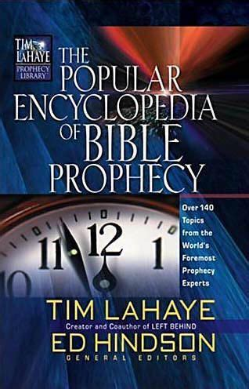
Tony Kessinger
“The doctrine of imminence holds that Christ can come to rapture His church at any moment. Believers in the early church, including the apostle Paul, believed that Christ could come in their lifetime (1 Thessalonians 1:10; 4:13-15; Titus 2:13). The church sees this doctrine as an incentive for ministry and godly living. Does this mean that Christ's return for His church will be at any moment, without any sign, and with no yet-to-be-fulfilled prophesied event to precede it?”
Tony Kessinger, "Pre-Wrath Rapture," in The Popular Encyclopedia of Bible Prophecy: Over 140 Topics from the World's Foremost Prophecy Experts, ed. Tim LaHaye and Ed Hindson (Eugene, OR: Harvest, 2004), 293.

Slide 111
Tony Kessinger
“Pre-wrath rapturists argue that Christ could come in any generation but that signs will herald the general time. Those signs include (1) the emergence of the antichrist, (2) wars and rumors of war, (3) famine, (4) pestilence, and (5) cosmic disturbance. Pre-wrath rapturists emphasize Christians' expectancy of Christ's return rather than its imminency. This expectancy of Christ's return is the catalyst for holy living.”
Tony Kessinger, "Pre-Wrath Rapture," in The Popular Encyclopedia of Bible Prophecy: Over 140 Topics from the World's Foremost Prophecy Experts, ed. Tim LaHaye and Ed Hindson (Eugene, OR: Harvest, 2004), 293.

Slide 112
Robert Lightner
Robert Lightner, Last Days Handbook: A Complete Guide to the End Times, Including the Meaning of the Year 2000 in Bible Prophecy, rev. ed. (Nashville: Thomas Nelson, 1997), 95.
“The prewrath Rapture view is different from the normal pretribulational view in that it does not consistently distinguish between God's program with Israel and His program with the church. The way it differs is that it has the church in Israel's seventieth week and does not hold to the doctrine of imminency”

Slide 113
II. Pre-Wrath Rapture Theory Problems
Places the Church in Daniel’s 70th Week
Fails to acknowledge the missing Church (Rev. 4‒22)
Confines God’s wrath to only a portion of the Tribulation's second half
Denies the Rapture’s imminency
Fails to consistently explain how the rapture is a comfort to the believer (John 14:1; 1 Thess. 4:18; Titus 2:13)
Misinterprets the restrainer (2 Thess. 2:6-7) as Michael the Archangel rather than the Holy Spirit

Slide 114
John 14:1–4
¹ “Do not let your heart be troubled; believe in God, believe also in Me. ² “In My Father’s house are many dwelling places; if it were not so, I would have told you; for I go to prepare a place for you. ³ “If I go and prepare a place for you, I will come again and receive you to Myself, that where I am, there you may be also. ⁴ “And you know the way where I am going.”

Slide 115
1 Thessalonians 4:16-18
¹⁶ For the Lord Himself will descend from heaven with a shout, with the voice of the archangel and with the trumpet of God, and the dead in Christ will rise first. ¹⁷ Then we who are alive and remain will be caught up [harpazō] together with them in the clouds to meet the Lord in the air, and so we shall always be with the Lord. ¹⁸ Therefore comfort one another with these words."

Slide 116
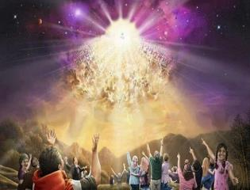
Titus 2:13
“Looking for the blessed hope and the appearing of the glory of our great God and Savior, Christ Jesus.”

Slide 118
Marvin J. Rosenthal, The Pre-Wrath Rapture of the Church: A New Understanding of the Tribulation, and the Second Coming (Nashville, TN: Thomas Nelson, 1990), 112.

Slide 119
1st Six Seals (Revelation 6)
SEAL 1 – 6:1-2 – Advent of antichrist
SEAL 2 – 6:3-4 – War
SEAL 3 – 6:5-6 – Famine
SEAL 4 – 6:7-8 – Death
SEAL 5 – 6:9-11 – Martyrdoms
SEAL 6 – 6:12-17 – Cosmic disturbances

Slide 120
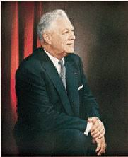
Donald Grey Barnhouse
Cited in Mark Hitchcock, “An Overview of Pretribulational arguments,” online: www.pre-trib.org, accessed 27 August 2013, 29-30.
“Jesus may come today, Glad day! Glad day!
And I would see my friend;
Dangers and troubles would end If Jesus should come today.
Glad day! Glad day! Is it the crowning day?
I’ll live for today, nor anxious be, Jesus, my Lord, I soon shall see;
Glad day! Glad day! Is it the crowning day?”

Slide 121
Donald Grey Barnhouse
Cited in Mark Hitchcock, “An Overview of Pretribulational arguments,” online: www.pre-trib.org, accessed 27 August 2013, 29-30.
By way of parody, Dr. Barnhouse also pointed out that if the midtrib or posttrib advocates sang this song, it would instead have to say:
“Jesus can’t come today, Sad day! Sad day! And I won't see my friend; Dangers and troubles won’t end Because Jesus can’t come today. Sad day! Sad day! Today is not the crowning day? I won’t live for today, and anxious I’ll be, The Beast and the False Prophet I soon shall see, Sad day! Sad day! Today is not the crowning day?”

Slide 122
II. Pre-Wrath Rapture Theory Problems
Places the Church in Daniel’s 70th Week
Fails to acknowledge the missing Church (Rev. 4‒22)
Confines God’s wrath to only a portion of the Tribulation's second half
Denies the Rapture’s imminency
Fails to consistently explain how the rapture is a comfort to the believer (John 14:1; 1 Thess. 4:18; Titus 2:13)
Misinterprets the restrainer (2 Thess. 2:6-7) as Michael the Archangel rather than the Holy Spirit

Slide 123
2 Thessalonians 2:6-7
⁶And you know what restrains [katechon; neuter] him now, so that in his time he will be revealed. ⁷For the mystery of lawlessness is already at work; only he who now restrains [katechōn; masculine] will do so until he is taken out of the way.

Slide 124
Marvin Rosenthal
“…of paramount importance is the identification of the one who restraints or hinders the Antichrist until ‘he [the restrainer] be taken out of the way.’ The restrainer is neither the Holy Spirit nor human government. Evidence is strained to support either of those contentions. There is, however, substantial evidence to identify the restrainer. He who restraints until ‘he be taken out of the way’ is the Archangel Michael.”
Marvin J. Rosenthal, The Pre-Wrath Rapture of the Church: A New Understanding of the Tribulation, and the Second Coming (Nashville, TN: Thomas Nelson, 1990), 112.

Slide 125
Marvin J. Rosenthal, The Pre-Wrath Rapture of the Church: A New Understanding of the Tribulation, and the Second Coming (Nashville, TN: Thomas Nelson, 1990), 112.

Slide 126
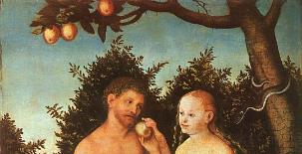
2 Thessalonians 2:9
“that is, the one whose coming is in accord with the activity of Satan, with all power and signs and false wonders.”

Slide 127
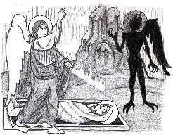
Jude 9
“But Michael the archangel, when he disputed with the devil and argued about the body of Moses, did not dare pronounce against him a railing judgment, but said, ‘The Lord rebuke you!’”

Slide 128
Daniel 12:1
“Now at that time Michael, the great prince who stands guard over the sons of your people [Israel], will arise. And there will be a time of distress such as never occurred since there was a nation until that time; and at that time your people, everyone who is found written in the book, will be rescued.”

Slide 129
2 Thessalonians 2:6-7
⁶And you know what restrains [katechon; neuter] him now, so that in his time he will be revealed. ⁷For the mystery of lawlessness is already at work; only he who now restrains [katechōn; masculine] will do so until he is taken out of the way.

Slide 130
Tony Kessinger
“The pre-wrath view holds to the rather inventive idea that Michael the archangel is the restrainer. This concept fails to take into consideration Michael's special protective ministry toward Israel.”
Tony Kessinger, "Pre-Wrath Rapture," in The Popular Encyclopedia of Bible Prophecy: Over 140 Topics from the World's Foremost Prophecy Experts, ed. Tim LaHaye and Ed Hindson (Eugene, OR: Harvest, 2004), 294.

Slide 131
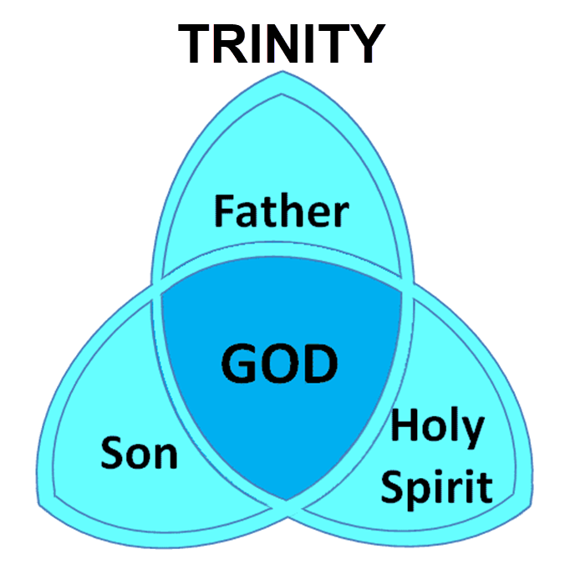

Slide 132
3 Reasons Why the Restrainer is the Holy Spirit (2 Thessalonians 2:6-7)
The Holy Spirit is omnipotent
The Holy Spirit view handles well the switch in gender from the neuter (vs. 6) to the masculine (vs. 7)
The Holy Spirit is active in the world (Gen. 6:3; John 16:7-11)

Slide 133
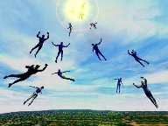
Restrainer Must First be Removed
Restrainer holds back the Antichrist (2 Thess 2:6-7)
Restrainer = the omnipotent Holy Spirit (2 Thess 2:9)
Holy Spirit permanently indwells all Christians (John 14:16; Rom 8:9)
Spirit indwelt Christians must first be removed prior to the Antichrist's advent

Slide 134
II. Pre-Wrath Rapture Theory Problems
Places the Church in Daniel’s 70th Week
Fails to acknowledge the missing Church (Rev. 4‒22)
Confines God’s wrath to only a portion of the Tribulation's second half
Denies the Rapture’s imminency
Fails to consistently explain how the rapture is a comfort to the believer (John 14:1; 1 Thess. 4:18; Titus 2:13)
Misinterprets the restrainer (2 Thess. 2:6-7) as Michael the Archangel rather than the Holy Spirit

Slide 135
Pre-Wrath Rapturism
Description of the view
Six problems with the view considering prior Pre-Tribulational Arguments
Three additional problems with the view

Slide 136
III. Additional Problems with Pre-Wrath Rapturism
It imposes an unnatural construct on Daniel’s 70th Week
It places the Rapture in Revelation 7:9-17
It places the Rapture in Matthew 24:31

Slide 137
III. Additional Problems with Pre-Wrath Rapturism
It imposes an unnatural construct on Daniel’s 70th Week
It places the Rapture in Revelation 7:9-17
It places the Rapture in Matthew 24:31

Slide 138
Daniel 9:27
And he will make a firm covenant with the many for one week, but in the middle of the week he will put a stop to sacrifice and grain offering; and on the wing of abominations will come one who makes desolate, even until a complete destruction, one that is decreed, is poured out on the one who makes desolate.

Slide 140
PROPHETIC SYNONYMNS
Division of the Tribulation into two 3½ year periods
42 months - Rev. 11:2; 13:5
1260 days – Rev. 11:3; 12:6
Time, times, and a half a time – Dan. 7:25; 12:7; 12:14

Slide 141
Matthew 24:15-16, 20
“¹⁵ Therefore when you see the abomination of desolation which was spoken of through Daniel the prophet, standing in the holy place (let the reader understand) ¹⁶ then those who are in Judea must flee to the mountains…²⁰ But pray that your flight will not be in the winter, or on a Sabbath.”

Slide 142
Marvin J. Rosenthal, The Pre-Wrath Rapture of the Church: A New Understanding of the Tribulation, and the Second Coming (Nashville, TN: Thomas Nelson, 1990), 112.

Slide 143
III. Additional Problems with Pre-Wrath Rapturism
It imposes an unnatural construct on Daniel’s 70th Week
It places the Rapture in Revelation 7:9-17
It places the Rapture in Matthew 24:31

Slide 144
Revelation 7:9, 13-14
“⁹ After these things I looked, and behold, a great multitude which no one could count, from every nation and all the tribes, peoples, and languages, standing before the throne and before the Lamb, clothed in white robes, and palm branches were in their hands…¹³ Then one of the elders responded, saying to me, . . .

Slide 145
Revelation 7:9, 13-14
. . ‘These who are clothed in the white robes, who are they, and where have they come from?’ ¹⁴ I said to him, ‘My lord, you know.’ And he said to me, ‘These are the ones who come out of the great tribulation [thlípsis], and they have washed their robes and made them white in the blood of the Lamb.’”

Slide 146
Marvin Rosenthal
“That great multitude represents the true Church which goes into the Seventieth Week of Daniel. They are rapture and at the end of the great tribulation but before the Day of the Lord begins. They are raptured before God‘s wrath is poured out but are not exempt from the ultimate rebellion of unregenerate men...Therefore, in chapter 7 the Church is raptured. But immediately prior to the rapture of the Church the 144,000 Jews are sealed...The 144,000 must be sealed for protection to go through the Day of the Lord before the Church can be caught up to the throne in heaven.”
Marvin J. Rosenthal, The Pre-Wrath Rapture of the Church: A New Understanding of the Tribulation, and the Second Coming (Nashville, TN: Thomas Nelson, 1990), 185.

Slide 147
Ephesians 2:20
“having been built on the foundation of the apostles and prophets, Christ Jesus Himself being the corner stone.”

Slide 148
Rev. 7:14 Robert L. Thomas, Revelation 1–7: An Exegetical Commentary, ed. Kenneth Barker (Chicago: Moody, 1992), 497, n. 119.
"A third possible understanding that it is a departure after the Great Tribulation is completed (Marvin Rosenthal, The Pre-Wrath Rapture of the Church [Nashville: Thomas Nelson, 1990], p. 185) can be dismissed because it neglects the ongoing nature of the departure indicated by the present participle ἐρχόμενοι and rests on an unwarranted distinction between the Great Tribulation and the day of the God’s wrath."

Slide 149
1 Corinthians 15:52
“in a moment [atomos], in the twinkling of an eye, at the last trumpet; for the trumpet will sound, and the dead will be raised imperishable, and we will be changed.”

Slide 150
Gerald B. Stanton
“However, the innumerable multitude is not like the Church, which goes to heaven as a group at the rapture. Rather, they are martyrs who one at a time lay down their lives throughout the seven-year period. The Greek present tense in Revelation 7:14 stresses that they ‘continually come’ out of great Tribulation, and obviously do not go to heaven as a single group. It is likewise strange, if they do represent the Church, that John could not recognize them, for John was an apostle of Christ, a member of the early Church, and part of its essential foundation. Also, the Church is composed of all believers since Pentecost, and cannot be limited solely to Tribulation martyrs.”
Gerald B. Stanton, Kept from the Hour: Biblical Evidence for the Pretribulational Return of Christ (Grand Rapids: Zondervan, 1956; reprint, Miami Springs, FL: Schoettle, 1991), 390.

Slide 151
Distinctions Between 144,000 & Multitude
144,000 | MULTITUDE
Revelation 7:1-8 | Revelation 7:9-17
Numbered | Innumerable
Jews | All nations
Sealed | Slain
Sealed before the Tribulation | Converted out of the Tribulation
Hitchcock and Ice, The Truth Behind Left Behind, 77

Slide 152
III. Additional Problems with Pre-Wrath Rapturism
It imposes an unnatural construct on Daniel’s 70th Week
It places the Rapture in Revelation 7:9-17
It places the Rapture in Matthew 24:31

Slide 153
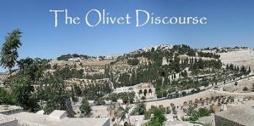
Matthew 24:31
“And He will send forth His angels with a great trumpet and they will gather together [episynagō] His elect from the four winds, from one end of the sky to the other.”

Slide 154
1 Thessalonians 4:13-18
. . . have fallen asleep. ¹⁶ For the Lord Himself will descend from heaven with a shout, with the voice of the archangel and with the trumpet of God, and the dead in Christ will rise first. ¹⁷ Then we who are alive and remain will be caught up together with them in the clouds to meet the Lord in the air, and so we shall always be with the Lord. ¹⁸ Therefore comfort one another with these words."

Slide 155
1 Corinthians 15:50-51
“⁵⁰ Now I say this, brethren, that flesh and blood cannot inherit the kingdom of God; nor does the perishable inherit the imperishable. ⁵¹ Behold, I tell you a mystery; we will not all sleep, but we will all be changed.”

Slide 156
John A. Sproule
"An Exegetical Defense of Pretribulationalism" (Th.D. diss., Grace Theological Seminary, 1981), 53.
“Where does Paul mention the darkening of the sun (Matt. 24:29), the moon not giving its light (Matt. 24:29), the stars falling from the sky (Matt. 24:29), the powers of the heavens being shaken (Matt. 24:29), all the tribes of the earth mourning (Matt. 24:30), all the world seeing the coming of the Son of Man (Matt. 24:30), or God sending forth angels (Matt.24:31)?”

Slide 157
Paul D. Feinberg
“Notice what happens when you examine both passages carefully. In Matthew the Son of Man comes on the clouds, while in 1 Thessalonians 4 the ascending believers are in them. In Matthew the angels gather the elect; in 1 Thessalonians the Lord Himself (note the emphasis) gathers the believers. Thessalonians only speaks of the voice of the archangel. In the Olivet Discourse nothing is said about a resurrection, while in the latter text it is the central point. In the two passages the differences in what will take place prior to the appearance of Christ is striking. Moreover, the order of ascent is absent from Matthew in spite of the fact that it is the central part of the epistle.”
"Response: Paul D. Feinberg," in The Rapture: Pre-, Mid-, or Posttribulational, ed. Richard R. Reiter (Grand Rapids: Zondervan, 1984), 225.

Slide 158
Preview of Matthew 24–25
The problem
The larger context
The immediate context (23:37-39)
The Disciples’ questions (24:1-3)
The Tribulation’s first half (24:4-14)
The Tribulation’s mid-point (24:15-20)
The Tribulation’s second half (24:21-22)
The Second Advent (24:23-31)
Eight parabolic exhortations (24:32‒25:46)

Slide 159
Matthew 23:37-39
³⁷ “Jerusalem, Jerusalem, who kills the prophets and stones those who are sent to her! How often I wanted to gather [episynagō] your children together, the way a hen gathers [episynagō] her chicks under her wings, and you were unwilling. ³⁸ Behold, your house is being left to you desolate! ³⁹ For I say to you, from now on you will not see Me until you say, ‘Blessed is He who comes in the name of the Lord!’”

Slide 160
Matthew 24:31
“And He will send forth His angels with a great trumpet and they will gather together [episynagō] His elect from the four winds, from one end of the sky to the other.”

Slide 161
Isaiah 27:13
“It will come about also in that day that a great trumpet will be blown, and those who were perishing in the land of Assyria and who were scattered in the land of Egypt will come and worship the Lord in the holy mountain at Jerusalem.”

Slide 162
Isaiah 11:11-12
Then it will happen on that day that the Lord Will again recover the second time with His hand The remnant of His people, who will remain, From Assyria, Egypt, Pathros, Cush, Elam, Shinar, Hamath, And from the islands of the sea.¹² And He will lift up a standard for the nations And assemble the banished ones of Israel, And will gather the dispersed of Judah From the four corners of the earth.

Slide 163
Conclusion

Slide 164
Pre-Wrath Rapturism
Description of the view
Six problems with the view considering prior Pre-Tribulational Arguments
Three additional problems with the view

