Slide 1
PRACTICAL RIGHTEOUSNESS
Dr. Andy Woods
Senior Pastor – Sugar Land Bible Church
President – Chafer Theological Seminary

Slide 2
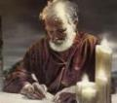
Answering Eleven Questions
Who wrote it? – James
What do we know about the author? – Christ’s ½ Brother
Who was the audience? – Believing Jews in the Diaspora
Where was if written from? – Jerusalem
When was the book written? – A.D. 44‒47
What was the book’s occasion? – Practical righteousness
What is the book’s purpose? – Achieving practical righteousness
What is the book about? – Practical righteousness
What is the book’s theme? – Daily living
What makes the book different? – Practicality
How is the book organized? – Faith and Wisdom

Slide 3
JAMES STRUCTURE
Faith (James 1:1‒3:12)
Wisdom (James 3:13‒5:20)

Slide 4
JAMES STRUCTURE
Faith (James 1:1‒3:12)
Wisdom (James 3:13‒5:20)

Slide 5
JAMES STRUCTURE
Faith (1:1–3:12)
Trials (1:2-18)
Obedience to the Word (1:19-27)
Favoritism (2:1-13)
Faith manifesting works (2:14-26)
Tongue (3:1-12)

Slide 6
JAMES STRUCTURE
Faith (1:1–3:12)
Trials (1:2-18)
Obedience to the Word (1:19-27)
Favoritism (2:1-13)
Faith manifesting works (2:14-26)
Tongue (3:1-12)

Slide 7
James 1:2-18
Trials – Jas 1:2-18
Rejoicing during trials – Jas 1:2-12
Command not to charge God with temptation – Jas 1:13-18

Slide 8
JAMES STRUCTURE
Faith (1:1–3:12)
Trials (1:2-18)
Obedience to the Word (1:19-27)
Favoritism (2:1-13)
Faith manifesting works (2:14-26)
Tongue (3:1-12)

Slide 9
Faith Obeys God (James 1:19-27)
Need for Slowness in Speaking & Anger (1:19-20)
Need for Obedience to God’s Word (1:21-25)
Need for True Religion (1:26-27)

Slide 10
JAMES STRUCTURE
Faith (1:1–3:12)
Trials (1:2-18)
Obedience to the Word (1:19-27)
Favoritism (2:1-13)
Faith manifesting works (2:14-26)
Tongue (3:1-12)

Slide 11
Favoritism (2:1-13)
Command: no favoritism (2:1)
Situation: favoritism in the assembly (2:2-3)
Reasoning: favoritism is contrary to God’s character & purposes (2:4-13)

Slide 12
JAMES STRUCTURE
Faith (1:1–3:12)
Trials (1:2-18)
Obedience to the Word (1:19-27)
Favoritism (2:1-13)
Faith manifesting works (2:14-26)
Tongue (3:1-12)

Slide 13
Faith Manifesting Works (2:14-26)
Thesis: works accompany useful faith (2:14)
Five illustrations (2:15-26)
Needy brother (2:15-17)
Demonic monotheist (2:18-19)
Abraham (2:20-24)
Rahab (2:25)
Lifeless corpse (2:26)

Slide 14
JAMES STRUCTURE
Faith (1:1–3:12)
Trials (1:2-18)
Obedience to the Word (1:19-27)
Favoritism (2:1-13)
Faith manifesting works (2:14-26)
Tongue (3:1-12)

Slide 15
Taming the Tongue (3:1-12)
The Tongue’s Influence (3:1-5)
Teaching (1)
All of Life (2)
Illustrations (3-5)
The Tongue’s Evil Potential (3:6-12)
Satanic Potential (6)
Untamable (7-8)
Inconsistency (9-12)

Slide 16
JAMES STRUCTURE
Faith (James 1:1‒3:12)
Wisdom (James 3:13‒5:20)

Slide 17
Structure
Wisdom (3:13–5:20)
Wisdom defined (3:13-18)
Spirituality (4:1-12)
Commerce (4:13-17)
Use of wealth (5:1-6)
Waiting for the Lord’s return (5:7-12)
Prayer (5:13-18)
Restoration of the erring brother (5:19-20)

Slide 18
Structure
Wisdom (3:13–5:20)
Wisdom defined (3:13-18)
Spirituality (4:1-12)
Commerce (4:13-17)
Use of wealth (5:1-6)
Waiting for the Lord’s return (5:7-12)
Prayer (5:13-18)
Restoration of the erring brother (5:19-20)

Slide 19
Wisdom (3:13-18)
Wisdom is demonstrated by her actions (3:13)
Human or earthly wisdom (3:14-16)
Heavenly wisdom (3:17-18)

Slide 20
Wisdom (3:13-18)
Wisdom is demonstrated by her actions (3:13)
Human or earthly wisdom (3:14-16)
Heavenly wisdom (3:17-18)

Slide 21
James 3:13
“Who among you is wise and understanding? Let him show by his good behavior his deeds in the gentleness of wisdom.”

Slide 22
Wisdom (3:13-18)
Wisdom is demonstrated by her actions (3:13)
Human or earthly wisdom (3:14-16)
Heavenly wisdom (3:17-18)

Slide 23
James 3:14-16
“¹⁴ But if you have bitter jealousy and selfish ambition in your heart, do not be arrogant and so lie against the truth. ¹⁵ This wisdom is not that which comes down from above, but is earthly, natural, demonic. ¹⁶ For where jealousy and selfish ambition exist, there is disorder and every evil thing.”

Slide 24
Human or Earthly Wisdom (3:14-16)
Jealous (Prov. 6:34)
Selfish ambition (Prov. 16:18)
Arrogant (Prov. 8:13)
Earthly, natural (Prov. 14:12)
Demonic (Prov. 27:20)
Contentious (Prov. 11:29)
Adapted from Wilkinson and Boa, Talk Thru the Bible, 466.

Slide 25
Wisdom (3:13-18)
Wisdom is demonstrated by her actions (3:13)
Human or earthly wisdom (3:14-16)
Heavenly wisdom (3:17-18)

Slide 26
James 3:17–18
¹⁷ But the wisdom from above is first pure, then peaceable, gentle, reasonable, full of mercy and good fruits, unwavering, without hypocrisy. ¹⁸ And the seed whose fruit is righteousness is sown in peace by those who make peace.

Slide 27
Heavenly Wisdom (3:17-18)
Pure (Prov. 15:26)
Peaceable (Prov. 3:1-2)
Gentle (Prov. 16:32)
Reasonable (Prov. 14:15)
Full of mercy and good fruits (Prov. 11:17; 3:18)
Unwavering (Prov. 24:16)
Without hypocrisy (Prov. 28:13)
Adapted from Wilkinson and Boa, Talk Thru the Bible, 466.

Slide 28
James 3:17–18
¹⁷ But the wisdom from above is first pure, then peaceable, gentle, reasonable, full of mercy and good fruits, unwavering, without hypocrisy. ¹⁸ And the seed whose fruit is righteousness is sown in peace by those who make peace.

Slide 29
Heavenly Wisdom (3:17-18)
Pure (Prov. 15:26)
Peaceable (Prov. 3:1-2)
Gentle (Prov. 16:32)
Reasonable (Prov. 14:15)
Full of mercy and good fruits (Prov. 11:17; 3:18)
Unwavering (Prov. 24:16)
Without hypocrisy (Prov. 28:13)
Adapted from Wilkinson and Boa, Talk Thru the Bible, 466.

Slide 30
James 3:17–18
¹⁷ But the wisdom from above is first pure, then peaceable, gentle, reasonable, full of mercy and good fruits, unwavering, without hypocrisy. ¹⁸ And the seed whose fruit is righteousness is sown in peace by those who make peace.

Slide 31
Heavenly Wisdom (3:17-18)
Pure (Prov. 15:26)
Peaceable (Prov. 3:1-2)
Gentle (Prov. 16:32)
Reasonable (Prov. 14:15)
Full of mercy and good fruits (Prov. 11:17; 3:18)
Unwavering (Prov. 24:16)
Without hypocrisy (Prov. 28:13)
Adapted from Wilkinson and Boa, Talk Thru the Bible, 466.

Slide 32
Isaiah 9:6-7
⁶ For a child will be born to us, a son will be given to us; And the government will rest on His shoulders; And His name will be called Wonderful Counselor, Mighty God, Eternal Father, Prince of Peace. ⁷ There will be no end to the increase of His government or of peace, On the throne of David and over his kingdom, To establish it and to uphold it with justice and righteousness From then on and forevermore. The zeal of the Lord of hosts will accomplish this.

Slide 33
James 3:17–18
¹⁷ But the wisdom from above is first pure, then peaceable, gentle, reasonable, full of mercy and good fruits, unwavering, without hypocrisy. ¹⁸ And the seed whose fruit is righteousness is sown in peace by those who make peace.

Slide 34
Heavenly Wisdom (3:17-18)
Pure (Prov. 15:26)
Peaceable (Prov. 3:1-2)
Gentle (Prov. 16:32)
Reasonable (Prov. 14:15)
Full of mercy and good fruits (Prov. 11:17; 3:18)
Unwavering (Prov. 24:16)
Without hypocrisy (Prov. 28:13)
Adapted from Wilkinson and Boa, Talk Thru the Bible, 466.

Slide 35
James 3:13
“Who among you is wise and understanding? Let him show by his good behavior his deeds in the gentleness of wisdom.”

Slide 36
James 3:17–18
¹⁷ But the wisdom from above is first pure, then peaceable, gentle, reasonable, full of mercy and good fruits, unwavering, without hypocrisy. ¹⁸ And the seed whose fruit is righteousness is sown in peace by those who make peace.

Slide 37
Heavenly Wisdom (3:17-18)
Pure (Prov. 15:26)
Peaceable (Prov. 3:1-2)
Gentle (Prov. 16:32)
Reasonable (Prov. 14:15)
Full of mercy and good fruits (Prov. 11:17; 3:18)
Unwavering (Prov. 24:16)
Without hypocrisy (Prov. 28:13)
Adapted from Wilkinson and Boa, Talk Thru the Bible, 466.

Slide 38
James 3:17–18
¹⁷ But the wisdom from above is first pure, then peaceable, gentle, reasonable, full of mercy and good fruits, unwavering, without hypocrisy. ¹⁸ And the seed whose fruit is righteousness is sown in peace by those who make peace.

Slide 39
Heavenly Wisdom (3:17-18)
Pure (Prov. 15:26)
Peaceable (Prov. 3:1-2)
Gentle (Prov. 16:32)
Reasonable (Prov. 14:15)
Full of mercy and good fruits (Prov. 11:17; 3:18)
Unwavering (Prov. 24:16)
Without hypocrisy (Prov. 28:13)
Adapted from Wilkinson and Boa, Talk Thru the Bible, 466.

Slide 40
James 3:17–18
¹⁷ But the wisdom from above is first pure, then peaceable, gentle, reasonable, full of mercy and good fruits, unwavering, without hypocrisy. ¹⁸ And the seed whose fruit is righteousness is sown in peace by those who make peace.

Slide 41
Heavenly Wisdom (3:17-18)
Pure (Prov. 15:26)
Peaceable (Prov. 3:1-2)
Gentle (Prov. 16:32)
Reasonable (Prov. 14:15)
Full of mercy and good fruits (Prov. 11:17; 3:18)
Unwavering (Prov. 24:16)
Without hypocrisy (Prov. 28:13)
Adapted from Wilkinson and Boa, Talk Thru the Bible, 466.

Slide 42
James 3:17–18
¹⁷ But the wisdom from above is first pure, then peaceable, gentle, reasonable, full of mercy and good fruits, unwavering, without hypocrisy. ¹⁸ And the seed whose fruit is righteousness is sown in peace by those who make peace.

Slide 43
Heavenly Wisdom (3:17-18)
Pure (Prov. 15:26)
Peaceable (Prov. 3:1-2)
Gentle (Prov. 16:32)
Reasonable (Prov. 14:15)
Full of mercy and good fruits (Prov. 11:17; 3:18)
Unwavering (Prov. 24:16)
Without hypocrisy (Prov. 28:13)
Adapted from Wilkinson and Boa, Talk Thru the Bible, 466.

Slide 44
Wisdom (3:13-18)
Wisdom is demonstrated by her actions (3:13)
Human or earthly wisdom (3:14-16)
Heavenly wisdom (3:17-18)

Slide 45
Structure
Wisdom (3:13–5:20)
Wisdom defined (3:13-18)
Spirituality (4:1-12)
Commerce (4:13-17)
Use of wealth (5:1-6)
Waiting for the Lord’s return (5:7-12)
Prayer (5:13-18)
Restoration of the erring brother (5:19-20)

Slide 46
Spiritual Life (4:1-12)
Avoid wrangling (4:1-3)
Avoid worldliness (4:4-6)
Essence of spiritual wisdom (4:7-12)

Slide 47
Spiritual Life (4:1-12)
Avoid wrangling (4:1-3)
Avoid worldliness (4:4-6)
Essence of spiritual wisdom (4:7-12)

Slide 48
I. Avoid Wrangling (4:1-3)
The problem (4:1a)
The source (4:1b-3)
Internal (4:1b-2a)
Prayerlessness (4:2b)
Misdirected prayer (4:3)

Slide 49
I. Avoid Wrangling (4:1-3)
The problem (4:1a)
The source (4:1b-3)
Internal (4:1b-2a)
Prayerlessness (4:2b)
Misdirected prayer (4:3)

Slide 50
I. Avoid Wrangling (4:1-3)
The problem (4:1a)
The source (4:1b-3)
Internal (4:1b-2a)
Prayerlessness (4:2b)
Misdirected prayer (4:3)

Slide 51
I. Avoid Wrangling (4:1-3)
The problem (4:1a)
The source (4:1b-3)
Internal (4:1b-2a)
Prayerlessness (4:2b)
Misdirected prayer (4:3)

Slide 52
Mark 7:20-23
“²⁰ And He was saying, ‘That which proceeds out of the man, that is what defiles the man. ²¹ For from within, out of the heart of men, proceed the evil thoughts, fornications, thefts, murders, adulteries, ²² deeds of coveting and wickedness, as well as deceit, sensuality, envy, slander, pride and foolishness. ²³ All these evil things proceed from within and defile the man.’”

Slide 53
Galatians 5:19-21
“¹⁹ Now the deeds of the flesh are evident, which are: sexual immorality, impurity, indecent behavior, ²⁰ idolatry, witchcraft, hostilities, strife, jealousy, outbursts of anger, selfish ambition, dissensions, factions, ²¹ envy, drunkenness, carousing, and things like these, of which I forewarn you, just as I have forewarned you, that those who practice such things will not inherit the kingdom of God.”

Slide 54
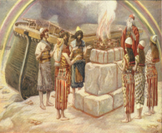
Genesis 8:21
The Lord smelled the soothing aroma; and the Lord said to Himself, “I will never again curse the ground on account of man, for the intent of man’s heart is evil from his youth; and I will never again destroy every living thing, as I have done.[emphasis mine].

Slide 55
Jeremiah 17:9
“The heart is more deceitful than all else And is desperately sick; Who can understand it?.”

Slide 56
Psalm 51:5
“Behold, I was brought forth in guilt, And in sin my mother conceived me.”

Slide 57
I. Avoid Wrangling (4:1-3)
The problem (4:1a)
The source (4:1b-3)
Internal (4:1b-2a)
Prayerlessness (4:2b)
Misdirected prayer (4:3)

Slide 58
I. Avoid Wrangling (4:1-3)
The problem (4:1a)
The source (4:1b-3)
Internal (4:1b-2a)
Prayerlessness (4:2b)
Misdirected prayer (4:3)

Slide 59
Spiritual Life (4:1-12)
Avoid wrangling (4:1-3)
Avoid worldliness (4:4-6)
Essence of spiritual wisdom (4:7-12)

Slide 60
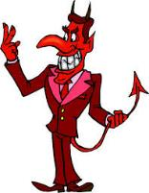
Names & Titles Demonstrating Satan’s Post-Fall, Earthly Authority (Job 1:7; 2:2; Luke 4:5-8; Rom. 8:19-22)
Prince of this world (John 12:31; 14:30; 16:11)
God of this age (2 Cor. 4:4)
Prince and power of the air (Eph. 2:2)
Who the believer wrestles with (Eph. 6:12)
Roaring lion (1 Pet. 5:8)
Whole world lies in his power (1 John 5:19)

Slide 61
II. Avoid Worldliness (4:4-6)
The Consequences (4:4-5)
Enmity against God (4:4)
Alienation of the Holy Spirit (4:5)
The Cause (4:6)

Slide 62
II. Avoid Worldliness (4:4-6)
The Consequences (4:4-5)
Enmity against God (4:4)
Alienation of the Holy Spirit (4:5)
The Cause (4:6)

Slide 63
II. Avoid Worldliness (4:4-6)
The Consequences (4:4-5)
Enmity against God (4:4)
Alienation of the Holy Spirit (4:5)
The Cause (4:6)

Slide 64
Audience
Jewish (1:1)
Persecution (Acts 8:1-4; 11:19)
In Babylon-Mesopotamia or North-Central Turkey?
Believers (Jas 1:2-4)

Slide 65
James 1:1
“¹ James, a bond-servant of God and of the Lord Jesus Christ, To the twelve tribes who are dispersed abroad: Greetings.”

Slide 66
II. Avoid Worldliness (4:4-6)
The Consequences (4:4-5)
Enmity against God (4:4)
Alienation of the Holy Spirit (4:5)
The Cause (4:6)

Slide 67
1 Samuel 16:13-14
¹³ So Samuel took the horn of oil and anointed him in the midst of his brothers; and the Spirit of the Lord rushed upon David from that day forward. And Samuel set out and went to Ramah. ¹⁴ Now the Spirit of the Lord left Saul, and an evil spirit from the Lord terrified him.”

Slide 68
John 14:16-17
¹⁶ I will ask the Father, and He will give you another Helper, so that He may be with you forever; ¹⁷ the Helper is the Spirit of truth, whom the world cannot receive, because it does not see Him or know Him; but you know Him because He remains with you and will be in you.”

Slide 69
Audience
Jewish (1:1)
Persecution (Acts 8:1-4; 11:19)
In Babylon-Mesopotamia or North-Central Turkey?
Believers (Jas 1:2-4)

Slide 70
II. Avoid Worldliness (4:4-6)
The Consequences (4:4-5)
Enmity against God (4:4)
Alienation of the Holy Spirit (4:5)
The Cause (4:6)

Slide 71
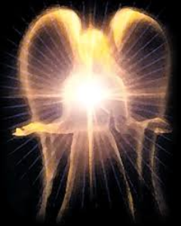
Original State and First Sin (cont’d)
Isaiah 14:12-15
5 “I will” statements
Ascend to heaven (13)
Raise my throne above the stars of God (13)
Sit enthroned on the Mt. of the Assembly (13)
Ascend above the tops of the clouds (14)
Make myself like the Most High (14)

Slide 72
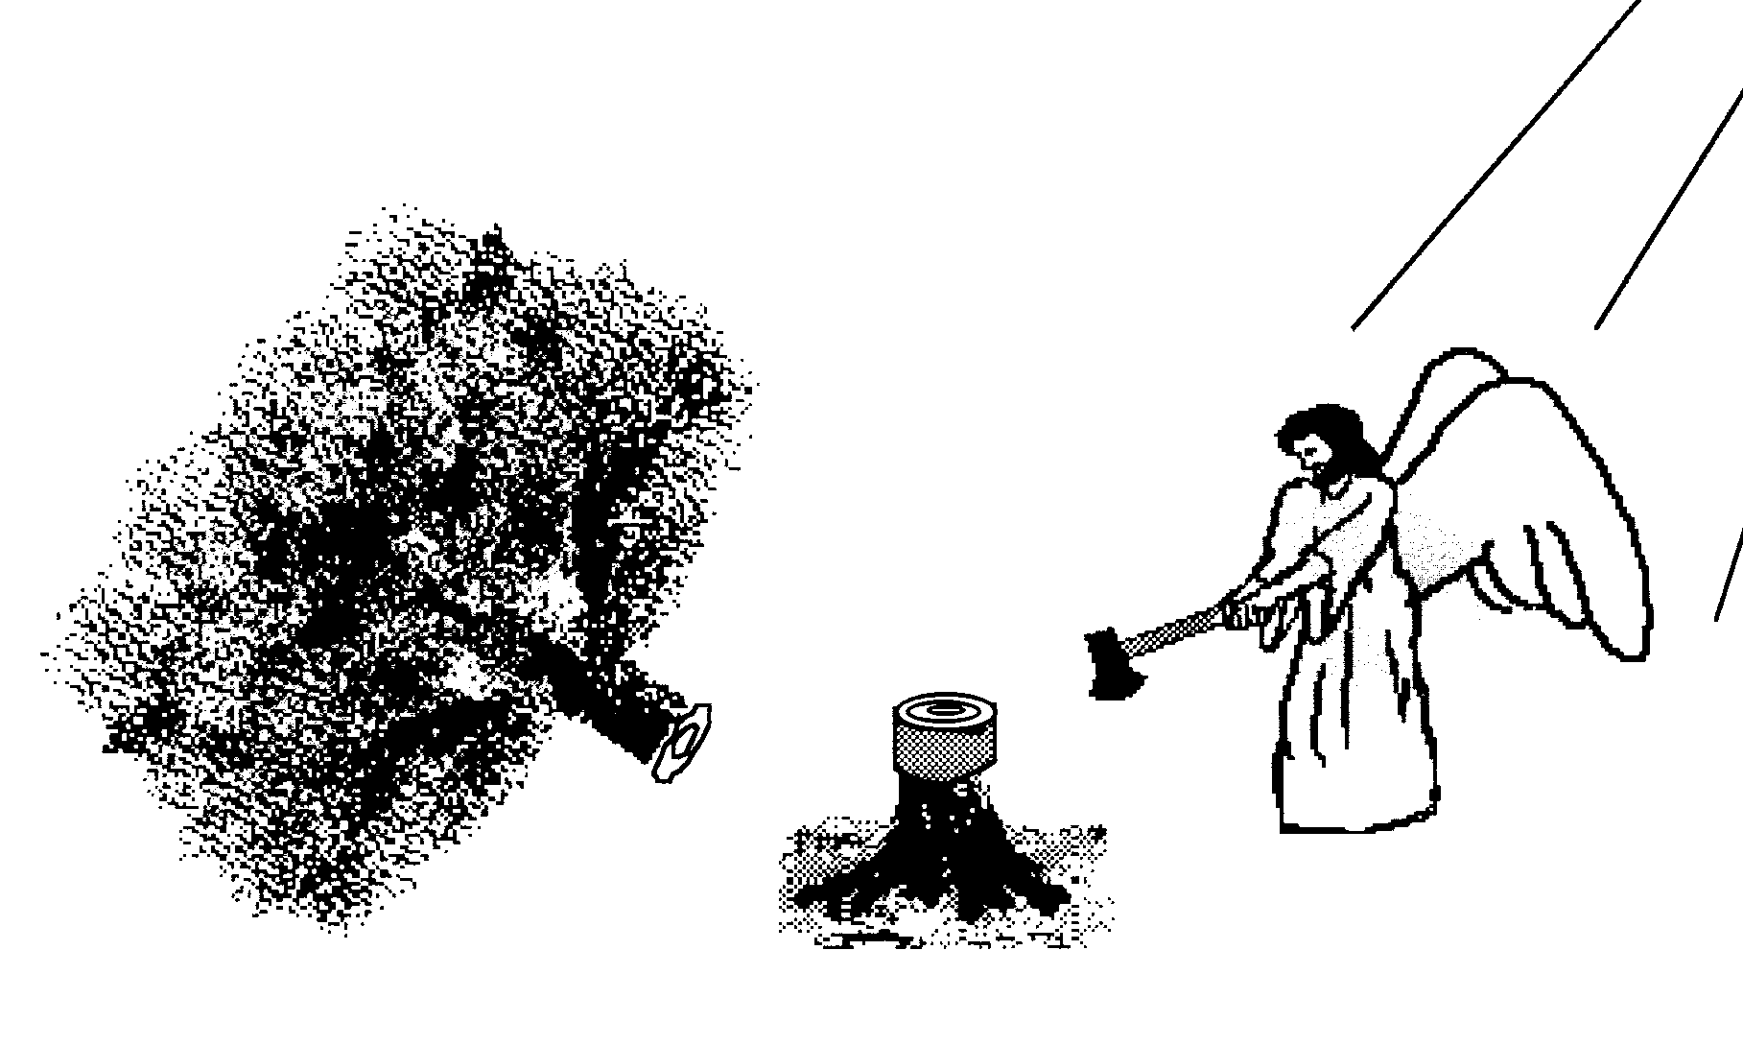
Hall of the Humbled (Prov. 16:18; 1 Peter 5:5)
Satan (Isa. 14:12-15; Ezek. 28:12-17; 1 Tim. 3:6)
Uzziah (2 Chron 26:16)
Herod (Acts 12:20-23)
Paul (2 Cor 12:1-10)

Slide 73
Scripture and Pride
Prov 16:18
Isa 14:12-15; Ezek 28:12-17
1 Tim 3:6
Acts 12:21-23
2 Cor 12:7
1 Pet 5:5

Slide 74
Spiritual Life (4:1-12)
Avoid wrangling (4:1-3)
Avoid worldliness (4:4-6)
Essence of spiritual wisdom (4:7-12)

Slide 75
III. Essence of Spiritual Wisdom (4:7-12)
Submission to God (4:7a)
Resist Satan (4:7b)
Draw near to God (4:8a)
Repent (4:8b-9)
Humility (4:10)
Forego judgment (11-12)

Slide 76
III. Essence of Spiritual Wisdom (4:7-12)
Submission to God (4:7a)
Resist Satan (4:7b)
Draw near to God (4:8a)
Repent (4:8b-9)
Humility (4:10)
Forego judgment (11-12)

Slide 77
Three Tenses of Salvation
Phase | Justification | Sanctification | Glorification
Tense | Past | Present | Future
Saved from sin’s: | Penalty | Power | Presence
Scripture | Eph 2:8-9; Titus 3:5 | Philip 2:12 | Rom 5:10
Nature | Single | Dual | Single

Slide 78
III. Essence of Spiritual Wisdom (4:7-12)
Submission to God (4:7a)
Resist Satan (4:7b)
Draw near to God (4:8a)
Repent (4:8b-9)
Humility (4:10)
Forego judgment (11-12)

Slide 79
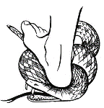
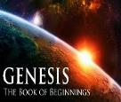
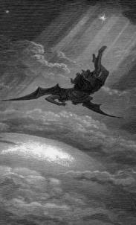
Satan’s Progressive Defeat
Initial eviction from heaven (Isa 14:12-15; Ezek 28:12-17)
Eden (Gen 3:15)
Pre-diluvian world (1 Pet 3:19-20)
Cross (John 12:31; 16:11; Col 2:15; Heb 2:14; 1 John 3:8)
Mid point of the Tribulation (Rev 12:9)
Beginning of millennium (Rev 20:2-3)
End of millennium (Rev 20:10)

Slide 82
III. Essence of Spiritual Wisdom (4:7-12)
Submission to God (4:7a)
Resist Satan (4:7b)
Draw near to God (4:8a)
Repent (4:8b-9)
Humility (4:10)
Forego judgment (11-12)

Slide 83
III. Essence of Spiritual Wisdom (4:7-12)
Submission to God (4:7a)
Resist Satan (4:7b)
Draw near to God (4:8a)
Repent (4:8b-9)
Humility (4:10)
Forego judgment (11-12)

Slide 84
Three Tenses of Salvation
Phase | Justification | Sanctification | Glorification
Tense | Past | Present | Future
Saved from sin’s: | Penalty | Power | Presence
Scripture | Eph 2:8-9; Titus 3:5 | Philip 2:12 | Rom 5:10
Nature | Single | Dual | Single

Slide 85
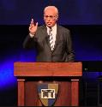
John F. MacArthur
“One of the most comprehensive invitations to salvation in all the Epistles comes in James 4:7 – 10. While James directs most of his epistle to genuine believers, it is also evident that he is concerned about those who are not genuine. He wants no one to be deceived regarding true salvation, so he calls for a real, living, saving faith that is distinct from the dead faith of chapter 2. He states his objective in 5:20. It is to see ‘the sinner converted from the error of his way and his soul saved from death.’”
John F. MacArthur, The Gospel According to Jesus: What Does Jesus Mean When He Says, "Follow Me"? (Grand Rapids: Zondervan, 1988), 218-19.

Slide 86
John F. MacArthur
“The invitation in 4:7 – 10 is directed at those who are not saved — guilty, wicked hearers of the Word who are not doers (cf. 1:21 – 22); who are still captive to dead faith (cf. 2:14 – 20); who are bitter, selfish, arrogant liars whose ‘wisdom is not what comes from above but is earthy, natural, demonic” (3:15); who are loving the world and thus are the enemies of God (4:4); whose inner spirit is still dominated by lusts (cf. 4:5); and who are proud and self-sufficient (cf. 4:6). They are in desperate need of God’s grace.”
John F. MacArthur, The Gospel According to Jesus: What Does Jesus Mean When He Says, "Follow Me"? (Grand Rapids: Zondervan, 1988), 218-19.

Slide 87
John F. MacArthur
“But since God only ‘gives grace to the humble’ (v. 6), James calls these ‘sinners’ (a term used in Scripture only of the unregenerate) to turn from their pride and humble themselves. Ten imperatives delineate the commands in James’s call to sinners: submit yourself to God (salvation); resist the devil (transferring allegiance); draw near to God (intimacy of relationship); cleanse your hands (repentance); purify your hearts (confession); be miserable, mourn, weep, and let your laughter and joy be turned to gloom (sorrow).”
John F. MacArthur, The Gospel According to Jesus: What Does Jesus Mean When He Says, "Follow Me"? (Grand Rapids: Zondervan, 1988), 218-19.

Slide 88
John F. MacArthur
“The final imperative summarizes the mentality of those who are converted: ‘Humble yourselves in the presence of the Lord.’ All this is a work of God, who gives His more abundant grace (4:6).”
John F. MacArthur, The Gospel According to Jesus: What Does Jesus Mean When He Says, "Follow Me"? (Grand Rapids: Zondervan, 1988), 218-19.

Slide 89
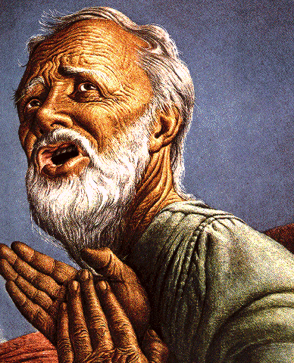
Belief – God’s One Condition for Justification
Gen 15:6
Then he believed in the LORD; and He reckoned it to him as righteousness.
John 3:16
For God so loved the world, that He gave His only begotten Son, that whoever believes in Him shall not perish, but have eternal life.
Acts 16:30-31
"Sirs, what must I do to be saved?" They said, "Believe in the Lord Jesus, and you will be saved..."

Slide 90
III. Essence of Spiritual Wisdom (4:7-12)
Submission to God (4:7a)
Resist Satan (4:7b)
Draw near to God (4:8a)
Repent (4:8b-9)
Humility (4:10)
Forego judgment (11-12)

Slide 91
III. Essence of Spiritual Wisdom (4:7-12)
Submission to God (4:7a)
Resist Satan (4:7b)
Draw near to God (4:8a)
Repent (4:8b-9)
Humility (4:10)
Forego judgment (11-12)

Slide 92
1 Corinthians 4:5
“ Therefore do not go on passing judgment before the time, but wait until the Lord comes who will both bring to light the things hidden in the darkness and disclose the motives of men’s hearts; and then each man’s praise will come to him from God.”
Notes:
Rapture and Bema

Slide 93
CONCLUSION

Slide 94
Spiritual Life (4:1-12)
Avoid wrangling (4:1-3)
Avoid worldliness (4:4-6)
Essence of spiritual wisdom (4:7-12)

Slide 95
Structure
Wisdom (3:13–5:20)
Wisdom defined (3:13-18)
Spirituality (4:1-12)
Commerce (4:13-17)
Use of wealth (5:1-6)
Waiting for the Lord’s return (5:7-12)
Prayer (5:13-18)
Restoration of the erring brother (5:19-20)

