Slide 1
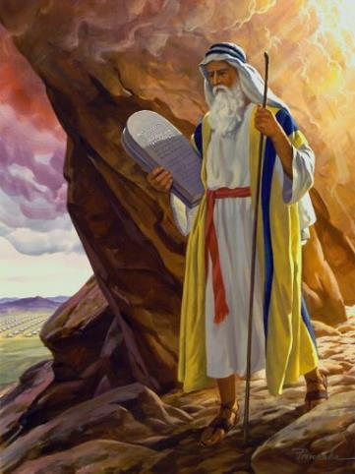
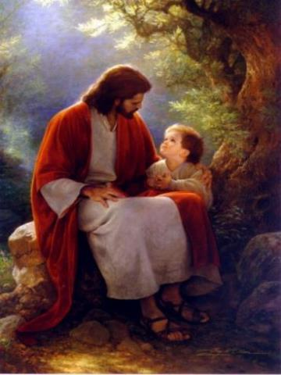
Law and Grace: An Overview Jim McGowan, Th.D. Sugar Land Bible Church 03-14-2021
…but grace and truth were realized through Jesus Christ - John 1:17
For the Law was given through Moses…
Special thanks to Dr. Vern Peterman for access to his insights and resources.

Slide 2
Session 27 Outline
Review
Purpose, Aim, and Objective
Session 26
Until Then – Matthew 5:11–20
General Information
Concluding Observations
Comparisons & Contrasts

Slide 3
OUR PURPOSE, AIM AND OBJECTIVE
Law and Grace
…is to Compare and Contrast Law and Grace so as to properly understand these two important themes and how they are related to the life of the New Testament Believer.

Slide 4
C. I. SCOFIELD, D. D.
The Grace of God, The Fundamentals Vol. 3, Chapter VII, p. 98
We have, most of us, been reared and now live under the influence of Galatianism. Protestant theology, alas, is for the most part, thoroughly Galatianized, in that neither law nor grace are given their distinct and separated places, as in the counsels of God, but are mingled together in one incoherent system.
The law is no longer, as in the Divine intent, a ministration of death (2 Cor. 3:7), of cursing (Gal. 3:10), of conviction (Rom. 3:19), because we are taught that we must try to keep it, and that by Divine help we may.
Nor, on the other hand, does grace bring us blessed deliverance from the dominion of sin, for we are kept under the law as a rule of life despite the plain declaration, “Sin shall not have dominion over you: for ye are not under the law, but under grace” (Rom. 6:14). (emphasis mine)

Slide 5
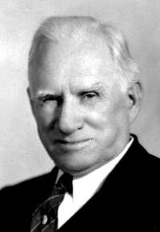
William R. Newell
Romans Verse-by-Verse (p. 274).
Grand Rapids, MI: Christian Classics Ethereal Library.
It is because Reformed theology has kept us Gentiles under the Law,—if not as a means of righteousness, then as “a rule of life,” that all the trouble has arisen. The Law is no more a rule of life than it is a means of righteousness. Walking in the Spirit has now taken the place of walking by ordinances. God has another principle under which He has put his saints: “Ye are not under law, but, under grace! (Rom. 6:14)” (italics mine)
PDF Download Here: https://archive.org/details/Romans_Verse_By_Verse-NewellWR

Slide 6
Henry Ironside
The Continual Burnt Offering: Daily Meditations on the Word of God (p. 265). Neptune, NJ: Loizeaux Brothers.
In Romans 7 we have a man renewed by the Spirit of God, but struggling under law, hoping thereby to subdue or find deliverance from the power of the old Adamic nature. In chapter 8 we have God’s way of deliverance through the death and resurrection of Christ with which the believer is identified before God. The chapter begins with “no condemnation” and ends with “no separation.” All who are in Christ Jesus are accepted in the Beloved and as free from every charge of guilt as He is Himself. He paid our penalty on the cross. Now we are linked up with Him in resurrection, not under law but under grace.

Slide 7
Session 27 Outline
Review
Purpose, Aim, and Objective
Session 26
Until Then – Matthew 5:11–20
General Information
Concluding Observations
Comparisons & Contrasts

Slide 8
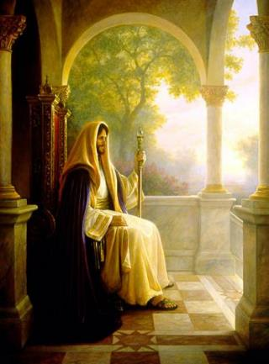
Matthew’s Purposes
Law and Grace: Review Session 26 The SOM – Matthew 5:1–8:1 (Luke 6:17–49)
To explain that Jesus in whom they had believed was the long-awaited Jewish Messiah
To explain why the kingdom had been postponed despite the fact that the king had arrived
To explain the interim program of God during the kingdom’s absence

Slide 9
Matthew & the Kingdom
Law and Grace: Review Session 26 The SOM – Matthew 5:1–8:1 (Luke 6:17–49)
Kingdom offered
Kingdom rejected
Kingdom postponed
Kingdom ultimately accepted
Interim program

Slide 10
Matthew’s Message
Law and Grace: Review Session 26 The SOM – Matthew 5:1–8:1 (Luke 6:17–49)
Jesus is the predicted Jewish king who ushered in an interim program by building the sons of the kingdom into the church in between Israel’s past rejection and future acceptance of her king

Slide 11
³ Blessed are the poor in spirit, for theirs is the kingdom of heaven. ⁴ Blessed are those who mourn, for they shall be comforted. ⁵ Blessed are the gentle, for they shall inherit the earth. ⁶ Blessed are those who hunger and thirst for righteousness, for they shall be satisfied. ⁷ Blessed are the merciful, for they shall receive mercy. ⁸ Blessed are the pure in heart, for they shall see God. ⁹ Blessed are the peacemakers, for they shall be called sons of God. ¹⁰Blessed are those who have been persecuted for the sake of righteousness, for theirs is the kingdom of heaven.
Law and Grace: Review Session 26 The SOM – Matthew 5:1–8:1 (Luke 6:17–49)
THE INCLUSIO IN MATTHEW 5:3-10
Inclusi – What?

Slide 12
The Lexham Glossary of Theology states, “An Inclusio is a literary device that repeats words or themes at the beginning and end of a section. The repetition brackets the section. The Bible makes frequent use of inclusios to structure both long and short sections of text.”
Law and Grace: Review Session 26 The SOM – Matthew 5:1–8:1 (Luke 6:17–49)
INCLUSIO
Mangum, D. (2014). The Lexham Glossary of Theology. Bellingham, WA: Lexham Press.

Slide 13
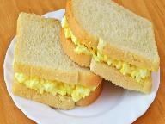
The Believers Church Bible Commentary states, that an ‘Inclusio’ is “A literary device in which a section’s opening and closing are identical or at least similar. An inclusio by definition ties the end to the beginning; it recapitulates. One might think of an inclusio as a sandwich: material is placed between identical phrases. The effect of such a device is to give unity and emphasis to the passage.”
Law and Grace: Review Session 26 The SOM – Matthew 5:1–8:1 (Luke 6:17–49)
INCLUSIO
The Believers Church Bible Commentary; Martens, E. A. (1986). Jeremiah (p. 3). Scottdale, PA: Herald Press.

Slide 14
³ BLESSED ARE the poor in spirit, FOR THEIRS IS THE KINGDOM OF HEAVEN. ⁴ Blessed are those who mourn, for they shall be comforted. ⁵ Blessed are the gentle, for they shall inherit the earth. ⁶ Blessed are those who hunger and thirst for righteousness, for they shall be satisfied. ⁷ Blessed are the merciful, for they shall receive mercy. ⁸ Blessed are the pure in heart, for they shall see God. ⁹ Blessed are the peacemakers, for they shall be called sons of God. ¹⁰ BLESSED ARE those who have been persecuted for the sake of righteousness, FOR THEIRS IS THE KINGDOM OF HEAVEN.
Law and Grace: Review Session 26 The SOM – Matthew 5:1–8:1 (Luke 6:17–49)
THE INCLUSIO IN MATTHEW 5:3-10

Slide 15
Law and Grace: Session 26 Review The SOM – Matthew 5:1–8:1 (Luke 6:17–49)

Slide 16
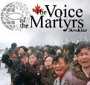
³ BLESSED ARE the poor in spirit, FOR THEIRS IS THE KINGDOM OF HEAVEN. ⁴ Blessed are those who mourn, for they shall be comforted. ⁵ Blessed are the gentle, for they shall inherit the earth. ⁶ Blessed are those who hunger and thirst for righteousness, for they shall be satisfied. ⁷ Blessed are the merciful, for they shall receive mercy. ⁸ Blessed are the pure in heart, for they shall see God. ⁹ Blessed are the peacemakers, for they shall be called sons of God. ¹⁰ BLESSED ARE who have been persecuted for the sake of righteousness, FOR THEIRS IS THE KINGDOM OF HEAVEN.
Law and Grace: Session 27 The SOM – Matthew 5:1–8:1 (Luke 6:17–49)
THE INCLUSIO IN MATTHEW 5:3-10

Slide 17
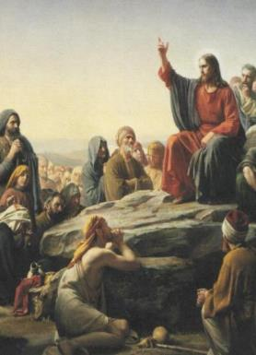
How did Christ intend for us to view the Sermon on the Mount?
Law and Grace: Session 27 The SOM – Matthew 5:1–8:1 (Luke 6:17–49)
The Sermon on the Mount was primarily and directly addressed to the Jews of Jesus’ day given after:
intense interest in the person of Jesus was stirred up – was He the Messiah?
the selection of the Twelve Disciples.
several conflicts with the Pharisees regarding Pharisaic Judaism and the Pharisaic interpretation of the Mosaic Law.

Slide 18
How did Christ intend for us to view the Sermon on the Mount?
Law and Grace: Session 27 The SOM – Matthew 5:1–8:1 (Luke 6:17–49)
The sermon was designed to lead [the Jewish] multitude away from a false concept of righteousness to a true concept of righteousness; from a false hope of entrance into the kingdom to a sure foundation for entrance into Messiah’s kingdom…the Sermon on the Mount in its historical setting was Christ’s instruction to that generation to which He was offering Himself as Saviour and Sovereign…
Pentecost, J. D. (1995). Thy Kingdom Come: Tracing God’s Kingdom Program and Covenant Promises throughout History (pp. 205–206). Grand Rapids, MI: Kregel Publications.

Slide 19
³ BLESSED ARE the poor in spirit, FOR THEIRS IS THE KINGDOM OF HEAVEN. ⁴ Blessed are those who mourn, for they shall be comforted. ⁵ Blessed are the gentle, for they shall inherit the earth. ⁶ Blessed are those who hunger and thirst for righteousness, for they shall be satisfied. ⁷ Blessed are the merciful, for they shall receive mercy. ⁸ Blessed are the pure in heart, for they shall see God. ⁹ Blessed are the peacemakers, for they shall be called sons of God. ¹⁰ BLESSED ARE who have been persecuted for the sake of righteousness, FOR THEIRS IS THE KINGDOM OF HEAVEN.
Law and Grace: Session 27 The SOM – Matthew 5:1–8:1 (Luke 6:17–49)
THE INCLUSIO IN MATTHEW 5:3-10

Slide 20
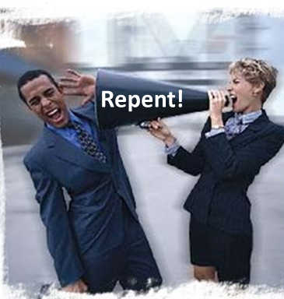
Persecuted for the sake of righteousness
Law and Grace: Session 27 The SOM – Matthew 5:1–8:1 (Luke 6:17–49)

Slide 21
Persecuted for the sake of righteousness
Law and Grace: Session 27 The SOM – Matthew 5:1–8:1 (Luke 6:17–49)
Many godly Israelites will be persecuted for the sake of righteousness during the reign of Antichrist before the start of the Millennial Kingdom. Similarly, many Church saints will be persecuted for the sake of righteousness before the Rapture.

Slide 22
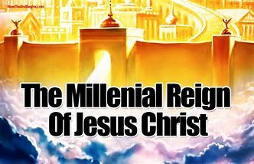
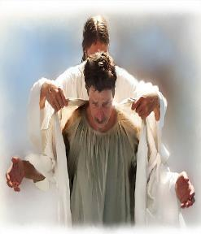
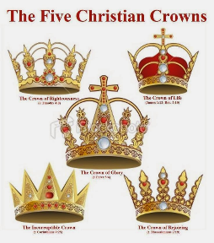
Persecuted for the sake of righteousness
Law and Grace: Session 27 The SOM – Matthew 5:1–8:1 (Luke 6:17–49)
But being persecuted has its ultimate payoff: for Israelites in the Kingdom, and Church saints rewarded in heaven.

Slide 23
The Inclusio in Matthew 5:3-10 | Comparison & Contrast
³ Blessed are the poor in spirit, for theirs is the kingdom of heaven. | Philippians 4:23; Philemon 25
⁴ Blessed are those who mourn, for they shall be comforted. | John 14:16; 26; 15:26; 16:7
⁵ Blessed are the gentle, for they shall inherit the earth. | Galatians 5:22,23
⁶ Blessed are those who hunger and thirst for righteousness, for shall be satisfied. | 1 Peter 2:2; Romans 10:4
⁷ Blessed are the merciful, for they shall receive mercy. | Ephesians 2:4-7
⁸ Blessed are the pure in heart, for they shall see God. | 2 Corinthians 3:18; Hebrews 12:2
⁹ Blessed are the peacemakers, for they shall be called sons of God. | Galatians 5:22-23
¹⁰ Blessed are those who have been persecuted for the sake of righteousness, for theirs is the kingdom of heaven. | 2 Timothy 3:12

Slide 24
Session 27 Outline
Review
Purpose, Aim, and Objective
Session 26
Until Then – Matthew 5:11–20
General Information
Concluding Observations
Comparisons & Contrasts

Slide 25
Matthew 5:11–20
¹¹ “Blessed are you when people insult you and persecute you, and falsely say all kinds of evil against you because of Me. ¹² “Rejoice and be glad, for your reward in heaven is great; for in the same way they persecuted the prophets who were before you. ¹³ “You are the salt of the earth; but if the salt has become tasteless, how can it be made salty again? It is no longer good for anything, except to be thrown out and trampled under foot by men. ¹⁴ “You are the light of the world. A city set on a hill cannot be hidden; ¹⁵ nor does anyone light a lamp and put it under a basket, but on the . . .

Slide 26
Matthew 5:11–20
…lampstand, and it gives light to all who are in the house. ¹⁶ “Let your light shine before men in such a way that they may see your good works, and glorify your Father who is in heaven. ¹⁷ “Do not think that I came to abolish the Law or the Prophets; I did not come to abolish but to fulfill. ¹⁸ “For truly I say to you, until heaven and earth pass away, not the smallest letter or stroke shall pass from the Law until all is accomplished. ¹⁹ “Whoever then annuls one of the least of these commandments, and teaches others to do the same, shall be called least in the kingdom of heaven; but whoever…

Slide 27
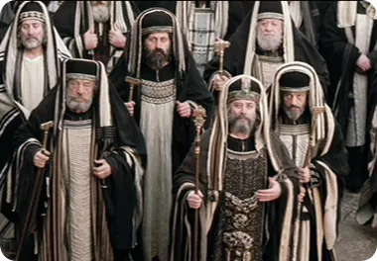
Matthew 5:11–20
…keeps and teaches them, he shall be called great in the kingdom of heaven. ²⁰ “For I say to you that unless your righteousness surpasses that of the scribes and Pharisees, you will not enter the kingdom of heaven.

Slide 28
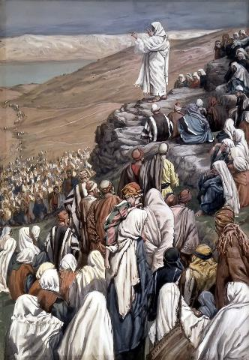
Law and Grace: Session 27 The SOM – Matthew 5:1–8:1 (Luke 6:17–49)
To Whom is Jesus speaking in the SOM?
Rose are red
And violets are bluish
All of those listening to Jesus are Jewish!

Slide 29
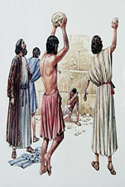
Matthew 5:11–12
¹¹ “Blessed are you when people insult you and persecute you, and falsely say all kinds of evil against you because of Me. ¹² “Rejoice and be glad, for your reward in heaven is great; for in the same way they persecuted the prophets who were before you.

Slide 30
Happy Persecution Day? Mathew 5:11-12
Law and Grace: Session 27 The SOM – Matthew 5:1–8:1 (Luke 6:17–49)
Vv. 11-12 broaden the persecution spoken of in v. 10, but more importantly, they associate true righteousness with Jesus Himself as opposed to the Pharisees.
Jesus connected His listeners with the O.T. prophets. The persecution they endure would evidence their true righteousness too! Again, this true righteousness stands in contradistinction to that of the Pharisees. But there is more…

Slide 31
Happy Persecution Day? Mathew 5:11-12
Law and Grace: Session 27 The SOM – Matthew 5:1–8:1 (Luke 6:17–49)
The prophets were persecuted because they faithfully followed the God of Israel.
Jesus’ audience would be persecuted because they faithfully follow Him.
This is a veiled reference to Jesus’ deity.
RELATIONSHIP OF THE BLESSED PERSECUTED
Prophets | servants of | God
Believing Jewish Audience | servants of | Jesus
Prophets | = | Believing Jewish Audience
God | = | Jesus

Slide 32
Happy Persecution Day? Mathew 5:11-12
Law and Grace: Session 27 The SOM – Matthew 5:1–8:1 (Luke 6:17–49)
For those Israelites who proclaim Jesus to be the Messiah, the King of Israel, persecution awaits.
For those in the Church who proclaim Christ as the God-Man and Savior, persecution awaits.
2 Timothy 3:12
Indeed, all who desire to live godly in Christ Jesus will be persecuted.

Slide 33
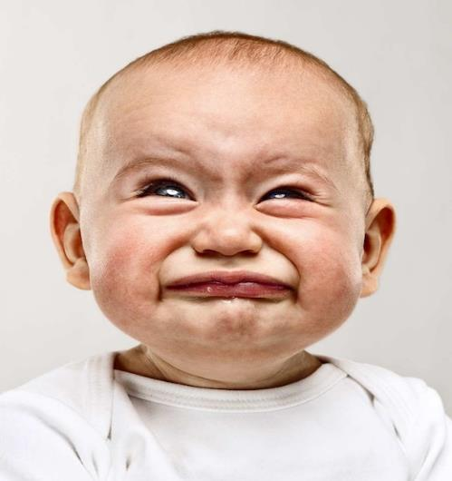
Happy Persecution Day? Mathew 5:11-12
Law and Grace: Session 27 The SOM – Matthew 5:1–8:1 (Luke 6:17–49)

Slide 34
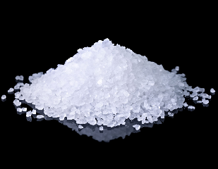
Matthew 5:13
¹³ “You are the salt of the earth; but if the salt has become tasteless, how can it be made salty again? It is no longer good for anything, except to be thrown out and trampled under foot by men.

Slide 35
Matthew 5:13
¹³ “You are the salt of the earth; but if the salt has become tasteless, how can it be made salty again? It is no longer good for anything, except to be thrown out and trampled under foot by men.

Slide 36
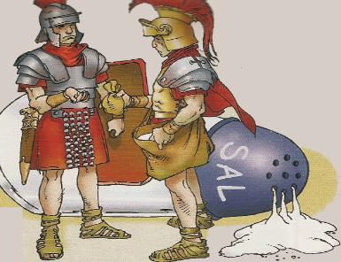
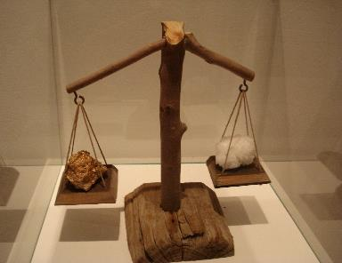
Law and Grace: Session 27 The SOM – Matthew 5:1–8:1 (Luke 6:17–49)
The Salt
Matthew 5:13
Salt was coveted and so valuable that it was equivalent to gold during the time of Christ.
The Latin word from which we get our word ‘salary’ “salarium” meant ‘salt money’.

Slide 37
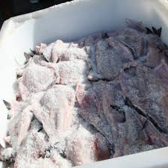
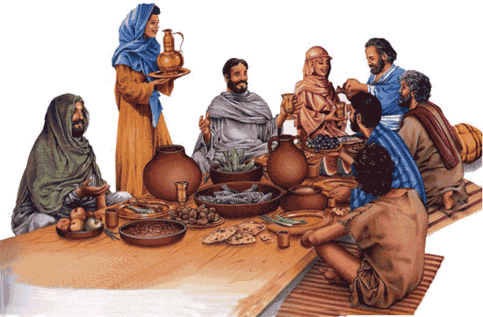
Law and Grace: Session 27 The SOM – Matthew 5:1–8:1 (Luke 6:17–49)
The Salt
Matthew 5:13
Salt was also used as today for seasoning for meals, as a preservative since there was no refrigeration.
Consider the feeding of the 5000 (cf. Matt. 14:13–21; Mark 6:32–44; Luke 9:12–17; John 6:1–14) and later the 4000 (cf. Matt. 15:32–38; Mark 8:1–10).

Slide 38
Law and Grace: Session 27 The SOM – Matthew 5:1–8:1 (Luke 6:17–49)
The Salt
Matthew 5:13
And salt was also used as a general antiseptic. As such it was common to mix olive oil and salt together and rub it on newborns (Eze. 16:4).

Slide 39
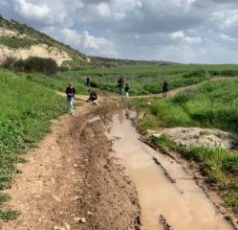
Matthew 5:13
¹³ “You are the salt of the earth; but if the salt has become tasteless, how can it be made salty again? It is no longer good for anything, except to be thrown out and trampled under foot by men.

Slide 40
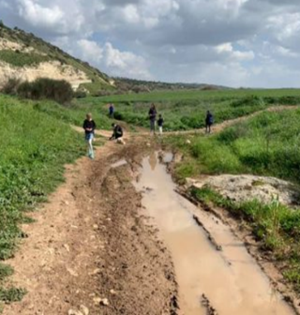
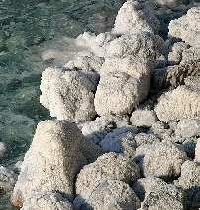
Law and Grace: Session 27 The SOM – Matthew 5:1–8:1 (Luke 6:17–49)
The Salt
Matthew 5:13
Over time, the savory aspect of salt will leach out and render it worthless.
When this happened, it would either be thrown into the roadway to help keep the roadway from getting muddy.

Slide 41
Galatians 6:8-10
⁸ For the one who sows to his own flesh will from the flesh reap corruption, but the one who sows to the Spirit will from the Spirit reap eternal life. ⁹ Let us not lose heart in doing good, for in due time we will reap if we do not grow weary. ¹⁰ So then, while we have opportunity, let us do good to all people, and especially to those who are of the household of the faith.

Slide 42
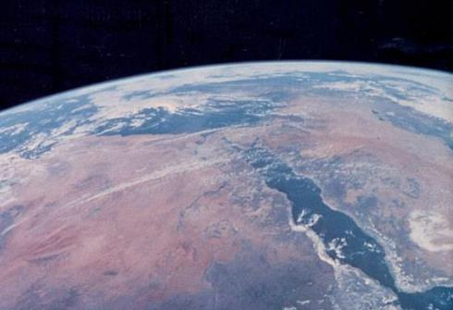
Matthew 5:14
“You are the light of the world. A city set on a hill cannot be hidden;
Israel,
the light of the world

Slide 43
Law and Grace: Session 27 The SOM – Matthew 5:1–8:1 (Luke 6:17–49)
Israel will be the light of the world
Matthew 5:14
God had Isaiah write these words about the people and land of Israel in the kingdom:

Slide 44
Law and Grace: Session 27 The SOM – Matthew 5:1–8:1 (Luke 6:17–49)
The Body of Christ is also Light
‘in Christ’ who is the Light
To be a ‘child of’ or ‘son of’ in biblical terms: to be like in character and close in relationship.

Slide 45
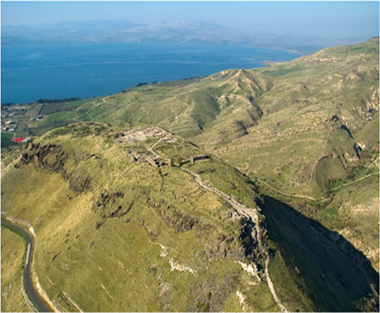
Matthew 5:14
“You are the light of the world. A city set on a hill cannot be hidden;

Slide 46
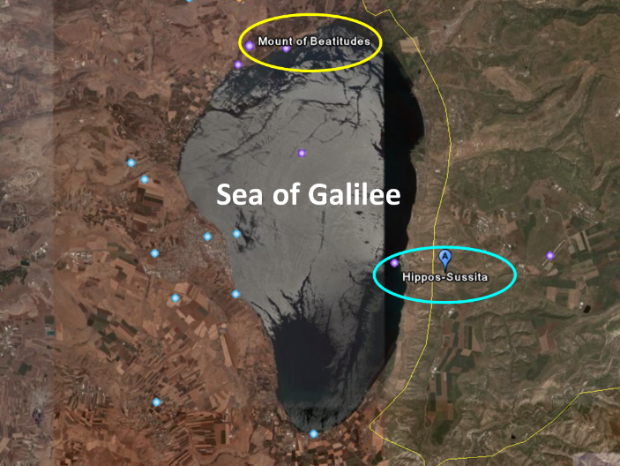
Law and Grace: Session 27 The SOM – Matthew 5:1–8:1 (Luke 6:17–49)
City on a Hill
Matthew 5:14

Slide 47
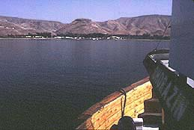
Law and Grace: Session 27 The SOM – Matthew 5:1–8:1 (Luke 6:17–49)
Hippos: A City on a hill…
On the left, looking from Hippos toward the Mount of Beatitudes and on the right, the opposite view from a boat on the Sea of Galilee.
Hippos
Hippos

Slide 48
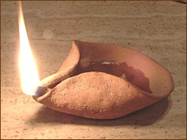
Matthew 5:15–16
¹⁵ nor does anyone light a lamp and put it under a basket, but on the lampstand, and it gives light to all who are in the house. ¹⁶ “Let your light shine before men in such a way that they may see your good works, and glorify your Father who is in heaven.

Slide 49
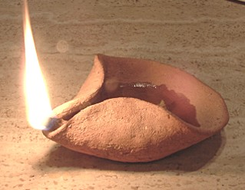
Law and Grace: Session 27 The SOM – Matthew 5:1–8:1 (Luke 6:17–49)
Lit Lamps In Israel’s Land
Matthew 5:15-16
Lamps typically burned olive oil, and the woman of the house was responsible to keep the lamp lit all of the time.

Slide 51
Law and Grace: Session 27 The SOM – Matthew 5:1–8:1 (Luke 6:17–49)
Our Spiritual Light
OPEN & EVIDENT? or PRIVATE & SECRET?
Matthew 5:15-16

Slide 52
Matthew 5:17–20
¹⁷ “Do not think that I came to abolish the Law or the Prophets; I did not come to abolish but to fulfill. ¹⁸ “For truly I say to you, until heaven and earth pass away, not the smallest letter or stroke shall pass from the Law until all is accomplished. ¹⁹ “Whoever then annuls one of the least of these commandments, and teaches others to do the same, shall be called least in the kingdom of heaven; but whoever keeps and teaches them, he shall be called great in the kingdom of heaven. ²⁰ “For I say to you that unless your righteousness surpasses that of the scribes and Pharisees, you will not enter the kingdom of heaven.

Slide 53
Law and Grace: Session 27 The SOM – Matthew 5:1–8:1 (Luke 6:17–49)
What Jesus came to do…may surprise you!
Matthew 5:17-20
Jesus came to the people of Israel to:
keep the Law of Moses,
to uphold the Law of Moses,
and to reclaim the Law of Moses from the corruption of Pharisaic Judaism!

Slide 54
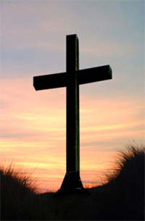
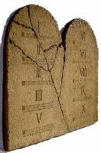
Law and Grace: Session 27 The SOM – Matthew 5:1–8:1 (Luke 6:17–49)
What Jesus came to do…may surprise you!
Matthew 5:17-20
But among us in the church, Christ’s death accomplished our dying to the Law of Moses, so that the life of Christ Himself would do the living in us! (Rom. 7:4-6; Gal. 2:19, 20; 2 Cor. 4:11)

Slide 55
Romans 7:4-6
⁴ Therefore, my brethren, you also were made to die to the Law through the body of Christ, so that you might be joined to another, to Him who was raised from the dead, in order that we might bear fruit for God. ⁵ For while we were in the flesh, the sinful passions, which were aroused by the Law, were at work in the members of our body to bear fruit for death. ⁶ But now we have been released from the Law, having died to that by which we were bound, so that we serve in newness of the Spirit and not in oldness of the letter.

Slide 56
Galatians 2:19–20
¹⁹ “For through the Law I died to the Law, so that I might live to God. ²⁰ “I have been crucified with Christ; and it is no longer I who live, but Christ lives in me; and the life which I now live in the flesh I live by faith in the Son of God, who loved me and gave Himself up for me.
2 Corinthians 4:11
For we who live are constantly being delivered over to death for Jesus’ sake, so that the life of Jesus also may be manifested in our mortal flesh.

Slide 57
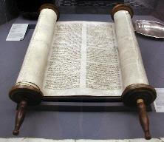
Matthew 5:17–18
¹⁷ “Do not think that I came to abolish the Law or the Prophets; I did not come to abolish but to fulfill. ¹⁸ “For truly I say to you, until heaven and earth pass away, not the smallest letter or stroke shall pass from the Law until all is accomplished.

Slide 58
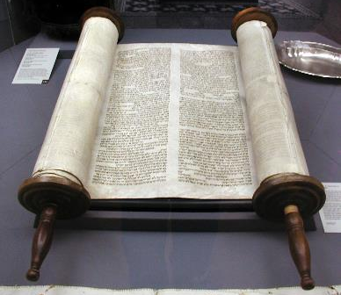
Law and Grace: Session 27 The SOM – Matthew 5:1–8:1 (Luke 6:17–49)
Christ fulfilled & will fulfill the Law & the Prophets (1)
Matthew 5:17-20
Christ fulfilled the Law and the Prophets by living righteously in full accordance with all of the 613 Laws of Moses.

Slide 59
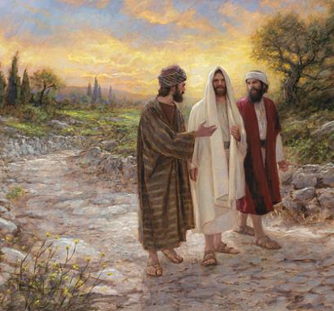
Law and Grace: Session 27 The SOM – Matthew 5:1–8:1 (Luke 6:17–49)
Christ fulfilled & will fulfill the Law & the Prophets (1)
Matthew 5:17-20
Christ fulfilled the Law and the Prophets by fulfilling all that was prophesied about Him in the Law and the Prophets.

Slide 60
Luke 24:25–27
²⁵ And He said to them, “O foolish men and slow of heart to believe in all that the prophets have spoken! ²⁶ “Was it not necessary for the Christ to suffer these things and to enter into His glory?” ²⁷ Then beginning with Moses and with all the prophets, He explained to them the things concerning Himself in all the Scriptures.

Slide 61
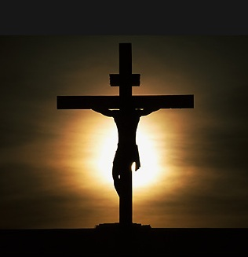
Law and Grace: Session 27 The SOM – Matthew 5:1–8:1 (Luke 6:17–49)
Christ fulfilled & will fulfill the Law & the Prophets (1)
Matthew 5:17-20
And Christ died the death that the Law required of each Law-breaker, just as the prophets said He would, for all of us.
Christ’s death also ratified Israel’s New Covenant.

Slide 62
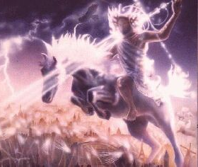
Law and Grace: Session 27 The SOM – Matthew 5:1–8:1 (Luke 6:17–49)
Christ fulfilled & will fulfill the Law & the Prophets (2)
Matthew 5:17-20
Christ will fulfill everything that the Law and the Prophets said He would fulfill in His Second Coming and reigning in the Coming Kingdom as King of Israel and as the King of kings and Lord of lords over all of the Gentiles.

Slide 63
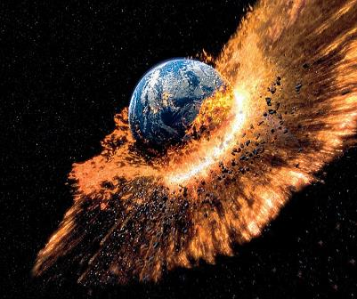
Law and Grace: Session 27 The SOM – Matthew 5:1–8:1 (Luke 6:17–49)
Christ fulfilled & will fulfill the Law & the Prophets (2)
Matthew 5:17-20
Every prophecy concerning Him will be fulfilled until the day heaven and earth pass away.

Slide 64
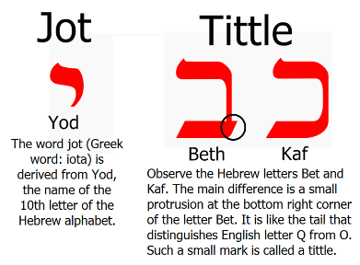
Matthew 5:18
“For truly I say to you, until heaven and earth pass away, not the smallest letter or stroke shall pass from the Law until all is accomplished.

Slide 65
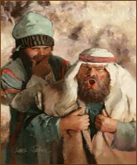
Matthew 5:19
¹⁹ “Whoever then annuls one of the least of these commandments, and teaches others to do the same, shall be called least in the kingdom of heaven; but whoever keeps and teaches them, he shall be called great in the kingdom of heaven.

Slide 66
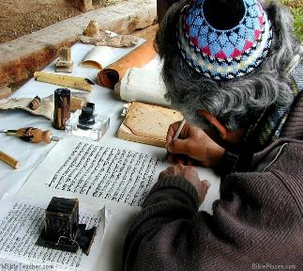
Law and Grace: Session 27 The SOM – Matthew 5:1–8:1 (Luke 6:17–49)
Surpassing Righteousness & Kingdom Entry
Matthew 5:19
V. 19 stresses the importance of True Righteousness as revealed by how an Israelite views and treats the Law. (cf. Mark 7:9; 13)

Slide 67
Matthew 5:20
²⁰ “For I say to you that unless your righteousness surpasses that of the scribes and Pharisees, you will not enter the kingdom of heaven.

Slide 68
Law and Grace: Session 27 The SOM – Matthew 5:1–8:1 (Luke 6:17–49)
Surpassing Righteousness & Kingdom Entry
Matthew 5:20
Verse 20 calls the Israelite back to the standard of righteousness taught in the Old Testament and by Jesus, regarding the Law of Moses, a standard that exceeds that of Pharisaical Judaism.

Slide 69
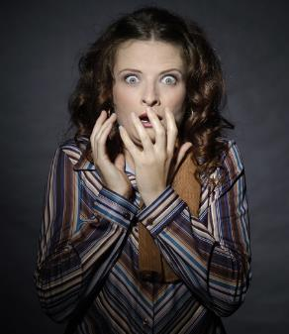
Law and Grace: Session 27 The SOM – Matthew 5:1–8:1 (Luke 6:17–49)
Surpassing Righteousness & Kingdom Entry
Matthew 5:20
Christ reveals a shocking and astounding revelation to His Jewish audience: Not every Jew would enter the Coming Kingdom!

Slide 70
Matthew 5:20
²⁰ “For I say to you that unless your righteousness surpasses that of the scribes and Pharisees, you will not enter the kingdom of heaven.

Slide 72
Matthew 7:13-14
¹³ Enter through the narrow gate; for the gate is wide and the way is broad that leads to destruction, and there are many who enter through it. ¹⁴ For the gate is small and the way is narrow that leads to life, and there are few who find it.

Slide 73
Matthew 7:21; 23
²¹ “Not everyone who says to Me, ‘Lord, Lord,’ will enter the kingdom of heaven,… ²³ “…I will declare to them, ‘I never knew you; depart from Me, you who practice lawlessness.’

Slide 74
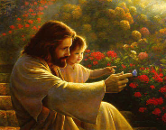
Matthew 18:1-3
¹ At that time the disciples came to Jesus and said, "Who then is greatest in the kingdom of heaven?" ² And He called a child to Himself and set him before them, ³ and said, "Truly I say to you, unless you are converted and become like children, you will not enter the kingdom of heaven.

Slide 75
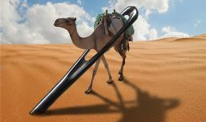
Matthew 19:23-24
(cf. Luke 18:24-25 & Mark 10:23-25)
²³ And Jesus said to His disciples, “Truly I say to you, it is hard for a rich man to enter the kingdom of heaven. ²⁴ Again I say to you, it is easier for a camel to go through the eye of a needle, than for a rich man to enter the kingdom of God.”

Slide 76
Matthew 21:31
“Which of the two did the will of his father?" They said, "The first." Jesus said to them, "Truly I say to you that the tax collectors and prostitutes will get into the kingdom of God before you.”

Slide 77
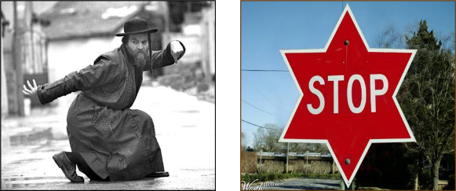
Matthew 23:13
“But woe to you, scribes and Pharisees, hypocrites, because you shut off the kingdom of heaven from people; for you do not enter in yourselves, nor do you allow those who are entering to go in.”

Slide 78
Session 27 Outline
Review
Purpose, Aim, and Objective
Session 26
Until Then – Matthew 5:11–20
General Information
Concluding Observations
Comparisons & Contrasts

Slide 79
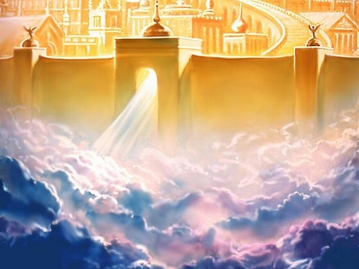
Law and Grace: Session 27 The SOM – Matthew 5:1–8:1 (Luke 6:17–49)
So How Does One Now Enter Heaven?

Slide 80
Law and Grace: Session 27 The SOM – Matthew 5:1–8:1 (Luke 6:17–49)
So How Does One Now Enter Heaven?
Are we to strive really hard, and work ourselves to the bone in order to enter the narrow gate?

Slide 81
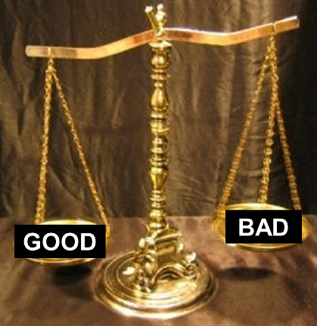
Law and Grace: Session 27 The SOM – Matthew 5:1–8:1 (Luke 6:17–49)
So How Does One Now Enter Heaven?
Do we do our best and hope that the scales of justice will swing in our favor when the time comes?

Slide 82
Law and Grace: Session 27 The SOM – Matthew 5:1–8:1 (Luke 6:17–49)
So How Does One Now Enter Heaven?
Secret: Keep going – don’t slip

Slide 83
Law and Grace: Session 27 The SOM – Matthew 5:1–8:1 (Luke 6:17–49)
So How Does One Now Enter Heaven?
Secret: Keep going – don’t slip

Slide 84
Law and Grace: Session 27 The SOM – Matthew 5:1–8:1 (Luke 6:17–49)
So How Does One Now Enter Heaven?
Secret: Keep going – don’t slip

Slide 85
Law and Grace: Session 27 The SOM – Matthew 5:1–8:1 (Luke 6:17–49)
So How Does One Now Enter Heaven?
I sure hope it turns out OK!

Slide 86
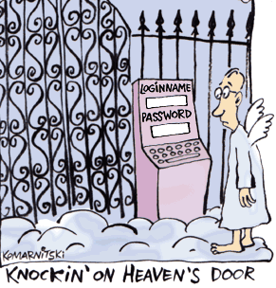
Law and Grace: Session 27 The SOM – Matthew 5:1–8:1 (Luke 6:17–49)
So How Does One Now Enter Heaven?

Slide 87
Law and Grace: Session 27 The SOM – Matthew 5:1–8:1 (Luke 6:17–49)
So How Does One Now Enter Heaven?
Ephesians 2:8-9
⁸ For by grace you have been saved through faith; and that not of yourselves, it is the gift of God; ⁹ not as a result of works, so that no one may boast.

Slide 88
Law and Grace: An Overview Jim McGowan, Th.D. Sugar Land Bible Church 03-14-2021
…but grace and truth were realized through Jesus Christ - John 1:17
For the Law was given through Moses…
Special thanks to Dr. Vern Peterman for access to his insights and resources.

