Slide 1
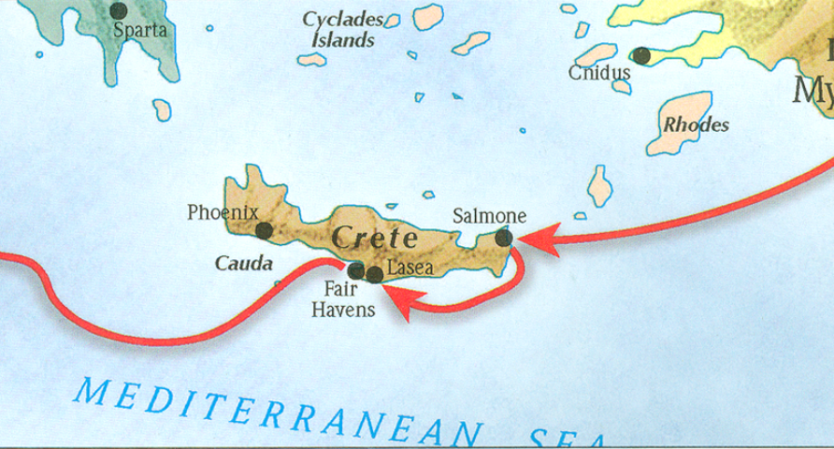
The book of Titus
Worthy of the Gospel

Slide 2
8 Questions?
Who wrote it?
What do we know about the author?
Who was the book written to?
When was the book written?
Where was the book written from?
What’s the purpose of the book?
What’s in the book? (Outline)
What makes this book unique?

Slide 3
8 Questions?
Who wrote it?
What do we know about the author?
Who was the book written to?
When was the book written?
Where was the book written from?
What’s the purpose of the book?
What’s in the book? (Outline)
What makes this book unique?

Slide 4
8 Questions?
Where was the book written? Macedonia
What is the purpose of the book?
Task Titus in bringing order to the churches in Crete by appointing elders.
Provide the churches at Crete doctrinal instruction to promote good works
To warn believers of the false teachers

Slide 5
Titus 1:5
“For this reason I left you in Crete, that you would set in order what remains and appoint elders in every city as I directed you…”

Slide 6
II. Assignment Explained (1:5-3:11)
Appoint Leaders (1:5b-16)
Personal Qualifications of Elders (1:6-8)
Marital relationships (1:6a)
Familial relationships (1:6b)
Interpersonal relationship (1:7-8)
Doctrinal Qualifications of Elders (1:9)
Outline adapted from Titus Argument, Article by Andy Woods, 2007.

Slide 7
1 Timothy 3:4-5
4 “He must be one who manages his own household well, keeping his children under control with all dignity 5 (but if a man does not know how to manage his own household, how will he take care of the church of God?)”

Slide 8
II. Assignment Explained (1:5-3:11)
Appoint Leaders (1:5b-16)
Personal Qualifications of Elders (1:6-8)
Marital relationships (1:6a)
Familial relationships (1:6b)
Interpersonal relationship (1:7-8)
Doctrinal Qualifications of Elders (1:9)
Outline adapted from Titus Argument, Article by Andy Woods, 2007.

Slide 9
Titus 1:7–9
7 “For the overseer must be above reproach as God’s steward, not self-willed, not quick-tempered, not addicted to wine, not pugnacious, not fond of sordid gain, 8 but hospitable, loving what is good, sensible, just, devout, self-controlled, 9 holding fast the faithful word which is in accordance with the teaching, so that he will be able both to exhort in sound doctrine and to refute those who contradict.

Slide 10
The Book of Titus
“Why appoint elders?”
Titus 1:10-16

Slide 11
Outline of Titus
Salutation (1-5a)
Assignor (1:1-3)
Assignee (1:4)
Assignment (1:5)
Assignment Explained (1:5-3:11)
Appoint Elders (1:5b-16)
Addressing Doctrinal Issues (2:1-3:11)
Conclusion (3:12-15)
Requests (3:12-14)
Greetings (3:15a-b)
Benediction (3:15c)
Outline adapted from Titus Argument, Article by Andy Woods, 2007.

Slide 12
II. Assignment Explained (1:5-3:11)
II. Assignment Explained (1:5-3:11)
Appoint Elders (1:5b-16)
Personal Qualifications of Elders (1:6-8)
Marital relationships (1:6a)
Familial relationships (1:6b)
Interpersonal relationship (1:7-8)
Doctrinal Qualifications of Elders (1:9)
Reason for appointing Elders (1:10-16)
Addressing Doctrinal Issues (2:1-3:11)
III. Conclusion (3:12-15)
Outline adapted from Titus Argument, Article by Andy Woods, 2007.

Slide 13
II. Assignment Explained (1:5-3:11)
II. Assignment Explained (1:5-3:11)
Appoint Elders (1:5b-16)
Personal Qualifications of Elders (1:6-8)
Marital relationships (1:6a)
Familial relationships (1:6b)
Interpersonal relationship (1:7-8)
Doctrinal Qualifications of Elders (1:9)
Reason for appointing Elders (1:10-16)
Addressing Doctrinal Issues (2:1-3:11)
III. Conclusion (3:12-15)
Outline adapted from Titus Argument, Article by Andy Woods, 2007.

Slide 14
II. Assignment Explained (1:5-3:11)
vi. Reasons for appointing elders (1:10-16)
Presence of false teachers; their character and conduct
How to deal with false teachers
Key Characteristics of False Teachers
Outline adapted from Titus Argument, Article by Andy Woods, 2007.

Slide 16
Jeremiah 29:11
“For I know the plans that I have for you,’ declares the LORD, ‘plans for welfare and not for calamity to give you a future and a hope.”

Slide 17
Jeremiah 29:8-9
“For thus says the LORD of hosts, the God of Israel, ‘Do not let your prophets who are in your midst and your diviners deceive you, and do not listen to the dreams which they dream. ‘For they prophesy falsely to you in My name; I have not sent them,’ declares the LORD.”

Slide 18
False Teachers and Apostasy in the NT
Gospels (Matt 13)
Early Church (Acts 20:29-31)
Pauline Epistles (Rom 16:17-18; Gal 1:6-9; 2 Cor 11:1-15; Phil 3:2, 18-19; Col 2:8; 1 Tim 4:2; 2 Tim 3:4; Titus 1:10-16)
General Letters (Heb 2:1-4; 2 Peter 2-3; Jude; 1 John 4:1-6)
Revelation (2-3)

Slide 19
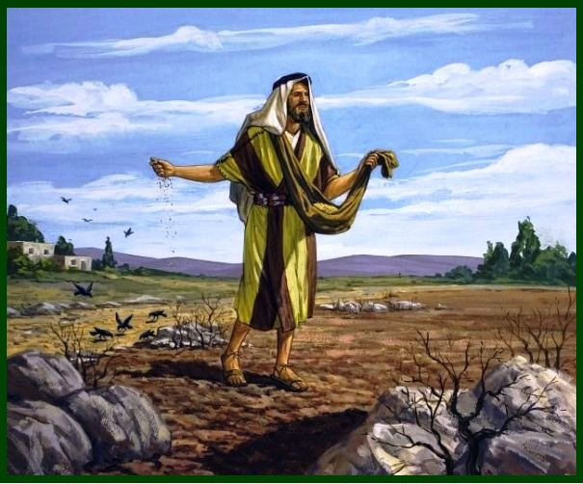
The Parable of the Sower
Preaching the gospel will yield varying results.

Slide 20
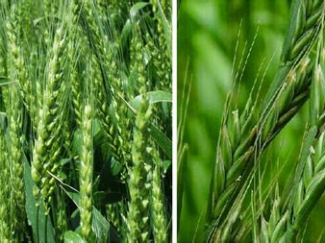
The Parable of the Wheat and Tares
It will be difficult to distinguish between the saved and unsaved in Christendom.

Slide 21
The Parable of the Dragnet
The coexistence of the righteous and the wicked only to be separated at the age’s conclusion.

Slide 22
False Teachers and Apostasy in the NT
Gospels (Matt 13)
Early Church (Acts 20:29-31)
Pauline Epistles (Rom 16:17-18; Gal 1:6-9; 2 Cor 11:1-15; Phil 3:2, 18-19; Col 2:8; 1 Tim 4:2; 2 Tim 3:4; Titus 1:10-16)
General Letters (Heb 2:1-4; 2 Peter 2-3; Jude; 1 John 4:1-6)
Revelation (2-3)

Slide 23
II. Assignment Explained (1:5-3:11)
vi. Reasons for appointing elders (1:10-16)
Presence of false teachers; their character and conduct
How to deal with false teachers
Key Characteristics of False Teachers
Outline adapted from Titus Argument, Article by Andy Woods, 2007.

Slide 24
Titus 1:10
“For there are many rebellious men, empty talkers and deceivers, especially those of the circumcision…”

Slide 25
II. Assignment Explained (1:5-3:11)
vi. Reasons for appointing elders (1:10-16)
Presence of false teachers; their character and conduct (10)
How to deal with false teachers (11-14)
Key Characteristics of False Teachers (15-16)
Outline adapted from Titus Argument, Article by Andy Woods, 2007.

Slide 26
Titus 1:10
“For there are many rebellious men, empty talkers and deceivers, especially those of the circumcision…”

Slide 27
Titus 1:10
“For there are many rebellious men, empty talkers and deceivers, especially those of the circumcision…”

Slide 28
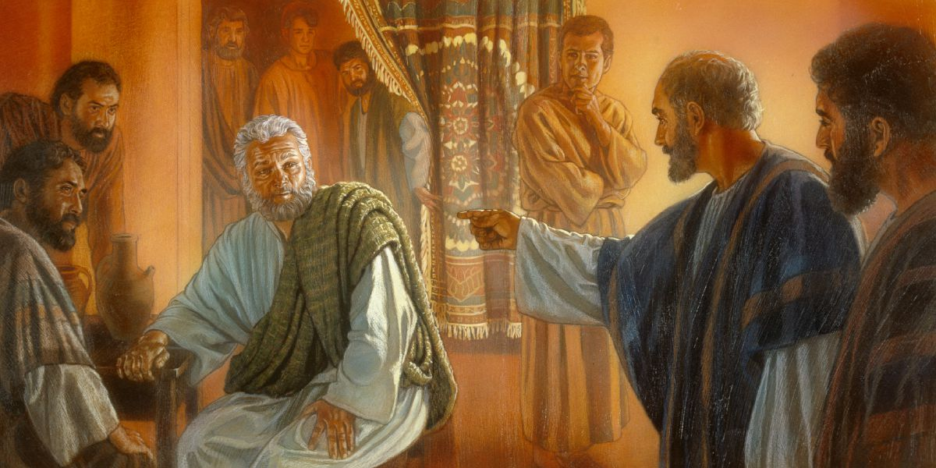
Paul rebukes Peter (Galatians 2:11-14)

Slide 29
Titus 1:10-11
10 “For there are many rebellious men, empty talkers and deceivers, especially those of the circumcision, 11 who must be silenced because they are upsetting whole families, teaching things they should not teach for the sake of sordid gain.
”

Slide 30
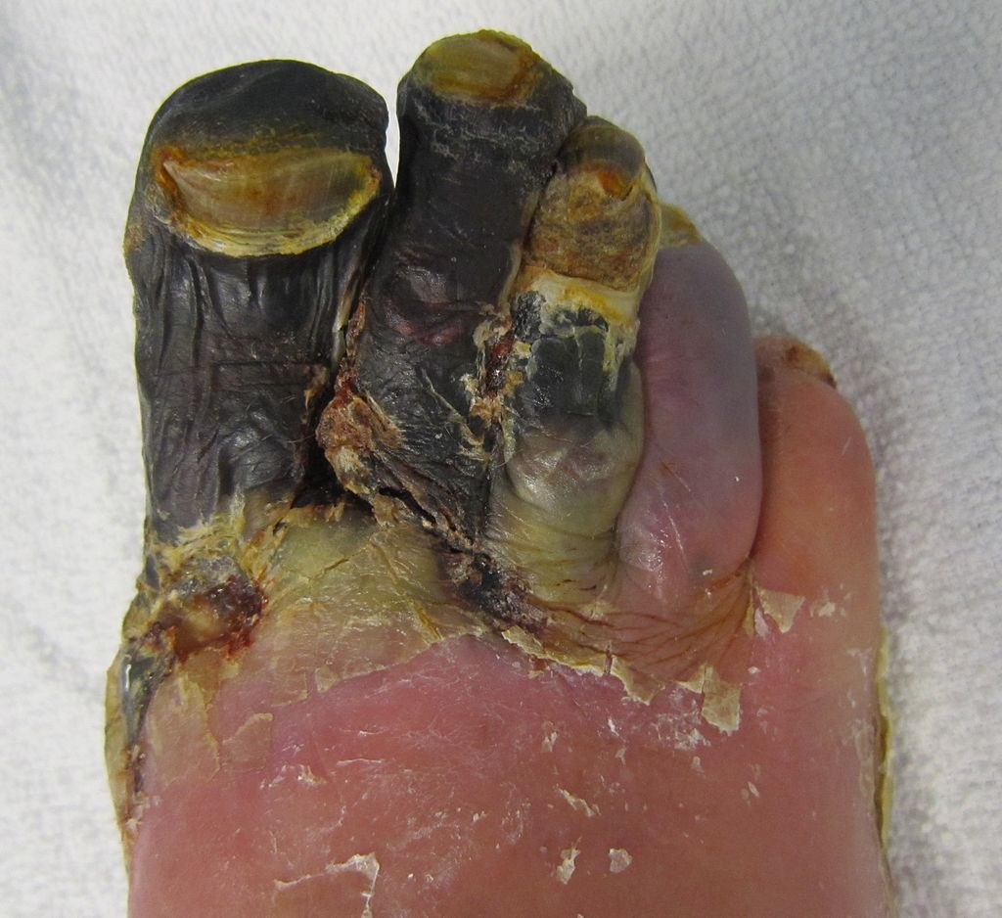
2 Timothy 2:17
“But avoid worldly and empty chatter, for it will lead to further ungodliness, and their talk will spread like gangrene. Among them are Hymenaeus and Philetus…”
Gangrene Patient

Slide 31
Titus 1:10-11
10 “For there are many rebellious men, empty talkers and deceivers, especially those of the circumcision, 11 who must be (dei) silenced because they are upsetting whole families, teaching things they should not (me dei) teach for the sake of sordid gain.
”

Slide 32
It is a total abandonment of self-will… It is an exchange of all that we are for all that Christ is and denotes implicit obedience, full surrender to the lordship of Christ. Nothing less can qualify as saving faith.
(John F. MacArthur, The Gospel According to Jesus, p. 140.)

Slide 33
2 Timothy 2:17
“But avoid worldly and empty chatter, for it will lead to further ungodliness, and their talk will spread like gangrene. Among them are Hymenaeus and Philetus…”
Gangrene Patient

Slide 34
SLBC Membership Covenant:
#4. I have read, understand, and agree with the Church’s Philosophy and Statement of Faith (Articles II and III of the Constitution). I also read the Position Statements, and fully agree with all except (list here):

Slide 35
SLBC Membership Covenant:
#5. I understand that SLBC is an elder ruled church and that the Leaders (which includes the Senior Pastor) and members of SLBC are committed to me, and the well being of my whole person. I will keep them informed of my needs that they might be better able to minister to me, which may include accountability and correction (see Article – Government, Section 5: Disposition of Members, paragraph of the SLBC Constitution).

Slide 36
Titus 1:10-11
10 “For there are many rebellious men, empty talkers and deceivers, especially those of the circumcision, 11 who must be silenced because they are upsetting whole families, teaching things they should not teach for the sake of sordid gain.”

Slide 37
Titus 1:10-11
10 “For there are many rebellious men, empty talkers and deceivers, especially those of the circumcision, 11 who must be silenced because they are upsetting whole families, teaching things they should not teach for the sake of sordid gain.”

Slide 38
False Doctrines affects every Major Doctrine of the Bible
The faith (1 Tim 4:1)
God (Jude 4)
Christ and His death (2 Pet 2:1)
Christ’s return (2 Pet 3:3-4)
Sound doctrine (2 Tim 4:3-4)
The Resurrection (2 Tim 2:16-18)
God as Creator (2 Pet 3:5)

Slide 39
“I don’t believe making disciples must equal adherents to the Christian religion. It may be advisable in many (not all!) circumstances to help people become followers of Jesus and remain within their Buddhist, Hindu, or Jewish contexts”
Brian McClaren, A Generous Orthodoxy, 260.

Slide 40
“Evangelism or missions for me is no longer persuading people to believe what I believe, no matter how edgy or creative I get. Its more about shared experiences and encounters. Its about walking the journey of life and faith together, each distinct to his or her own tradition and culture but with the possibility of encountering God and truth from one another.
Gibbs and Bolger, Emerging Churches, 131.

Slide 41
Matthew 28:19-20
“Go therefore and make disciples of all the nations, baptizing them in the name of the Father and the Son and the Holy Spirit, teaching them to observe all that I commanded you; and lo, I am with you always, even to the end of the age.”

Slide 42
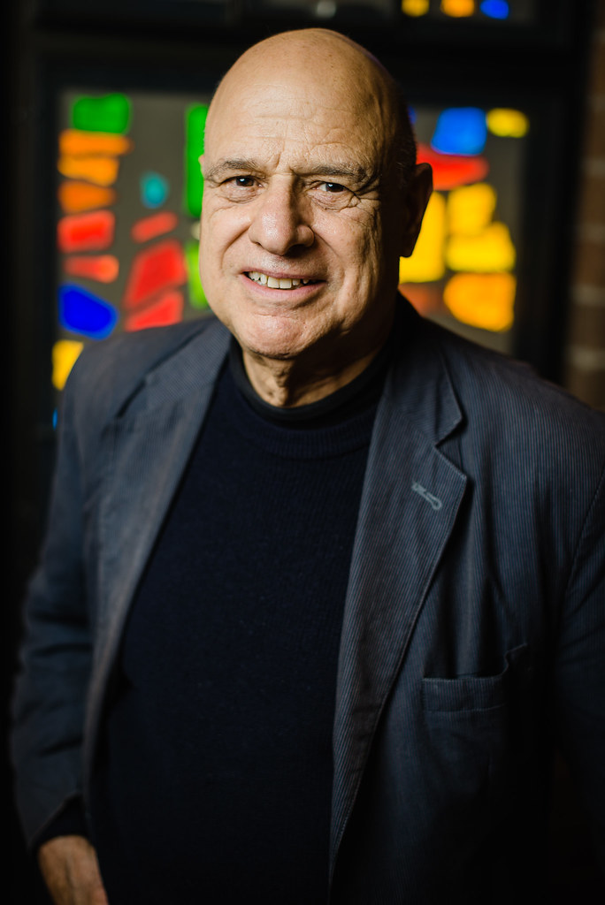
“In a mystical relationship with God, there is a coming together of people where theology is left behind and in this spirituality, they found a commonality. It seems to the Muslim mystics as they talk about Jesus and their love for Jesus, it’s a lot closer to the New Testament Christianity than a lot of the Christians that I hear.”
Tony Campolo, On Evangelicals and Interfaith Cooperation: An Interview with Tony Campolo by Shane Claiborne, Cross Currents, March 22, 2005.

Slide 43
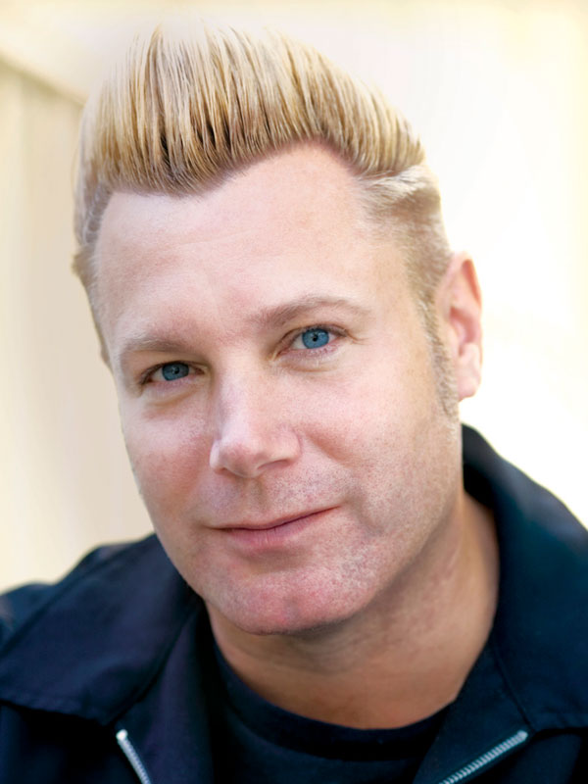
“The old paradigm taught that if you had the right teaching, you will experience God. The new paradigm says that if you experience God, you will have the right teaching.”
Dan Kimball, The Emerging Church: Vintage Christianity for the New Generation, 2003, p.188 (Zondervan).

Slide 44
“Preaching doesn’t work…preaching, as we know it, is a broken endeavor...”
Doug Pagitt, Preaching Reimagined: The Role of Sermon in Communities of Faith, 2005, pp. 18-19 (Zondervan).

Slide 45
2 Timothy 4:2-3
2 “Preach the word; be ready in season and out of season; reprove, rebuke, exhort, with great patience and instruction. For the time will come when they will not endure sound doctrine; but wanting to have their ears tickled, they will accumulate for themselves teachers in accordance to their own desires, and will turn away their ears from the truth and will turn aside to myths.”

Slide 46
Titus 1:12-13
12 “One of themselves, a prophet of their own, said, “Cretans are always liars, evil beasts, lazy gluttons.” 13 This testimony is true. For this reason reprove them severely so that they may be sound in the faith…”

Slide 47
Titus 1:12-13
12 “One of themselves, a prophet of their own, said, “Cretans are always liars, evil beasts, lazy gluttons.” 13 This testimony is true. For this reason reprove them severely so that they may be sound in the faith…”

Slide 48
Titus 1:13-15
13 “This testimony is true. For this reason reprove them severely so that they may be sound in the faith, 14 not paying attention to Jewish myths and commandments of men who turn away from the truth. 15 To the pure, all things are pure; but to those who are defiled and unbelieving, nothing is pure, but both their mind and their conscience are defiled.”

Slide 49
Paul rebukes Peter (Galatians 2:11-14)

Slide 50
Romans 14:20
“Do not tear down the work of God for the sake of food. All things indeed are clean, but they are evil for the man who eats and gives offense.”

Slide 51
Titus 1:15-16
15 To the pure, all things are pure; but to those who are defiled and unbelieving, nothing is pure, but both their mind and their conscience are defiled. They profess to know God, but by their deeds they deny Him, being detestable and disobedient and worthless for any good deed.”

Slide 52
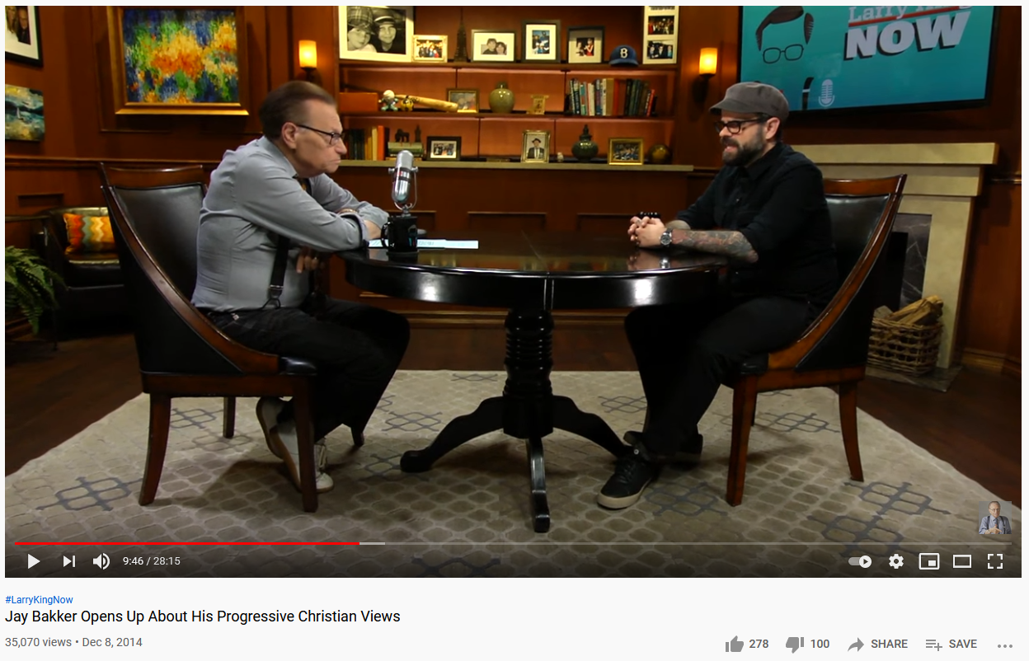
Jay Bakker Opens Up About His Progressive Christian Views - https://www.youtube.com/watch?v=H6HENm_-Qvw

Slide 53
“According to [one] interpretation, in Romans 1 Paul is railing against idolatry and the obscene sexual practices that he was familiar with in Corinth; he was not condemning homosexuality per se.”
Brian McClaren & Tony Campolo, Adventures In Missing the Point, 2003, p. 207-208 (Zondervan).

Slide 54
“How does punishing an innocent person make things better? That just sounds like one more injustice in the cosmic equation. It sounds like divine child abuse.”
Brian McClaren, The Story We Find Ourselves In, 2003, (Jossey-Bass).

Slide 55
“Jesus’ sacrifice was to appease an angry god. Penal substitution was the name of this vile doctrine (p.168).
The Church’s fixation on the death of Jesus as the universal saving act must end…the cross must be reimagined in Christian faith. Why? Because of the cult of suffering and the vindictive God behind it.” (p.132)
Alan Jones, Reimagining Christianity, 2004, pp. 132, 168 (Wiley).

Slide 56
Titus 1:15-16
15 To the pure, all things are pure; but to those who are defiled and unbelieving, nothing is pure, but both their mind and their conscience are defiled. They profess to know God, but by their deeds they deny Him, being detestable and disobedient and worthless for any good deed.”

Slide 57
II. Assignment Explained (1:5-3:11)
vi. Reasons for appointing elders (1:10-16)
Presence of false teachers; their character and conduct (10)
How to deal with false teachers (11-14)
Key Characteristics of False Teachers (15-16)
Outline adapted from Titus Argument, Article by Andy Woods, 2007.

Slide 58
John 14:6
“Jesus said to him, “I am the way, and the truth, and the life; no one comes to the Father but through Me.”

Slide 59
Titus 1:6
“…namely, if any man is above reproach, the husband of one wife, having children who believe, not accused of dissipation or rebellion.”

Slide 60
The book of Titus
Worthy of the Gospel

