Slide 1
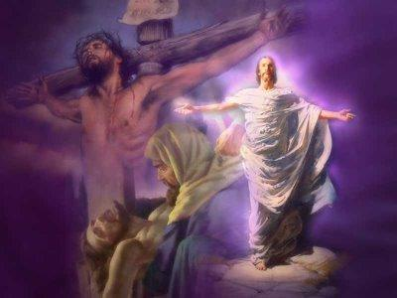
GETTING THE GOSPEL RIGHT & WRONG
Dr. Dennis Rokser
Pastor at Duluth Bible Church, Mn.

Slide 2
GETTING THE GOSPEL RIGHT

Slide 3
I. THE ENTRANCE OF THE GOSPEL (1 Cor. 15:1-2)
II. THE ELEMENTS OF THE GOSPEL (1 Cor. 15:3-4)
III. THE EVIDENCES OF THE GOSPEL (1Cor. 15:5-11)

Slide 4
I. THE ENTRANCE OF THE GOSPEL (1 Cor. 15:1-2)
A. Their PAST ENCOUNTER with the Gospel. (15:1-2a)
1 Corinthians 15:1-2
Moreover, brethren, I declare to you the gospel
which I preached to you, {in the past}
which also you received {in the past}
And in which you stand, {perfect tense}
by which also you are saved {present tense},

Slide 5
I. THE ENTRANCE OF THE GOSPEL (1 Cor. 15:1-2)
A. Their PAST ENCOUNTER with the Gospel. (15:1-2a)
B. Their PRESENT ISSUE Involving the Gospel. (15:2b)
15:2 by which also you are saved, if {1st} you hold fast that word which I preached to you-- unless you believed {aorist, active, indicative} in vain {without just reason or failing its purpose}.

Slide 6
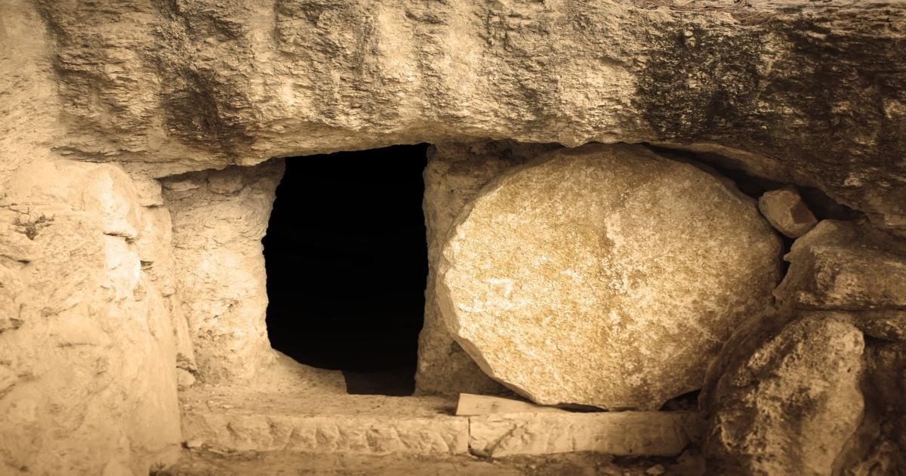
1 Corinthians 15:12 Now if Christ is preached that He has been raised from the dead, how do some among you say that there is no resurrection of the dead?

Slide 7
I. THE ENTRANCE OF THE GOSPEL (1 Cor. 15:1-2)
II. THE ELEMENTS OF THE GOSPEL (1 Cor. 15:3-4)

Slide 8
II. THE ELEMENTS OF THE GOSPEL (1 Corinthians 15:3-4)
A. The AUTHORITY and IMPORTANCE of the Gospel. (15:3a)
1. The message of the Gospel was AUTHORITATIVELY DELIVERED by Paul without apology.
1 Corinthians 15:3 For I delivered to you first of all that which I also received
Galatians 1:11-12 But I make known to you, brethren, that the gospel which was preached by me is not according to man. 12 For I neither received it from man, nor was I taught it, but it came through the revelation of Jesus Christ.

Slide 9
II. THE ELEMENTS OF THE GOSPEL (1 Corinthians 15:3-4)
A. The AUTHORITY and IMPORTANCE of the Gospel. (15:3a)
1. The message of the Gospel was AUTHORATATIVELY DELIVERED by Paul without apology.
2. The message of the Gospel was of PRIMARY IMPORTANCE ...”first of all”.
1 Corinthians 15:3 For I delivered to you first of all that which I also received:

Slide 10
II. THE ELEMENTS OF THE GOSPEL
(1 Corinthians 15:3-4)
A. The AUTHORITY and IMPORTANCE of the Gospel. (15:3a)
B. The ANALYSIS and CONTENT of the Gospel. (15:3b)

Slide 11
II. THE ELEMENTS OF THE GOSPEL
(1 Corinthians 15:3-4)
A. The AUTHORITY and IMPORTANCE of the Gospel. (15:3a)
B. The ANALYSIS and CONTENT of the Gospel. (15:3b)
1. The Gospel of salvation centers in a specific person who is JESUS CHRIST.
1 Corinthians 15:3 For I delivered to you first of all that which I also received: that Christ died for our sins according to the Scriptures,

Slide 12
Why is this significant? (2 reasons)
Because of WHO Jesus Christ is!

Slide 14
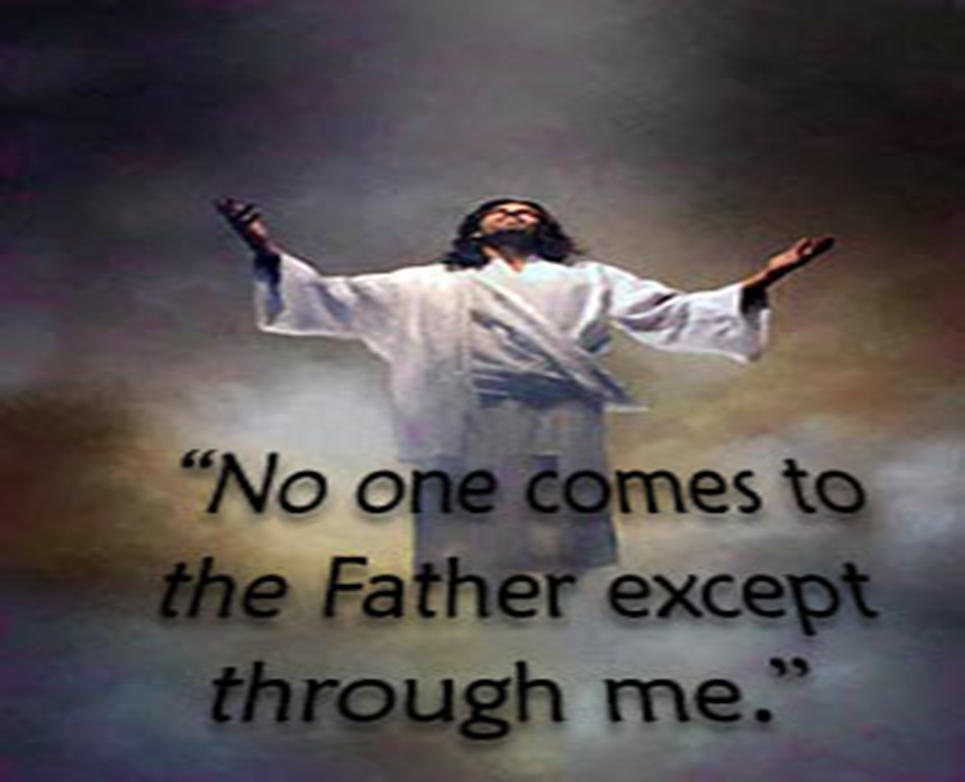

Slide 15
Why is this significant? (2 reasons)
Because of WHO Jesus Christ is!
Because of WHY Jesus Christ came!

Slide 16
II. THE ELEMENTS OF THE GOSPEL (1 Cor. 15:3-4)
A. The AUTHORITY and IMPORTANCE of the Gospel. (15:3a)
B. The ANALYSIS and CONTENT of the Gospel. (15:3b)
1. The Gospel of salvation centers in a specific person who is JESUS CHRIST.
2. The Gospel of salvation centers in a specific work, namely that Christ DIED and ROSE AGAIN.

Slide 17
Why is this significant? (2 reasons)
Because through His death, the penalty for sin was paid.

Slide 18
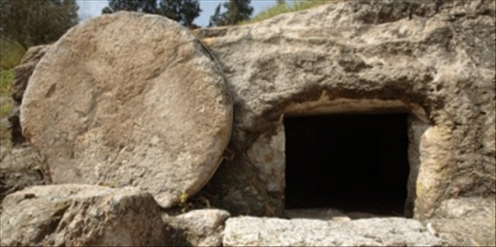
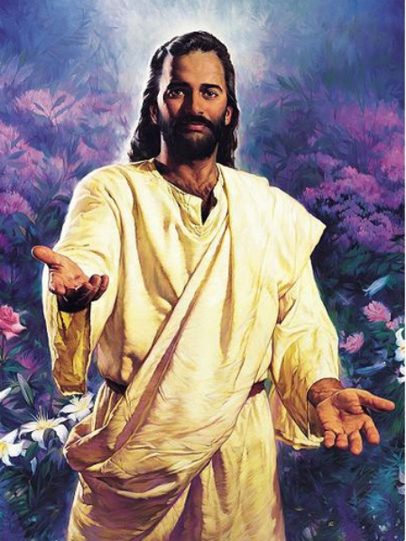
Why is this significant? (2 reasons)
Because through His death, the penalty for sin was paid.
Because through His resurrection He conquered sin and death and can now offer eternal life to you and me.

Slide 20
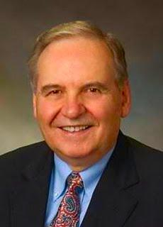
Norman Geisler writes, “The bodily resurrection of Christ is the crowning proof that Jesus was who He claimed to be, God manifested in human flesh. Indeed, the resurrection of Christ in the flesh is of such importance to the Christian faith that the New Testament insists that no one can be saved without it (Romans.10:9; 1 Cor.15:1-7)

Slide 21
II. THE ELEMENTS OF THE GOSPEL (1 Corinthians 15:3-4)
A. The AUTHORITY and IMPORTANCE of the Gospel. (15:3a)
B. The ANALYSIS and CONTENT of the Gospel. (15:3b)
1. The Gospel of salvation centers in a specific person who is JESUS CHRIST.
2. The Gospel of salvation centers in a specific work, namely that Christ DIED and ROSE AGAIN.
3. The Gospel of salvation centers in a specific accomplishment, namely that Christ died FOR OUR SINS.

Slide 22
1 Corinthians 15:3-4 For I delivered to you first of all that which I also received: that Christ died for our sins according to the Scriptures, 4 and that He was buried, and that He rose again the third day according to the Scriptures,

Slide 23
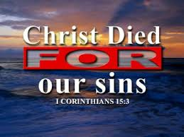
Why is this significant? (2 reasons)
Because Christ’s death was a SUBSTITUTIONARY SACRIFICE!
1 Corinthians 15:3-4 For I delivered to you first of all that which I also received: that Christ died for [huper – on behalf of; in the place of] our sins according to the Scriptures, 4 and that He was buried, and that He rose again the third day according to the Scriptures,

Slide 26
Why is this significant? (2 reasons)
Because Christ’s death was a SUBSTITUTIONARY SACRIFICE!
Because Christ’s death was a COMPLETE SACRIFICE for our sins.

Slide 28
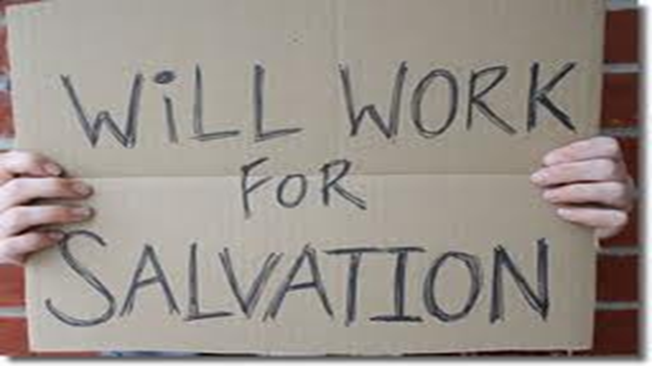

Slide 29
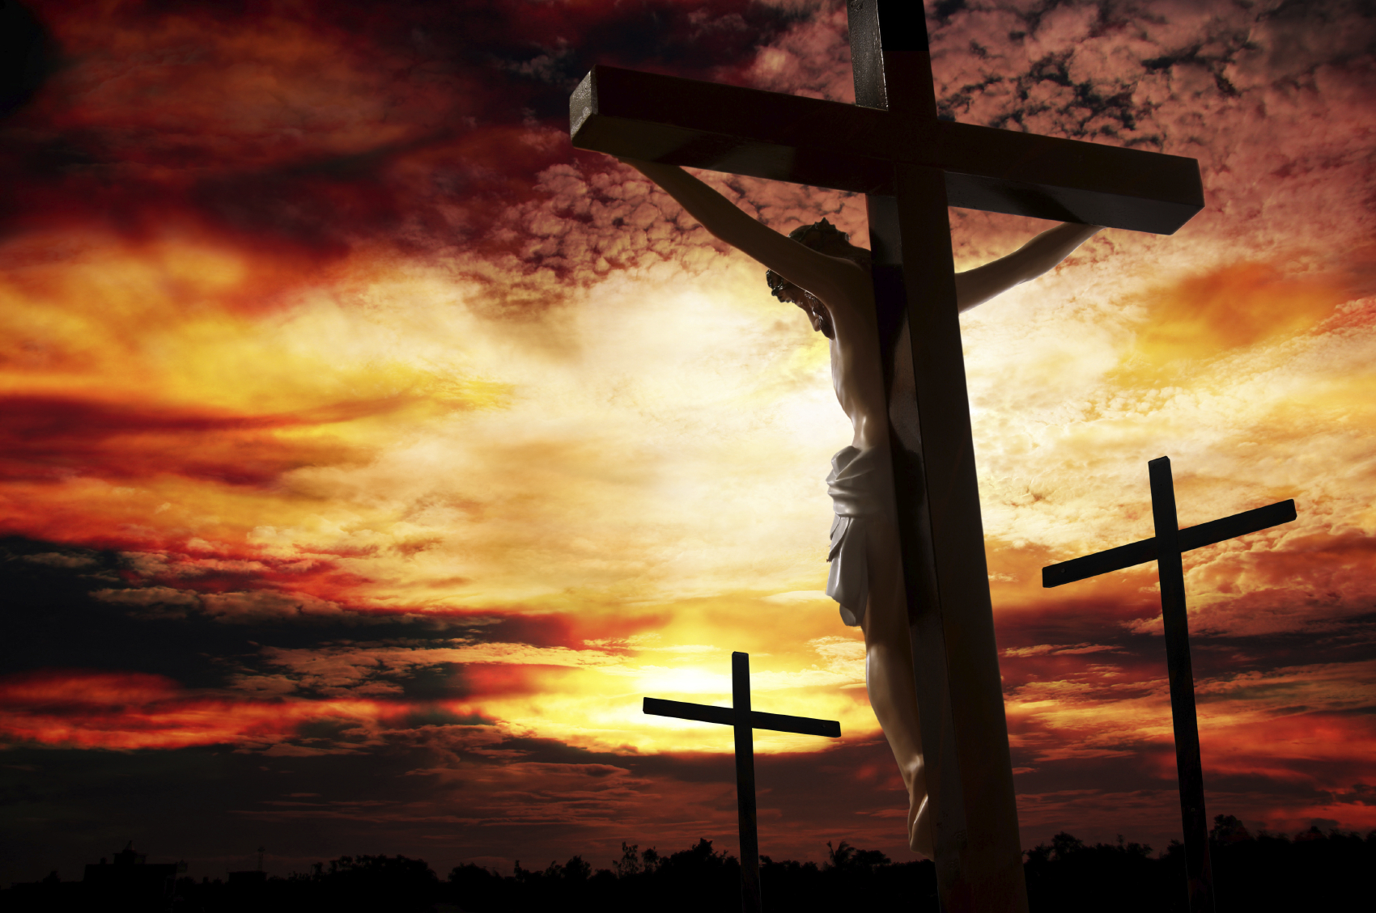
Galatians 2:21 I do not frustrate the grace of God: for if righteousness come by the law, then Christ is dead in vain.

Slide 31
II. THE ELEMENTS OF THE GOSPEL (1 Corinthians 15:3-4)
B. The ANALYSIS and CONTENT of the Gospel. (15:3b)
1. The Gospel of salvation centers in a specific person who is JESUS CHRIST.
2. The Gospel of salvation centers in a specific work, namely that Christ DIED and ROSE AGAIN.
3. The Gospel of salvation centers in a specific accomplishment, namely that Christ died FOR OUR SINS.
4. The Gospel of salvation requires a specific response to receive its blessings, namely FAITH alone in CHRIST alone as presented in the Gospel. (15:2, 11)

Slide 32
1 Corinthians 15:11 Therefore, whether it was I or they, so we preach and so you believed {aorist tense, active voice, indicative mood of pisteuo}. What did they believe? THE GOSPEL!

Slide 34
I. THE ENTRANCE OF THE GOSPEL (1 Cor. 15:1-2)
II. THE ELEMENTS OF THE GOSPEL (1 Cor. 15:3-4)
III.THE EVIDENCES OF THE GOSPEL (1 Cor. 15:3-11)

Slide 35
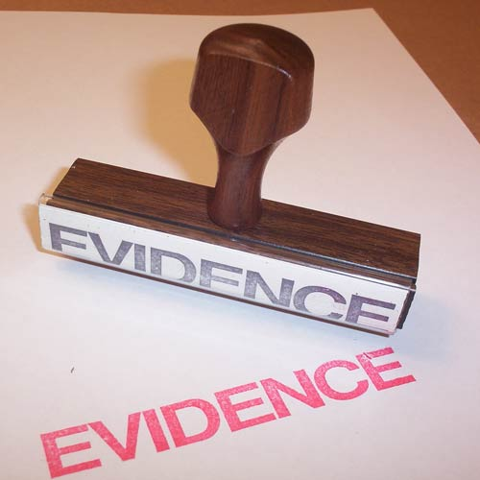
III.THE EVIDENCES OF THE GOSPEL (1 Corinthians 15:3-11)
A. Proof #1: The Gospel FULFILLED THE SCRIPTURES. (15:3-4)

Slide 36
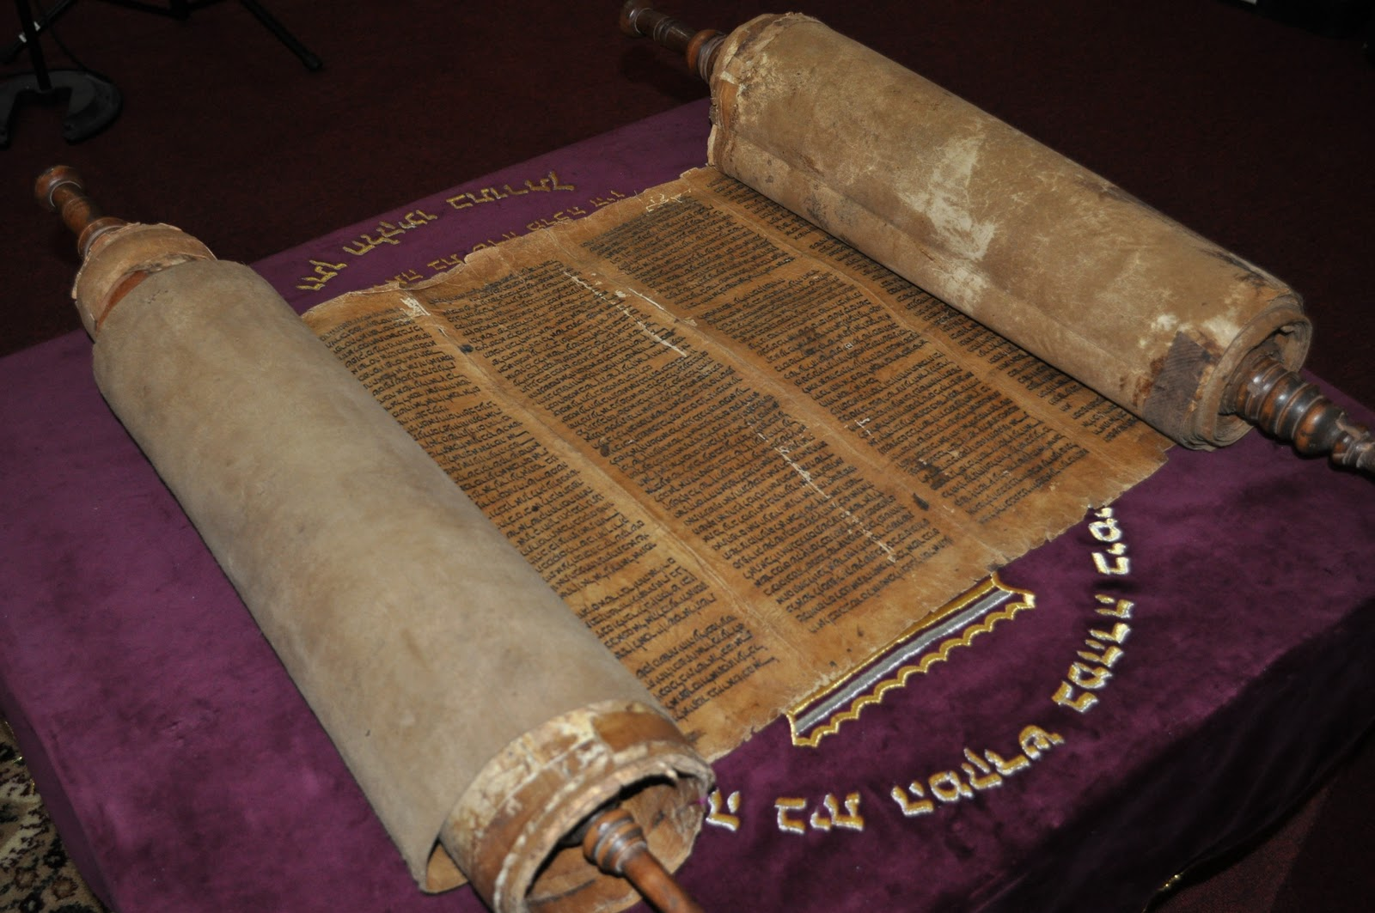
III.THE EVIDENCES OF THE GOSPEL (1 Cor. 15:3-11)
A. Proof #1: The Gospel FULFILLED THE SCRIPTURES. (15:3-4)
1. The DEATH of Jesus Christ was ACCORDING TO THE SCRIPTURES. (15:3)

Slide 37
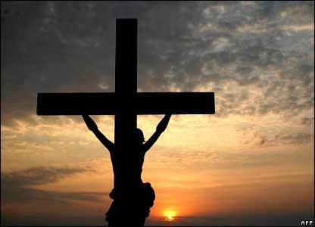
• Where in the Old Testament was Christ’s death predicted?
Psalm 22:1-18
Isaiah 53
Zechariah 12:10
Daniel 9:24-27

Slide 39
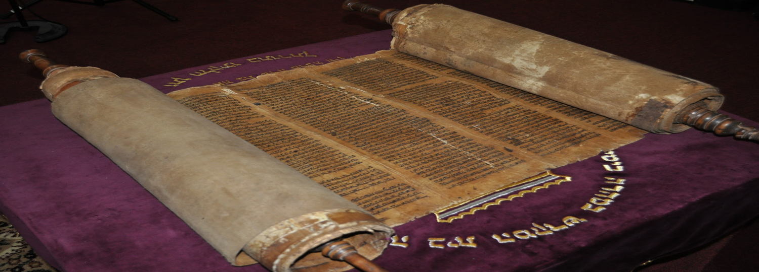
III.THE EVIDENCES OF THE GOSPEL (1 Corinthians 15:3-11)
A. Proof #1: The Gospel FULFILLED THE SCRIPTURES. (15:3-4)
1. The DEATH of Jesus Christ was ACCORDING TO THE SCRIPTURES. (15:3)
2. The RESURRECTION of Jesus Christ was ACCORDING TO THE SCRIPTURES. (15:4)

Slide 40
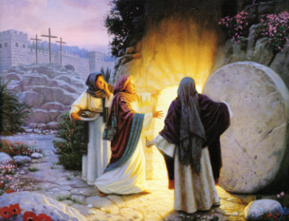
• Where in the Old Testament would this be found?
Psalm 22:19- 24
Isaiah 53:10
Psalm 16:8-11 Acts 2:22-36

Slide 41
What is significant about all this?
The Bible bears witness to its divine inspiration through its fulfilled prophecies like no other ‘holy book’ of any religion.

Slide 43
III.THE EVIDENCES OF THE GOSPEL
(1 Corinthians 15:3-11)
A. Proof #1: The Gospel FULFILLED THE SCRIPTURES. (15:3-4)
B. Proof #2: The Gospel is HISTORICALLY VERIFIABLE. (15:5-8)

Slide 44
1 Corinthians 15:4-8 Eyewitnesses of the Resurrected Christ
and that He was buried, and that He rose again the third day according to the Scriptures, 5 and that He was seen by Cephas, then by the twelve. 6 After that He was seen by over five hundred brethren at once, of whom the greater part remain to the present, but some have fallen asleep. 7 After that He was seen by James, then by all the apostles. 8 Then last of all He was seen by me also, as by one born out of due time.

Slide 45
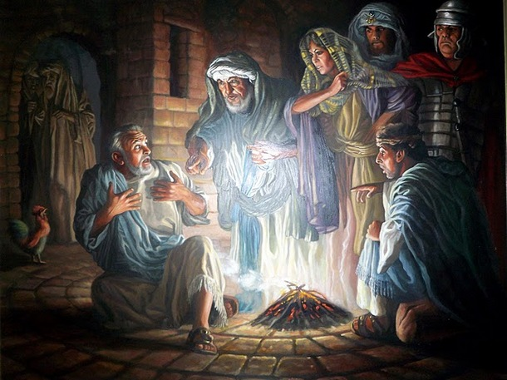

Slide 46
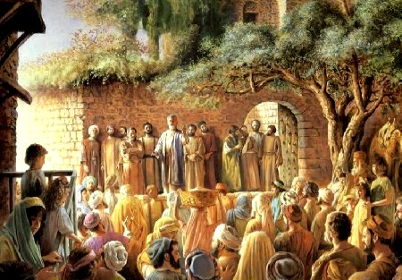

Slide 47
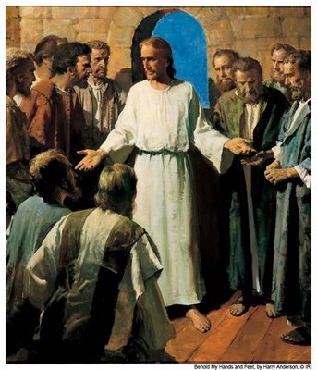
Mark 16:14 Later He appeared to the eleven as they sat at the table; and He rebuked their unbelief and hardness of heart, because they did not believe those who had seen Him after He had risen.

Slide 48
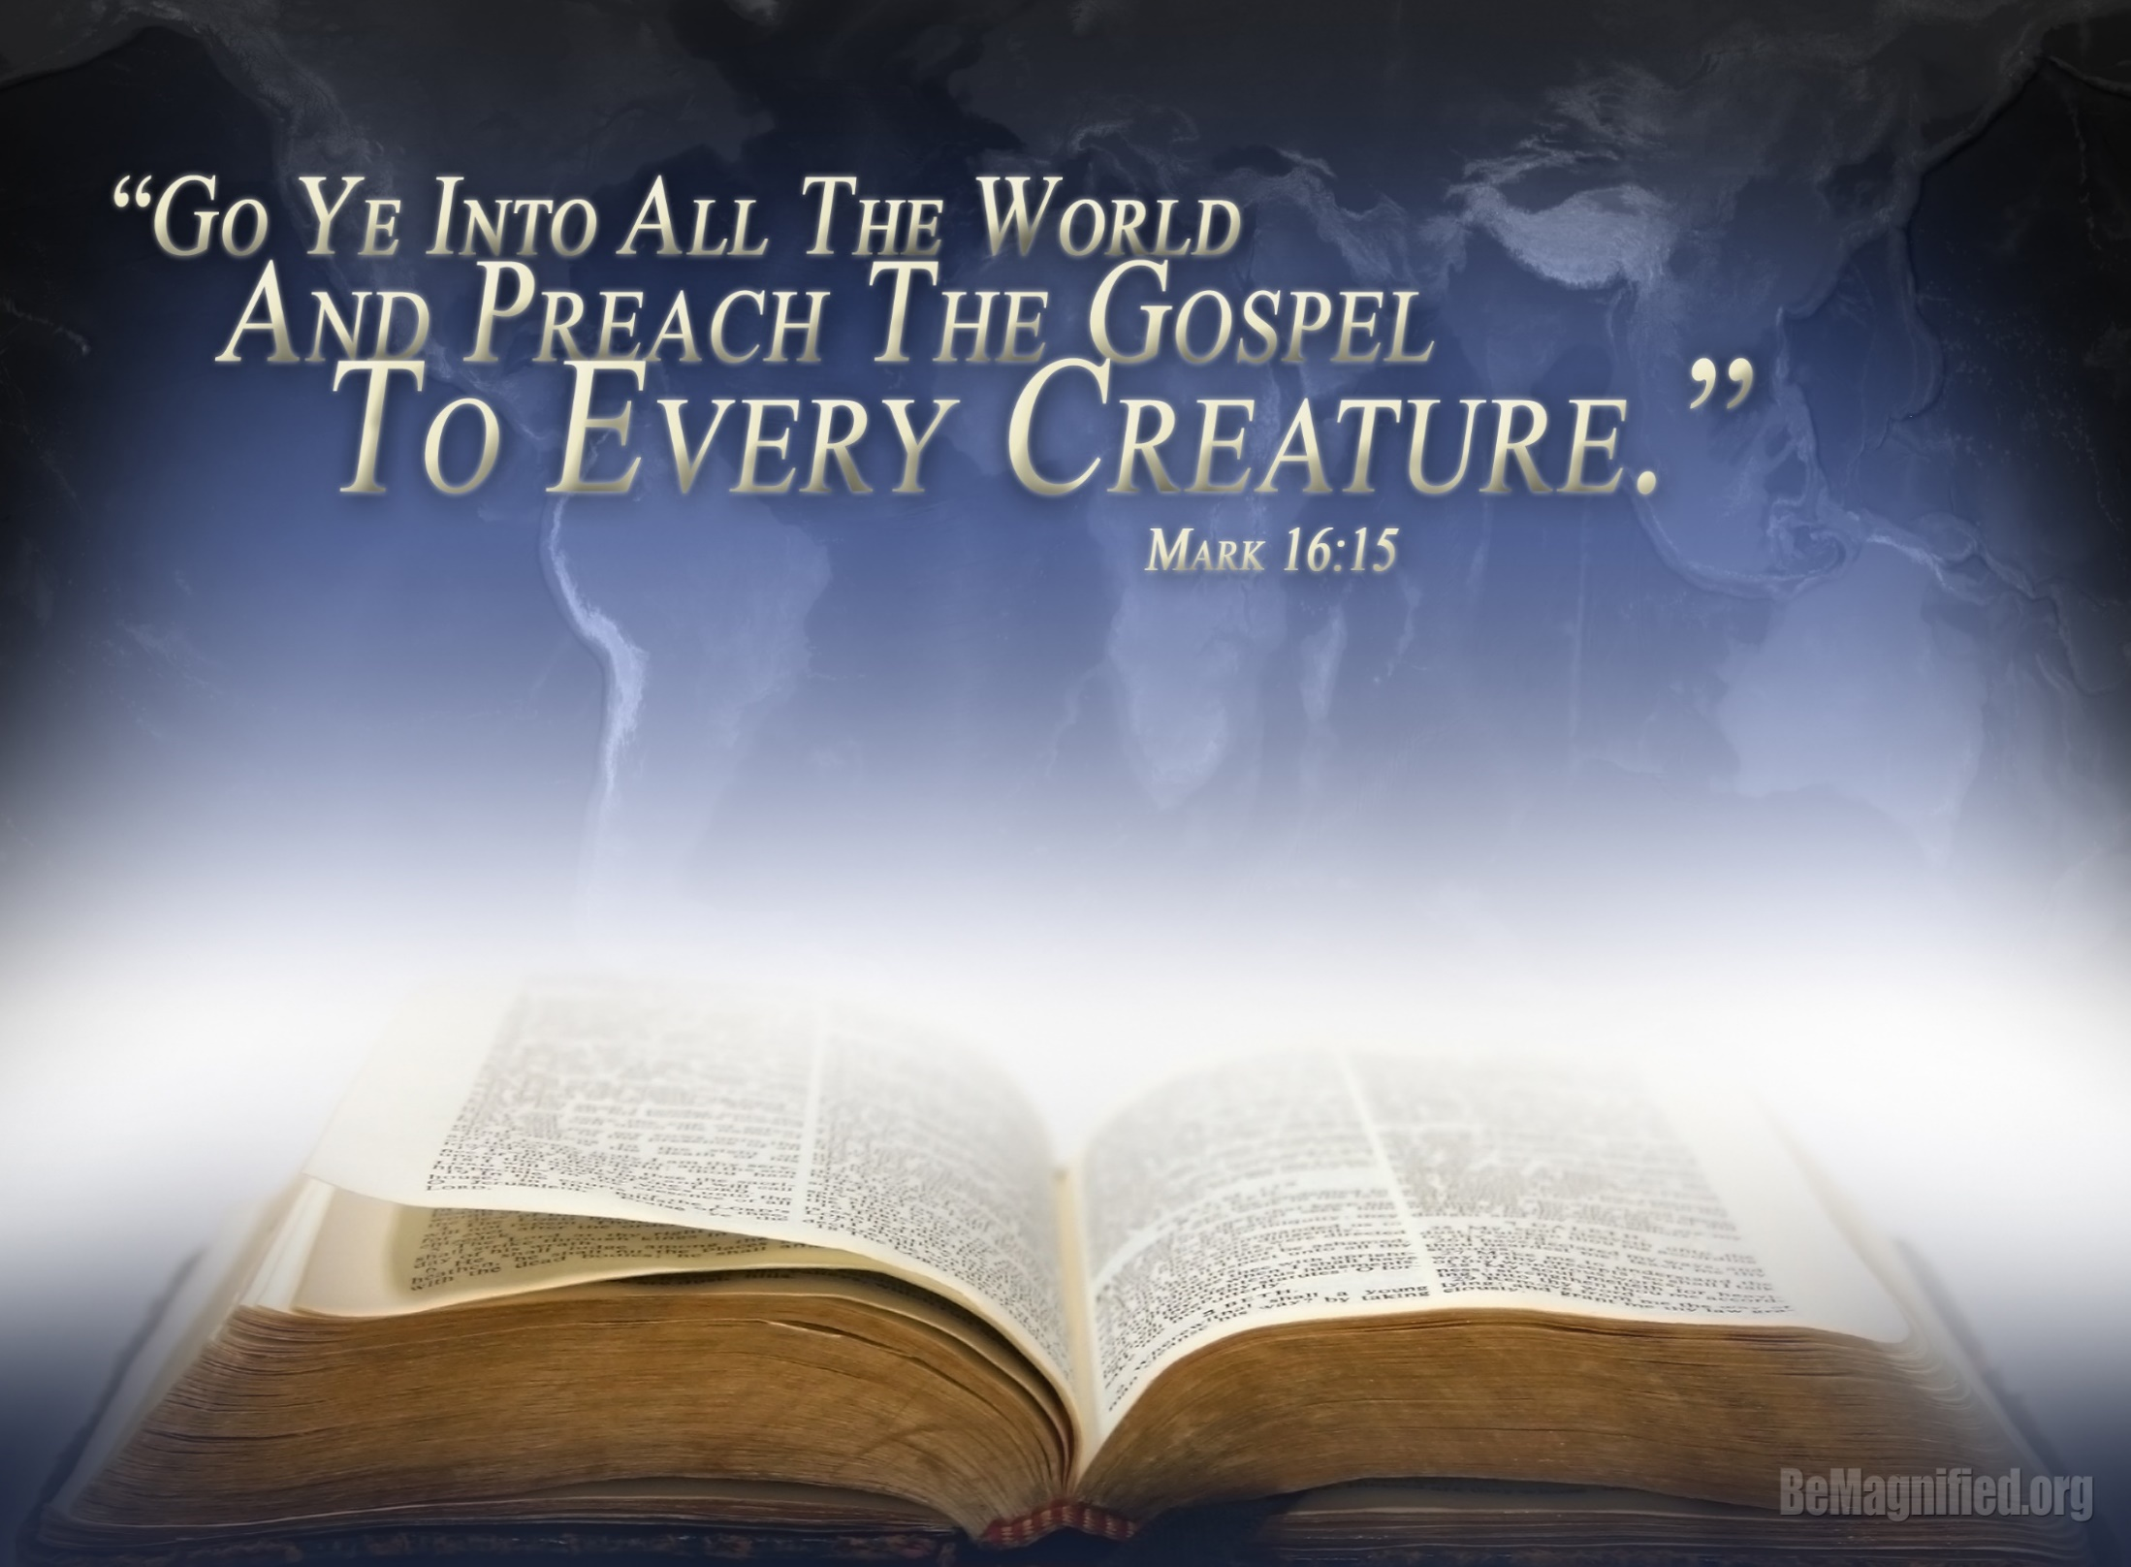

Slide 49
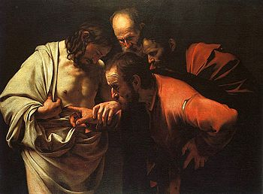
John 20: 27-29 Then He said to Thomas, "Reach your finger here, and look at My hands; and reach your hand here, and put it into My side. Do not be unbelieving, but believing." 28 And Thomas answered and said to Him, "My Lord and my God!" 29 Jesus said to him, "Thomas, because you have seen Me, you have believed. Blessed are those who have not seen and yet have believed."

Slide 50
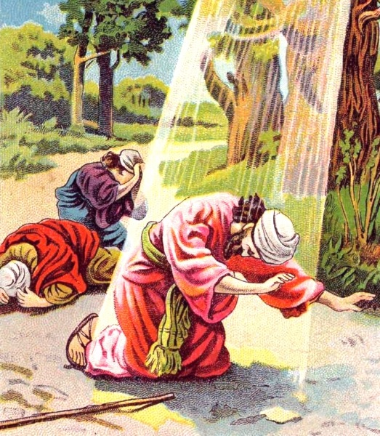
1 Corinthians 15:8-9 Then last of all He was seen by me also, as by one born out of due time. 9 For I am the least of the apostles, who am not worthy to be called an apostle, because I persecuted the church of God.

Slide 51
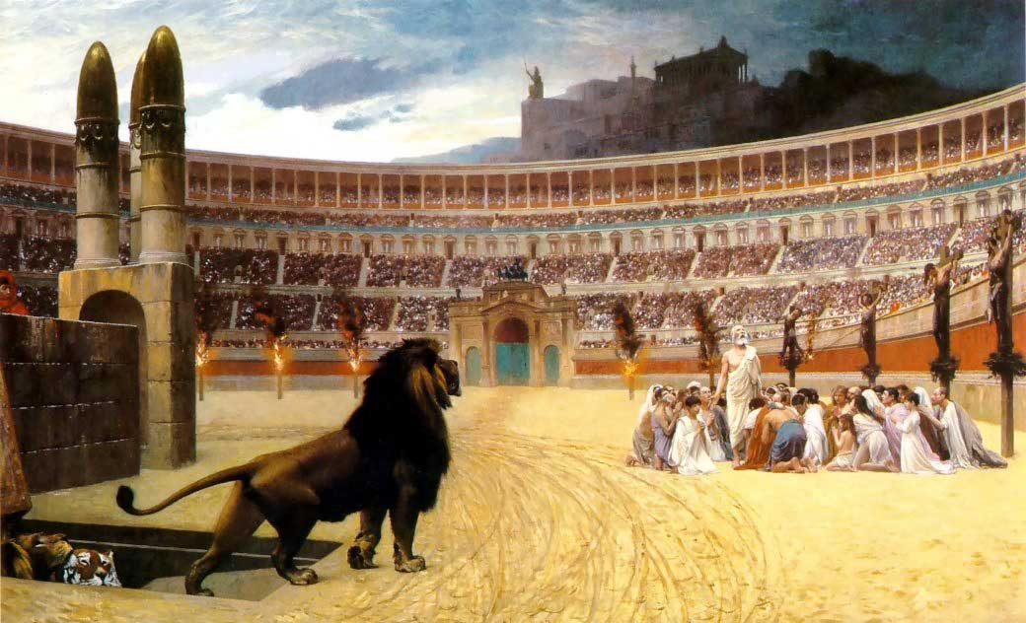
• What is significant about all this?
These witnesses of the resurrected Christ were so impacted by seeing the resurrected Christ that they were never the same, preaching the Gospel in many countries with many of them eventually even giving their lives in martyrdom for the testimony of Jesus Christ!

Slide 52
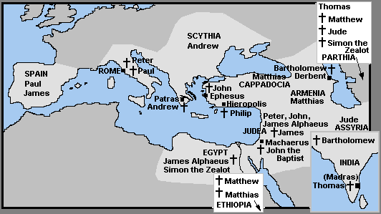

Slide 53
C. Proof #3: The Gospel is PERSONALLY TRANSFORMING. (15:10-11)
1. Exhibit A of this truth is how the truth of the Gospel of Jesus Christ transformed SAUL OF TARSUS into the APOSTLE PAUL. (15:10)

Slide 54
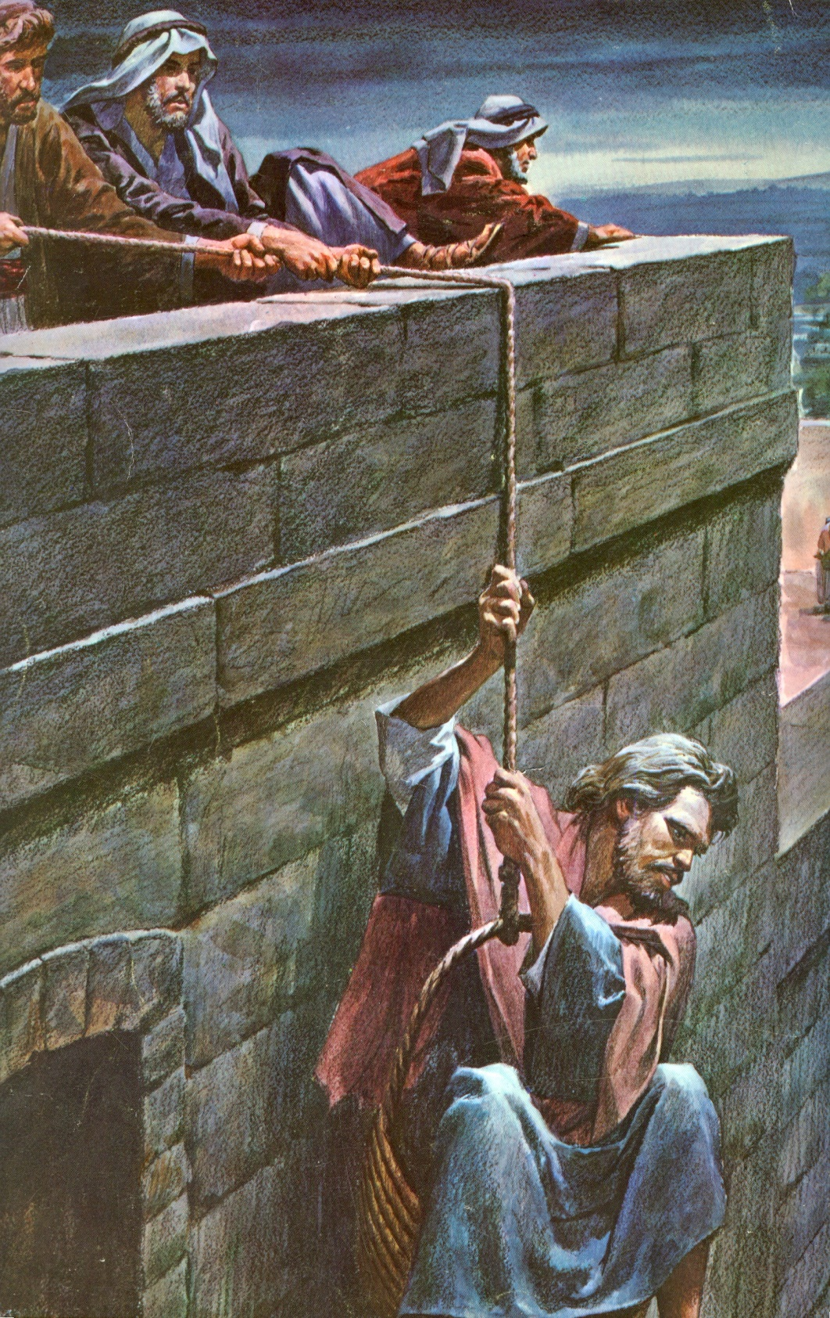

Slide 56
C. Proof #3: The Gospel is PERSONALLY TRANSFORMING. (15:10-11)
1. Exhibit A of this truth is how the truth of the Gospel of Jesus Christ transformed SAUL OF TARSUS into the APOSTLE PAUL. (15:10)
2. The testimony of Paul emphasizes the GRACE OF GOD in SALVATION, SPIRITUAL GROWTH, and SERVICE for Jesus Christ.

Slide 57
1 Corinthians 15:10 But by the grace of God I am what I am, and His grace toward me was not in vain; but I labored more abundantly than they all, yet not I, but the grace of God which was with me.

Slide 58
The Proper Place of Good Works
FAITH
Salvation
GOOD
WORKS
HS
By God’s Grace

Slide 59
• What is the conclusion to all this? (15:11)
1 Corinthians 15:11 Therefore, whether it was I or they, so we preach and so you believed.

Slide 60
GETTING THE GOSPEL WRONG

Slide 61
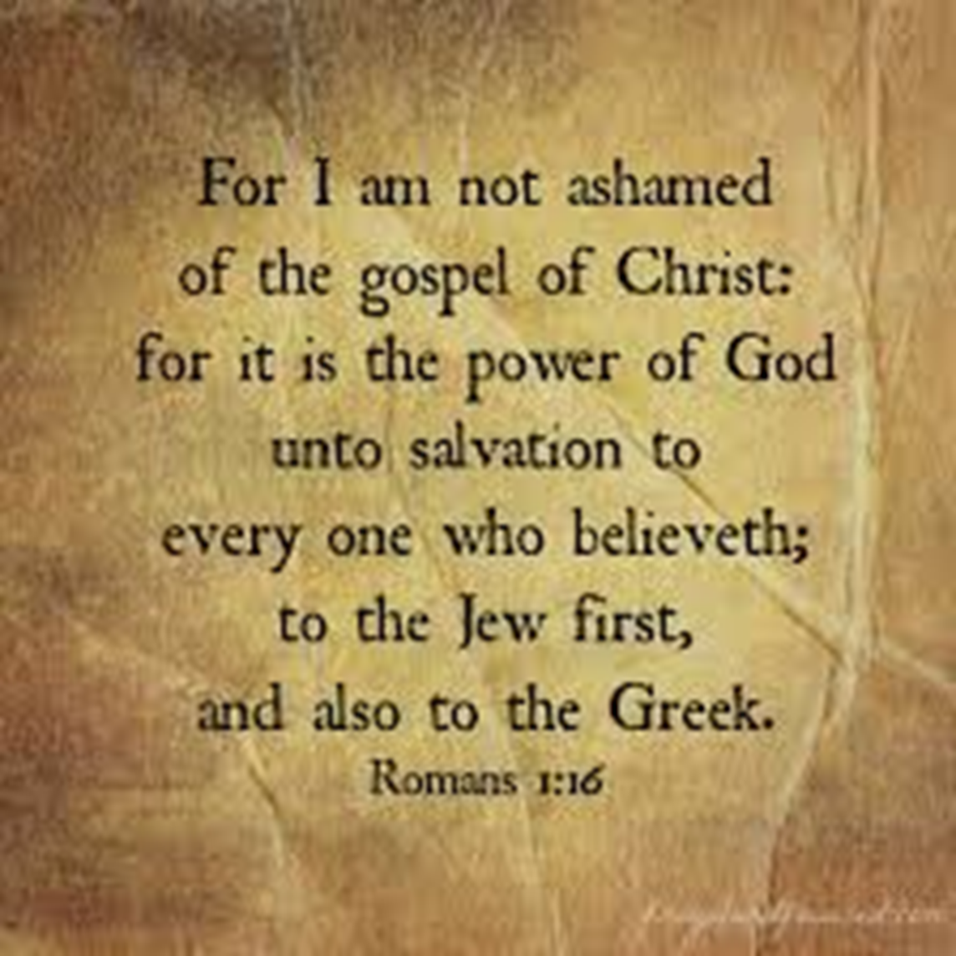

Slide 62
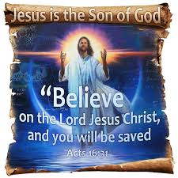
A. The One and Only Condition for Eternal Salvation is FAITH alone in CHRIST alone as presented in the Gospel. (Acts 16:30-31 ; John 3:16-18; 3:36; 5:24; John 6:47)

Slide 63
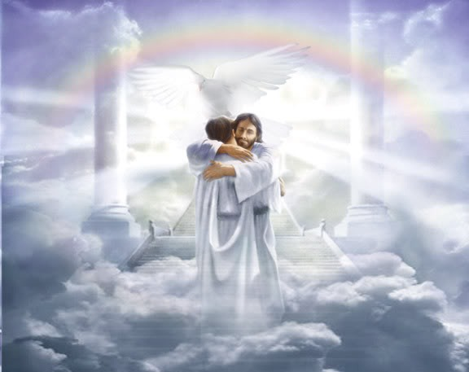
Ephesians 2:8-9 For by grace you have been saved through faith, and that not of yourselves; it is the gift of God, not of works, lest anyone should boast.

Slide 64
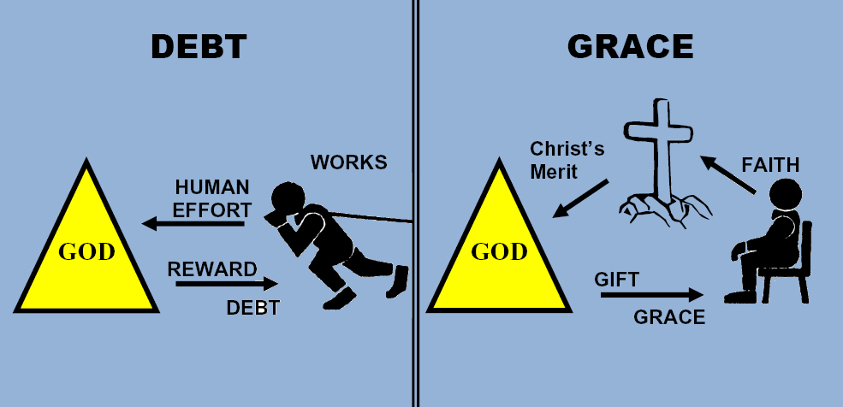
Romans 4:4-5 Now to him who works, the wages are not counted as grace but as debt. But to him who does not work but believes on Him who justifies the ungodly, his faith is accounted for righteousness,

Slide 65
Consider the analogies of “faith” in John’s writings:
The receiving of a gift. (John 1:12)
John 1:12 But as many as received Him, to them He gave the right to become children of God, to those who believe in His name:

Slide 66
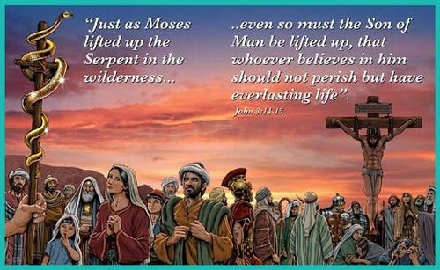
Consider the analogies of “faith” in John’s writings:
The receiving of a gift. (John 1:12)
One look at a pole (John 3:14)

Slide 67
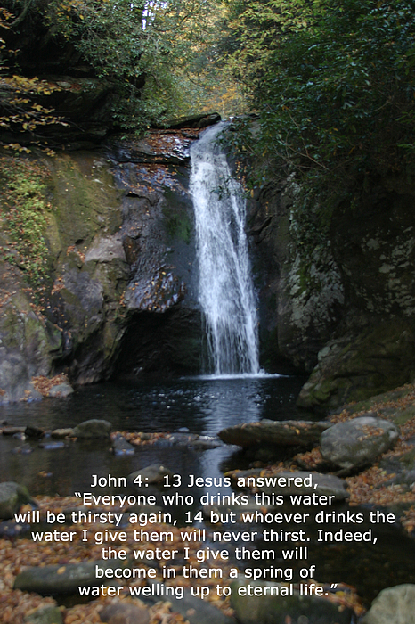
Consider the analogies of “faith” in John’s writings:
1) The receiving of a gift. (John 1:12)
2) One look at a pole (John 3:14)
3) Taking one drink of water (4:13-14)

Slide 68
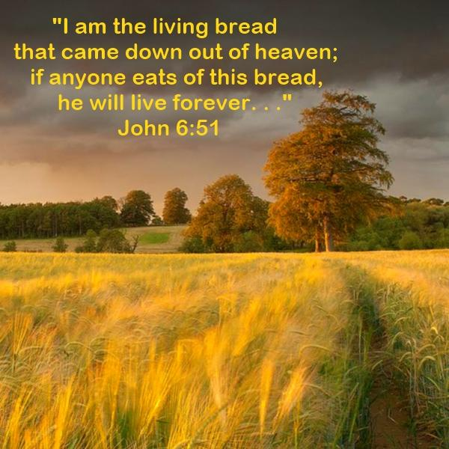
Consider the analogies of “faith” in John’s writings:
1) The receiving of a gift. 1:12)
2) One look at a pole (John 3:14)
3) Taking one drink of water (4:13-14)
4) Eating a piece of bread (John 6:51)

Slide 69
Consider the analogies of “faith” in John’s writings:
1) The receiving of a gift. (John 1:12)
2) One look at a pole (John 3:14)
3) Taking one drink of water (4:13-14)
4) Eating a piece of bread (John 6:51)
5) The believing of a record or testimony (1 Jn 5:9 -13)

Slide 71
C. What Are Some of the Wrong Responses to the Gospel Today? Faith in Jesus Christ plus …
1. BE WATER BAPTIZED.
1 Corinthians 1:17-18 For Christ did not send me to baptize, but to preach the gospel, not with wisdom of words, lest the cross of Christ should be made of no effect. 18 For the message of the cross is foolishness to those who are perishing, but to us who are being saved it is the power of God.

Slide 75
C. What Are Some of the Wrong Responses to the Gospel Today? Faith in Jesus Christ plus …
1. BE WATER BAPTIZED.
Clarification: Water baptism is only for those who have been ALREADY SAVED by God’s GRACE through FAITH in Christ alone and acts as a means of PUBLIC IDENTIFICATION and PROCLAMATION of the Gospel one has already believed.

Slide 76
Acts 8:35-39 Then Philip opened his mouth, and beginning at this Scripture, preached Jesus to him. 36 Now as they went down the road, they came to some water. And the eunuch said, "See, here is water. What hinders me from being baptized?" 37 Then Philip said, "If you believe with all your heart, you may." And he answered and said, "I believe that Jesus Christ is the Son of God." 38 So he commanded the chariot to stand still. And both Philip and the eunuch went down into the water, and he baptized him. 39 Now when they came up out of the water, the Spirit of the Lord caught Philip away, so that the eunuch saw him no more; and he went on his way rejoicing.

Slide 77
Acts 18:8 Then Crispus, the ruler of the synagogue, believed on the Lord with all his household. And many of the Corinthians, hearing, believed and were baptized.

Slide 78
C. What Are Some of the Wrong Responses to the Gospel Today? Faith in Jesus Christ plus …
1. BE WATER BAPTIZED. (1 Cor.1:17-18)
2. Be HOLY; don’t SIN too much. (Titus 3:5)
Titus 3:5 not by works of righteousness which we have done, but according to His mercy He saved us.

Slide 79
C. What Are Some of the Wrong Responses to the Gospel Today? Faith in Jesus Christ plus …
1. BE WATER BAPTIZED.
2. Be HOLY ; don’t SIN too much. (Titus 3:5)
Clarification: While God desires all believers to live a holy life as a RESULT of being saved, it is not the means of obtaining or maintaining salvation; otherwise, salvation would not be by God’s GRACE but by our WORKS. (1 Peter 1:3-5, 13-19)

Slide 80
1 Peter 1:13-19 Therefore gird up the loins of your mind, be sober, and rest your hope fully upon the grace that is to be brought to you at the revelation of Jesus Christ; 14 as obedient children, not conforming yourselves to the former lusts, as in your ignorance; 15 but as He who called you is holy, you also be holy in all your conduct, 16 because it is written, "Be holy, for I am holy.” And if you call on the Father, who without partiality judges according to each one's work, conduct yourselves throughout the time of your stay here in fear; 18 knowing that you were not redeemed with corruptible things, like silver or gold, from your aimless conduct received by tradition from your fathers, 19 but with the precious blood of Christ, as of a lamb without blemish and without spot.

Slide 82
C. What Are Some of the Wrong Responses to the Gospel Today? Faith in Jesus Christ plus …
1. BE WATER BAPTIZED. (1 Cor. 1:17-18)
2. Be HOLY ; don’t SIN too much. (Titus 3:5)
3. REPENT FROM YOUR SINS.
John 3:18 "He who believes in Him is not condemned; but he who does not believe is condemned already, because he has not believed in the name of the only begotten Son of God.

Slide 84
C. What Are Some of the Wrong Responses to the Gospel Today? Faith in Jesus Christ plus …
1. BE BAPTIZED. (1 Cor. 1:17-18)
2. Be HOLY ; don’t SIN too much. (Titus 3:5)
3. REPENT FROM YOUR SINS.
Clarification: The issue at salvation is not repenting of your sins but CHANGING YOUR MIND about the SAVIOR who died for your sins so as to trust in His finished work alone. Repentance from sin does have a place LATER in the believer’s life as part of the SANCTIFICATION process but is not a condition for justification before God. . (2 Cor.7:8-11; 1 John 1:5-10)

Slide 85
C. What Are Some of the Wrong Responses to the Gospel Today? Faith in Jesus Christ plus …
1. BE WATER BAPTIZED. (1 Cor. 1:17-18)
2. Be HOLY ; don’t SIN too much. (Titus 3:5)
3. REPENT FROM YOUR SINS.
4. ASK / INVITE JESUS INTO YOUR HEART.

Slide 86
John 1:12 But as many as received Him, to them He gave the right to become children of God, to those who believe in His name.
Galatians 4:6 And because you are sons, God has sent forth the Spirit of His Son into your hearts, crying out, "Abba, Father!"
Colossians 1:27 To them God willed to make known what are the riches of the glory of this mystery among the Gentiles: which is Christ in you, the hope of glory.
Clarification: NO WHERE in Scripture are we told to ask/invite Jesus Christ into our hearts for He AUTOMATICALLY comes in{as does the Holy Spirit} the moment we trust in Christ alone as presented in the Gospel. To ask Jesus into your heart CONFUSES the Gospel as you do not ask for a free gift.

Slide 87
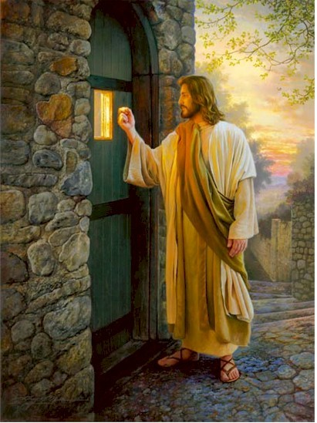
Revelation 3:19-20 "As many as I love {phileo}, I rebuke and chasten {Heb. 12:5-11} . Therefore be zealous and repent. 20 "Behold, I stand at the door and knock. If anyone hears My voice and opens the door, I will come in to him and dine with him, and he with Me.

Slide 88
C. What Are Some of the Wrong Responses to the Gospel Today? Faith in Jesus Christ plus …
1. BE WATER BAPTIZED. (1 Cor. 1:17-18)
2. Be HOLY ; don’t SIN too much. (Titus 3:5)
3. REPENT FROM YOUR SINS.
4. ASK / INVITE JESUS INTO YOUR HEART.
5. GIVE YOUR LIFE / HEART TO CHRIST.
Clarification: Salvation is NOT obtained by GIVING [your money, your commitment, or your life] but by RECEIVING the gift of salvation through FAITH in CHRIST alone.}

Slide 92
C. What Are Some of the Wrong Responses to the Gospel Today? Faith in Jesus Christ plus …
6. SUBMIT TO CHRIST’S LORDSHIP OVER YOUR LIFE.
Romans 12:1 I beseech you therefore, brethren, by the mercies of God, that you present your bodies a living sacrifice, holy, acceptable to God, which is your reasonable service.

Slide 93
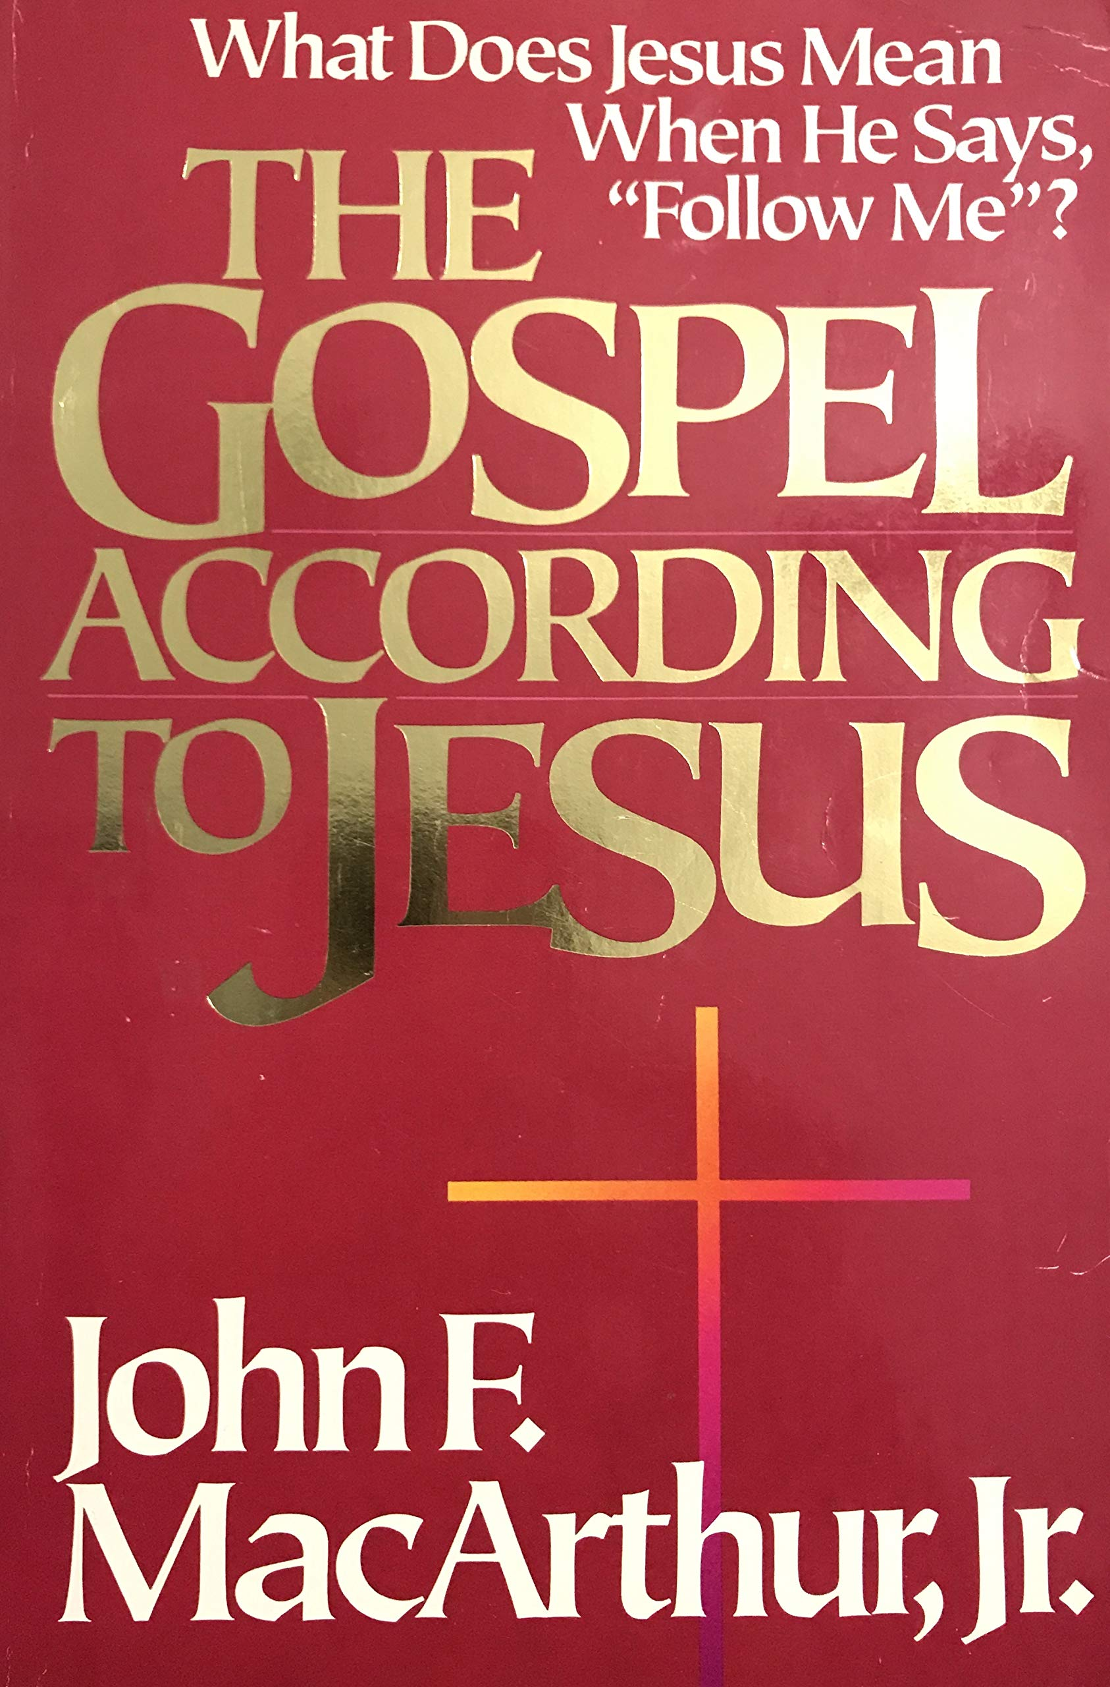
It is a total abandonment of self-will… It is an exchange of all that we are for all that Christ is and denotes implicit obedience, full surrender to the lordship of Christ. Nothing less can qualify as saving faith.
(John F. MacArthur, The Gospel According to Jesus, p. 140.)

Slide 94
The hard words of Jesus come out: “It’s not about you, it’s about Me and sacrificing yourself to follow Me.”
(John F. MacArthur, Hard To Believe, p. 17.)

Slide 95
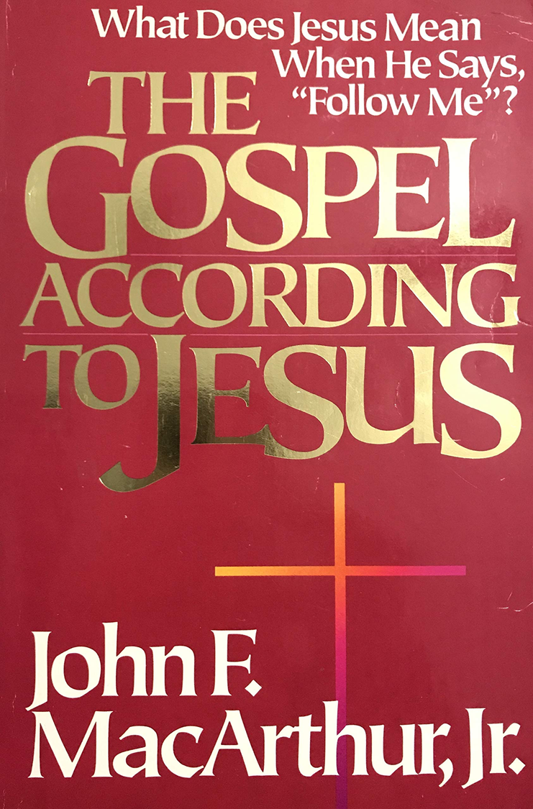
They stumble over the twin truths that salvation is a free gift, yet it costs everything. (John F. MacArthur, The Gospel According to Jesus, p. 31.)
This paradox may be difficult but it is nevertheless true: salvation is both free and costly. (John F. MacArthur, The Gospel According to Jesus, p. 31.)

Slide 96
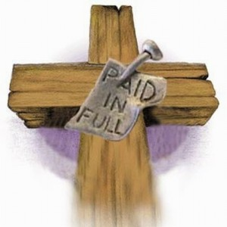
Can something be both free and costly to the recipient?
Is salvation both free and costly to the sinner?
Does salvation cost you everything or was it paid in full by Christ on the cross?

Slide 97
“Self-discipline comes when you look back to the covenant of your salvation… That is to say when you remember that at the point of your salvation you made a promise to submit to the Lord. You made a pledge at that time to be obedient to Christ. You confessed Him as Lord...and Lord means that He is above all. It's essential then as believers to remember that we made a covenant of obedience when we confessed Jesus as Lord.

Slide 98
We were saved unto obedience which God had before ordained that we should walk...and obedience characterized by good works...and obedience to God's Word. That pledge was inherent in salvation. God at the time you came to Him for salvation promised you forgiveness and eternal life and all the grace necessary to fulfill His will, and the Holy Spirit, and you pledged obedience. And you need to go back and remember that and have the integrity to be faithful to your original promise…”
MacArthur, John, Transcription of The Art of Self-Discipline Pt. 2., www.gty.org.

Slide 100
Faith in Jesus Christ plus …
6. SUBMIT TO CHRIST’S LORDSHIP OVER YOUR LIFE.
Clarification: While a sinner MUST believe on the Lord [God] Jesus Christ to be saved {Acts 16:31}, it is not a matter of surrendering or submitting to Christ’s Lordship in EXCHANGE for salvation for then salvation would be a REWARD, not a gift.
Salvation 1st tense is not an issue of behavior but of BIRTH (John 3:3). Instead it was CHRIST’S submission to God’s will that took Him to the cross to die for their sins that saves a sinner. Only AFTER salvation does God wants all believers to YIELD / PRESENT themselves to God as a RESULT of His mercies to them. (Rom.12:1-2)

Slide 101
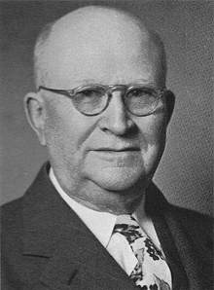
Dr. Harry Ironside (1876-1951), wrote:
When anyone comes promising salvation to those “who make full surrender” of all that they have to God, and who “pay the price of full salvation” he is preaching another gospel, for the price was paid on Calvary’s cross and the work that saves is finished. It was Christ Jesus who made the full surrender when He yielded His life on Calvary that saves us, not our surrender in any way to Him.

Slide 102
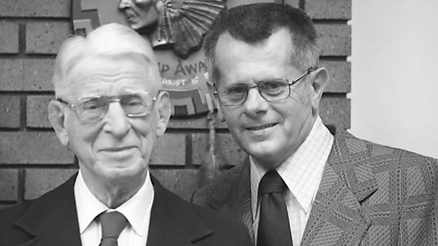
Lance Latham, pastor and co-founder of AWANA (1894-1985) wrote:
Surely we must recognize WHO HE IS, or we will die in our sins (John 8:24). But this is vastly different from making Him your Lord in your life, in other words, promising to obey the rest of your life. This latter is preaching “works.”

Slide 105
Is the clarity of the Gospel secondary or semantics?
NO !!!
Galatians 1:6-9 I marvel that you are turning away so soon from Him who called you in the grace of Christ, to a different gospel, 7 which is not another; but there are some who trouble you and want to pervert the gospel of Christ. 8 But even if we, or an angel from heaven, preach any other gospel to you than what we have preached to you, let him be accursed. 9 As we have said before, so now I say again, if anyone preaches any other gospel to you than what you have received, let him be accursed.

Slide 106
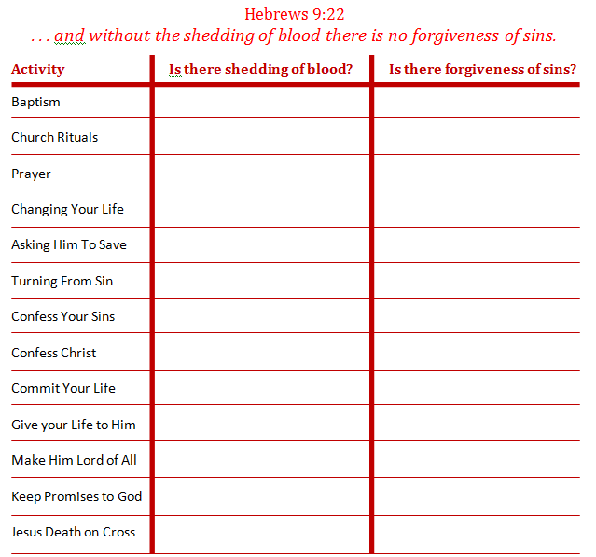
NO
NO
NO
NO
NO
NO
NO
NO
NO
NO
NO
NO
NO
NO
NO
NO
Acts 10:43
“To Him all the prophets witness that, through His name, whoever believes in Him will receive remission of sins.”
NO
NO
NO
NO
NO
NO
NO
NO
YES!
YES!

Slide 107
NO
NO
NO
NO
NO
NO
NO
NO
NO
NO
NO
NO
NO
NO
NO
NO
Acts 10:43
“To Him all the prophets witness that, through His name, whoever believes in Him will receive remission of sins.”
NO
NO
NO
NO
NO
NO
NO
NO
YES!
YES!

Slide 108
How does all of this apply to you …
As a believer in Christ?
As a lost sinner w/o Christ?

