Slide 1
Sugarland Bible Church, Tx.
Dr. Dennis Rokser, Duluth Bible Church, Mn.
KNOW, RECKON, PRESENT, OBEY (Answering 25 Key Questions about Romans 6:1-16)
Notes:
I was saved by the grace of God in April of 1973, 48 years ago. And at first my Christian life went nowhere as I was thankful to be going to Heaven but I had my own plans as I was soon to graduate from High School.
During the first few months of my Christian life I lived in carnality until God disciplined me in love and showed me I was making a mess of my life. So in July of 1973, I decided for the first time to actually yield to the Lord and to live for Him, though I didn’t have a clue how to do this. Yet God can work with a positive volition … {elaborate}
My learning of 1 John 1:9 …
My failures in living the Christian life created a hunger to learn God’s way of victory – by grace; through the cross; and through the power of the HS.
And my mother-in-law introduced me to the book …

Slide 2


Notes:
This book excited me …
This book encouraged me …
This book introduced me …
But what was lacking in this book was a very by verse explanation of the vital truths of Romans 6-8.
And maybe you are here today and …
So I want to walk through with you today the first 16 verses of Romans 6 as we discover the truths of …KNOW, RECKON, PRESENT, OBEY.
JUST READ 6:1-16

Slide 3
1. What is the context of Romans 6?
I. THE RIGHTEOUSNESS OF GOD INTRODUCED – the MESSAGE of the GOSPEL. (Rom. 1:1-17)
II. THE RIGHTEOUSNESS OF GOD REQUIRED – Man’s SIN and God’s CONDEMNATION (Romans 1:18-3:20)
III. THE RIGHTEOUSNESS OF GOD RECEIVED – SALVATION from SIN’S PENALTY and JUSTIFICATION (Romans 3:21-5:21)
IV. THE RIGHTEOUSNESS OF GOD REPRODUCED – SALVATION from SIN’S POWER and SANCTIFICATION (Romans 6:1-8:17)
Notes:
A TEXT W/O A CONTEXT IS A PRETEXT. SO ….
NOW WHAT IS IMPORTANT TO OBSERVE REGARDING ROMANS 6 IS …

Slide 4
2. What are some important observations to make about this section?
a) Paul has settled the issue of justification by grace and eternal security BEFORE he discusses your Christian walk.
b) Note the striking contrast between ADAM and CHRIST. (5:12-21)
Notes:
NOW HOW DOES ROMANS 6 BEGIN? WITH A LOGICAL QUESTION …

Slide 5

1 Corinthians 15:22
For as in Adam all die, even so in Christ shall all be made alive.
Believe
In Adam
In Christ

Slide 6
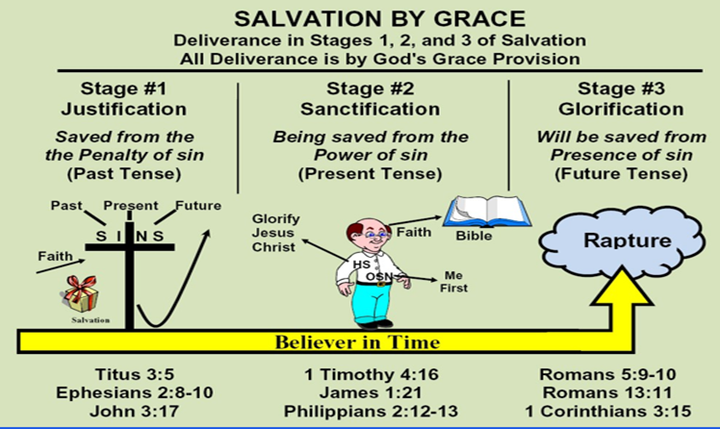
2. What are some important observations to make about this section?
c)Paul sees God’s plan for you as a believer in 3 stages:
JUSTIFICATION (3:21-5:21); SANCTIFICATION (6:1-8:17); and GLORIFICATION (8:18-39).
Notes:
NOW HOW DOES ROMANS 6 BEGIN? WITH A LOGICAL QUESTION …

Slide 7
3. What logical question should you anticipate if you preach the Gospel of grace clearly? (6:1a)
Romans 6:1 What shall we say then? Shall we continue in sin that grace may abound?
Romans 5:20-21 Moreover the law entered that the offense might abound. But where sin abounded, grace abounded much more, 21 so that as sin reigned in death, even so grace might reign through righteousness to eternal life through Jesus Christ our Lord.
Notes:
This is the anticipated objection of license.
BADGE OF HONOR
NEVER SAID OF A FALSE GOSPEL PER SE
NEVER STATED OF SOME FORM OF LEGALISM
WHY IS THE QUESTION EVEN RAISED? 5:20-21 {CLICK}

Slide 8


Slide 9
4. What is the emotional answer to this anticipated objection? (6:2a)
Romans 6:1-2 What shall we say then? Shall we continue in sin that grace may abound? 2 Certainly not!
Notes:
The words “Certainly not” (NKJ) are translated “God forbid” in the King James Version.
These words come from the Greek μή γενοίτα (may genoita) that literally means “may it never be.”
We could translate this “perish the thought” or “that’s unthinkable!”
Grace does not free us TO sin; it frees us FROM sin and to now live a life in fellowship w God that will honor & glory to our Lord & Savior, JC.
God’s grace is not an excuse to sin but rather a reason to love & serve Him freely and more fully.

Slide 10
5. What is the theological reason a believer should no longer live in sin? (6:2b)
Romans 6:2 Certainly not! How shall we who died to sin {our position} live any longer in it {our practice}?
Notes:
Your position is WHO you are in Christ. Your identity. Your spiritual position.
Your condition is how you live & conduct yourself each day.
Should your position impact your condition? YES!
Does your condition ever impact your position? NO!
Driving in England illustration.
So your condition should reflect your position more and more each and every day, though the two will not be fully one until you are home in glory.

Slide 11
God’s Righteousness
Man’s Sinfulness

Slide 12
God’s Righteousness
(Positional Sanctification)
standing/position
Justification
Man’s Sinfulness

Slide 13

God’s Righteousness
(Positional Sanctification)
standing/position
Adult
Holy Spirit
Word of God
Yielded
Justification
Sanctification
Adolescent
(Practical/Experiential)
state/condition
Babe
Man’s Sinfulness

Slide 14

God’s Righteousness
(Positional Sanctification)
standing/position
Adult
Holy Spirit
Word of God
Yielded
Justification
Sanctification
Adolescent
(Practical/Experiential)
state/condition
Babe
Man’s Sinfulness

Slide 15
God’s Righteousness
(Positional Sanctification)
standing/position
Adult
Holy Spirit
Word of God
Yielded
Justification
Sanctification
Adolescent
(Practical/Experiential)
state/condition
Babe
Man’s Sinfulness

Slide 16
God’s Righteousness
Glorification
(Ultimate Sanctification)
standing & state
match
(Positional Sanctification)
standing/position
Adult
Holy Spirit
Word of God
Yielded
Justification
Sanctification
Adolescent
(Practical/Experiential)
state/condition
Babe
Man’s Sinfulness

Slide 17
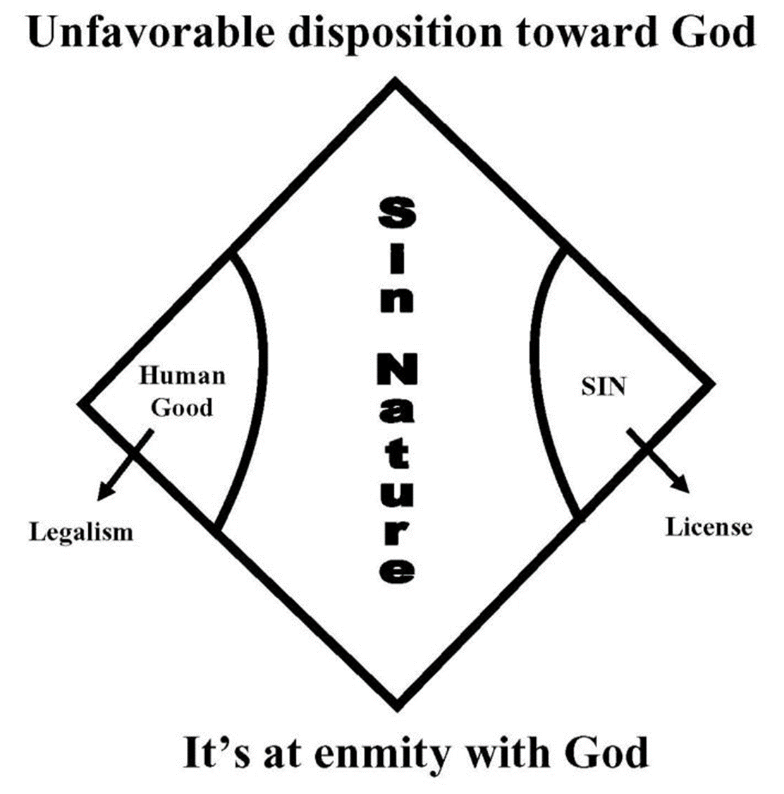
6. What is “sin” normally referring to throughout Romans 6-8?
“{THE} SIN {NATURE}
Notes:
The word “sin” in Romans 6:1-7:13 is used 25 times.
In every case except 6:15, it is a noun, not a verb, and in the Greek includes the definite article, so could read “the sin.”
This is not in reference to an act of sinning, or it would be a verb, and is not in reference to sin in general, or there would be no definite article.
If Paul was talking about acts of sin, the word would be plural.
This is best understood to be in reference to the “sinful nature” that every believer possesses

Slide 18
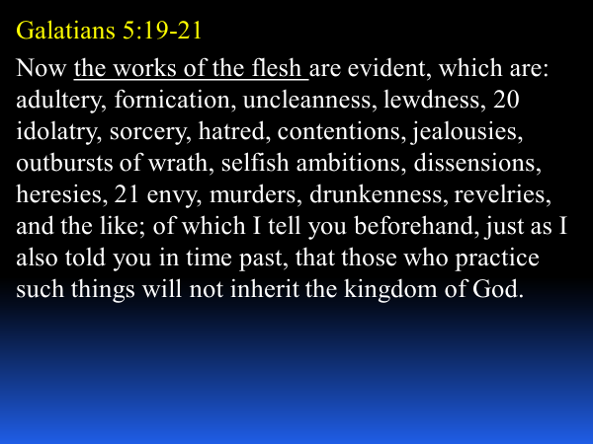

Notes:
Explain this passage
Paul in Romans 6 is going after the ROOT of sin, while 1 John 1:9 merely deals with the FRUIT of sin.

Slide 19
7. When did you die to sin? (6:2)
“died {aorist, active, indicative} to sin” – positionally in Christ at the cross; personally at the pt. of salvation

Slide 20
"dead to (the) sin (nature)" does not mean:
sin is dead in me (eradication)
we have two natures - the sin nature is not dead
we should die to sin (it is a fact not a command)
we are helpless against our sin nature – we need HS
we are dying to sin (aorist tense – not present)
- not an ongoing death – completed action in the past
It does mean that every believer has been CRUCIFIED WITH CHRIST IN GOD’S EYES , so that we have been SEPARATED / FREED from the sin nature’s right to rule in our lives.
Notes:
Slide first.
[1 Click]
The aorist verb here means that this is a completed act, not something that is ongoing.
[1 Click]
Death in the Bible does not mean annihilation or non-existence.
It means separation.
Every believer in Christ has died to sin, has been separated from the sin nature’s legal right to reign in our lives.

Slide 21
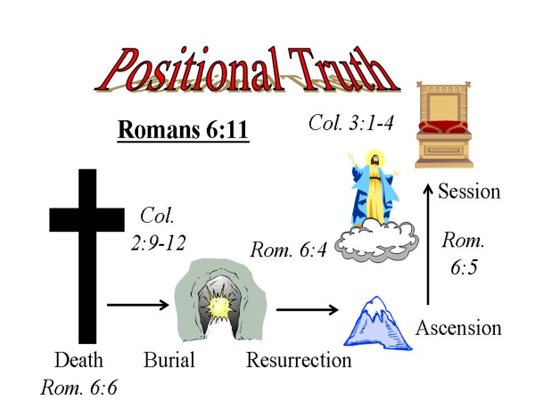
8. How did you die to sin? (6:3)
Romans 6:3 Or do you not know that as many of us as were baptized into Christ Jesus were baptized into His death?

Slide 22
9. What does the word “baptized” mean and refer to? (6:3)
Romans 6:3 Or do you not know that as many of us as were baptized {aorist, passive, indicative} into Christ Jesus were baptized {aorist, passive, indicative} into His death?
Notes:
Verses 3-5 are the doctrinal explanation of how you DIED TO SIN.
“BAPTIZED” MEANS ‘TO BE IDENTIFIED W; TO BE PLACED INTO; TO BE IMMERSED.
7 different baptisms in the Bible: 4 DRY; 3 WET – EACH ONE CARRIES SOME FORM OF ‘IDENTIFICATION’ CONCEPT W IT
THIS IS REFERRING TO THE BAPTISM BY THE HS THAT PLACES YOU INTO UNION W X – DRY AS THE SAHARA
ILLUSTRATE W PEN & BIBLE

Slide 23
What was the purpose of your co-crucifixion, co-burial, and co-resurrection with Christ? (6:4-5)
Romans 6:4-5 Therefore we were buried with Him through baptism into death, that just as Christ was raised from the dead by the glory of the Father, even so we also should walk {IN OUR CONDITION} in newness of life. 5 For if we have been united together in the likeness of His death, certainly we also shall be in the likeness of His resurrection,
Notes:
Our POSITION IN CHRIST was designed that it should IMPACT our daily walk with Christ. Amen?
“SHOULD” NOT ABSOLUTELY GUARANTEED THAT WE “WILL” – DEPENDS ON VS. 11-13 // ONE OF THE PROBLEMS W LS

Slide 24
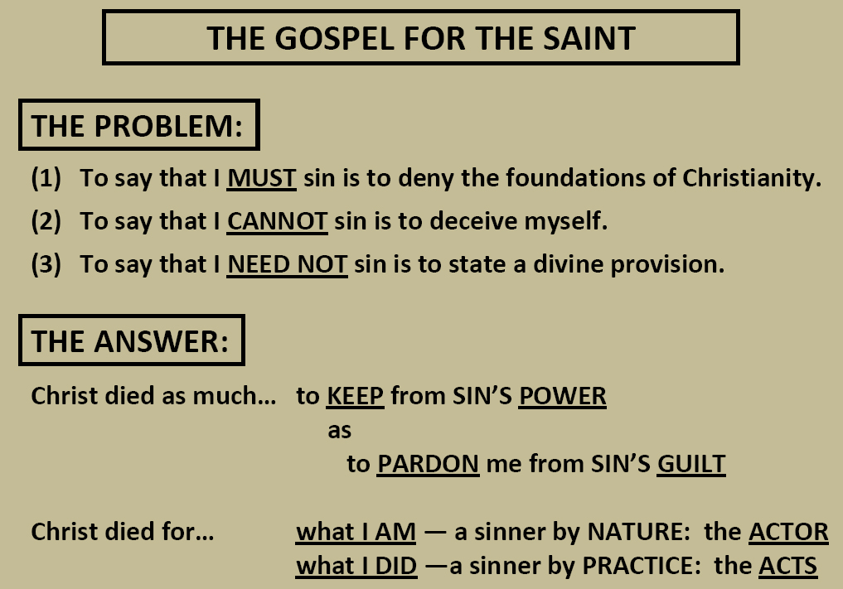

Slide 25
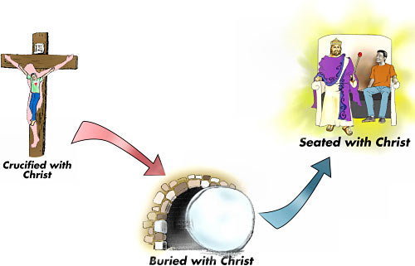


Slide 26
What does God now want you to know? (6:6a)
Romans 6:6 knowing this, that our old man was crucified with Him, that the body of sin might be done away with, that we should no longer be slaves of sin.
Notes:
Verses 6-10 provide for us the IMPORTANT RAMIFICATIONS of verses 1-5.
THESE ARE TRUTHS THAT GOD EXPECTS YOU TO “KNOW” – UNFORTUNATELY MANY BELIEVERS DO NOT ‘KNOW’ THIS AND TOO MANY PASTORS DO NOT TEACH THIS.
KNOW – VS.3, 6, 8
“I WOULD NOT HAVE YOU TO BE IGNORANT BRETHREN”
CHURCHES THAT UPPLAY MUSIC AND DOWNPLAY BIBLE TEACHING – COMMENT ON SLBC

Slide 27
The words “know”, “knowing”, “knowledge”, “known”, “knows” etc. are found almost 1500x in the Bible.
The words “feel” and “feeling[s]” are found only 8x in the Bible.
The words, “experience” or ‘experienced” are found only 3x in the Bible.
What does this indicate? God puts a high priority in KNOWING HIS WORD, not on going by your feelings or experiences!!!
Notes:
DID YOU KNOW ….
BUT KEEP IN MIND THAT KNOWING BIBLE DOCTRINE IS NOT AN END IN ITSELF BUT A MEANS TO AN END – TO WALK BY FAITH IN NEWNESS OF LIFE!
OTHERWISE YOU ARE CONTENT W MERE KNOWLEDGE INSTEAD OF BEING A DOER OF THE WORD ….
BUT LETS DIG DEEPER INTO VS. 6 …

Slide 28
12. What is the “old man” referring to? (6:6a)
Romans 6:6 knowing this, that our old man was crucified with Him, that the body of sin might be done away with, that we should no longer be slaves of sin.
“old man” is not referring to the sin nature but all that you were in Adam in contrast to now being a new creation in Christ (2 Cor. 5:17).
Note: 6:2 – “we who died” / “us … were baptized into His death” / “we” – vs.4 & 5 / 6:7 / Gal. 2:20

Slide 29
“was crucified” carries the idea of being “put to death legally”.
The “old man” refers to all that you were in Adam before your salvation in contrast to now being a new creation in Christ.

Slide 30
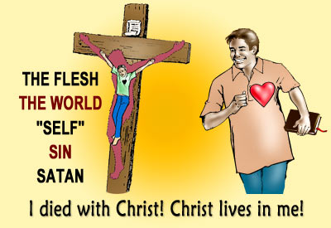

Slide 31
13. Why would God “crucify the old man” with Jesus Christ? (6:6b)
Romans 6:6 knowing this, that our old man was crucified with Him, that the body of sin might be done away with, that we should no longer be slaves of sin.
“the body of sin” - seems to best refer to THE SIN NATURE’S PAST USE AND DOMINATION OF OUR BODY.
“done away with” - means to be RENDERED POWERLESS; RENDERED INOPERATIVE; PUT OUT OF BUSINESS; STRIPPED OF ITS RULING POWER.

Slide 32
The Main Point to Understand
Because of the believer’s identification with Jesus Christ in His death, the sin nature’s RIGHT TO RULE as a master in the believer’s body has been LEGALLY BROKEN, so that the believer is legally FREED from enslavement to the sin nature.
Notes:
Slide title first.
[Click Main Point]
As a believer, you are no longer the legal slave of the sin nature.

Slide 33
Because of the cross-work of Christ and your position in Him, what are you no longer? (6:6c)
14. Because of the cross-work of Christ and your position in Him, what are you no longer? (6:6c)
Romans 6:6 knowing this, that our old man was crucified with Him, that the body of sin might be done away with, that we should no longer be slaves of {the} sin.
Literally … “that we should no longer BE ENSLAVED to the sin {nature}. POSITONALLY!

Slide 34
Because of the cross-work of Christ and your position in Him, what are you no longer? (6:6c)
15. What does this mean practically about you living any longer in sin? (6:7)
Romans 6:7 For he who has died has been freed from {the} sin.

Slide 35
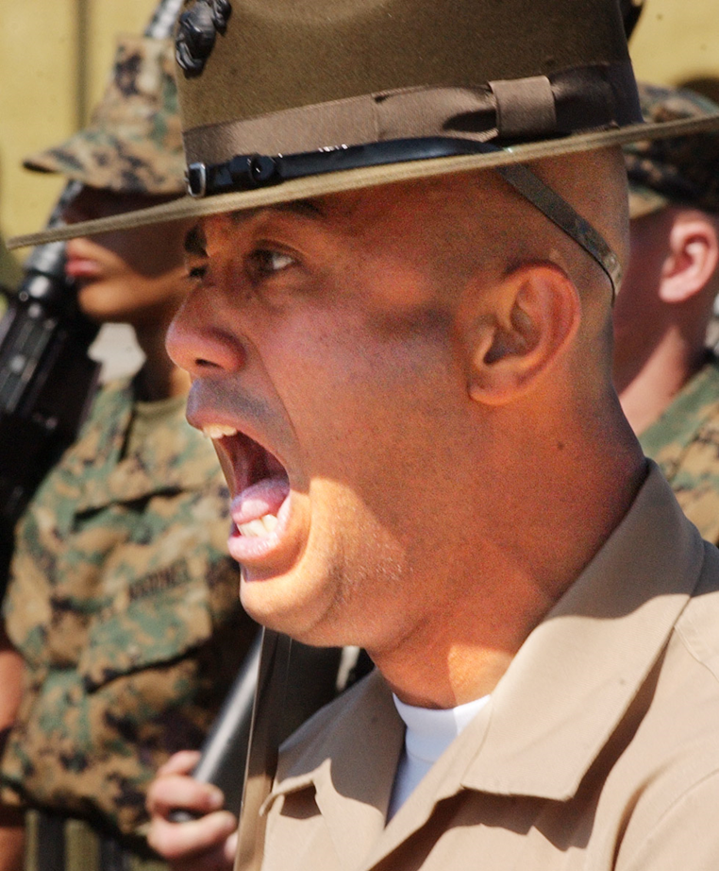
* The point: Because of the believer’s identification with Christ in His death, the sin nature’s LEGAL RIGHT TO RULE as a master in the believer’s body has been STRIPPED OF IT’S AUTHORITY so that he now is legally FREED from enslavement to the sin nature.

Slide 36
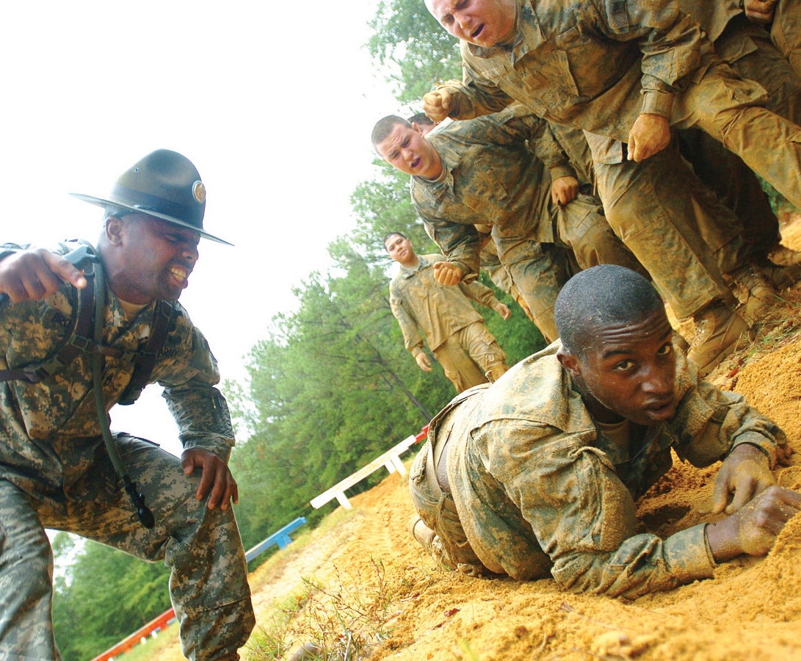
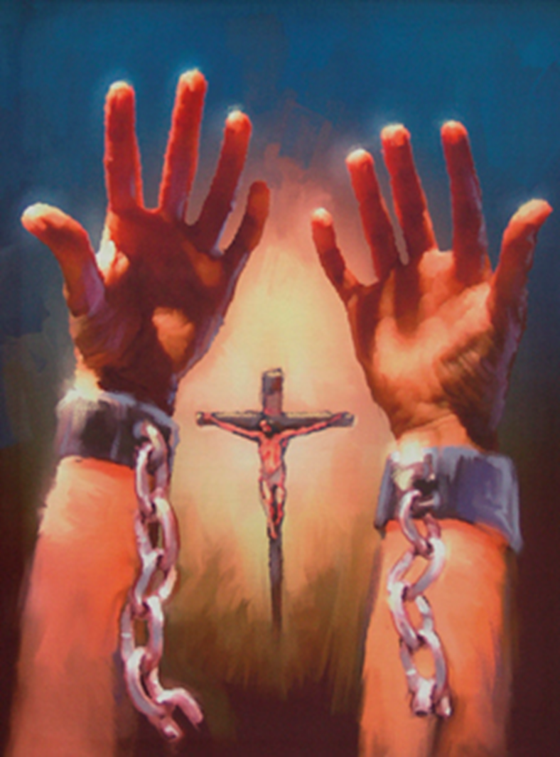

Slide 37
But, what if I don't "know" that I am free?
You will live like a slave in bondage to your sin nature.
You will focus on trying to get rid of your sin nature or sins by trying harder to live the “Christian life”
You will try and reform your sin nature through good works – like trying to put lipstick on a pig

Slide 38
Because of the cross-work of Christ and your position in Him, what are you no longer? (6:6c)
16. In addition to knowing that you died with Christ, what does God want you to believe about living with Christ due to your identification with Him? (6:8-10)
Romans 6:8-10 Now if {1ST} we died with Christ, we believe that we shall also live with {or by means of} Him, 9 knowing that Christ, having been raised from the dead, dies no more. Death no longer has dominion over Him. 10
For the death that He died, He died to sin once for all; but the life that He lives, He lives to God.

Slide 39
How is Christ’s death ‘to sin” different from Christ’s death “for our sins”?
SUBSTITUTION TRUTH | IDENTIFICATION TRUTH
Christ died for our SINS (I Cor. 15:3) | Christ died unto SIN (Rom. 6:10)

Slide 40
How is Christ’s death ‘to sin” different from Christ’s death “for our sins”?
SUBSTITUTION TRUTH | IDENTIFICATION TRUTH
Christ died for our SINS (I Cor. 15:3) | Christ died unto SIN (Rom. 6:10)
CHRIST died for you (Rom. 5:8) | YOU died with Christ (Gal. 2:20)

Slide 41
How is Christ’s death ‘to sin” different from Christ’s death “for our sins”?
SUBSTITUTION TRUTH | IDENTIFICATION TRUTH
Christ died for our SINS (I Cor. 15:3) | Christ died unto SIN (Rom. 6:10)
CHRIST died for you (Rom. 5:8) | YOU died with Christ (Gal. 2:20)
CHRIST was buried (1 Cor. 15:4) | YOU were buried with Christ (Col. 2:12)

Slide 42
How is Christ’s death ‘to sin” different from Christ’s death “for our sins”?
SUBSTITUTION TRUTH | IDENTIFICATION TRUTH
Christ died for our SINS (I Cor. 15:3) | Christ died unto SIN (Rom. 6:10)
CHRIST died for you (Rom. 5:8) | YOU died with Christ (Gal. 2:20)
CHRIST was buried (1 Cor. 15:4) | YOU were buried with Christ (Col. 2:12)
Christ was risen for your JUSTIFICATION (Rom. 4:25) | You have been risen with Christ for your SANCTIFICATION (Col. 3:1)

Slide 43
How is Christ’s death ‘to sin” different from Christ’s death “for our sins”?
SUBSTITUTION TRUTH | IDENTIFICATION TRUTH
Christ died for our SINS (I Cor. 15:3) | Christ died unto SIN (Rom. 6:10)
CHRIST died for you (Rom. 5:8) | YOU died with Christ (Gal. 2:20)
CHRIST was buried (1 Cor. 15:4) | YOU were buried with Christ (Col. 2:12)
Christ was risen for your JUSTIFICATION (Rom. 4:25) | You have been risen with Christ for your SANCTIFICATION (Col. 3:1)
CHRIST ascended and is seated at God's right hand (Eph. 4:10; Col 3:1) | YOU are seated in the heavenlies in Christ (Eph. 2:6)

Slide 44
How is Christ’s death ‘to sin” different from Christ’s death “for our sins”?
SUBSTITUTION TRUTH | IDENTIFICATION TRUTH
Christ died for our SINS (I Cor. 15:3) | Christ died unto SIN (Rom. 6:10)
CHRIST died for you (Rom. 5:8) | YOU died with Christ (Gal. 2:20)
CHRIST was buried (1 Cor. 15:4) | YOU were buried with Christ (Col. 2:12)
Christ was risen for your JUSTIFICATION (Rom. 4:25) | You have been risen with Christ for your SANCTIFICATION (Col. 3:1)
CHRIST ascended and is seated at God's right hand (Eph. 4:10; Col 3:1) | YOU are seated in the heavenlies in Christ (Eph. 2:6)
Christ freed you from sin's PENALTY. (Rom. 5:9-10) | Christ freed you from sin's POWER (Rom. 6:6-7)

Slide 45
How is Christ’s death ‘to sin” different from Christ’s death “for our sins”?
SUBSTITUTION TRUTH | IDENTIFICATION TRUTH
Christ died for our SINS (I Cor. 15:3) | Christ died unto SIN (Rom. 6:10)
CHRIST died for you (Rom. 5:8) | YOU died with Christ (Gal. 2:20)
CHRIST was buried (1 Cor. 15:4) | YOU were buried with Christ (Col. 2:12)
Christ was risen for your JUSTIFICATION (Rom. 4:25) | You have been risen with Christ for your SANCTIFICATION (Col. 3:1)
CHRIST ascended and is seated at God's right hand (Eph. 4:10; Col 3:1) | YOU are seated in the heavenlies in Christ (Eph. 2:6)
Christ freed you from sin's PENALTY. (Rom. 5:9-10) | Christ freed you from sin's POWER (Rom. 6:6-7)
God accepted CHRIST’S WORK on your behalf (1 John 2:2, 4:10) | God accepts YOU in Christ (Eph. 1:6)

Slide 46
Because of the cross-work of Christ and your position in Him, what are you no longer? (6:6c)
17. What is the first imperative in Romans regarding the daily Christian life? (6:11)
Romans 6:11 Likewise {just like Jesus Christ died to sin & is alive to God} you also, reckon {present, imperative of logizomai} yourselves to be dead indeed to sin, but alive to God in Christ Jesus our Lord.

Slide 47
“reckon” (logizomai) – refers to a logical faith based upon the facts
- “reckon” (logizomai) – refers to a logical faith based upon the facts;
- present tense - repeatedly; this is to be your daily mindset as you live by faith;
- active voice - you must choose this voluntarily instead of dwelling on your past or viewing yourself from the world’s viewpoint as it is not automatic;
- imperative mood – this is a command, a necessity to victorious Christian living
Your first issue every day is to focus on Jesus Christ and your identity with Him.

Slide 48
Because of the cross-work of Christ and your position in Him, what are you no longer? (6:6c)
18. How does one “reckon”? (6:11)
BY FAITH in THE FACTS of what GOD HAS SAID IS TRUE OF YOU IN CHRIST!

Slide 49
1. Fact

Slide 50
1. Fact
2. Faith

Slide 51
1. Fact
2. Faith
3. Feeling

Slide 52
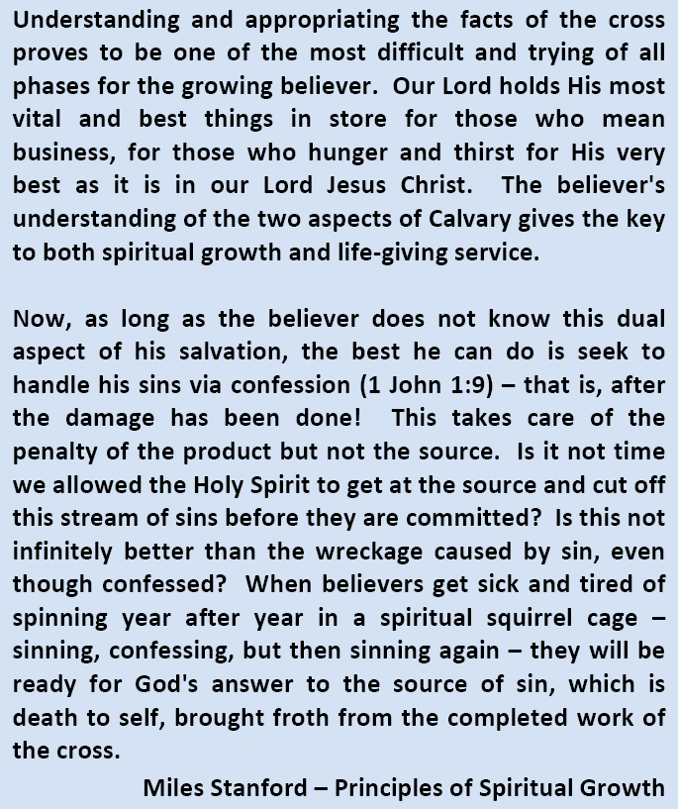

Slide 53
Walking By Faith
GOD
BIBLE
Knowledge
Renewing
Your Mind
Romans 12:2
Walking by Faith in God
Hebrews 11:6
Faith Alone in Christ Alone
(John 1:12)
All by God’s grace through
yielded dependence
on the Lord via the Holy Spirit
Death
or
Rapture
Physical
Birth
POINT
of Time
POINT
of Time
PROCESS of TIME
POINT
of Time

Slide 54
Because of the cross-work of Christ and your position in Him, what are you no longer? (6:6c)
19. What are you to “reckon” to be true because it is? (6:11)
Romans 6:11 Likewise {just like Jesus Christ} you also, reckon {present, imperative of logizomai} yourselves
{1} to be dead indeed to {the} sin,
but
{2} (to be) alive to God
in Christ Jesus our Lord.
Notes:
Explain about IN CHRIST JESUS
OUR LORD
5:20-21; 6:23; 7:24-25; 8:38-39
ACTS 10:36 – JC – HE IS LORD OF ALL // ACTS 16:31 //

Slide 56
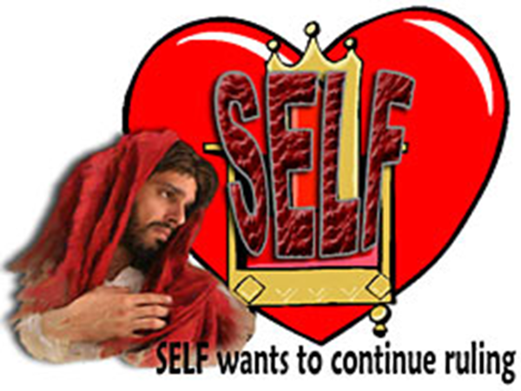
Because of the cross-work of Christ and your position in Him, what are you no longer? (6:6c)
What does vs.12 indicate about your sin nature yet? (6:12)
Romans 6:12 Therefore do not let {the} sin reign in your mortal body, that you should obey it in its lusts.
Notes:
THAT YOU STILL HAVE A SIN NATURE IN YOUR BODY; THAT THE S.N. STILL WANTS TO RULE IN YOUR LIFE LIKE THAT OLD ARMY SERGEANT BUT YOU HAVE A CHOICE
THAT TO BE TEMPTED IS NOT SIN, BUT TEMPTATION YIELDED TO IS SIN

Slide 57
Because of the cross-work of Christ and your position in Him, what are you no longer? (6:6c)
In contrast to presenting yourself or your members to the sin nature to reign, what should you repeatedly do from day to day? (6:13)
Romans 6:13 And do not present your members as instruments of unrighteousness to sin, but present{aorist, active, imperative of paristemi} yourselves to God as being alive from the dead, and your members as instruments of righteousness to God.

Slide 58
“present” (paristemi) – to make available for use; to place at one’s disposal; yield or present to serve another
- aorist tense … the emphasis is on the need to begin this action which is urgent; not a once for all (see Rom.13:7; 2 Tim.4:2)
- active voice … you must voluntarily chose to present based upon believing the truth of 6:11
- imperative mood … a command; a necessity to do the will of God
Romans 6:13 And do not present your members as instruments of unrighteousness to sin, but present yourselves to God as being alive from the dead, and your members as instruments of righteousness to God.

Slide 59
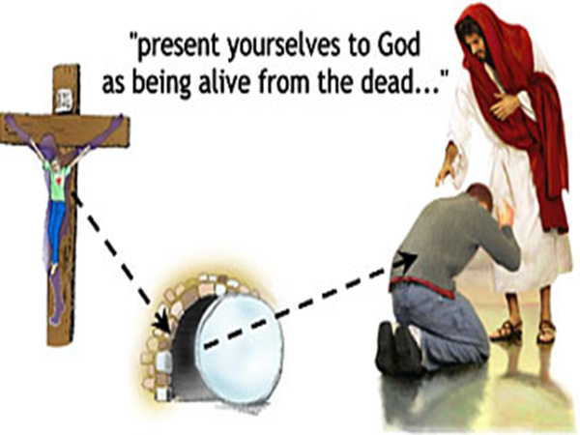

Slide 60
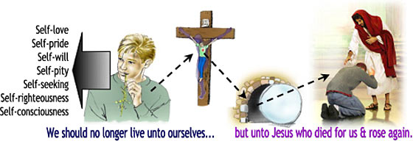
2 Corinthians 5:14-15 For the love of Christ compels us, because we judge thus: that if One died for all, then all died; 15 and He died for all, that those who live should live no longer for themselves, but for Him who died for them and rose again.

Slide 61
Because of the cross-work of Christ and your position in Him, what are you no longer? (6:6c)
How is the Christian life not to be lived? (6:14a)
Romans 6:14 For sin shall not have dominion over you, for you are not under law but under grace.
Notes:
THERE IS NO DEFINITE ARTICLE BEFORE “LAW” MEANING MORE THAN JUST THE MOSAIC LAW BUT IN A LEGALISTIC MANNER.
AND KEEP IN MIND THAT LEGALISM IS A M.A. IN WHICH WE SEEK TO GAIN SALVATION OR SP. BLESSINGS BY OUR RELIGIOUS WORKS OR RITUALS FOR EITHER JUSTIFICATION OR SANCTIFICATION.
AND THERE ARE MANY FORMS OF LEGALISM OUT THERE
“UNDER” HUPO – UNDER THE AUTHORITY

Slide 62
Because of the cross-work of Christ and your position in Him, what are you no longer? (6:6c)
How is the Christian life now to be lived? (6:14b)
Romans 6:14 For sin shall not have dominion over you, for you are not under {hupo} law but under {hupo} grace.
Notes:
It’s a Christian life that is not a performance but a relationship of grace enjoyed by faith in JC.
Tony Evans story

Slide 63
The Personal APPLICATIONS. (vs. 11-14)
The Practical IMPLICATIONS. (vs. 15-23)
a. Another ANTICIPATED QUESTION… "Shall we SIN, because we are not UNDER LAW, but GRACE?" (6:15a)
b. Another EMOTIONAL ANSWER… CERTAINLY NOT! (6:15)
* Principle to remember:
LIVING UNDER GRACE IS NOT DESIGNED TO LEAD BELIEVERS TO EVEN ONE ACT OF SIN.

Slide 64
Because of the cross-work of Christ and your position in Him, what are you no longer? (6:6c)
What principle must you remember and two options that you have each day? (6:15-16)
Romans 6:15-16 What then? Shall we sin because we are not under law but under grace? Certainly not!
16 Principle: Do you not know that to whom you present yourselves slaves to obey, you are that one's slaves whom you obey, whether of …
{1} sin leading to death,
or
{2} of obedience leading to righteousness?
Notes:
Tony Evans story

Slide 65
Because of the cross-work of Christ and your position in Him, what are you no longer? (6:6c)
What are the 4 key words in this passage and their logical order?
KNOW
RECKON {BY FAITH}
PRESENT {BY FAITH}
OBEY {BY THE POWER OF THE HOLY SPIRIT}
Notes:
Tony Evans story

Slide 66
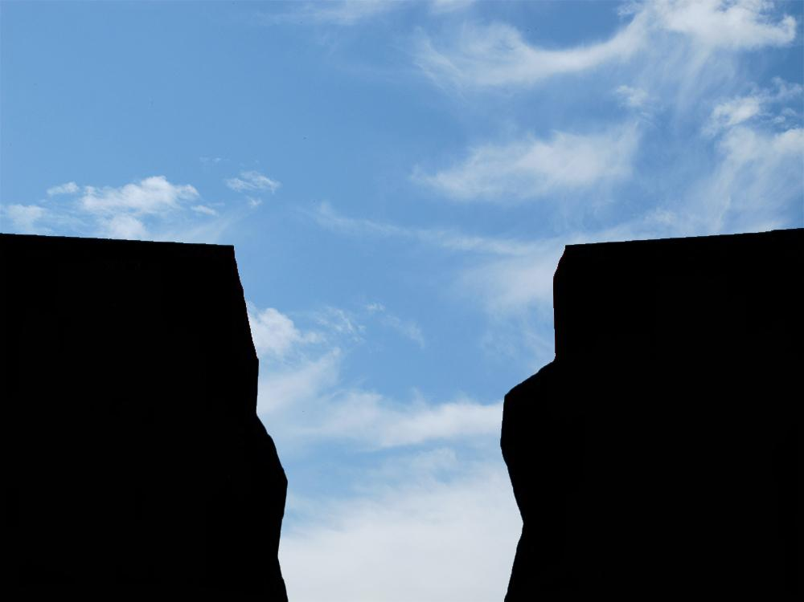

For the wages of sin is death,
but the gift of God is eternal life in Christ Jesus our Lord.
Romans 6:23
but
SINNER
GOD
For the wages of sin is death,
the gift of God
For the wages of sin
the gift of God is eternal life
For the wages of sin is death,
For the wages
the gift of God is eternal life in Jesus Christ
our Lord.

Slide 67
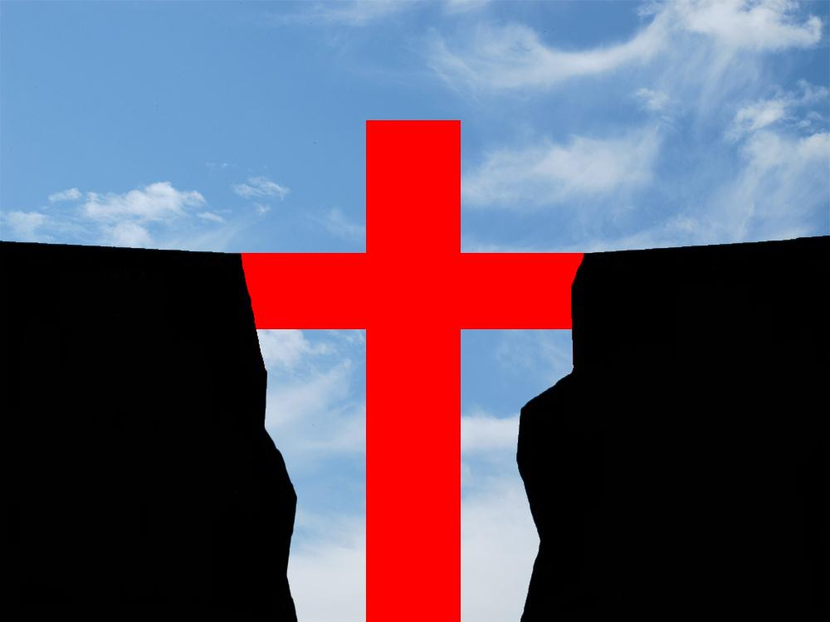

For the wages of sin is death,
but the gift of God is eternal life in Christ Jesus our Lord.
Romans 6:23
SINNER
JESUS CHRIST
GOD
For the wages of sin is death,
our
LORD
the gift of God is eternal life in Jesus Christ
our Lord.

