Slide 1
THE RAPTURE
What and When? – Part 41
Andrew Marshall Woods, Th.M., JD., PhD.
Sr. Pastor, Sugar Land Bible Church

Slide 2
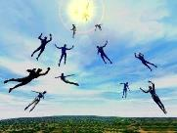
The Rapture Course Overview
What is the Rapture?
When is the Rapture?
Strengthening the Pre-Tribulational case
The opposing views
One second after the Rapture

Slide 3
The Rapture Course Overview
What is the Rapture?
When is the Rapture?
Strengthening the Pre-Tribulational case
The opposing views
One second after the Rapture

Slide 4
What is the Rapture?
An important doctrine
Distinct from the Second Advent
Catching away of all living believers (1 Thess 4:17)
Reunion (1 Thess 4:14-16)
Resurrection (1 Cor 15:50-54)
Exemption from death (1 Cor 15:51, 54-56)
Instantaneous (1 Cor 15:52)
Mystery (1 Cor 15:51)
Imminent (1 Cor 15:51; 1 Thess 4:15)
Traditional doctrine now being recovered

Slide 5
The Rapture Course Overview
What is the Rapture?
When is the Rapture?
Strengthening the Pre-Tribulational case
The opposing views
One second after the Rapture

Slide 6
When is the Rapture?
7 Arguments Favoring the Pre-Tribulation View
Tribulation's purpose concerns Israel (Jer 30:7; Dan 9:24)
No biblical reference to the church on earth during the Tribulation period (Rev 4-22)
Church is promised an exemption from divine wrath (1 Thess 1:10; 5:9; Rom 5:9; Rev 3:10; 6:17)
Rapture is imminent (1 Cor 15:51; 1 Thess 4:15)
Rapture is a comfort (1 Thess 4:18)
Antichrist cannot come to power until the restrainer is removed (2 Thess 2:6-7)
Symbolic parallels (2 Peter 2:5-9)

Slide 7
The Rapture Course Overview
What is the Rapture?
When is the Rapture?
Strengthening the Pre-Tribulational case
The opposing views
One second after the Rapture

Slide 8
Strengthening the Pre-Tribulation Case
John 14:1-4
Revelation 3:10
First Thessalonians 4‒5
Second Thessalonians 2:3a
Matthew 24‒25

Slide 9
The Rapture Course Overview
What is the Rapture?
When is the Rapture?
Strengthening the Pre-Tribulational case
The opposing views
One second after the Rapture

Slide 10
When Will the Rapture Take Place Relative to the Tribulation Period?
Pre-tribulation rapture theory
Mid-tribulation rapture theory
Post-tribulation rapture theory
Pre-wrath rapture theory
Partial rapture theory

Slide 12
Post-tribulation Rapture Theory
According to 1 Thessalonians 4:16 and 1 Corinthians 15:52, the rapture will take place at the sounding of the last trumpet which, according to Matthew 24:30-31, will take place upon Christ's return at the end of the Tribulation period.
The Rapture is found in Revelation 19:11-21.
According to Revelation 20:4-6, the resurrection of all believers will transpire at the end of the Tribulation period thereby necessitating that the rapture will also take place at this time.

Slide 13
Post-tribulation Rapture Theory
Although the church is exempted from God's wrath, the church will be on the earth during the entire Tribulation period because the Book of Revelation portrays God's people being supernaturally protected from many of the apocalyptic judgments during this time period.
The post-tribulational rapture position has been the dominant view held by theologians throughout the history of the church.

Slide 14
Post-tribulation Rapture Theory Problems
Who will populate the millennium?
The Hebrew Wedding Sequence.
The Pointlessness of the Preparation of the Believers' Heavenly Dwelling Places in John 14:1-3.
The Lack of Time necessary for the Bema Seat Judgment of Christ and the Marriage of the Lamb.
The Pointlessness of the Church Being Caught Up Only to Immediately Return to the Earth.

Slide 15
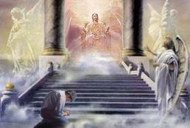
2 Corinthians 5:10
“For we must all appear before the judgment seat of Christ, so that each one may be recompensed for his deeds in the body, according to what he has done, whether good or bad.”

Slide 16
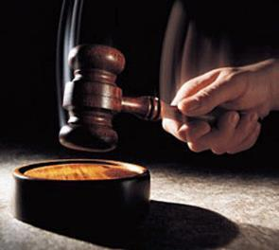
Why?
Not to judge sin (John 19:30)
Not to determine salvation (John 5:24)
But rather to give or not give rewards

Slide 17
Scripture’s Five Crowns (Rev 4:10: 3:11; 2 John 8)
Scripture | Crown | Purpose
1 Cor. 9:24-27 | Incorruptible | Gaining mastery over the flesh
1 Thess. 2:19-20 | Rejoicing | Soul winning
Jas. 1:12; Rev. 2:10 | Life | Enduring trials
1 Pet. 5:2-4 | Glory | Shepherding God’s people
2 Tim. 4:8 | Righteousness | Longing for His appearing

Slide 18
1 Corinthians 4:5
“Therefore do not go on passing judgment before the time, but wait until the Lord comes who will both bring to light the things hidden in the darkness and disclose the motives of men’s hearts; and then each man’s praise will come to him from God.”

Slide 19
2 Timothy 4:8
“In the future there is laid up for me the crown of righteousness, which the Lord, the righteous Judge, will award to me on that day; and not only to me, but also to all who have loved His appearing.”

Slide 20
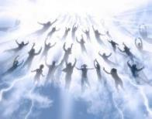
1 Thessalonians 4:17
“Then we who are alive and remain will be caught up [harpazō] together with them in the clouds to meet the Lord in the air, and so we shall always be with the Lord.”

Slide 21
J. Dwight Pentecost Things to Come, Page 221
“It is scarcely necessary to point out that this examination must take place in the sphere of the heavenlies. It is said in 1 Thessalonians 4:17 that ‘we shall be caught up... in the clouds, to meet the Lord in the air.’ Since the bema follows the translation, the ‘air’ must be the scene of it. This is further supported by 2 Corinthians 5:1-8, where Paul is describing events that take place when the believer is ‘absent from the body, and...present with the Lord.’ Thus, this event must take place in the Lord's presence in the sphere of the ‘heavenlies.’”

Slide 23
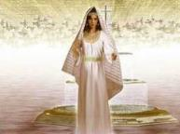
Revelation 19:7-8
“⁷ Let us rejoice and be glad and give the glory to Him, for the marriage of the Lamb has come and His bride has made herself ready.” ⁸ It was given to her to clothe herself in fine linen, bright and clean; for the fine linen is the righteous acts of the saints.

Slide 24
When?
After the Rapture
Rewards are associated with the day of the Lord’s coming for the church (1 Cor. 4:5; 2 Tim. 4:8)
Bride is already rewarded (Rev. 19:8)

Slide 25
Revelation 8:1; 22:2
^{1 “}When the Lamb broke the seventh seal, there was silence in heaven for about half an hour.”. . . ^{2:22} “in the middle of its street. On either side of the river was the tree of life, bearing twelve kinds of fruit, yielding its fruit every month; and the leaves of the tree were for the healing of the nations.”
Notes:
READ…

Slide 26
Revelation 21:16-17
¹⁶ The city was laid out like a square, as long as it was wide. He measured the city with the rod and found it to be [1500 miles] in length, and as wide and high as it is long. ¹⁷ He measured its wall and it was 144 cubits thick, by man's measurement, which the angel was using.
Notes:
READ…

Slide 27
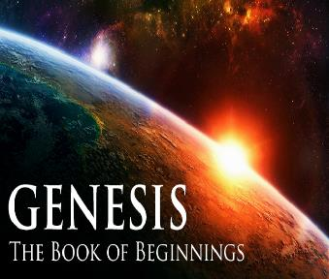
Genesis 1:1–2:3 Outline
Original creation on the first day (Gen 1:1)
Original creation in its unfilled and unformed state (Gen 1:2)
Creation week (Gen 1:3–2:3): “And God said,” “good”
First day 1:3-5
Second day 1:6-8
Third day 1:9-13
Fourth day 1:14-19
Fifth day 1:20-23
Sixth day 1:24-31
Seventh day 2:1-3

Slide 28
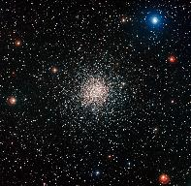
Genesis 1:14
Then God said, “Let there be lights in the expanse of the heavens to separate the day from the night, and let them be for signs and for seasons and for days and years.”

Slide 30
Post-tribulation Rapture Theory Problems
Who will populate the millennium?
The Hebrew Wedding Sequence.
The Pointlessness of the Preparation of the Believers' Heavenly Dwelling Places in John 14:1-3.
The Lack of Time necessary for the Bema Seat Judgment of Christ and the Marriage of the Lamb.
The Pointlessness of the Church Being Caught Up Only to Immediately Return to the Earth.

Slide 31
Revelation 19:7-8, 14
“⁷ Let us rejoice and be glad and give the glory to Him, for the marriage of the Lamb has come and His bride has made herself ready.” ⁸ It was given to her to clothe herself in fine linen, bright and clean; for the fine linen is the righteous acts of the saints. . .¹⁴ And the armies which are in heaven, clothed in fine linen, white and clean, were following Him on white horses.

Slide 32
Revelation 1:6
“and He has made us to be a kingdom, priests to His God and Father—to Him be the glory and the dominion forever and ever. Amen.”

Slide 33
Revelation 5:10
“You have made them to be a kingdom and priests to our God; and they will reign [basileuō] upon the earth [gē].”

Slide 34
1 Thessalonians 4:16-18
¹⁶ For the Lord Himself will descend from heaven with a shout, with the voice of the archangel and with the trumpet of God, and the dead in Christ will rise first. ¹⁷ Then we who are alive and remain will be caught up [harpazō] together with them in the clouds to meet the Lord in the air, and so we shall always be with the Lord. ¹⁸ Therefore comfort one another with these words."

Slide 36
Conclusion

Slide 37
When Will the Rapture Take Place Relative to the Tribulation Period?
Pre-tribulation rapture theory
Mid-tribulation rapture theory
Post-tribulation rapture theory
Pre-wrath rapture theory
Partial rapture theory

Slide 38
Post-tribulation Rapture Theory Problems
Who will populate the millennium?
The Hebrew Wedding Sequence.
The Pointlessness of the Preparation of the Believers' Heavenly Dwelling Places in John 14:1-3.
The Lack of Time necessary for the Bema Seat Judgment of Christ and the Marriage of the Lamb.
The Pointlessness of the Church Being Caught Up Only to Immediately Return to the Earth.

Slide 39
Post-tribulation Rapture Theory
According to 1 Thessalonians 4:16 and 1 Corinthians 15:52, the rapture will take place at the sounding of the last trumpet which, according to Matthew 24:30-31, will take place upon Christ's return at the end of the Tribulation period.
The Rapture is found in Revelation 19:11-21.
According to Revelation 20:4-6, the resurrection of all believers will transpire at the end of the Tribulation period thereby necessitating that the rapture will also take place at this time.

Slide 40
Post-tribulation Rapture Theory
Although the church is exempted from God's wrath, the church will be on the earth during the entire Tribulation period because the Book of Revelation portrays God's people being supernaturally protected from many of the apocalyptic judgments during this time period.
The post-tribulational rapture position has been the dominant view held by theologians throughout the history of the church.

Slide 41
When Will the Rapture Take Place Relative to the Tribulation Period?
Pre-tribulation rapture theory
Mid-tribulation rapture theory
Post-tribulation rapture theory
Pre-wrath rapture theory
Partial rapture theory

