Slide 1
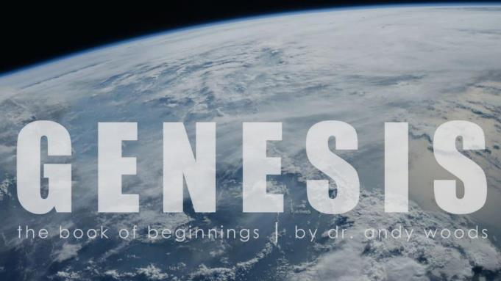
Genesis 6‒9
The Flood and Continuation of the Messianic Promise

Slide 2
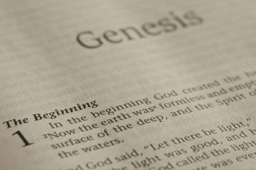
GENESIS STRUCTURE
Beginning of the Human race (Gen. 1‒11)
Beginning of the Hebrew race (Gen. 12‒50)

Slide 3
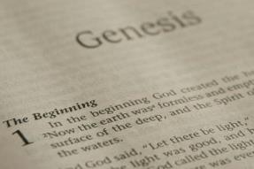
GENESIS STRUCTURE
Genesis 1-11 (four events)
Creation (1-2)
Fall (3-5)
Flood (6-9)
National dispersion (10-11)

Slide 4
GENESIS STRUCTURE
Genesis 1-11 (four events)
Creation (1-2)
Fall (3-5)
Flood (6-9)
National dispersion (10-11)

Slide 5
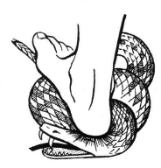
Genesis 3:15
“And I will put enmity Between you and the woman, And between your seed and her seed; He shall bruise you on the head, And you shall bruise him on the heel.”

Slide 6
GENESIS STRUCTURE
Genesis 1-11 (four events)
Creation (1-2)
Fall (3-5)
Flood (6-9)
National dispersion (10-11)

Slide 7
The Flood (Gen 6–9)
Events before the flood (Gen 6)
The flood (Gen 7)
The abating of the waters (Gen 8)
Events following the flood (Gen 9)

Slide 8
Genesis 6 Outline
God’s Grief (Gen 6:1-7)
God’s Grace (6:8-10)
God’s Destruction (6:11-13)
God’s Instruction (6:14-22)

Slide 9
I. God’s Grief (Gen 6:1-7)
The specific sin (6:1-4)
The general sin (6:5)
God’s sorrow (6:6-7)

Slide 10
Genesis 6 Outline
God’s Grief (Gen 6:1-7)
God’s Grace (6:8-10)
God’s Destruction (6:11-13)
God’s Instruction (6:14-22)

Slide 11
II. God’s Grace (Gen 6:8-10)
The object of Grace (6:8)
The results of Grace (6:9)
The descendants of Grace (6:10)

Slide 12
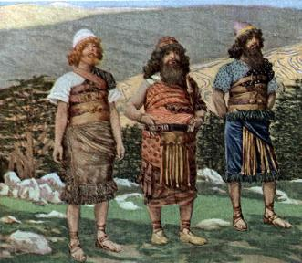
Genesis 6:10
“And Noah begot three sons: Shem, Ham, and Japheth.”

Slide 13
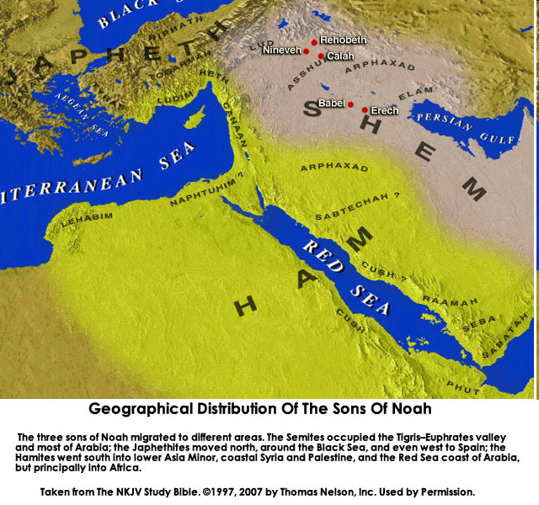

Slide 14
Genesis 6 Outline
God’s Grief (Gen 6:1-7)
God’s Grace (6:8-10)
God’s Destruction (6:11-13)
God’s Instruction (6:14-22)

Slide 15
III. God’s Destruction (Gen 6:11-13)
The sin (6:11-12)
The prediction (6:13)

Slide 16
III. God’s Destruction (Gen 6:11-13)
The sin (6:11-12)
The prediction (6:13)

Slide 17
Genesis 6:11-13
“¹¹ Now the earth was corrupt in the sight of God, and the earth was filled with violence. ¹² And God looked on the earth, and behold, it was corrupt; for humanity had corrupted its way upon the earth. ¹³ Then God said to Noah, ‘The end of humanity has come before Me; for the earth is filled with violence because of people; and behold, I am about to destroy them with the earth.’”

Slide 18
Genesis 6:11-13
“¹¹ Now the earth was corrupt in the sight of God, and the earth was filled with violence. ¹² And God looked on the earth, and behold, it was corrupt; for humanity had corrupted its way upon the earth. ¹³ Then God said to Noah, ‘The end of humanity has come before Me; for the earth is filled with violence because of people; and behold, I am about to destroy them with the earth.’”

Slide 19
Genesis 6:11-13
“¹¹ Now the earth was corrupt in the sight of God, and the earth was filled with violence. ¹² And God looked on the earth, and behold, it was corrupt; for humanity had corrupted its way upon the earth. ¹³ Then God said to Noah, ‘The end of humanity has come before Me; for the earth is filled with violence because of people; and behold, I am about to destroy them with the earth.’”

Slide 20
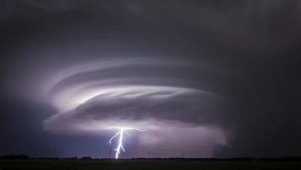
Exodus 9:24
“…It was the worst storm in all the land of Egypt since it had become a nation.” (NIV Emphasis mine)

Slide 21
Genesis 1:1-3
“¹ In the beginning God created the heavens and the earth. ² The earth was formless and void, and darkness was over the surface of the deep, and the Spirit of God was moving over the surface of the waters. ³ Then God said, ‘Let there be light’; and there was light.”

Slide 22
Genesis 6:11-13
“¹¹ Now the earth was corrupt in the sight of God, and the earth was filled with violence. ¹² And God looked on the earth, and behold, it was corrupt; for humanity had corrupted its way upon the earth. ¹³ Then God said to Noah, ‘The end of humanity has come before Me; for the earth is filled with violence because of people; and behold, I am about to destroy them with the earth.’”

Slide 23
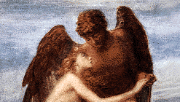
A. The Specific Sin (6:1-4)
Population – Gen. 6:1
Procreation – Gen. 6:2
Patience – Gen. 6:3
Product – Gen. 6:4

Slide 24
III. God’s Destruction (Gen 6:11-13)
The sin (6:11-12)
The prediction (6:13)

Slide 25
Genesis 6:11-13
“¹¹ Now the earth was corrupt in the sight of God, and the earth was filled with violence. ¹² And God looked on the earth, and behold, it was corrupt; for humanity had corrupted its way upon the earth. ¹³ Then God said to Noah, ‘The end of humanity has come before Me; for the earth is filled with violence because of people; and behold, I am about to destroy them with the earth.’”

Slide 26
John 13:19; 14:29
“¹⁹ From now on I am telling you before it comes to pass, so that when it does occur, you may believe that I am He . . . ^{14:29} Now I have told you before it happens, so that when it happens, you may believe.”

Slide 27
Christ’s Short-Term Predictions
PROPHECY | SCRIPTURE
Betrayal by a Friend | John 13:21
Three-fold Denial by Peter | Matthew 26:34, 75
Manner of His Own Death | Matthew 20:18-19
Manner of Disciples’ Deaths | John 21:18-22
AD 70 Events | Luke 19:41-44

Slide 28
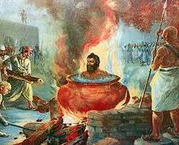
Tertullian Prescription Against Heretics, 36
“…where the Apostle John was first plunged, unhurt, into boiling oil, and thence remitted to his island-exile!”

Slide 30
Genesis 6:11-13
“¹¹ Now the earth was corrupt in the sight of God, and the earth was filled with violence. ¹² And God looked on the earth, and behold, it was corrupt; for humanity had corrupted its way upon the earth. ¹³ Then God said to Noah, ‘The end of humanity has come before Me; for the earth is filled with violence because of people; and behold, I am about to destroy them with the earth.’”

Slide 31
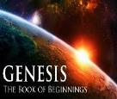
Genesis 4 Outline
First murder (Gen 4:1-15)
Ungodly line of Cain (4:16-24)
Godly line of Seth (4:25-26)

Slide 32
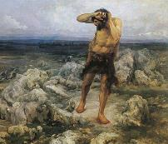
Ungodly Line of Cain (Gen 4:16-24)
Evil line that will not bring forth the Messiah (Gen 3:15)
Continuation of Cain’s line (4:16-18)
Immorality (4:19)
Technological but not spiritual advancement (4:20-22)
Violence (4:23-24)

Slide 33
Genesis 1:26-28
²⁶ Then God said, “Let Us make man in Our image, according to Our likeness; and let them rule over the fish of the sea and over the birds of the sky and over the cattle and over all the earth, and over every creeping thing that creeps on the earth.” ²⁷ God created man in His own image, in the image of God He created him; male and female He created them. ²⁸ God blessed them; and God said to them, “Be fruitful and multiply, and fill the earth, and subdue it; and rule over the fish of the sea and over the birds of the sky and over every living thing that moves on the earth.”

Slide 34
Genesis 9:6
“Whoever sheds man’s blood, By man his blood shall be shed, For in the image of God He made man.”

Slide 35
Revelation 9:20-21
“The rest of mankind, who were not killed by these plagues, did not repent of the works of their hands, so as not to worship demons, and the idols of gold and of silver and of brass and of stone and of wood, which can neither see nor hear nor walk; ²¹ and they did not repent of their murders nor of their sorceries (pharmakeia) nor of their immorality nor of their thefts.”

Slide 36
Genesis 6 Takeaways
Corruption of man in Noah’s day and Noah’s “perfection” (Gen 6:1-13)
Building of the ark (Gen 6:14-22)

Slide 37
Genesis 6 Takeaways
Corruption of man in Noah’s day and Noah’s “perfection” (Gen 6:1-13)
Building of the ark (Gen 6:14-22)

Slide 38
Genesis 6 Outline
God’s Grief (Gen 6:1-7)
God’s Grace (6:8-10)
God’s Destruction (6:11-13)
God’s Instruction (6:14-22)

Slide 39
IV. God’s Instruction (Gen 6:14-22)
The structure (6:14-16)
The reason (6:17-18)
The animals (6:19-20)
The food (6:21)
The obedience (6:22)

Slide 40
IV. God’s Instruction (Gen 6:14-22)
The structure (6:14-16)
The reason (6:17-18)
The animals (6:19-20)
The food (6:21)
The obedience (6:22)

Slide 41
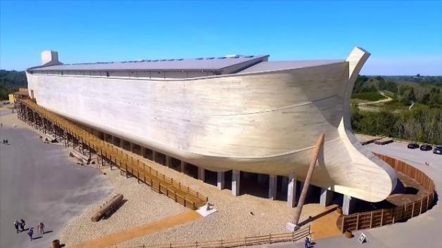
Dimensions of the Ark? (Genesis 6:15)
Ark = 450ft long, 75ft wide, 45 feet high
Ark capable of holding 125,000 animals

Slide 42
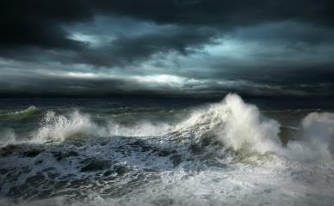
Dimensions of the Ark
Biblical flood account
Pagan flood accounts (300)
Similarities and differences

Slide 43
Hugh Ross
The Genesis Question (Navpress, Colorado Springs, CO 1998), 164-65.
“First, when God pours out judgment, He gives ample warning ahead of time. He sends a spokesperson, a prophet, and gives that prophet a kind of platform from which to be heard. For the antediluvians, Noah was that prophet and the scaffolding around the ark was his platform.”

Slide 44
Biblical vs. Babylonian Flood Account
ITEM | GENESIS | GILGAMESH EPIC
Flood planned | God | Council
View of God | Monotheism | Polytheism
Revelation to a hero | God warned Noah | Ea warned Utnapishtim
Reason | Sin | Noise
Punishment | Ethics | Ambiguous, regretted
Salvation of hero | Included in God’s plan | Done secretly
Lives saved | 8 | Reps of all living things
Boat | 300x50x30 cubits-3 levels | 120x120x120 cubits-7 levels
Duration | 40 days, 40 nights | 6 days, 6 nights
Landing | Mountains of Ararat | Mount Nisir
Birds | Raven, dove (3x) | Dove, swallow, raven
Sacrifice | Worship | Appeasement
Blessing | Covenant | Divinity, immortality

Slide 45
Biblical vs. Babylonian Creation Account
GENESIS | ENUMA ELISH
Purpose: praise God | Purpose: praise Marduk
Starts with the deep | Starts with the deep
Sequence of days | No sequence of days
Ex nihlo (by speech) | Creation from formerly existing matter
Waters divided above & below firmament | Waters divided above and below corpse of Tiamat
Man to rule creation | Man created to ease the God’s work load
Man created from the soil | Man created from a slain super hero
Comparisons/contrasts taken from Walton, Chronological and Background charts of the OT, 80-81.

Slide 46
Explanation of Similarities & Differences Between the Biblical and Pagan Flood Accounts
The pagans accounts (Babylonian creation – Enuma Elish & flood – Gilgamesh) borrowed from the Bible? – Unlikely since some pagan accounts (1800 B.C.) precede the time when Gen. was written (1446 B.C.)
The Bible borrowed from the pagan accounts? – A possibility

Slide 47
Explanation of Similarities & Differences Between the Biblical and Pagan Flood Accounts
Common source
Historical event
Noahic Bible
Toledoth
Spreading knowledge of historical event into all early cultures
Paganism’s adjustment (monotheism, sin, ethics)-Rom. 1:18-32
God’s readjustment-correction through Moses

Slide 48
Dr. Arnold G. Fruchtenbaum
The Book of Genesis Record, 142
“The eleventh observation is connected with archeology. There are two kings’ lists from archeology that reflect what is happening in this chapter. The first is the Sumerian King List from Sumer in Mesopotamia, dating from about the year 2000 b.c. It lists a total of ten kings, with a total of 241,200 years. That is an average of about 24,000 years per king. Therefore, the concept of longevity of ten generations is something reflected in the Sumerian King List.”

Slide 49
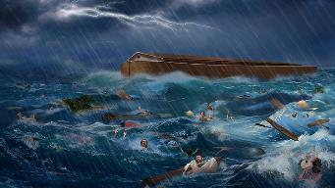
Dr. Arnold G. Fruchtenbaum
The Book of Genesis Record, 142
“It is also interesting that after the list of the ten kings, it then adds, ‘and then the flood came.’ The flood came with the tenth, just as it is in this Genesis 5 passage. The second is the Berussos King List. Berussos was a Babylonian priest of the third century b.c., and he also lists ten kings before the flood.”

Slide 50
Biblical vs. Babylonian Flood Account
ITEM | GENESIS | GILGAMESH EPIC
Flood planned | God | Council
View of God | Monotheism | Polytheism
Revelation to a hero | God warned Noah | Ea warned Utnapishtim
Reason | Sin | Noise
Punishment | Ethics | Ambiguous, regretted
Salvation of hero | Included in God’s plan | Done secretly
Lives saved | 8 | Reps of all living things
Boat | 300x50x30 cubits-3 levels | 120x120x120 cubits-7 levels
Duration | 40 days, 40 nights | 6 days, 6 nights
Landing | Mountains of Ararat | Mount Nisir
Birds | Raven, dove (3x) | Dove, swallow, raven
Sacrifice | Worship | Appeasement
Blessing | Covenant | Divinity, immortality

Slide 51
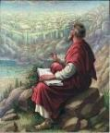
John 20:30-31
“³⁰ Therefore many other signs Jesus also performed in the presence of the disciples, which are not written in this book; ³¹ but these have been written so that you may believe that Jesus is the Christ, the Son of God; and that believing you may have life in His name.”

Slide 53
7 “I AM” statements in John
I am the Bread of Life | 6:35
I am the Light of the world | 8:12
I am the Gate for the sheep | 10:7; cf. v.9
I am the Good Shepherd | 10:11,14
I am the Resurrection and the Life | 11:25
I am the Way and the Truth and the Life | 14:6
I am the true Vine | 15:1; cf. v.5

Slide 54
IV. God’s Instruction (Gen 6:14-22)
The structure (6:14-16)
The reason (6:17-18)
The animals (6:19-20)
The food (6:21)
The obedience (6:22)

Slide 55
Noahic vs. Abrahamic & Mosaic Covenants
Name | NOAHIC | ABRAHAMIC | MOSAIC
Human agent | Noah | Abraham | Moses
Scripture | Gen. 8‒9 | Gen. 12‒17 | Exod. 19‒40
Covenant (Berith) | Gen. 9:9 | Gen. 15:18 | Exod. 19:5
Party | World, humanity | Israel, Hebrews | Israel, Hebrews
Israel | Pre-Israel | Post-Israel | Post-Israel

Slide 56
Noahic vs. Abrahamic & Mosaic Covenants
Covenant | NOAHIC | ABRAHAMIC | MOSAIC
Conditional or unconditional | Unconditional | Unconditional | Conditional
Promises | No more flood judgment, enduring earth, capital punishment | Ownership of land, seed, and blessing | Enjoyment or possession of land, seed, and blessing
Sign | Rainbow | Circumcision | Sabbath
Purpose | Restrain & preserve | Redemptive | Redemptive
Directly binding today? | Yes | No | No

Slide 57
Biblical vs. Babylonian Flood Account
ITEM | GENESIS | GILGAMESH EPIC
Flood planned | God | Council
View of God | Monotheism | Polytheism
Revelation to a hero | God warned Noah | Ea warned Utnapishtim
Reason | Sin | Noise
Punishment | Ethics | Ambiguous, regretted
Salvation of hero | Included in God’s plan | Done secretly
Lives saved | 8 | Reps of all living things
Boat | 300x50x30 cubits-3 levels | 120x120x120 cubits-7 levels
Duration | 40 days, 40 nights | 6 days, 6 nights
Landing | Mountains of Ararat | Mount Nisir
Birds | Raven, dove (3x) | Dove, swallow, raven
Sacrifice | Worship | Appeasement
Blessing | Covenant | Divinity, immortality

Slide 58
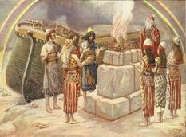
Genesis 8:21
The Lord smelled the soothing aroma; and the Lord said to Himself, “I will never again curse the ground on account of man, for the intent of man’s heart is evil from his youth; and I will never again destroy every living thing, as I have done.[emphasis mine].

Slide 59
Genesis 3:15
“And I will put enmity Between you and the woman, And between your seed and her seed; He shall bruise you on the head, And you shall bruise him on the heel.”

Slide 60
IV. God’s Instruction (Gen 6:14-22)
The structure (6:14-16)
The reason (6:17-18)
The animals (6:19-20)
The food (6:21)
The obedience (6:22)

Slide 61
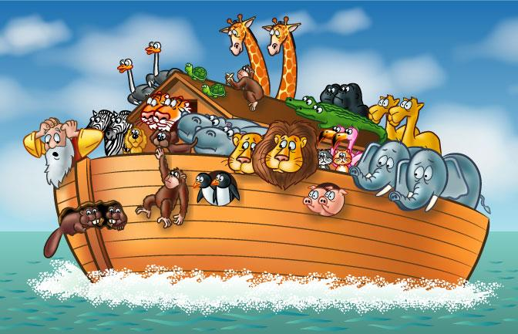

Slide 62
How Did Noah Fit All of the Animals on to the Ark? (John 3:12)
No
Sea creatures (6:20)
Insects (7:22)
Plants (6:20)
Woodmoorape, Noah’s Ark: A Feasibility Study

Slide 63
How Did Noah Fit All of the Animals on to the Ark? (John 3:12)
Limitations
Seven pairs or just sevens? (7:2)
Only clean animals (7:2; Lev 11; Deut 14)
Kind (6:20)
Extinct animals overstated
Not fully grown
Hybernation

Slide 64
How Did Noah Fit All of the Animals on to the Ark? (John 3:12)
16,000 animals
Ark = 450ft long, 75ft wide, 45 feet high
Ark capable of holding 125,000 animals

Slide 65
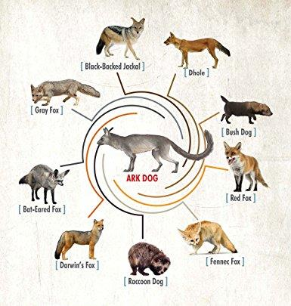

Slide 66
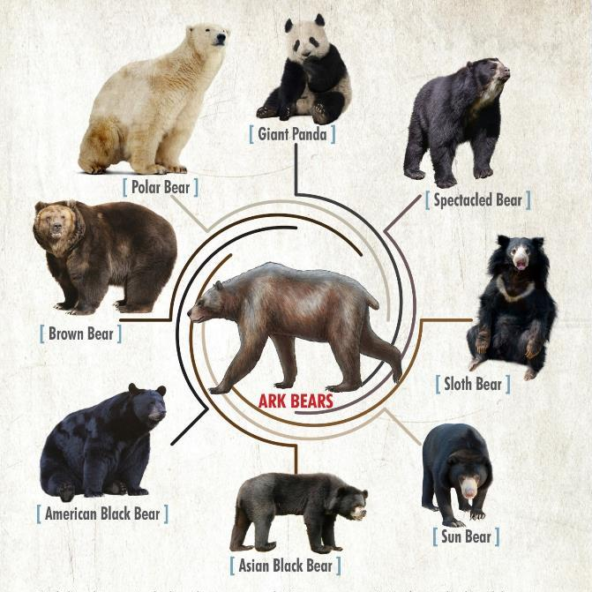

Slide 67
IV. God’s Instruction (Gen 6:14-22)
The structure (6:14-16)
The reason (6:17-18)
The animals (6:19-20)
The food (6:21)
The obedience (6:22)

Slide 68
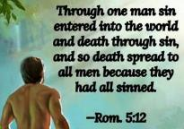
Genesis 1:29-30
“²⁹ Then God said, ‘Behold, I have given you every plant yielding seed that is on the surface of all the earth, and every tree which has fruit yielding seed; it shall be food for you; ³⁰ and to every beast of the earth and to every bird of the sky and to every thing that moves on the earth which has life, I have given every green plant for food’; and it was so.”

Slide 69
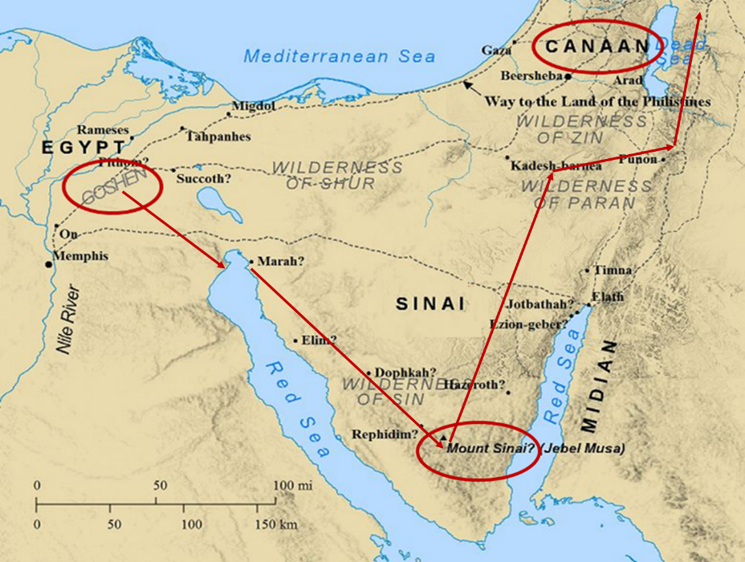

Slide 70
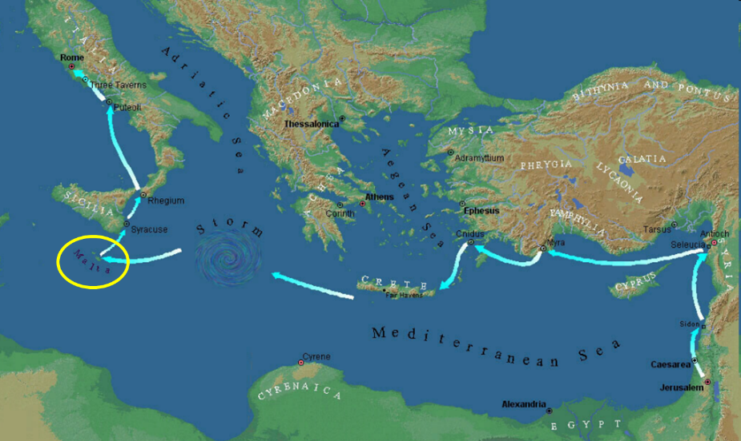

Slide 71
IV. God’s Instruction (Gen 6:14-22)
The structure (6:14-16)
The reason (6:17-18)
The animals (6:19-20)
The food (6:21)
The obedience (6:22)

Slide 72
Dimensions of the Ark? (Genesis 6:15)
Ark = 450ft long, 75ft wide, 45 feet high
Ark capable of holding 125,000 animals

Slide 73
Conclusion

Slide 74
GENESIS STRUCTURE
Genesis 1-11 (four events)
Creation (1-2)
Fall (3-5)
Flood (6-9)
National dispersion (10-11)

Slide 75
The Flood (Gen 6–9)
Events before the flood (Gen 6)
The flood (Gen 7)
The abating of the waters (Gen 8)
Events following the flood (Gen 9)

Slide 76
Genesis 6 Outline
God’s Grief (Gen 6:1-7)
God’s Grace (6:8-10)
God’s Destruction (6:11-13)
God’s Instruction (6:14-22)

Slide 77
“The Lord bless you and keep you; the Lord make his face shine on you and be gracious to you; the Lord turn his face toward you and give you peace.” (NIV)

