Slide 1
Genesis 6‒9
The Flood and Continuation of the Messianic Promise

Slide 2
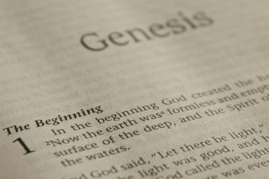
GENESIS STRUCTURE
Beginning of the Human race (Gen. 1‒11)
Beginning of the Hebrew race (Gen. 12‒50)

Slide 3
GENESIS STRUCTURE
Genesis 1-11 (four events)
Creation (1-2)
Fall (3-5)
Flood (6-9)
National dispersion (10-11)

Slide 4
GENESIS STRUCTURE
Genesis 1-11 (four events)
Creation (1-2)
Fall (3-5)
Flood (6-9)
National dispersion (10-11)

Slide 5
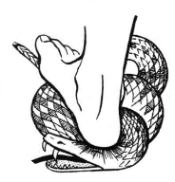
Genesis 3:15
“And I will put enmity Between you and the woman, And between your seed and her seed; He shall bruise you on the head, And you shall bruise him on the heel.”

Slide 6
GENESIS STRUCTURE
Genesis 1-11 (four events)
Creation (1-2)
Fall (3-5)
Flood (6-9)
National dispersion (10-11)

Slide 7
The Flood (Gen 6–9)
Events before the flood (Gen 6)
The flood (Gen 7)
The abating of the waters (Gen 8)
Events following the flood (Gen 9)

Slide 8
Genesis 6 Outline
God’s Grief (Gen 6:1-7)
God’s Grace (6:8-10)
God’s Destruction (6:11-13)
God’s Instruction (6:14-22)

Slide 9
I. God’s Grief (Gen 6:1-7)
The specific sin (6:1-4)
The general sin (6:5)
God’s sorrow (6:6-7)

Slide 10
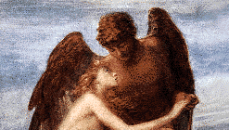
A. The Specific Sin (6:1-4)
Population – Gen. 6:1
Procreation – Gen. 6:2
Patience – Gen. 6:3
Product – Gen. 6:4

Slide 11
I. God’s Grief (Gen 6:1-7)
The specific sin (6:1-4)
The general sin (6:5)
God’s sorrow (6:6-7)

Slide 12
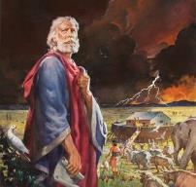
Genesis 6:5
“Then the Lord saw that the wickedness of mankind was great on the earth, and that every intent of the thoughts of their hearts was only evil continually.”

Slide 13
Genesis 6:5
“Then the Lord saw that the wickedness of mankind was great on the earth, and that every intent of the thoughts of their hearts was only evil continually.”

Slide 14
Total Depravity
What total depravity is not:
Man is as evil as he can possibly be & indulges every possible sin
Man is incapable of doing good things
Gen. 3:22
Matt. 7:11
Acts 10:1-2
Rom. 2:14-15

Slide 15
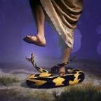
Genesis 3:22
“Then the Lord God said, ‘Behold, the man has become like one of Us, knowing good and evil; and now, he might stretch out his hand, and take also from the tree of life, and eat, and live forever’—.”

Slide 16
Matthew 7:11
“If you then, being evil, know how to give good gifts to your children, how much more will your Father who is in heaven give what is good to those who ask Him!”

Slide 17
Romans 2:14-15
“¹⁴ For when Gentiles who do not have the Law do instinctively the things of the Law, these, not having the Law, are a law to themselves, ¹⁵ in that they show the work of the Law written in their hearts, their conscience bearing witness and their thoughts alternately accusing or else defending them.”

Slide 18
Henry Clarence Thiessen
Lectures in Systematic Theology, rev. ed. (Grand Rapids: Eerdmans, 1979), 191.
“The Scriptures speak of human nature as totally depraved. However, the doctrine of ‘total depravity’ is easily misunderstood and misinterpreted. From the negative standpoint, it is important to know both what it does not mean and what it does mean. This does not mean that every sinner is devoid of all qualities pleasing to men; that he commits, or is prone to every form of sin; or that he is bitterly opposed to God as it is possible for him to be. Jesus recognize the existence of pleasing qualities in some individuals (Mark 10:21); He said that the scribes and Pharisees did some things God demanded (Matt. 23:23); Paul asserted that some Gentiles ‘do instinctively the things of the law’ (Rom. 2:14); God told Abraham that the iniquity of the Amorites would grow worse (Gen. 15:16); and Paul says that ‘evil men and imposters will proceed from bad to worse’ (2 Tim. 3:13).”

Slide 19
Total Depravity
What total depravity is:
Every area of man’s being is touched by sin
Intellect (Prov. 3:5-6; 14:12; 2 Cor. 4:4; Rom. 3:11a)
Conscience (1 Tim 4:2)
Will (Rom 1:28; 3:11b)
Deeds (Rom. 3:12)
Speech (Rom. 3:13-14)
Feet (Rom. 3:15)

Slide 20
Total Depravity
What total depravity is:
Every area of man’s being is touched by sin (cont’d)
Heart (Mark 7:21; Eph 4:18)
Body (Gen 3:19; Rom. 8:23)
Total being (Rom 1:18–3:20)
Man is incapable of earning merit favor from God (Isa 64:6; Eph. 2:8-9)

Slide 21
I. God’s Grief (Gen 6:1-7)
The specific sin (6:1-4)
The general sin (6:5)
God’s sorrow (6:6-7)

Slide 22
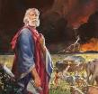
Genesis 6:6-7
“⁶ So the Lord was sorry that He had made mankind on the earth, and He was grieved in His heart. ⁷ Then the Lord said, ‘I will wipe out mankind whom I have created from the face of the land; mankind, and animals as well, and crawling things, and the birds of the sky. For I am sorry that I have made them.’”

Slide 23
Genesis 6:6-7
“⁶ So the Lord was sorry that He had made mankind on the earth, and He was grieved in His heart. ⁷ Then the Lord said, ‘I will wipe out mankind whom I have created from the face of the land; mankind, and animals as well, and crawling things, and the birds of the sky. For I am sorry that I have made them.’”

Slide 24
Genesis 6 Outline
God’s Grief (Gen 6:1-7)
God’s Grace (6:8-10)
God’s Destruction (6:11-13)
God’s Instruction (6:14-22)

Slide 25
II. God’s Grace (Gen 6:8-10)
The object (6:8)
The results (6:9)
The descendants (6:10)

Slide 26
II. God’s Grace (Gen 6:8-10)
The object (6:8)
The results (6:9)
The descendants (6:10)

Slide 27
Genesis 6:8-9
“ ⁸ But Noah found favor in the eyes of the Lord. ⁹ These are the records of the generations of Noah. Noah was a righteous man, blameless in his time; Noah walked with God.”

Slide 28
Genesis 6:8-9 (NKJV)
“⁸ But Noah found grace in the eyes of the Lord. ⁹ This is the genealogy of Noah. Noah was a just man, perfect in his generations. Noah walked with God.”

Slide 29
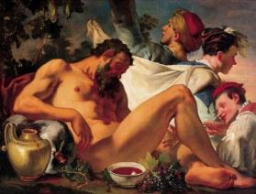
Genesis 9:20-21
“²⁰ Then Noah began farming and planted a vineyard. ²¹ He drank of the wine and became drunk, and uncovered himself inside his tent.”

Slide 30
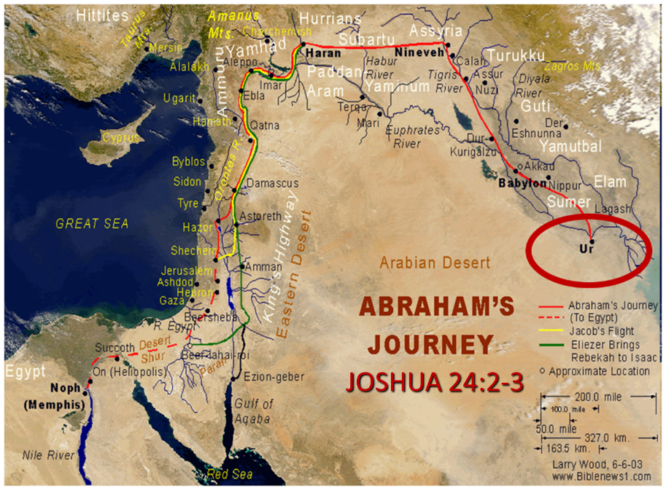

Slide 31
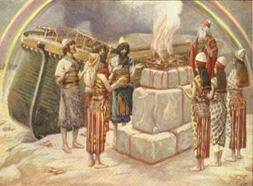
Romans 3:23
“for all have sinned and fall short of the glory of God.”

Slide 32
II. God’s Grace (Gen 6:8-10)
The object (6:8)
The results (6:9)
The descendants (6:10)

Slide 33
Genesis 6:8-9
“ ⁸ But Noah found favor in the eyes of the Lord. ⁹ These are the records of the generations of Noah. Noah was a righteous man, blameless in his time; Noah walked with God.”

Slide 34
Genesis 6:8-9
“ ⁸ But Noah found favor in the eyes of the Lord. ⁹ These are the records of the generations of Noah. Noah was a righteous man, blameless in his time; Noah walked with God.”

Slide 35
Matt. 7:21-23
²¹ “Not everyone who says to Me, ‘Lord, Lord,’ will enter the kingdom of heaven, but he who does the will of My Father who is in heaven will enter. ²² Many will say to Me on that day, ‘Lord, Lord, did we not prophesy in Your name, and in Your name cast out demons, and in Your name perform many miracles?’ ²³ And then I will declare to them, ‘I never knew you; depart from Me, you who practice lawlessness.’”

Slide 36
Genesis 6:8-9
“ ⁸ But Noah found favor in the eyes of the Lord. ⁹ These are the records of the generations of Noah. Noah was a righteous man, blameless in his time; Noah walked with God.”

Slide 37
Genesis 6:8-9
“ ⁸ But Noah found favor in the eyes of the Lord. ⁹ These are the records of the generations of Noah. Noah was a righteous man, blameless in his time; Noah walked with God.”

Slide 38
Genesis 9:20-21
“²⁰ Then Noah began farming and planted a vineyard. ²¹ He drank of the wine and became drunk, and uncovered himself inside his tent.”

Slide 39
Romans 3:23
“for all have sinned and fall short of the glory of God.”

Slide 40
Genesis 6:8-9
“ ⁸ But Noah found favor in the eyes of the Lord. ⁹ These are the records of the generations of Noah. Noah was a righteous man, blameless in his time; Noah walked with God.”

Slide 41
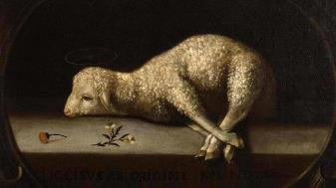
Exodus 12:5
“Your lamb shall be an unblemished male a year old; you may take it from the sheep or from the goats.”

Slide 42
Genesis 3:15
“And I will put enmity Between you and the woman, And between your seed and her seed; He shall bruise you on the head, And you shall bruise him on the heel.”

Slide 43
A. The Specific Sin (6:1-4)
Population – Gen. 6:1
Procreation – Gen. 6:2
Patience – Gen. 6:3
Product – Gen. 6:4

Slide 44
Noah Spared
Genesis 3:15
Genesis 5:1 (Adam) to Genesis 5:32 (Noah)
Genesis 6:9
Genesis 7:1

Slide 45
Genesis 6:8-9
“ ⁸ But Noah found favor in the eyes of the Lord. ⁹ These are the records of the generations of Noah. Noah was a righteous man, blameless in his time; Noah walked with God.”

Slide 46
Toledoth “And These Are the Generations of…”
Introduction to the generations (1:1–2:3)
Generations of the heaven and earth (2:4–4:26)
Generations of Adam (5:1–6:8)
Generations of Noah (6:9–9:29)
Generations of the sons of Noah (10:1–11:9)
Generations of Shem (11:10–26)
Generations of Terah (11:27–25:11)
Generations of Ishmael (25:12-18)
Generations of Isaac (25:19–35:29)
Generations of Esau (36:1–37:1)
Generations of Jacob (37:2–50:26)

Slide 47
Toledoth “And These Are the Generations of…”
Introduction to the generations (1:1–2:3)
Generations of the heaven and earth (2:4–4:26)
Generations of Adam (5:1–6:8)
Generations of Noah (6:9–9:29)
Generations of the sons of Noah (10:1–11:9)
Generations of Shem (11:10–26)
Generations of Terah (11:27–25:11)
Generations of Ishmael (25:12-18)
Generations of Isaac (25:19–35:29)
Generations of Esau (36:1–37:1)
Generations of Jacob (37:2–50:26)

Slide 49
Luke 1:1-4
“¹ Since many have undertaken to compile an account of the things accomplished among us, ² just as they were handed down to us by those who from the beginning were eyewitnesses and servants of the word, ³ it seemed fitting to me as well, having investigated everything carefully from the beginning, to write it out for you in an orderly sequence, most excellent Theophilus; ⁴ so that you may know the exact truth about the things you have been taught.”

Slide 50
II. God’s Grace (Gen 6:8-10)
The object (6:8)
The results (6:9)
The descendants (6:10)

Slide 51
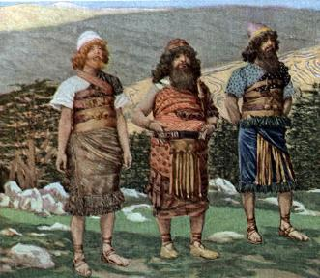
Genesis 6:10
“And Noah begot three sons: Shem, Ham, and Japheth.”

Slide 52
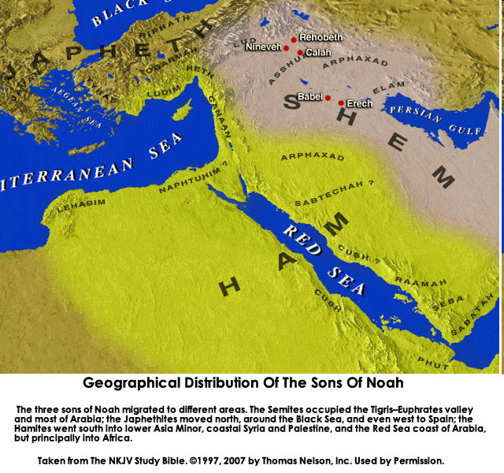

Slide 53
Genesis 6 Outline
God’s Grief (Gen 6:1-7)
God’s Grace (6:8-10)
God’s Destruction (6:11-13)
God’s Instruction (6:14-22)

Slide 54
III. God’s Destruction (Gen 6:11-13)
The sin (6:11-12)
The prediction (6:13)

Slide 55
III. God’s Destruction (Gen 6:11-13)
The sin (6:11-12)
The prediction (6:13)

Slide 56
Genesis 6:11-13
“¹¹ Now the earth was corrupt in the sight of God, and the earth was filled with violence. ¹² And God looked on the earth, and behold, it was corrupt; for humanity had corrupted its way upon the earth. ¹³ Then God said to Noah, ‘The end of humanity has come before Me; for the earth is filled with violence because of people; and behold, I am about to destroy them with the earth.’”

Slide 57
Genesis 6:11-13
“¹¹ Now the earth was corrupt in the sight of God, and the earth was filled with violence. ¹² And God looked on the earth, and behold, it was corrupt; for humanity had corrupted its way upon the earth. ¹³ Then God said to Noah, ‘The end of humanity has come before Me; for the earth is filled with violence because of people; and behold, I am about to destroy them with the earth.’”

Slide 58
Genesis 6:11-13
“¹¹ Now the earth was corrupt in the sight of God, and the earth was filled with violence. ¹² And God looked on the earth, and behold, it was corrupt; for humanity had corrupted its way upon the earth. ¹³ Then God said to Noah, ‘The end of humanity has come before Me; for the earth is filled with violence because of people; and behold, I am about to destroy them with the earth.’”

Slide 59
Genesis 1:1-3
“¹ In the beginning God created the heavens and the earth. ² The earth was formless and void, and darkness was over the surface of the deep, and the Spirit of God was moving over the surface of the waters. ³ Then God said, ‘Let there be light’; and there was light.”

Slide 60
Genesis 6:11-13
“¹¹ Now the earth was corrupt in the sight of God, and the earth was filled with violence. ¹² And God looked on the earth, and behold, it was corrupt; for humanity had corrupted its way upon the earth. ¹³ Then God said to Noah, ‘The end of humanity has come before Me; for the earth is filled with violence because of people; and behold, I am about to destroy them with the earth.’”

Slide 61
III. God’s Destruction (Gen 6:11-13)
The sin (6:11-12)
The prediction (6:13)

Slide 62
Genesis 6:11-13
“¹¹ Now the earth was corrupt in the sight of God, and the earth was filled with violence. ¹² And God looked on the earth, and behold, it was corrupt; for humanity had corrupted its way upon the earth. ¹³ Then God said to Noah, ‘The end of humanity has come before Me; for the earth is filled with violence because of people; and behold, I am about to destroy them with the earth.’”

Slide 63
John 13:19; 14:29
“¹⁹ From now on I am telling you before it comes to pass, so that when it does occur, you may believe that I am He… ^{14:29} Now I have told you before it happens, so that when it happens, you may believe.”

Slide 64
Christ’s Short-Term Predictions
PROPHECY | SCRIPTURE
Betrayal by a Friend | John 13:21
Three-fold Denial by Peter | Matthew 26:34, 75
Manner of His Own Death | Matthew 20:18-19
Manner of Disciples’ Deaths | John 21:18-22
AD 70 Events | Luke 19:41-44

Slide 65
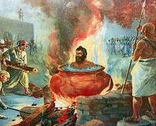
Tertullian Prescription Against Heretics, 36
“…where the Apostle John was first plunged, unhurt, into boiling oil, and thence remitted to his island-exile!”

Slide 66
Genesis 6:11-13
“¹¹ Now the earth was corrupt in the sight of God, and the earth was filled with violence. ¹² And God looked on the earth, and behold, it was corrupt; for humanity had corrupted its way upon the earth. ¹³ Then God said to Noah, ‘The end of humanity has come before Me; for the earth is filled with violence because of people; and behold, I am about to destroy them with the earth.’”

Slide 67
Genesis 4 Outline
First murder (Gen 4:1-15)
Ungodly line of Cain (4:16-24)
Godly line of Seth (4:25-26)

Slide 68
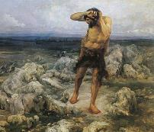
Ungodly Line of Cain (Gen 4:16-24)
Evil line that will not bring forth the Messiah (Gen 3:15)
Continuation of Cain’s line (4:16-18)
Immorality (4:19)
Technological but not spiritual advancement (4:20-22)
Violence (4:23-24)

Slide 69
Genesis 1:26-28
²⁶ Then God said, “Let Us make man in Our image, according to Our likeness; and let them rule over the fish of the sea and over the birds of the sky and over the cattle and over all the earth, and over every creeping thing that creeps on the earth.” ²⁷ God created man in His own image, in the image of God He created him; male and female He created them. ²⁸ God blessed them; and God said to them, “Be fruitful and multiply, and fill the earth, and subdue it; and rule over the fish of the sea and over the birds of the sky and over every living thing that moves on the earth.”

Slide 70
Genesis 9:6
“Whoever sheds man’s blood, By man his blood shall be shed, For in the image of God He made man.”

Slide 71
Revelation 9:20-21
“The rest of mankind, who were not killed by these plagues, did not repent of the works of their hands, so as not to worship demons, and the idols of gold and of silver and of brass and of stone and of wood, which can neither see nor hear nor walk; ²¹ and they did not repent of their murders nor of their sorceries (pharmakeia) nor of their immorality nor of their thefts.”

Slide 72
Genesis 6 Outline
God’s Grief (Gen 6:1-7)
God’s Grace (6:8-10)
God’s Destruction (6:11-13)
God’s Instruction (6:14-22)

Slide 73
IV. God’s Instruction (Gen 6:14-22)
The structure (6:14-16)
The reason (6:17-18)
The animals (6:19-20)
The food (6:21)
The obedience (6:22)

Slide 74
IV. God’s Instruction (Gen 6:14-22)
The structure (6:14-16)
The reason (6:17-18)
The animals (6:19-20)
The food (6:21)
The obedience (6:22)

Slide 75
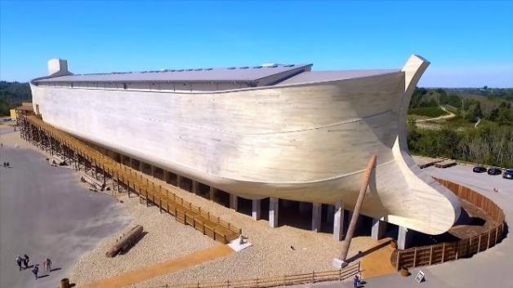
Dimensions of the Ark? (Genesis 6:15)
Ark = 450ft long, 75ft wide, 45 feet high
Ark capable of holding 125,000 animals

Slide 76
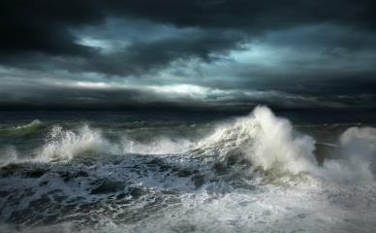
Dimensions of the Ark
Biblical flood account
Pagan flood accounts (300)
Similarities and differences

Slide 77
Hugh Ross
The Genesis Question (Navpress, Colorado Springs, CO 1998), 164-65.
“First, when God pours out judgment, He gives ample warning ahead of time. He sends a spokesperson, a prophet, and gives that prophet a kind of platform from which to be heard. For the antediluvians, Noah was that prophet and the scaffolding around the ark was his platform.”

Slide 78
Biblical vs. Babylonian Flood Account
ITEM | GENESIS | GILGAMESH EPIC
Flood planned | God | Council
View of God | Monotheism | Polytheism
Revelation to a hero | God warned Noah | Ea warned Utnapishtim
Reason | Sin | Noise
Punishment | Ethics | Ambiguous, regretted
Salvation of hero | Included in God’s plan | Done secretly
Lives saved | 8 | Reps of all living things
Boat | 300x50x30 cubits-3 levels | 120x120x120 cubits-7 levels
Duration | 40 days, 40 nights | 6 days, 6 nights
Landing | Mountains of Ararat | Mount Nisir
Birds | Raven, dove (3x) | Dove, swallow, raven
Sacrifice | Worship | Appeasement
Blessing | Covenant | Divinity, immortality

Slide 79
Biblical vs. Babylonian Creation Account
GENESIS | ENUMA ELISH
Purpose: praise God | Purpose: praise Marduk
Starts with the deep | Starts with the deep
Sequence of days | No sequence of days
Ex nihlo (by speech) | Creation from formerly existing matter
Waters divided above & below firmament | Waters divided above and below corpse of Tiamat
Man to rule creation | Man created to ease the God’s work load
Man created from the soil | Man created from a slain super hero
Comparisons/contrasts taken from Walton, Chronological and Background charts of the OT, 80-81.

Slide 80
Explanation of Similarities & Differences Between the Biblical and Pagan Flood Accounts
The pagans accounts (Babylonian creation – Enuma Elish & flood – Gilgamesh) borrowed from the Bible? – Unlikely since some pagan accounts (1800 B.C.) precede the time when Gen. was written (1446 B.C.)
The Bible borrowed from the pagan accounts? – A possibility

Slide 81
Explanation of Similarities & Differences Between the Biblical and Pagan Flood Accounts
Common source
Historical event
Noahic Bible
Toledoth
Spreading knowledge of historical event into all early cultures
Paganism’s adjustment (monotheism, sin, ethics)-Rom. 1:18-32
God’s readjustment-correction through Moses

Slide 82
Dr. Arnold G. Fruchtenbaum
The Book of Genesis Record, 142
“The eleventh observation is connected with archeology. There are two kings’ lists from archeology that reflect what is happening in this chapter. The first is the Sumerian King List from Sumer in Mesopotamia, dating from about the year 2000 b.c. It lists a total of ten kings, with a total of 241,200 years. That is an average of about 24,000 years per king. Therefore, the concept of longevity of ten generations is something reflected in the Sumerian King List.”

Slide 83
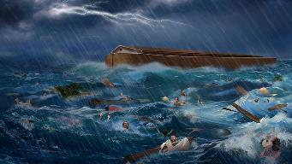
Dr. Arnold G. Fruchtenbaum
The Book of Genesis Record, 142
“It is also interesting that after the list of the ten kings, it then adds, ‘and then the flood came.’ The flood came with the tenth, just as it is in this Genesis 5 passage. The second is the Berussos King List. Berussos was a Babylonian priest of the third century b.c., and he also lists ten kings before the flood.”

Slide 84
Biblical vs. Babylonian Flood Account
ITEM | GENESIS | GILGAMESH EPIC
Flood planned | God | Council
View of God | Monotheism | Polytheism
Revelation to a hero | God warned Noah | Ea warned Utnapishtim
Reason | Sin | Noise
Punishment | Ethics | Ambiguous, regretted
Salvation of hero | Included in God’s plan | Done secretly
Lives saved | 8 | Reps of all living things
Boat | 300x50x30 cubits-3 levels | 120x120x120 cubits-7 levels
Duration | 40 days, 40 nights | 6 days, 6 nights
Landing | Mountains of Ararat | Mount Nisir
Birds | Raven, dove (3x) | Dove, swallow, raven
Sacrifice | Worship | Appeasement
Blessing | Covenant | Divinity, immortality

Slide 85
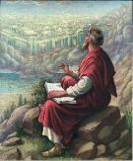
John 20:30-31
“³⁰ Therefore many other signs Jesus also performed in the presence of the disciples, which are not written in this book; ³¹ but these have been written so that you may believe that Jesus is the Christ, the Son of God; and that believing you may have life in His name.”

Slide 87
7 “I AM” statements in John
I am the Bread of Life | 6:35
I am the Light of the world | 8:12
I am the Gate for the sheep | 10:7; cf. v.9
I am the Good Shepherd | 10:11,14
I am the Resurrection and the Life | 11:25
I am the Way and the Truth and the Life | 14:6
I am the true Vine | 15:1; cf. v.5

Slide 88
IV. God’s Instruction (Gen 6:14-22)
The structure (6:14-16)
The reason (6:17-18)
The animals (6:19-20)
The food (6:21)
The obedience (6:22)

Slide 89
Noahic vs. Abrahamic & Mosaic Covenants
Name | NOAHIC | ABRAHAMIC | MOSAIC
Human agent | Noah | Abraham | Moses
Scripture | Gen. 8‒9 | Gen. 12‒17 | Exod. 19‒40
Covenant (Berith) | Gen. 9:9 | Gen. 15:18 | Exod. 19:5
Party | World, humanity | Israel, Hebrews | Israel, Hebrews
Israel | Pre-Israel | Post-Israel | Post-Israel

Slide 90
Noahic vs. Abrahamic & Mosaic Covenants
Covenant | NOAHIC | ABRAHAMIC | MOSAIC
Conditional or unconditional | Unconditional | Unconditional | Conditional
Promises | No more flood judgment, enduring earth, capital punishment | Ownership of land, seed, and blessing | Enjoyment or possession of land, seed, and blessing
Sign | Rainbow | Circumcision | Sabbath
Purpose | Restrain & preserve | Redemptive | Redemptive
Directly binding today? | Yes | No | No

Slide 91
Biblical vs. Babylonian Flood Account
ITEM | GENESIS | GILGAMESH EPIC
Flood planned | God | Council
View of God | Monotheism | Polytheism
Revelation to a hero | God warned Noah | Ea warned Utnapishtim
Reason | Sin | Noise
Punishment | Ethics | Ambiguous, regretted
Salvation of hero | Included in God’s plan | Done secretly
Lives saved | 8 | Reps of all living things
Boat | 300x50x30 cubits-3 levels | 120x120x120 cubits-7 levels
Duration | 40 days, 40 nights | 6 days, 6 nights
Landing | Mountains of Ararat | Mount Nisir
Birds | Raven, dove (3x) | Dove, swallow, raven
Sacrifice | Worship | Appeasement
Blessing | Covenant | Divinity, immortality

Slide 92
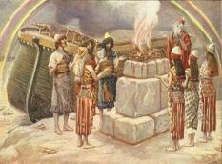
Genesis 8:21
The Lord smelled the soothing aroma; and the Lord said to Himself, “I will never again curse the ground on account of man, for the intent of man’s heart is evil from his youth; and I will never again destroy every living thing, as I have done.[emphasis mine].

Slide 93
Genesis 3:15
“And I will put enmity Between you and the woman, And between your seed and her seed; He shall bruise you on the head, And you shall bruise him on the heel.”

Slide 94
IV. God’s Instruction (Gen 6:14-22)
The structure (6:14-16)
The reason (6:17-18)
The animals (6:19-20)
The food (6:21)
The obedience (6:22)

Slide 95
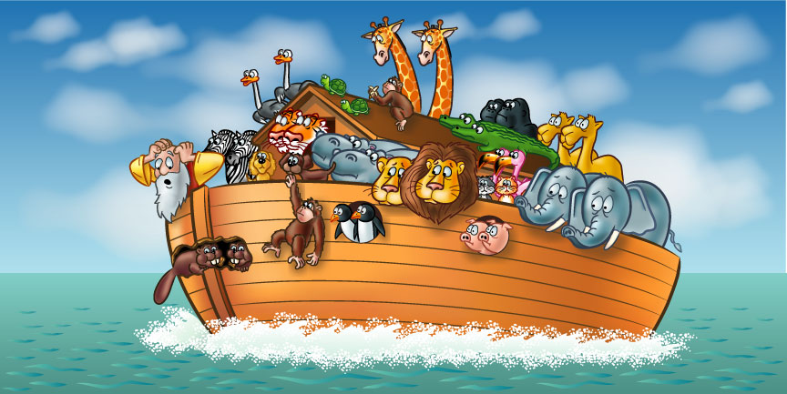

Slide 96
How Did Noah Fit All of the Animals on to the Ark? (John 3:12)
No
Sea creatures (6:20)
Insects (7:22)
Plants (6:20)
Woodmoorape, Noah’s Ark: A Feasibility Study

Slide 97
How Did Noah Fit All of the Animals on to the Ark? (John 3:12)
Limitations
Seven pairs or just sevens? (7:2)
Only clean animals (7:2; Lev 11; Deut 14)
Kind (6:20)
Extinct animals overstated
Not fully grown
Hybernation

Slide 98
How Did Noah Fit All of the Animals on to the Ark? (John 3:12)
16,000 animals
Ark = 450ft long, 75ft wide, 45 feet high
Ark capable of holding 125,000 animals

Slide 99
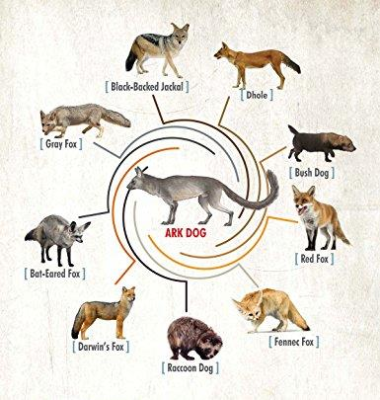

Slide 100
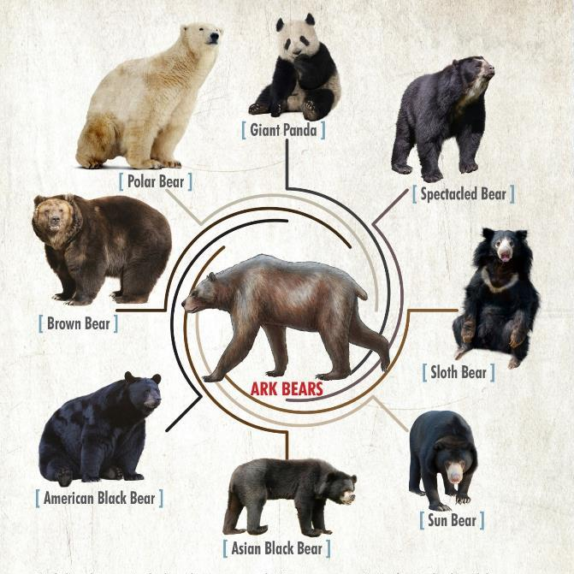

Slide 101
IV. God’s Instruction (Gen 6:14-22)
The structure (6:14-16)
The reason (6:17-18)
The animals (6:19-20)
The food (6:21)
The obedience (6:22)

Slide 102
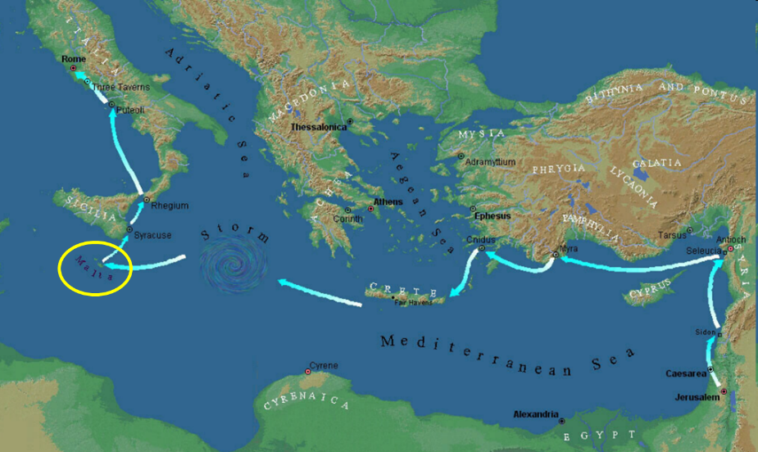

Slide 103
IV. God’s Instruction (Gen 6:14-22)
The structure (6:14-16)
The reason (6:17-18)
The animals (6:19-20)
The food (6:21)
The obedience (6:22)

Slide 104
Dimensions of the Ark? (Genesis 6:15)
Ark = 450ft long, 75ft wide, 45 feet high
Ark capable of holding 125,000 animals

Slide 105
Conclusion

Slide 106
GENESIS STRUCTURE
Genesis 1-11 (four events)
Creation (1-2)
Fall (3-5)
Flood (6-9)
National dispersion (10-11)

Slide 107
The Flood (Gen 6–9)
Events before the flood (Gen 6)
The flood (Gen 7)
The abating of the waters (Gen 8)
Events following the flood (Gen 9)

Slide 108
Genesis 6 Outline
God’s Grief (Gen 6:1-7)
God’s Grace (6:8-10)
God’s Destruction (6:11-13)
God’s Instruction (6:14-22)

Slide 109
“The Lord bless you and keep you; the Lord make his face shine on you and be gracious to you; the Lord turn his face toward you and give you peace.” (NIV)

