Slide 1
PRACTICAL RIGHTEOUSNESS
Dr. Andy Woods
Senior Pastor – Sugar Land Bible Church
President – Chafer Theological Seminary

Slide 2
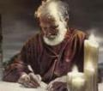
Answering Eleven Questions
Who wrote it? – James
What do we know about the author? – Christ’s ½ Brother
Who was the audience? – Believing Jews in the Diaspora
Where was if written from? – Jerusalem
When was the book written? – A.D. 44‒47
What was the book’s occasion? – Practical righteousness
What is the book’s purpose? – Achieving practical righteousness
What is the book about? – Practical righteousness
What is the book’s theme? – Daily living
What makes the book different? – Practicality
How is the book organized? – Faith and Wisdom

Slide 3
JAMES STRUCTURE
Faith (James 1:1‒3:12)
Wisdom (James 3:13‒5:20)

Slide 4
JAMES STRUCTURE
Faith (James 1:1‒3:12)
Wisdom (James 3:13‒5:20)

Slide 5
JAMES STRUCTURE
Faith (1:1–3:12)
Trials (1:2-18)
Obedience to the Word (1:19-27)
Favoritism (2:1-13)
Faith manifesting works (2:14-26)
Tongue (3:1-12)

Slide 6
JAMES STRUCTURE
Faith (1:1–3:12)
Trials (1:2-18)
Obedience to the Word (1:19-27)
Favoritism (2:1-13)
Faith manifesting works (2:14-26)
Tongue (3:1-12)

Slide 7
James 1:2-18
Trials – Jas 1:2-18
Rejoicing during trials – Jas 1:2-12
Command not to charge God with temptation – Jas 1:13-18

Slide 8
JAMES STRUCTURE
Faith (1:1–3:12)
Trials (1:2-18)
Obedience to the Word (1:19-27)
Favoritism (2:1-13)
Faith manifesting works (2:14-26)
Tongue (3:1-12)

Slide 9
Faith Obeys God (James 1:19-27)
Need for Slowness in Speaking & Anger (1:19-20)
Need for Obedience to God’s Word (1:21-25)
Need for True Religion (1:26-27)

Slide 10
JAMES STRUCTURE
Faith (1:1–3:12)
Trials (1:2-18)
Obedience to the Word (1:19-27)
Favoritism (2:1-13)
Faith manifesting works (2:14-26)
Tongue (3:1-12)

Slide 11
Favoritism (2:1-13)
Command: no favoritism (2:1)
Situation: favoritism in the assembly (2:2-3)
Reasoning: favoritism is contrary to God’s character & purposes (2:4-13)

Slide 12
JAMES STRUCTURE
Faith (1:1–3:12)
Trials (1:2-18)
Obedience to the Word (1:19-27)
Favoritism (2:1-13)
Faith manifesting works (2:14-26)
Tongue (3:1-12)

Slide 13
Faith Manifesting Works (2:14-26)
Thesis: works accompany useful faith (2:14)
Five illustrations (2:15-26)
Needy brother (2:15-17)
Demonic monotheist (2:18-19)
Abraham (2:20-24)
Rahab (2:25)
Lifeless corpse (2:26)

Slide 14
JAMES STRUCTURE
Faith (1:1–3:12)
Trials (1:2-18)
Obedience to the Word (1:19-27)
Favoritism (2:1-13)
Faith manifesting works (2:14-26)
Tongue (3:1-12)

Slide 15
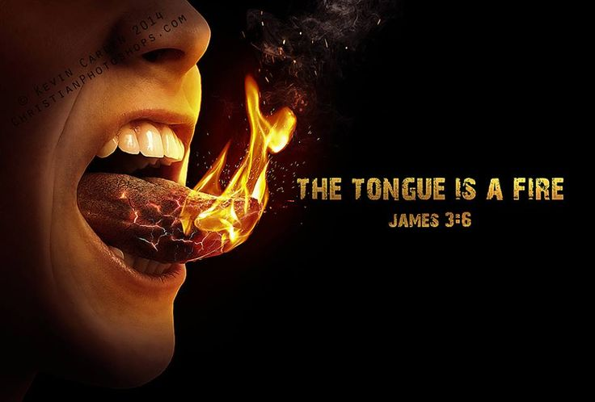
Taming the Tongue (3:1-12)
The Tongue’s Influence (3:1-5)
Teaching (1)
All of Life (2)
Illustrations (3-5)
The Tongue’s Evil Potential (3:6-12)
Satanic Potential (6)
Untamable (7-8)
Inconsistency (9-12)

Slide 16
Taming the Tongue (3:1-12)
The Tongue’s Influence (3:1-5)
Teaching (1)
All of Life (2)
Illustrations (3-5)
The Tongue’s Evil Potential (3:6-12)
Satanic Potential (6)
Untamable (7-8)
Inconsistency (9-12)

Slide 17
Taming the Tongue (3:1-12)
The Tongue’s Influence (3:1-5)
Teaching (1)
All of Life (2)
Illustrations (3-5)
The Tongue’s Evil Potential (3:6-12)
Satanic Potential (6)
Untamable (7-8)
Inconsistency (9-12)

Slide 18
Three Tenses of Salvation
Phase | Justification | Sanctification | Glorification
Tense | Past | Present | Future
Saved from sin’s: | Penalty | Power | Presence
Scripture | Eph 2:8-9; Titus 3:5 | Philip 2:12 | Rom 5:10
Nature | Single | Dual | Single

Slide 19
Taming the Tongue (3:1-12)
The Tongue’s Influence (3:1-5)
Teaching (1)
All of Life (2)
Illustrations (3-5)
The Tongue’s Evil Potential (3:6-12)
Satanic Potential (6)
Untamable (7-8)
Inconsistency (9-12)

Slide 20
Taming the Tongue (3:1-12)
The Tongue’s Influence (3:1-5)
Teaching (1)
All of Life (2)
Illustrations (3-5)
The Tongue’s Evil Potential (3:6-12)
Satanic Potential (6)
Untamable (7-8)
Inconsistency (9-12)

Slide 21
Illustrations (3:3-5)
Bit vs. the horse (3)
Rudder vs. the ship (4)
Spark vs. the fire (5)

Slide 22
Illustrations (3:3-5)
Bit vs. the horse (3)
Rudder vs. the ship (4)
Spark vs. the fire (5)

Slide 23
Illustrations (3:3-5)
Bit vs. the horse (3)
Rudder vs. the ship (4)
Spark vs. the fire (5)

Slide 24
Illustrations (3:3-5)
Bit vs. the horse (3)
Rudder vs. the ship (4)
Spark vs. the fire (5)

Slide 25
Taming the Tongue (3:1-12)
The Tongue’s Influence (3:1-5)
Teaching (1)
All of Life (2)
Illustrations (3-5)
The Tongue’s Evil Potential (3:6-12)
Satanic Potential (6)
Untamable (7-8)
Inconsistency (9-12)

Slide 26
Taming the Tongue (3:1-12)
The Tongue’s Influence (3:1-5)
Teaching (1)
All of Life (2)
Illustrations (3-5)
The Tongue’s Evil Potential (3:6-12)
Satanic Potential (6)
Untamable (7-8)
Inconsistency (9-12)

Slide 27
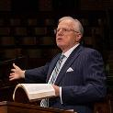
Erwin Lutzer
Hitler's Cross: How the Cross Was Used to Promote the Nazi Agenda (Chicago: Moody, 2016), 83.
“Earnest Pretzsche…introduced him [Hitler] to a psychedelic drug that produced clairvoyant visions and heightened spiritual perceptions. In this way he was empowered to perform the deeds that he believed fate had decreed. Even those who knew Hitler from his early days were well aware of his occult powers. August Kubizek, a friend, said, ‘It was as if another being spoke out of his body.… It was not a case of a speaker carried away by his own words…I felt as though he himself listened with astonishment and emotion to what broke forth from him.’”

Slide 28
Taming the Tongue (3:1-12)
The Tongue’s Influence (3:1-5)
Teaching (1)
All of Life (2)
Illustrations (3-5)
The Tongue’s Evil Potential (3:6-12)
Satanic Potential (6)
Untamable (7-8)
Inconsistency (9-12)

Slide 29
Untamable (3:7-8)
What man can tame (7)
What man cannot tame (8)

Slide 30
Untamable (3:7-8)
What man can tame (7)
What man cannot tame (8)

Slide 31
Untamable (3:7-8)
What man can tame (7)
What man cannot tame (8)

Slide 32
Taming the Tongue (3:1-12)
The Tongue’s Influence (3:1-5)
Teaching (1)
All of Life (2)
Illustrations (3-5)
The Tongue’s Evil Potential (3:6-12)
Satanic Potential (6)
Untamable (7-8)
Inconsistency (9-12)

Slide 33
Inconsistency (3:9-12)
Praises God & Curses Man (9-10)
Three Illustrations (11-12)
Fresh & bitter water (11)
Olives from a fig tree (12a)
Salt water from fresh water (12b)

Slide 34
Inconsistency (3:9-12)
Praises God & Curses Man (9-10)
Three Illustrations (11-12)
Fresh & bitter water (11)
Olives from a fig tree (12a)
Salt water from fresh water (12b)

Slide 35
Genesis 1:26-28
²⁶ Then God said, “Let Us make man in Our image, according to Our likeness; and let them rule over the fish of the sea and over the birds of the sky and over the cattle and over all the earth, and over every creeping thing that creeps on the earth.” ²⁷ God created man in His own image, in the image of God He created him; male and female He created them. ²⁸ God blessed them; and God said to them, “Be fruitful and multiply, and fill the earth, and subdue it; and rule over the fish of the sea and over the birds of the sky and over every living thing that moves on the earth.”

Slide 36
Genesis 9:6
“Whoever sheds man’s blood, By man his blood shall be shed, For in the image of God He made man.”

Slide 37
Three Tenses of Salvation
Phase | Justification | Sanctification | Glorification
Tense | Past | Present | Future
Saved from sin’s: | Penalty | Power | Presence
Scripture | Eph 2:8-9; Titus 3:5 | Philip 2:12 | Rom 5:10
Nature | Single | Dual | Single

Slide 38
Inconsistency (3:9-12)
Praises God & Curses Man (9-10)
Three Illustrations (11-12)
Fresh & bitter water (11)
Olives from a fig tree (12a)
Salt water from fresh water (12b)

Slide 39
UNIQUE CHARACTERISTICS
Sermon on Mt | Concise
OT | High quality GK
Illustrations from nature & daily living | Proverbs & Amos of the NT
Undeveloped Christology | Imperatives (54)
Practical | Oldest book in NT
Many literary devices | Difficult to outline

Slide 40
Inconsistency (3:9-12)
Praises God & Curses Man (9-10)
Three Illustrations (11-12)
Fresh & bitter water (11)
Olives from a fig tree (12a)
Salt water from fresh water (12b)

Slide 41
Inconsistency (3:9-12)
Praises God & Curses Man (9-10)
Three Illustrations (11-12)
Fresh & bitter water (11)
Olives from a fig tree (12a)
Salt water from fresh water (12b)

Slide 42
Three Tenses of Salvation
Phase | Justification | Sanctification | Glorification
Tense | Past | Present | Future
Saved from sin’s: | Penalty | Power | Presence
Scripture | Eph 2:8-9; Titus 3:5 | Philip 2:12 | Rom 5:10
Nature | Single | Dual | Single

Slide 43
Inconsistency (3:9-12)
Praises God & Curses Man (9-10)
Three Illustrations (11-12)
Fresh & bitter water (11)
Olives from a fig tree (12a)
Salt water from fresh water (12b)

Slide 44
CONCLUSION

Slide 45
Taming the Tongue (3:1-12)
The Tongue’s Influence (3:1-5)
Teaching (1)
All of Life (2)
Illustrations (3-5)
The Tongue’s Evil Potential (3:6-12)
Satanic Potential (6)
Untamable (7-8)
Inconsistency (9-12)

