Slide 1


Genesis 6‒9
The First Murder and Continuation of the Messianic Promise

Slide 2

GENESIS STRUCTURE
  Beginning of the Human race (Gen. 1‒11)
  Beginning of the Hebrew race (Gen. 12‒50)

Slide 3

GENESIS STRUCTURE
  Genesis 1-11 (four events)
    Creation (1-2)
    Fall (3-5)
    Flood (6-9)
    National dispersion (10-11)

Slide 4
GENESIS STRUCTURE
  Genesis 1-11 (four events)
    Creation (1-2)
    Fall (3-5)
    Flood (6-9)
    National dispersion (10-11)

Slide 5


Genesis 3:15
“And I will put enmity Between you and the woman, And between your seed and her seed; He shall bruise you on the head, And you shall bruise him on the heel.”

Slide 6
GENESIS STRUCTURE
  Genesis 1-11 (four events)
    Creation (1-2)
    Fall (3-5)
    Flood (6-9)
    National dispersion (10-11)

Slide 7

The Flood
(Gen 6–9)
  Events before the flood (Gen 6)
  The flood (Gen 7)
  The abating of the waters (Gen 8)
  Events following the flood (Gen 9)

Slide 8
The Flood
(Gen 6–9)
  Events before the flood (Gen 6)
  The flood (Gen 7)
  The abating of the waters (Gen 8)
  Events following the flood (Gen 9)

Slide 9
Genesis 6 Takeaways
  Corruption of man in Noah’s day and Noah’s “perfection” (Gen 6:1-13)
  Building of the ark (Gen 6:14-22)

Slide 10
Genesis 6 Outline
  God’s Grief (Gen 6:1-7)
  God’s Grace (6:8-10)
  God’s Destruction (6:11-13)
  God’s Instruction (6:14-22)

Slide 11
Genesis 6 Outline
  God’s Grief (Gen 6:1-7)
  God’s Grace (6:8-10)
  God’s Destruction (6:11-13)
  God’s Instruction (6:14-22)

Slide 12
I. God’s Grief
(Gen 6:1-7)
    The specific sin (6:1-4)
    The general sin (6:5)
    God’s sorrow (6:6-7)

Slide 13
I. God’s Grief
(Gen 6:1-7)
    The specific sin (6:1-4)
    The general sin (6:5)
    God’s sorrow (6:6-7)

Slide 14
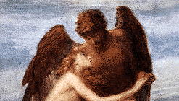
A. The Specific Sin
(6:1-4)
  Population – Gen. 6:1
  Procreation – Gen. 6:2
  Patience – Gen. 6:3
  Product – Gen. 6:4

Slide 15
A. The Specific Sin
(6:1-4)
  Population – Gen. 6:1
  Procreation – Gen. 6:2
  Patience – Gen. 6:3
  Product – Gen. 6:4

Slide 16

Genesis 6:1-4
“¹ Now it came about, when men began to multiply on the face of the land, and daughters were born to them, ² that the sons of God saw that the daughters of men were beautiful; and they took wives for themselves, whomever they chose. ³ Then the Lord said, ‘My Spirit shall not strive with man forever, because he also is flesh; nevertheless his days shall be one hundred and twenty years.’ ⁴ The Nephilim were on the earth in those days, and also afterward, when the sons of God came in to the daughters of men, and they bore children to them. Those were the mighty men who were of old, men of renown.”

Slide 17
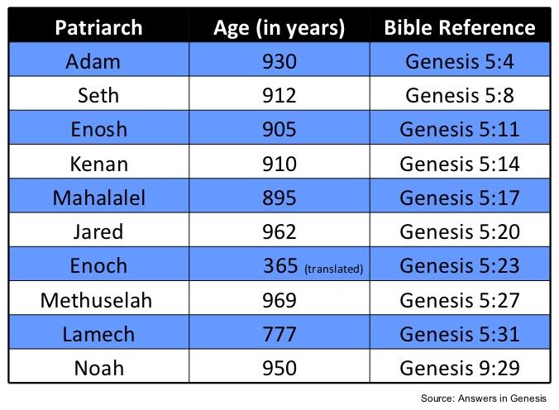

Slide 18

Dr. Henry M. Morris
The Genesis Record, 144
“The ancient quibble about ‘Cain’s wife’ is thus seen to be quite trivial. Long before Cain died, there was a large population in the earth. By the time of the Deluge, 1,656 years after Creation by the Ussher chronology, even using the above conservative assumptions, the world population would have been at least seven billion people!”

Slide 19
A. The Specific Sin
(6:1-4)
  Population – Gen. 6:1
  Procreation – Gen. 6:2
  Patience – Gen. 6:3
  Product – Gen. 6:4

Slide 20
Genesis 6:1-4
“¹ Now it came about, when men began to multiply on the face of the land, and daughters were born to them, ² that the sons of God saw that the daughters of men were beautiful; and they took wives for themselves, whomever they chose. ³ Then the Lord said, ‘My Spirit shall not strive with man forever, because he also is flesh; nevertheless his days shall be one hundred and twenty years.’ ⁴ The Nephilim were on the earth in those days, and also afterward, when the sons of God came in to the daughters of men, and they bore children to them. Those were the mighty men who were of old, men of renown.”

Slide 21
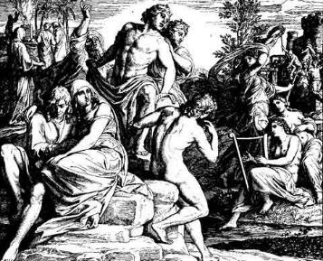
Alternative Views
  Intermarriage between the Godly line of Seth and the ungodly lines of Cain
  Polygamous Cainite despots
  Fallen angels procreating with human women

Slide 22
DOES NOT REFER TO ANGELS | DOES REFER TO ANGELS
Millard Erickson | John MacArthur
J. Sidlow Baxter | Henry Morris
Warren Wiersbe | Arnold Fruchtenbaum
Paul Enns | Robert Lightner
Gleason Archer | D. Edmond Hiebert
John Sailhammer | James Boice
Wayne Grudem | Robert Morey
Meredith Kline | M. R. DeHann
Leupold | Charles Ryrie
Williamson, unpublished paper, DTS

Slide 23


Renald Showers
Those Invisible Spirits Called Angels (Bellmawr, NJ: Friends of Israel, 1997), 96-97.
“﻿...it is interesting to note that the Sethite Line-Cainite View does not begin until the fourth century A.D. This makes it the newest of the three major views. The New Catholic Encyclopedia states that this view ‘that sees in these sons of God the Sethites and in the daughters of men the Cainites dates from the fourth century and is influenced by theological concern for maintaining the spirituality of the Angels.’ This seems to imply that the major motivation for starting this view was not exegesis of Scripture but opposition to the angel view...”

Slide 24
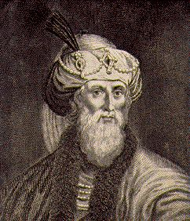
Jewish Tradition
Philo
Josephus
Most Rabbinical Writers
Apocrypha
Pseudepigrapha
Renald Showers, Those Invisible Spirits Called Angels, 93-109

Slide 25
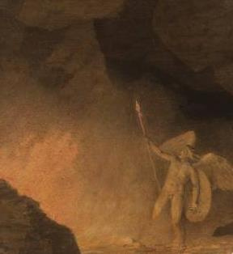
Christian Tradition
Justin
Clement
Tertullian
Cyprian
Ambrose
Lactantius
Renald Showers, Those Invisible Spirits Called Angels, 93-109

Slide 26

Genesis 6:1-4
“¹ Now it came about, when men began to multiply on the face of the land, and daughters were born to them, ² that the sons of God saw that the daughters of men were beautiful; and they took wives for themselves, whomever they chose. ³ Then the Lord said, ‘My Spirit shall not strive with man forever, because he also is flesh; nevertheless his days shall be one hundred and twenty years.’ ⁴ The Nephilim were on the earth in those days, and also afterward, when the sons of God came in to the daughters of men, and they bore children to them. Those were the mighty men who were of old, men of renown.”

Slide 27


Job 1:6
“Now there was a day when the sons of God came to present themselves before the Lord, and Satan also came among them.”

Slide 28


Ezekiel 28:14, 16
“¹⁴ You were the anointed cherub who covers, And I placed you there. You were on the holy mountain of God; You walked in the midst of the stones of fire.”… ¹⁶ By the abundance of your trade You were internally filled with violence, And you sinned; Therefore I have cast you as profane From the mountain of God. And I have destroyed you, O covering cherub, From the midst of the stones of fire.”

Slide 29
Job 2:1
“Again there was a day when the sons of God came to present themselves before the Lord, and Satan also came among them to present himself before the Lord.”

Slide 30
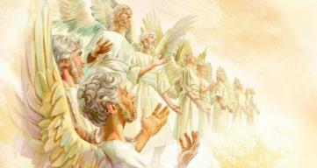
Job 38:7
“When the morning stars sang together
And all the sons of God shouted for joy?”

Slide 31
Genesis 3:15
“And I will put enmity Between you and the woman, And between your seed and her seed; He shall bruise you on the head, And you shall bruise him on the heel.”

Slide 32
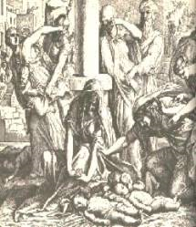
Satanic Attempts to Stop Messiah
  Cain; Gen. 4, 1 Jn. 3:12
  Demonic incursion (Gen. 6:1-4)
  Pharaoh; Ex. 1
  Athaliah; 2 Chron. 22
  Haman; Esther
  Herod; Mt.2; Rev 12:4
  Matt 4:5-7

Slide 33
Satanic Attempts to Stop Messiah
  Cain; Gen. 4, 1 Jn. 3:12
  Demonic incursion (Gen. 6:1-4)
  Pharaoh; Ex. 1
  Athaliah; 2 Chron. 22
  Haman; Esther
  Herod; Mt.2; Rev 12:4
  Matt 4:5-7

Slide 34
Satanic Attempts to Stop Messiah
  Cain; Gen. 4, 1 Jn. 3:12
  Demonic incursion (Gen. 6:1-4)
  Pharaoh; Ex. 1
  Athaliah; 2 Chron. 22
  Haman; Esther
  Herod; Mt.2; Rev 12:4
  Matt 4:5-7

Slide 35
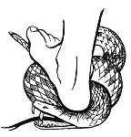
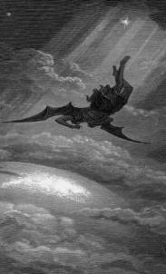
Satan’s Progressive Defeat
  Initial eviction from heaven (Isa 14:12-15; Ezek 28:12-17)
  Eden (Gen 3:15)
  Pre-diluvian world (1 Pet 3:19-20)
  Cross (John 12:31; 16:11; Col 2:15; Heb 2:14; 1 John 3:8)
  Mid point of the Tribulation (Rev 12:9)
  Beginning of millennium (Rev 20:2-3)
  End of millennium (Rev 20:10)

Slide 36
Satan’s Progressive Defeat
  Initial eviction from heaven (Isa 14:12-15; Ezek 28:12-17)
  Eden (Gen 3:15)
  Pre-diluvian world (1 Pet 3:19-20)
  Cross (John 12:31; 16:11; Col 2:15; Heb 2:14; 1 John 3:8)
  Mid point of the Tribulation (Rev 12:9)
  Beginning of millennium (Rev 20:2-3)
  End of millennium (Rev 20:10)

Slide 37
Genesis 3:15
“And I will put enmity Between you and the woman, And between your seed and her seed; He shall bruise you on the head, And you shall bruise him on the heel.”

Slide 38


Matthew 22:30
“For in the resurrection they neither marry nor are given in marriage, but are like angels in heaven.”

Slide 39

1 Peter 3:19-20
“¹⁹ in which also He went and made proclamation the spirits now in prison, ²⁰ who once were disobedient, when the patience of God kept waiting in the days of Noah, during the construction of the ark, in which a few, that is, eight persons, were brought safely through the water.”

Slide 40
2 Peter 2:4-5
“⁴ For if God did not spare angels when they sinned, but cast them into hell and committed them to pits of darkness, reserved for judgment; ⁵ and did not spare the ancient world, but preserved Noah, a preacher of righteousness, with seven others, when He brought a flood upon the world of the ungodly.”

Slide 41
Jude 6-7
“⁶ And angels who did not keep their own domain, but abandoned their proper abode, He has kept in eternal bonds under darkness for the judgment of the great day, ⁷ just as Sodom and Gomorrah and the cities around them, since they in the same way as these indulged in gross immorality and went after strange flesh, are exhibited as an example in undergoing the punishment of eternal fire.”

Slide 42
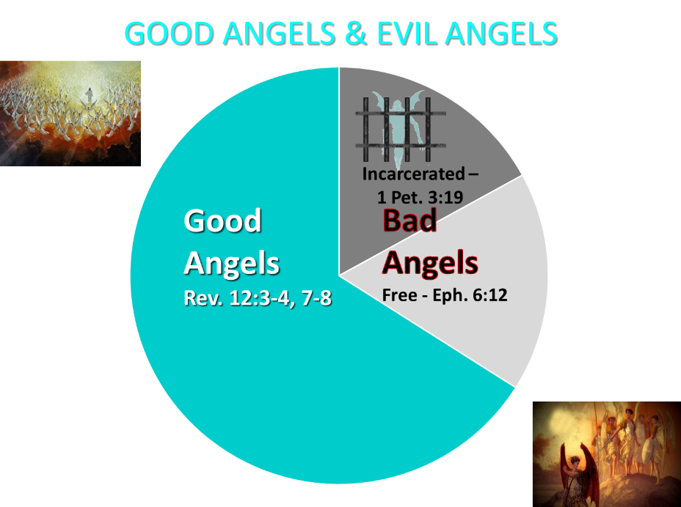

Slide 43

Notes:
Robbie Dean – Paper on Seal & Trumpet Judgments

Slide 44


7th Seal & 1st Six Trumpets (Revelation 8‒9)
7th Seal (8:1-6) – Trumpet preparation
1st Trumpet (8:7) – 1/3 vegetation destroyed
2nd Trumpet (8:8-9) – 1/3 ocean destroyed
3rd Trumpet (8:10-11) – 1/3 water destroyed
4th Trumpet (8:12-13) – 1/3 luminaries darkened
5th Trumpet (9:1-12) – Demons released
6th Trumpet (9:13-21) – 1/3 humanity destroyed

Slide 45
A. The Specific Sin
(6:1-4)
  Population – Gen. 6:1
  Procreation – Gen. 6:2
  Patience – Gen. 6:3
  Product – Gen. 6:4

Slide 46
Genesis 6:1-4
“¹ Now it came about, when men began to multiply on the face of the land, and daughters were born to them, ² that the sons of God saw that the daughters of men were beautiful; and they took wives for themselves, whomever they chose. ³ Then the Lord said, ‘My Spirit shall not strive with man forever, because he also is flesh; nevertheless his days shall be one hundred and twenty years.’ ⁴ The Nephilim were on the earth in those days, and also afterward, when the sons of God came in to the daughters of men, and they bore children to them. Those were the mighty men who were of old, men of renown.”

Slide 47
Genesis 6:3
“¹ Now it came about, when men began to multiply on the face of the land, and daughters were born to them, ² that the sons of God saw that the daughters of men were beautiful; and they took wives for themselves, whomever they chose. ³ Then the Lord said, ‘My Spirit shall not strive with man forever, because he also is flesh; nevertheless his days shall be one hundred and twenty years.’ ⁴ The Nephilim were on the earth in those days, and also afterward, when the sons of God came in to the daughters of men, and they bore children to them. Those were the mighty men who were of old, men of renown.”

Slide 48

John 16:7-11
“⁷ But I tell you the truth, it is to your advantage that I go away; for if I do not go away, the Helper [paraklētos] will not come to you; but if I go, I will send Him to you. ⁸ And He, when He comes, will convict the world concerning sin and righteousness and judgment; ⁹ concerning sin, because they do not believe in Me; ¹⁰ and concerning righteousness, because I go to the Father and you no longer see Me; ¹¹ and concerning judgment, because the ruler of this world has been judged.”

Slide 49
Genesis 6:1-4
“¹ Now it came about, when men began to multiply on the face of the land, and daughters were born to them, ² that the sons of God saw that the daughters of men were beautiful; and they took wives for themselves, whomever they chose. ³ Then the Lord said, ‘My Spirit shall not strive with man forever, because he also is flesh; nevertheless his days shall be one hundred and twenty years.’ ⁴ The Nephilim were on the earth in those days, and also afterward, when the sons of God came in to the daughters of men, and they bore children to them. Those were the mighty men who were of old, men of renown.”

Slide 50

Dr. Arnold G. Fruchtenbaum
The Book of Genesis Record, 137
“In Hebrew, Methuselah may mean ‘man of the spear, or more likely ‘when he dies, it shall be sent.’ If this is true, his name was given to him prophetically. ‘It shall be sent’ was a prophecy of the Flood, as Methuselah’s father, who was also functioning as a prophet according to Jude 14–15, gave him this name. Indeed, according to the chronology of Genesis, the very year Methuselah died was when the Flood came.”

Slide 52
Genesis 6:1-4
“¹ Now it came about, when men began to multiply on the face of the land, and daughters were born to them, ² that the sons of God saw that the daughters of men were beautiful; and they took wives for themselves, whomever they chose. ³ Then the Lord said, ‘My Spirit shall not strive with man forever, because he also is flesh; nevertheless his days shall be one hundred and twenty years.’ ⁴ The Nephilim were on the earth in those days, and also afterward, when the sons of God came in to the daughters of men, and they bore children to them. Those were the mighty men who were of old, men of renown.”

Slide 53
A. The Specific Sin
(6:1-4)
  Population – Gen. 6:1
  Procreation – Gen. 6:2
  Patience – Gen. 6:3
  Product – Gen. 6:4

Slide 54
Genesis 6:4
“¹ Now it came about, when men began to multiply on the face of the land, and daughters were born to them, ² that the sons of God saw that the daughters of men were beautiful; and they took wives for themselves, whomever they chose. ³ Then the Lord said, ‘My Spirit shall not strive with man forever, because he also is flesh; nevertheless his days shall be one hundred and twenty years.’ ⁴ The Nephilim were on the earth in those days, and also afterward, when the sons of God came in to the daughters of men, and they bore children to them. Those were the mighty men who were of old, men of renown.”

Slide 55
Genesis 6:1-4
“¹ Now it came about, when men began to multiply on the face of the land, and daughters were born to them, ² that the sons of God saw that the daughters of men were beautiful; and they took wives for themselves, whomever they chose. ³ Then the Lord said, ‘My Spirit shall not strive with man forever, because he also is flesh; nevertheless his days shall be one hundred and twenty years.’ ⁴ The Nephilim were on the earth in those days, and also afterward, when the sons of God came in to the daughters of men, and they bore children to them. Those were the mighty men who were of old, men of renown.”

Slide 56


Slide 57
Numbers 13:32-33
³² So they gave out to the sons of Israel a bad report of the land which they had spied out, saying, “The land through which we have gone, in spying it out, is a land that devours its inhabitants; and all the people whom we saw in it are men of great size. ³³ There also we saw the Nephilim (the sons of Anak are part of the Nephilim); and we became like grasshoppers in our own sight, and so we were in their sight.”

Slide 58
Genesis 6:1-4
“¹ Now it came about, when men began to multiply on the face of the land, and daughters were born to them, ² that the sons of God saw that the daughters of men were beautiful; and they took wives for themselves, whomever they chose. ³ Then the Lord said, ‘My Spirit shall not strive with man forever, because he also is flesh; nevertheless his days shall be one hundred and twenty years.’ ⁴ The Nephilim were on the earth in those days, and also afterward, when the sons of God came in to the daughters of men, and they bore children to them. Those were the mighty men who were of old, men of renown.”

Slide 59
Genesis 3:15
“And I will put enmity Between you and the woman, And between your seed and her seed; He shall bruise you on the head, And you shall bruise him on the heel.”

Slide 60
Genesis 6:4
“¹ Now it came about, when men began to multiply on the face of the land, and daughters were born to them, ² that the sons of God saw that the daughters of men were beautiful; and they took wives for themselves, whomever they chose. ³ Then the Lord said, ‘My Spirit shall not strive with man forever, because he also is flesh; nevertheless his days shall be one hundred and twenty years.’ ⁴ The Nephilim were on the earth in those days, and also afterward, when the sons of God came in to the daughters of men, and they bore children to them. Those were the mighty men who were of old, men of renown.”

Slide 61
Genesis 6:4
“¹ Now it came about, when men began to multiply on the face of the land, and daughters were born to them, ² that the sons of God saw that the daughters of men were beautiful; and they took wives for themselves, whomever they chose. ³ Then the Lord said, ‘My Spirit shall not strive with man forever, because he also is flesh; nevertheless his days shall be one hundred and twenty years.’ ⁴ The Nephilim were on the earth in those days, and also afterward, when the sons of God came in to the daughters of men, and they bore children to them. Those were the mighty men who were of old, men of renown.”

Slide 62


Finis Jennings Dake
God's Plan for Man: Revealing God's Perfect Plan for All Creation (Lawrenceville, GA: Dake Bible Sales, 1949), 197.
“There were two eruptions of the fallen angels among men. They produced races of giants on the Earth each time. The first eruption was before the flood, and the second one was after the flood. This is plainly stated in Gen. 6:4: ‘There were giants in the earth in those days [before the flood]; and also after that [after the flood], when the sons of God came in unto the daughters of men, and they bare children to them, the same became mighty men which were of old, men of renown.’”

Slide 63

Finis Jennings Dake
God's Plan for Man: Revealing God's Perfect Plan for All Creation (Lawrenceville, GA: Dake Bible Sales, 1949), 197-198.
“The second eruption of fallen angels was evidently smaller in number and more limited in area; they were for the most part confined to the land of Canaan, and their offspring were known as the nations of Canaan. They were known as Rephaim (Gen. 14:5; 15:20; Deut. 2:11, 20, 21; 3:11-13; Josh. 12:4; 13:12; 15:8; 17:15; 18:16); Anakim (Num. 13:22; Deut. 1:28; 2:10-11, 21; 9:2; Josh. 11:21-22; 14:12-15); Horim (Gen. 14:6; Deut. 2:12, 20, 21); Avim (Deut. 2:23; Josh. 13:3); Zanzumim (Deut. 2:20); and other names. They are enumerated in Gen. 15:18-21; Exod. 3:8, 17; 23:23; Num. 13:22; Deut. 7:1; 20:17; Josh. 12:8...”

Slide 64
Finis Jennings Dake
God's Plan for Man: Revealing God's Perfect Plan for All Creation (Lawrenceville, GA: Dake Bible Sales, 1949), 197-198.
“…These were to be utterly destroyed by the sword of Israel just as the flood had destroyed the ones that had lived in the Dispensation of Conscience (Deut. 7:1-5; 20:17; Josh. 3:10). Israel failed in this purpose so the giants were left to test and prove the chosen people (Josh. 13:13; 15:63; 16:10; 17:18; Judg. 1:19-36; 2:1-5; 3:1-7). The giants made trouble for Israel until the time of David when the last of the races of the giants were killed (1 Sam. 17; 2 Sam. 21:15-22; 1 Chron. 20:4-8).”

Slide 66
Numbers 13:32-33
³² So they gave out to the sons of Israel a bad report of the land which they had spied out, saying, “The land through which we have gone, in spying it out, is a land that devours its inhabitants; and all the people whom we saw in it are men of great size. ³³ There also we saw the Nephilim (the sons of Anak are part of the Nephilim); and we became like grasshoppers in our own sight, and so we were in their sight.”

Slide 67
Numbers 13:32-33
³² So they gave out to the sons of Israel a bad report of the land which they had spied out, saying, “The land through which we have gone, in spying it out, is a land that devours its inhabitants; and all the people whom we saw in it are men of great size. ³³ There also we saw the Nephilim (the sons of Anak are part of the Nephilim); and we became like grasshoppers in our own sight, and so we were in their sight.”

Slide 68


Ronald Allen
"Numbers," in Expositor's Bible Commentary, ed. Frank E. Gaebelein et al (Grand Rapids: Zondervan, 1981), Numbers 13:31-33.
“By speaking evil concerning the land, the faithless spies were speaking evil of him. At this point their words became exaggerations and distortions. The Anakites (who were of large size) were now said to be Nephilim, the race of giants described briefly in the mysterious context of the cohabitation of the sons of God and the daughters of men (Gen 6:4). The use of the term Nephilim seems to be deliberately provocative of fear, a term not unlike the concept of bogeymen and hobgoblins. The exaggeration of the faithless led them to their final folly: ‘We seemed like grasshoppers in our own eyes, and we looked the same to them.’ ” We have noted the possible use of rhetorical . . .

Slide 69
Ronald Allen
"Numbers," in Expositor's Bible Commentary, ed. Frank E. Gaebelein et al (Grand Rapids: Zondervan, 1981), Numbers 13:31-33.
“. . . exaggeration, hyperbole, in the numbers of the tribes of Israel—power numbers to bring encouragement to the nation in the confidence they must have in the fulfillment of the promises of God (see Introduction, sections on large numbers). In the report of the evil spies, we see that rhetorical exaggeration can work both ways. By describing themselves as mere grasshoppers in the sight of the fabulous Nephilim, they frightened the sandals off the people and led a nation to grievous sin of unbelief against their caring God.”

Slide 70
1 Peter 3:19-20
“¹⁹ in which also He went and made proclamation the spirits now in prison, ²⁰ who once were disobedient, when the patience of God kept waiting in the days of Noah, during the construction of the ark, in which a few, that is, eight persons, were brought safely through the water.”

Slide 71
2 Peter 2:4-5
“⁴ For if God did not spare angels when they sinned, but cast them into hell and committed them to pits of darkness, reserved for judgment; ⁵ and did not spare the ancient world, but preserved Noah, a preacher of righteousness, with seven others, when He brought a flood upon the world of the ungodly.”

Slide 72
Jude 6-7
“⁶ And angels who did not keep their own domain, but abandoned their proper abode, He has kept in eternal bonds under darkness for the judgment of the great day, ⁷ just as Sodom and Gomorrah and the cities around them, since they in the same way as these indulged in gross immorality and went after strange flesh, are exhibited as an example in undergoing the punishment of eternal fire.”

Slide 74
Finis Jennings Dake
God's Plan for Man: Revealing God's Perfect Plan for All Creation (Lawrenceville, GA: Dake Bible Sales, 1949), 197.
“There were two eruptions of the fallen angels among men. They produced races of giants on the Earth each time. The first eruption was before the flood, and the second one was after the flood. This is plainly stated in Gen. 6:4: ‘There were giants in the earth in those days [before the flood]; and also after that [after the flood], when the sons of God came in unto the daughters of men, and they bare children to them, the same became mighty men which were of old, men of renown.’”

Slide 75
Genesis 6:4
“¹ Now it came about, when men began to multiply on the face of the land, and daughters were born to them, ² that the sons of God saw that the daughters of men were beautiful; and they took wives for themselves, whomever they chose. ³ Then the Lord said, ‘My Spirit shall not strive with man forever, because he also is flesh; nevertheless his days shall be one hundred and twenty years.’ ⁴ The Nephilim were on the earth in those days, and also afterward, when the sons of God came in to the daughters of men, and they bore children to them. Those were the mighty men who were of old, men of renown.”

Slide 76
Genesis 6:1-4
“¹ Now it came about, when men began to multiply on the face of the land, and daughters were born to them, ² that the sons of God saw that the daughters of men were beautiful; and they took wives for themselves, whomever they chose. ³ Then the Lord said, ‘My Spirit shall not strive with man forever, because he also is flesh; nevertheless his days shall be one hundred and twenty years.’ ⁴ The Nephilim were on the earth in those days, and also afterward, when the sons of God came in to the daughters of men, and they bore children to them. Those were the mighty men who were of old, men of renown.”

Slide 77
Genesis 1:26-28
²⁶ Then God said, “Let Us make man in Our image, according to Our likeness; and let them rule over the fish of the sea and over the birds of the sky and over the cattle and over all the earth, and over every creeping thing that creeps on the earth.” ²⁷ God created man in His own image, in the image of God He created him; male and female He created them. ²⁸ God blessed them; and God said to them, “Be fruitful and multiply, and fill the earth, and subdue it; and rule over the fish of the sea and over the birds of the sky and over every living thing that moves on the earth.”

Slide 78

Genesis 2:24
For this reason a man shall leave his father and his mother, and be joined to his wife; and they shall become one flesh.

Slide 79

Matthew 19:3-6
³ Some Pharisees came to Jesus, testing Him and asking, “Is it lawful for a man to divorce his wife for any reason at all?” ⁴ And He answered and said, “Have you not read that He who created them from the beginning made them male and female, ⁵ and said, ‘For this reason a man shall leave his father and mother and be joined to his wife, and the two shall become one flesh’? ⁶ “So they are no longer two, but one flesh. What therefore God has joined together, let no man separate.”

Slide 80

Revelation 9:20-21
“The rest of mankind, who were not killed by these plagues, did not repent of the works of their hands, so as not to worship demons, and the idols of gold and of silver and of brass and of stone and of wood, which can neither see nor hear nor walk; ²¹ and they did not repent of their murders nor of their sorceries (pharmakeia) nor of their immorality nor of their thefts.”

Slide 81
Baker Faces Prison for Refusing to Bake Same-Sex Wedding Cake
“Jack Phillips is a baker who declined to bake a wedding cake for a same-sex couple because his Christian belief is that marriage exists only between a man and woman. Now a Colorado judge has ordered him to bake cakes for same-sex marriages, and if Phillips refuses, he could go to jail.”
Ken Klukowski, “Baker Faces Prison for Refusing to Bake Same-Sex Wedding Cake,” online: http://www.breitbart.com/Big-Government/2013/12/12/Christian-Baker-Willing-to-Go-to-Jail-for-Declining-Gay-Wedding-Cake, 12 December 2013, accessed 16 May 2014.

Slide 82
I. God’s Grief
(Gen 6:1-7)
    The specific sin (6:1-4)
    The general sin (6:5)
    God’s sorrow (6:6-7)

Slide 83

Total Depravity
What total depravity is not:
  Man is as evil as he can possibly be & indulges every possible sin
  Man is incapable of doing good things
    Gen. 3:22
    Matt. 7:11
    Acts 10:1-2
    Rom. 2:14-15

Slide 84
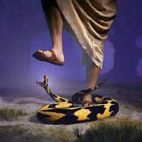
Genesis 3:22
“Then the Lord God said, ‘Behold, the man has become like one of Us, knowing good and evil; and now, he might stretch out his hand, and take also from the tree of life, and eat, and live forever’—.”

Slide 85

Matthew 7:11
“If you then, being evil, know how to give good gifts to your children, how much more will your Father who is in heaven give what is good to those who ask Him!”

Slide 86
Romans 2:14-15
“¹⁴ For when Gentiles who do not have the Law do instinctively the things of the Law, these, not having the Law, are a law to themselves, ¹⁵ in that they show the work of the Law written in their hearts, their conscience bearing witness and their thoughts alternately accusing or else defending them.”

Slide 87
Henry Clarence Thiessen
Lectures in Systematic Theology, rev. ed. (Grand Rapids: Eerdmans, 1979), 191.
“The Scriptures speak of human nature as totally depraved. However, the doctrine of ‘total depravity’ is easily misunderstood and misinterpreted. From the negative standpoint, it is important to know both what it does not mean and what it does mean. This does not mean that every sinner is devoid of all qualities pleasing to men; that he commits, or is prone to every form of sin; or that he is bitterly opposed to God as it is possible for him to be. Jesus recognize the existence of pleasing qualities in some individuals (Mark 10:21); He said that the scribes and Pharisees did some things God demanded (Matt. 23:23); Paul asserted that some Gentiles ‘do instinctively the things of the law’ (Rom. 2:14); God told Abraham that the iniquity of the Amorites would grow worse (Gen. 15:16); and Paul says that ‘evil men and imposters will proceed from bad to worse’ (2 Tim. 3:13).”

Slide 88
Total Depravity
What total depravity is:
  Every area of man’s being is touched by sin
    Intellect (Prov. 3:5-6; 14:12; 2 Cor. 4:4; Rom. 3:11a)
    Conscience (1 Tim 4:2)
    Will (Rom 1:28; 3:11b)
    Deeds (Rom. 3:12)
    Speech (Rom. 3:13-14)
    Feet (Rom. 3:15)

Slide 89
Total Depravity
What total depravity is:
  Every area of man’s being is touched by sin (cont’d)
    Heart (Mark 7:21; Eph 4:18)
    Body (Gen 3:19; Rom. 8:23)
    Total being (Rom 1:18–3:20)
  Man is incapable of earning merit favor from God (Isa 64:6; Eph. 2:8-9)

Slide 90
I. God’s Grief
(Gen 6:1-7)
    The specific sin (6:1-4)
    The general sin (6:5)
    God’s sorrow (6:6-7)

Slide 91
Genesis 6 Outline
  God’s Grief (Gen 6:1-7)
  God’s Grace (6:8-10)
  God’s Destruction (6:11-13)
  God’s Instruction (6:14-22)

Slide 92
II. God’s Grace
(Gen 6:8-10)
  The object (6:8)
  The results (6:9)
  The descendants (6:10)

Slide 93
II. God’s Grace
(Gen 6:8-10)
  The object (6:8)
  The results (6:9)
  The descendants (6:10)

Slide 94
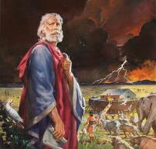
Genesis 6:8-9
“ ⁸ But Noah found favor in the eyes of the Lord. ⁹ These are the records of the generations of Noah. Noah was a righteous man, blameless in his time; Noah walked with God.”

Slide 95
II. God’s Grace
(Gen 6:8-10)
  The object (6:8)
  The results (6:9)
  The descendants (6:10)

Slide 96
Genesis 6:8-9
“ ⁸ But Noah found favor in the eyes of the Lord. ⁹ These are the records of the generations of Noah. Noah was a righteous man, blameless in his time; Noah walked with God.”

Slide 97
Genesis 6:8-9
“ ⁸ But Noah found favor in the eyes of the Lord. ⁹ These are the records of the generations of Noah. Noah was a righteous man, blameless in his time; Noah walked with God.”

Slide 98
Genesis 6:8-9
“ ⁸ But Noah found favor in the eyes of the Lord. ⁹ These are the records of the generations of Noah. Noah was a righteous man, blameless in his time; Noah walked with God.”

Slide 99
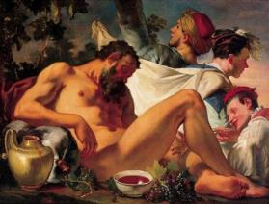
Genesis 9:20-21
“²⁰ Then Noah began farming and planted a vineyard. ²¹ He drank of the wine and became drunk, and uncovered himself inside his tent.”

Slide 100

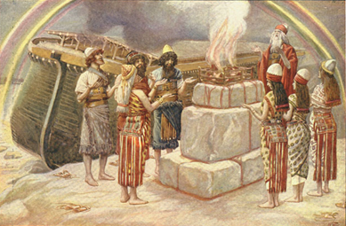
Romans 3:23
“for all have sinned and fall short of the glory of God.”

Slide 101
Genesis 6:8-9
“ ⁸ But Noah found favor in the eyes of the Lord. ⁹ These are the records of the generations of Noah. Noah was a righteous man, blameless in his time; Noah walked with God.”

Slide 102
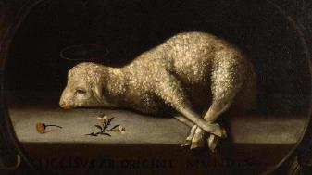
Exodus 12:5
“Your lamb shall be an unblemished male a year old; you may take it from the sheep or from the goats.”

Slide 103
Genesis 3:15
“And I will put enmity Between you and the woman, And between your seed and her seed; He shall bruise you on the head, And you shall bruise him on the heel.”

Slide 104
Noah Spared
  Gen 3:15
  Gen 5:1 (Adam) to Gen. 5:32 (Noah)
  Gen 6:9
  Gen 7:1

Slide 105
Genesis 6:8-9
“ ⁸ But Noah found favor in the eyes of the Lord. ⁹ These are the records of the generations of Noah. Noah was a righteous man, blameless in his time; Noah walked with God.”

Slide 106
Toledoth
“And These Are the Generations of…”
Introduction to the generations (1:1–2:3)
Generations of the heaven and earth (2:4–4:26)
Generations of Adam (5:1–6:8)
Generations of Noah (6:9–9:29)
Generations of the sons of Noah (10:1–11:9)
Generations of Shem (11:10–26)
Generations of Terah (11:27–25:11)
Generations of Ishmael (25:12-18)
Generations of Isaac (25:19–35:29)
Generations of Esau (36:1–37:1)
Generations of Jacob (37:2–50:26)

Slide 107
Toledoth
“And These Are the Generations of…”
Introduction to the generations (1:1–2:3)
Generations of the heaven and earth (2:4–4:26)
Generations of Adam (5:1–6:8)
Generations of Noah (6:9–9:29)
Generations of the sons of Noah (10:1–11:9)
Generations of Shem (11:10–26)
Generations of Terah (11:27–25:11)
Generations of Ishmael (25:12-18)
Generations of Isaac (25:19–35:29)
Generations of Esau (36:1–37:1)
Generations of Jacob (37:2–50:26)

Slide 108
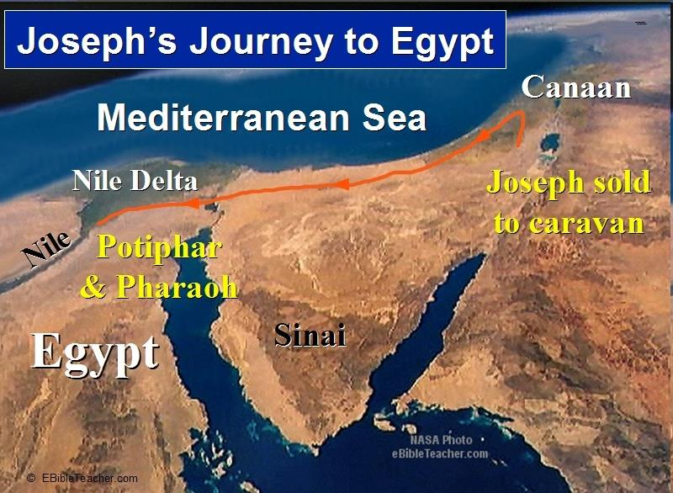

Slide 109
Luke 1:1-4
“¹ Since many have undertaken to compile an account of the things accomplished among us, ² just as they were handed down to us by those who from the beginning were eyewitnesses and servants of the word, ³ it seemed fitting to me as well, having investigated everything carefully from the beginning, to write it out for you in an orderly sequence, most excellent Theophilus; ⁴ so that you may know the exact truth about the things you have been taught.”

Slide 110
II. God’s Grace
(Gen 6:8-10)
  The object (6:8)
  The results (6:9)
  The descendants (6:10)

Slide 111
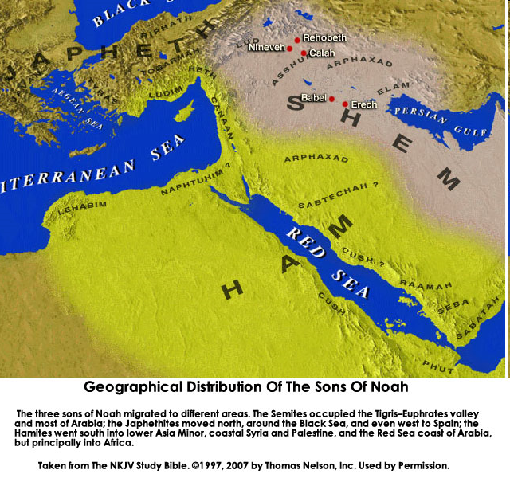

Slide 112
Genesis 6 Outline
  God’s Grief (Gen 6:1-7)
  God’s Grace (6:8-10)
  God’s Destruction (6:11-13)
  God’s Instruction (6:14-22)

Slide 113
III. God’s Destruction
(Gen 6:11-13)
  The sin (6:11-12)
  The prediction (6:13)

Slide 114
III. God’s Destruction
(Gen 6:11-13)
  The sin (6:11-12)
  The prediction (6:13)

Slide 115


Genesis 6:11
“Now the earth was corrupt in the sight of God, and the earth was filled with violence.”

Slide 116
Genesis 6:11
“Now the earth was corrupt in the sight of God, and the earth was filled with violence.”

Slide 117
III. God’s Destruction
(Gen 6:11-13)
  The sin (6:11-12)
  The prediction (6:13)

Slide 118

John 13:19; 14:29
“¹⁹ From now on I am telling you before it comes to pass, so that when it does occur, you may believe that I am He… ^{14:29} Now I have told you before it happens, so that when it happens, you may believe.”

Slide 119
Christ’s Short-Term Predictions
Prophecy | Scripture
Betrayal by a Friend | John 13:21
Three-fold Denial by Peter | Matthew 26:34, 75
Manner of His Own Death | Matthew 20:18-19
Manner of Disciples’ Deaths | John 21:18-22
AD 70 Events | Luke 19:41-44

Slide 120
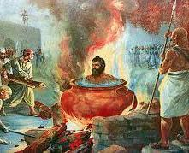
Tertullian
Prescription Against Heretics, 36
“…where the Apostle John was first plunged, unhurt, into boiling oil, and thence remitted to his island-exile!”

Slide 121


Genesis 9:6
“Whoever sheds man’s blood, By man his blood shall be shed, For in the image of God He made man.”

Slide 122
Genesis 6 Outline
  God’s Grief (Gen 6:1-7)
  God’s Grace (6:8-10)
  God’s Destruction (6:11-13)
  God’s Instruction (6:14-22)

Slide 123
IV. God’s Instruction
(Gen 6:14-22)
  The structure (6:14-16)
  The reason (6:17-18)
  The animals (6:19-20)
  The food (6:21)
  The obedience (6:22)

Slide 124
IV. God’s Instruction
(Gen 6:14-22)
  The structure (6:14-16)
  The reason (6:17-18)
  The animals (6:19-20)
  The food (6:21)
  The obedience (6:22)

Slide 125
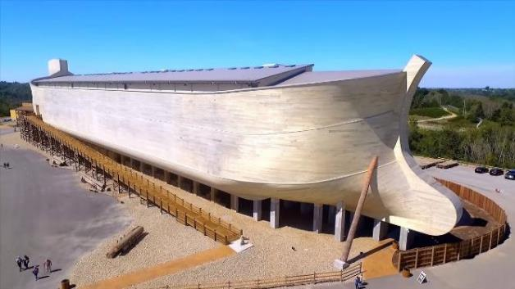
Dimensions of the Ark?
(Genesis 6:15)
  Ark = 450ft long, 75ft wide, 45 feet high
  Ark capable of holding 125,000 animals

Slide 126
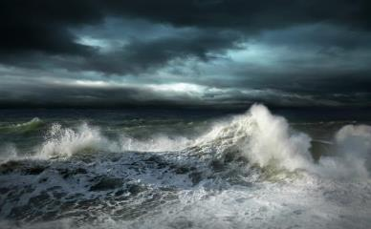
Dimensions of the Ark
  Biblical flood account
  Pagan flood accounts (300)
  Similarities and differences

Slide 127
Hugh Ross
The Genesis Question (Navpress, Colorado Springs, CO 1998), 164-65.
“First, when God pours out judgment, He gives ample warning ahead of time. He sends a spokesperson, a prophet, and gives that prophet a kind of platform from which to be heard. For the antediluvians, Noah was that prophet and the scaffolding around the ark was his platform.”

Slide 128
Biblical vs. Babylonian Flood Account
ITEM | GENESIS | GILGAMESH EPIC
Flood planned | God | Council
View of God | Monotheism | Polytheism
Revelation to a hero | God warned Noah | Ea warned Utnapishtim
Reason | Sin | Noise
Punishment | Ethics | Ambiguous, regretted
Salvation of hero | Included in God’s plan | Done secretly
Lives saved | 8 | Reps of all living things
Boat | 300x50x30 cubits-3 levels | 120x120x120 cubits-7 levels
Duration | 40 days, 40 nights | 6 days, 6 nights
Landing | Mountains of Ararat | Mount Nisir
Birds | Raven, dove (3x) | Dove, swallow, raven
Sacrifice | Worship | Appeasement
Blessing | Covenant | Divinity, immortality

Slide 129
Biblical vs. Babylonian Creation Account
GENESIS | ENUMA ELISH
Purpose: praise God | Purpose: praise Marduk
Starts with the deep | Starts with the deep
Sequence of days | No sequence of days
Ex nihlo (by speech) | Creation from formerly existing matter
Waters divided above & below firmament | Waters divided above and below corpse of Tiamat
Man to rule creation | Man created to ease the God’s work load
Man created from the soil | Man created from a slain super hero
Comparisons/contrasts taken from Walton, Chronological and Background charts of the OT, 80-81.

Slide 130
Explanation of Similarities & Differences Between the Biblical and Pagan Flood Accounts
The pagans accounts (Babylonian creation – Enuma Elish & flood – Gilgamesh) borrowed from the Bible? – Unlikely since some pagan accounts (1800 B.C.) precede the time when Gen. was written (1446 B.C.)
The Bible borrowed from the pagan accounts? – A possibility

Slide 131
Explanation of Similarities & Differences Between the Biblical and Pagan Flood Accounts
Common source
  Historical event
  Noahic Bible
  Toledoth
  Spreading knowledge of historical event into all early cultures
  Paganism’s adjustment (monotheism, sin, ethics)-Rom. 1:18-32
  God’s readjustment-correction through Moses

Slide 132
Dr. Arnold G. Fruchtenbaum
The Book of Genesis Record, 142
“The eleventh observation is connected with archeology. There are two kings’ lists from archeology that reflect what is happening in this chapter. The first is the Sumerian King List from Sumer in Mesopotamia, dating from about the year 2000 b.c. It lists a total of ten kings, with a total of 241,200 years. That is an average of about 24,000 years per king. Therefore, the concept of longevity of ten generations is something reflected in the Sumerian King List.”

Slide 133
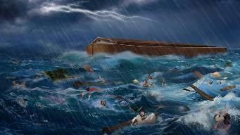
Dr. Arnold G. Fruchtenbaum
The Book of Genesis Record, 142
“It is also interesting that after the list of the ten kings, it then adds, ‘and then the flood came.’ The flood came with the tenth, just as it is in this Genesis 5 passage. The second is the Berussos King List. Berussos was a Babylonian priest of the third century b.c., and he also lists ten kings before the flood.”

Slide 134
Biblical vs. Babylonian Flood Account
ITEM | GENESIS | GILGAMESH EPIC
Flood planned | God | Council
View of God | Monotheism | Polytheism
Revelation to a hero | God warned Noah | Ea warned Utnapishtim
Reason | Sin | Noise
Punishment | Ethics | Ambiguous, regretted
Salvation of hero | Included in God’s plan | Done secretly
Lives saved | 8 | Reps of all living things
Boat | 300x50x30 cubits-3 levels | 120x120x120 cubits-7 levels
Duration | 40 days, 40 nights | 6 days, 6 nights
Landing | Mountains of Ararat | Mount Nisir
Birds | Raven, dove (3x) | Dove, swallow, raven
Sacrifice | Worship | Appeasement
Blessing | Covenant | Divinity, immortality

Slide 135

John 20:30-31
“³⁰ Therefore many other signs Jesus also performed in the presence of the disciples, which are not written in this book; ³¹ but these have been written so that you may believe that Jesus is the Christ, the Son of God; and that believing you may have life in His name.”

Slide 136
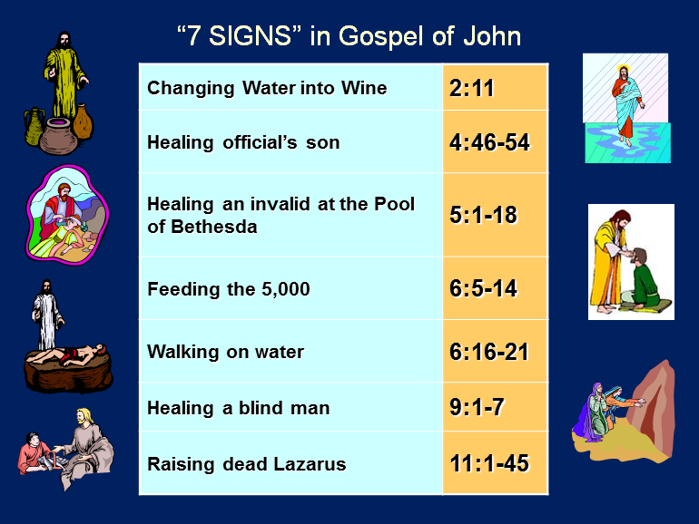

Slide 137

7 “I AM” statements in John
I am the Bread of Life | 6:35
I am the Light of the world | 8:12
I am the Gate for the sheep | 10:7; cf. v.9
I am the Good Shepherd | 10:11,14
I am the Resurrection and the Life | 11:25
I am the Way and the Truth and the Life | 14:6
I am the true Vine | 15:1; cf. v.5

Slide 138
IV. God’s Instruction
(Gen 6:14-22)
  The structure (6:14-16)
  The reason (6:17-18)
  The animals (6:19-20)
  The food (6:21)
  The obedience (6:22)

Slide 139
Noahic vs. Abrahamic & Mosaic Covenants
Name | NOAHIC | ABRAHAMIC | MOSAIC
Human agent | Noah | Abraham | Moses
Scripture | Gen. 8‒9 | Gen. 12‒17 | Exod. 19‒40
Covenant (Berith) | Gen. 9:9 | Gen. 15:18 | Exod. 19:5
Party | World, humanity | Israel, Hebrews | Israel, Hebrews
Israel | Pre-Israel | Post-Israel | Post-Israel

Slide 140
Noahic vs. Abrahamic & Mosaic Covenants
Covenant | NOAHIC | ABRAHAMIC | MOSAIC
Conditional or unconditional | Unconditional | Unconditional | Conditional
Promises | No more flood judgment, enduring earth, capital punishment | Ownership of land, seed, and blessing | Enjoyment or possession of land, seed, and blessing
Sign | Rainbow | Circumcision | Sabbath
Purpose | Restrain & preserve | Redemptive | Redemptive
Directly binding today? | Yes | No | No

Slide 141
Biblical vs. Babylonian Flood Account
ITEM | GENESIS | GILGAMESH EPIC
Flood planned | God | Council
View of God | Monotheism | Polytheism
Revelation to a hero | God warned Noah | Ea warned Utnapishtim
Reason | Sin | Noise
Punishment | Ethics | Ambiguous, regretted
Salvation of hero | Included in God’s plan | Done secretly
Lives saved | 8 | Reps of all living things
Boat | 300x50x30 cubits-3 levels | 120x120x120 cubits-7 levels
Duration | 40 days, 40 nights | 6 days, 6 nights
Landing | Mountains of Ararat | Mount Nisir
Birds | Raven, dove (3x) | Dove, swallow, raven
Sacrifice | Worship | Appeasement
Blessing | Covenant | Divinity, immortality

Slide 142

Genesis 8:21
The Lord smelled the soothing aroma; and the Lord said to Himself, “I will never again curse the ground on account of man, for the intent of man’s heart is evil from his youth; and I will never again destroy every living thing, as I have done.[emphasis mine].

Slide 143
Genesis 3:15
“And I will put enmity Between you and the woman, And between your seed and her seed; He shall bruise you on the head, And you shall bruise him on the heel.”

Slide 144
IV. God’s Instruction
(Gen 6:14-22)
  The structure (6:14-16)
  The reason (6:17-18)
  The animals (6:19-20)
  The food (6:21)
  The obedience (6:22)

Slide 145
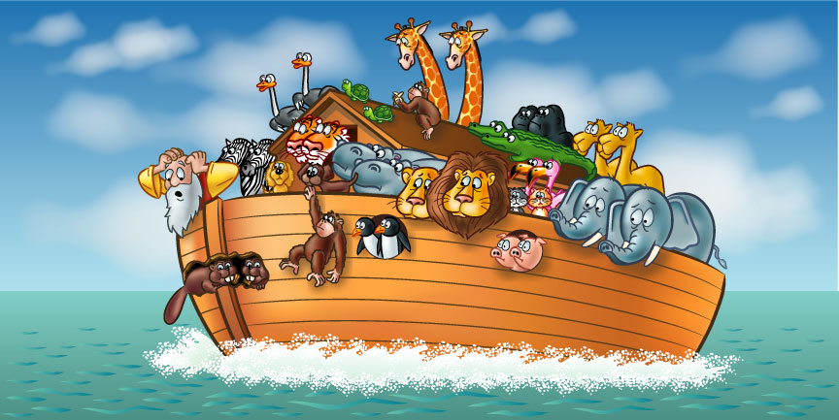

Slide 146

How Did Noah Fit All of the Animals on to the Ark?
(John 3:12)
  No
  Sea creatures (6:20)
  Insects (7:22)
  Plants (6:20)
Woodmoorape, Noah’s Ark: A Feasibility Study

Slide 147
How Did Noah Fit All of the Animals on to the Ark?
(John 3:12)
  Limitations
  Seven pairs or just sevens? (7:2)
  Only clean animals (7:2; Lev 11; Deut 14)
  Kind (6:20)
  Extinct animals overstated
  Not fully grown
  Hybernation

Slide 148

How Did Noah Fit All of the Animals on to the Ark?
(John 3:12)
  16,000 animals
  Ark = 450ft long, 75ft wide, 45 feet high
  Ark capable of holding 125,000 animals

Slide 149
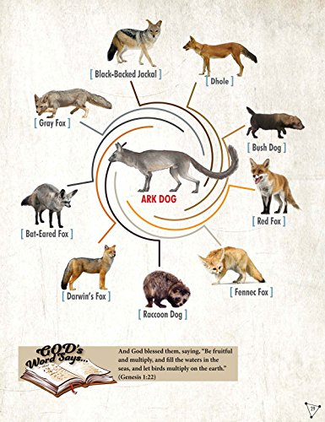

Slide 150
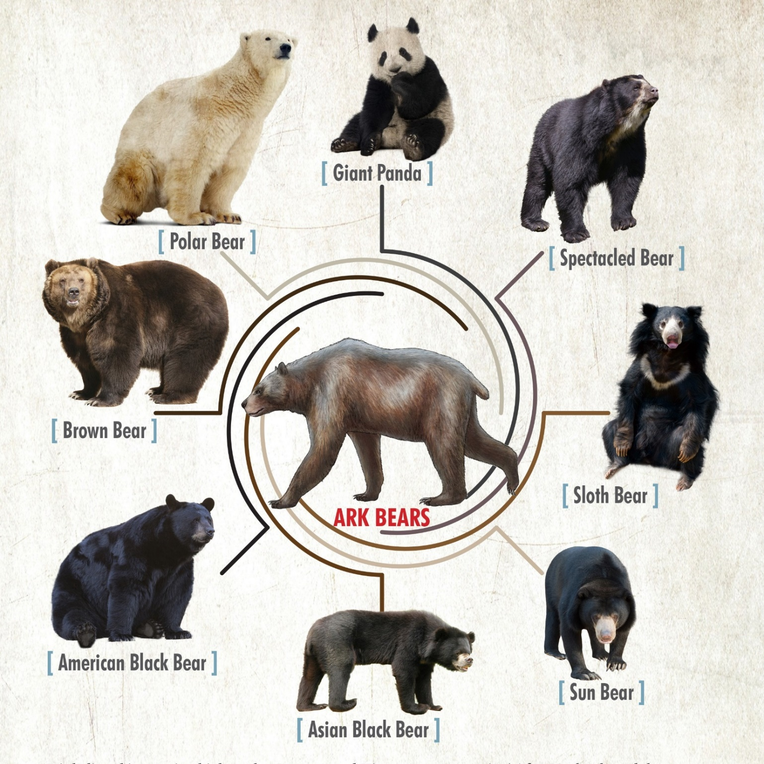

Slide 151
IV. God’s Instruction
(Gen 6:14-22)
  The structure (6:14-16)
  The reason (6:17-18)
  The animals (6:19-20)
  The food (6:21)
  The obedience (6:22)

Slide 152
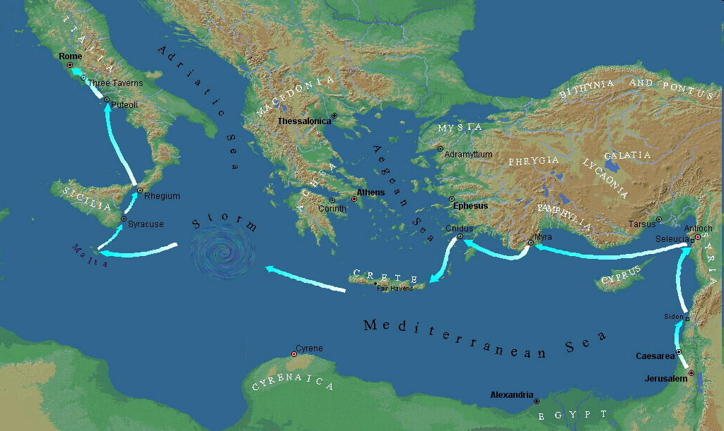

Slide 153
IV. God’s Instruction
(Gen 6:14-22)
  The structure (6:14-16)
  The reason (6:17-18)
  The animals (6:19-20)
  The food (6:21)
  The obedience (6:22)

Slide 154
Dimensions of the Ark?
(Genesis 6:15)
  Ark = 450ft long, 75ft wide, 45 feet high
  Ark capable of holding 125,000 animals

Slide 155
Conclusion

Slide 156
GENESIS STRUCTURE
  Genesis 1-11 (four events)
    Creation (1-2)
    Fall (3-5)
    Flood (6-9)
    National dispersion (10-11)

Slide 157
The Flood
(Gen 6–9)
  Events before the flood (Gen 6)
  The flood (Gen 7)
  The abating of the waters (Gen 8)
  Events following the flood (Gen 9)

Slide 158
Genesis 6 Outline
  God’s Grief (Gen 6:1-7)
  God’s Grace (6:8-10)
  God’s Destruction (6:11-13)
  God’s Instruction (6:14-22)

Slide 159

“The Lord bless you and keep you; the Lord make his face shine on you and be gracious to you; the Lord turn his face toward you and give you peace.” (NIV)

