Slide 1


Genesis 4‒5
The First Murder and Continuation of the Messianic Promise

Slide 2

GENESIS STRUCTURE
  Beginning of the Human race (Gen. 1‒11)
  Beginning of the Hebrew race (Gen. 12‒50)

Slide 3

GENESIS STRUCTURE
  Genesis 1-11 (four events)
    Creation (1-2)
    Fall (3-5)
    Flood (6-9)
    National dispersion (10-11)

Slide 4
GENESIS STRUCTURE
  Genesis 1-11 (four events)
    Creation (1-2)
    Fall (3-5)
    Flood (6-9)
    National dispersion (10-11)

Slide 5

Genesis 3 Outline
  3:1-5 Temptation by the serpent
  3:6 Sin of Adam and Eve
  3:7-13 Results of the sin
  3:14-19 Imposition of divine judgments
  3:20-24 God’s provision in spite of the sin

Slide 6


Genesis 3:15
“And I will put enmity Between you and the woman, And between your seed and her seed; He shall bruise you on the head, And you shall bruise him on the heel.”

Slide 7
Genesis 4 Outline
  First murder (Gen 4:1-15)
  Ungodly line of Cain (4:16-24)
  Godly line of Seth (4:25-26)

Slide 8
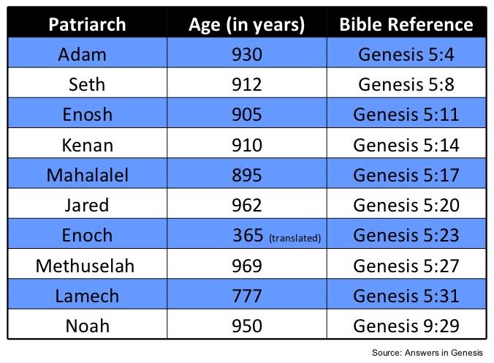

Slide 9
Genealogy
(Gen 5)
  Line through which the messianic blessing (Gen. 3:15) would come
  From Adam (Gen. 5:1) to Noah (Gen. 5:32)
  Knowledge of the protevangelium (Gen. 3:15) was obviously passed down given Adam’s advanced age at his death (Gen. 5:5)

Slide 10

Genesis 5 Outline
  Introduction (5:1-2)
  Adam (5:3-5)
  Seth (5:6-8)
  Enosh (5:9-11)
  Kenan (5:12-14)
  Mahalalel (5:15-17)

Slide 11
Genesis 5 Outline
  Jared (5:18-20)
  Enoch (5:21-24)
  Methuselah (5:25-27)
  Lamech (5:28-31)
  Noah (5:32)

Slide 12
Six-fold Repetition: Significance
(Gen 5)
    Long patriarchal ages at time of death indicate ante-diluvian conditions
    Repetition of “and he died” shows the reality of the curse (Gen 2:17; 3:19)
    Monotony allows easy memorization and immediately draws attention to deviations

Slide 13
Genesis 5 Outline
  Jared (5:18-20)
  Enoch (5:21-24)
  Methuselah (5:25-27)
  Lamech (5:28-31)
  Noah (5:32)

Slide 14
Genealogy: Adam to Noah
(Gen 5)
Hope that the curse would be done away with
  Enoch’s translation (5:24)
  Meaning of Methuselah’s name (Gen. 5:27; 6:3; 1 Pet. 3:20)
  Lamech mistakenly believed that Noah was the fulfillment of Genesis 3:15 (Gen. 5:29; 3:17; 4:1; Dan. 11:37)

Slide 15
Genealogy: Adam to Noah
(Gen 5)
Hope that the curse would be done away with
  Enoch’s translation (5:24)
  Meaning of Methuselah’s name (Gen. 5:27; 6:3; 1 Pet. 3:20)
  Lamech mistakenly believed that Noah was the fulfillment of Genesis 3:15 (Gen. 5:29; 3:17; 4:1; Dan. 11:37)

Slide 16
Genesis 5 Outline
  Jared (5:18-20)
  Enoch (5:21-24)
  Methuselah (5:25-27)
  Lamech (5:28-31)
  Noah (5:32)

Slide 17
Genealogy: Adam to Noah
(Gen 5)
Hope that the curse would be done away with
  Enoch’s translation (5:24)
  Meaning of Methuselah’s name (Gen. 5:27; 6:3; 1 Pet. 3:20)
  Lamech mistakenly believed that Noah was the fulfillment of Genesis 3:15 (Gen. 5:29; 3:17; 4:1; Dan. 11:37)

Slide 18

Dr. Arnold G. Fruchtenbaum
The Book of Genesis Record, 137
“In Hebrew, Methuselah may mean ‘man of the spear, or more likely ‘when he dies, it shall be sent.’ If this is true, his name was given to him prophetically. ‘It shall be sent’ was a prophecy of the Flood, as Methuselah’s father, who was also functioning as a prophet according to Jude 14–15, gave him this name. Indeed, according to the chronology of Genesis, the very year Methuselah died was when the Flood came.”

Slide 19
Genesis 5 Outline
  Jared (5:18-20)
  Enoch (5:21-24)
  Methuselah (5:25-27)
  Lamech (5:28-31)
  Noah (5:32)

Slide 20
Six-Fold Pattern
Genesis 5:28-31
  Name & meaning: Lamech; warrior
  Age at birth of seed-son: 182 years
  Additional years lived: 595 years
  Begat other sons & daughters: Yes
  Total years lived: 777 years
  Death: Yes

Slide 22
Genealogy: Adam to Noah
(Gen 5)
Hope that the curse would be done away with
  Enoch’s translation (5:24)
  Meaning of Methuselah’s name (Gen. 5:27; 6:3; 1 Pet. 3:20)
  Lamech mistakenly believed that Noah was the fulfillment of Genesis 3:15 (Gen. 5:29; 3:17; 4:1; Dan. 11:37)

Slide 23
Genesis 3:15
“And I will put enmity Between you and the woman, And between your seed and her seed; He shall bruise you on the head, And you shall bruise him on the heel.”

Slide 24

Genesis 4:1
“Now the man had relations with his wife Eve, and she conceived and gave birth to Cain, and she said, ‘I have gotten a manchild with the help of the Lord.’”

Slide 25
Genesis 4:1
“Now the man had relations with his wife Eve, and she conceived and gave birth to Cain, and she said, ‘I have gotten a manchild with the help of the Lord.’”

Slide 26
Genesis 5:29
“Now he called his name Noah, saying, ‘This one will give us rest from our work and from the toil of our hands arising from the ground which the Lord has cursed.’”

Slide 27

Genesis 3:17
“Then to Adam He said, ‘Because you have listened to the voice of your wife, and have eaten from the tree about which I commanded you, saying, ‘You shall not eat from it’; Cursed is the ground because of you; In toil you will eat of it All the days of your life.’”

Slide 28
Dr. Arnold G. Fruchtenbaum
The Book of Genesis Record, 138-39
“Then comes the break from the norm. In Genesis 5:29, Lamech names his seed-son: He called his name Noah: saying, This same shall comfort us. The Hebrew word for comfort is nacham; hence, Noah means ‘comfort.’ Here again is a word play that only works in Hebrew. The name was given on the assumption that Noah was the Seed of the Woman or the Messiah: This same shall comfort us in our work and in the toil of our hands, which comes because of the ground which Jehovah had cursed, in reference to the Adamic curse.”

Slide 29
Dr. Arnold G. Fruchtenbaum
The Book of Genesis Record, 138-39
“Lamech made the same mistake that Eve made. When Cain was born, Eve thought that he was the Messiah. When Lamech sired Noah, he recognized that Noah was going to play an important role in human history. But he misinterpreted that role, and Lamech thought that Noah was the Messiah and would remove the Adamic curse from the earth. So Lamech recognized that Noah was a special person in the will and plan of God, but made the wrong application.”

Slide 30
Daniel 11:37
“He will show no regard for the gods of his fathers or for the desire of women, nor will he show regard for any other god; for he will magnify himself above them all.”

Slide 31
Genesis 5 Outline
  Jared (5:18-20)
  Enoch (5:21-24)
  Methuselah (5:25-27)
  Lamech (5:28-31)
  Noah (5:32)

Slide 32
Noah
Genesis 5:32
  Name & meaning: Noah; comfort
  Age at birth of sons: 500 years
  Sons: Shem, Ham, Japheth

Slide 33
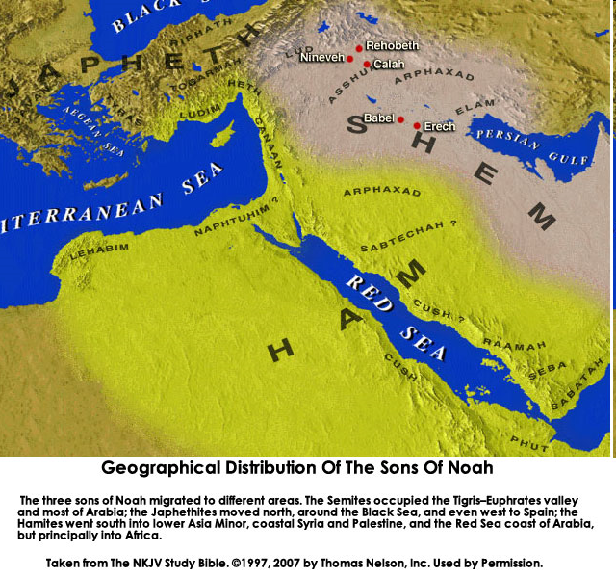

Slide 34
Genealogy: Adam to Noah
(Gen 5)
Three concluding observations
  First language: Hebrew?
  Ante-diluvian patriarchs living through multiple generations
  Modern archeology: Sumerian King List?

Slide 35
Genealogy: Adam to Noah
(Gen 5)
Three concluding observations
  First language: Hebrew?
  Ante-diluvian patriarchs living through multiple generations
  Modern archeology: Sumerian King List?

Slide 36

Genesis 11:1-4
¹ Now the whole earth used the same language and the same words. ² It came about as they journeyed east, that they found a plain in the land of Shinar and settled there. ³ They said to one another, “Come, let us make bricks and burn them thoroughly.” And they used brick for stone, and they used tar for mortar. ⁴ They said, “Come, let us build for ourselves a city, and a tower whose top will reach into heaven, and let us make for ourselves a name, otherwise we will be scattered abroad over the face of the whole earth.”

Slide 37
Dr. Arnold G. Fruchtenbaum
The Book of Genesis Record, 141
“A second observation is that all these ten names are Hebrew names and only make sense in Hebrew, although Jewish history has not yet begun. Moreover, all these people and their names existed prior to the Tower of Babel in Genesis 11, again indicating that the first language was the Hebrew language.”

Slide 38
Genealogy: Adam to Noah
(Gen 5)
Three concluding observations
  First language: Hebrew?
  Ante-diluvian patriarchs living through multiple generations
  Modern archeology: Sumerian King List?

Slide 39
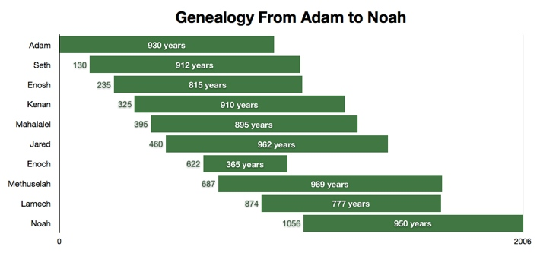

Slide 40
Dr. Arnold G. Fruchtenbaum
The Book of Genesis Record, 142
“Adam lived until the 56th year of Lamech, the father of Noah. This means the tradition as told from Adam to his descendants was only once removed from Lamech and only twice removed from Noah.”

Slide 41


Slide 42
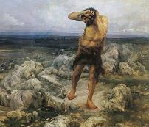
Ungodly Line of Cain
(Gen 4:16-24)
  Evil line that will not bring forth the Messiah (Gen 3:15)
    Continuation of Cain’s line (4:16-18)
    Immorality (4:19)
    Technological but not spiritual advancement (4:20-22)
    More immorality (4:23a)
    Violence (4:23b)
    Humanistic (4:24)

Slide 43

Genesis 11:6
The Lord said, “Behold, they are one people, and they all have the same language. And this is what they began to do, and now nothing which they purpose to do will be impossible for them.”

Slide 44
Genealogy: Adam to Noah
(Gen 5)
Three concluding observations
  First language: Hebrew?
  Ante-diluvian patriarchs living through multiple generations
  Modern archeology: Sumerian King List?

Slide 45
Dr. Arnold G. Fruchtenbaum
The Book of Genesis Record, 142
“The eleventh observation is connected with archeology. There are two kings’ lists from archeology that reflect what is happening in this chapter. The first is the Sumerian King List from Sumer in Mesopotamia, dating from about the year 2000 b.c. It lists a total of ten kings, with a total of 241,200 years. That is an average of about 24,000 years per king. Therefore, the concept of longevity of ten generations is something reflected in the Sumerian King List.”

Slide 46
Dr. Arnold G. Fruchtenbaum
The Book of Genesis Record, 142
“It is also interesting that after the list of the ten kings, it then adds, ‘and then the flood came.’ The flood came with the tenth, just as it is in this Genesis 5 passage. The second is the Berussos King List. Berussos was a Babylonian priest of the third century b.c., and he also lists ten kings before the flood.”

Slide 47
Conclusion

Slide 48
Genesis 5 Outline
  Introduction (5:1-2)
  Adam (5:3-5)
  Seth (5:6-8)
  Enosh (5:9-11)
  Kenan (5:12-14)
  Mahalalel (5:15-17)

Slide 49
Genesis 5 Outline
  Jared (5:18-20)
  Enoch (5:21-24)
  Methuselah (5:25-27)
  Lamech (5:28-31)
  Noah (5:32)

Slide 50
GENESIS STRUCTURE
  Genesis 1-11 (four events)
    Creation (1-2)
    Fall (3-5)
    Flood (6-9)
    National dispersion (10-11)

Slide 51

“The Lord bless you and keep you; the Lord make his face shine on you and be gracious to you; the Lord turn his face toward you and give you peace.” (NIV)

