Slide 1


Genesis 4‒5
The First Murder and Continuation of the Messianic Promise

Slide 2

GENESIS STRUCTURE
  Beginning of the Human race (Gen. 1‒11)
  Beginning of the Hebrew race (Gen. 12‒50)

Slide 3

GENESIS STRUCTURE
  Genesis 1-11 (four events)
    Creation (1-2)
    Fall (3-5)
    Flood (6-9)
    National dispersion (10-11)

Slide 4
GENESIS STRUCTURE
  Genesis 1-11 (four events)
    Creation (1-2)
    Fall (3-5)
    Flood (6-9)
    National dispersion (10-11)

Slide 5

Genesis 3 Outline
  3:1-5 Temptation by the serpent
  3:6 Sin of Adam and Eve
  3:7-13 Results of the sin
  3:14-19 Imposition of divine judgments
  3:20-24 God’s provision in spite of the sin

Slide 6


Genesis 3:15
“And I will put enmity Between you and the woman, And between your seed and her seed; He shall bruise you on the head, And you shall bruise him on the heel.”

Slide 7
Genesis 4 Outline
  First murder (Gen 4:1-15)
  Ungodly line of Cain (4:16-24)
  Godly line of Seth (4:25-26)

Slide 8
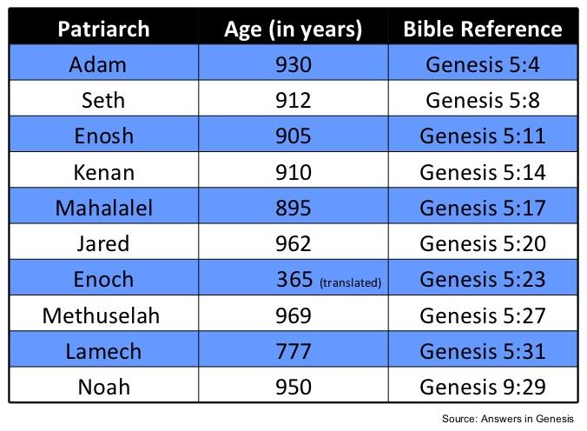

Slide 9
Genealogy
(Gen 5)
  Line through which the messianic blessing (Gen. 3:15) would come
  From Adam (Gen. 5:1) to Noah (Gen. 5:32)
  Knowledge of the protevangelium (Gen. 3:15) was obviously passed down given Adam’s advanced age at his death (Gen. 5:5)

Slide 10

Genesis 5 Outline
  Introduction (5:1-2)
  Adam (5:3-5)
  Seth (5:6-8)
  Enosh (5:9-11)
  Kenan (5:12-14)
  Mahalalel (5:15-17)

Slide 11
Genesis 5 Outline
  Jared (5:18-20)
  Enoch (5:21-24)
  Methuselah (5:25-27)
  Lamech (5:28-31)
  Noah (5:32)

Slide 12
Genesis 5 Outline
  Introduction (5:1-2)
  Adam (5:3-5)
  Seth (5:6-8)
  Enosh (5:9-11)
  Kenan (5:12-14)
  Mahalalel (5:15-17)

Slide 13
Genesis 5 Outline
  Introduction (5:1-2)
  Adam (5:3-5)
  Seth (5:6-8)
  Enosh (5:9-11)
  Kenan (5:12-14)
  Mahalalel (5:15-17)

Slide 14
Six-Fold Pattern
Genesis 5:3-5
  Name & meaning: Adam; Man
  Age at birth of seed-son: 130 years
  Additional years lived: 800 years
  Begat other sons & daughters: Yes
  Total years lived: 930 years
  Death: Yes

Slide 15
Six-fold Repetition: Significance
(Gen 5)
    Names indicate historicity (1 Chron. 1:1-4; Luke 3:36-38; Heb. 11:4-7)
    Age of patriarch at birth of seed-son demonstrate no genealogical gaps
    Begetting of other sons and daughters explains the population explosion (Gen. 4:14, 17; 6:1)

Slide 16
Six-fold Repetition: Significance
(Gen 5)
    Long patriarchal ages at time of death indicate ante-diluvian conditions
    Repetition of “and he died” shows the reality of the curse (Gen 2:17; 3:19)
    Monotony allows easy memorization and immediately draws attention to deviations

Slide 17
Genesis 5 Outline
  Introduction (5:1-2)
  Adam (5:3-5)
  Seth (5:6-8)
  Enosh (5:9-11)
  Kenan (5:12-14)
  Mahalalel (5:15-17)

Slide 18
Six-Fold Pattern
Genesis 5:6-8
  Name & meaning: Seth; Substitute
  Age at birth of seed-son: 105 years
  Additional years lived: 807 years
  Begat other sons & daughters: Yes
  Total years lived: 912 years
  Death: Yes

Slide 19

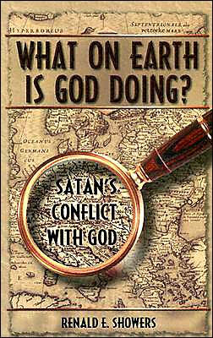
Renald Showers
What on Earth is God Doing: Satan’s Conflict with God (Bellmawr, NJ: Friends of Israel, 2003), 226.
“In His war against Satan, God counteracted the murder of Abel by giving Adam and Eve another godly son named Seth (Gen. 4:25). Since this name means ‘substitute,’ it is apparent that God meant Seth to be a substitute for Abel. (H. C. Leupold, Exposition of Genesis, p. 226). The genealogies found in Genesis 5; 11:10–32; and Luke 3:23–38 reveal that God also intended the Redeemer to come through Seth’s line of descent.”

Slide 20
Genesis 5 Outline
  Introduction (5:1-2)
  Adam (5:3-5)
  Seth (5:6-8)
  Enosh (5:9-11)
  Kenan (5:12-14)
  Mahalalel (5:15-17)

Slide 21
Six-Fold Pattern
Genesis 5:9-11
  Name & meaning: Enosh; Frailty
  Age at birth of seed-son: 90 years
  Additional years lived: 815 years
  Begat other sons & daughters: Yes
  Total years lived: 905 years
  Death: Yes

Slide 22
Genesis 5 Outline
  Introduction (5:1-2)
  Adam (5:3-5)
  Seth (5:6-8)
  Enosh (5:9-11)
  Kenan (5:12-14)
  Mahalalel (5:15-17)

Slide 23
Six-Fold Pattern
Genesis 5:12-14
  Name & meaning: Kenan; smith
  Age at birth of seed-son: 70 years
  Additional years lived: 840 years
  Begat other sons & daughters: Yes
  Total years lived: 910 years
  Death: Yes

Slide 24
Genesis 5 Outline
  Introduction (5:1-2)
  Adam (5:3-5)
  Seth (5:6-8)
  Enosh (5:9-11)
  Kenan (5:12-14)
  Mahalalel (5:15-17)

Slide 25
Six-Fold Pattern
Genesis 5:15-17
  Name & meaning: Mahalalel; praise God
  Age at birth of seed-son: 65 years
  Additional years lived: 830 years
  Begat other sons & daughters: Yes
  Total years lived: 895 years
  Death: Yes

Slide 26
Genesis 5 Outline
  Jared (5:18-20)
  Enoch (5:21-24)
  Methuselah (5:25-27)
  Lamech (5:28-31)
  Noah (5:32)

Slide 27
Six-Fold Pattern
Genesis 5:18-20
  Name & meaning: Jared; descent
  Age at birth of seed-son: 162 years
  Additional years lived: 800 years
  Begat other sons & daughters: Yes
  Total years lived: 962 years
  Death: Yes

Slide 28
Genesis 5 Outline
  Jared (5:18-20)
  Enoch (5:21-24)
  Methuselah (5:25-27)
  Lamech (5:28-31)
  Noah (5:32)

Slide 29
Six-Fold Pattern
Genesis 5:21-24
  Name & meaning: Enoch; dedication
  Age at birth of seed-son: 65 years
  Additional years lived: 300 years
  Begat other sons & daughters: Yes
  Total years lived: 365 years
  Death: No!

Slide 30
LINEAGE OF ADAM
UNGODLY LINE | GODLY LINE
CAIN | SETH
ENOCH | ENOSH
IRAD | KENAN
MEHUJAEL | MAHALALEL
METHUSHAEL | JARED
LAMECH | ENOCH
JUBA, TUBAL-CAIN | METHUSELAH
 | LAMECH
 | NOAH
 | SHEM, HAM, JAPHETH

Slide 31
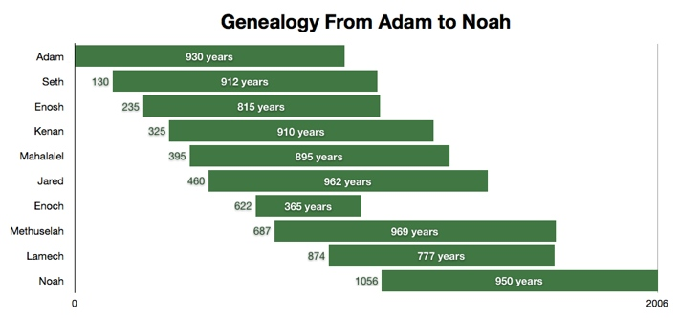

Slide 32
Six-Fold Pattern
Genesis 5:21-24
  Name & meaning: Enoch; dedication
  Age at birth of seed-son: 65 years
  Additional years lived: 300 years
  Begat other sons & daughters: Yes
  Total years lived: 365 years
  Death: No!

Slide 33
Genealogy: Adam to Noah
(Gen 5)
Hope that the curse would be done away with
  Enoch’s translation (5:24)
  Meaning of Methuselah’s name (Gen. 5:27; 6:3; 1 Pet. 3:20)
  Lamech mistakenly believed that Noah was the fulfillment of Genesis 3:15 (Gen. 5:29; 3:17; 4:1; Dan. 11:37)

Slide 34
Genealogy: Adam to Noah
(Gen 5)
Hope that the curse would be done away with
  Enoch’s translation (5:24)
  Meaning of Methuselah’s name (Gen. 5:27; 6:3; 1 Pet. 3:20)
  Lamech mistakenly believed that Noah was the fulfillment of Genesis 3:15 (Gen. 5:29; 3:17; 4:1; Dan. 11:37)

Slide 36
LINEAGE OF ADAM
UNGODLY LINE | GODLY LINE
CAIN | SETH
ENOCH | ENOSH
IRAD | KENAN
MEHUJAEL | MAHALALEL
METHUSHAEL | JARED
LAMECH | ENOCH
JUBA, TUBAL-CAIN | METHUSELAH
 | LAMECH
 | NOAH
 | SHEM, HAM, JAPHETH

Slide 37
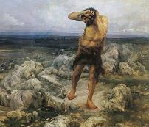
Ungodly Line of Cain
(Gen 4:16-24)
  Evil line that will not bring forth the Messiah (Gen 3:15)
    Continuation of Cain’s line (4:16-18)
    Immorality (4:19)
    Technological but not spiritual advancement (4:20-22)
    More immorality (4:23a)
    Violence (4:23b)
    Humanistic (4:24)

Slide 38
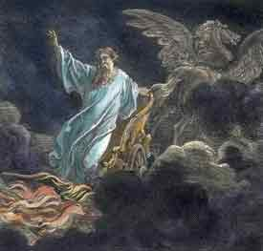
Exemption from Death
(1 Cor 15:54-56)
Enoch (Gen 5)
Elijah (2 Kings 2)
Christ (Acts 1:11; Rev 12:5)
Philip (Acts 8:39)
Paul (2 Cor 12:2, 4)
John (Rev 4:1-2)
Two witnesses (Rev 11)

Slide 39

1 Corinthians 15:50-51
“⁵⁰ Now I say this, brethren, that flesh and blood cannot inherit the kingdom of God; nor does the perishable inherit the imperishable. ⁵¹ Behold, I tell you a mystery; we will not all sleep, but we will all be changed.”

Slide 40
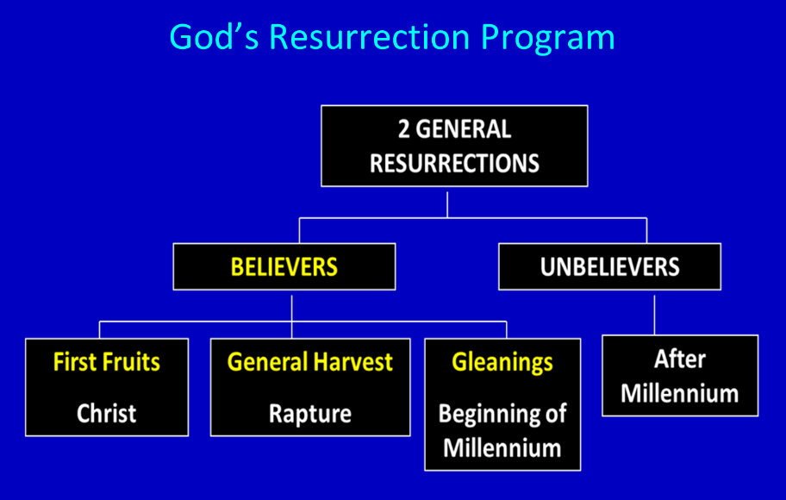

Slide 41
1 Corinthians 15:50-51
“⁵⁰ Now I say this, brethren, that flesh and blood cannot inherit the kingdom of God; nor does the perishable inherit the imperishable. ⁵¹ Behold, I tell you a mystery; we will not all sleep, but we will all be changed.”

Slide 42
LINEAGE OF ADAM
UNGODLY LINE | GODLY LINE
CAIN | SETH
ENOCH | ENOSH
IRAD | KENAN
MEHUJAEL | MAHALALEL
METHUSHAEL | JARED
LAMECH | ENOCH
JUBA, TUBAL-CAIN | METHUSELAH
 | LAMECH
 | NOAH
 | SHEM, HAM, JAPHETH

Slide 43
Genesis 5 Outline
  Jared (5:18-20)
  Enoch (5:21-24)
  Methuselah (5:25-27)
  Lamech (5:28-31)
  Noah (5:32)

Slide 44
Six-Fold Pattern
Genesis 5:25-27
  Name & meaning: Methuselah; when he dies it shall be sent
  Age at birth of seed-son: 187 years
  Additional years lived: 782 years
  Begat other sons & daughters: Yes
  Total years lived: 969 years
  Death: Yes

Slide 45

Dr. Arnold G. Fruchtenbaum
The Book of Genesis Record, 137
“In Hebrew, Methuselah may mean ‘man of the spear, or more likely ‘when he dies, it shall be sent.’ If this is true, his name was given to him prophetically. ‘It shall be sent’ was a prophecy of the Flood, as Methuselah’s father, who was also functioning as a prophet according to Jude 14–15, gave him this name. Indeed, according to the chronology of Genesis, the very year Methuselah died was when the Flood came.”

Slide 47
Genealogy: Adam to Noah
(Gen 5)
Hope that the curse would be done away with
  Enoch’s translation (5:24)
  Meaning of Methuselah’s name (Gen. 5:27; 6:3; 1 Pet. 3:20)
  Lamech mistakenly believed that Noah was the fulfillment of Genesis 3:15 (Gen. 5:29; 3:17; 4:1; Dan. 11:37)

Slide 48

Genesis 6:1-4
“¹ Now it came about, when men began to multiply on the face of the land, and daughters were born to them, ² that the sons of God saw that the daughters of men were beautiful; and they took wives for themselves, whomever they chose. ³ Then the Lord said, ‘My Spirit shall not strive with man forever, because he also is flesh; nevertheless his days shall be one hundred and twenty years.’ ⁴ The Nephilim were on the earth in those days, and also afterward, when the sons of God came in to the daughters of men, and they bore children to them. Those were the mighty men who were of old, men of renown.”

Slide 49
Genesis 5 Outline
  Jared (5:18-20)
  Enoch (5:21-24)
  Methuselah (5:25-27)
  Lamech (5:28-31)
  Noah (5:32)

Slide 50
Six-Fold Pattern
Genesis 5:28-31
  Name & meaning: Lamech; warrior
  Age at birth of seed-son: 182 years
  Additional years lived: 595 years
  Begat other sons & daughters: Yes
  Total years lived: 777 years
  Death: Yes

Slide 51
Genealogy: Adam to Noah
(Gen 5)
Hope that the curse would be done away with
  Enoch’s translation (5:24)
  Meaning of Methuselah’s name (Gen. 5:27; 6:3; 1 Pet. 3:20)
  Lamech mistakenly believed that Noah was the fulfillment of Genesis 3:15 (Gen. 5:29; 3:17; 4:1; Dan. 11:37)

Slide 52
Genesis 3:15
“And I will put enmity Between you and the woman, And between your seed and her seed; He shall bruise you on the head, And you shall bruise him on the heel.”

Slide 53

Genesis 4:1
“Now the man had relations with his wife Eve, and she conceived and gave birth to Cain, and she said, ‘I have gotten a manchild with the help of the Lord.’”

Slide 54
Genesis 4:1
“Now the man had relations with his wife Eve, and she conceived and gave birth to Cain, and she said, ‘I have gotten a manchild with the help of the Lord.’”

Slide 55
Genesis 5:29
“Now he called his name Noah, saying, ‘This one will give us rest from our work and from the toil of our hands arising from the ground which the Lord has cursed.’”

Slide 56

Genesis 3:17
“Then to Adam He said, ‘Because you have listened to the voice of your wife, and have eaten from the tree about which I commanded you, saying, ‘You shall not eat from it’; Cursed is the ground because of you; In toil you will eat of it All the days of your life.’”

Slide 57
Dr. Arnold G. Fruchtenbaum
The Book of Genesis Record, 138-39
“Then comes the break from the norm. In Genesis 5:29, Lamech names his seed-son: He called his name Noah: saying, This same shall comfort us. The Hebrew word for comfort is nacham; hence, Noah means “comfort.” Here again is a word play that only works in Hebrew. The name was given on the assumption that Noah was the Seed of the Woman or the Messiah: This same shall comfort us in our work and in the toil of our hands, which comes because of the ground which Jehovah had cursed, in reference to the Adamic curse.”

Slide 58
Dr. Arnold G. Fruchtenbaum
The Book of Genesis Record, 138-39
“Lamech made the same mistake that Eve made. When Cain was born, Eve thought that he was the Messiah. When Lamech sired Noah, he recognized that Noah was going to play an important role in human history. But he misinterpreted that role, and Lamech thought that Noah was the Messiah and would remove the Adamic curse from the earth. So Lamech recognized that Noah was a special person in the will and plan of God, but made the wrong application.”

Slide 59
Daniel 11:37
“He will show no regard for the gods of his fathers or for the desire of women, nor will he show regard for any other god; for he will magnify himself above them all.”

Slide 60
Genesis 5 Outline
  Jared (5:18-20)
  Enoch (5:21-24)
  Methuselah (5:25-27)
  Lamech (5:28-31)
  Noah (5:32)

Slide 61
Noah
Genesis 5:32
  Name & meaning: Noah; comfort
  Age at birth of sons: 500 years
  Sons: Shem, Ham, Japheth

Slide 62
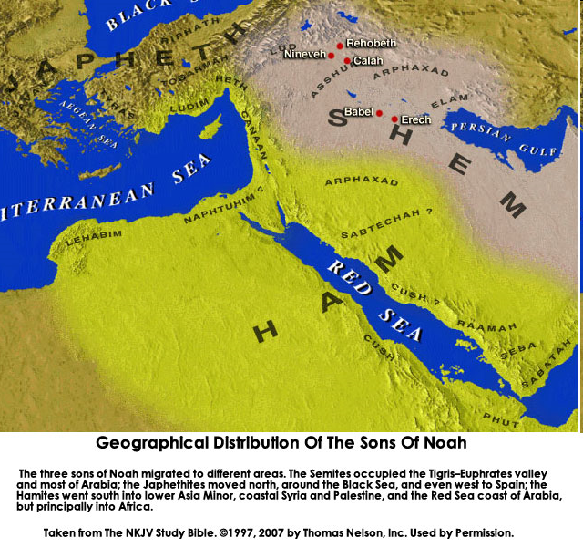

Slide 63
Genealogy: Adam to Noah
(Gen 5)
Three concluding observations
  First language: Hebrew?
  Ante-diluvian patriarchs living through multiple generations
  Modern archeology: Sumerian King List?

Slide 64
Genealogy: Adam to Noah
(Gen 5)
Three concluding observations
  First language: Hebrew?
  Ante-diluvian patriarchs living through multiple generations
  Modern archeology: Sumerian King List?

Slide 65

Genesis 11:1-4
¹ Now the whole earth used the same language and the same words. ² It came about as they journeyed east, that they found a plain in the land of Shinar and settled there. ³ They said to one another, “Come, let us make bricks and burn them thoroughly.” And they used brick for stone, and they used tar for mortar. ⁴ They said, “Come, let us build for ourselves a city, and a tower whose top will reach into heaven, and let us make for ourselves a name, otherwise we will be scattered abroad over the face of the whole earth.”

Slide 66
Dr. Arnold G. Fruchtenbaum
The Book of Genesis Record, 141
“A second observation is that all these ten names are Hebrew names and only make sense in Hebrew, although Jewish history has not yet begun. Moreover, all these people and their names existed prior to the Tower of Babel in Genesis 11, again indicating that the first language was the Hebrew language.”

Slide 67
Genealogy: Adam to Noah
(Gen 5)
Three concluding observations
  First language: Hebrew?
  Ante-diluvian patriarchs living through multiple generations
  Modern archeology: Sumerian King List?

Slide 69
Dr. Arnold G. Fruchtenbaum
The Book of Genesis Record, 142
“Adam lived until the 56th year of Lamech, the father of Noah. This means the tradition as told from Adam to his descendants was only once removed from Lamech and only twice removed from Noah.”

Slide 70
Ungodly Line of Cain
(Gen 4:16-24)
  Evil line that will not bring forth the Messiah (Gen 3:15)
    Continuation of Cain’s line (4:16-18)
    Immorality (4:19)
    Technological but not spiritual advancement (4:20-22)
    More immorality (4:23a)
    Violence (4:23b)
    Humanistic (4:24)

Slide 71

Genesis 11:6
The Lord said, “Behold, they are one people, and they all have the same language. And this is what they began to do, and now nothing which they purpose to do will be impossible for them.”

Slide 72
Genealogy: Adam to Noah
(Gen 5)
Three concluding observations
  First language: Hebrew?
  Ante-diluvian patriarchs living through multiple generations
  Modern archeology: Sumerian King List?

Slide 73
Dr. Arnold G. Fruchtenbaum
The Book of Genesis Record, 142
“The eleventh observation is connected with archeology. There are two kings’ lists from archeology that reflect what is happening in this chapter. The first is the Sumerian King List from Sumer in Mesopotamia, dating from about the year 2000 b.c. It lists a total of ten kings, with a total of 241,200 years. That is an average of about 24,000 years per king. Therefore, the concept of longevity of ten generations is something reflected in the Sumerian King List.”

Slide 74
Dr. Arnold G. Fruchtenbaum
The Book of Genesis Record, 142
“It is also interesting that after the list of the ten kings, it then adds, ‘and then the flood came.’ The flood came with the tenth, just as it is in this Genesis 5 passage. The second is the Berussos King List. Berussos was a Babylonian priest of the third century b.c., and he also lists ten kings before the flood.”

Slide 75
Conclusion

Slide 76
Genesis 5 Outline
  Introduction (5:1-2)
  Adam (5:3-5)
  Seth (5:6-8)
  Enosh (5:9-11)
  Kenan (5:12-14)
  Mahalalel (5:15-17)

Slide 77
Genesis 5 Outline
  Jared (5:18-20)
  Enoch (5:21-24)
  Methuselah (5:25-27)
  Lamech (5:28-31)
  Noah (5:32)

Slide 78

“The Lord bless you and keep you; the Lord make his face shine on you and be gracious to you; the Lord turn his face toward you and give you peace.” (NIV)

