Slide 1
THE RAPTURE
What and When? – Part 35
Andrew Marshall Woods, Th.M., JD., PhD.
Sr. Pastor, Sugar Land Bible Church

Slide 2
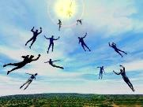
The Rapture Course Overview
What is the Rapture?
When is the Rapture?
Strengthening the Pre-Tribulational case
The opposing views
One second after the Rapture

Slide 3
The Rapture Course Overview
What is the Rapture?
When is the Rapture?
Strengthening the Pre-Tribulational case
The opposing views
One second after the Rapture

Slide 4
What is the Rapture?
An important doctrine
Distinct from the Second Advent
Catching away of all living believers (1 Thess 4:17)
Reunion (1 Thess 4:14-16)
Resurrection (1 Cor 15:50-54)
Exemption from death (1 Cor 15:51, 54-56)
Instantaneous (1 Cor 15:52)
Mystery (1 Cor 15:51)
Imminent (1 Cor 15:51; 1 Thess 4:15)
Traditional doctrine now being recovered

Slide 5
The Rapture Course Overview
What is the Rapture?
When is the Rapture?
Strengthening the Pre-Tribulational case
The opposing views
One second after the Rapture

Slide 6
When is the Rapture?
7 Arguments Favoring the Pre-Tribulation View
Tribulation's purpose concerns Israel (Jer 30:7; Dan 9:24)
No biblical reference to the church on earth during the Tribulation period (Rev 4-22)
Church is promised an exemption from divine wrath (1 Thess 1:10; 5:9; Rom 5:9; Rev 3:10; 6:17)
Rapture is imminent (1 Cor 15:51; 1 Thess 4:15)
Rapture is a comfort (1 Thess 4:18)
Antichrist cannot come to power until the restrainer is removed (2 Thess 2:6-7)
Symbolic parallels (2 Peter 2:5-9)

Slide 7
The Rapture Course Overview
What is the Rapture?
When is the Rapture?
Strengthening the Pre-Tribulational case
The opposing views
One second after the Rapture

Slide 8
Strengthening the Pre-Tribulation Case
John 14:1-4
Revelation 3:10
First Thessalonians 4‒5
Second Thessalonians 2:3a
Matthew 24‒25

Slide 9
The Rapture Course Overview
What is the Rapture?
When is the Rapture?
Strengthening the Pre-Tribulational case
The opposing views
One second after the Rapture

Slide 10
When Will the Rapture Take Place Relative to the Tribulation Period?
Pre-tribulation rapture theory
Mid-tribulation rapture theory
Post-tribulation rapture theory
Pre-wrath rapture theory
Partial rapture theory

Slide 11
When Will the Rapture Take Place Relative to the Tribulation Period?
Pre-tribulation rapture theory
Mid-tribulation rapture theory
Post-tribulation rapture theory
Pre-wrath rapture theory
Partial rapture theory

Slide 13
Post-tribulation Rapture Theory
According to 1 Thessalonians 4:16 and 1 Corinthians 15:52, the rapture will take place at the sounding of the last trumpet which, according to Matthew 24:30-31, will take place upon Christ's return at the end of the Tribulation period.
The Rapture is found in Revelation 19:11-21.
According to Revelation 20:4-6, the resurrection of all believers will transpire at the end of the Tribulation period thereby necessitating that the rapture will also take place at this time.

Slide 14
Post-tribulation Rapture Theory
According to 1 Thessalonians 4:16 and 1 Corinthians 15:52, the rapture will take place at the sounding of the last trumpet which, according to Matthew 24:30-31, will take place upon Christ's return at the end of the Tribulation period.
The Rapture is found in Revelation 19:11-21.
According to Revelation 20:4-6, the resurrection of all believers will transpire at the end of the Tribulation period thereby necessitating that the rapture will also take place at this time.

Slide 15
What is the Rapture?
An important doctrine
Distinct from the Second Advent
Catching away of all living believers (1 Thess 4:17)
Reunion (1 Thess 4:14-16)
Resurrection (1 Cor 15:50-54)
Exemption from death (1 Cor 15:51, 54-56)
Instantaneous (1 Cor 15:52)
Mystery (1 Cor 15:51)
Imminent (1 Cor 15:51; 1 Thess 4:15)
Traditional doctrine now being recovered

Slide 16
1 Thessalonians 4:13-18
...have fallen asleep. ¹⁶ For the Lord Himself will descend from heaven with a shout, with the voice of the archangel and with the trumpet of God, and the dead in Christ will rise first. ¹⁷ Then we who are alive and remain will be caught up [harpazō] together with them in the clouds to meet the Lord in the air, and so we shall always be with the Lord. ¹⁸ Therefore comfort one another with these words."

Slide 17
1 Corinthians 15:50-51
“⁵⁰ Now I say this, brethren, that flesh and blood cannot inherit the kingdom of God; nor does the perishable inherit the imperishable. ⁵¹ Behold, I tell you a mystery; we will not all sleep, but we will all be changed.”

Slide 18
Revelation 20:4-6
“⁴ Then I saw thrones, and they sat on them, and judgment was given to them. And I saw the souls of those who had been beheaded because of their testimony of Jesus and because of the word of God, and those who had not worshiped the beast or his image, and had not received the mark on their forehead and on their hand; and they came to life [zaō] and reigned with Christ for a thousand years….

Slide 19
Revelation 20:4-6
…⁵ The rest of the dead did not come to life [zaō] until the thousand years were completed. This is the first resurrection [anastasis]. ⁶ Blessed and holy is the one who has a part in the first resurrection [anastasis]; over these the second death has no power, but they will be priests of God and of Christ and will reign with Him for a thousand years.”

Slide 21
George Eldon Ladd
The Blessed Hope (Grand Rapids: Eerdmans, 1956), 165.
According to posttribulationalist George Ladd, "With the exception of one passage, the author will grant that the Scripture nowhere explicitly states that the Church will go through the Great Tribulation… However, in one passage, Revelation 20, the Resurrection is placed at the return of Christ in glory. This is more than an inference…which requires a posttribulation view...”

Slide 22
Revelation 20:4-6
“⁴ Then I saw thrones, and they sat on them, and judgment was given to them. And I saw the souls of those who had been beheaded because of their testimony of Jesus and because of the word of God, and those who had not worshiped the beast or his image, and had not received the mark on their forehead and on their hand; and they came to life [zaō] and reigned with Christ for a thousand years….

Slide 23
Norman Geisler
Systematic Theology, vol. 4
(Minneapolis, MN: Bethany, 2004), 654.
“Revelation 20:4-6 is speaking of the believers who have died during the Tribulation, not those resurrected at the Rapture (1 Thess. 4:13-18; 1 Cor. 15:50-58).”

Slide 24
Revelation 20:4-6
“⁴ Then I saw thrones, and they sat on them, and judgment was given to them. And I saw the souls of those who had been beheaded because of their testimony of Jesus and because of the word of God, and those who had not worshiped the beast or his image, and had not received the mark on their forehead and on their hand; and they came to life [zaō] and reigned with Christ for a thousand years….

Slide 25
Revelation 20:4-6
…⁵ The rest of the dead did not come to life [zaō] until the thousand years were completed. This is the first resurrection [anastasis]. ⁶ Blessed and holy is the one who has a part in the first resurrection [anastasis]; over these the second death has no power, but they will be priests of God and of Christ and will reign with Him for a thousand years.”

Slide 26
1 Thessalonians 4:13-18
¹³ "But we do not want you to be uninformed, brethren, about those who are asleep, so that you will not grieve as do the rest who have no hope. ¹⁴ For if we believe that Jesus died and rose again, even so God will bring with Him those who have fallen asleep in Jesus. ¹⁵ For this we say to you by the word of the Lord, that we who are alive and remain until the coming of the Lord, will not precede those who . . .

Slide 27
1 Thessalonians 4:13-18
. . . have fallen asleep. ¹⁶ For the Lord Himself will descend from heaven with a shout, with the voice of the archangel and with the trumpet of God, and the dead in Christ will rise first. ¹⁷ Then we who are alive and remain will be caught up [harpazō] together with them in the clouds to meet the Lord in the air, and so we shall always be with the Lord. ¹⁸ Therefore comfort one another with these words."

Slide 28
1 Corinthians 15:50-51
“⁵⁰ Now I say this, brethren, that flesh and blood cannot inherit the kingdom of God; nor does the perishable inherit the imperishable. ⁵¹ Behold, I tell you a mystery; we will not all sleep, but we will all be changed.”

Slide 29
Charles Ryrie
What You Should Know About the Rapture, Current Christian Issues (Chicago: Moody, 1981), 63-64.
“...Revelation 20:4 speaks only of a resurrection of the dead, not of a translation of living people, a truth that is prominent and a vital part of the other descriptions of the rapture in 1 Thessalonians 4:13-18 and 1 Corinthians 15:51-58).”

Slide 30
Revelation 20:4-6
…⁵ The rest of the dead did not come to life [zaō] until the thousand years were completed. This is the first resurrection [anastasis]. ⁶ Blessed and holy is the one who has a part in the first resurrection [anastasis]; over these the second death has no power, but they will be priests of God and of Christ and will reign with Him for a thousand years.”

Slide 32
Revelation 20:4-6
…⁵ The rest of the dead did not come to life [zaō] until the thousand years were completed. This is the first resurrection [anastasis]. ⁶ Blessed and holy is the one who has a part in the first resurrection [anastasis]; over these the second death has no power, but they will be priests of God and of Christ and will reign with Him for a thousand years.”

Slide 34
Post-tribulation Rapture Theory
Although the church is exempted from God's wrath, the church will be on the earth during the entire Tribulation period because the Book of Revelation portrays God's people being supernaturally protected from many of the apocalyptic judgments during this time period.
The post-tribulational rapture position has been the dominant view held by theologians throughout the history of the church.

Slide 35
When is the Rapture?
7 Arguments Favoring the Pre-Tribulation View
Tribulation's purpose concerns Israel (Jer 30:7; Dan 9:24)
No biblical reference to the church on earth during the Tribulation period (Rev 4-22)
Church is promised an exemption from divine wrath (1 Thess 1:10; 5:9; Rom 5:9; Rev 3:10; 6:17)
Rapture is imminent (1 Cor 15:51; 1 Thess 4:15)
Rapture is a comfort (1 Thess 4:18)
Antichrist cannot come to power until the restrainer is removed (2 Thess 2:6-7)
Symbolic parallels (2 Peter 2:5-9)

Slide 36
Promised Exemption from Divine Wrath
The promise (1 Thess 1:10; 5:9; Rom 5:9; 8:1; Rev 3:10)
Tribulation = divine wrath/anger (Rev 6:16-17; 11:18; 14:10; 15:1, 7; 16:1, 19; 19:15)

Slide 37
Protection Through the Tribulation?
(Revelation 3:10)
Like the protection in Goshen (Exod. 8:22, 24; 9;4, 6; 11:4-7; Rev. 9:4; 16:2)
Effective? Rev. 6:9-11; 7:13-14; 13:10, 15; 20:4

Slide 38
Protection Through the Tribulation?
(Revelation 3:10)
Like the protection in Goshen (Exod. 8:22, 24; 9;4, 6; 11:4-7; Rev. 9:4; 16:2)
Effective? Rev. 6:9-11; 7:13-14; 13:10, 15; 20:4

Slide 39
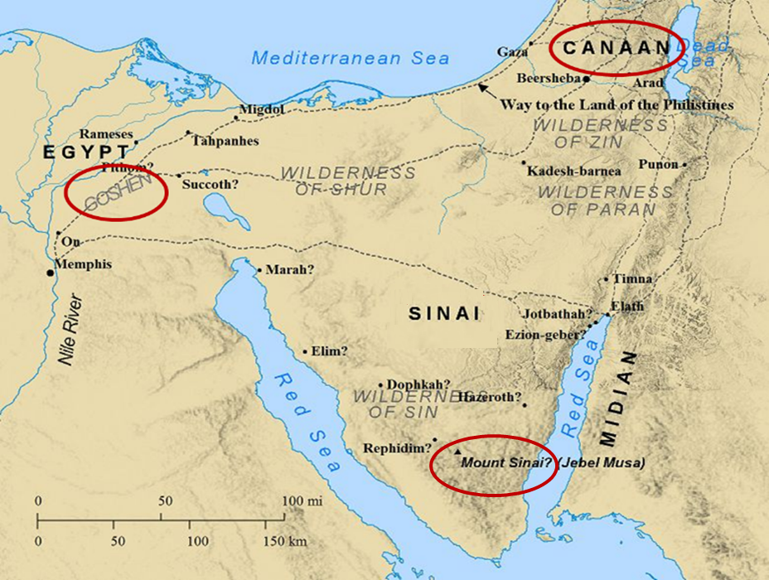

Slide 40
Protection Through the Tribulation?
(Revelation 3:10)
Like the protection in Goshen (Exod. 8:22, 24; 9;4, 6; 11:4-7; Rev. 9:4; 16:2)
Effective? Rev. 6:9-11; 7:13-14; 13:10, 15; 20:4

Slide 41
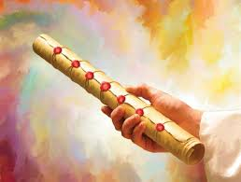
1st Six Seals (Revelation 6)
SEAL 1 – 6:1-2 – Advent of antichrist
SEAL 2 – 6:3-4 – War
SEAL 3 – 6:5-6 – Famine
SEAL 4 – 6:7-8 – Death
SEAL 5 – 6:9-11 – Martyrdoms
SEAL 6 – 6:12-17 – Cosmic disturbances

Slide 42
Distinctions Between 144,000 & Multitude
144,000 | MULTITUDE
Revelation 7:1-8 | Revelation 7:9-17
Numbered | Innumerable
Jews | All nations
Sealed | Slain
Sealed before the Tribulation | Converted out of the Tribulation
Hitchcock and Ice, The Truth Behind Left Behind, 77

Slide 43
Protection Through the Tribulation?
(Revelation 3:10)
Like the protection in Goshen (Exod. 8:22, 24; 9;4, 6; 11:4-7; Rev. 9:4; 16:2)
Effective? Rev. 6:9-11; 7:13-14; 13:10, 15; 20:4

Slide 44
Revelation 3:10
“Because you have kept the word of My perseverance, I also will keep you from the hour [hōra] of testing, that hour which is about to come upon the whole world, to test those who dwell on the earth.”

Slide 45
Charles Ryrie
What You Should Know About the Rapture, Current Christian Issues (Chicago: Moody, 1981), 116-17.
“However, the promise of Revelation 3:10 not only guarantees being kept from the trials of the Tribulation period but being kept from the time period of the Tribulation. The promise is not, I will keep you from the trials. It is I will keep you from the hour of the trials...But how clear and plain is the promise. ‘I...will keep you from the hour of testing.’ Not just from any persecution, but from the coming time that will affect the whole earth. (The only way to escape worldwide trouble is not to be on the earth.) And not just from the events, but from the time. And the only way to escape the time when the events take place is not to be in a place where time ticks on. The only place that meets those qualifications is heaven.”

Slide 46
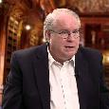
Ron Rhodes
The End Times in Chronological Order: A Complete Overview to Understanding Bible Prophecy (Eugene, OR: Harvest, 2012), 50.
“The posttribulational view, expressed in the writings of George Eldon Ladd, Robert Gundry, and others, is the view that Christ will rapture the church after the tribulation period at the second coming of Christ. This means the church will go through the time of judgment prophesied in the book of Revelation, but believers will be kept from Satan's wrath during the tribulation (Revelation 3:10). Pretribulationalists (such as myself) respond, however, that Revelation 3:10 indicates that believers will be saved out of or separated from (Greek: ek) the actual time period of the tribulation.”

Slide 47
Norman Geisler
Systematic Theology, vol. 4
(Minneapolis, MN: Bethany, 2004), 654.
“In context, the statement about being saved 'out of' (Gk: ek) the time of trial does mean saved from it (not through it). One cannot be saved from an entire hour by being in any part of it.”

Slide 48
Post-tribulation Rapture Theory
Although the church is exempted from God's wrath, the church will be on the earth during the entire Tribulation period because the Book of Revelation portrays God's people being supernaturally protected from many of the apocalyptic judgments during this time period.
The post-tribulational rapture position has been the dominant view held by theologians throughout the history of the church.

Slide 49
George Eldon Ladd
The Blessed Hope (Grand Rapids: Eerdmans, 1956), 31.
According to posttribulationalist George Ladd, "every church father who deals with the subject expects the church to suffer at the hands of the Antichrist" and "the prevailing view is post-tribulational premillennialism.”

Slide 50
Robert H. Gundry
The Church and the Tribulation (Grand Rapids: Zondervan, 1973), 173.
Gundry similarly concludes, "Until Augustine in the fourth century, the early Church generally held to the premillennarian understanding of Biblical eschatology...And it was post-tribulational.”

Slide 51
What is the Rapture?
An important doctrine
Distinct from the Second Advent
Catching away of all living believers (1 Thess 4:17)
Reunion (1 Thess 4:14-16)
Resurrection (1 Cor 15:50-54)
Exemption from death (1 Cor 15:51, 54-56)
Instantaneous (1 Cor 15:52)
Mystery (1 Cor 15:51)
Imminent (1 Cor 15:51; 1 Thess 4:15)
Traditional doctrine now being recovered

Slide 52
Post-tribulationalism’s Appeal to Antiquity?
First, the issue is not when the view became popular but if it is taught in the Bible.
Second, the notion that the earliest Church Fathers were universally post-tribulational is a highly debatable proposition.
Third, prophetic truth is designed by the Holy Spirit to become progressively more understandable as the world approaches the allotted time period when the prophecies will be fulfilled.

Slide 53
Post-tribulationalism’s Appeal to Antiquity?
First, the issue is not when the view became popular but if it is taught in the Bible.
Second, the notion that the earliest Church Fathers were universally post-tribulational is a highly debatable proposition.
Third, prophetic truth is designed by the Holy Spirit to become progressively more understandable as the world approaches the allotted time period when the prophecies will be fulfilled.

Slide 54
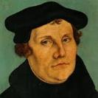
“I ask for the Scripture, and Eck offers me the Fathers. I ask for the sun, and he shows me his lanterns. I ask, ‘where is your Scripture proof?’ and he adduces Ambrose and Cyril…With all due respect to the Fathers, I prefer the authority of Scripture.”
Martin Luther
Quoted by F.W. Farrar, History of interpretation (NY: E.P. Dutton and Company, 1886), 327.

Slide 55
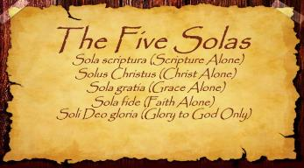
The Five Solas (Alone or By Itself)
Solus Christus – Christ alone
Sola Fide – faith alone
Sola Gratia – grace alone
Sola Scriptura – Scripture alone
Soli Deo Gloria – To the glory of God alone

Slide 56
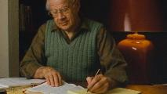
J. Dwight Pentecost Things to Come, Page 168
“If the same line of reasoning were followed one would not accept the doctrine of justification by faith, for it was not clearly taught until the Reformation. The failure to discern the teaching of Scripture does not nullify that teaching.”

Slide 57
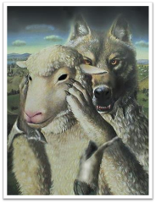
Acts 20:29
“For I know this, that after my departure savage wolves will come in among you, not sparing the flock.” (Italics added).

Slide 58
Post-tribulationalism’s Appeal to Antiquity?
First, the issue is not when the view became popular but if it is taught in the Bible.
Second, the notion that the earliest Church Fathers were universally post-tribulational is a highly debatable proposition.
Third, prophetic truth is designed by the Holy Spirit to become progressively more understandable as the world approaches the allotted time period when the prophecies will be fulfilled.

Slide 59
J. Dwight Pentecost Things to Come, Page 168
“The early church lived in the light of the belief in the imminent return of Christ. Their expectation was that Christ might return at any time. Pre-tribulationism is the only position consistent with this doctrine of imminence.”

Slide 60
Jesse Forest Silver
The Lord’s Return: Seen in History and in Scripture as Premillennial and Imminent (NY: Revell, 1914), 62-64.
Silver says of the apostolic fathers that “they expected the return of the Lord in their day…They believed the time was imminent because the Lord had taught them to live in a watchful attitude.” Concerning the ante Nicene fathers, he says: “by tradition they knew the faith of the apostles. They taught the doctrine of the imminent and pre-millennial return of the Lord.”

Slide 61
Second Epistle of Clement to the Corinthians 4.15. (A.D. 95‒140)
“Wherefore let us every hour expect the kingdom of God in love and righteousness; because we know not the day of God's appearing.”

Slide 62
Didache 16.1. (A.D. 120)
“Watch for your life's sake. Let not your lamps be quenched, nor your loins unloosed; but be ready, for you know not the hour in which our Lord will come.”

Slide 63
Epistle of Barnabas 21. (A.D. 70‒135)
“For the day is at hand on which all things shall perish with the evil [one]. The Lord is near, and His reward.”

Slide 64
Pseudo Ephraem (4th-6th century A.D.)
“Why therefore do we not reject every care of earthly actions and prepare ourselves for the meeting of the Lord Christ, so that he may draw us from the confusion, which overwhelms all the world…For all the saints and the elect of God are gathered, prior to the tribulation that is to come, and are taken to the Lord lest they see the confusion that is to overwhelm the world because of our sins.”

Slide 65
Post-tribulationalism’s Appeal to Antiquity?
First, the issue is not when the view became popular but if it is taught in the Bible.
Second, the notion that the earliest Church Fathers were universally post-tribulational is a highly debatable proposition.
Third, prophetic truth is designed by the Holy Spirit to become progressively more understandable as the world approaches the allotted time period when the prophecies will be fulfilled.

Slide 66
“The Rapture” a Traditional Doctrine Now Being Recovered
Sola scriptura
Negative influence of Augustine and Origen
Pseudo Ephraem (4th-6th century A.D.)
Progressive illumination

Slide 67
Jude 3
“Beloved, while I was making every effort to write you about our common salvation, I felt the necessity to write to you appealing that you contend earnestly for the faith which was once for all handed down to the saints.”

Slide 68
Revelation 22:18-19
“I testify to everyone who hears the words of the prophecy of this book: if anyone adds to them, God will add to him the plagues which are written in this book; ¹⁹ and if anyone takes away from the words of the book of this prophecy, God will take away his part from the tree of life and from the holy city, which are written in this book.”

Slide 69
Daniel 12:4, 9
“⁴ But as for you, Daniel, conceal these words and seal up the book until the end of time; many will go back and forth, and knowledge will increase...⁹ Go your way, Daniel, for these words are concealed and sealed up until the end time.”

Slide 70
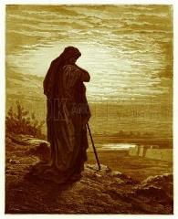
Amos 8:12
“People will stagger from sea to sea And from the north even to the east; They will go to and fro to seek the word of the Lord, But they will not find it.”

Slide 71
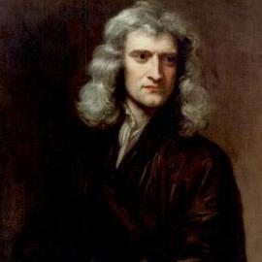
Sir Isaac Newton (1642–1727)
"About the time of the end, a body of men will be raised up who will turn their attention to the Prophecies, and insist upon their literal interpretation, in the midst of much clamor and opposition."
Isaac Newton cited in Nathaniel West, The Thousand Years in Both Testaments, 462.

Slide 72
Daniel 8:27
“Then I, Daniel, was exhausted and sick for days. Then I got up again and carried on the king’s business; but I was astounded at the vision, and there was none to explain it.”

Slide 73
1 Peter 1:10-11
¹⁰ As to this salvation, the prophets who prophesied of the grace that would come to you made careful searches and inquiries, ¹¹ seeking to know what person or time the Spirit of Christ within them was indicating as He predicted the sufferings of Christ and the glories to follow.

Slide 74
History of Doctrine
Canon (A.D. 180)
Christology (A.D. 500)
Atonement (A.D. 1100)
Salvation (A.D. 1500)
Eschatology (A.D. 1800)

Slide 75
James Orr
The Progress of Dogma (Grand Rapids: Eerdmans, 1952), 21-31.
Orr outlines the progress of Christian dogma in a similar way. “The second century was the age of Apologetics. The doctrine of God and especially the Trinity then took center stage in the third and fourth centuries as the Church dealt with the Monarchian, Arian, and Macedonian controversies. Anthropology then became the Church's focus in the early fifth century during the Augustinian and Pelagian controversies...The late fifth and then sixth and seventh centuries were characterized by an ecclesiastical interest in Christological (Nestorian, Eutychian, Monphysite, Monothelite) matters. In the . . .

Slide 76
James Orr
The Progress of Dogma (Grand Rapids: Eerdmans, 1952), 21-31.
“. . .sixteenth century the reformers focused upon salvific or Soteriological concerns. Finally, the Church gave itself to correcting a Mythical and Mediaeval pre-reformation Eschatology.” Thus, Eschatology was the last of the branches of theology to be systematized since it was not designed to be progressively unsealed or illuminated by the Holy Spirit until just before the fulfillment of the predicted events (Dan. 12:4, 8-9).

Slide 77
Conclusion

Slide 78
When Will the Rapture Take Place Relative to the Tribulation Period?
Pre-tribulation rapture theory
Mid-tribulation rapture theory
Post-tribulation rapture theory
Pre-wrath rapture theory
Partial rapture theory

Slide 79
Post-tribulation Rapture Theory
According to 1 Thessalonians 4:16 and 1 Corinthians 15:52, the rapture will take place at the sounding of the last trumpet which, according to Matthew 24:30-31, will take place upon Christ's return at the end of the Tribulation period.
The Rapture is found in Revelation 19:11-21.
According to Revelation 20:4-6, the resurrection of all believers will transpire at the end of the Tribulation period thereby necessitating that the rapture will also take place at this time.

Slide 80
Post-tribulation Rapture Theory
Although the church is exempted from God's wrath, the church will be on the earth during the entire Tribulation period because the Book of Revelation portrays God's people being supernaturally protected from many of the apocalyptic judgments during this time period.
The post-tribulational rapture position has been the dominant view held by theologians throughout the history of the church.

Slide 81
When Will the Rapture Take Place Relative to the Tribulation Period?
Pre-tribulation rapture theory
Mid-tribulation rapture theory
Post-tribulation rapture theory
Pre-wrath rapture theory
Partial rapture theory

