Slide 1
Why God Became Man
(Hebrews 2:5-18)
Dr. Andrew M. Woods
Sugar Land Bible Church
Christmas 2020
Some artwork by Pat Marvenko Smith, Copyright 1992 is used from a series titled, “Revelation Illustrated” and is used with permission. It is available in fine art prints and visual teaching materials. Call 1-800-3277330 for a free brochure, or go to www.revelationillustrated.com

Slide 2

REMEMBRANCE
In Second Peter
Has forgotten that he has been cleansed (1:9)
I will always remind you of these things (1:12)
It is right to refresh your memory (1:13)
You will always be able to remember these things (1:15)
I have written both of them as reminders (3:1)
Do not forget (3:8)
Bear in mind (3:15)

Slide 3
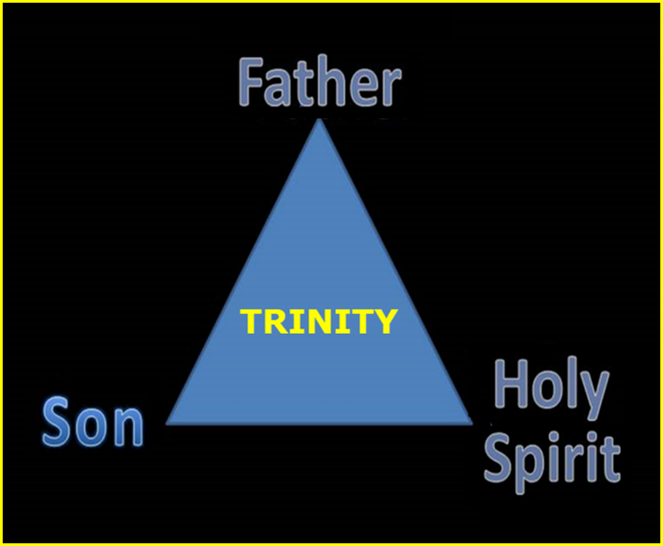

Slide 4


Slide 5

An Important Doctrine
Incarnation
Hypostatic Union
100% God
100 % Man
Unique God-Man

Slide 6

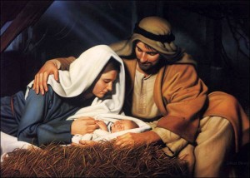
John 1:14
“And the Word became flesh, and dwelt among us, and we saw His glory, glory as of the only begotten [monogenēs] from the Father, full of grace and truth.”

Slide 7
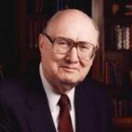
Dr. John Walvoord
Jesus Christ Our Lord, 143-44
“The act of kenosis as stated in Philippians 2 may therefore be properly understood to mean that Christ surrendered no attribute of deity, but that He did voluntarily restrict their independent use in keeping with His purpose of living among men and their limitations.”

Slide 8
Why God Became Man
Preview
To restore God’s original purpose for man (5-8)
To taste death for every man (9)
To bring many to glory (10-13)
To break Satan’s rule over humanity (14)
To remove the fear of death (15)
To become our merciful high priest (16-17a)
To make a complete purification for sin (17b)
To sympathize with those tested (18)
Adapted from J. Dwight Pentecost, Faith that Endures (Grand Rapids, MI: Kregel, 2000), 60-71.

Slide 9
Why God Became Man
(Heb. 2:5-18)
To restore God’s original purpose for man (5-8)
To taste death for every man (9)
To bring many to glory (10-13)
To break Satan’s rule over humanity (14)
To remove the fear of death (15)
To become our merciful high priest (16-17a)
To make a complete purification for sin (17b)
To sympathize with those tested (18)
Adapted from J. Dwight Pentecost, Faith that Endures (Grand Rapids, MI: Kregel, 2000), 60-71.

Slide 10
Genesis 1:26-28
²⁶ Then God said, “Let Us make man in Our image, according to Our likeness; and let them rule over the fish of the sea and over the birds of the sky and over the cattle and over all the earth, and over every creeping thing that creeps on the earth.” ²⁷ God created man in His own image, in the image of God He created him; male and female He created them. ²⁸ God blessed them; and God said to them, “Be fruitful and multiply, and fill the earth, and subdue it; and rule over the fish of the sea and over the birds of the sky and over every living thing that moves on the earth.”

Slide 11
Genesis 1:26-28
²⁶ Then God said, “Let Us make man in Our image, according to Our likeness; and let them rule over the fish of the sea and over the birds of the sky and over the cattle and over all the earth, and over every creeping thing that creeps on the earth.” ²⁷ God created man in His own image, in the image of God He created him; male and female He created them. ²⁸ God blessed them; and God said to them, “Be fruitful and multiply, and fill the earth, and subdue it; and rule over the fish of the sea and over the birds of the sky and over every living thing that moves on the earth.”

Slide 12
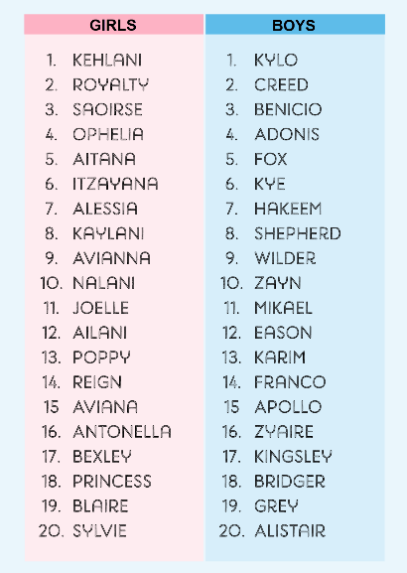
Biblical Significance of Naming
Genesis 1:8
Numbers 32:37-38
2 Kings 23:24
2 Kings 24:17
Daniel 1:6-7
Fruchtenbaum, Genesis, 84

Slide 13
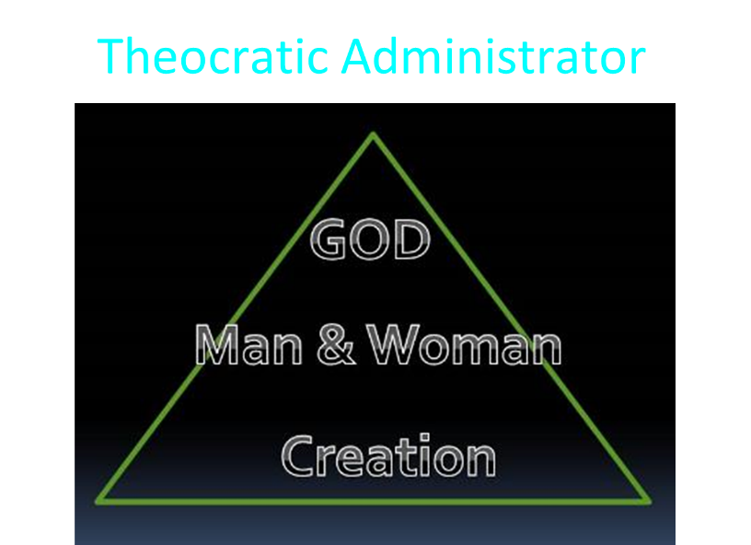

Slide 14
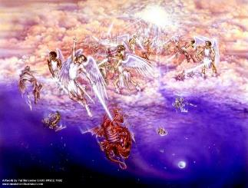
Satan as Ruler of this World
Job 1:7; 2:2
Luke 4:5-7
John 12:31; 14:30; 16:11
2 Corinthians 4:4
Ephesians 2:2
1 John 4:4; 5:19

Slide 15

Names & Titles Demonstrating Satan’s Post-Fall, Earthly Authority
(Job 1:7; 2:2; Luke 4:5-8; Rom. 8:19-22)
Prince of this world (John 12:31; 14:30; 16:11)
God of this world (2 Cor. 4:4)
Prince and power of the air (Eph. 2:2)
Who the believer wrestles with (Eph. 6:12)
Roaring lion (1 Pet. 5:8)
Whole world lies in his power (1 John 5:19)

Slide 16

Romans 8:19–23
¹⁹ For the anxious longing of the creation waits eagerly for the revealing of the sons of God. ²⁰ For the creation was subjected to futility, not willingly, but because of Him who subjected it, in hope ²¹ that the creation itself also will be set free from its slavery to corruption into the freedom of the glory of the children of God. ²² For we know that the whole creation groans and suffers the pains of childbirth together until now. ²³ And not only this, but also we ourselves, having the first fruits of the Spirit, even we ourselves groan within ourselves, waiting eagerly for our adoption as sons, the redemption of our body.

Slide 17
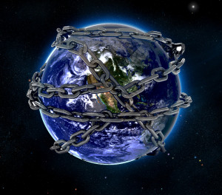

Slide 19


Slide 20
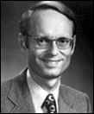
Charles Ryrie
Basic Theology, Page 511
“Why is an earthly kingdom necessary? Did He not receive His inheritance when He was raised and exalted in heaven? Is not His present rule His inheritance? Why does there need to be an earthly kingdom? Because He must be triumphant in the same arena where He was seemingly defeated. His rejection by the rulers of this world was on this earth (1Cor. 2:8). His exaltation must also be on this earth. And so it shall be when He comes again to rule this world in righteousness. He has waited long for His inheritance; soon He shall receive it.”

Slide 21
To Reverse Man’s Sinful Condition
Adam’s disobedience affected all
Christ’s obedience blessed all
Christ is the last Adam
  1 Cor 15:45; Rom 5:18-19

Slide 22
The Two Most Influential Men in World History
 | Adam | Jesus
Single action | Disobedience | Obedience
Tree | Knowledge | Cross
Universal impact | Curse | Blessing
Birth | Physical | Spiritual
Adam | First | Last

Slide 23
Why God Became Man
(Heb. 2:5-18)
To restore God’s original purpose for man (5-8)
To taste death for every man (9)
To bring many to glory (10-13)
To break Satan’s rule over humanity (14)
To remove the fear of death (15)
To become our merciful high priest (16-17a)
To make a complete purification for sin (17b)
To sympathize with those tested (18)
Adapted from J. Dwight Pentecost, Faith that Endures (Grand Rapids, MI: Kregel, 2000), 60-71.

Slide 24

Hebrews 2:9
But we do see Him who was made for a little while lower than the angels, namely, Jesus, because of the suffering of death crowned with glory and honor, so that by the grace of God He might taste death for everyone.

Slide 25
Hebrews 2:9
But we do see Him who was made for a little while lower than the angels, namely, Jesus, because of the suffering of death crowned with glory and honor, so that by the grace of God He might taste death for everyone.

Slide 26

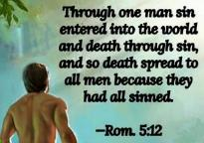
Genesis 2:16-17
“¹⁶ The Lord God commanded the man, saying, ‘From any tree of the garden you may eat freely; ¹⁷ but from the tree of the knowledge of good and evil you shall not eat, for in the day that you eat from it you will surely die (muwth).’”

Slide 27
To Pay the Penalty for Man’s Sin
Gen. 2:17
Gen. 3:21
Ezek. 18:20
Rom. 6:23
Hebrews 2:9

Slide 28
Hebrews 2:9
But we do see Him who was made for a little while lower than the angels, namely, Jesus, because of the suffering of death crowned with glory and honor, so that by the grace of God He might taste death for everyone.

Slide 29
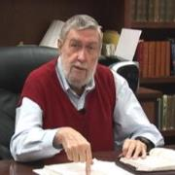
Jay Adams
Competent to Counsel, 70.
“But counselors, as Christians, are obligated to present the claims of Christ. They must present the good news that Christ Jesus died on the cross in the place of His own, that He bore the guilt and suffered the penalty for their sins. He died that all whom the Father had given to Him might come unto Him and have life everlasting. As a reformed Christian, the writer believes that counselors must not tell any unsaved counselee that Christ died for him, FOR THEY CANNOT SAY THAT. No man knows except Christ Himself who are His elect for whom He died." [emphasis mine]

Slide 30
Why God Became Man
(Heb. 2:5-18)
To restore God’s original purpose for man (5-8)
To taste death for every man (9)
To bring many to glory (10-13)
To break Satan’s rule over humanity (14)
To remove the fear of death (15)
To become our merciful high priest (16-17a)
To make a complete purification for sin (17b)
To sympathize with those tested (18)
Adapted from J. Dwight Pentecost, Faith that Endures (Grand Rapids, MI: Kregel, 2000), 60-71.

Slide 31
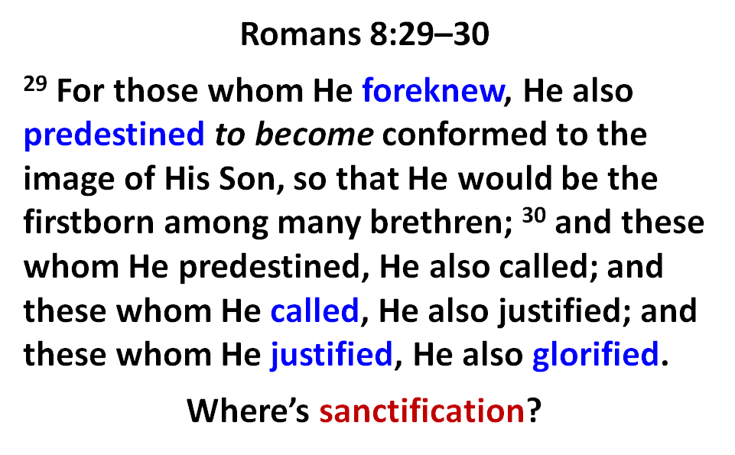

Slide 32
Why God Became Man
(Heb. 2:5-18)
To restore God’s original purpose for man (5-8)
To taste death for every man (9)
To bring many to glory (10-13)
To break Satan’s rule over humanity (14)
To remove the fear of death (15)
To become our merciful high priest (16-17a)
To make a complete purification for sin (17b)
To sympathize with those tested (18)
Adapted from J. Dwight Pentecost, Faith that Endures (Grand Rapids, MI: Kregel, 2000), 60-71.

Slide 33

Hebrews 2:14
Therefore, since the children share in flesh and blood, He Himself likewise also partook of the same, that through death He might render powerless him who had the power of death, that is, the devil.

Slide 34
Hebrews 2:14
Therefore, since the children share in flesh and blood, He Himself likewise also partook of the same, that through death He might render powerless him who had the power of death, that is, the devil.

Slide 35
Satan as Ruler of this World
Job 1:7; 2:2
Luke 4:5-7
John 12:31; 14:30; 16:11
2 Corinthians 4:4
Ephesians 2:2
1 John 4:4; 5:19

Slide 36
Names & Titles Demonstrating Satan’s Post-Fall, Earthly Authority
(Job 1:7; 2:2; Luke 4:5-8; Rom. 8:19-22)
Prince of this world (John 12:31; 14:30; 16:11)
God of this world (2 Cor. 4:4)
Prince and power of the air (Eph. 2:2)
Who the believer wrestles with (Eph. 6:12)
Roaring lion (1 Pet. 5:8)
Whole world lies in his power (1 John 5:19)

Slide 38

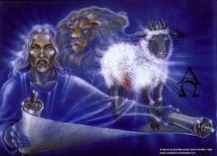
God’s Role in Redemption (Rev 5)
Seven sealed scroll (5:1)
John weeps (5:2-4)
Christ is qualified to open the scroll (5:5-6)
Christ takes the scroll (5:7)
Christ praised by various entities (5:8-14)

Slide 39
God’s Role in Redemption (Rev 5)
Seven sealed scroll (5:1)
John weeps (5:2-4)
Christ is qualified to open the scroll (5:5-6)
Christ takes the scroll (5:7)
Christ praised by various entities (5:8-14)

Slide 40
God’s Role in Redemption (Rev 5)
Seven sealed scroll (5:1)
John weeps (5:2-4)
Christ is qualified to open the scroll (5:5-6)
Christ takes the scroll (5:7)
Christ praised by various entities (5:8-14)

Slide 41
God’s Role in Redemption (Rev 5)
Seven sealed scroll (5:1)
John weeps (5:2-4)
Christ is qualified to open the scroll (5:5-6)
Christ takes the scroll (5:7)
Christ praised by various entities (5:8-14)

Slide 42

A Manifestation
(Rev. 5:5b-6)
Right tribe: Judah (5:5b)
Right lineage: Davidic (5:5c)
Right victory: Overcame (5:5d)
Right mission: Lamb (5:6)

Slide 43
God’s Role in Redemption (Rev 5)
Seven sealed scroll (5:1)
John weeps (5:2-4)
Christ is qualified to open the scroll (5:5-6)
Christ takes the scroll (5:7)
Christ praised by various entities (5:8-14)

Slide 44
God’s Role in Redemption (Rev 5)
Seven sealed scroll (5:1)
John weeps (5:2-4)
Christ is qualified to open the scroll (5:5-6)
Christ takes the scroll (5:7)
Christ praised by various entities (5:8-14)

Slide 45
Ultimate Exodus
(Rev 11:15)
Sores: 6th plague (Ex 9:8-12), 1st bowl (Rev 16:1-2)
Rivers to blood: 1st plague (Ex 7:19-21), 3rd bowl (Rev 16:4-7)
Darkness: 9th plague (Ex 10:21-23), 5th bowl (Rev 16:10-11)
Frogs: 2nd plague (Ex 7:25‒8:15), 6th bowl (Rev 16:13)
Hail: 7th plague (Ex 9:22-26), 7th bowl (Rev 16:17-21)

Slide 46


Slide 47

Satan’s Progressive Defeat
Initial eviction from heaven (Isa 14:12-15; Ezek 28:12-17)
Eden (Gen 3:15)
Pre-diluvian world (1 Pet 3:19-20)
Cross (John 12:31; 16:11; Col 2:15; Heb 2:14; 1 John 3:8)
Mid point of the Tribulation (Rev 12:9)
Beginning of millennium (Rev 20:2-3)
End of millennium (Rev 20:10)

Slide 48
Satan’s Progressive Defeat
Initial eviction from heaven (Isa 14:12-15; Ezek 28:12-17)
Eden (Gen 3:15)
Pre-diluvian world (1 Pet 3:19-20)
Cross (John 12:31; 16:11; Col 2:15; Heb 2:14; 1 John 3:8)
Mid point of the Tribulation (Rev 12:9)
Beginning of millennium (Rev 20:2-3)
End of millennium (Rev 20:10)

Slide 49
Why God Became Man
(Heb. 2:5-18)
To restore God’s original purpose for man (5-8)
To taste death for every man (9)
To bring many to glory (10-13)
To break Satan’s rule over humanity (14)
To remove the fear of death (15)
To become our merciful high priest (16-17a)
To make a complete purification for sin (17b)
To sympathize with those tested (18)
Adapted from J. Dwight Pentecost, Faith that Endures (Grand Rapids, MI: Kregel, 2000), 60-71.

Slide 50

Hebrews 2:15
and release those who through fear of death were all their lifetime subject to bondage.

Slide 51
Hebrews 2:15
and release those who through fear of death were all their lifetime subject to bondage.

Slide 53
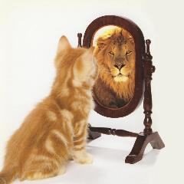
2 Corinthians 5:8
we are of good courage, I say, and prefer rather to be absent from the body and to be at home with the Lord.

Slide 54
2 Corinthians 5:8
we are of good courage, I say, and prefer rather to be absent from the body and to be at home with the Lord.

Slide 55
Philippians 1:21-24
²¹ For to me, to live is Christ and to die is gain. ²² But if I am to live on in the flesh, this will mean fruitful labor for me; and I do not know which to choose. ²³ But I am hard-pressed from both directions, having the desire to depart and be with Christ, for that is very much better; ²⁴ yet to remain on in the flesh is more necessary for your sake.

Slide 56
Why God Became Man
(Heb. 2:5-18)
To restore God’s original purpose for man (5-8)
To taste death for every man (9)
To bring many to glory (10-13)
To break Satan’s rule over humanity (14)
To remove the fear of death (15)
To become our merciful high priest (16-17a)
To make a complete purification for sin (17b)
To sympathize with those tested (18)
Adapted from J. Dwight Pentecost, Faith that Endures (Grand Rapids, MI: Kregel, 2000), 60-71.

Slide 57
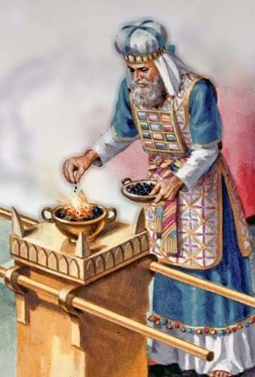
To Become Man’s Merciful High Priest
Definition of a priest
Job’s cry (Job 9:32-33)
One mediator (1 Timothy 2:5)

Slide 58
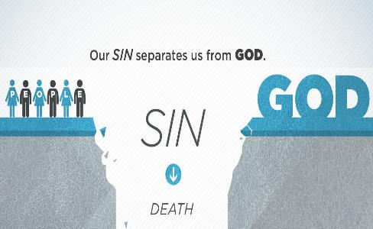
Job 9:32-33
³² “For He is not a man as I am that I may answer Him, That we may go to court together. ³³ There is no umpire between us, Who may lay his hand upon us both.”

Slide 59
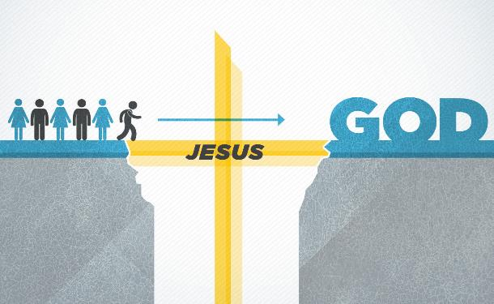
1 Timothy 2:5
“For there is one God, and one mediator also between God and men, the man Christ Jesus.”

Slide 60
Why God Became Man
(Heb. 2:5-18)
To restore God’s original purpose for man (5-8)
To taste death for every man (9)
To bring many to glory (10-13)
To break Satan’s rule over humanity (14)
To remove the fear of death (15)
To become our merciful high priest (16-17a)
To make a complete purification for sin (17b)
To sympathize with those tested (18)
Adapted from J. Dwight Pentecost, Faith that Endures (Grand Rapids, MI: Kregel, 2000), 60-71.

Slide 61
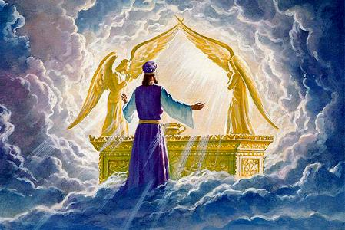
Hebrews 2:17
Therefore, in all things He had to be made like His brethren, that He might be a merciful and faithful High Priest in things pertaining to God, to make propitiation for the sins of the people.

Slide 62
Hebrews 2:17
Therefore, in all things He had to be made like His brethren, that He might be a merciful and faithful High Priest in things pertaining to God, to make propitiation [hilasmos; hilaskomai] for the sins of the people.

Slide 63
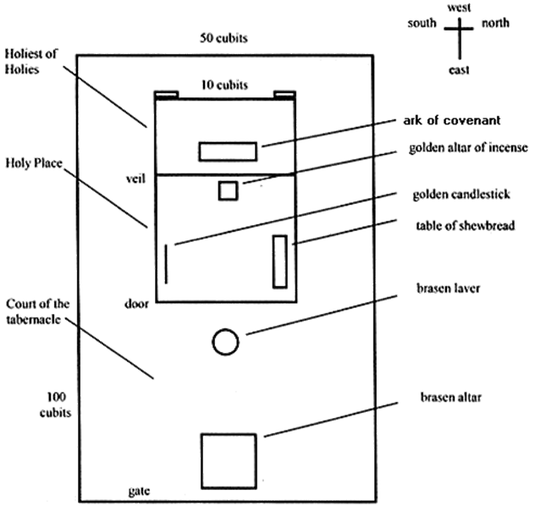
Tabernacle Diagram

Slide 64
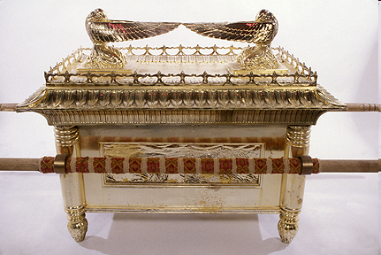
Ark of the Covenant

Slide 65
Hebrews 10:5-7
⁵ Therefore, when He comes into the world, He says, “Sacrifice and offering You have not desired, But a body You have prepared for Me;⁶ In whole burnt offerings and sacrifices for sin You have taken no pleasure.⁷ “Then I said, ‘Behold, I have come (In the scroll of the book it is written of Me) To do Your will, O God.’”

Slide 66
Hebrews 10:5-7
⁵ Therefore, when He comes into the world, He says, “Sacrifice and offering You have not desired, But a body You have prepared for Me;⁶ In whole burnt offerings and sacrifices for sin You have taken no pleasure.⁷ “Then I said, ‘Behold, I have come (In the scroll of the book it is written of Me) To do Your will, O God.’”

Slide 67

John 19:30
Therefore when Jesus had received the sour wine, He said, “It is finished!” And He bowed His head and gave up His spirit.

Slide 68
John 19:30
Therefore when Jesus had received the sour wine, He said, “It is finished!” [tetelestai] And He bowed His head and gave up His spirit.

Slide 69
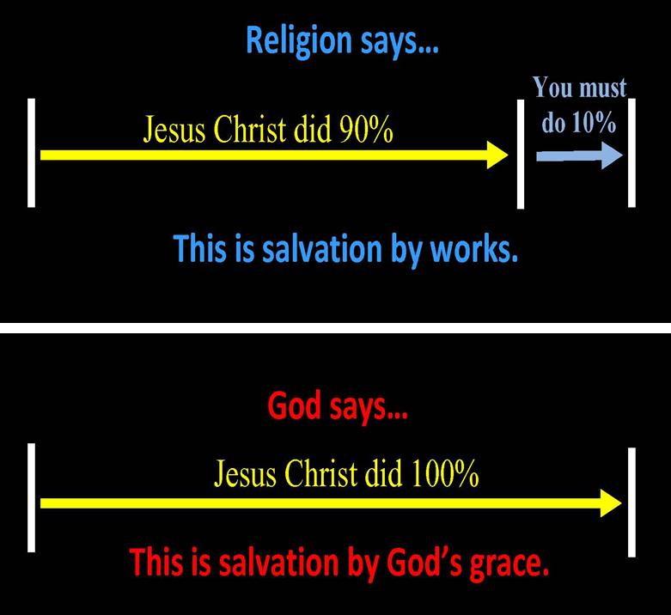
Chart courtesy of Thomas Stegall

Slide 70
Why God Became Man
(Heb. 2:5-18)
To restore God’s original purpose for man (5-8)
To taste death for every man (9)
To bring many to glory (10-13)
To break Satan’s rule over humanity (14)
To remove the fear of death (15)
To become our merciful high priest (16-17a)
To make a complete purification for sin (17b)
To sympathize with those tested (18)
Adapted from J. Dwight Pentecost, Faith that Endures (Grand Rapids, MI: Kregel, 2000), 60-71.

Slide 71

Hebrews 2:18
For since He Himself was tempted in that which He has suffered, He is able to come to the aid of those who are tempted.

Slide 72

To Become Man’s Merciful High Priest
Definition of a priest
Christ experienced temptations (Heb 2:18)
Christ experienced our trials (Heb 4:15)

Slide 73
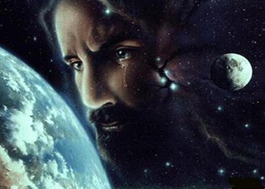
Christ’s Human Experiences
Labor (Mark 6:3)
Distress (Luke 22:44)
Being troubled (John 12:27)
Thirst (John 19:28)
Hunger (Matt 4:2)
Fatigue (John 4:6)
Sadness (John 11:35)
Lack of understanding (Matt 24:36)
Temptation (Luke 4:1-13; Heb. 4:15)

Slide 74
Hebrews 4:15-16
¹⁵ For we do not have a high priest who cannot sympathize with our weaknesses, but One who has been tempted in all things as we are, yet without sin. ¹⁶ Therefore let us draw near with confidence to the throne of grace, so that we may receive mercy and find grace to help in time of need.

Slide 75
Conclusion

Slide 76
Why God Became Man
(Heb. 2:5-18)
To restore God’s original purpose for man (5-8)
To taste death for every man (9)
To bring many to glory (10-13)
To break Satan’s rule over humanity (14)
To remove the fear of death (15)
To become our merciful high priest (16-17a)
To make a complete purification for sin (17b)
To sympathize with those tested (18)
Adapted from J. Dwight Pentecost, Faith that Endures (Grand Rapids, MI: Kregel, 2000), 60-71.

Slide 77
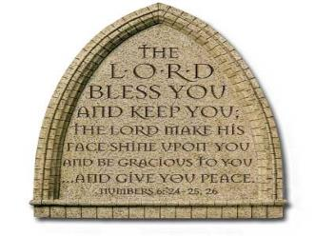
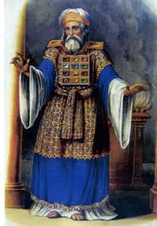
“The Lord bless you and keep you; the Lord make his face shine on you and be gracious to you; the Lord turn his face toward you and give you peace.” (NIV)

