Slide 1


THE RAPTURE
What and When? – Part 32
Andrew Marshall Woods, Th.M., JD., PhD.
Sr. Pastor, Sugar Land Bible Church

Slide 2

What is the Rapture?
An important doctrine
Distinct from the Second Advent
Catching away of all living believers (1 Thess 4:17)
Reunion (1 Thess 4:14-16)
Resurrection (1 Cor 15:50-54)
Exemption from death (1 Cor 15:51, 54-56)
Instantaneous (1 Cor 15:52)
Mystery (1 Cor 15:51)
Imminent (1 Cor 15:51; 1 Thess 4:15)
Traditional doctrine now being recovered

Slide 3


Slide 4
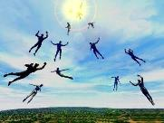
Strengthening the Pre-Tribulation Case
John 14:1-4
Revelation 3:10
First Thessalonians 4‒5
Second Thessalonians 2:3a
Matthew 24‒25

Slide 5
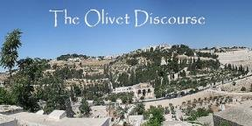
Preview of Matthew 24–25
The problem
The larger context
The immediate context (23:37-39)
The Disciples’ questions (24:1-3)
The Tribulation’s first half (24:4-14)
The Tribulation’s mid-point (24:15-20)
The Tribulation’s second half (24:21-22)
The Second Advent (24:23-31)
Eight parabolic exhortations (24:32‒25:46)

Slide 6
THE RAPTURE IN MATTHEW 24
Note the order of events:
        ²⁹ There are days of tribulation
        ³⁰ The whole world sees Jesus return
        ³¹ The elect are gathered to Him
        ⁴⁰⁻⁴¹ The rapture reiterated
How do Pre-Tribulation theorists explain the Rapture occurring before the apocalypse and before the Second Coming? Jesus says exactly the opposite in simple, unmistakable language.
Are there two Raptures - one before this that Jesus mysteriously didn't describe and then this one, which He did? Why would He leave one out? Or is there only one, but when he discusses it He jumbles up the order of events? Why would He do that?

Slide 7
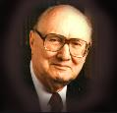
John F. Walvoord
"Christ's Olivet Discourse on the End of the Age - Part I," Bibliotheca Sacra 128/#510 (April 1971), p. 116..
“In Matthew 24–Matthew 25 the expositor should, therefore, understand that the program of God for the end of the age has in view the period ending with the second coming of Christ to the earth and the establishment of His earthly Kingdom, not the church age specifically ending with the rapture. Both the questions of the disciples and the answers of Christ are therefore, keyed to the Jewish expectation based on Old Testament prophecy, and the program of God for the earth in general rather than the church as the body of Christ.”

Slide 8
Preview of Matthew 24–25
The problem
The larger context
The immediate context (23:37-39)
The Disciples’ questions (24:1-3)
The Tribulation’s first half (24:4-14)
The Tribulation’s mid-point (24:15-20)
The Tribulation’s second half (24:21-22)
The Second Advent (24:23-31)
Eight parabolic exhortations (24:32‒25:46)

Slide 9
Matthew’s Purposes
To explain that Jesus in whom they had believed was indeed the long-awaited Jewish Messiah
To explain why the kingdom had been postponed despite the fact that the king had arrived
To explain the interim program of God during the kingdom’s absence

Slide 10
Preview of Matthew 24–25
The problem
The larger context
The immediate context (23:37-39)
The Disciples’ questions (24:1-3)
The Tribulation’s first half (24:4-14)
The Tribulation’s mid-point (24:15-20)
The Tribulation’s second half (24:21-22)
The Second Advent (24:23-31)
Eight parabolic exhortations (24:32‒25:46)

Slide 11

Matthew 23:37-39
³⁷ “Jerusalem, Jerusalem, who kills the prophets and stones those who are sent to her! How often I wanted to gather [episynagō] your children together, the way a hen gathers [episynagō] her chicks under her wings, and you were unwilling. ³⁸ Behold, your house is being left to you desolate! ³⁹ For I say to you, from now on you will not see Me until you say, ‘Blessed is He who comes in the name of the Lord!’”

Slide 12
Preview of Matthew 24–25
The problem
The larger context
The immediate context (23:37-39)
The Disciples’ questions (24:1-3)
The Tribulation’s first half (24:4-14)
The Tribulation’s mid-point (24:15-20)
The Tribulation’s second half (24:21-22)
The Second Advent (24:23-31)
Eight parabolic exhortations (24:32‒25:46)

Slide 13
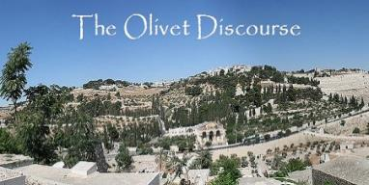
Matthew 24:3
“³ As He was sitting on the Mount of Olives, the disciples came to Him privately, saying, ‘Tell us, when will these things happen, and what will be the sign of Your coming, and of the end of the age?’”

Slide 14
Preview of Matthew 24–25
The problem
The larger context
The immediate context (23:37-39)
The Disciples’ questions (24:1-3)
The Tribulation’s first half (24:4-14)
The Tribulation’s mid-point (24:15-20)
The Tribulation’s second half (24:21-22)
The Second Advent (24:23-31)
Eight parabolic exhortations (24:32‒25:46)

Slide 15
Matt 24 / Rev 6 Parallels
Prediction | Birth pangs (Matt 24) | Seal judgments (Rev 6)
1. False Christ | 24:5 | 6:2
2. War | 24:6 | 6:3-4
3. Famine | 24:7 | 6:5-6
4. Death | 24:6-7 | 6:7-8
5. Martyrs | 24:9-13 | 6:9-11
6. Earthquakes | 24:7 | 6:12-17
7. Evangelism | 24:14 | 7:1-9

Slide 16
Preview of Matthew 24–25
The problem
The larger context
The immediate context (23:37-39)
The Disciples’ questions (24:1-3)
The Tribulation’s first half (24:4-14)
The Tribulation’s mid-point (24:15-20)
The Tribulation’s second half (24:21-22)
The Second Advent (24:23-31)
Eight parabolic exhortations (24:32‒25:46)

Slide 17


Slide 18
Preview of Matthew 24–25
The problem
The larger context
The immediate context (23:37-39)
The Disciples’ questions (24:1-3)
The Tribulation’s first half (24:4-14)
The Tribulation’s mid-point (24:15-20)
The Tribulation’s second half (24:21-22)
The Second Advent (24:23-31)
Eight parabolic exhortations (24:32‒25:46)

Slide 19

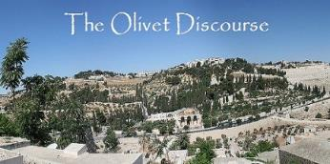
Matthew 24:21-22
“²¹ For then there will be a great tribulation, such as has not occurred since the beginning of the world until now, nor ever will. ²² Unless those days had been cut short, no life would have been saved; but for the sake of the elect those days will be cut short.”

Slide 20
Preview of Matthew 24–25
The problem
The larger context
The immediate context (23:37-39)
The Disciples’ questions (24:1-3)
The Tribulation’s first half (24:4-14)
The Tribulation’s mid-point (24:15-20)
The Tribulation’s second half (24:21-22)
The Second Advent (24:23-31)
Eight parabolic exhortations (24:32‒25:46)

Slide 22
Matthew 24:31
“And He will send forth His angels with a great trumpet and they will gather together [episynagō] His elect from the four winds, from one end of the sky to the other.”

Slide 23
Matthew 16:1–3
¹ The Pharisees and Sadducees came up, and testing Jesus, they asked Him to show them a sign from heaven. ² But He replied to them, “When it is evening, you say, ‘It will be fair weather, for the sky is red.’ ³ “And in the morning, ‘There will be a storm today, for the sky is red and threatening.’ Do you know how to discern the appearance of the sky, but cannot discern the signs of the times?

Slide 24
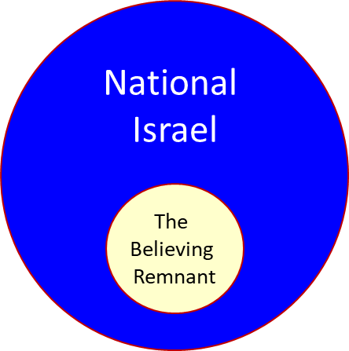

Slide 25
Zechariah 13:8-9
⁸“It will come about in all the land,” Declares the Lord, “That two parts in it will be cut off and perish; But the third will be left in it. ⁹“And I will bring the third part through the fire, Refine them as silver is refined, And test them as gold is tested. They will call on My name, And I will answer them; I will say, ‘They are My people,’ And they will say, ‘The Lord is my God.’ ”

Slide 26
Preview of Matthew 24–25
The problem
The larger context
The immediate context (23:37-39)
The Disciples’ questions (24:1-3)
The Tribulation’s first half (24:4-14)
The Tribulation’s mid-point (24:15-20)
The Tribulation’s second half (24:21-22)
The Second Advent (24:23-31)
Eight parabolic exhortations (24:32‒25:46)

Slide 27
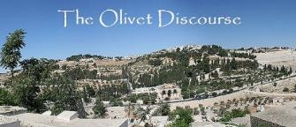
VIII. Eight Parabolic Exhortations
(Matthew 24:32–25:46)
The fig tree (24:32-35)
The days of Noah (24:36-39)
The comparison of two men & women (24:40-41)
The householder (24:42-44)
The wise servant (24:45-51)
The wise virgins (25:1-13)
The talents (25:14-30)
The sheep & goat judgment (25:31-46)

Slide 28
VIII. Eight Parabolic Exhortations
(Matthew 24:32–25:46)
The fig tree (24:32-35)
The days of Noah (24:36-39)
The comparison of two men & women (24:40-41)
The householder (24:42-44)
The wise servant (24:45-51)
The wise virgins (25:1-13)
The talents (25:14-30)
The sheep & goat judgment (25:31-46)

Slide 29
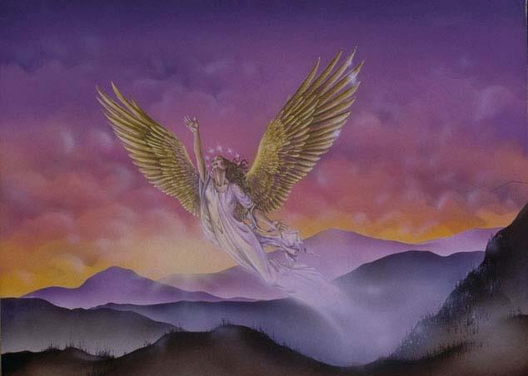
CONNECTING
REV 12 & ANTI-SEMITISM
DANIEL’S 70th WEEK (7 years)
Israel flees
3 ½ years
1260 days

Slide 30
VIII. Eight Parabolic Exhortations
(Matthew 24:32–25:46)
The fig tree (24:32-35)
The days of Noah (24:36-39)
The comparison of two men & women (24:40-41)
The householder (24:42-44)
The wise servant (24:45-51)
The wise virgins (25:1-13)
The talents (25:14-30)
The sheep & goat judgment (25:31-46)

Slide 31

Matthew 24:36-39
³⁶ “But of that day and hour no one knows, not even the angels of heaven, nor the Son, but the Father alone. ³⁷ For the coming of the Son of Man will be just like the days of Noah. ³⁸ For as in those days before the flood they were eating and drinking, marrying and giving in marriage, until the day that Noah entered the ark, ³⁹ and they did not understand until the flood came and took them all away; so will the coming of the Son of Man be.”

Slide 32
VIII. Eight Parabolic Exhortations
(Matthew 24:32–25:46)
The fig tree (24:32-35)
The days of Noah (24:36-39)
The comparison of two men & women (24:40-41)
The householder (24:42-44)
The wise servant (24:45-51)
The wise virgins (25:1-13)
The talents (25:14-30)
The sheep & goat judgment (25:31-46)

Slide 33
Matthew 24:36-41
³⁶ “But of that day and hour no one knows, not even the angels of heaven, nor the Son, but the Father alone. ³⁷ For the coming of the Son of Man will be just like the days of Noah. ³⁸ For as in those days before the flood they were eating and drinking, marrying and giving in marriage, until the day that Noah entered the ark, ³⁹ and they did not understand until the flood came and took them all away; so will the coming of the Son of Man be. ⁴⁰ Then there will be two men in the field; one will be taken and one will be left. ⁴¹ Two women will be grinding at the mill; one will be taken and one will be left.”

Slide 34
C. The Comparison of Two Men and Women
Matthew 24:40-41
No rapture reasons
  Preceding context
  Days of Noah chronology
  Son of Man
  Other Matthean judgments
  Lukan parallel passage

Slide 35
C. The Comparison of Two Men and Women
Matthew 24:40-41
Pro-rapture reasons
  From airō to paralambanō
  Day or hour can be known in the Tribulation
  Normal life activities at the end of the Tribulation
  Peri De (“Now Concerning”) construction

Slide 36
VIII. Eight Parabolic Exhortations
(Matthew 24:32–25:46)
The fig tree (24:32-35)
The days of Noah (24:36-39)
The comparison of two men & women (24:40-41)
The householder (24:42-44)
The wise servant (24:45-51)
The wise virgins (25:1-13)
The talents (25:14-30)
The sheep & goat judgment (25:31-46)

Slide 37
VIII. Eight Parabolic Exhortations
(Matthew 24:32–25:46)
The fig tree (24:32-35)
The days of Noah (24:36-39)
The comparison of two men & women (24:40-41)
The householder (24:42-44)
The wise servant (24:45-51)
The wise virgins (25:1-13)
The talents (25:14-30)
The sheep & goat judgment (25:31-46)

Slide 38
VIII. Eight Parabolic Exhortations
(Matthew 24:32–25:46)
The fig tree (24:32-35)
The days of Noah (24:36-39)
The comparison of two men & women (24:40-41)
The householder (24:42-44)
The wise servant (24:45-51)
The wise virgins (25:1-13)
The talents (25:14-30)
The sheep & goat judgment (25:31-46)

Slide 39
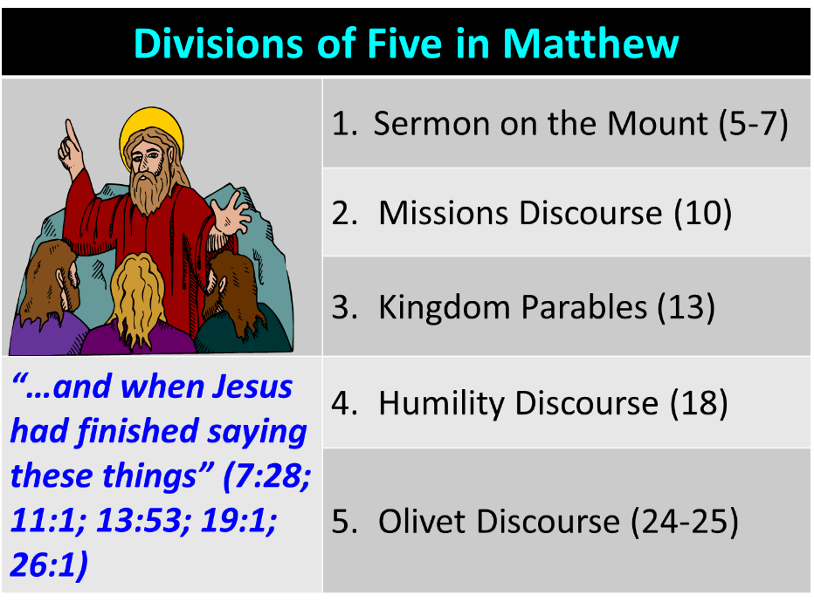

Slide 40

F. Partial Rapture of the Church?
(Matthew 25:1-13)
  Chapter division & preceding context
  Demoted from bride to [bride] maidens
  Bride? Body? In Christ?
  Translation? Resurrection?
  Bridegroom comes to the earth

Slide 41
F. Partial Rapture of the Church?
(Matthew 25:1-13)
  All asleep (vs. 5)
  Rapture for all Christians (1 Cor. 15:51)
  End of the Inter-Advent Age
  Consistency with the other Parables
  Dispensationally misapplied passage

Slide 42
VIII. Eight Parabolic Exhortations
(Matthew 24:32–25:46)
The fig tree (24:32-35)
The days of Noah (24:36-39)
The comparison of two men & women (24:40-41)
The householder (24:42-44)
The wise servant (24:45-51)
The wise virgins (25:1-13)
The talents (25:14-30)
The sheep & goat judgment (25:31-46)

Slide 43
VIII. Eight Parabolic Exhortations
(Matthew 24:32–25:46)
The fig tree (24:32-35)
The days of Noah (24:36-39)
The comparison of two men & women (24:40-41)
The householder (24:42-44)
The wise servant (24:45-51)
The wise virgins (25:1-13)
The talents (25:14-30)
The sheep & goat judgment (25:31-46)

Slide 44
Matthew 23:37-39
³⁷ “Jerusalem, Jerusalem, who kills the prophets and stones those who are sent to her! How often I wanted to gather [episynagō] your children together, the way a hen gathers [episynagō] her chicks under her wings, and you were unwilling. ³⁸ Behold, your house is being left to you desolate! ³⁹ For I say to you, from now on you will not see Me until you say, ‘Blessed is He who comes in the name of the Lord!’”

Slide 45
Matthew 24:31
“And He will send forth His angels with a great trumpet and they will gather together [episynagō] His elect from the four winds, from one end of the sky to the other.”

Slide 46

Jeremiah 30:7
“Alas! for that day is great, There is none like it; And it is the time of Jacob’s distress (Gen. 32:8; 35:10), But he will be saved from it.”

Slide 47


Slide 48
Ezekiel 20:33-38
³³ “As I live,” declares the Lord God, “surely with a mighty hand and with an outstretched arm and with wrath poured out, I shall be king over you. ³⁴ I will bring you out from the peoples and gather you from the lands where you are scattered, with a mighty hand and with an outstretched arm and with wrath poured out; ³⁵ and I will bring you into the wilderness of the peoples, and there I will enter into judgment . . .

Slide 49
Ezekiel 20:33-38
…with you face to face. ³⁶ As I entered into judgment with your fathers in the wilderness of the land of Egypt, so I will enter into judgment with you,” declares the Lord God. ³⁷ “I will make you pass under the rod, and I will bring you into the bond of the covenant; ³⁸ and I will purge from you the rebels and those who transgress against Me; I will bring them out of the land where they sojourn, but they will not enter the land of Israel. Thus you will know that I am the Lord.

Slide 50
Matthew 24:21-22
“²¹ For then there will be a great tribulation, such as has not occurred since the beginning of the world until now, nor ever will. ²² Unless those days had been cut short, no life would have been saved; but for the sake of the elect those days will be cut short.”

Slide 51
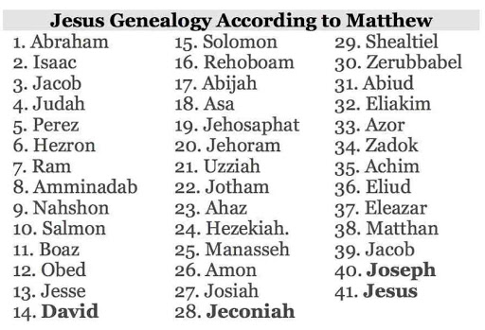

Slide 52
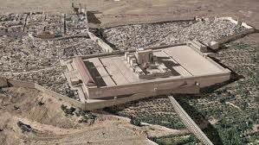
Christ’s Five Trips to Jerusalem
Feast | Verse
Passover | John 2:23
Unnamed | John 5:1
Tabernacles | John 7:2
Dedication | John 10:22
Passover | John 13:1

Slide 53


Slide 55
CONNECTING
REV 12 & ANTI-SEMITISM
DANIEL’S 70th WEEK (7 years)
Israel flees
3 ½ years
1260 days

Slide 56
Matthew 24:21-22
“²¹ For then there will be a great tribulation, such as has not occurred since the beginning of the world until now, nor ever will. ²² Unless those days had been cut short, no life would have been saved; but for the sake of the elect those days will be cut short.”

Slide 57

Kevin DeYoung
“Seven Passages on Social Justice (4),” The Gospel Coalition, 13 April 2010 (italics original).
“Matthew 25 is about social justice in the sense that it is about caring for the needy. But the needy in view are fellow Christians, especially those dependent on our hospitality and generosity for their ministry.... Jesus says if we are too embarrassed, too lazy, or too cowardly to support our fellow Christians who depend on our assistance and are suffering for the sake of the gospel, we will go to hell. We should not make this passage say anything more or less than this.”

Slide 58
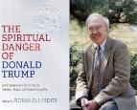
Ronald J. Sider
“Rich Christians in an Age of Hunger, Sixth Edition (Nashville: Thomas Nelson, 2015), 64.
“Jesus expressed it even more pointedly. To those who do not feed the hungry, clothe the naked, and visit the prisoners, he will speak a terrifying word at the final judgment: “Depart from me, you cursed, into the eternal fire prepared for the devil and his angels” (Matt. 25:41). The meaning is clear. Jesus intends that his disciples imitate his own concern for the poor and needy. Those who disobey will experience eternal damnation.”

Slide 59


Joe Scarborough
“Morning Joe,” MSNBC, 26 June 2018.
“[In Matthew 25] Jesus actually is asked by [His] disciples who is going to be able to sit on your right hand and who is going to be cast away. And Jesus goes through the list and He talks about anyone that does this for the least among us is doing it to Me. They will be with the sheep. Those who don’t will be tossed out—will be with the goats.... It is one of the few times...Jesus says, “This is what you have to do to get to heaven; and if you don’t do it, you will not get to heaven”—one of the times He says, “This is it: giving a cup of water in the Master’s name, feeding the hungry, clothing the naked, visiting those in prison, and, again, helping the least among us.”

Slide 60

John Piper
Message preached at the 2015 Gospel Coalition National Conference. Cited in Paul R. Wilkinson, Israel Betrayed: Volume 2: The Rise of Christian Palestinianism (San Antonio, TX: Ariel, 2018), 331.
“For two generations, perhaps, we have failed to study prophecy with anything like the rigor that it deserves. We have been so afraid of being viewed as one of those Zionist, right-wing, antichrist-sniffing, culture-denying, alarmist left-overs from the Scofield prophecy conference era that we give hardly any energy to putting the prophetic pieces together - at least not in public.”

Slide 61

Jim Wallis
Cited in Mary Danielsen, What You Need to Know About Jim Wallis and the Social-Justice "Gospel" (Eureka, MT: Lighthouse Trails, 2014), 9.
“It’s all too easy to make fun of the extreme examples of prophecy belief that we encounter on bumper stickers and best-seller lists. When people talk breathlessly of the dangers of Universal Product Codes and automated teller machines as signs of the impending Tribulation, giggles and head-shaking are hard to repress… when we ridicule apocalyptic interpretations of bar codes and the European Common Market, we are… properly rejecting an interpretive method that (suggests a) correspondence between biblical events and symbols, and our own lives. Ought Revelation to be included within the family of Christian texts, or should it be thrown on the fire of apocalyptic excesses?”

Slide 62
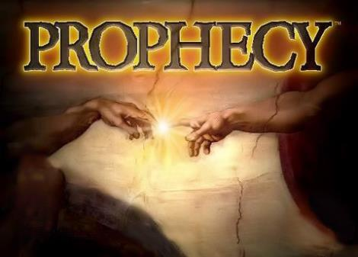
Biblical Prophecy: Importance
27% of Scripture was prophetic at the time it was written
2 Pet 1:19

Slide 63
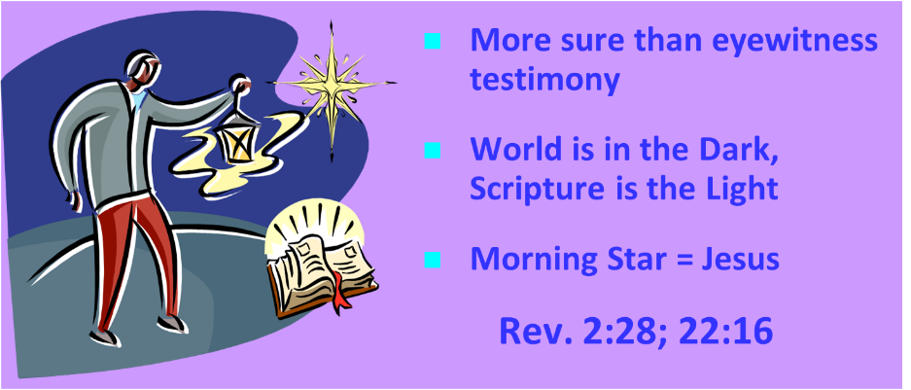
AUTHORITY OF SCRIPTURE
2 Peter 1:19

Slide 64

2 Peter 3:3-4
“³ Know this first of all, that in the last days mockers will come with their mocking, following after their own lusts, ⁴ and saying, “Where is the promise of His coming? For ever since the fathers fell asleep, all continues just as it was from the beginning of creation.”

Slide 65

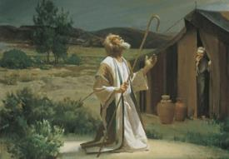
Genesis 12:3
“And I will bless those who bless you, And the one who curses you I will curse. And in you all the families of the earth will be blessed.”

Slide 66


Slide 67
Scripture’s Four Judgments
Name | Sheep and Goat | Judgment of the Jews | Bema Seat | Great White Throne
Scripture | Matt 25:31-46 | Ezek 20:33-44 | 1 Cor 3:10-15 | Rev 20:11-15
Place | Earth, Jerusalem | Earth, wilderness | Heaven | Earth
Audience | Gentile Tribulation survivors | Jewish Tribulation survivors | Church Age believers | All unsaved
When | After Tribulation | After Tribulation | After rapture | After Millennium
Purpose | Saved Gentiles enter kingdom | Saved Jews enter kingdom | Reward believers | Degree of punishment in hell
Evaluation | Treatment of Christ’s brethren | Passing under shepherd’s rod | Works taken through fire | Not in the book; judged by books

Slide 69
SHEEP & GOAT VS GREAT WHITE THRONE
MATT. 25:31-46 | REV. 20:11-15
Post Second Advent | Post Millennium
Living Nations | Dead
Believers & Unbelievers | Unbelievers Only
Angels, Sheep, Goats, Brethren | Unbelievers Only
David’s Throne | Great White Throne
Earthly | Non-earthly
Pentecost, Things To Come, 425-26

Slide 70
SHEEP & GOAT VS GREAT WHITE THRONE
MATT. 25:31-46 | REV. 20:11-15
After Poverty, Imprisonment, Sickness | After Utopia
Entrance into Kingdom & Hades | Entrance into Lake of Fire Only
Basis: Treatment of Brethren | Basis: Book of Life and Books
Not After Resurrection | After Resurrection
Subjects: Tribulation Survivors | Subjects: Unbelievers of All Ages
After Regathering of the Elect | After the Second Resurrection
Pentecost, Things To Come, 425-26

Slide 71
Conclusion

Slide 72
VIII. Eight Parabolic Exhortations
(Matthew 24:32–25:46)
The fig tree (24:32-35)
The days of Noah (24:36-39)
The comparison of two men & women (24:40-41)
The householder (24:42-44)
The wise servant (24:45-51)
The wise virgins (25:1-13)
The talents (25:14-30)
The sheep & goat judgment (25:31-46)

Slide 73
Preview of Matthew 24–25
The problem
The larger context
The immediate context (23:37-39)
The Disciples’ questions (24:1-3)
The Tribulation’s first half (24:4-14)
The Tribulation’s mid-point (24:15-20)
The Tribulation’s second half (24:21-22)
The Second Advent (24:23-31)
Eight parabolic exhortations (24:32‒25:46)

