Slide 1


Genesis 4
The First Murder and Continuation of the Messianic Promise

Slide 2

GENESIS STRUCTURE
  Beginning of the Human race (Gen. 1‒11)
  Beginning of the Hebrew race (Gen. 12‒50)

Slide 3

GENESIS STRUCTURE
  Genesis 1-11 (four events)
  Creation (1-2)
  Fall (3-5)
  Flood (6-9)
  National dispersion (10-11)

Slide 4
GENESIS STRUCTURE
  Genesis 1-11 (four events)
  Creation (1-2)
  Fall (3-5)
  Flood (6-9)
  National dispersion (10-11)

Slide 5

Genesis Structure
  3:1-5 Temptation by the serpent
  3:6 Sin of Adam and Eve
  3:7-13 Results of the sin
  3:14-19 Imposition of divine judgments
  3:20-24 God’s provision in spite of the sin

Slide 6
Genesis 4 Outline
  First murder (Gen 4:1-15)
  Ungodly line of Cain (4:16-24)
  Godly line of Seth (4:25-26)

Slide 7
Genesis 4 Outline
  First murder (Gen 4:1-15)
  Ungodly line of Cain (4:16-24)
  Godly line of Seth (4:25-26)

Slide 8
I. First Murder
(Gen 4:1-15)
  Births of Cain & Abel (Gen 4:1-2)
  Cain murders Abel (4:3-8)
  Cain’s punishment (4:9-15)

Slide 9
I. First Murder
(Gen 4:1-15)
  Births of Cain & Abel (Gen 4:1-2)
  Cain murders Abel (4:3-8)
  Cain’s punishment (4:9-15)

Slide 10
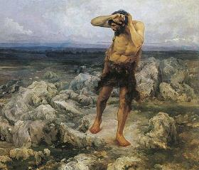
Cain’s Punishment
(4:9-15)
  Probing – Gen. 4:9
  Punishment – Gen. 4:10-12
  Protest – Gen. 4:13-14
  Provision – Gen. 4:15

Slide 11
Genesis 4 Outline
  First murder (Gen 4:1-15)
  Ungodly line of Cain (4:16-24)
  Godly line of Seth (4:25-26)

Slide 12
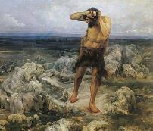
Ungodly Line of Cain
(Gen 4:16-24)
  Evil line that will not bring forth the Messiah (Gen 3:15)
    Continuation of Cain’s line (4:16-18)
    Immorality (4:19)
    Technological but not spiritual advancement (4:20-22)
    Violence (4:23-24)

Slide 13
Ungodly Line of Cain
(Gen 4:16-24)
  Evil line that will not bring forth the Messiah (Gen 3:15)
    Continuation of Cain’s line (4:16-18)
    Immorality (4:19)
    Technological but not spiritual advancement (4:20-22)
    Violence (4:23-24)

Slide 14
    Continuation of Cain’s line
    (4:16-18)
  Location – Gen. 4:16
  Birth of Enoch – Gen. 4:17
  Line of Cain – Gen. 4:18

Slide 15
    Continuation of Cain’s line
    (4:16-18)
  Location – Gen. 4:16
  Birth of Enoch – Gen. 4:17
  Line of Cain – Gen. 4:18

Slide 16
Similarities Between Genesis 3 & 4
ITEM | GENESIS 3 | GENESIS 4
Sin | (3:6-8) | (4:8)
“Where are you?” | (3:9) | (4:9)
Divine curses | (3:14-19) | (4:11-12)
Curse on the land | (3:17-19) | (4:11)
Divine protection | (3:21) | (4:15)
Transgressor’s lack of remorse | (3:12-13) | (4:9)
Transgressors leave God’s presence | (3:24) | (4:16)
Similarities and dissimilarities taken from Wenham, Genesis 1-15, pp. 99-100

Slide 17
Disimilarities Between Genesis 3 & 4
ITEM | GENESIS 3 | GENESIS 4
Sin present at the outset |  | (4:5)
Absence of persuasion to sin | (3:1-5) | (4:6-7)
Murder |  | (4:3-8)
Protestation over judgment | (3:14-20) | (4:14)
Driven further from the presence of God | (3:23-24) | (4:16)
Similarities and dissimilarities taken from Wenham, Genesis 1-15, pp. 99-100

Slide 18
    Continuation of Cain’s line
    (4:16-18)
  Location – Gen. 4:16
  Birth of Enoch – Gen. 4:17
  Line of Cain – Gen. 4:18

Slide 19

Where Did Cain Get His Wife?
  He married his sister
  Adam and Eve lived long (Gen 5:5) and had many children (Gen 1:28; 5:4)
  First generation had to marry their brothers and sisters or there would have been no second generation

Slide 20

Dr. Henry M. Morris
The Genesis Record, 144
“The ancient quibble about ‘Cain’s wife’ is thus seen to be quite trivial. Long before Cain died, there was a large population in the earth. By the time of the Deluge, 1,656 years after Creation by the Ussher chronology, even using the above conservative assumptions, the world population would have been at least seven billion people!”

Slide 21
Where Did Cain Get His Wife?
  First generation was genetically pure (Gen 1:31; Gen 20:12)
  Mosaic Law (Lev 18-20) not given until 2600 years later

Slide 22
Dr. Henry M. Morris
The Genesis Record, 143-44
“In order to get this process of multiplication started, of course, at least one of Adam’s sons had to marry one of Adam’s daughters. Probably, in that first generation, all marriages were brother-sister marriages. In that early time, there were no mutant genes in the genetic systems of any of these children, so that no genetic harm could have resulted from close marriages. Many, many generations later, during the time of Moses, such mutations had accumulated to the point where such unions were genetically dangerous, so that incest was thenceforth prohibited in the Mosaic laws.”

Slide 23
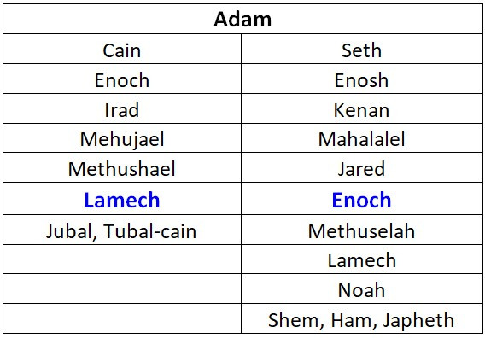

Slide 24
    Continuation of Cain’s line
    (4:16-18)
  Location – Gen. 4:16
  Birth of Enoch – Gen. 4:17
  Line of Cain – Gen. 4:18

Slide 26


Genesis 3:15
“And I will put enmity Between you and the woman, And between your seed and her seed; He shall bruise you on the head, And you shall bruise him on the heel.”

Slide 27
Ungodly Line of Cain
(Gen 4:16-24)
  Evil line that will not bring forth the Messiah (Gen 3:15)
    Continuation of Cain’s line (4:16-18)
    Immorality (4:19)
    Technological but not spiritual advancement (4:20-22)
    Violence (4:23-24)

Slide 28

Genesis 1:26-28
²⁶ Then God said, “Let Us make man in Our image, according to Our likeness; and let them rule over the fish of the sea and over the birds of the sky and over the cattle and over all the earth, and over every creeping thing that creeps on the earth.” ²⁷ God created man in His own image, in the image of God He created him; male and female He created them. ²⁸ God blessed them; and God said to them, “Be fruitful and multiply, and fill the earth, and subdue it; and rule over the fish of the sea and over the birds of the sky and over every living thing that moves on the earth.”

Slide 29

Genesis 2:24
For this reason a man shall leave his father and his mother, and be joined to his wife; and they shall become one flesh.

Slide 30

Genesis 6:1-4
“¹ Now it came about, when men began to multiply on the face of the land, and daughters were born to them, ² that the sons of God saw that the daughters of men were beautiful; and they took wives for themselves, whomever they chose. ³ Then the Lord said, ‘My Spirit shall not strive with man forever, because he also is flesh; nevertheless his days shall be one hundred and twenty years.’ ⁴ The Nephilim were on the earth in those days, and also afterward, when the sons of God came in to the daughters of men, and they bore children to them. Those were the mighty men who were of old, men of renown.”

Slide 31

Revelation 9:20-21
“The rest of mankind, who were not killed by these plagues, did not repent of the works of their hands, so as not to worship demons, and the idols of gold and of silver and of brass and of stone and of wood, which can neither see nor hear nor walk; ²¹ and they did not repent of their murders nor of their sorceries (pharmakeia) nor of their immorality nor of their thefts.”

Slide 32
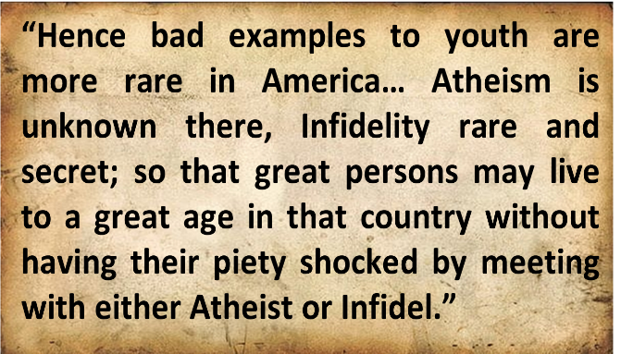
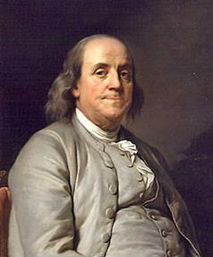
Benjamin Franklin
Benjamin Franklin, “Advice on Coming to America,” America in Person, ed. George D. Youstra, 109.

Slide 33
Ungodly Line of Cain
(Gen 4:16-24)
  Evil line that will not bring forth the Messiah (Gen 3:15)
    Continuation of Cain’s line (4:16-18)
    Immorality (4:19)
    Technological but not spiritual advancement (4:20-22)
    Violence (4:23-24)

Slide 34
Technological Advancement
Genesis 4:20-22
  Livestock – Gen. 4:20
  Music – Gen. 4:21
  Metallurgy – Gen. 4:22

Slide 35
Technological Advancement
Genesis 4:20-22
  Livestock – Gen. 4:20
  Music – Gen. 4:21
  Metallurgy – Gen. 4:22

Slide 36
Technological Advancement
Genesis 4:20-22
  Livestock – Gen. 4:20
  Music – Gen. 4:21
  Metallurgy – Gen. 4:22

Slide 37
Dr. Henry M. Morris
The Genesis Record, 147-48
“Musical instruments, another important aspect of modern culture, were also an early development. All of these things, in addition, confirm the necessary coexistence of a written language for formal communications. This is further intimated by use of the word ‘book’ in Genesis 5:1. More and more modern archaeological discoveries today are verifying the high degree of technology possessed by the earliest men, thus indirectly validating this Biblical testimony.”

Slide 38
Technological Advancement
Genesis 4:20-22
  Livestock – Gen. 4:20
  Music – Gen. 4:21
  Metallurgy – Gen. 4:22

Slide 39
Dr. Henry M. Morris
The Genesis Record, 144
“Not only did the population increase, but the technological and cultural level, at least of the Cainitic civilization, seems to have been very high. Metal tools and implements of all kinds were available to produce creature comforts, as well as musical instruments to stimulate the emotional and esthetic senses.”

Slide 40
Dr. Henry M. Morris
The Genesis Record, 147-48
“The ‘standard of living’ of the antediluvians, especially the Cainitic branch, was elevated tremendously by these talented sons of Lamech...Once again, it is significant to note that the elements which modern evolutionary archaeologists and anthropologists identify as the attributes of the emergence of evolving men from the stone age into true civilization—namely, urbanization, agriculture, animal domestication, and metallurgy—all were accomplished quickly by the early descendants of Adam and did not take hundreds of thousands of years.”

Slide 41
Dr. Henry M. Morris
The Genesis Record, 145
“It is interesting that one of the identifying marks which evolutionary anthropologists use to denote the emergence of a ‘stone age’ culture into a civilized society is the development of urbanization. According to the Bible, the first such ‘city’…is the city built by Cain, in the very first generation after Adam. No long, million-year development here!”

Slide 42
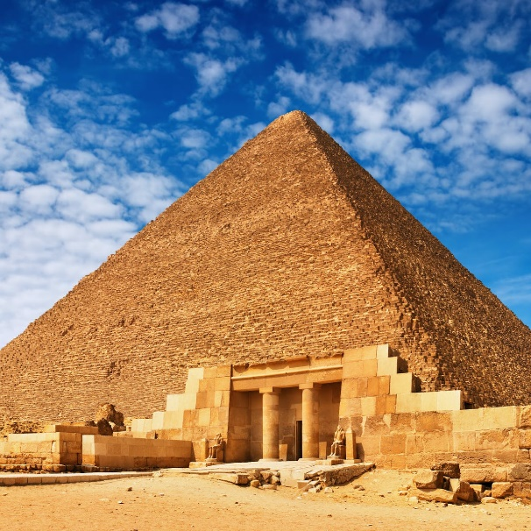
The Genius of Ancient Man
(Gen 4:19)
  The Palace at Knossos on Crete
  La Bastida in Spain
  The Great Pyramids of Egypt
  The Stonehenge of England
  The Great Wall of China
  The architecture of the Incas
Landis, Don. "Ancient Man ‒ Genius or Primitive?" In Searching for Adam: Genesis & the Truth About Man's Origin, edited by Terry Mortenson, 415-44. Green Forest, AR: Master Books, 2016.

Slide 43
Dr. Henry M. Morris
The Genesis Record, 144
“Although these and other facets of civilization can be used for good purposes, they can easily become an end in themselves and can even be used as a means of further rebellion against God. The latter seems to have been their effect, and perhaps even their purpose, among the descendants of Cain.”

Slide 44
Ungodly Line of Cain
(Gen 4:16-24)
  Evil line that will not bring forth the Messiah (Gen 3:15)
    Continuation of Cain’s line (4:16-18)
    Immorality (4:19)
    Technological but not spiritual advancement (4:20-22)
    Violence (4:23-24)

Slide 45


Genesis 6:11
“Now the earth was corrupt in the sight of God, and the earth was filled with violence.”

Slide 46
Genesis 4 Outline
  First murder (Gen 4:1-15)
  Ungodly line of Cain (4:16-24)
  Godly line of Seth (4:25-26)

Slide 47

Godly Line of Seth
(Gen 4:25-26)
  Seth’s birth (4:25)
  Enosh’s birth (4:26a)
  Good line (4:26b) – How God continued the messianic line despite Satan’s attempt to preempt the messianic promise of Genesis 3:15

Slide 48
Godly Line of Seth
(Gen 4:25-26)
  Seth’s birth (4:25)
  Enosh’s birth (4:26a)
  Good line (4:26b) – How God continued the messianic line despite Satan’s attempt to preempt the messianic promise of Genesis 3:15

Slide 49
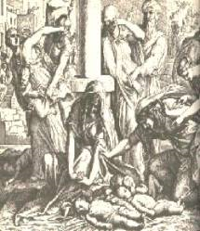
Satanic Attempts to Stop Messiah
Cain; Gen. 4, 1 Jn. 3:12
Sons of God; Gen. 6:1-4
Pharaoh; Ex. 1
Athaliah; 2 Chron. 22
Haman; Esther
Herod; Mt.2; Rev 12:4
Matt 4:5-7

Slide 50
Satanic Attempts to Stop Messiah
Cain; Gen. 4, 1 Jn. 3:12
Sons of God; Gen. 6:1-4
Pharaoh; Ex. 1
Athaliah; 2 Chron. 22
Haman; Esther
Herod; Mt.2; Rev 12:4
Matt 4:5-7

Slide 51
Godly Line of Seth
(Gen 4:25-26)
  Seth’s birth (4:25)
  Enosh’s birth (4:26a)
  Good line (4:26b) – How God continued the messianic line despite Satan’s attempt to preempt the messianic promise of Genesis 3:15

Slide 52
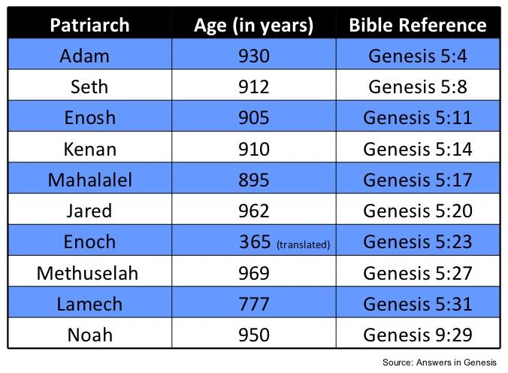

Slide 53
Godly Line of Seth
(Gen 4:25-26)
  Seth’s birth (4:25)
  Enosh’s birth (4:26a)
  Good line (4:26b) – How God continued the messianic line despite Satan’s attempt to preempt the messianic promise of Genesis 3:15

Slide 55
Ungodly Line of Cain
(Gen 4:16-24)
  Evil line that will not bring forth the Messiah (Gen 3:15)
    Continuation of Cain’s line (4:16-18)
    Immorality (4:19)
    Technological but not spiritual advancement (4:20-22)
    Violence (4:23-24)

Slide 56
Genesis 3:15
“And I will put enmity Between you and the woman, And between your seed and her seed; He shall bruise you on the head, And you shall bruise him on the heel.”

Slide 57
Conclusion

Slide 58
Genesis 4 Outline
  First murder (Gen 4:1-15)
  Ungodly line of Cain (4:16-24)
  Godly line of Seth (4:25-26)

Slide 59

“The Lord bless you and keep you; the Lord make his face shine on you and be gracious to you; the Lord turn his face toward you and give you peace.” (NIV)

