Slide 1


PRACTICAL RIGHTEOUSNESS
Dr. Andy Woods
Senior Pastor – Sugar Land Bible Church
President – Chafer Theological Seminary

Slide 2
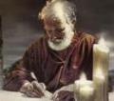
Answering Eleven Questions
Who wrote it? – James
What do we know about the author? – Christ’s ½ Brother
Who was the audience? – Believing Jews in the Diaspora
Where was if written from? – Jerusalem
When was the book written? – A.D. 44‒47
What was the book’s occasion? – Practical righteousness
What is the book’s purpose? – Achieving practical righteousness
What is the book about? – Practical righteousness
What is the book’s theme? – Daily living
What makes the book different? – Practicality
How is the book organized? – Faith and Wisdom

Slide 3
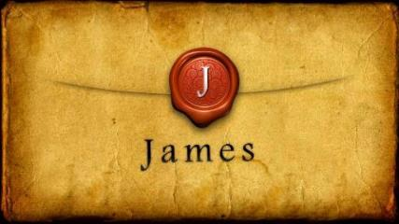
JAMES STRUCTURE
  Faith (James 1:1‒3:12)
  Wisdom (James 3:13‒5:20)

Slide 4
JAMES STRUCTURE
  Faith (James 1:1‒3:12)
  Wisdom (James 3:13‒5:20)

Slide 5

JAMES STRUCTURE
Faith (1:1–3:12)
  Trials (1:2-18)
  Obedience to the Word (1:19-27)
  Favoritism (2:1-13)
  Faith manifesting works (2:14-26)
  Tongue (3:1-12)

Slide 6
JAMES STRUCTURE
Faith (1:1–3:12)
  Trials (1:2-18)
  Obedience to the Word (1:19-27)
  Favoritism (2:1-13)
  Faith manifesting works (2:14-26)
  Tongue (3:1-12)

Slide 7
James 1:2-18
Trials – Jas 1:2-18
  Rejoicing during trials – Jas 1:2-12
  Command not to charge God with temptation – Jas 1:13-18

Slide 8
JAMES STRUCTURE
Faith (1:1–3:12)
  Trials (1:2-18)
  Obedience to the Word (1:19-27)
  Favoritism (2:1-13)
  Faith manifesting works (2:14-26)
  Tongue (3:1-12)

Slide 9

Faith Obeys God
(James 1:19-27)
  Need for Slowness in Speaking & Anger (1:19-20)
  Need for Obedience to God’s Word (1:21-25)
  Need for True Religion (1:26-27)

Slide 10
JAMES STRUCTURE
Faith (1:1–3:12)
  Trials (1:2-18)
  Obedience to the Word (1:19-27)
  Favoritism (2:1-13)
  Faith manifesting works (2:14-26)
  Tongue (3:1-12)

Slide 11
Favoritism
(2:1-13)
  Command: no favoritism (2:1)
  Situation: favoritism in the assembly (2:2-3)
  Reasoning: favoritism is contrary to God’s character & purposes (2:4-13)

Slide 12
Favoritism
(2:1-13)
  Command: no favoritism (2:1)
  Situation: favoritism in the assembly (2:2-3)
  Reasoning: favoritism is contrary to God’s character & purposes (2:4-13)

Slide 13

III. Reasoning: Favoritism is Contrary to God’s Character & Purposes
(2:4-13)
  We judge where God has not (4)
  God elects all (2:5)
  Rich oppressors (2:6-7)
  Favoritism violates God’s Law (2:8-11)
  God will judge those showing favoritism (2:12-13)

Slide 14
III. Reasoning: Favoritism is Contrary to God’s Character & Purposes
(2:4-13)
  We judge where God has not (4)
  God elects all (2:5)
  Rich oppressors (2:6-7)
  Favoritism violates God’s Law (2:8-11)
  God will judge those showing favoritism (2:12-13)

Slide 15

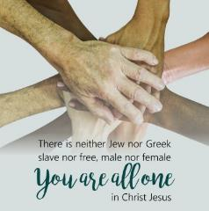
Galatians 3:28
“There is neither Jew nor Greek, there is neither slave nor free man, there is neither male nor female; for you are all one in Christ Jesus.”

Slide 16
III. Reasoning: Favoritism is Contrary to God’s Character & Purposes
(2:4-13)
  We judge where God has not (4)
  God elects all (2:5)
  Rich oppressors (2:6-7)
  Favoritism violates God’s Law (2:8-11)
  God will judge those showing favoritism (2:12-13)

Slide 17
III. Reasoning: Favoritism is Contrary to God’s Character & Purposes
(2:4-13)
  We judge where God has not (4)
  God elects all (2:5)
  Rich oppressors (2:6-7)
  Favoritism violates God’s Law (2:8-11)
  God will judge those showing favoritism (2:12-13)

Slide 18
C. Rich God Haters
(Jas 2:6-7)
Oppressors (6)
Blasphemers (7)

Slide 19
III. Reasoning: Favoritism is Contrary to God’s Character & Purposes
(2:4-13)
  We judge where God has not (4)
  God elects all (2:5)
  Rich oppressors (2:6-7)
  Favoritism violates God’s Law (2:8-11)
  God will judge those showing favoritism (2:12-13)

Slide 20


Slide 21

Psalm 147:19-20
“He declares His words to Jacob, His statutes and His ordinances to Israel. He has not dealt thus with any nation; And as for His ordinances, they have not known them. Praise the Lord!”

Slide 22
SIMILARITIES WITH ACTS 15
 | James | Acts 15
Greetings | 1:1 | 15:23
Visit | 1:27 | 15:14
Listen | 2:5 | 15:13
Turn | 5:19-20 | 15:19
Being called by God’s name | 2:7 | 15:17

Slide 23
Date
(AD 44-47)
AD 70
AD 62-63
AD 49
AD 48-49
Sermon on the Mount
Primitive congregational worship (Jas 2:2; 3:1; 5:14)
Jas 1:1 = Acts 8:1-4; 11:19

Slide 24
Order of Paul’s Letters
Galatians (A.D. 49)
1‒2 Thessalonians (A.D. 51)
1‒2 Corinthians (A.D. 56)
Romans (A.D. 57)
Ephesians, Colossians, Philemon, Philippians (A.D. 60‒62)
1 Timothy, Titus (A.D. 62‒66)
2 Timothy (A.D. 67)

Slide 25

2 Timothy 3:16-17
“All Scripture is inspired by God and profitable for teaching, for reproof, for correction, for training in righteousness; ¹⁷ so that the man of God may be adequate, equipped for every good work.”

Slide 26
Romans 15:3-4
“For even Christ did not please Himself, but as it is written: “The taunts of those who taunt You have fallen on Me.” For whatever was written in earlier times was written for our instruction, so that through perseverance and the encouragement of the Scriptures we might have hope.”

Slide 27

Thomas Constable
“Notes on James,” 48, accessed December 1, 2020, http://www.soniclight.com.
“Christians live under a new set of rules, the law of liberty. Israelites lived under a different set of rules, the Law of Moses. The fact that the ‘golden rule’ was part of both the Mosaic Law and the law of Christ, does not mean that we are still under the Mosaic Law.”

Slide 28
III. Reasoning: Favoritism is Contrary to God’s Character & Purposes
(2:4-13)
  We judge where God has not (4)
  God elects all (2:5)
  Rich oppressors (2:6-7)
  Favoritism violates God’s Law (2:8-11)
  God will judge those showing favoritism (2:12-13)

Slide 29


Slide 30
Scripture’s Four Judgments
Name | Sheep and Goat | Judgment of the Jews | Bema Seat | Great White Throne
Scripture | Matt 25:31-46 | Ezek 20:33-44 | 1 Cor 3:10-15 | Rev 20:11-15
Place | Earth, Jerusalem | Earth, wilderness | Heaven | Earth
Audience | Gentile Tribulation survivors | Jewish Tribulation survivors | Church Age believers | All unsaved
When | After Tribulation | After Tribulation | After rapture | After Millennium
Purpose | Saved Gentiles enter kingdom | Saved Jews enter kingdom | Reward believers | Degree of punishment in hell
Evaluation | Treatment of Christ’s brethren | Passing under shepherd’s rod | Works taken through fire | Not in the book; judged by books

Slide 31

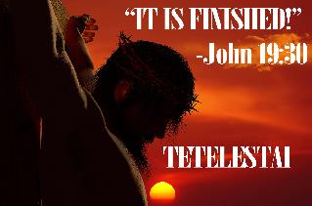
John 19:30
“Therefore when Jesus had received the sour wine, He said, ‘It is finished!’ And He bowed His head and gave up His spirit.”

Slide 32
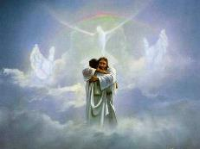
John 5:24
“Truly, truly, I say to you, he who hears My word, and believes Him who sent Me, has eternal life, and does not come into judgment, but has passed out of death into life.”

Slide 33
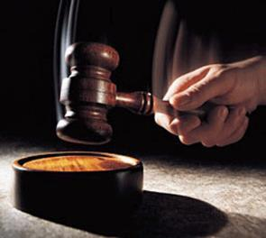
Why?
Not to judge sin (John 19:30)
Not to determine salvation (John 5:24)
But rather to give or not give rewards

Slide 34
Scripture’s Five Crowns (Rev 4:10: 3:11; 2 John 8)
Scripture | Crown | Purpose
1 Cor. 9:24-27 | Incorruptible | Gaining mastery over the flesh
1 Thess. 2:19-20 | Rejoicing | Soul winning
Jas. 1:12; Rev. 2:10 | Life | Enduring trials
1 Pet. 5:2-4 | Glory | Shepherding God’s people
2 Tim. 4:8 | Righteousness | Longing for His appearing

Slide 35
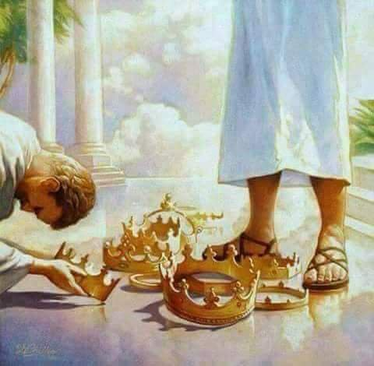

Slide 36
Donald. W. Burdick
“Since he is speaking to believers, the judgment to which he refers must be the judgment of believers at the judgment seat of Christ (2 Cor. 5:10).”
Hebrews-Revelation. Vol. 12 of The Expositor's Bible Commentary. 12 vols. Edited by Frank E. Gaebelein and J. D. Douglas. Grand Rapids: Zondervan Publishing House, 1981, p. 180.

Slide 37
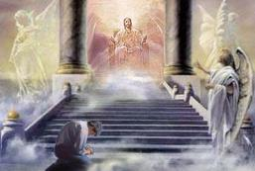
2 Corinthians 5:10
“For we must all appear before the judgment seat of Christ, so that each one may be recompensed for his deeds in the body, according to what he has done, whether good or bad.”

Slide 38
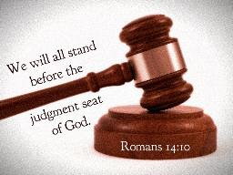
Romans 14:10, 12
“¹⁰…For we will all stand before the judgment seat of God…¹² So then each one of us will give an account of himself to God.”

Slide 39
1 Corinthians 3:10-15
“¹⁰ According to the grace of God which was given to me, like a wise master builder I laid a foundation, and another is building on it. But each man must be careful how he builds on it. ¹¹ For no man can lay a foundation other than the one which is laid, which is Jesus Christ. ¹² Now if any man builds on the foundation with gold, silver, precious stones, wood, hay, straw…”

Slide 40
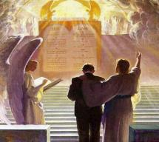
1 Corinthians 3:14-15
“¹⁴ If any man’s work which he has built on it remains, he will receive a reward. ¹⁵ If any man’s work is burned up, he will suffer loss; but he himself will be saved, yet so as through fire.”

Slide 41
1 Corinthians 9:24-27
“²⁴ Do you not know that those who run in a race all run, but only one receives the prize? Run in such a way that you may win. ²⁵ Everyone who competes in the games exercises self-control in all things. They then do it to receive a perishable wreath, but we an imperishable. ²⁶ Therefore I run in such a way, as not without aim; I box in such a way, as not beating the air; ²⁷ but I discipline my body and make it my slave, so that, after I have preached to others, I myself will not be disqualified.”

Slide 42

1 John 2:28
“²⁸ Now, little children, abide in Him, so that when He appears, we may have confidence and not shrink away from Him in shame at His coming. If any man’s work which he has built on it remains, he will receive a reward.”

Slide 43
1 Corinthians 4:5
“Therefore do not go on passing judgment before the time, but wait until the Lord comes who will both bring to light the things hidden in the darkness and disclose the motives of men’s hearts; and then each man’s praise will come to him from God.”

Slide 44

Samuel Hoyt
“The Judgment Seat of Christ in Theological Perspective,” Part 2, Bibliotheca Sacra, electronic media.
“The judgment seat of Christ might be compared to a commencement ceremony. At graduation there is some measure of disappointment and remorse that one did not do better and work harder. However, at such an event the overwhelming emotion is joy, not remorse. The graduates do not leave the auditorium weeping because they did not earn better grades. Rather, they are thankful that they have been graduated, and they are grateful for what they did achieve. To overdo the sorrow aspect of the judgment seat of Christ is to make heaven hell. To under do the sorrow aspect is to make faithfulness inconsequential” (underlining mine).

Slide 45


Areas of Systematic Theology
Prolegomena – Introduction
Bibliology – Study of the Bible
Theology – Study of God
Christology – Study of Christ
Pneumatology – Study of the Holy Spirit
Anthropology – Study of Man
Hamartiology – Study of sin
Soteriology – Study of salvation
Angelology – Study of angels
Ecclesiology – Study of the Church
Eschatology – Study of the end

Slide 46
Areas of Systematic Theology
Prolegomena – Introduction
Bibliology – Study of the Bible
Theology – Study of God
Christology – Study of Christ
Pneumatology – Study of the Holy Spirit
Anthropology – Study of Man
Hamartiology – Study of sin
Soteriology – Study of salvation
Angelology – Study of angels
Ecclesiology – Study of the Church
Eschatology – Study of the end

Slide 47
CONCLUSION

Slide 48
JAMES STRUCTURE
Faith (1:1–3:12)
  Trials (1:2-18)
  Obedience to the Word (1:19-27)
  Favoritism (2:1-13)
  Faith manifesting works (2:14-26)
  Tongue (3:1-12)

Slide 49
Favoritism
(2:1-13)
  Command: no favoritism (2:1)
  Situation: favoritism in the assembly (2:2-3)
  Reasoning: favoritism is contrary to God’s character & purposes (2:4-13)

Slide 50
III. Reasoning: Favoritism is Contrary to God’s Character & Purposes
(2:4-13)
  We judge where God has not (4)
  God elects all (2:5)
  Rich oppressors (2:6-7)
  Favoritism violates God’s Law (2:8-11)
  God will judge those showing favoritism (2:12-13)

Slide 51
JAMES STRUCTURE
Faith (1:1–3:12)
  Trials (1:2-18)
  Obedience to the Word (1:19-27)
  Favoritism (2:1-13)
  Faith manifesting works (2:14-26)
  Tongue (3:1-12)

Slide 52

Faith Manifesting Works
(2:14-26)
Thesis: works accompany useful faith (2:14)
Five illustrations (2:15-26)
  Needy brother (2:15-17)
  Demonic monotheist (2:18-19)
  Abraham (2:20-24)
  Rahab (2:25)
  Lifeless corpse (2:26)

Slide 53
Three Tenses of Salvation
Phase | Justification | Sanctification | Glorification
Tense | Past | Present | Future
Saved from sin’s: | Penalty | Power | Presence
Scripture | Eph 2:8-9; Titus 3:5 | Philip 2:12 | Rom 5:10
Nature | Single | Dual | Single

Slide 54
Three Tenses of Salvation
Phase | Justification | Sanctification | Glorification
Tense | Past | Present | Future
Saved from sin’s: | Penalty | Power | Presence
Scripture | Eph 2:8-9; Titus 3:5 | Philip 2:12 | Rom 5:10
Nature | Single | Dual | Single

Slide 55
Harmony Between Paul and James
 | PAUL | JAMES
Phase of Salvation | Justification | Sanctification
Tense of Salvation | First tense | Second tense
Issue | Self righteous Judaism | Dead orthodoxy
Genesis | Gen 15:6 | Gen 22

Slide 56
Harmony Between Paul and James
 | PAUL | JAMES
Justification | Declaration of innocence before God | Evidence of the usefulness believer's faith before man
Save | Justification | Sanctification
Faith | Saving faith | Serving faith
Works | Favor with God | Believer's moral deeds

Slide 57

Lewis Sperry Chafer
Systematic Theology (Grand Rapids, MI: Kregel Publications, 1993), vol. 7, 148.
“In its larger usage, the word faith represents at least four varied ideas: (1) As above, it can be personal confidence in God. This the most common aspect of faith may be subdivided into three features: (a) Saving faith, which is the inwrought confidence in God’s promises and provisions respecting the Savior that leads one to elect to repose upon and trust in the One who alone can save. (b) Serving faith, which contemplates as true the fact of divinely bestowed gifts and all details respecting divine appointments for service. This faith is always a personal matter, and so one believer should not become a pattern for another. That such faith with its personal characteristic may be kept inviolate, …

Slide 58
Lewis Sperry Chafer
Systematic Theology (Grand Rapids, MI: Kregel Publications, 1993), vol. 7, 148.
“…the Apostle writes: “Hast thou faith? have it to thyself before God” (Rom. 14:22). Great injury may be wrought if one Christian imitates another in matters of appointment for service. (c) Sanctifying or sustaining faith, which lays hold of the power of God for one’s daily life. It is the life lived in dependence upon God, working upon a new life-principle (Rom. 6:4). The justified one, having become what he is by faith, must go ahead living on the same principle of utter dependence upon God.”

Slide 59
Romans 12:3-8
“³ For through the grace given to me I say to everyone among you not to think more highly of himself than he ought to think; but to think so as to have sound judgment, as God has allotted to each a measure of faith. ⁴ For just as we have many members in one body and all the members do not have the same function, ⁵ so we, who are many, are one body in Christ, and individually members one of another.”

Slide 60
Romans 12:3-8
“⁶ Since we have gifts that differ according to the grace given to us, each of us is to exercise them accordingly: if prophecy, according to the proportion of his faith; ⁷ if service, in his serving; or he who teaches, in his teaching; ⁸ or he who exhorts, in his exhortation; he who gives, with liberality; he who leads, with diligence; he who shows mercy, with cheerfulness.”

