Slide 1


Genesis 4
The First Murder and Continuation of the Messianic Promise

Slide 2

GENESIS STRUCTURE
  Beginning of the Human race (Gen. 1‒11)
  Beginning of the Hebrew race (Gen. 12‒50)

Slide 3

GENESIS STRUCTURE
  Genesis 1-11 (four events)
  Creation (1-2)
  Fall (3-5)
  Flood (6-9)
  National dispersion (10-11)

Slide 4

Contradictory Account of Creation?
Genesis 1 – Overview of the whole creation
Genesis 2 – Details surrounding the creation of the garden, the first man, and his activities on day 6

Slide 5
GENESIS STRUCTURE
  Genesis 1-11 (four events)
  Creation (1-2)
  Fall (3-5)
  Flood (6-9)
  National dispersion (10-11)

Slide 6

Genesis Structure
  3:1-5 Temptation by the serpent
  3:6 Sin of Adam and Eve
  3:7-13 Results of the sin
  3:14-19 Imposition of divine judgments
  3:20-24 God’s provision in spite of the sin

Slide 7
Genesis 4 Outline
  First murder (Gen 4:1-15)
  Ungodly line of Cain (4:16-24)
  Godly line of Seth (4:25-26)

Slide 8
Genesis 4 Outline
  First murder (Gen 4:1-15)
  Ungodly line of Cain (4:16-24)
  Godly line of Seth (4:25-26)

Slide 9
I. First Murder
(Gen 4:1-15)
  Births of Cain & Abel (Gen 4:1-2)
  Cain murders Abel (4:3-8)
  Cain’s punishment (4:9-15)

Slide 10
I. First Murder
(Gen 4:1-15)
  Births of Cain & Abel (Gen 4:1-2)
  Cain murders Abel (4:3-8)
  Cain’s punishment (4:9-15)

Slide 11
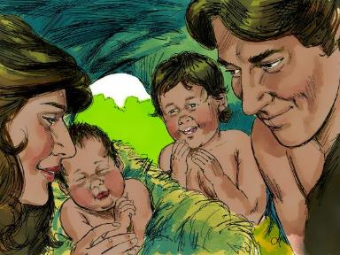
Births of Cain and Abel
(4:1-2)
  4:1 – Cain’s birth, literal translation, Dan. 11:37
  4:2 – Abel’s birth, vanity

Slide 12
Births of Cain and Abel
(4:1-2)
  4:1 – Cain’s birth, literal translation, Dan. 11:37
  4:2 – Abel’s birth, vanity

Slide 13

Genesis 4:1
“Now the man had relations with his wife Eve, and she conceived and gave birth to Cain, and she said, ‘I have gotten a manchild with the help of the Lord.’”

Slide 14
Genesis 4:1
“Now the man had relations with his wife Eve, and she conceived and gave birth to Cain, and she said, ‘I have gotten a manchild with the help of the Lord.’”

Slide 15


Genesis 3:15
“And I will put enmity Between you and the woman, And between your seed and her seed; He shall bruise you on the head, And you shall bruise him on the heel.”

Slide 16
Genesis 5:29
“Now he called his name Noah, saying, ‘This one will give us rest from our work and from the toil of our hands arising from the ground which the Lord has cursed.’”

Slide 17

Daniel 11:37
“He will show no regard for the gods of his fathers or for the desire of women, nor will he show regard for any other god; for he will magnify himself above them all.”

Slide 18
Births of Cain and Abel
(4:1-2)
  4:1 – Cain’s birth, literal translation, Dan. 11:37
  4:2 – Abel’s birth, vanity

Slide 19
I. First Murder
(Gen 4:1-15)
  Births of Cain & Abel (Gen 4:1-2)
  Cain murders Abel (4:3-8)
  Cain’s punishment (4:9-15)

Slide 20
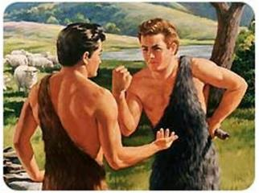
Cain Murders Abel
(4:3-8)
  4:3-5a – Two offerings
  4:5b-7 – Premeditation
  4:8 – Murder

Slide 21
Cain Murders Abel
(4:3-8)
  4:3-5a – Two offerings
  4:5b-7 – Premeditation
  4:8 – Murder

Slide 22
Cain Murders Abel
(4:3-8)
  4:3-5a
  Messianic line through Abel (Gen 3:21; Heb 11:4) contrary to Eve’s false expectation (4:1)
  Begins selection of younger over older pattern (Abel over Cain, Seth over Cain, Shem over Japheth, Isaac over Ishmael, Jacob over Esau, Judah and Joseph over their brothers, and Ephraim over Manasseh)

Slide 23
Cain Murders Abel
(4:3-8)
  4:3-5a – Two offerings
  4:5b-7 – Premeditation
  4:8 – Murder

Slide 24
Parallel Between Genesis 3:16 & 4:7
Genesis 3:16
“your desire [TESHUQAH] will be for your husband, and he will rule over you.”
Genesis 4:7
“its [sin] desire [TESHUQAH] is for you, but you must master it.”
Susan T. Foh, “What is the Woman’s Desire?”, The Westminster Theological Journal 37 (1974-75), 376-83.

Slide 25

Thomas Jefferson
"My views ... are the result of a life of inquiry and reflection, and very different from the anti-Christian system imputed to me by those who know nothing of my opinions. To the corruptions of Christianity, I am, indeed, opposed; but not to the genuine precepts of Jesus Himself. I am a Christian in the only sense in which He wished any one to be; sincerely attached to his doctrines in preference to all others...His system of morals...if filled up in the style and spirit of the rich fragments He left us, would be the most perfect and sublime that has ever been taught by man...”
On April 21, 1803, Jefferson wrote to Dr. Benjamin Rush, also a signer of the Declaration

Slide 26
Thomas Jefferson
“His moral doctrines...were more pure and perfect than those of the most correct of the philosophers...gathering all into one family under the bonds of love, charity, peace, common wants and common aids. A development of this head will evince the peculiar superiority of the system of Jesus over all others. The precepts of philosophy, and of the Hebrew code, laid hold of actions only. He pushed his scrutinies into the heart of man; erected his tribunal in the region of his thoughts, and purified the waters at the fountain head.”
On April 21, 1803, Jefferson wrote to Dr. Benjamin Rush, also a signer of the Declaration

Slide 27
Cain Murders Abel
(4:3-8)
  4:3-5a – Two offerings
  4:5b-7 – Premeditation
  4:8 – Murder

Slide 28
Genesis 3:15
“And I will put enmity Between you and the woman, And between your seed and her seed; He shall bruise you on the head, And you shall bruise him on the heel.”

Slide 29
Cain Murders Abel
(4:3-8)
  4:5b-8
  Satanic attempt to prevent the fulfillment of Gen 3:15
  1 John 3:12; Rev 12:4
  Bruising of the heel

Slide 30
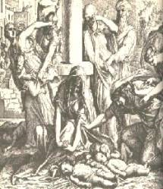
Satanic Attempts to Stop Messiah
Cain; Gen. 4, 1 Jn. 3:12
Sons of God; Gen. 6:1-4
Pharaoh; Ex. 1
Athaliah; 2 Chron. 22
Haman; Esther
Herod; Mt.2; Rev 12:4
Matt 4:5-7

Slide 31
Satanic Attempts to Stop Messiah
Cain; Gen. 4, 1 Jn. 3:12
Sons of God; Gen. 6:1-4
Pharaoh; Ex. 1
Athaliah; 2 Chron. 22
Haman; Esther
Herod; Mt.2; Rev 12:4
Matt 4:5-7

Slide 32
Satanic Attempts to Stop Messiah
Cain; Gen. 4, 1 Jn. 3:12
Sons of God; Gen. 6:1-4
Pharaoh; Ex. 1
Athaliah; 2 Chron. 22
Haman; Esther
Herod; Mt.2; Rev 12:4
Matt 4:5-7

Slide 33


Renald Showers
What on Earth is God Doing: Satan’s Conflict with God (Bellmawr, NJ: Friends of Israel, 2003), 225.
“﻿SATAN WAS PRESENT IN EDEN TO hear God’s first promise of the coming Redeemer. He realized that it would be fatal for him and his cause if the Redeemer were to come. Thus Satan’s primary goal throughout Old Testament history became the prevention of the Redeemer’s coming. Sometime after Adam and Eve gave birth to Cain and Abel, it became evident that one son was godly in attitude and that the other was ungodly. Evidently Abel’s godly attitude convinced Satan that Abel was either the Redeemer or the one through whose line of descent the Redeemer would come.”

Slide 34
Renald Showers
What on Earth is God Doing: Satan’s Conflict with God (Bellmawr, NJ: Friends of Israel, 2003), 225.
“﻿Thus it became imperative to Satan to get rid of Abel. Inasmuch as Cain already was controlled by a rebellious, angry attitude, it didn’t take much to prompt him to kill his brother (Gen. 4:1–8). That Satan was involved in Cain’s slaying of his brother was made evident in 1 John 3:10–12. Because of Satan’s involvement Christ stated that the devil ‘was a murderer from the beginning’ (Jn. 8:44). Thus the first murder in history was committed because of Satan’s goal to prevent the Redeemer’s coming.”

Slide 35
I. First Murder
(Gen 4:1-15)
  Births of Cain & Abel (Gen 4:1-2)
  Cain murders Abel (4:3-8)
  Cain’s punishment (4:9-15)

Slide 36
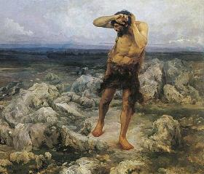
Cain’s Punishment
(4:9-15)
  Probing – Gen. 4:9
  Punishment – Gen. 4:10-12
  Protest – Gen. 4:13-14
  Provision – Gen. 4:15

Slide 37
Cain’s Punishment
(4:9-15)
  Probing – Gen. 4:9
  Punishment – Gen. 4:10-12
  Protest – Gen. 4:13-14
  Provision – Gen. 4:15

Slide 38
Cain’s Punishment
(4:9-15)
  Probing – Gen. 4:9
  Punishment – Gen. 4:10-12
  Protest – Gen. 4:13-14
  Provision – Gen. 4:15

Slide 39

Genesis 3:17-19a
¹⁷ Then to Adam He said, “Because you have listened to the voice of your wife, and have eaten from the tree about which I commanded you, saying, ‘You shall not eat from it’; Cursed is the ground because of you; In toil you will eat of it All the days of your life. ¹⁸ “Both thorns and thistles it shall grow for you; And you will eat the plants of the field; ¹⁹ By the sweat of your face You will eat bread...”

Slide 40
Cain’s Punishment
(4:9-15)
  Probing – Gen. 4:9
  Punishment – Gen. 4:10-12
  Protest – Gen. 4:13-14
  Provision – Gen. 4:15

Slide 41

Dr. Henry M. Morris
The Genesis Record, 143
“Although we have no exact figures, it is possible to make a reasonable guess as to how rapidly the total human population developed. Since, according to the record in Genesis 5, each named patriarch lived many hundreds of years and ‘begat sons and daughters,’ it is reasonable and very conservative to assume that each family had, on the average, at least six children—three sons and three daughters.”

Slide 42
Dr. Henry M. Morris
The Genesis Record, 143
“If it is further assumed that, on the average, these children grew to maturity, married, and began to have children of their own by the time their parents were eighty years old, and that the parents lived through an average of five such ‘generations,’ or four hundred years, then it can easily be calculated that the earth had acquired within its first eight hundred years (presumably approximately the lifetime of Cain, as a minimum) a population of at least one hundred and twenty thousand. It is probable that the figure was much more than this, since people lived to greater ages than assumed and probably had many more children than assumed.”

Slide 43
Cain’s Punishment
(4:9-15)
  Probing – Gen. 4:9
  Punishment – Gen. 4:10-12
  Protest – Gen. 4:13-14
  Provision – Gen. 4:15

Slide 44
Provision of Protection
Genesis 4:15
  Divine Vengeance – Gen. 4:15a
  Protective Mark – Gen. 4:15b

Slide 45
Provision of Protection
Genesis 4:15
  Divine Vengeance – Gen. 4:15a
  Protective Mark – Gen. 4:15b

Slide 46
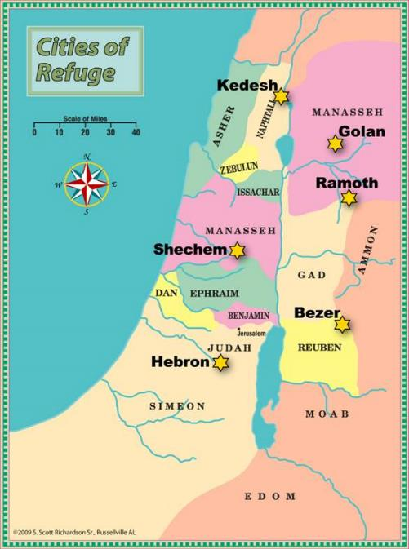

Slide 47

Genesis 1:27
God created man in His own image, in the image of God He created him; male and female He created them.

Slide 48

Genesis 9:6
“Whoever sheds man’s blood, By man his blood shall be shed, For in the image of God He made man.”

Slide 49


Genesis 6:11
“Now the earth was corrupt in the sight of God, and the earth was filled with violence.”

Slide 50
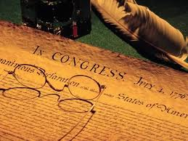
Declaration of Independence
“the Laws of Nature and of Nature’s God,”
“we hold these truths to be self evident, that all men are created equal,”
“they are endowed by their Creator with certain unalienable Rights,”
“appealing to the Supreme Judge of the world for the rectitude of our intentions,”
“with firm reliance on the protection of Divine Providence.”
Church of the Holy Trinity v. U.S., 143 U.S. 457, 467-68 (1892)

Slide 51
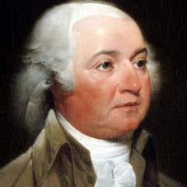
John Adams
John Adams - America's second President "Rights [are] antecedent to all earthly government; Rights... cannot be repealed or restrained by human laws; Rights [are] derived from the great Legislature of the universe."
John Adams, The Works of John Adams, Second President of the United States, ed. Charles Francis Adams, 10 vols. (Boston: Little, Brown, 1856), 3:449.

Slide 52
Declaration of Independence
“We hold these truths to be self-evident, that all men are created equal, that they are endowed by their Creator with certain unalienable Rights, that among these are Life, Liberty and the pursuit of Happiness.”
“That TO SECURE THESE RIGHTS, Governments are instituted among Men, deriving their just powers from the consent of the governed,”
“That whenever any Form of Government becomes destructive of these ends, it is the Right of the People to alter or to abolish it, and to institute new Government…”
Declaration of Independence, In Congress, July 4, 1776, The unanimous Declaration of the thirteen united States of America

Slide 53
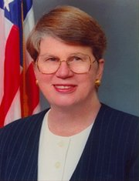
Speech by Attorney General Janet Reno, Newark, New Jersey, May 5, 1995. Quoted in James Bovard, “Waco Must Get a Hearing,” Wall Street Journal, May 15, 1995.
Former Attorney General Janet Reno
“You are part of a government that has given its people more freedom…than any other government in the history of the world.”

Slide 54
Provision of Protection
Genesis 4:15
  Divine Vengeance – Gen. 4:15a
  Protective Mark – Gen. 4:15b

Slide 55
Genesis 4 Outline
  First murder (Gen 4:1-15)
  Ungodly line of Cain (4:16-24)
  Godly line of Seth (4:25-26)

Slide 56
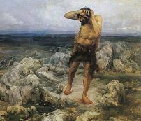
Ungodly Line of Cain
(Gen 4:16-24)
  Evil line that will not bring forth the Messiah (Gen 3:15)
    Continuation of Cain’s line (4:16-18)
    Immorality (4:19)
    Technological but not spiritual advancement (4:20-22)
    Violence (4:23-24)

Slide 57
Ungodly Line of Cain
(Gen 4:16-24)
  Evil line that will not bring forth the Messiah (Gen 3:15)
    Continuation of Cain’s line (4:16-18)
    Immorality (4:19)
    Technological but not spiritual advancement (4:20-22)
    Violence (4:23-24)

Slide 58
    Continuation of Cain’s line
    (4:16-18)
  Location – Gen. 4:16
  Birth of Enoch – Gen. 4:17
  Line of Cain – Gen. 4:18

Slide 59
    Continuation of Cain’s line
    (4:16-18)
  Location – Gen. 4:16
  Birth of Enoch – Gen. 4:17
  Line of Cain – Gen. 4:18

Slide 60
Similarities Between Genesis 3 & 4
Item | Genesis 3 | Genesis 4
Sin | (3:6-8) | (4:8)
“Where are you?” | (3:9) | (4:9)
Divine curses | (3:14-19) | (4:11-12)
Curse on the land | (3:17-19) | (4:11)
Divine protection | (3:21) | (4:15)
Transgressor’s lack of remorse | (3:12-13) | (4:9)
Transgressors leave God’s presence | (3:24) | (4:16)
Similarities and dissimilarities taken from Wenham, Genesis 1-15, pp. 99-100

Slide 61
Disimilarities Between Genesis 3 & 4
Item | Genesis 3 | Genesis 4
Sin present at the outset |  | (4:5)
Absence of persuasion to sin | (3:1-5) | (4:6-7)
Murder |  | (4:3-8)
Protestation over judgment | (3:14-20) | (4:14)
Driven further from the presence of God | (3:23-24) | (4:16)
Similarities and dissimilarities taken from Wenham, Genesis 1-15, pp. 99-100

Slide 62
    Continuation of Cain’s line
    (4:16-18)
  Location – Gen. 4:16
  Birth of Enoch – Gen. 4:17
  Line of Cain – Gen. 4:18

Slide 63

Where Did Cain Get His Wife?
  He married his sister
  Adam and Eve lived long (Gen 5:5) and had many children (Gen 1:28; 5:4)
  First generation had to marry their brothers and sisters or there would have been no second generation

Slide 64
Dr. Henry M. Morris
The Genesis Record, 144
“The ancient quibble about ‘Cain’s wife’ is thus seen to be quite trivial. Long before Cain died, there was a large population in the earth. By the time of the Deluge, 1,656 years after Creation by the Ussher chronology, even using the above conservative assumptions, the world population would have been at least seven billion people!”

Slide 65
Where Did Cain Get His Wife?
  First generation was genetically pure (Gen 1:31; Gen 20:12)
  Mosaic Law (Lev 18-20) not given until 2600 years later

Slide 66
Dr. Henry M. Morris
The Genesis Record, 143-44
“In order to get this process of multiplication started, of course, at least one of Adam’s sons had to marry one of Adam’s daughters. Probably, in that first generation, all marriages were brother-sister marriages. In that early time, there were no mutant genes in the genetic systems of any of these children, so that no genetic harm could have resulted from close marriages. Many, many generations later, during the time of Moses, such mutations had accumulated to the point where such unions were genetically dangerous, so that incest was thenceforth prohibited in the Mosaic laws.”

Slide 67
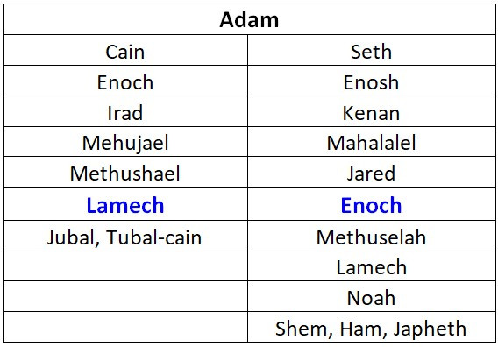

Slide 68
    Continuation of Cain’s line
    (4:16-18)
  Location – Gen. 4:16
  Birth of Enoch – Gen. 4:17
  Line of Cain – Gen. 4:18

Slide 69
Genesis 3:15
“And I will put enmity Between you and the woman, And between your seed and her seed; He shall bruise you on the head, And you shall bruise him on the heel.”

Slide 70
Ungodly Line of Cain
(Gen 4:16-24)
  Evil line that will not bring forth the Messiah (Gen 3:15)
    Continuation of Cain’s line (4:16-18)
    Immorality (4:19)
    Technological but not spiritual advancement (4:20-22)
    Violence (4:23-24)

Slide 71

Genesis 1:26-28
²⁶ Then God said, “Let Us make man in Our image, according to Our likeness; and let them rule over the fish of the sea and over the birds of the sky and over the cattle and over all the earth, and over every creeping thing that creeps on the earth.” ²⁷ God created man in His own image, in the image of God He created him; male and female He created them. ²⁸ God blessed them; and God said to them, “Be fruitful and multiply, and fill the earth, and subdue it; and rule over the fish of the sea and over the birds of the sky and over every living thing that moves on the earth.”

Slide 72

Genesis 2:24
For this reason a man shall leave his father and his mother, and be joined to his wife; and they shall become one flesh.

Slide 73

Genesis 6:1-4
“¹ Now it came about, when men began to multiply on the face of the land, and daughters were born to them, ² that the sons of God saw that the daughters of men were beautiful; and they took wives for themselves, whomever they chose. ³ Then the Lord said, ‘My Spirit shall not strive with man forever, because he also is flesh; nevertheless his days shall be one hundred and twenty years.’ ⁴ The Nephilim were on the earth in those days, and also afterward, when the sons of God came in to the daughters of men, and they bore children to them. Those were the mighty men who were of old, men of renown.”

Slide 74

Revelation 9:20-21
“The rest of mankind, who were not killed by these plagues, did not repent of the works of their hands, so as not to worship demons, and the idols of gold and of silver and of brass and of stone and of wood, which can neither see nor hear nor walk; ²¹ and they did not repent of their murders nor of their sorceries (pharmakeia) nor of their immorality nor of their thefts.”

Slide 75
Ungodly Line of Cain
(Gen 4:16-24)
  Evil line that will not bring forth the Messiah (Gen 3:15)
    Continuation of Cain’s line (4:16-18)
    Immorality (4:19)
    Technological but not spiritual advancement (4:20-22)
    Violence (4:23-24)

Slide 76
Technological Advancement
Genesis 4:20-22
  Livestock – Gen. 4:20
  Music – Gen. 4:21
  Metallurgy – Gen. 4:22

Slide 77
Technological Advancement
Genesis 4:20-22
  Livestock – Gen. 4:20
  Music – Gen. 4:21
  Metallurgy – Gen. 4:22

Slide 78
Technological Advancement
Genesis 4:20-22
  Livestock – Gen. 4:20
  Music – Gen. 4:21
  Metallurgy – Gen. 4:22

Slide 79
Dr. Henry M. Morris
The Genesis Record, 147-48
“Musical instruments, another important aspect of modern culture, were also an early development. All of these things, in addition, confirm the necessary coexistence of a written language for formal communications. This is further intimated by use of the word ‘book’ in Genesis 5:1. More and more modern archaeological discoveries today are verifying the high degree of technology possessed by the earliest men, thus indirectly validating this Biblical testimony.”

Slide 80
Technological Advancement
Genesis 4:20-22
  Livestock – Gen. 4:20
  Music – Gen. 4:21
  Metallurgy – Gen. 4:22

Slide 81
Dr. Henry M. Morris
The Genesis Record, 144
“Not only did the population increase, but the technological and cultural level, at least of the Cainitic civilization, seems to have been very high. Metal tools and implements of all kinds were available to produce creature comforts, as well as musical instruments to stimulate the emotional and esthetic senses.”

Slide 82
Dr. Henry M. Morris
The Genesis Record, 147-48
“The ‘standard of living’ of the antediluvians, especially the Cainitic branch, was elevated tremendously by these talented sons of Lamech...Once again, it is significant to note that the elements which modern evolutionary archaeologists and anthropologists identify as the attributes of the emergence of evolving men from the stone age into true civilization—namely, urbanization, agriculture, animal domestication, and metallurgy—all were accomplished quickly by the early descendants of Adam and did not take hundreds of thousands of years.”

Slide 83
Dr. Henry M. Morris
The Genesis Record, 145
“It is interesting that one of the identifying marks which evolutionary anthropologists use to denote the emergence of a ‘stone age’ culture into a civilized society is the development of urbanization. According to the Bible, the first such ‘city’…is the city built by Cain, in the very first generation after Adam. No long, million-year development here!”

Slide 84
Dr. Henry M. Morris
The Genesis Record, 144
“Although these and other facets of civilization can be used for good purposes, they can easily become an end in themselves and can even be used as a means of further rebellion against God. The latter seems to have been their effect, and perhaps even their purpose, among the descendants of Cain.”

Slide 85
Ungodly Line of Cain
(Gen 4:16-24)
  Evil line that will not bring forth the Messiah (Gen 3:15)
    Continuation of Cain’s line (4:16-18)
    Immorality (4:19)
    Technological but not spiritual advancement (4:20-22)
    Violence (4:23-24)

Slide 86
Genesis 6:11
“Now the earth was corrupt in the sight of God, and the earth was filled with violence.”

Slide 87
Genesis 4 Outline
  First murder (Gen 4:1-15)
  Ungodly line of Cain (4:16-24)
  Godly line of Seth (4:25-26)

Slide 88
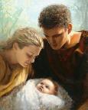
Godly Line of Seth
(Gen 4:25-26)
  Seth’s birth (4:25)
  Enosh’s birth (4:26a)
  Good line (4:26b) – How God continued the messianic line despite Satan’s attempt to preempt the messianic promise of Genesis 3:15

Slide 89
Godly Line of Seth
(Gen 4:25-26)
  Seth’s birth (4:25)
  Enosh’s birth (4:26a)
  Good line (4:26b) – How God continued the messianic line despite Satan’s attempt to preempt the messianic promise of Genesis 3:15

Slide 90
Satanic Attempts to Stop Messiah
Cain; Gen. 4, 1 Jn. 3:12
Sons of God; Gen. 6:1-4
Pharaoh; Ex. 1
Athaliah; 2 Chron. 22
Haman; Esther
Herod; Mt.2; Rev 12:4
Matt 4:5-7

Slide 91
Satanic Attempts to Stop Messiah
Cain; Gen. 4, 1 Jn. 3:12
Sons of God; Gen. 6:1-4
Pharaoh; Ex. 1
Athaliah; 2 Chron. 22
Haman; Esther
Herod; Mt.2; Rev 12:4
Matt 4:5-7

Slide 92
Godly Line of Seth
(Gen 4:25-26)
  Seth’s birth (4:25)
  Enosh’s birth (4:26a)
  Good line (4:26b) – How God continued the messianic line despite Satan’s attempt to preempt the messianic promise of Genesis 3:15

Slide 93
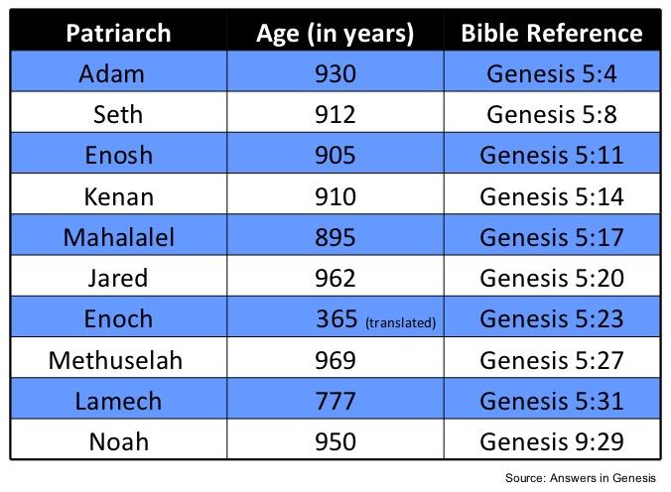

Slide 94
Godly Line of Seth
(Gen 4:25-26)
  Seth’s birth (4:25)
  Enosh’s birth (4:26a)
  Good line (4:26b) – How God continued the messianic line despite Satan’s attempt to preempt the messianic promise of Genesis 3:15

Slide 96
Ungodly Line of Cain
(Gen 4:16-24)
  Evil line that will not bring forth the Messiah (Gen 3:15)
    Continuation of Cain’s line (4:16-18)
    Immorality (4:19)
    Technological but not spiritual advancement (4:20-22)
    Violence (4:23-24)

Slide 97
Genesis 3:15
“And I will put enmity Between you and the woman, And between your seed and her seed; He shall bruise you on the head, And you shall bruise him on the heel.”

Slide 98
Conclusion

Slide 99
Genesis 4 Outline
  First murder (Gen 4:1-15)
  Ungodly line of Cain (4:16-24)
  Godly line of Seth (4:25-26)

Slide 100

“The Lord bless you and keep you; the Lord make his face shine on you and be gracious to you; the Lord turn his face toward you and give you peace.” (NIV)

