Slide 1


THE RAPTURE
What and When? – Part 29
Andrew Marshall Woods, Th.M., JD., PhD.
Sr. Pastor, Sugar Land Bible Church

Slide 2

What is the Rapture?
An important doctrine
Distinct from the Second Advent
Catching away of all living believers (1 Thess 4:17)
Reunion (1 Thess 4:14-16)
Resurrection (1 Cor 15:50-54)
Exemption from death (1 Cor 15:51, 54-56)
Instantaneous (1 Cor 15:52)
Mystery (1 Cor 15:51)
Imminent (1 Cor 15:51; 1 Thess 4:15)
Traditional doctrine now being recovered

Slide 3
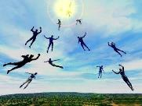
When Will the Rapture Take Place Relative to the Tribulation Period?
Pre-tribulation rapture theory
Mid-tribulation rapture theory
Post-tribulation rapture theory
Pre-wrath rapture theory
Partial rapture theory

Slide 4


Slide 5
When is the Rapture?
7 Arguments Favoring the Pre-Tribulation View
Tribulation's purpose concerns Israel (Jer 30:7; Dan 9:24)
No biblical reference to the church on earth during the Tribulation period (Rev 4-22)
Church is promised an exemption from divine wrath (1 Thess 1:10; 5:9; Rom 5:9; Rev 3:10; 6:17)
Rapture is imminent (1 Cor 15:51; 1 Thess 4:15)
Rapture is a comfort (1 Thess 4:18)
Antichrist cannot come to power until the restrainer is removed (2 Thess 2:6-7)
Symbolic parallels (2 Peter 2:5-9)

Slide 6
Strengthening the Pre-Tribulation Case
John 14:1-4
Revelation 3:10
First Thessalonians 4‒5
Second Thessalonians 2:3a
Matthew 24‒25

Slide 7
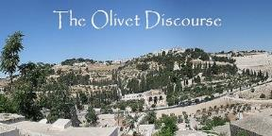
Preview of Matthew 24–25
The problem
The larger context
The immediate context (23:37-39)
The Disciples’ questions (24:1-3)
The Tribulation’s first half (24:4-14)
The Tribulation’s mid-point (24:15-20)
The Tribulation’s second half (24:21-22)
The Second Advent (24:23-31)
Eight parabolic exhortations (24:32‒25:46)

Slide 8
Preview of Matthew 24–25
The problem
The larger context
The immediate context (23:37-39)
The Disciples’ questions (24:1-3)
The Tribulation’s first half (24:4-14)
The Tribulation’s mid-point (24:15-20)
The Tribulation’s second half (24:21-22)
The Second Advent (24:23-31)
Eight parabolic exhortations (24:32‒25:46)

Slide 9
THE RAPTURE IN MATTHEW 24
Note the order of events:
        ²⁹ There are days of tribulation
        ³⁰ The whole world sees Jesus return
        ³¹ The elect are gathered to Him
        ⁴⁰⁻⁴¹ The rapture reiterated
How do Pre-Tribulation theorists explain the Rapture occurring before the apocalypse and before the Second Coming? Jesus says exactly the opposite in simple, unmistakable language.
Are there two Raptures - one before this that Jesus mysteriously didn't describe and then this one, which He did? Why would He leave one out? Or is there only one, but when he discusses it He jumbles up the order of events? Why would He do that?

Slide 10
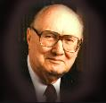
John F. Walvoord
"Christ's Olivet Discourse on the End of the Age - Part I," Bibliotheca Sacra 128/#510 (April 1971), p. 116..
“In Matthew 24–Matthew 25 the expositor should, therefore, understand that the program of God for the end of the age has in view the period ending with the second coming of Christ to the earth and the establishment of His earthly Kingdom, not the church age specifically ending with the rapture. Both the questions of the disciples and the answers of Christ are therefore, keyed to the Jewish expectation based on Old Testament prophecy, and the program of God for the earth in general rather than the church as the body of Christ.”

Slide 11
Preview of Matthew 24–25
The problem
The larger context
The immediate context (23:37-39)
The Disciples’ questions (24:1-3)
The Tribulation’s first half (24:4-14)
The Tribulation’s mid-point (24:15-20)
The Tribulation’s second half (24:21-22)
The Second Advent (24:23-31)
Eight parabolic exhortations (24:32‒25:46)

Slide 12
Matthew’s Purposes
To explain that Jesus in whom they had believed was the long-awaited Jewish Messiah
To explain why the kingdom had been postponed despite the fact that the king had arrived
To explain the interim program of God during the kingdom’s absence

Slide 13
Preview of Matthew 24–25
The problem
The larger context
The immediate context (23:37-39)
The Disciples’ questions (24:1-3)
The Tribulation’s first half (24:4-14)
The Tribulation’s mid-point (24:15-20)
The Tribulation’s second half (24:21-22)
The Second Advent (24:23-31)
Eight parabolic exhortations (24:32‒25:46)

Slide 14

Matthew 23:37-39
³⁷ “Jerusalem, Jerusalem, who kills the prophets and stones those who are sent to her! How often I wanted to gather [episynagō] your children together, the way a hen gathers [episynagō] her chicks under her wings, and you were unwilling. ³⁸ Behold, your house is being left to you desolate! ³⁹ For I say to you, from now on you will not see Me until you say, ‘Blessed is He who comes in the name of the Lord!’”

Slide 15
Preview of Matthew 24–25
The problem
The larger context
The immediate context (23:37-39)
The Disciples’ questions (24:1-3)
The Tribulation’s first half (24:4-14)
The Tribulation’s mid-point (24:15-20)
The Tribulation’s second half (24:21-22)
The Second Advent (24:23-31)
Eight parabolic exhortations (24:32‒25:46)

Slide 16

Matthew 24:3
“³ As He was sitting on the Mount of Olives, the disciples came to Him privately, saying, ‘Tell us, when will these things happen, and what will be the sign of Your coming, and of the end of the age?’”

Slide 17
Preview of Matthew 24–25
The problem
The larger context
The immediate context (23:37-39)
The Disciples’ questions (24:1-3)
The Tribulation’s first half (24:4-14)
The Tribulation’s mid-point (24:15-20)
The Tribulation’s second half (24:21-22)
The Second Advent (24:23-31)
Eight parabolic exhortations (24:32‒25:46)

Slide 18
Matt 24 / Rev 6 Parallels
Prediction | Birth pangs (Matt 24) | Seal judgments (Rev 6)
1. False Christ | 24:5 | 6:2
2. War | 24:6 | 6:3-4
3. Famine | 24:7 | 6:5-6
4. Death | 24:6-7 | 6:7-8
5. Martyrs | 24:9-13 | 6:9-11
6. Earthquakes | 24:7 | 6:12-17
7. Evangelism | 24:14 | 7:1-9

Slide 19
Preview of Matthew 24–25
The problem
The larger context
The immediate context (23:37-39)
The Disciples’ questions (24:1-3)
The Tribulation’s first half (24:4-14)
The Tribulation’s mid-point (24:15-20)
The Tribulation’s second half (24:21-22)
The Second Advent (24:23-31)
Eight parabolic exhortations (24:32‒25:46)

Slide 20


Slide 21
Preview of Matthew 24–25
The problem
The larger context
The immediate context (23:37-39)
The Disciples’ questions (24:1-3)
The Tribulation’s first half (24:4-14)
The Tribulation’s mid-point (24:15-20)
The Tribulation’s second half (24:21-22)
The Second Advent (24:23-31)
Eight parabolic exhortations (24:32‒25:46)

Slide 22

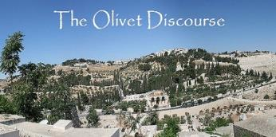
Matthew 24:21-22
“²¹ For then there will be a great tribulation, such as has not occurred since the beginning of the world until now, nor ever will. ²² Unless those days had been cut short, no life would have been saved; but for the sake of the elect those days will be cut short.”

Slide 23
Preview of Matthew 24–25
The problem
The larger context
The immediate context (23:37-39)
The Disciples’ questions (24:1-3)
The Tribulation’s first half (24:4-14)
The Tribulation’s mid-point (24:15-20)
The Tribulation’s second half (24:21-22)
The Second Advent (24:23-31)
Eight parabolic exhortations (24:32‒25:46)

Slide 25
Matthew 24:31
“And He will send forth His angels with a great trumpet and they will gather together [episynagō] His elect from the four winds, from one end of the sky to the other.”

Slide 26

Isaiah 27:13
“It will come about also in that day that a great trumpet will be blown, and those who were perishing in the land of Assyria and who were scattered in the land of Egypt will come and worship the Lord in the holy mountain at Jerusalem.”

Slide 27
Matthew 16:1–3
¹ The Pharisees and Sadducees came up, and testing Jesus, they asked Him to show them a sign from heaven. ² But He replied to them, “When it is evening, you say, ‘It will be fair weather, for the sky is red.’ ³ “And in the morning, ‘There will be a storm today, for the sky is red and threatening.’ Do you know how to discern the appearance of the sky, but cannot discern the signs of the times?

Slide 28

Lewis Sperry Chafer
Systematic Theology, Vol. 4, p. 367
“THE IMMINENT RETURN OF CHRIST. Whether it be that coming of Christ to the earth in glory when Israel is to be delivered or that coming into the air to receive His Bride, the coming is imminent. Scripture which directs Israel in the tribulation, which time is terminated by the glorious return of Christ as their judge and Deliverer, warns her to watch, for He will then come “as a thief in the night” (cf. Matt. 24:32–25:13; 1 Thess. 5:1–8; 2 Pet. 3:8, 10). Over against this, the Church is instructed to wait and to look for His return for her (1 Thess. 1:9–10; Titus 2:13; Heb. 9:28).”

Slide 29
Lewis Sperry Chafer
Systematic Theology, Vol. 4, p. 367
“In both instances the return of Christ is unannounced and therefore impending, within the period to which each event belongs. The return of Christ for His Church was not impending in Old Testament days; nor is the glorious appearing impending until the tribulation (2 Thess. 2:3).”

Slide 30
Preview of Matthew 24–25
The problem
The larger context
The immediate context (23:37-39)
The Disciples’ questions (24:1-3)
The Tribulation’s first half (24:4-14)
The Tribulation’s mid-point (24:15-20)
The Tribulation’s second half (24:21-22)
The Second Advent (24:23-31)
Eight parabolic exhortations (24:32‒25:46)

Slide 31
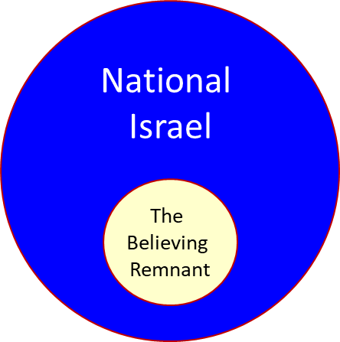

Slide 32
Zechariah 13:8-9
⁸“It will come about in all the land,” Declares the Lord, “That two parts in it will be cut off and perish; But the third will be left in it. ⁹“And I will bring the third part through the fire, Refine them as silver is refined, And test them as gold is tested. They will call on My name, And I will answer them; I will say, ‘They are My people,’ And they will say, ‘The Lord is my God.’ ”

Slide 33
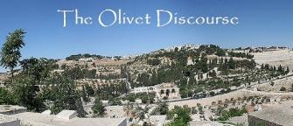
VIII. Eight Parabolic Exhortations
(Matthew 24:32–25:46)
The fig tree (24:32-35)
The days of Noah (24:36-39)
The comparison of two men & women (24:40-41)
The householder (24:42-44)
The wise servant (24:45-51)
The wise virgins (25:1-13)
The talents (25:14-30)
The sheep & goat judgment (25:31-46)

Slide 34
VIII. Eight Parabolic Exhortations
(Matthew 24:32–25:46)
The fig tree (24:32-35)
The days of Noah (24:36-39)
The comparison of two men & women (24:40-41)
The householder (24:42-44)
The wise servant (24:45-51)
The wise virgins (25:1-13)
The talents (25:14-30)
The sheep & goat judgment (25:31-46)

Slide 35
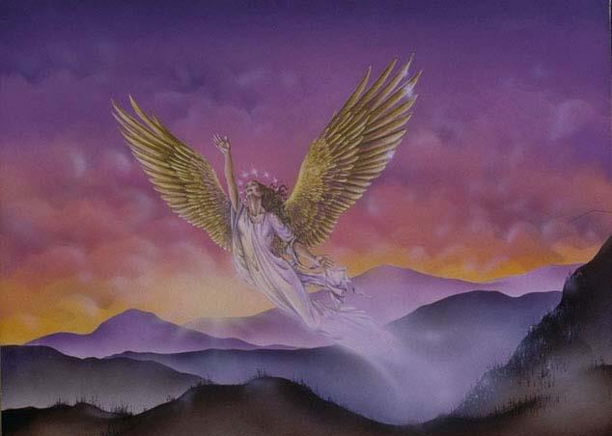
CONNECTING
REV 12 & ANTI-SEMITISM
DANIEL’S 70th WEEK (7 years)
Israel flees
3 ½ years
1260 days

Slide 36
VIII. Eight Parabolic Exhortations
(Matthew 24:32–25:46)
The fig tree (24:32-35)
The days of Noah (24:36-39)
The comparison of two men & women (24:40-41)
The householder (24:42-44)
The wise servant (24:45-51)
The wise virgins (25:1-13)
The talents (25:14-30)
The sheep & goat judgment (25:31-46)

Slide 37

Matthew 24:36-39
³⁶ “But of that day and hour no one knows, not even the angels of heaven, nor the Son, but the Father alone. ³⁷ For the coming of the Son of Man will be just like the days of Noah. ³⁸ For as in those days before the flood they were eating and drinking, marrying and giving in marriage, until the day that Noah entered the ark, ³⁹ and they did not understand until the flood came and took them all away; so will the coming of the Son of Man be.”

Slide 38
VIII. Eight Parabolic Exhortations
(Matthew 24:32–25:46)
The fig tree (24:32-35)
The days of Noah (24:36-39)
The comparison of two men & women (24:40-41)
The householder (24:42-44)
The wise servant (24:45-51)
The wise virgins (25:1-13)
The talents (25:14-30)
The sheep & goat judgment (25:31-46)

Slide 39
Matthew 24:36-41
³⁶ “But of that day and hour no one knows, not even the angels of heaven, nor the Son, but the Father alone. ³⁷ For the coming of the Son of Man will be just like the days of Noah. ³⁸ For as in those days before the flood they were eating and drinking, marrying and giving in marriage, until the day that Noah entered the ark, ³⁹ and they did not understand until the flood came and took them all away; so will the coming of the Son of Man be. ⁴⁰ Then there will be two men in the field; one will be taken and one will be left. ⁴¹ Two women will be grinding at the mill; one will be taken and one will be left.”

Slide 40
C. The Comparison of Two Men and Women
Matthew 24:40-41
No rapture reasons
  Preceding context
  Days of Noah chronology
  Son of Man
  Other Matthean judgments
  Lukan parallel passage

Slide 41
C. The Comparison of Two Men and Women
Matthew 24:40-41
No rapture reasons
  Preceding context
  Days of Noah chronology
  Son of Man
  Other Matthean judgments
  Lukan parallel passage

Slide 42
C. The Comparison of Two Men and Women
Matthew 24:40-41
No rapture reasons
  Preceding context
  Days of Noah chronology
  Son of Man
  Other Matthean judgments
  Lukan parallel passage

Slide 43
Matthew 24:36-41
³⁶ “But of that day and hour no one knows, not even the angels of heaven, nor the Son, but the Father alone. ³⁷ For the coming of the Son of Man will be just like the days of Noah. ³⁸ For as in those days before the flood they were eating and drinking, marrying and giving in marriage, until the day that Noah entered the ark, ³⁹ and they did not understand until the flood came and took them all away; so will the coming of the Son of Man be. ⁴⁰ THEN (tote) there will be two men in the field; one will be taken and one will be left. ⁴¹ Two women will be grinding at the mill; one will be taken and one will be left.”

Slide 44
C. The Comparison of Two Men and Women
Matthew 24:40-41
No rapture reasons
  Preceding context
  Days of Noah chronology
  Son of Man
  Other Matthean judgments
  Lukan parallel passage

Slide 45
Matthew 24:36-41
³⁶ “But of that day and hour no one knows, not even the angels of heaven, nor the Son, but the Father alone. ³⁷ For the coming of the Son of Man will be just like the days of Noah. ³⁸ For as in those days before the flood they were eating and drinking, marrying and giving in marriage, until the day that Noah entered the ark, ³⁹ and they did not understand until the flood came and took them all away; so will the coming of the Son of Man be. ⁴⁰ Then there will be two men in the field; one will be taken and one will be left. ⁴¹ Two women will be grinding at the mill; one will be taken and one will be left.”

Slide 46
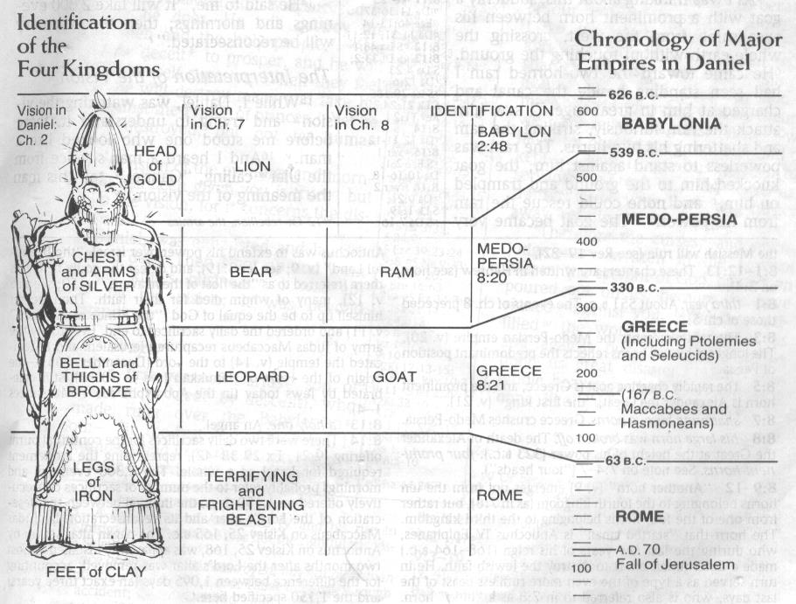

Slide 47
C. The Comparison of Two Men and Women
Matthew 24:40-41
No rapture reasons
  Preceding context
  Days of Noah chronology
  Son of Man
  Other Matthean judgments
  Lukan parallel passage

Slide 48

Matthew 13:30
‘Allow both to grow together until the harvest; and in the time of the harvest I will say to the reapers, “First gather up the tares and bind them in bundles to burn them up; but gather the wheat into my barn.” ’ ”

Slide 49
C. The Comparison of Two Men and Women
Matthew 24:40-41
No rapture reasons
  Preceding context
  Days of Noah chronology
  Son of Man
  Other Matthean judgments
  Lukan parallel passage

Slide 50

Luke 17:34-37
³⁴ “I tell you, on that night there will be two in one bed; one will be taken and the other will be left. ³⁵ “There will be two women grinding at the same place; one will be taken and the other will be left. ³⁶ “Two men will be in the field; one will be taken and the other will be left.” ³⁷ And answering they said to Him, “Where, Lord?” And He said to them, “Where the body is, there also the vultures will be gathered.”

Slide 51
C. The Comparison of Two Men and Women
Matthew 24:40-41
Pro-rapture reasons
  From airō to paralambanō
  Day or hour can be known in the Tribulation
  Normal life activities at the end of the Tribulation
  Peri De (“Now Concerning”) construction

Slide 52
C. The Comparison of Two Men and Women
Matthew 24:40-41
Pro-rapture reasons
  From airō to paralambanō
  Day or hour can be known in the Tribulation
  Normal life activities at the end of the Tribulation
  Peri De (“Now Concerning”) construction

Slide 53
Matthew 24:36-41
³⁶ “But of that day and hour no one knows, not even the angels of heaven, nor the Son, but the Father alone. ³⁷ For the coming of the Son of Man will be just like the days of Noah. ³⁸ For as in those days before the flood they were eating and drinking, marrying and giving in marriage, until the day that Noah entered the ark, ³⁹ and they did not understand until the flood came and took (airō) them all away; so will the coming of the Son of Man be. ⁴⁰ Then there will be two men in the field; one will be taken (paralambanō) and one will be left. ⁴¹ “Two women will be grinding at the mill; one will be taken (paralambanō) and one will be left.”

Slide 54

John 14:1–4
¹ “Do not let your heart be troubled; believe in God, believe also in Me. ² “In My Father’s house are many dwelling places; if it were not so, I would have told you; for I go to prepare a place for you. ³ “If I go and prepare a place for you, I will come again and receive you (paralambanō) to Myself, that where I am, there you may be also. ⁴ “And you know the way where I am going.”

Slide 55
2 Kings 2:1, 3, 5
“¹ And it came about when the LORD was about to take up [alah] Elijah by a whirlwind to heaven, that Elijah went with Elisha from Gilgal….³ Then the sons of the prophets who were at Bethel came out to Elisha and said to him, “Do you know that the LORD will take away [laqach] your master from over you today?” And he said, “Yes, I know; be still.”…⁵ The sons of the prophets who were at Jericho approached Elisha and said to him, “Do you know that the LORD will take away [laqach] your master from over you today?” And he answered, “Yes, I know; be still.”

Slide 56
John 19:15-16
“¹⁵ So they cried out, “Away with Him [airō], away with Him, crucify Him!” Pilate said to them, “Shall I crucify your King?” The chief priests answered, “We have no king but Caesar.” ¹⁶ So he then handed Him over [paralambanō] to them to be crucified.

Slide 57
C. The Comparison of Two Men and Women
Matthew 24:40-41
Pro-rapture reasons
  From airō to paralambanō
  Day or hour can be known in the Tribulation
  Normal life activities at the end of the Tribulation
  Peri De (“Now Concerning”) construction

Slide 58
Matthew 24:36-41
³⁶ “But of that day and hour no one knows, not even the angels of heaven, nor the Son, but the Father alone. ³⁷ For the coming of the Son of Man will be just like the days of Noah. ³⁸ For as in those days before the flood they were eating and drinking, marrying and giving in marriage, until the day that Noah entered the ark, ³⁹ and they did not understand until the flood came and took them all away; so will the coming of the Son of Man be. ⁴⁰ Then there will be two men in the field; one will be taken and one will be left. ⁴¹ “Two women will be grinding at the mill; one will be taken and one will be left.”

Slide 60


Slide 61

Genesis 6:1-4
“¹ Now it came about, when men began to multiply on the face of the land, and daughters were born to them, ² that the sons of God saw that the daughters of men were beautiful; and they took wives for themselves, whomever they chose. ³ Then the Lord said, ‘My Spirit shall not strive with man forever, because he also is flesh; nevertheless his days shall be one hundred and twenty years.’ . . .

Slide 62
Matthew 24:36-41
³⁶ “But of that day and hour no one knows, not even the angels of heaven, nor the Son, but the Father alone. ³⁷ For the coming of the Son of Man will be just like the days of Noah. ³⁸ For as in those days before the flood they were eating and drinking, marrying and giving in marriage, until the day that Noah entered the ark, ³⁹ and they did not understand until the flood came and took them all away; so will the coming of the Son of Man be. ⁴⁰ Then there will be two men in the field; one will be taken and one will be left. ⁴¹ “Two women will be grinding at the mill; one will be taken and one will be left.”

Slide 63
C. The Comparison of Two Men and Women
Matthew 24:40-41
Pro-rapture reasons
  From airō to paralambanō
  Day or hour can be known in the Tribulation
  Normal life activities at the end of the Tribulation
  Peri De (“Now Concerning”) construction

Slide 64
Matthew 24:36-41
³⁶ “But of that day and hour no one knows, not even the angels of heaven, nor the Son, but the Father alone. ³⁷ For the coming of the Son of Man will be just like the days of Noah. ³⁸ For as in those days before the flood they were eating and drinking, marrying and giving in marriage, until the day that Noah entered the ark, ³⁹ and they did not understand until the flood came and took them all away; so will the coming of the Son of Man be. ⁴⁰ Then there will be two men in the field; one will be taken and one will be left. ⁴¹ “Two women will be grinding at the mill; one will be taken and one will be left.”

Slide 66
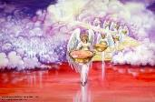

Seven Bowls
(Revelation 16)
1st Bowl (16:1-2) – Boils
2nd Bowl (16:3) – Sea becomes blood
3rd Bowl (16:4-7) – Freshwater destroyed
4th Bowl (16:8-9) – Sun scorches man
5th Bowl (16:10-11) – Darkness
6th Bowl (16:13-16) – Euphrates dried
7th Bowl (16:17-21) – Greatest earthquake

Slide 67

Arnold G. Fruchtenbaum
Yeshua: The Life of Messiah from a Messianic Jewish Perspective, 4 vols., vol. 3 (San Antonio, TX: Ariel Ministries, 2017), 366.
“The rapture will occur when conditions on earth are normal and people are eating and drinking, marrying and giving in marriage (Matt. 24:38). These are common activities in human society. Marrying and giving in marriage are necessary to propagate life; eating and drinking are essential to sustain it. During the time of Noah, life was normal when suddenly the flood came and took the people away. The rapture will occur in the same manner: so shall be the coming of the Son of Man (Matt. 24:39). Nothing spectacular will forewarn people that the believers are about to be taken up. However, things . . .

Slide 68
Arnold G. Fruchtenbaum
Yeshua: The Life of Messiah from a Messianic Jewish Perspective, 4 vols., vol. 3 (San Antonio, TX: Ariel Ministries, 2017), 366.
. . .will be abnormal at the time of the second coming. Nearly three-quarters of the earth will be destroyed in seven long years of tribulation. A blackness paired with tremendous tidal waves, anarchy, confusion, and perplexity will envelop the world. The Olivet Discourse shows that conditions will be abnormal at the time of the second coming, and so it is better to interpret this passage as referring to the rapture.”

Slide 69


Matthew 24:32-33
³² “Now learn the parable from the fig tree: when its branch has already become tender and puts forth its leaves, you know that summer is near; ³³ so, you too, when you see all these things, recognize that He is near, right at the door.”

Slide 70
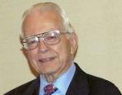

Dr. Roy B. Zuck
Basic Bible Interpretation, p. 215-16.
“﻿Usually a parable, like a sermon illustration, is teaching a single truth. When Jesus explained a number of His parables, He usually…stated one spiritual truth. For example when the man found his one lost sheep, he rejoiced, and Jesus said this illustrates the truth that there is rejoicing in heaven when a sinner repents (Luke 15:7)...He gave one simple spiritual lesson, and made no attempt to see any spiritual significance to the vineyard, the denarius, or the sixth hour, the ninth hour, or the eleventh hour, nor the vineyard foreman…To hunt for meanings in every detail in the parables is to turn them into allegories.”

Slide 71
C. The Comparison of Two Men and Women
Matthew 24:40-41
Pro-rapture reasons
  From airō to paralambanō
  Day or hour can be known in the Tribulation
  Normal life activities at the end of the Tribulation
  Peri De (“Now Concerning”) construction

Slide 72
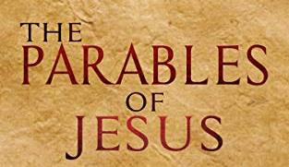
Matthew 24:36
“But (peri de) of that day and hour no one knows, not even the angels of heaven, nor the Son, but the Father alone.”

Slide 73
Arnold G. Fruchtenbaum
Yeshua: The Life of Messiah from a Messianic Jewish Perspective, 4 vols., vol. 3 (San Antonio, TX: Ariel Ministries, 2017), 365.
“Matthew began the passage with the word but (Matt. 24:36). In the Greek language, there is more than one way of saying but. Here, the English word is a translation of two Greek words, peri de, meaning ‘now concerning.’ As Greek grammar books show, this construction denotes a contrast and often introduces a new subject. Paul uses the formula frequently in his writings when presenting a new topic (eg. 1 Cor. 7:1, 25; 8:1; 12:1; 16:1, 12; 1 Thess. 4:9; 5:1; etc.). In the context of Matthew 24, Yeshua had been talking about one topic (the second coming), then introduced a new subject (the rapture)...In the passage above, He introduced the new topic by using the peri de construction.”

Slide 74
Arnold G. Fruchtenbaum
Yeshua: The Life of Messiah from a Messianic Jewish Perspective, 4 vols., vol. 3 (San Antonio, TX: Ariel Ministries, 2017), 365.
“Matthew began the passage with the word but (Matt. 24:36). In the Greek language, there is more than one way of saying but. Here, the English word is a translation of two Greek words, peri de, meaning ‘now concerning.’ As Greek grammar books show, this construction denotes a contrast and often introduces a new subject. Paul uses the formula frequently in his writings when presenting a new topic (eg. 1 Cor. 7:1, 25; 8:1; 12:1; 16:1, 12; 1 Thess. 4:9; 5:1; etc.). In the context of Matthew 24, Yeshua had been talking about one topic (the second coming), then introduced a new subject (the rapture)...In the passage above, He introduced the new topic by using the peri de construction.”

Slide 75
A Comparison of the Olivet & Upper Room Discourses
Discourse | Olivet | Upper Room
Scripture | Matt 24─25 | John 13─17
Location | Mount of Olives | Upper Room
PASSION WEEK | THIRD DAY | SIXTH DAY
General focus | Farewell: Israel | Hello: Church
Specific focus | Israel’s future | Divine provisions
Prompting | Temple's destruction | Christ's imminent departure
Explanations | Written OT | Unwritten NT
Apostles | Israel (Matt. 19:28) | Church (Eph. 2:20)

Slide 76
VIII. Eight Parabolic Exhortations
(Matthew 24:32–25:46)
The fig tree (24:32-35)
The days of Noah (24:36-39)
The comparison of two men & women (24:40-41)
The householder (24:42-44)
The wise servant (24:45-51)
The wise virgins (25:1-13)
The talents (25:14-30)
The sheep & goat judgment (25:31-46)

Slide 77
VIII. Eight Parabolic Exhortations
(Matthew 24:32–25:46)
The fig tree (24:32-35)
The days of Noah (24:36-39)
The comparison of two men & women (24:40-41)
The householder (24:42-44)
The wise servant (24:45-51)
The wise virgins (25:1-13)
The talents (25:14-30)
The sheep & goat judgment (25:31-46)

Slide 78
VIII. Eight Parabolic Exhortations
(Matthew 24:32–25:46)
The fig tree (24:32-35)
The days of Noah (24:36-39)
The comparison of two men & women (24:40-41)
The householder (24:42-44)
The wise servant (24:45-51)
The wise virgins (25:1-13)
The talents (25:14-30)
The sheep & goat judgment (25:31-46)

Slide 79
VIII. Eight Parabolic Exhortations
(Matthew 24:32–25:46)
The fig tree (24:32-35)
The days of Noah (24:36-39)
The comparison of two men & women (24:40-41)
The householder (24:42-44)
The wise servant (24:45-51)
The wise virgins (25:1-13)
The talents (25:14-30)
The sheep & goat judgment (25:31-46)

Slide 80
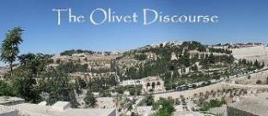
F. Partial Rapture of the Church?
(Matthew 25:1-13)
  Chapter division & preceding context
  Demoted from bride to maidens
  Bride? Body? In Christ?
  Translation? Resurrection?
  Bridegroom comes to the earth

Slide 81
F. Partial Rapture of the Church?
(Matthew 25:1-13)
  All asleep (vs. 5)
  Rapture for all Christians (1 Cor. 15:51)
  End of the Inter-Advent Age
  Consistency with the other Parables
  Dispensationally misapplied passage

Slide 82
F. Partial Rapture of the Church?
(Matthew 25:1-13)
  Chapter division & preceding context
  Demoted from bride to maidens
  Bride? Body? In Christ?
  Translation? Resurrection?
  Bridegroom comes to the earth

Slide 83
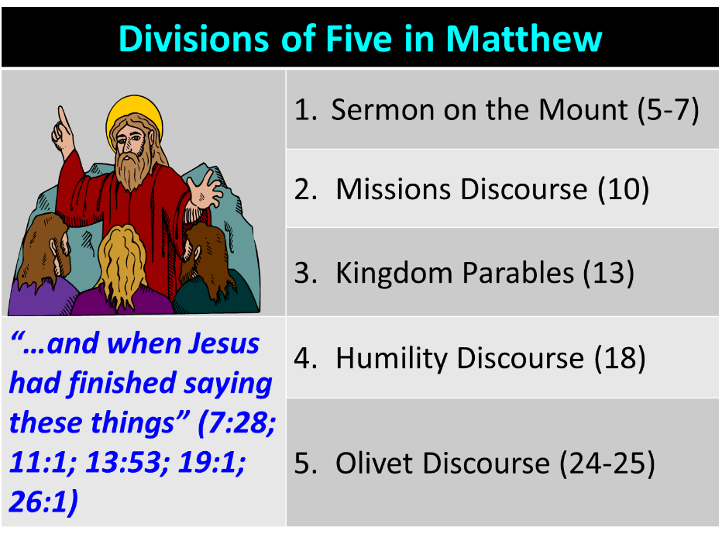

Slide 84
F. Partial Rapture of the Church?
(Matthew 25:1-13)
  Chapter division & preceding context
  Demoted from bride to maidens
  Bride? Body? In Christ?
  Translation? Resurrection?
  Bridegroom comes to the earth

Slide 85
F. Partial Rapture of the Church?
(Matthew 25:1-13)
  Chapter division & preceding context
  Demoted from bride to maidens
  Bride? Body? In Christ?
  Translation? Resurrection?
  Bridegroom comes to the earth

Slide 86
F. Partial Rapture of the Church?
(Matthew 25:1-13)
  Chapter division & preceding context
  Demoted from bride to maidens
  Bride? Body? In Christ?
  Translation? Resurrection?
  Bridegroom comes to the earth

Slide 87

1 Thessalonians 4:16-18
¹⁶ For the Lord Himself will descend from heaven with a shout, with the voice of the archangel and with the trumpet of God, and the dead in Christ will rise first. ¹⁷ Then we who are alive and remain will be caught up [harpazō] together with them in the clouds to meet the Lord in the air, and so we shall always be with the Lord. ¹⁸ Therefore comfort one another with these words."

Slide 88

Catching Away of All Living Believers
(1 Thess 4:17)
Harpazo = seized or caught up by force
Harpazo (Greek) = rapere (Latin) = rapture (English)

Slide 89
1 Corinthians 15:50-51
“⁵⁰ Now I say this, brethren, that flesh and blood cannot inherit the kingdom of God; nor does the perishable inherit the imperishable. ⁵¹ Behold, I tell you a mystery; we will not all sleep, but we will all be changed.”

Slide 90
F. Partial Rapture of the Church?
(Matthew 25:1-13)
  Chapter division & preceding context
  Demoted from bride to maidens
  Bride? Body? In Christ?
  Translation? Resurrection?
  Bridegroom comes to the earth

Slide 91
F. Partial Rapture of the Church?
(Matthew 25:1-13)
  All asleep (vs. 5)
  Rapture for all Christians (1 Cor. 15:51)
  End of the Inter-Advent Age
  Consistency with the other Parables
  Dispensationally misapplied passage

Slide 92
F. Partial Rapture of the Church?
(Matthew 25:1-13)
  All asleep (vs. 5)
  Rapture for all Christians (1 Cor. 15:51)
  End of the Inter-Advent Age
  Consistency with the other Parables
  Dispensationally misapplied passage

Slide 93
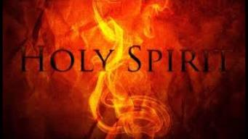
1 Corinthians 12:13
“For by one Spirit we were all baptized into one body, whether Jews or Greeks, whether slaves or free, and we were all made to drink of one Spirit.”

Slide 94

1 Corinthians 15:50-51
“⁵⁰ Now I say this, brethren, that flesh and blood cannot inherit the kingdom of God; nor does the perishable inherit the imperishable. ⁵¹ Behold, I tell you a mystery; we will not all sleep, but we will all be changed.”

Slide 95
F. Partial Rapture of the Church?
(Matthew 25:1-13)
  All asleep (vs. 5)
  Rapture for all Christians (1 Cor. 15:51)
  End of the Inter-Advent Age
  Consistency with the other Parables
  Dispensationally misapplied passage

Slide 96


Slide 97
F. Partial Rapture of the Church?
(Matthew 25:1-13)
  All asleep (vs. 5)
  Rapture for all Christians (1 Cor. 15:51)
  End of the Inter-Advent Age
  Consistency with the other Parables
  Dispensationally misapplied passage

Slide 98
F. Partial Rapture of the Church?
(Matthew 25:1-13)
  All asleep (vs. 5)
  Rapture for all Christians (1 Cor. 15:51)
  End of the Inter-Advent Age
  Consistency with the other Parables
  Dispensationally misapplied passage

Slide 99
VIII. Eight Parabolic Exhortations
(Matthew 24:32–25:46)
The fig tree (24:32-35)
The days of Noah (24:36-39)
The comparison of two men & women (24:40-41)
The householder (24:42-44)
The wise servant (24:45-51)
The wise virgins (25:1-13)
The talents (25:14-30)
The sheep & goat judgment (25:31-46)

Slide 100
VIII. Eight Parabolic Exhortations
(Matthew 24:32–25:46)
The fig tree (24:32-35)
The days of Noah (24:36-39)
The comparison of two men & women (24:40-41)
The householder (24:42-44)
The wise servant (24:45-51)
The wise virgins (25:1-13)
The talents (25:14-30)
The sheep & goat judgment (25:31-46)

Slide 101
Matthew 23:37-39
³⁷ “Jerusalem, Jerusalem, who kills the prophets and stones those who are sent to her! How often I wanted to gather [episynagō] your children together, the way a hen gathers [episynagō] her chicks under her wings, and you were unwilling. ³⁸ Behold, your house is being left to you desolate! ³⁹ For I say to you, from now on you will not see Me until you say, ‘Blessed is He who comes in the name of the Lord!’”

Slide 102
Matthew 24:31
“And He will send forth His angels with a great trumpet and they will gather together [episynagō] His elect from the four winds, from one end of the sky to the other.”

Slide 103

Jeremiah 30:7
“Alas! for that day is great, There is none like it; And it is the time of Jacob’s distress (Gen. 32:8; 35:10), But he will be saved from it.”

Slide 104
Matthew 24:21-22
“²¹ For then there will be a great tribulation, such as has not occurred since the beginning of the world until now, nor ever will. ²² Unless those days had been cut short, no life would have been saved; but for the sake of the elect those days will be cut short.”

Slide 105
CONNECTING
REV 12 & ANTI-SEMITISM
DANIEL’S 70th WEEK (7 years)
Israel flees
3 ½ years
1260 days

Slide 106

Kevin DeYoung
“Seven Passages on Social Justice (4),” The Gospel Coalition, 13 April 2010 (italics original).
“Matthew 25 is about social justice in the sense that it is about caring for the needy. But the needy in view are fellow Christians, especially those dependent on our hospitality and generosity for their ministry....Jesus says if we are too embarrassed, too lazy, or too cowardly to support our fellow Christians who depend on our assistance and are suffering for the sake of the gospel, we will go to hell. We should not make this passage say anything more or less than this.”

Slide 107
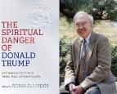
Ronald J. Sider
“Rich Christians in an Age of Hunger, Sixth Edition (Nashville: Thomas Nelson, 2015), 64.
“Jesus expressed it even more pointedly. To those who do not feed the hungry, clothe the naked, and visit the prisoners, he will speak a terrifying word at the final judgment: “Depart from me, you cursed, into the eternal fire prepared for the devil and his angels” (Matt. 25:41). The meaning is clear. Jesus intends that his disciples imitate his own concern for the poor and needy. Those who disobey will experience eternal damnation.”

Slide 108


Joe Scarborough
“Morning Joe,” MSNBC, 26 June 2018.
“[In Matthew 25] Jesus actually is asked by [His] disciples who is going to be able to sit on your right hand and who is going to be cast away. And Jesus goes through the list and He talks about anyone that does this for the least among us is doing it to Me. They will be with the sheep. Those who don’t will be tossed out—will be with the goats. . . . It is one of the few times . . . Jesus says, “This is what you have to do to get to heaven; and if you don’t do it, you will not get to heaven”—one of the times He says, “This is it: giving a cup of water in the Master’s name, feeding the hungry, clothing the naked, visiting those in prison, and, again, helping the least among us.”

Slide 110
Scripture’s Four Judgments
Name | Sheep and Goat | Judgment of the Jews | Bema Seat | Great White Throne
Scripture | Matt 25:31-46 | Ezek 20:33-44 | 1 Cor 3:10-15 | Rev 20:11-15
Place | Earth, Jerusalem | Earth, wilderness | Heaven | Earth
Audience | Gentile Tribulation survivors | Jewish Tribulation survivors | Church Age believers | All unsaved
When | After Tribulation | After Tribulation | After rapture | After Millennium
Purpose | Saved Gentiles enter kingdom | Saved Jews enter kingdom | Reward believers | Degree of punishment in hell
Evaluation | Treatment of Christ’s brethren | Passing under shepherd’s rod | Works taken through fire | Not in the book; judged by books

Slide 112
SHEEP & GOAT VS GREAT WHITE THRONE
MATT. 25:31-46 | REV. 20:11-15
Post Second Advent | Post Millennium
Living Nations | Dead
Believers & Unbelievers | Unbelievers Only
Angels, Sheep, Goats, Brethren | Unbelievers Only
David’s Throne | Great White Throne
Earthly | Non-earthly
Pentecost, Things To Come, 425-26

Slide 113
SHEEP & GOAT VS GREAT WHITE THRONE
MATT. 25:31-46 | REV. 20:11-15
After Poverty, Imprisonment, Sickness | After Utopia
Entrance into Kingdom & Hades | Entrance into Lake of Fire Only
Basis: Treatment of Brethren | Basis: Book of Life and Books
Not After Resurrection | After Resurrection
Subjects: Tribulation Survivors | Subjects: Unbelievers of All Ages
After Regathering of the Elect | After the Second Resurrection
Pentecost, Things To Come, 425-26

Slide 114
Conclusion

Slide 115
VIII. Eight Parabolic Exhortations
(Matthew 24:32–25:46)
The fig tree (24:32-35)
The days of Noah (24:36-39)
The comparison of two men & women (24:40-41)
The householder (24:42-44)
The wise servant (24:45-51)
The wise virgins (25:1-13)
The talents (25:14-30)
The sheep & goat judgment (25:31-46)

Slide 116
Preview of Matthew 24–25
The problem
The larger context
The immediate context (23:37-39)
The Disciples’ questions (24:1-3)
The Tribulation’s first half (24:4-14)
The Tribulation’s mid-point (24:15-20)
The Tribulation’s second half (24:21-22)
The Second Advent (24:23-31)
Eight parabolic exhortations (24:32‒25:46)

