Slide 1


Genesis 3
The Fall of Man

Slide 2

GENESIS STRUCTURE
  Beginning of the Human race (Gen. 1‒11)
  Beginning of the Hebrew race (Gen. 12‒50)

Slide 3

GENESIS STRUCTURE
  Genesis 1-11 (four events)
  Creation (1-2)
  Fall (3-5)
  Flood (6-9)
  National dispersion (10-11)

Slide 4

Contradictory Account of Creation?
Genesis 1 – Overview of the whole creation
Genesis 2 – Details surrounding the creation of the garden, the first man, and his activities on day 6

Slide 5
GENESIS STRUCTURE
  Genesis 1-11 (four events)
  Creation (1-2)
  Fall (3-5)
  Flood (6-9)
  National dispersion (10-11)

Slide 6
GENESIS 3: THE FALL OF MAN
“This chapter is the pivot on which the whole Bible turns”
-W. H. Griffith Thomas

Slide 7

Genesis Structure
  3:1-5 Temptation by the serpent
  3:6 Sin of Adam and Eve
  3:7-13 Results of the sin
  3:14-19 Imposition of divine judgments
  3:20-24 God’s provision in spite of the sin

Slide 8
Genesis Structure
  3:1-5 Temptation by the serpent
  3:6 Sin of Adam and Eve
  3:7-13 Results of the sin
  3:14-19 Imposition of divine judgments
  3:20-24 God’s provision in spite of the sin

Slide 9
Satan’s Tactics (2 Cor 2:11)
  Adds to God’s Word (3:1; 2:16-17)
  Challenges God’s goodness (3:1; 2:16-17)
  Subtracts from God’s Word (3:4; 2:17)
  Offers wisdom without submission to God (3:5; Prov 1:7)

Slide 10

Adam and Eve’s Mistakes (Eph 6:10-20)
  Subtracting from God’s Word (3:2; 2:16)
  Adding to God’s Word (3:3; 2:17)
  Doubting God’s goodness (3:2-3; 2:16-17)
  Initial break down in male headship (2:4-7, 16-17, 18-25)

Slide 11
Genesis Structure
  3:1-5 Temptation by the serpent
  3:6 Sin of Adam and Eve
  3:7-13 Results of the sin
  3:14-19 Imposition of divine judgments
  3:20-24 God’s provision in spite of the sin

Slide 12
Sin of Adam and Eve (3:6)
  Three avenues of temptation (1 John 2:16)
  Lust of the flesh
  Lust of the eye
  Pride of life
  Break down in male headship (1 Tim 2:13; Gen 2:23)

Slide 13
Genesis Structure
  3:1-5 Temptation by the serpent
  3:6 Sin of Adam and Eve
  3:7-13 Results of the sin
  3:14-19 Imposition of divine judgments
  3:20-24 God’s provision in spite of the sin

Slide 14
Results of the Sin
(3:7-13)
  Religion (3:7)
  Broken fellowship (3:8-10)
  “Buck passing” (3:11-13)
  Reversal creation hierarchy (3:11-13)

Slide 15
Genesis Structure
  3:1-5 Temptation by the serpent
  3:6 Sin of Adam and Eve
  3:7-13 Results of the sin
  3:14-19 Imposition of divine judgments
  3:20-24 God’s provision in spite of the sin

Slide 16
Divine Judgments
(3:14-19)
  Serpent (3:14-15)
  Woman (3:16)
  Man (3:17-19)

Slide 17


Slide 18

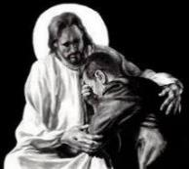
Revelation 21:4
“and He will wipe away every tear from their eyes; and there will no longer be any death; there will no longer be any mourning, or crying, or pain; the first things have passed away.”

Slide 19
Divine Judgments
(3:14-19)
  Serpent (3:14-15)
  Woman (3:16)
  Man (3:17-19)

Slide 20
Genesis Structure
  3:1-5 Temptation by the serpent
  3:6 Sin of Adam and Eve
  3:7-13 Results of the sin
  3:14-19 Imposition of divine judgments
  3:20-24 God’s provision in spite of the sin

Slide 21
God’s Provision
(3:20-24)
  Continuation of the race (3:20)
  Forgiveness (3:21, 7)
  Expulsion of Adam and Eve from Eden (3:22-24)

Slide 22
God’s Provision
(3:20-24)
  Continuation of the race (3:20)
  Forgiveness (3:21, 7)
  Expulsion of Adam and Eve from Eden (3:22-24)

Slide 23


Genesis 3:19
“By the sweat of your face You will eat bread, Till you return to the ground, Because from it you were taken; For you are dust, And to dust you shall return.”

Slide 24

Acts 17:26
“and He made from one man every nation of mankind to live on all the face of the earth, having determined their appointed times and the boundaries of their habitation.” (Italics added)

Slide 25


Matthew 24:21-22
“²¹ For then there will be a great tribulation, such as has not occurred since the beginning of the world until now, nor ever will. ²² Unless those days had been cut short, no life would have been saved; but for the sake of the elect those days will be cut short.”

Slide 26
God’s Provision
(3:20-24)
  Continuation of the race (3:20)
  Forgiveness (3:21, 7)
  Expulsion of Adam and Eve from Eden (3:22-24)

Slide 27

Genesis 1:29-30
“²⁹ Then God said, ‘Behold, I have given you every plant yielding seed that is on the surface of all the earth, and every tree which has fruit yielding seed; it shall be food for you; ³⁰ and to every beast of the earth and to every bird of the sky and to every thing that moves on the earth which has life, I have given every green plant for food’; and it was so.”

Slide 28

Genesis 9:3
“³ Every moving thing that is alive shall be food for you; I give all to you, as I gave the green plant.”

Slide 29
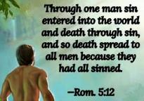
Genesis 2:16-17
“¹⁶ The Lord God commanded the man, saying, ‘From any tree of the garden you may eat freely; ¹⁷ but from the tree of the knowledge of good and evil you shall not eat, for in the day that you eat from it you will surely die (muwth).’”

Slide 30

1 Corinthians 15:21-22
“²¹ For since by a man came death, by a man also came the resurrection of the dead. ²² For as in Adam all die, so also in Christ all will be made alive.”

Slide 31

Romans 5:12
“Therefore, just as through one man sin entered into the world, and death through sin, and so death spread to all men, because all sinned—.”

Slide 32


Slide 33


Slide 34


Philippians 3:9
“and may be found in Him, not having a righteousness of my own derived from the Law, but that which is through faith in Christ, the righteousness which comes from God on the basis of faith.”

Slide 35
Results of the Sin
(3:7-13)
  Religion (3:7)
  Broken fellowship (3:8-10)
  “Buck passing” (3:11-13)
  Reversal creation hierarchy (3:11-13)

Slide 36
God’s Provision
(3:20-24)
  Continuation of the race (3:20)
  Forgiveness (3:21, 7)
  Expulsion of Adam and Eve from Eden (3:22-24)

Slide 37


Slide 38
Genesis 1:26-28
²⁶ Then God said, “Let Us make man in Our image, according to Our likeness; and let them rule over the fish of the sea and over the birds of the sky and over the cattle and over all the earth, and over every creeping thing that creeps on the earth.” ²⁷ God created man in His own image, in the image of God He created him; male and female He created them. ²⁸ God blessed them; and God said to them, “Be fruitful and multiply, and fill the earth, and subdue it; and rule over the fish of the sea and over the birds of the sky and over every living thing that moves on the earth.”

Slide 39
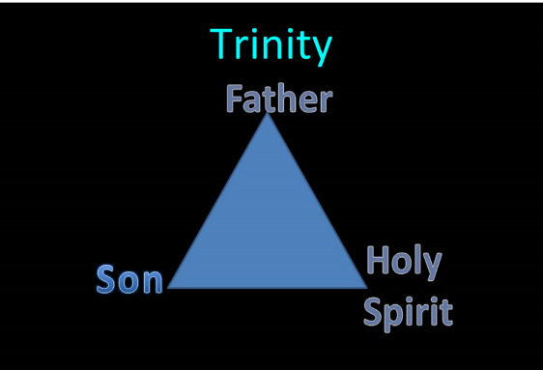
TRINITARIANISM IN GENESIS
  Gen 1:26
  Gen 3:22
  Gen 11:7
  Isa 6:8

Slide 40
THE DIVINE INSTITUTIONS
Conscience (Gen. 3:22)
Marriage and family (Gen. 1:26-28; 2:18-25)
Labor (Gen. 2:15; 3:19)
Government (Gen. 9:6)
Nationalism (Gen. 11:1-9)

Slide 41
THE DIVINE INSTITUTIONS
Conscience (Gen. 3:22)
Marriage and family (Gen. 1:26-28; 2:18-25)
Labor (Gen. 2:15; 3:19)
Government (Gen. 9:6)
Nationalism (Gen. 11:1-9)

Slide 42
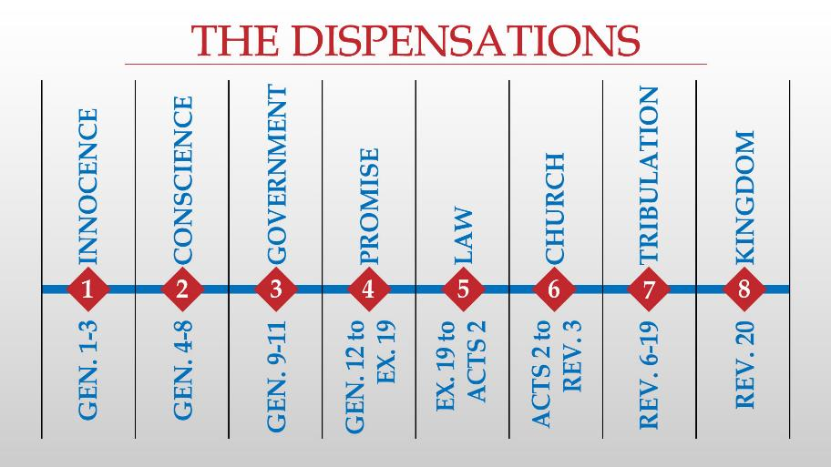

Slide 43
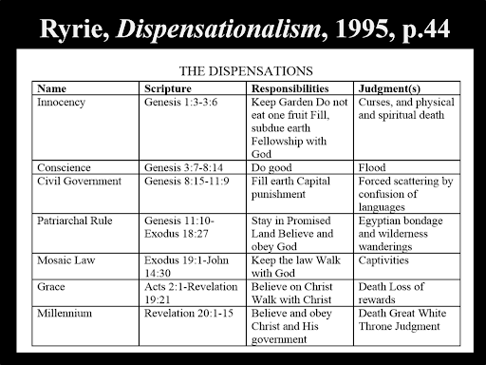

Slide 44
Conclusion

Slide 45
Genesis Structure
  3:1-5 Temptation by the serpent
  3:6 Sin of Adam and Eve
  3:7-13 Results of the sin
  3:14-19 Imposition of divine judgments
  3:20-24 God’s provision in spite of the sin

Slide 46
God’s Provision
(3:20-24)
  Continuation of the race (3:20)
  Forgiveness (3:21, 7)
  Expulsion of Adam and Eve from Eden (3:22-24)

Slide 47

“The Lord bless you and keep you; the Lord make his face shine on you and be gracious to you; the Lord turn his face toward you and give you peace.” (NIV)

