Slide 1


PRACTICAL RIGHTEOUSNESS
Dr. Andy Woods
Senior Pastor – Sugar Land Bible Church
President – Chafer Theological Seminary

Slide 2
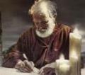
Answering Eleven Questions
Who wrote it? – James
What do we know about the author? – Christ’s ½ Brother
Who was the audience? – Believing Jews in the Diaspora
Where was if written from? – Jerusalem
When was the book written? – A.D. 44‒47
What was the book’s occasion? – Practical righteousness
What is the book’s purpose? – Achieving practical righteousness
What is the book about? – Practical righteousness
What is the book’s theme? – Daily living
What makes the book different? – Practicality
How is the book organized? – Faith and Wisdom

Slide 3

JAMES STRUCTURE
  Faith (James 1:1‒3:12)
  Wisdom (James 3:13‒5:20)

Slide 4
JAMES STRUCTURE
  Faith (James 1:1‒3:12)
  Wisdom (James 3:13‒5:20)

Slide 5

JAMES STRUCTURE
Faith (1:1–3:12)
  Trials (1:2-18)
  Obedience to the Word (1:19-27)
  Favoritism (2:1-13)
  Faith manifesting works (2:14-26)
  Tongue (3:1-12)

Slide 6
JAMES STRUCTURE
Faith (1:1–3:12)
  Trials (1:2-18)
  Obedience to the Word (1:19-27)
  Favoritism (2:1-13)
  Faith manifesting works (2:14-26)
  Tongue (3:1-12)

Slide 7
James 1:2-18
Trials – Jas 1:2-18
  Rejoicing during trials – Jas 1:2-12
  Command not to charge God with temptation – Jas 1:13-18

Slide 8
JAMES STRUCTURE
Faith (1:1–3:12)
  Trials (1:2-18)
  Obedience to the Word (1:19-27)
  Favoritism (2:1-13)
  Faith manifesting works (2:14-26)
  Tongue (3:1-12)

Slide 9

Faith Obeys God
(James 1:19-27)
  Need for Slowness in Speaking & Anger (1:19-20)
  Need for Obedience to God’s Word (1:21-25)
  Need for True Religion (1:26-27)

Slide 10
JAMES STRUCTURE
Faith (1:1–3:12)
  Trials (1:2-18)
  Obedience to the Word (1:19-27)
  Favoritism (2:1-13)
  Faith manifesting works (2:14-26)
  Tongue (3:1-12)

Slide 11
Favoritism
(2:1-13)
  Command: no favoritism (2:1)
  Situation: favoritism in the assembly (2:2-3)
  Reasoning: favoritism is contrary to God’s character & purposes (2:4-13)

Slide 12
Favoritism
(2:1-13)
  Command: no favoritism (2:1)
  Situation: favoritism in the assembly (2:2-3)
  Reasoning: favoritism is contrary to God’s character & purposes (2:4-13)

Slide 13

III. Reasoning: Favoritism is Contrary to God’s Character & Purposes
(2:4-13)
  We judge where God has not (4)
  God elects all (2:5)
  Rich oppressors (2:6-7)
  Favoritism violates God’s Law (2:8-11)
  God will judge those showing favoritism (2:12-13)

Slide 14
III. Reasoning: Favoritism is Contrary to God’s Character & Purposes
(2:4-13)
  We judge where God has not (4)
  God elects all (2:5)
  Rich oppressors (2:6-7)
  Favoritism violates God’s Law (2:8-11)
  God will judge those showing favoritism (2:12-13)

Slide 15

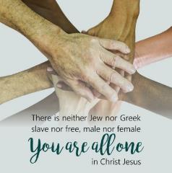
Galatians 3:28
“There is neither Jew nor Greek, there is neither slave nor free man, there is neither male nor female; for you are all one in Christ Jesus.”

Slide 16
III. Reasoning: Favoritism is Contrary to God’s Character & Purposes
(2:4-13)
  We judge where God has not (4)
  God elects all (2:5)
  Rich oppressors (2:6-7)
  Favoritism violates God’s Law (2:8-11)
  God will judge those showing favoritism (2:12-13)

Slide 17
III. Reasoning: Favoritism is Contrary to God’s Character & Purposes
(2:4-13)
  We judge where God has not (4)
  God elects all (2:5)
  Rich oppressors (2:6-7)
  Favoritism violates God’s Law (2:8-11)
  God will judge those showing favoritism (2:12-13)

Slide 18
C. Rich God Haters
(Jas 2:6-7)
Oppressors (6)
Blasphemers (7)

Slide 19
C. Rich God Haters
(Jas 2:6-7)
Oppressors (6)
Blasphemers (7)

Slide 20
C. Rich God Haters
(Jas 2:6-7)
Oppressors (6)
Blasphemers (7)

Slide 21
III. Reasoning: Favoritism is Contrary to God’s Character & Purposes
(2:4-13)
  We judge where God has not (4)
  God elects all (2:5)
  Rich oppressors (2:6-7)
  Favoritism violates God’s Law (2:8-11)
  God will judge those showing favoritism (2:12-13)

Slide 22


Slide 23

Psalm 147:19-20
“He declares His words to Jacob, His statutes and His ordinances to Israel. He has not dealt thus with any nation; And as for His ordinances, they have not known them. Praise the Lord!”

Slide 24
SIMILARITIES WITH ACTS 15
 | James | Acts 15
Greetings | 1:1 | 15:23
Visit | 1:27 | 15:14
Listen | 2:5 | 15:13
Turn | 5:19-20 | 15:19
Being called by God’s name | 2:7 | 15:17

Slide 25
Date
(AD 44-47)
AD 70
AD 62-63
AD 49
AD 48-49
Sermon on the Mount
Primitive congregational worship (Jas 2:2; 3:1; 5:14)
Jas 1:1 = Acts 8:1-4; 11:19

Slide 26
Order of Paul’s Letters
Galatians (A.D. 49)
1‒2 Thessalonians (A.D. 51)
1‒2 Corinthians (A.D. 56)
Romans (A.D. 57)
Ephesians, Colossians, Philemon, Philippians (A.D. 60‒62)
1 Timothy, Titus (A.D. 62‒66)
2 Timothy (A.D. 67)

Slide 27

2 Timothy 3:16-17
“All Scripture is inspired by God and profitable for teaching, for reproof, for correction, for training in righteousness; ¹⁷ so that the man of God may be adequate, equipped for every good work.”

Slide 28
Romans 15:3-4
“For even Christ did not please Himself, but as it is written: “The taunts of those who taunt You have fallen on Me.” For whatever was written in earlier times was written for our instruction, so that through perseverance and the encouragement of the Scriptures we might have hope.”

Slide 29
III. Reasoning: Favoritism is Contrary to God’s Character & Purposes
(2:4-13)
  We judge where God has not (4)
  God elects all (2:5)
  Rich oppressors (2:6-7)
  Favoritism violates God’s Law (2:8-11)
  God will judge those showing favoritism (2:12-13)

Slide 30


Slide 31
Scripture’s Four Judgments
Name | Sheep and Goat | Judgment of the Jews | Bema Seat | Great White Throne
Scripture | Matt 25:31-46 | Ezek 20:33-44 | 1 Cor 3:10-15 | Rev 20:11-15
Place | Earth, Jerusalem | Earth, wilderness | Heaven | Earth
Audience | Gentile Tribulation survivors | Jewish Tribulation survivors | Church Age believers | All unsaved
When | After Tribulation | After Tribulation | After rapture | After Millennium
Purpose | Saved Gentiles enter kingdom | Saved Jews enter kingdom | Reward believers | Degree of punishment in hell
Evaluation | Treatment of Christ’s brethren | Passing under shepherd’s rod | Works taken through fire | Not in the book; judged by books

Slide 32

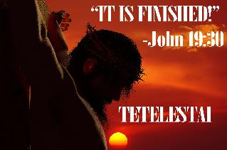
John 19:30
“Therefore when Jesus had received the sour wine, He said, ‘It is finished!’ And He bowed His head and gave up His spirit.”

Slide 33
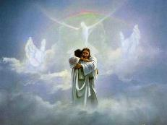
John 5:24
“Truly, truly, I say to you, he who hears My word, and believes Him who sent Me, has eternal life, and does not come into judgment, but has passed out of death into life.”

Slide 34
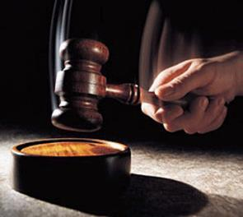
Why?
Not to judge sin (John 19:30)
Not to determine salvation (John 5:24)
But rather to give or not give rewards

Slide 35
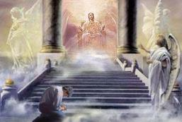
2 Corinthians 5:10
“For we must all appear before the judgment seat of Christ, so that each one may be recompensed for his deeds in the body, according to what he has done, whether good or bad.”

Slide 36
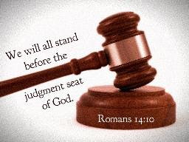
Romans 14:10, 12
“¹⁰…For we will all stand before the judgment seat of God…¹² So then each one of us will give an account of himself to God.”

Slide 37
1 Corinthians 3:10-15
“¹⁰ According to the grace of God which was given to me, like a wise master builder I laid a foundation, and another is building on it. But each man must be careful how he builds on it. ¹¹ For no man can lay a foundation other than the one which is laid, which is Jesus Christ. ¹² Now if any man builds on the foundation with gold, silver, precious stones, wood, hay, straw…”

Slide 38
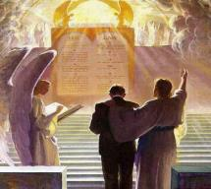
1 Corinthians 3:14-15
“¹⁴ If any man’s work which he has built on it remains, he will receive a reward. ¹⁵ If any man’s work is burned up, he will suffer loss; but he himself will be saved, yet so as through fire.”

Slide 39
1 Corinthians 9:24-27
“²⁴ Do you not know that those who run in a race all run, but only one receives the prize? Run in such a way that you may win. ²⁵ Everyone who competes in the games exercises self-control in all things. They then do it to receive a perishable wreath, but we an imperishable. ²⁶ Therefore I run in such a way, as not without aim; I box in such a way, as not beating the air; ²⁷ but I discipline my body and make it my slave, so that, after I have preached to others, I myself will not be disqualified.”

Slide 40


Areas of Systematic Theology
Prolegomena – Introduction
Bibliology – Study of the Bible
Theology – Study of God
Christology – Study of Christ
Pneumatology – Study of the Holy Spirit
Anthropology – Study of Man
Hamartiology – Study of sin
Soteriology – Study of salvation
Angelology – Study of angels
Ecclesiology – Study of the Church
Eschatology – Study of the end

Slide 41
CONCLUSION

Slide 42
JAMES STRUCTURE
Faith (1:1–3:12)
  Trials (1:2-18)
  Obedience to the Word (1:19-27)
  Favoritism (2:1-13)
  Faith manifesting works (2:14-26)
  Tongue (3:1-12)

Slide 43
Favoritism
(2:1-13)
  Command: no favoritism (2:1)
  Situation: favoritism in the assembly (2:2-3)
  Reasoning: favoritism is contrary to God’s character & purposes (2:4-13)

Slide 44
III. Reasoning: Favoritism is Contrary to God’s Character & Purposes
(2:4-13)
  We judge where God has not (4)
  God elects all (2:5)
  Rich oppressors (2:6-7)
  Favoritism violates God’s Law (2:8-11)
  God will judge those showing favoritism (2:12-13)

