Slide 1


Genesis 3
The Fall of Man

Slide 2

GENESIS STRUCTURE
  Beginning of the Human race (Gen. 1‒11)
  Beginning of the Hebrew race (Gen. 12‒50)

Slide 3

GENESIS STRUCTURE
  Genesis 1-11 (four events)
  Creation (1-2)
  Fall (3-5)
  Flood (6-9)
  National dispersion (10-11)

Slide 4

Contradictory Account of Creation?
Genesis 1 – Overview of the whole creation
Genesis 2 – Details surrounding the creation of the garden, the first man, and his activities on day 6

Slide 5
GENESIS STRUCTURE
  Genesis 1-11 (four events)
  Creation (1-2)
  Fall (3-5)
  Flood (6-9)
  National dispersion (10-11)

Slide 6
GENESIS 3: THE FALL OF MAN
“This chapter is the pivot on which the whole Bible turns”
-W. H. Griffith Thomas

Slide 7

Genesis Structure
  3:1-5 Temptation by the serpent
  3:6 Sin of Adam and Eve
  3:7-13 Results of the sin
  3:14-19 Imposition of divine judgments
  3:20-24 God’s provision in spite of the sin

Slide 8
Genesis Structure
  3:1-5 Temptation by the serpent
  3:6 Sin of Adam and Eve
  3:7-13 Results of the sin
  3:14-19 Imposition of divine judgments
  3:20-24 God’s provision in spite of the sin

Slide 9
Satan’s Tactics (2 Cor 2:11)
  Adds to God’s Word (3:1; 2:16-17)
  Challenges God’s goodness (3:1; 2:16-17)
  Subtracts from God’s Word (3:4; 2:17)
  Offers wisdom without submission to God (3:5; Prov 1:7)

Slide 10

Adam and Eve’s Mistakes (Eph 6:10-20)
  Subtracting from God’s Word (3:2; 2:16)
  Adding to God’s Word (3:3; 2:17)
  Doubting God’s goodness (3:2-3; 2:16-17)
  Initial break down in male headship (2:4-7, 16-17, 18-25)

Slide 11
Genesis Structure
  3:1-5 Temptation by the serpent
  3:6 Sin of Adam and Eve
  3:7-13 Results of the sin
  3:14-19 Imposition of divine judgments
  3:20-24 God’s provision in spite of the sin

Slide 12
Sin of Adam and Eve (3:6)
  Three avenues of temptation (1 John 2:16)
  Lust of the flesh
  Lust of the eye
  Pride of life
  Break down in male headship (1 Tim 2:13; Gen 2:23)

Slide 13
Genesis Structure
  3:1-5 Temptation by the serpent
  3:6 Sin of Adam and Eve
  3:7-13 Results of the sin
  3:14-19 Imposition of divine judgments
  3:20-24 God’s provision in spite of the sin

Slide 14
Results of the Sin
(3:7-13)
  Religion (3:7)
  Broken fellowship (3:8-10)
  “Buck passing” (3:11-13)
  Reversal creation hierarchy (3:11-13)

Slide 15
Genesis Structure
  3:1-5 Temptation by the serpent
  3:6 Sin of Adam and Eve
  3:7-13 Results of the sin
  3:14-19 Imposition of divine judgments
  3:20-24 God’s provision in spite of the sin

Slide 16
Divine Judgments
(3:14-19)
  Serpent (3:14-15)
  Woman (3:16)
  Man (3:17-19)

Slide 17
Divine Judgments
(3:14-19)
  Serpent (3:14-15)
  Woman (3:16)
  Man (3:17-19)

Slide 18
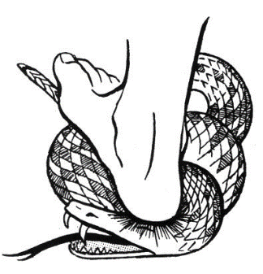
Serpent
(3:14-15)
  Serpent’s body (3:14)
  Protoevangelium (3:15)

Slide 19


Genesis 3:15
“And I will put enmity Between you and the woman, And between your seed and her seed; He shall bruise you on the head, And you shall bruise him on the heel.”

Slide 20
Divine Judgments
(3:14-19)
  Serpent (3:14-15)
  Woman (3:16)
  Man (3:17-19)

Slide 21
Woman
(3:16)
  Painful child birth (3:16a)
  Relational conflict (3:16b)

Slide 22
Woman
(3:16)
  Painful child birth (3:16a)
  Relational conflict (3:16b)

Slide 23

Genesis 1:26-28
²⁶ Then God said, “Let Us make man in Our image, according to Our likeness; and let them rule over the fish of the sea and over the birds of the sky and over the cattle and over all the earth, and over every creeping thing that creeps on the earth.” ²⁷ God created man in His own image, in the image of God He created him; male and female He created them. ²⁸ God blessed them; and God said to them, “Be fruitful and multiply, and fill the earth, and subdue it; and rule over the fish of the sea and over the birds of the sky and over every living thing that moves on the earth.”

Slide 24
Woman
(3:16)
  Painful child birth (3:16a)
  Relational conflict (3:16b)

Slide 25

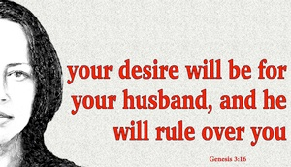
Genesis 3:16
“To the woman He said, ‘I will greatly multiply Your pain in childbirth, In pain you will bring forth children; Yet your desire [TESHUQAH] will be for your husband, And he will rule over you.’”

Slide 26

Song of Solomon 7:10
“I am my beloved’s, and his desire [TESHUQAH] is for me.”

Slide 27
Parallel Between Genesis 3:16 & 4:7
Genesis 3:16
“your desire [TESHUQAH] will be for your husband, and he will rule over you.”
Genesis 4:7
“its [sin] desire [TESHUQAH] is for you, but you must master it.”
Susan T. Foh, “What is the Woman’s Desire?”, The Westminster Theological Journal 37 (1974-75), 376-83.

Slide 28
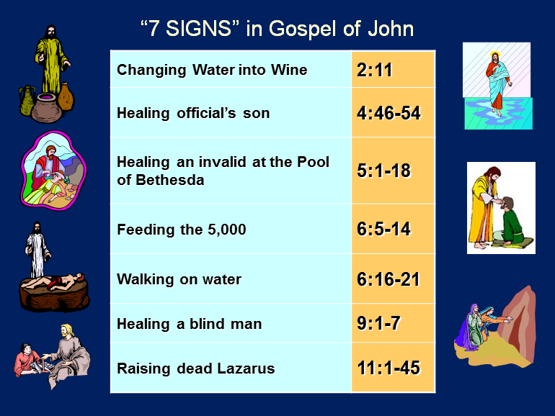

Slide 29


1 Corinthians 7:28
“But if you marry, you have not sinned; and if a virgin marries, she has not sinned. Yet such will have trouble in this life, and I am trying to spare you.”

Slide 30

Proverbs 21:9, 19; 25:24
“⁹ It is better to live in a corner of a roof
Than in a house shared with a contentious woman… ¹⁹ It is better to live in a desert land
Than with a contentious and vexing woman... ^{25:24} It is better to live in a corner of the roof
Than in a house shared with a contentious woman.”

Slide 31
Divine Judgments
(3:14-19)
  Serpent (3:14-15)
  Woman (3:16)
  Man (3:17-19)

Slide 32
Man
(3:17-19)
  Painful labor (3:17-19a)
  Death (3:19b)

Slide 33
Man
(3:17-19)
  Painful labor (3:17-19a)
  Death (3:19b)

Slide 34

Genesis 3:17-19
¹⁷ Then to Adam He said, “Because you have listened to the voice of your wife, and have eaten from the tree about which I commanded you, saying, ‘You shall not eat from it’; Cursed is the ground because of you; In toil you will eat of it All the days of your life. ¹⁸ “Both thorns and thistles it shall grow for you; And you will eat the plants of the field; ¹⁹ By the sweat of your face You will eat bread...”

Slide 35
Romans 8:19-22
¹⁹ For the anxious longing of the creation waits eagerly for the revealing of the sons of God. ²⁰ For the creation was subjected to futility, not willingly, but because of Him who subjected it, in hope ²¹ that the creation itself also will be set free from its slavery to corruption into the freedom of the glory of the children of God. ²² For we know that the whole creation groans and suffers the pains of childbirth together until now.

Slide 36
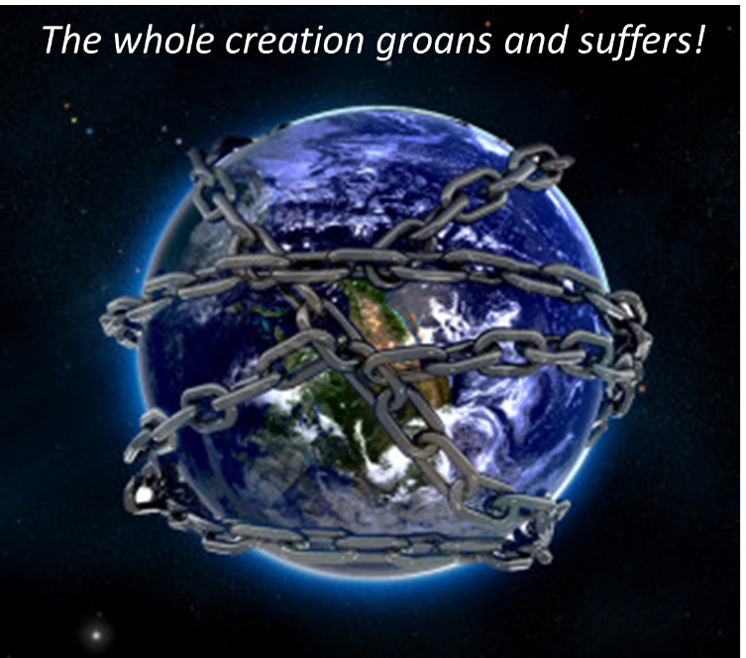

Slide 37
Serpent
(3:14-15)
  Serpent’s body (3:14)
  Protoevangelium (3:15)

Slide 38

Genesis 3:19
“By the sweat of your face You will eat bread, Till you return to the ground, Because from it you were taken; For you are dust, And to dust you shall return.”

Slide 39


Slide 40
Man
(3:17-19)
  Painful labor (3:17-19a)
  Death (3:19b)

Slide 41
Genesis 3:19
“By the sweat of your face You will eat bread, Till you return to the ground, Because from it you were taken; For you are dust, And to dust you shall return.”

Slide 42
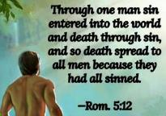
Genesis 2:16-17
“¹⁶ The Lord God commanded the man, saying, ‘From any tree of the garden you may eat freely; ¹⁷ but from the tree of the knowledge of good and evil you shall not eat, for in the day that you eat from it you will surely die (muwth).’”

Slide 43
Genesis 2:16-17
“¹⁶ The Lord God commanded the man, saying, ‘From any tree of the garden you may eat freely; ¹⁷ but from the tree of the knowledge of good and evil you shall not eat, for in the day that you eat from it you will surely die (muwth).’”

Slide 44

1 Corinthians 15:21-22
“²¹ For since by a man came death, by a man also came the resurrection of the dead. ²² For as in Adam all die, so also in Christ all will be made alive.”

Slide 45

Romans 5:12
“Therefore, just as through one man sin entered into the world, and death through sin, and so death spread to all men, because all sinned—.”

Slide 46
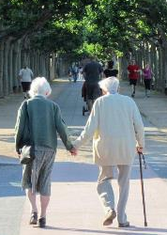
2 Cor. 4:16
Therefore we do not lose heart, but though our outer man is decaying, yet our inner man is being renewed day by day.

Slide 47


Slide 48
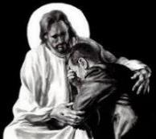
Revelation 21:4
“and He will wipe away every tear from their eyes; and there will no longer be any death; there will no longer be any mourning, or crying, or pain; the first things have passed away.”

Slide 49
Divine Judgments
(3:14-19)
  Serpent (3:14-15)
  Woman (3:16)
  Man (3:17-19)

Slide 50
Genesis Structure
  3:1-5 Temptation by the serpent
  3:6 Sin of Adam and Eve
  3:7-13 Results of the sin
  3:14-19 Imposition of divine judgments
  3:20-24 God’s provision in spite of the sin

Slide 51
God’s Provision
(3:20-24)
  Continuation of the race (3:20)
  Forgiveness (3:21, 7)
  Expulsion of Adam and Eve from Eden (3:22-24)

Slide 52
God’s Provision
(3:20-24)
  Continuation of the race (3:20)
  Forgiveness (3:21, 7)
  Expulsion of Adam and Eve from Eden (3:22-24)

Slide 53
Genesis 3:19
“By the sweat of your face You will eat bread, Till you return to the ground, Because from it you were taken; For you are dust, And to dust you shall return.”

Slide 54

Acts 17:26
“and He made from one man every nation of mankind to live on all the face of the earth, having determined their appointed times and the boundaries of their habitation.” (Italics added)

Slide 55
God’s Provision
(3:20-24)
  Continuation of the race (3:20)
  Forgiveness (3:21, 7)
  Expulsion of Adam and Eve from Eden (3:22-24)

Slide 56
God’s Provision
(3:20-24)
  Continuation of the race (3:20)
  Forgiveness (3:21, 7)
  Expulsion of Adam and Eve from Eden (3:22-24)

Slide 57
Genesis 1:26-28
²⁶ Then God said, “Let Us make man in Our image, according to Our likeness; and let them rule over the fish of the sea and over the birds of the sky and over the cattle and over all the earth, and over every creeping thing that creeps on the earth.” ²⁷ God created man in His own image, in the image of God He created him; male and female He created them. ²⁸ God blessed them; and God said to them, “Be fruitful and multiply, and fill the earth, and subdue it; and rule over the fish of the sea and over the birds of the sky and over every living thing that moves on the earth.”

Slide 58
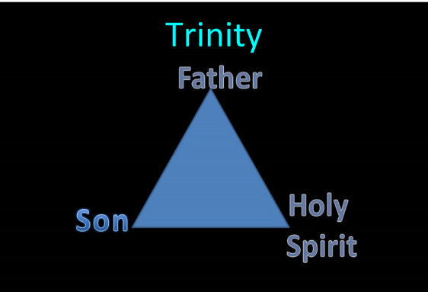
TRINITARIANISM IN GENESIS
  Gen 1:26
  Gen 3:22
  Gen 11:7
  Isa 6:8

Slide 59
THE DIVINE INSTITUTIONS
Conscience (Gen. 3:22)
Marriage and family (Gen. 1:26-28; 2:18-25)
Labor (Gen. 2:15; 3:19)
Government (Gen. 9:6)
Nationalism (Gen. 11:1-9)

Slide 60
THE DIVINE INSTITUTIONS
Conscience (Gen. 3:22)
Marriage and family (Gen. 1:26-28; 2:18-25)
Labor (Gen. 2:15; 3:19)
Government (Gen. 9:6)
Nationalism (Gen. 11:1-9)

Slide 61
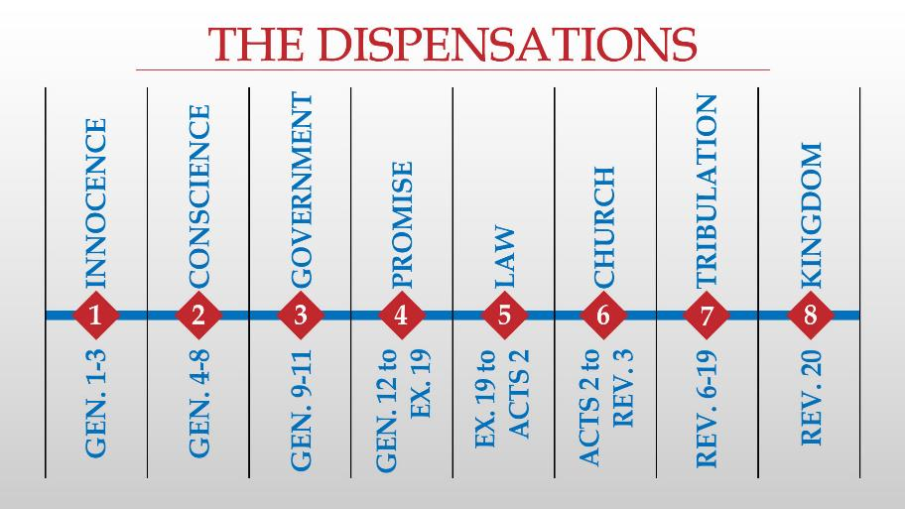

Slide 62
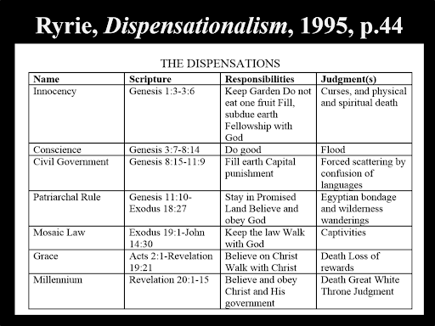

Slide 63
Conclusion

Slide 64
Genesis Structure Review
  3:1-5 Temptation by the serpent
  3:6 Sin of Adam and Eve
  3:7-13 Results of the sin
  3:14-19 Imposition of divine judgments
  3:20-24 God’s provision in spite of the sin

Slide 65

“The Lord bless you and keep you; the Lord make his face shine on you and be gracious to you; the Lord turn his face toward you and give you peace.” (NIV)

