Slide 1
PRACTICAL RIGHTEOUSNESS
Dr. Andy Woods
Senior Pastor – Sugar Land Bible Church
President – Chafer Theological Seminary

Slide 2
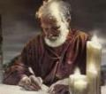
Answering Eleven Questions
Who wrote it? – James
What do we know about the author? – Christ’s ½ Brother
Who was the audience? – Believing Jews in the Diaspora
Where was if written from? – Jerusalem
When was the book written? – A.D. 44‒47
What was the book’s occasion? – Practical righteousness
What is the book’s purpose? – Achieving practical righteousness
What is the book about? – Practical righteousness
What is the book’s theme? – Daily living
What makes the book different? – Practicality
How is the book organized? – Faith and Wisdom

Slide 3
JAMES STRUCTURE
Faith (James 1:1‒3:12)
Wisdom (James 3:13‒5:20)

Slide 4
JAMES STRUCTURE
Faith (James 1:1‒3:12)
Wisdom (James 3:13‒5:20)

Slide 5
JAMES STRUCTURE
Faith (1:1–3:12)
Trials (1:2-18)
Obedience to the Word (1:19-27)
Favoritism (2:1-13)
Faith manifesting works (2:14-26)
Tongue (3:1-12)

Slide 6
JAMES STRUCTURE
Faith (1:1–3:12)
Trials (1:2-18)
Obedience to the Word (1:19-27)
Favoritism (2:1-13)
Faith manifesting works (2:14-26)
Tongue (3:1-12)

Slide 7
James 1:2-18
Trials – Jas 1:2-18
Rejoicing during trials – Jas 1:2-12
Command not to charge God with temptation – Jas 1:13-18

Slide 8
JAMES STRUCTURE
Faith (1:1–3:12)
Trials (1:2-18)
Obedience to the Word (1:19-27)
Favoritism (2:1-13)
Faith manifesting works (2:14-26)
Tongue (3:1-12)

Slide 9
Faith Obeys God (James 1:19-27)
Need for Slowness in Speaking & Anger (1:19-20)
Need for Obedience to God’s Word (1:21-25)
Need for True Religion (1:26-27)

Slide 10
JAMES STRUCTURE
Faith (1:1–3:12)
Trials (1:2-18)
Obedience to the Word (1:19-27)
Favoritism (2:1-13)
Faith manifesting works (2:14-26)
Tongue (3:1-12)

Slide 11
Favoritism (2:1-13)
Command: no favoritism (2:1)
Situation: favoritism in the assembly (2:2-3)
Reasoning: favoritism is contrary to God’s character & purposes (2:4-13)

Slide 12
Favoritism (2:1-13)
Command: no favoritism (2:1)
Situation: favoritism in the assembly (2:2-3)
Reasoning: favoritism is contrary to God’s character & purposes (2:4-13)

Slide 13
Favoritism (2:1-13)
Command: no favoritism (2:1)
Situation: favoritism in the assembly (2:2-3)
Reasoning: favoritism is contrary to God’s character & purposes (2:4-13)

Slide 14
James 2:2
“For if a man comes into your assembly [synagōgē] with a gold ring and dressed in fine clothes, and there also comes in a poor man in dirty clothes.”

Slide 15
Date (AD 44-47)
AD 70
AD 62-63
AD 49
AD 48-49
Sermon on the Mt
Primitive congregational worship (Jas 2:2; 3:1; 5:14)
Jas 1:1 = Acts 8:1-4; 11:19

Slide 16
Favoritism (2:1-13)
Command: no favoritism (2:1)
Situation: favoritism in the assembly (2:2-3)
Reasoning: favoritism is contrary to God’s character & purposes (2:4-13)

Slide 17
III. Reasoning: Favoritism is Contrary to God’s Character & Purposes (2:4-13)
We judge where God has not (4)
God elects all (2:5)
Rich oppressors (2:6-7)
Favoritism violates God’s Law (2:8-11)
God will judge those showing favoritism (2:12-13)

Slide 18
III. Reasoning: Favoritism is Contrary to God’s Character & Purposes (2:4-13)
We judge where God has not (4)
God elects all (2:5)
Rich oppressors (2:6-7)
Favoritism violates God’s Law (2:8-11)
God will judge those showing favoritism (2:12-13)

Slide 19
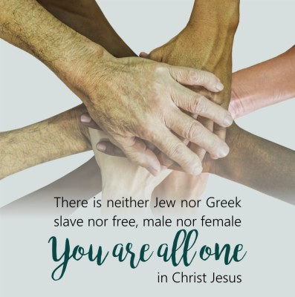
Galatians 3:28
“There is neither Jew nor Greek, there is neither slave nor free man, there is neither male nor female; for you are all one in Christ Jesus.”

Slide 20
Ephesians 2:14
“For He Himself is our peace, who made both groups into one and broke down the barrier of the dividing wall.”

Slide 21
1 Corinthians 4:5
“Therefore do not go on passing judgment before the time, but wait until the Lord comes who will both bring to light the things hidden in the darkness and disclose the motives of men’s hearts; and then each man’s praise will come to him from God.”

Slide 22
III. Reasoning: Favoritism is Contrary to God’s Character & Purposes (2:4-13)
We judge where God has not (4)
God elects all (2:5)
Rich oppressors (2:6-7)
Favoritism violates God’s Law (2:8-11)
God will judge those showing favoritism (2:12-13)

Slide 24
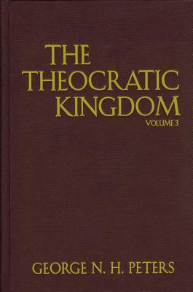
G.N.H. Peters Theocratic Kingdom, 1:600
Premillennial scholar Peters asks, “If the church is the Kingdom, and believers are now in it, why designate them ‘heirs,’ etc., of a Kingdom.”

Slide 25
CONCLUSION

Slide 26
JAMES STRUCTURE
Faith (1:1–3:12)
Trials (1:2-18)
Obedience to the Word (1:19-27)
Favoritism (2:1-13)
Faith manifesting works (2:14-26)
Tongue (3:1-12)

Slide 27
Favoritism (2:1-13)
Command: no favoritism (2:1)
Situation: favoritism in the assembly (2:2-3)
Reasoning: favoritism is contrary to God’s character & purposes (2:4-13)

